Slide 1

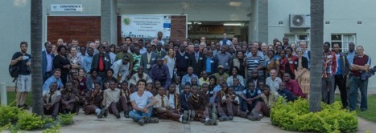
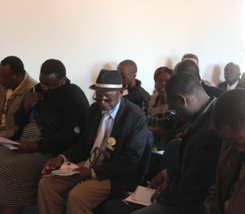
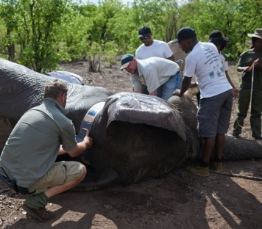
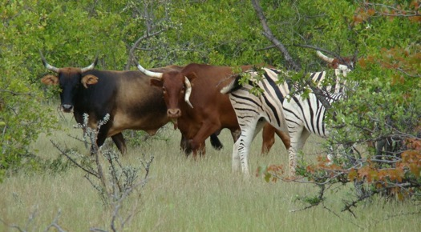
CIRAD in southern Africa
Alex Caron, CIRAD
Capacitating One Health in Eastern and Southern Africa (COHESA) partner orientation workshop
16 December 2021

Slide 2
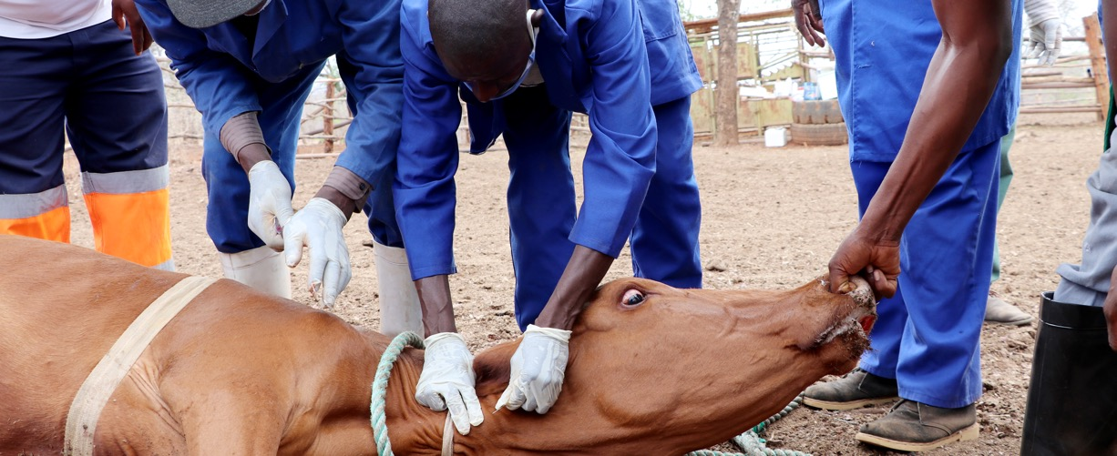
Cirad is in Zimbabwe & Mozambique
1 Research Platform “PCP”
“Production & Conservation in Partnership”
  7 Zimbabwean universities
  3 French research institutions
  1 Mozambique, 1 Zambia, 1 Botswana, 1 South Africa
6 researchers in Zimbabwe (2 for COHESA)
4 researchers in Mozambique (2 for COHESA)
50 students MSc, Mphil, Phds mostly from Zim and SADC)
1 Biotechnology platform, UZ

Slide 3
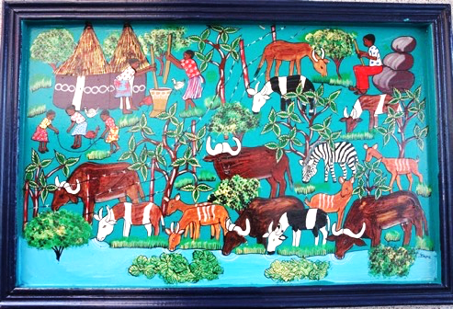











Research Platform
« Production and Conservation in Partnership »
2007
2016
2021
Chairman : Prof. E. Mwenje
Secretaty Coordinator & co: V. Grosbois, P. Mugabe
Scientific coordinator: H. Fritz, P. Mundy, S. Kativu; A. Caron
Administrators: Y. Maumbe & G. K. Muduve
RP-PCP Scientifc Committee team

Slide 4
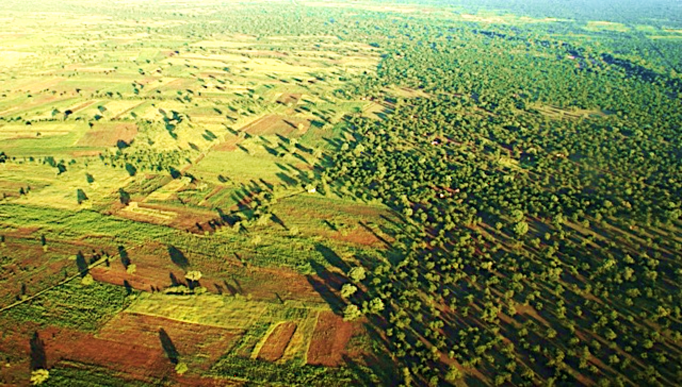
Scope & Objectives
Social – Ecological System Health approach
SESH (de Garine-Wichatitsky et al. 2021)
Research object:
Socio-ecological systems including protected areas and their peripheries in southern Africa
Our goal
To improve livelihood & well-being of
local citizens living at
« wild-domestic interfaces »
Our purpose:
Promote applied research (transdisciplinary holistic approach; demand–driven, co-construction) and post-graduate training (capacity building)

Slide 5
de Garine-Wichatitsky et al. 2021

Slide 6
Health & Environment
Thematic fields
Ecology & Sustainability
OH
Agriculture & Conservation
SESH
NR Governance & Institutions
EcoH
Socio-ecological systems
at the wild/domestic interface

Slide 7
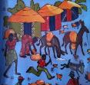
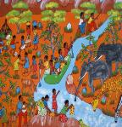
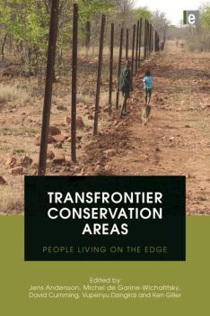
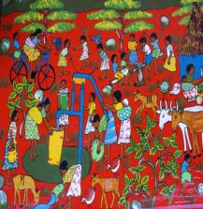
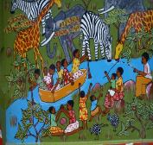

Post-graduate training & research
Examples
Since 2007,
163 MSc/Phd supervised, 58 on-going
>80 in academic insitutions & Gov Services, NGos linked to TFCAs
>160 articles & book chapter
w w w . r p – p c p . o r g

Slide 8
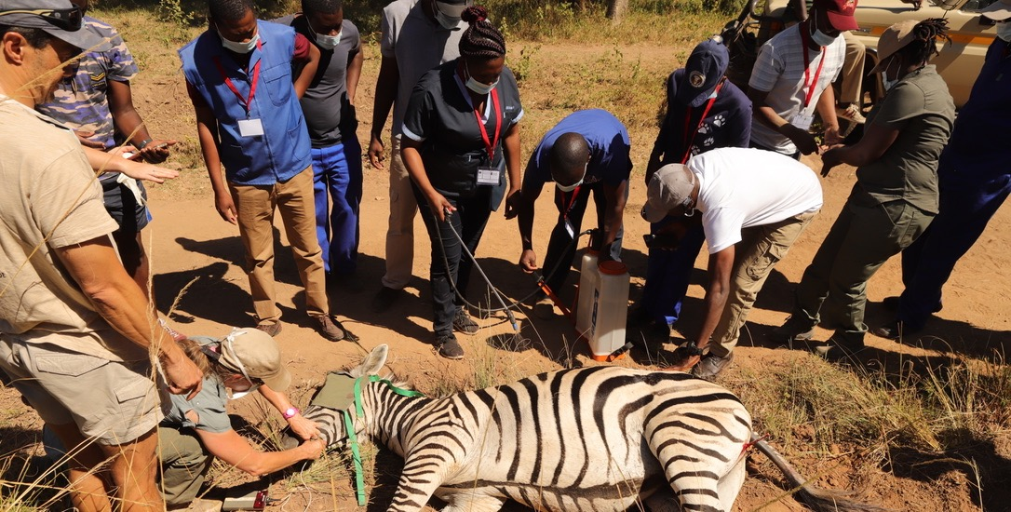
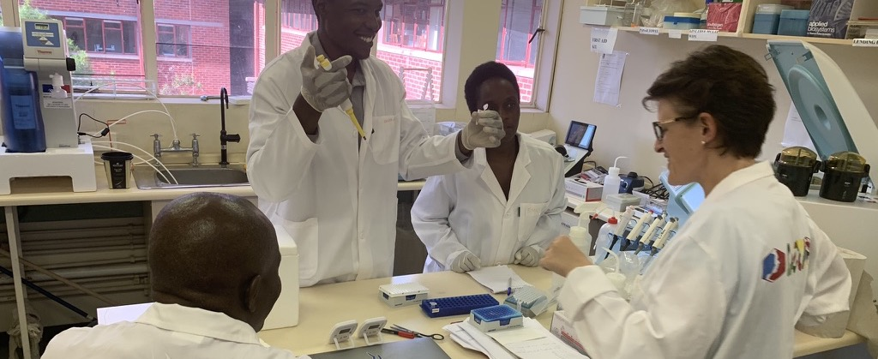
On-going / Future projects linked with COHESA
On-going projects
  LIPS-ZIM (EU – DESIRA, 5M€), ILRI
    2020 - 2023
    Animal health & Production
    ILRI coordinating
    Zimbabwe
  PACMAN (AFD; 2M€), Cirad
    2021 – 2024
    Support to biotechnology platform
    Zimbabwe
  BNP HUM-ANI (BNP; 0;7M€), IRD
    2021-2024
    Disease ecology W/L interface
    Zimbabwe
  + NIF NAF ASF (Moz, SA)

Slide 9
On-going / Future projects linked with COHESA
On-going projects
    Microm/Virus (Various, 0,4K€), Cirad
      2018-On-going
      Microm/human/virus interface
      Zim & Moz (Zamb?)
    ROADMAP AMR (EU, 2M€), INRA
      2019-2022
      AMR
      Mozambique
Future projects
  OLOH (AFD: 5M€); PPF
    2022-2026
    SESH approach of Limpopo NP buffer zone
    Mozambique
  PREZODE southern Africa (Zim, Moz, Zambie?)

Slide 10
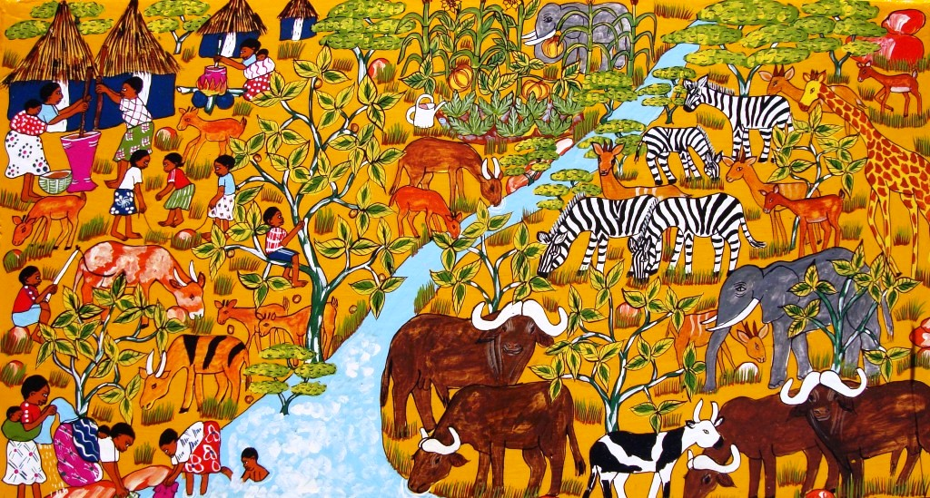


Obrigado
Merci
Thank you

