Slide 1
Restoration of Livestock Services in Conflict and Drought Affected Areas of Ethiopia (RESTORE)
Key points
Theodore Knight-Jones,
Animal and Human Health,
International Livestock Research Institute (ILRI)
25 March 2024
ILRI, Ethiopia

Slide 2
Who and Where
Focal regions: Afar, Tigray, South Ethiopia
EU IM3 funded regions: Amhara, Oromia, Somali region
ILRI lead
EVA partner
Non-Focal regions: South-West Region, Central Ethiopia
48 months

Slide 3
Impact (Overall Objective): Enhanced food security, nutrition and livelihood resilience for rural communities across the country, focussing on areas affected by drought and conflict
Outcomes (Specific objectives): Sustained recovery of the livestock system from the conflict and drought induced crises, with increased overall sector productivity and improved the marketing of livestock products

Slide 4
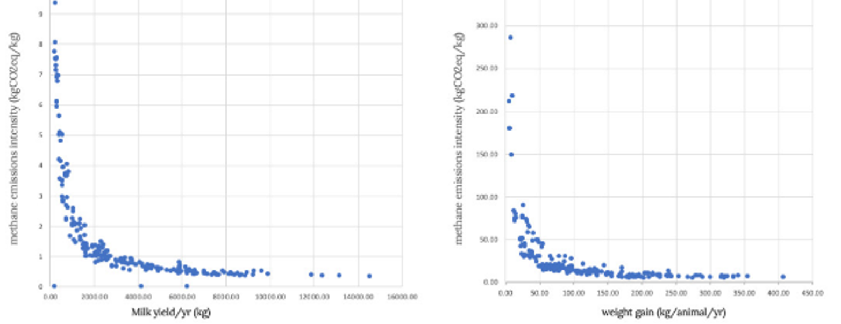
Relationship between methane emissions intensity per kg of product and a) milk yield and b) weight gain (Herrero et al., 2013a

Slide 5
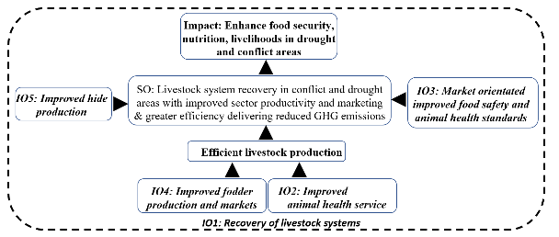

Slide 6
Intermediate Outcomes (IO) 1: Livestock service delivery systems restored in conflict and drought affected areas
IO 2: The quality and reliability of integrated public and private veterinary service delivery improved, with more efficient production
IO 3: Improved compliance and enforcement of animal health, food safety standards, responding to market requirements
IO 4: Availability and Quality of livestock feeds improved through farmers/pastoralists and private sector driven fodder production and marketing
IO 5: Enhanced quality of hide and skin through improved animal health intervention

Slide 7
WP1: Restore Livestock Service Delivery Systems
A1.1 Rapid assessment conducted to determine sustainable livestock levels, and livestock response plan, in close cooperation with the main institutions and cooperation partners supporting the livestock sector; including determining the status of feed, forage and pasture resources
A1.2-3 Restore routine and emergency animal health equipment, systems and inputs in regions (clinics, vet labs…)

Slide 8
1.2.1 Upgrade veterinary clinics in drought affected areas (including introduction of digital ICT)
1.2.2 Equip veterinary clinics/animal health posts with basic veterinary inputs (equipment, consumables, motor bikes, solar refrigerator, installation, maintenance etc.)
1.2.3 Provision of livestock emergency support (utilities, vaccine, drug, animal feeds, etc.) for emergency (drought, flood) affected woredas
1.2.4 Strengthen the operational and technical capacity of the Mekelle, Semera and Jinka regional veterinary laboratories and upgrade five facilities at satellite veterinary laboratories in Afar
1.2.5 Strengthen disease reporting systems (ADNIS & DOVAR) by providing servers, high-capacity computers, accessories and trainings (all Action regions will be involved in trainings)

Slide 9
WP2: Improved vet services
A2.1 Strengthening the capacity of public institutions to control and regulate animal health
  2.1.1 Support the development of harmonised animal disease surveillance, prevention, early warning and innovative risk-based, cost-effective control
  2.1.2 Promote the integration of private vet (laboratory, etc.) facilities within the national diagnostic and surveillance system
  2.1.3 Regional activities to strengthen animal health services
A2.2 Strengthening the quality of public and private veterinary services
  2.2.1 Create an enabling environment for expanded utilization of PPP in the delivery of animal health services (incl gender)
  2.2.2 Enhance public-private partnerships through contracting out selected public functions to private animal health service providers (including ambulatory health service, active disease surveillance, deworming and vaccination and extension services)
  2.2.3 Expand the services provided by PPP
A2.3 Investigate how improved livestock production efficiency can reduce livestock ecological and climate change impacts
A2.4 Continue to enhance the capacity of the animal health sector
  2.4.1 Capacitate new veterinary graduates to succeed in the private sector
  2.4.2 Institutionalize and pilot Et-CPD
  2.4.3 Build the capacity of CPD Providers and accreditors
  2.4.4 Develop and disseminate knowledge within the veterinary sector

Slide 10
WP3: Improved health and food safety standards
A3.1 Support for harmonization of legislation for sanitary inspection and certification procedures to meet international trade requirements
  Review requirements, challenges and opportunities for key markets
A3.2 Strengthening Ethiopian Veterinary Service capacity to address issues related to sanitary and phyto-sanitary and technical barriers to trade
  export livestock source area and Yelemat Tirufat Villages
  Gap assessment then capacitation, surveillance, standards and systems (ADNIS, DOVAR 2, LITS, LIMS)
A3.3 Capacitate domestic meat value chains to improve hygiene, inspection and certification – Simple equipment, training (ToT)
A3.4 Strengthen surveillance and control of priority zoonotic diseases
  ToT

Slide 11
WP4: Improved fodder
A4.1 Promote development of feed and forage production banks and sustainable pastureland management with nutritious, and drought tolerant fodder grass promoting marketable livestock feed
  4.1.1 Support farmer-private sector driven improved livestock feed and fodder production integrated within a mixed farming system or as a specialized crop for pastoralists
  4.1.2 Support industrialization of agro-industrial by-products for livestock feeding
A4.2 Support manure management in each region
  4.2.1 Support farmers in dung management in order to improve nutrient value and decrease GHG emissions

Slide 12
WP5: Improved hide and skin quality
A5.1 Conduct assessment with regions on existing skin and hide damaging diseases with recommendations for control
A5.2 Conduct stakeholders consultative workshop in regions with awareness creation on hide and skin quality issues, production and processing
A5.3 Provide Tot Training on the control of skin and hide damaging diseases in regions (including procurement and supply of chemicals, sprayers, PPE, etc), with possible PPP delivery, as part of a pilot of strategic control of relevant diseases and poor skin quality

Slide 13
Mainstreaming cross-cutting issues
a. Environmental Protection and Climate Change (reduction in GHG intensity)
b. Gender equality and empowerment of women and girls
c. Disability
d. Conflict sensitivity, peace and resilience
e. Disaster Risk Reduction
f. Animal Welfare

