Slide 1



Co-creation of theories of changes at value-chain level for the One-CGIAR initiative Sustainable Animal Productivity for Livelihoods, Nutrition and Gender Inclusion
Karen Marshall, Nils Teufel, Jane Poole, Helen Altshul: ILRI
SAPLING stakeholder workshops, mid 2022

Slide 2
Why do we need a Theory of Change (ToC)?
Many of us are involved in initiatives aimed at making CHANGE
But CHANGE is complex
Theory of Change is an approach to better make CHANGE happen

Slide 3
Theory of Change & SAPLING
Theory of Change has been important part of developing SAPLING overall
There is a SAPLING initiative level theory of change
We are now co-creating theory of changes for the 15 SAPLING value chains across 7 countries

Slide 4
Terminology - outcomes
Outcome: Change in human behaviour
  Who, what change
  Women and men farmers adopt integrated technology practices
  Input and service providers applying skills in business management
  Communities support women and youth to engage in profitable agribusinesses

Slide 5
Terminology – innovation package
Bundled service delivery including AI, vaccines, herd-health, and extension
Capacity development
Financing mechanism
Supportive regulatory framework
Innovations: products, technologies, services, institutional arrangements –
new or adapted
Capacity development
Enabling environment

Slide 6
Creating a theory of change – problem and vision
Problem statement
Vision

Slide 7
Creating a theory of change – working back from long-term outcomes
Vision
Long-term outcomes
(10 years)
Long-term outcome 1
Long-term outcome 2
Long-term outcome 3

Slide 8
Creating a theory of change – working back from long-term outcomes
Vision
Short-term outcomes
(3 years)
Long-term outcomes
(10 years)
Short-term outcome 1
Long-term outcome 1
Short-term outcome 2
Long-term outcome 2
Short-term outcome 3
Long-term outcome 3

Slide 9
Creating a theory of change – working back from long-term outcomes
Vision
Innovation packages
Innovation package 1
Short-term outcomes
(3 years)
Long-term outcomes
(10 years)
Technologies / processes
Capacity development
Short-term outcome 1
Long-term outcome 1
Enabling environment
Short-term outcome 2
Long-term outcome 2
Innovation package 2
Short-term outcome 3
Long-term outcome 3
Technologies / processes
Capacity development
Enabling environment

Slide 10
Creating a theory of change – working back from long-term outcomes
Vision
Innovation packages
Innovation package 1
Short-term outcomes
(3 years)
Long-term outcomes
(10 years)
Technologies processes
Capacity development
Short-term outcome 1
Long-term outcome 1
Actors
Enabling environment
Short-term outcome 2
Long-term outcome 2
Innovation package 2
Short-term outcome 3
Long-term outcome 3
Technologies processes
Capacity development
Actors
Enabling environment

Slide 11
Creating a theory of change – working back from long-term outcomes
Vision
Innovation packages
Innovation package 1
Short-term outcomes
(3 years)
Long-term outcomes
(10 years)
Technologies processes
Capacity development
Short-term outcome 1
Long-term outcome 1
Actors
Enabling environment
Assumptions
Short-term outcome 2
Assumptions
Long-term outcome 2
Innovation package 2
Short-term outcome 3
Long-term outcome 3
Technologies processes
Capacity development
Actors
Enabling environment

Slide 12
Creating a theory of change – working back from long-term outcomes
Vision
Innovation packages
Innovation package 1
Short-term outcomes
(3 years)
Long-term outcomes
(10 years)
Technologies processes
Capacity development
Short-term outcome 1
Long-term outcome 1
Actors
Enabling environment
Assumptions
Short-term outcome 2
Assumptions
Long-term outcome 2
Innovation package 2
Short-term outcome 3
Long-term outcome 3
Technologies processes
Capacity development
Actors
Enabling environment
Review and strengthen

Slide 13
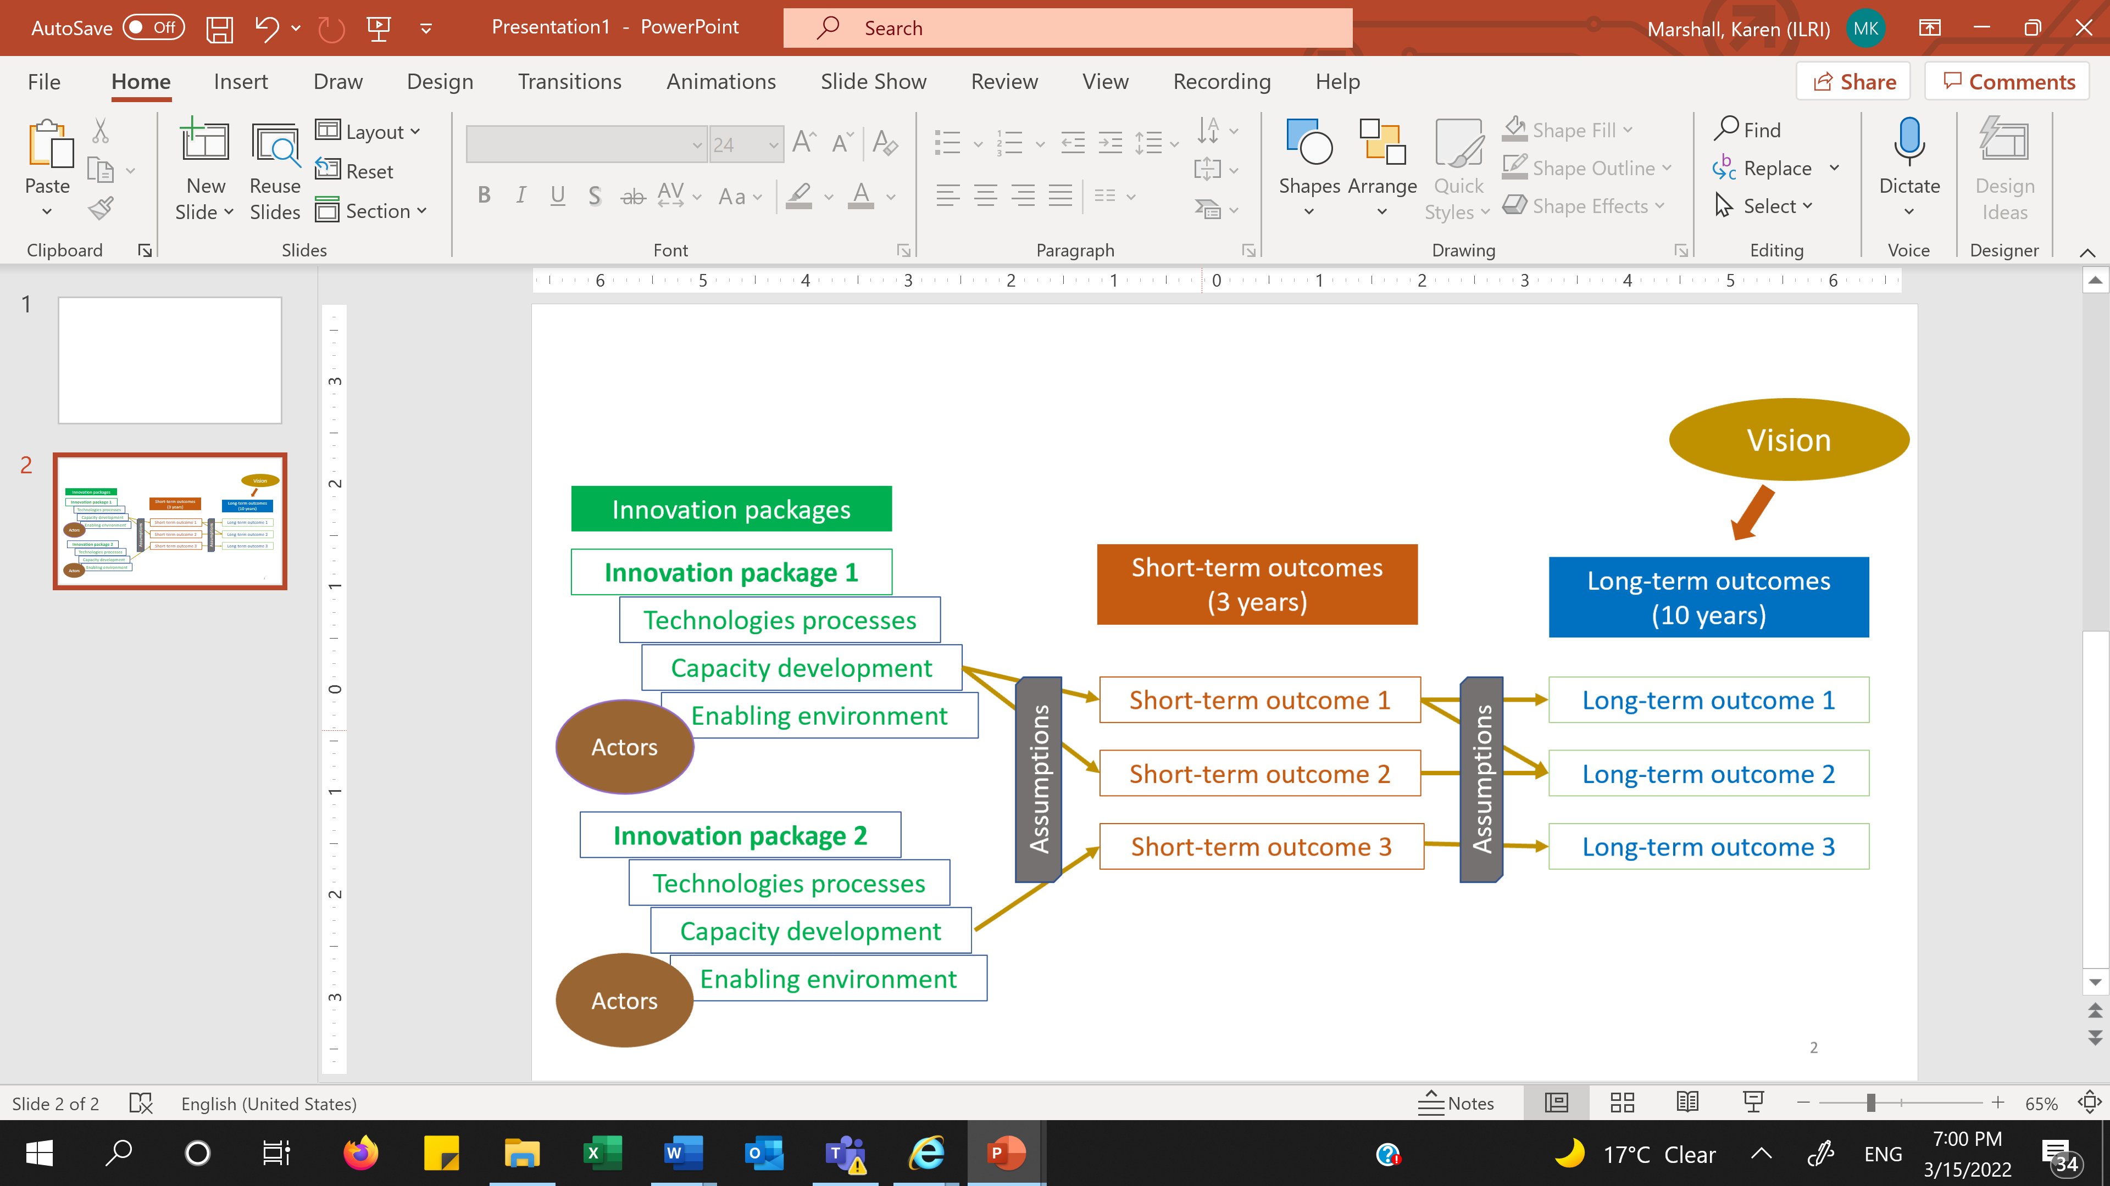
Theory of change – how it will be used
Activities
Monitoring, Evaluation, Learning

Slide 14
Theory of change (ToC) development - overview
Develop problem statements
Define the vision
Agree on key outcomes, long-term (10 years) and short-term (3 years)
List provisional innovation packages:
  Innovations - products, technologies, services, institutional arrangements
  Packaged together with changes to policy/enabling environment and capacity development
Identify and assign roles and responsibilities to different actors
Document assumptions
Review for gaps in overall causal logic

Slide 15
Notes
The process described above was used to co-create theory of changes (ToC) for the 15 SAPLING value-chains across 7 countries, during a series of country-level stakeholder workshops held mid-2022.
The resultant ToCs (from the workshops) were subsequently refined to produce the working theories of change for each value-chain. Continual revision of the ToCs, based on stakeholder feedback and in response to findings from the monitoring, evaluation and learning, is anticipated.

Slide 16
This research was conducted CGIAR initiative Sustainable Animal Productivity for Livelihoods, Nutrition and Gender Inclusion research is supported by contributions from the CGIAR Trust Fund. CGIAR is a global research partnership for a food-secure future dedicated to transforming food, land, and water systems in a climate crisis.

