Slide 1
On-farm chicken performance testing in Ethiopia (OCPT): Overview of activities and progress update
Tropical Poultry Genetics Solution (TPGS)
December 2024
Fasil Getachew¹, Deribe Gemiyo Talore², Getnet Zeleke³, Ararsa Bogale⁴, Kumlachew Geremew¹, Mulugeta Y. Birhanu¹, Tadelle Dessie¹
¹International Livestock Research Institute (ILRI)
²Central Ethiopia Agricultural Research Institute (CEARI)
³Amhara Agricultural Research Institute (ARARI)
⁴Holetta Agricultural Research Center (HARC)

Slide 2
Background and context
The smallholder poultry production system is integral to household livelihood activities in most developing countries, including Ethiopia.
It significantly contributes to household income, food, and nutritional security, especially for resource-constrained households(Wong, Bruyn et al. 2017, Birhanu, Osei-Amponsah et al. 2023).
The smallholder poultry production system is often mainly managed by women, and its contributions to them are significant in cash and nutrition.
However, the production system is mainly characterized by low input and output as farmers use unimproved indigenous ecotypes and traditional management practices. The production and productivity of the sub-sector are quite low (Birhanu, Alemayehu et al. 2021).

Slide 3
Background…
Enhancing the production and productivity of the sector has increasingly become an important focus of governments, researchers, and development practitioners, given the potentially significant effects of employment, income, and nutrition on poor households and women's empowerment.
This requires integrated technologies, including improved genotypes, which are locally adapted and farmer-preferred (Birhanu, Bruno et al. 2022).
Introducing high-producing and locally adapted genotypes demands identifying, testing, and evaluating the performance of different breeds as environmental conditions are highly heterogeneous, and the performance of chicken strains is affected by agroecology and production systems(Kebede, Komen et al. 2024).
This requires undertaking well-designed genotype by environment (GxE) studies (Kebede, Komen et al. 2024)

Slide 4
Background…
Through Sustainable Animal Productivity for Livelihoods, Nutrition and Gender Inclusion (SAPLING), the TPGS research program at ILRI implemented on-farm chicken performance test experiments in Ethiopia, Kenya, Tanzania, and Vietnam in partnership with national agricultural research institutes, private companies, and other stakeholders.
The main aim was to evaluate the performance of different chicken breeds under farmer management conduction, identify farmer-preferred breeds, enhance households’ knowledge and skill in animal source and other nutrient-dense food consumption, and develop an inclusive business model for scaling farmer-preferred breeds.

Slide 5
Methodology-on-farm testing components
The on-farm chicken performance testing has the following three major components.
  1) Delivery and testing of improved chicken genetics. Aimed at comparing the growth and egg production performance of selected breeds (strains) across different geographies.
  2) Households’ nutrition education: Introducing nutrition education at the household level aimed at building households’ knowledge and skill in enhanced poultry product consumption and documenting outcomes.
  3) Testing/validation of scaling business model. This involves implementing targeted interventions that enhance farmers’ access and use of integrated poultry technologies and generating evidence on different outcomes

Slide 6
Methodology-household selection
Household selection involves two stages:
  Stage I- Purposive sampling: identify farmers in a village meeting certain criteria
  Stage II- Random sampling: Providing equal chance for all farmers who fulfilled the selection criteria
.

Slide 7
Methodology-household selection
Stage I-Purpose sampling on the below criteria
  Chicken keeping experience for at least two years;
  Currently keeping not more than 50 adult chickens;
  Willingness to receive 25-75 tagged, brooded, and vaccinated birds of a randomly selected strain willingness to provide night shelter;
  Willingness to provide supplemental feeding to cover the daily requirements of the chickens;
  Willingness to follow recommended flock health management practices aiming at disease control and treatment;
  Willingness to take part in TPGS-related discussions;
  Willingness to participate for a minimum of 72 Weeks in TPGS data collection (pending adverse events outlined in the consent form).
.

Slide 8
Methodology-household selection
Random sampling:
If all households in a village meet the criteria and consent to participate, a 'hat' will be used to randomly select a strain and number of flocks.
  36 pieces of paper, with the name of each strain (i.e. , strain1, strain 2, strain 3) and flock size (i.e.,25, or 50, or 75).

Slide 9
Risks and benefits of on-farm participating households
1) Benefits
  Receive 25-75 vaccinated birds brooded to 28 or 42 days. These birds will have received all standard vaccinations;
  Male chickens, upon reaching 20 weeks, can be consumed or sold for your benefit;
  Receive training on recommended chicken management practices; and
  Others may benefit from the information we find in this study.
2) Risks
  If the existing chickens in the household die, they may not be replaced;
  (unless the cause of the death is related to the new strain that is vaccinated for economically important diseases)
  The introduced chickens may not be highly yielding
  The introduced birds might outcompete the existing birds in the household and vice versa.

Slide 10
Methodology-Experimental setup
The on-farm experiment involves dual-purpose poultry breeds (DPP) breeds (i.e., Sasso, Koekoek, and Kuroiler in Ethiopia since 2021) and commercial layer breeds.
Farmers will receive different chicken breeds with varying sizes of flock (25, 50, 75)-treatment combinations.
Famers’ chicken breeds and trait preferences are central in this performance testing.

Slide 11
Methodology-Experimental setup
There were nine treatment combinations in the OCPT component. These are listed as follows for corresponding households in a performance testing site (PTS):
    1. HH receiving strain 1 + flock level 1 (i.e. 25 chicks)
    2. HH receiving strain 1 + flock level 2 (i.e. 50 chicks)
    3. HH receiving strain 1 + flock level 3 (i.e. 75 chicks)
    4. HH receiving strain 2 + flock level 1 (i.e. 25 chicks)
    5. HH receiving strain 2 + flock level 2 (i.e. 50 chicks)
    6. HH receiving strain 2 + flock level 3(i.e. 75 chicks)
    7. HH receiving strain 3 + flock level 1 (i.e. 25 chicks)
    8. HH receiving strain 3 + flock level 2 (i.e. 50 chicks)
    9.HH receiving strain 3 + flock level 3 (i.e. 75 chicks

Slide 12
Data collection
The data collection involves baseline and endline data collection and monitoring data collection.
  On-farm monitoring data would be collected on selected indicators to measure the productivity of introduced and existing household breeds.
  The monitoring data would be collected at various growth stages of the chicken.
  Baseline and endline data would also be collected to assess the outcomes of nutrition and business model-related interventions.
The data would be collected through the Open Data Kit (ODK) system using trained enumerators.

Slide 13
Overview of monitoring data indicators
Prior to first visit
  Household recruitment to the study
  Random allocation of strain
First visit
  Household general information
  Tagged bird registration
Day 1 – 2 after first visit
  Bird sexing of tagged birds
Week 6, 22, 50 and 70
  Labor allocation to chickens, bird housing & water, (other) livestock inventory, Likability
Every weeks from week 18 to week 72
  Egg Production, sale, consumption & gifts
First visit and then every 4 weeks to week 72
  Bird inventory, Body weight of tagged birds
First visit and then every 4 weeks
  Entries & Exits, Health (prevention & treatment), Feeding

Slide 14
Progress made and observed results
The on-farm chicken performance testing was fully implemented in Ethiopia
Nutrition education and value chain-related interventions implemented.
Monitoring data on chicken productivity and production performance and endline data (nutrition and access to related inputs) were collected.
Farmers' field days and farmers' peer-peer visits were conducted to promote the introduced breeds.
Preliminary analysis on selected performance indicators conducted.

Slide 15
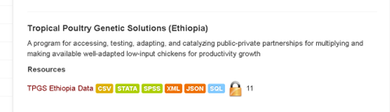
Progress made…..
The data collected is stored in ILRI data portal and available at:
  Ethiopia: https://data.ilri.org/portal/dataset/tpgs-ethiopia

Slide 16
Progress made…
Farmers' field day and farmers' peer-peer visits conducted aimed at promoting the introduced chicken breeds, enhancing to-farmers experience sharing, and monitoring the progress of the project activities
For instance, in Ethiopia (Doyogena and Konso districts), about 254 smallholder farmers (on-farm participating and non-participating),
Please see a report by one of the national TV broadcasting stations about the farmers' field day conducted in these districts.
https://www.youtube.com/watch?v=JBQ0i-nT50U

Slide 17
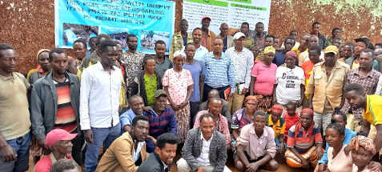
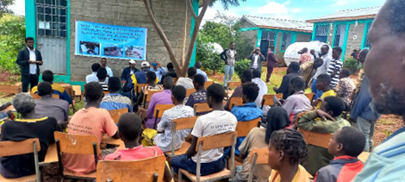
Progress made…
Farmers’ Field Day in Konso
The farmers’ field day involves
  Discussion on the project activities with researchers, policymakers, development partners, and on-farm participating and on-participating farmers
Discussion with farmers and home-to-home visit in Konso district, Ethiopia.
Photo credit: Kumlachew Geremew

Slide 18
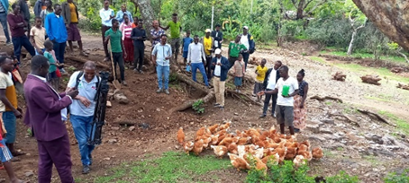
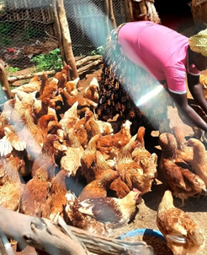
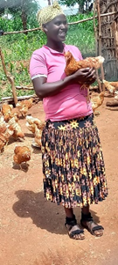
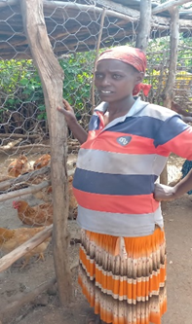
Progress made…
Farmers’ Field Day in Konso
Home-to-home visit of chicken breeds disseminated by SAPLING.
Home to home visit in Konso district, Ethiopia.
Photo credit: Kumlachew Geremew

Slide 19
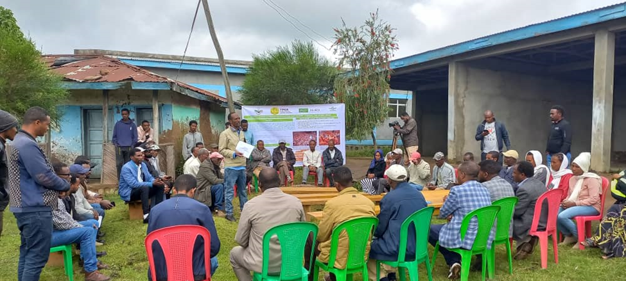
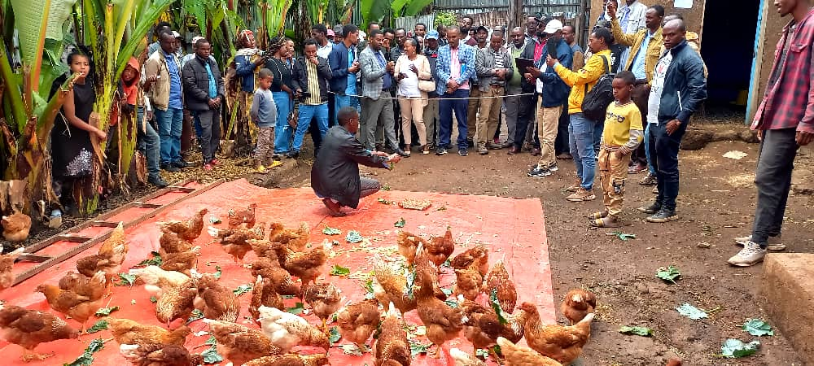
Progress made…
Farmers field day in Doyogena
  Discussion on the project activities with researchers, policymakers, development partners, on-farm participating and non-participating farmers, and home-to-home visits to one of the on-farm chicken performance participating farmer.
Discussion with farmers and home-to-home visit in Doyogena district, Ethiopia.
Photo credit: Kumlachew Geremew

Slide 20
Progress made...
Preliminary analysis of selected performance indicators
  Data management and data cleaning are jointly conducted by the ILRI team and researchers in the partner institutions.
  A preliminary analysis was conducted to assess the performance of the introduced male and female chicken breeds in terms of body weight gain.
  Results indicate good performance of the introduced breeds under farmer management conditions.

Slide 21
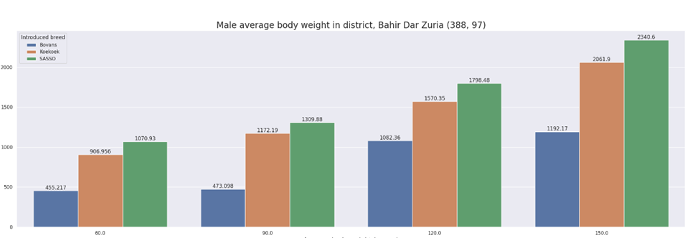
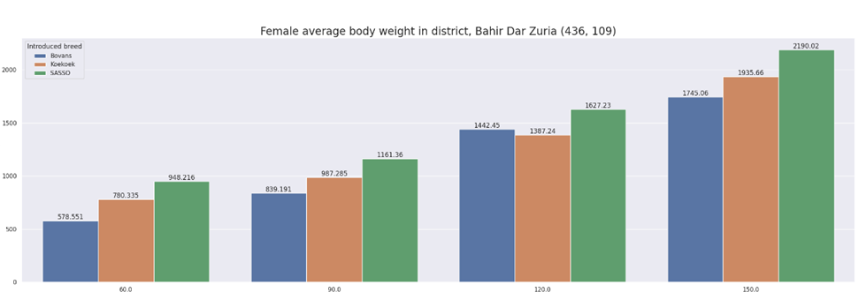
Progress made…
Preliminary analysis- Bahir Dar Zuria
Preliminary findings for male chicken body weight show that Sasso is the heaviest (2340g) breed at 150 days of age, followed by Koekoek (2062 g) and Bovans Brown (1197g).
For females, Sasso is the heaviest (2190g) breed at 150 days of age, followed by Koekoek (1936 g) and Bovans Brown (1715g).
Male growth performance of introduced breeds in Bahir Dar Zuria district, Amhara region
Female growth performance of introduced breeds in Bahir Dar Zuria district, Amhara region

Slide 22
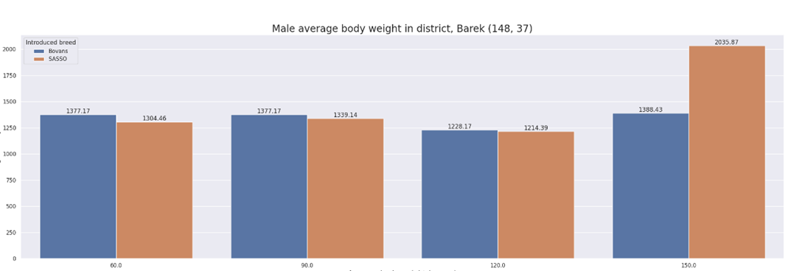
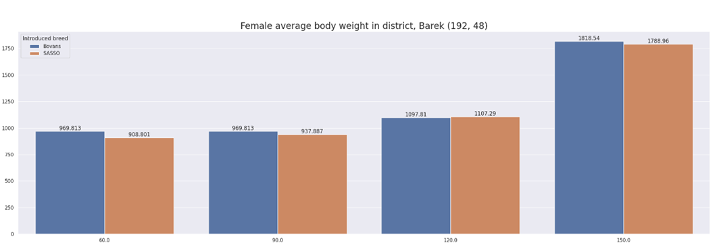
Progress made…
Preliminary analysis-Barek
Koekeok was not distributed in the Barek district for logistical reasons. Male Sasso had a higher body weight (2035g) than Bovans Brown (1388.43g) at 150 days of age.
The growth performance of female Sasso and Bovans Brown chicken at 150 days of age was comparable.
Male growth performance of introduced breeds in Barek district, Oromia region
Female growth performance of introduced breeds in Barek district, Oromia region

Slide 23
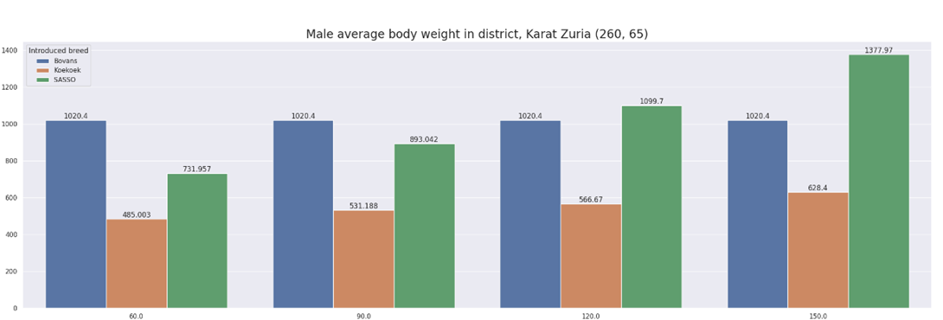
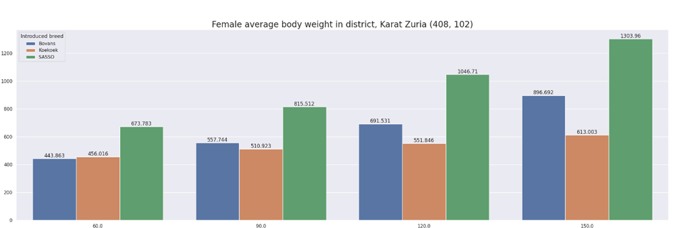
Progress made...
Preliminary analysis -Konso
Male Sasso reached 1378 g at 150 days of age, followed by Bovans (1020g) and Koekoek (628g) in Karat Zuria district.
Like the performance of males, the body weight of the female chickens was the highest for Sasso, followed by Bovans and Koekoek across ages in the Karat Zuria district (Figure 8).
Female Sasso reached 1303 g at 150 days of age, followed by Bovans (896g) and Koekoek (613g).
Male growth performance of introduced breeds in Karat Zuria District, Southern region
Female growth performance of introduced breeds in Karat Zuria district, Southern region

Slide 24
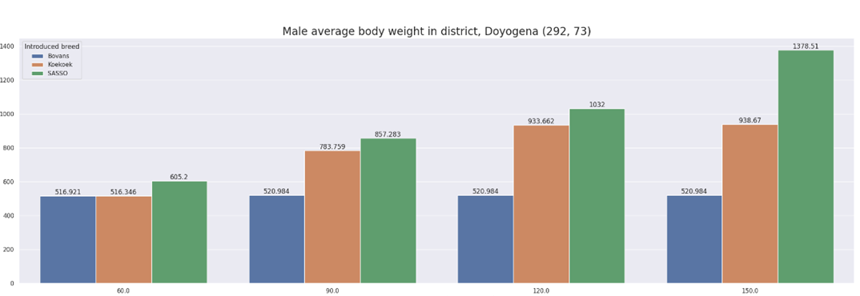
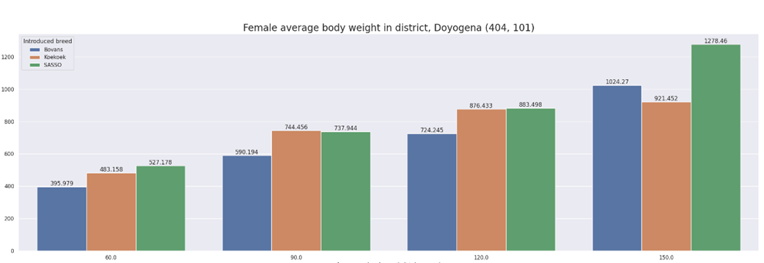
Progress made…
Preliminary analysis –Doyogena
Male Sasso reached 1378 g at 150 days of age, followed by Koekoek (839g) and Bovans (521g).
At 150 days of age, the average weight for female Sasso was the highest (1278 g), followed by Bovans (1024g) and Koekoek (921g).
Male growth performance of introduced breeds in Doyogena district, Southern region
Female growth performance of introduced breeds in Doyogena district, Southern region

Slide 25
Major challenges observed
Disease: The first batch of Koekoek was wiped out by diseases before reaching participant households, and the breed was not tested in the Mehal Meda district.
High cost of feed: The cost of feed was high, which made it difficult for farmers to keep 50 or 75 chicks in some households.
Lack of proper housing for chickens suitable for cold environments. There is a need to design affordable but more comfortable houses for villages in Mehal Meda district.
Farmers also had limited access to inputs and services such as drugs, veterinary, and extension.

Slide 26
Proposed activities
Finalize the data management and cleaning activity.
Conduct data analysis and develop a report (jointly by national partners and ILRI).
Present results to stakeholders, including policymakers and development partners.
Communicate results, reports, journal articles, and policy briefs.

Slide 27
References
Birhanu, M. Y., Alemayehu, T., Bruno, J. E., Kebede, F. G., Sonaiya, E. B., Goromela, E. H., Bamidele, O. & Dessie, T. 2021. Technical Efficiency of Traditional Village Chicken Production in Africa: Entry Points for Sustainable Transformation and Improved Livelihood. Sustainability, 13, 8539
Birhanu, M. Y., Bruno, J. E., Alemayehu, T., Esatu, W., Geremew, K., Yemane, T., Kebede, F. G. & Dessie, T. 2022. Beyond diffusion to sustained adoption of innovation: A case of smallholder poultry development in sub-Saharan Africa. International Journal of Agricultural Sustainability, Ahead-of-print, 1-19.doi: 10.1080/14735903.2022.2041235
Birhanu, M. Y., Osei-Amponsah, R., Obese, F. Y. & Dessie, T. 2023. Smallholder poultry production in the context of increasing global food prices: roles in poverty reduction and food security. Animal Frontiers, 13.https://doi.org/10.1093/af/vfac069
Kebede, F. G., Komen, H., Dessie, T., Hanotte, O., Kemp, S., Alemu, S. W. & Bastiaansen, J. W. M. 2024. Multi-environment performance analysis identifies more productive and widely adapted chicken breeds for smallholder farmers. Frontiers in Sustainable Food Systems, 8.10.3389/fsufs.2024.1441295
Wong, J. T., Bruyn, J. D., Bagnol, B. & Grieve, H. 2017. Small-scale poultry and food security in resource-poor settings: A review. Global Food Security. Global Food Security, 15, 43-52.doi: 10.1016/j.gfs.2017.04.003

Slide 28
Thank you!

Slide 29
Acknowledgements
This work was conducted as part of the CGIAR Initiative on Sustainable Animal Productivity. CGIAR research is supported by contributions to the CGIAR Trust Fund. CGIAR is a global research partnership for a food-secure future dedicated to transforming food, land, and water systems in a climate crisis.

