Slide 1
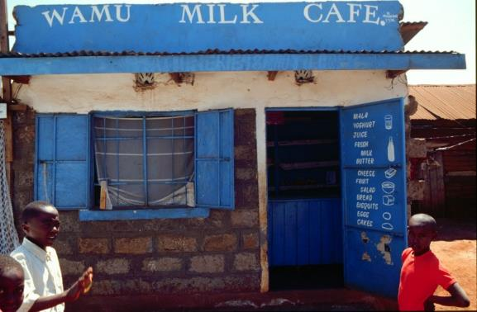
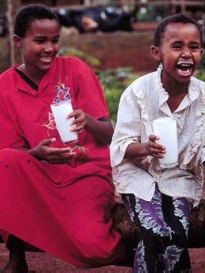
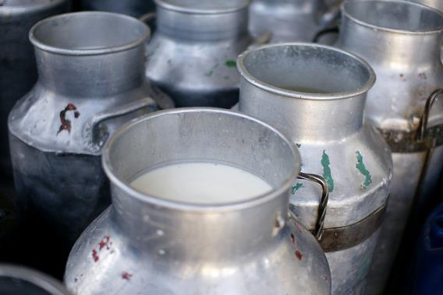


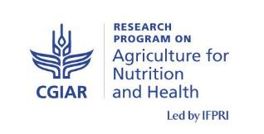
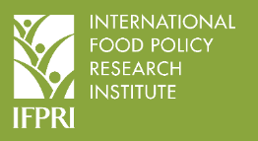


MoreMilk
making the most of milk
Silvia Alonso
(on behalf of the MoreMilk project research team)
“Growing with dairy”
Stakeholder dissemination meeting
9 March 2018, ILRI Campus, Nairobi
Notes:
There MUST be a CGIAR logo or a CRP logo. You can copy and paste the logo you need from the final slide of this presentation. Then you can delete that final slide
To replace a photo above, copy and paste this link in your browser: http://www.flickr.com/photos/ilri/sets/72157632057087650/detail/
Find a photo you like and the right size, copy and paste it in the block above.

Slide 2
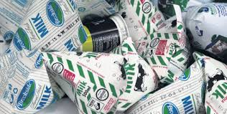
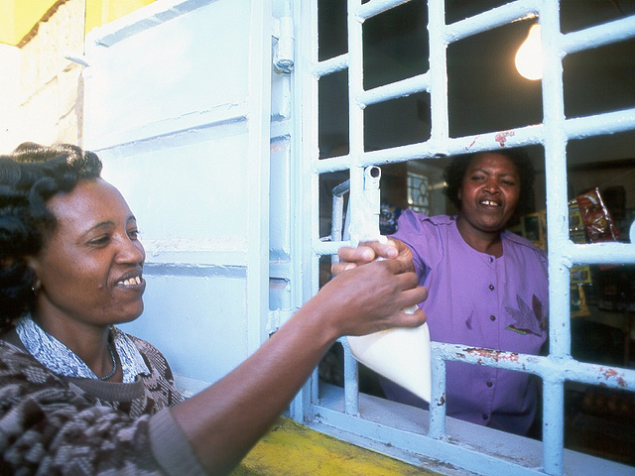
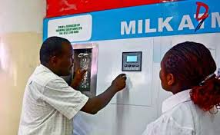

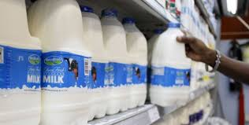

Slide 3
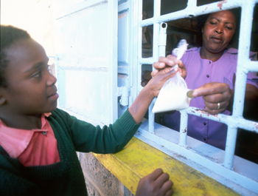
Informal milk markets
Most available and affordable form of dairy in many low- and middle-income countries
In rural areas in LIC fresh raw milk is easily available (incl. self-production)
In urban areas co-exists with pasteurized milk:
  Wide distribution channels (incl. door to door)
  Cheaper
  Taste preference
  Cultural values
  AFFORDABLE

Slide 4
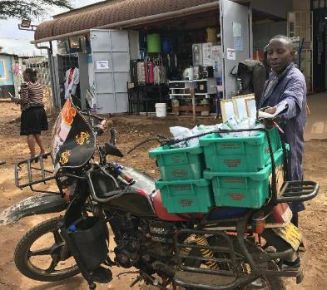
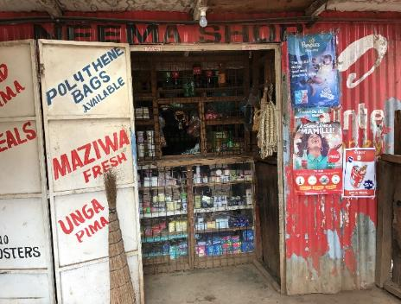
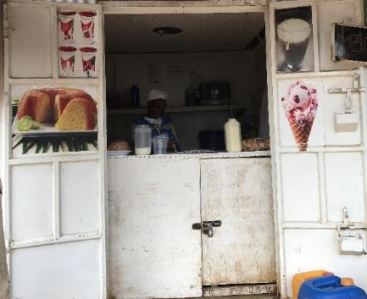
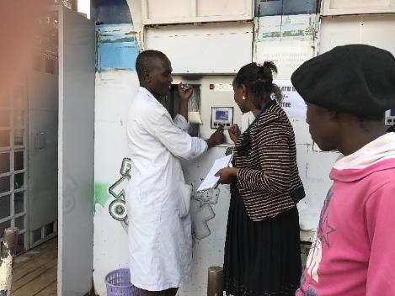
The “informal” (raw milk) dairy sector
Diverse typology of actors, poor infrastructure, lack of cold chain, informal agreement mechanisms between actors, often unlicensed, poorly regulated (government and self-regulation)
Notes:
(informal=raw milk / formal pasteurized milk) – 85% milk commercialized through informal sector;
Informal milk sector feeds (nutritional security) the largest amount of population; in urban sectors (great majority of consumers in informal settlements) – not access to supermarkets (price, proximity, …)
Informal sector meets the demand from poor consumers – need to buy small amounts (pasteurized milk in small packages), but still need milk at low prices.
VC actors: producers – traders (2 types: operating in more “structured” establishments / mobile vendors (door to door, bicycles,…) – consumers
Offers livelihoods to many (estimates of … numbers of jobs per litre); makes available and accessible a nutritional product to poor consumers
Despite regulators support over the past years, now backing – ATMs issues, unable to see the benefits from supporting informal sector, pressure from big processors

Slide 5
The “informal” (raw milk) dairy sector
Diverse typology of actors, poor infrastructure, lack of cold chain, informal agreement mechanisms between actors, often unlicensed, poorly regulated (government and self-regulation)
But… Informal dairy markets have an essential role in at least three main aspects:
  Food security (especially diet and nutrition needs of poorest children)
  Source of livelihoods for the population (higher prices for producers, jobs, “easy business opportunity”)
  Opportunity for women and youth
Notes:
(informal=raw milk / formal pasteurized milk) – 85% milk commercialized through informal sector;
Informal milk sector feeds (nutritional security) the largest amount of population; in urban sectors (great majority of consumers in informal settlements) – not access to supermarkets (price, proximity, …)
Informal sector meets the demand from poor consumers – need to buy small amounts (pasteurized milk in small packages), but still need milk at low prices.
VC actors: producers – traders (2 types: operating in more “structured” establishments / mobile vendors (door to door, bicycles,…) – consumers
Offers livelihoods to many (estimates of … numbers of jobs per litre); makes available and accessible a nutritional product to poor consumers
Despite regulators support over the past years, now backing – ATMs issues, unable to see the benefits from supporting informal sector, pressure from big processors

Slide 6
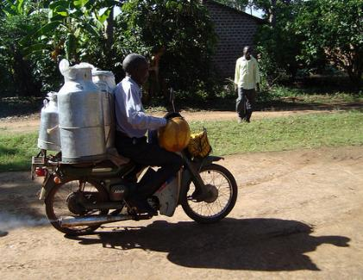
Raw milk and public health
Concerns over the safety of raw milk
Is it a health risk in Kenya?
Can it be made safer?
PUBLIC HEALTH INTERVENTIONS IN KENYA
Based on increased regulation and inspection of informal dairy VC actors
Promoting selling of boiled milk / ATM
Ban raw milk VC and promote pasteurization

Slide 7
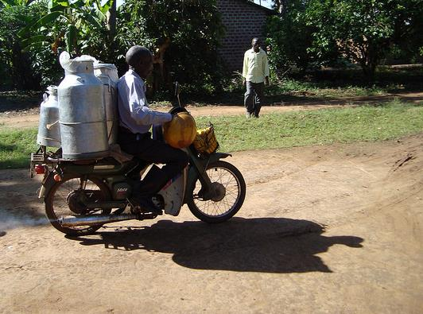
So do win-win options exist that will protect nutrition and livelihoods provided by these markets and still protect public health?

Slide 8


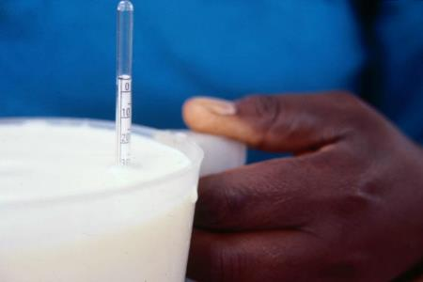
THE PROJECT’S VISION
… fair and competitive dairy markets…
(regulated)
…that sell safe milk… (food safety)
…and that help meet the nutrition needs of poor households, especially children. (inclusive)

Slide 9

Project aim
Identify policy and behavioural opportunities and constraints to milk consumption that could be leveraged to improve nutrition outcomes among vulnerable populations
Evaluate the potential of a market-based intervention in the informal dairy sector to generate sustainable and scalable nutrition and health benefits for children

Slide 10
MoreMilk project
Funder: DFID-BMGF
5 year project (Nov 2016-Oct 2021)
Project PIs: Delia Grace and Silvia Alonso (ILRI)
The project will include five clearly distinct research components.
Short name | Full description | Project partners
MILK MARKETS (mMarkets) | assessing the potential of informal dairy markets to meet children’s milk needs | ILRI - SUA
cRCT | assessing the impact of a trader-intervention on health and nutrition outcomes | ILRI - IFPRI
SCALE & SUSTAINABILITY (S&S) | assessing the scalability and sustainability of trader intervention in Kenya, the state of Assam (India) and Tanzania | ILRI - IIED
RURAL MILK CONSUMPTION (BCC) | identifying drivers to improving consumption of milk in dairy development projects | ILRI – SUA – Emory U
FOOD SAFETY SCOPING (FS scoping) | Scoping priority investments for food safety in three African countries | ILRI

Slide 11
(A bit of researchers talk…)
mMarkets: What is the potential of markets to meet children’s milk needs in an urban context?
cRCT: What is the impact of a milk trader-based intervention on health and nutrition of children?
S&S: What are the facilitators and barriers to scale and sustainability of milk-trader based interventions?

Slide 12
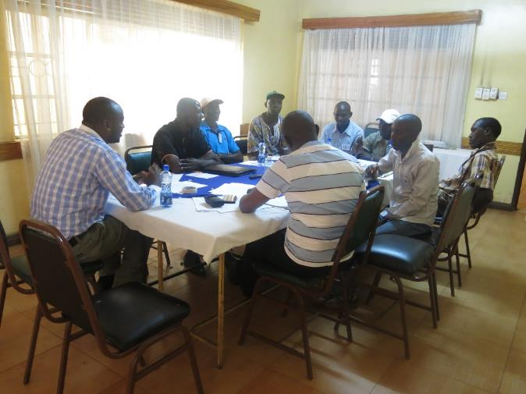
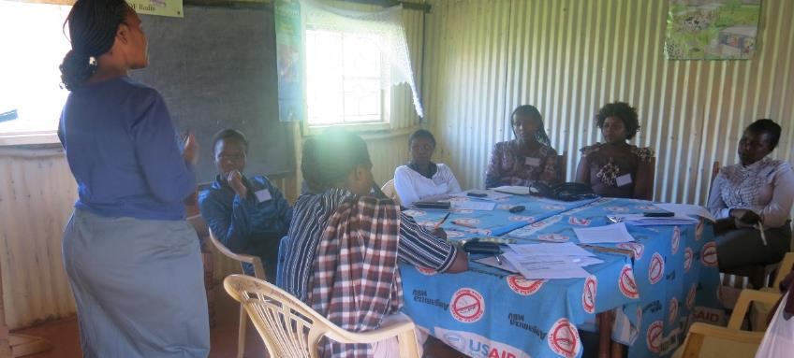
Upscaling the informal market
Training and certification
Milk quality/ milk hygiene
business skills / value addition
Sustainable/self-sustained
Notes:
Sustainable – designed so that it provided incentives for the different players (from authorities, to trainers and traders!)
Self-sustained (economically viable)
Studies showed improved milk safety and satisfaction among traders and consumers

Slide 13
Upscaling the informal market
Training and certification
Milk quality/ milk hygiene
business skills / value addition
Sustainable/self-sustained
FINDINGS:
Improved milk safety
Happy traders/ customers
Less buy-in than expected
Successful in other contexts
Notes:
Sustainable – designed so that it provided incentives for the different players (from authorities, to trainers and traders!)
Self-sustained (economically viable)
Studies showed improved milk safety and satisfaction among traders and consumers

Slide 14
Giving T&C another chance!
“MoreMilk: making the most of milk” project (2016-2021)
TCM scheme to improve milk safety and health & nutrition outcomes in children in peri-urban Nairobi
Training: milk quality, safety and hygiene
Certification: “quality mark”
Marketing: milk consumption messages to mothers/consumers

Slide 15
MoreMilk for better health and nutrition
Milk safety and quality
Traders
Promotion milk consumption

Slide 16
MoreMilk for better health and nutrition
- Pathogens
Milk safety and quality
- Adulteration
Traders
+ Quality
Promotion milk consumption

Slide 17
MoreMilk for better health and nutrition
- Pathogens
- Diarrhea/FBD
- Waste
Milk safety and quality
- Adulteration
Better nutrition
Traders
+ Quality
Promotion milk consumption

Slide 18
MoreMilk for better health and nutrition
- Pathogens
- Diarrhea/FBD
- Waste
Milk safety and quality
- Adulteration
Better nutrition
Traders
+ Quality
- Waste
Promotion milk consumption

Slide 19
MoreMilk for better health and nutrition
- Pathogens
- Diarrhea/FBD
- Waste
Milk safety and quality
- Adulteration
Better nutrition
Traders
+ Quality
- Waste
Promotion milk consumption
+ Consumption

Slide 20
MoreMilk for better health and nutrition
More loyal customers
- Pathogens
- Diarrhea/FBD
- Waste
Milk safety and quality
- Adulteration
Better nutrition
Traders
+ Quality
- Waste
Promotion milk consumption
+ Consumption
Higher returns

Slide 21
cRCT- cluster randomized control trial
Field experiment to test effectiveness of a training-certification-marketing (TCM) of traders (“intervention”) in children nutrition and health outcomes in peri-urban Nairobi.
Dagoretti division (excluding high-end wards)
Approx. 400 traders and 2,000-4,000 consumer households
Baseline / intervention / Endline (1 year)
[Smallholder dairy project]

Slide 22
Training, Certification and Marketing
Based on training manual SDP (East Africa)
Updated training, 4 components.
Delivered to dairy traders through BDS
Enable traders to recognized
  milk quality, handle milk hygienically (HEALTH)
  manage their business efficiently (INCENTIVE) and
  market their milk better (NUTRITION AND INCENT)
  [theory of change]

Slide 23
RCT – defining outcomes
Primary outcome/s:
Improvement in % of retailers meeting raw milk food safety standards
Mean dietary adequacy of intake of key milk-nutrients (protein, Ca, vitamin B12)
Secondary outcome/s:
Consumer household | Trader
Child anthropometric measures | Business profitability
Stunting/wasting | Women empowerment
Early Child Development | Milk composition
Dietary intake | KAP milk hygiene
Prevalence acute diarrhea

Slide 24
Scale and Sustainability
What makes the TCM sustainable and scalable?
Kenya, Tanzania and State of Assam (India)
Includes:
  Review of literature around the T&C in these countries
  Key Informant interviews and/or FGDs with researchers, policy makers, NGOs and traders,…
  Policy and market analysis
  Identification of keys to scale and sustainability

Slide 25
THE PROJECT’S VISION
… fair and competitive dairy markets…
(regulated)
…that sell safe milk… (food safety)
…and that help meet the nutrition needs of poor households, especially children. (inclusive)

