Slide 1
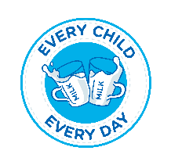

A training, certification and marketing scheme for informal dairy vendors in Kenya increases child milk intake in Eldoret, Kenya: The MoreMilk project
Silvia Alonso, Jef L Leroy, Emmanuel Muunda, Moira Donahue Angel, Emily Kilonzi, Giordano Palloni, Gideon Kiarie, Paula Dominguez-Salas and Delia Grace
CGIAR Innovations in Transforming Food Systems for Nourishing Nations
Micronutrient Forum 6th Global Conference, The Hague, Netherlands
16 October 2023

Slide 2
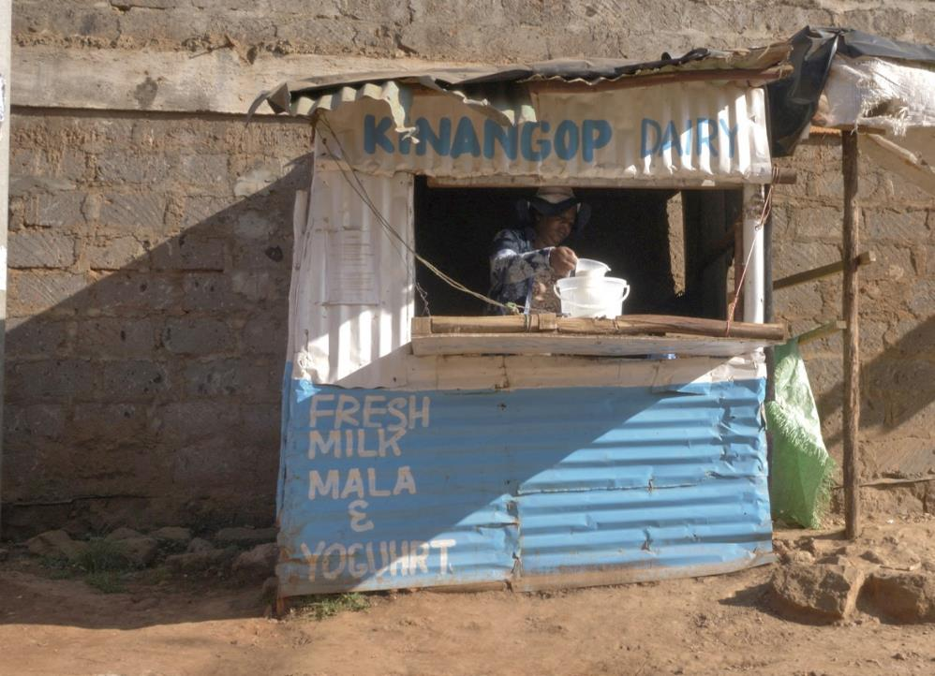
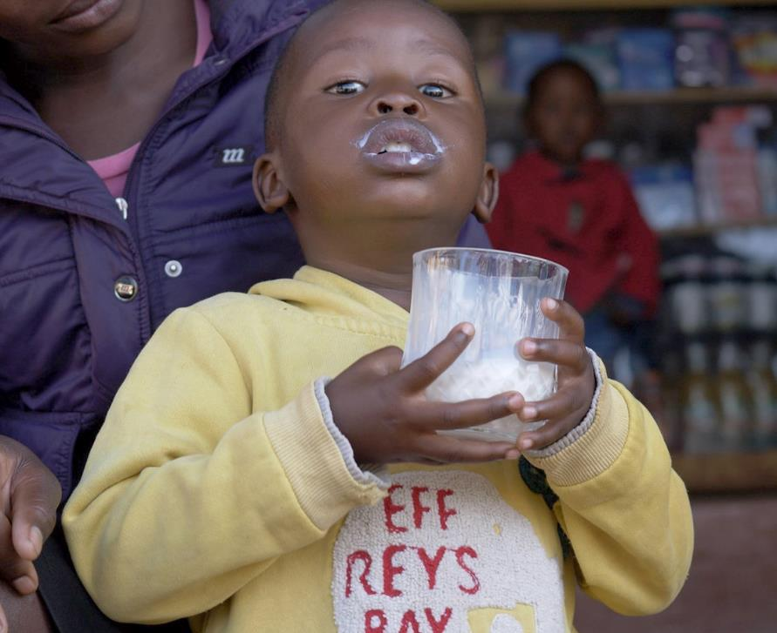
A ‘problem’
A ‘blessing’

Slide 3
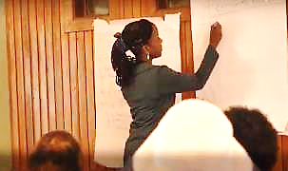
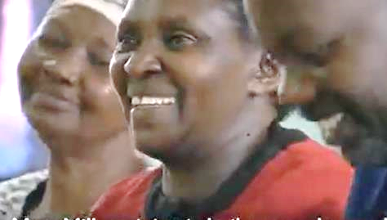
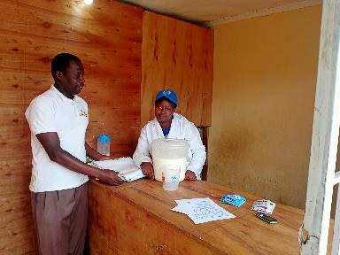
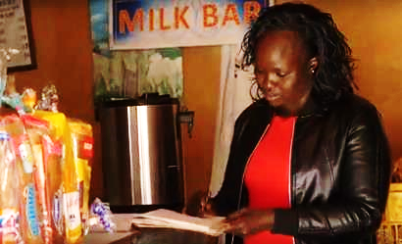
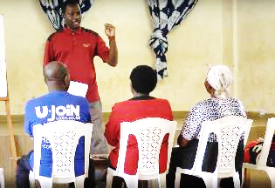
The intervention
Training
Check-in individual visits
MILK MARKETING CAMPAIGN

Slide 4

The milk marketing campaign
SAM messages (Simple, Actionable, Memorable)
  Development of SAM logo
  Development of SAM messages (approved by MoH)
Inspirational messages
Marketing products grounded in market research
  TO SEE - For the vendor and the shop
  TO TAKE - For customers to take home
A phased-release of the marketing materials

Slide 5
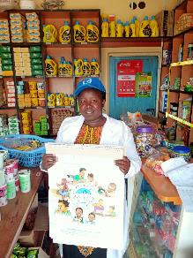
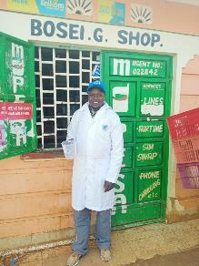



Phase 1
Phase 2
Phase 3
Phase 4
Phase 5
TO SEE
TO TAKE

Slide 6







Phase 1
Phase 2
Phase 3
Phase 4
Phase 5
TO SEE
TO TAKE

Slide 7

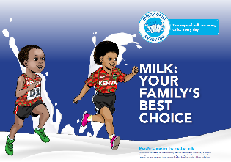


Phase 1
Phase 2
Phase 3
Phase 4
Phase 5
TO SEE
TO TAKE

Slide 8




Phase 1
Phase 2
Phase 3
Phase 4
Phase 5
TO SEE
TO TAKE

Slide 9
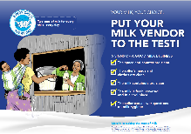



Phase 1
Phase 2
Phase 3
Phase 4
Phase 5
TO SEE
TO TAKE

Slide 10
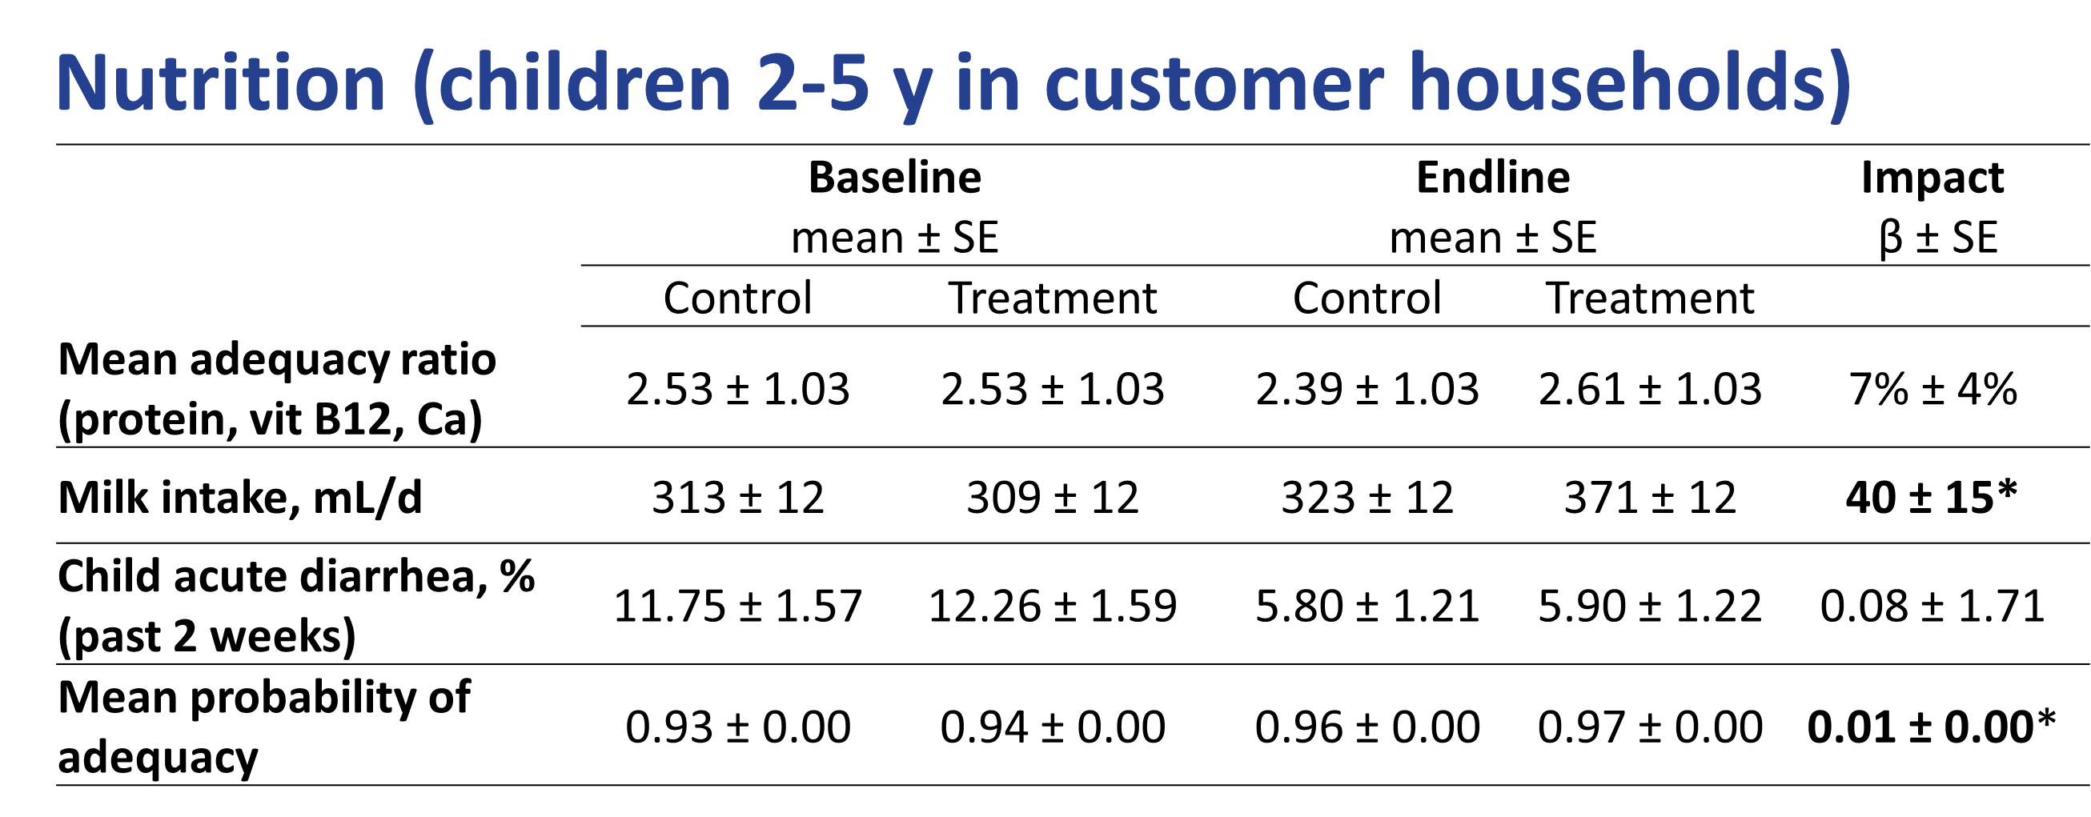
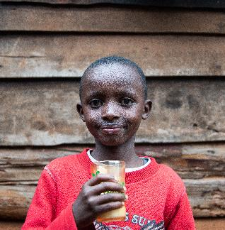
Impact
Increase of 40–50ml/d of milk intake in treatment group compared to control
No difference in diet adequacy on calcium, protein and vitamin B12
No difference in child acute diarrhoea incidence

Slide 11
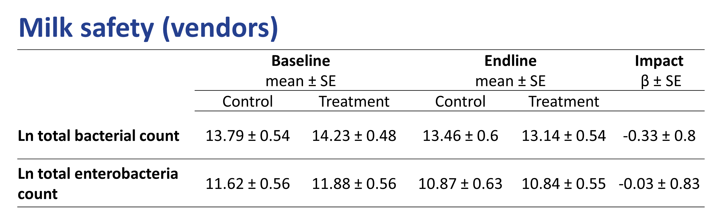
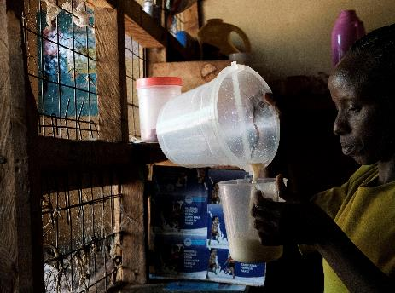
Impact
Microbiological quality of milk affected by earlier steps in the supply chain
Failure to sustain effect overtime
Capital investments needed
Other secondary outcomes to be analysed

Slide 12

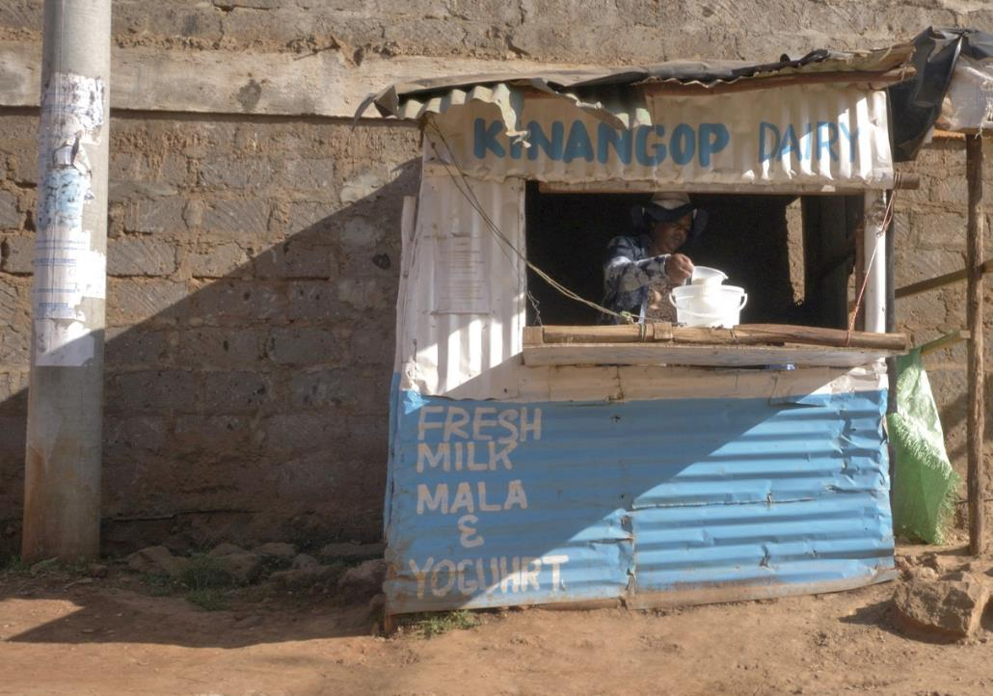
CONCLUSIONS
Milk intake in children increased…
… not at the expense of mean probability of micronutrient adequacy
Lack of observable effect on food safety might be due to…
…Contamination earlier in value chain
…Effect failed to sustain
Improvements in self-reported practices and outcomes
  Increased milk testing for quality
  Stronger negotiation with suppliers
  Better communication with customers around attributes of milk
  Increased sales
Regulator planning to scale the intervention

Slide 13



THANK YOU

