Slide 1
Food systems transformation
An African perspective of where we are and where to next
Namukolo Covic, Director General’s Representative to Ethiopia
CGIAR Regional Director, East and Southern Africa
Uppsala Health Summit 25 October 2022

Slide 2


Key messages
Africa has multiple food systems challenges
But we also have opportunities we can leverage, such as the current food systems transformation momentum to bring about positive change
But this will take all actors being deliberate about generating synergies for collective momentum

Slide 3
Summit Theme:
Healthy Lives from Sustainable Food Systems

Slide 4





We have multiple burdens of malnutrition
Africa’s current food systems is leading to a clear double burden of malnutrition
Source, GNR, 2019
Notes:
This slide shows that both undernutrition reflected by stunted growth of children under five years old, and overweight and obesity reflected by this in girls 5-19 years old are high. This is a clear indication of a double burden of malnutrition.
Stunting is an indicator of affected children being subjected to chronic undernutrition from poor diets as well as other aspects like poor sanitation and health facilities. The decrease seen from 38% in 2000 to 30% in 2018 is just too slow to meet our SDG targets.
On overweight which includes overweight and obesity, we are seeing a gradual increase across age groups. Higher in adolescents and highest in the adult women. This reflects an increasing magnitude in overweight and obesity faster than the reductions we are seeing in undernutrition at population levels.

Slide 5
Africa’s food systems is characterized by multiple challenges
But also strengths we should seek to leverage

Slide 6
Africa’s balance of trade for Maize (A) and Rice (B) (Abera et al., 2019; Covic et al., 2019; Karimov et al., 2019) Based on FAOstat data

Slide 7
Africa’s balance of trade for Wheat (C) (Abera et al., 2019; Covic et al., 2019; Karimov et al., 2019) Based on FAOstat data

Slide 8
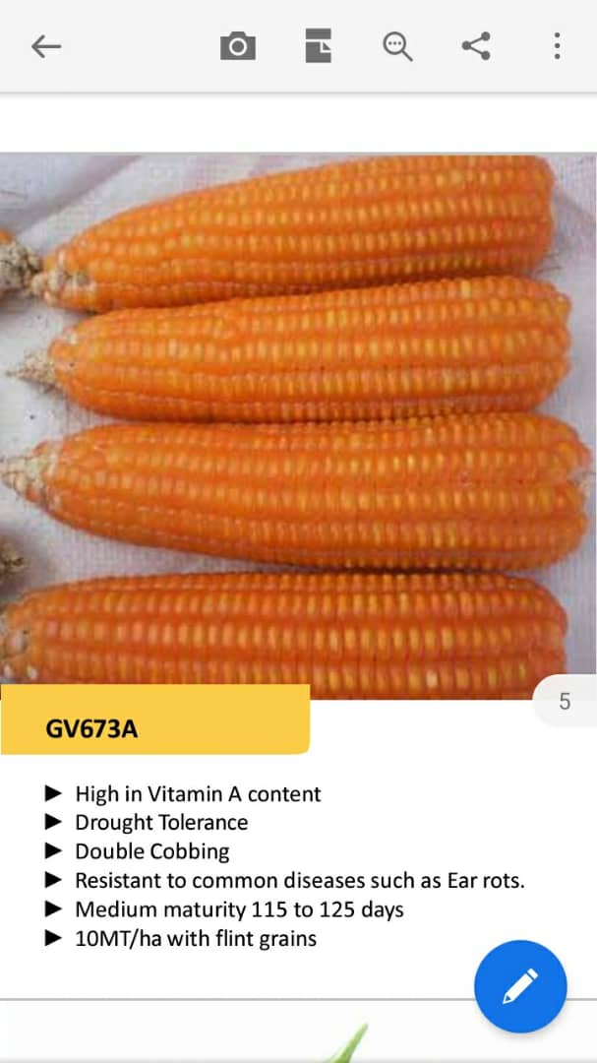
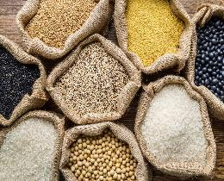
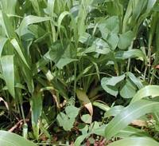
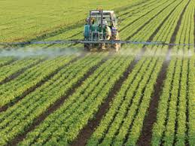
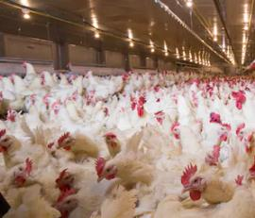

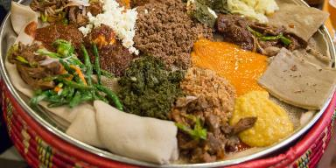
The transition to produce more food is on a path to other challenges
Residues
Monoculture
Fertilizer
Pesticides
+
-
Residues
Diversity
Anti-microbials
Pesticides
We need policies, regulatory instruments, surveillance, & One Health approach to manage and mitigate

Slide 9
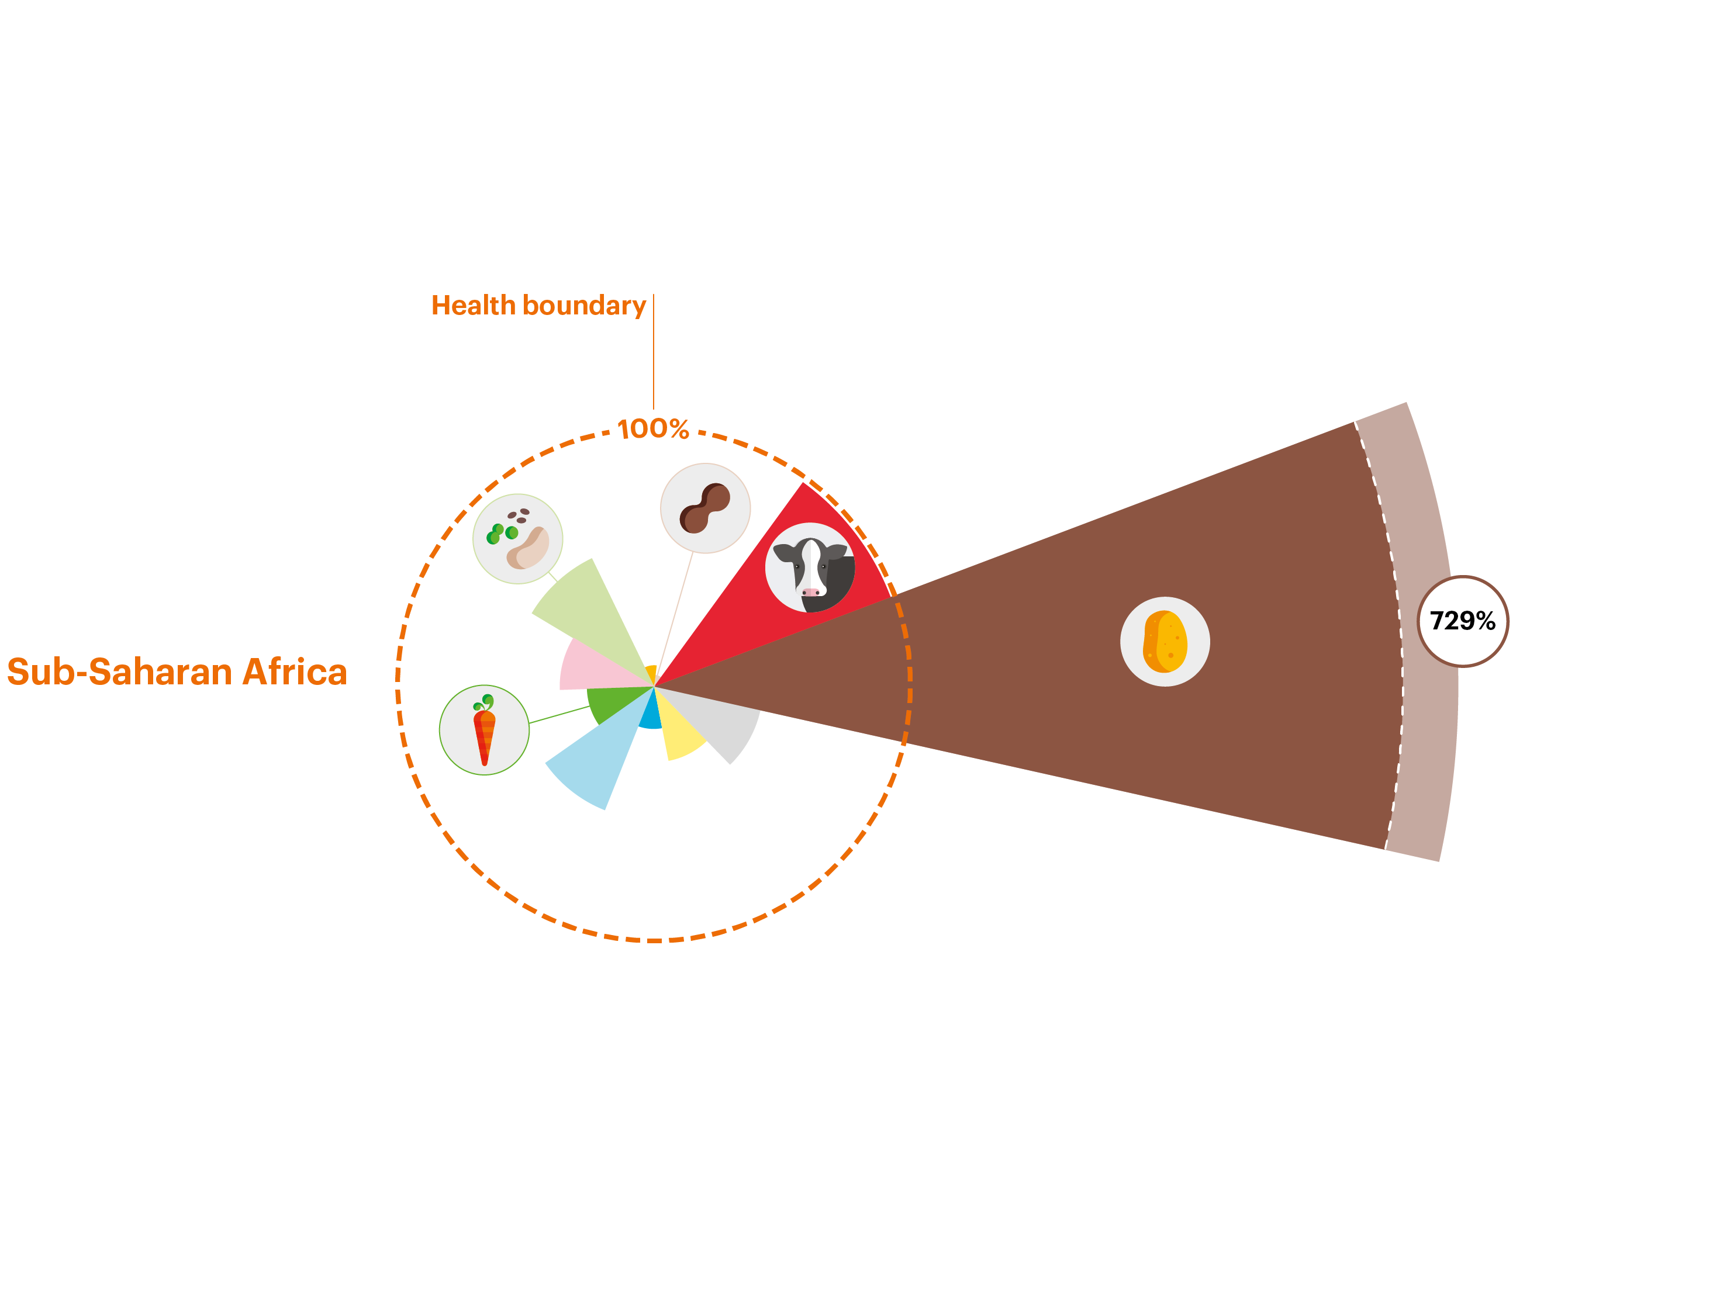
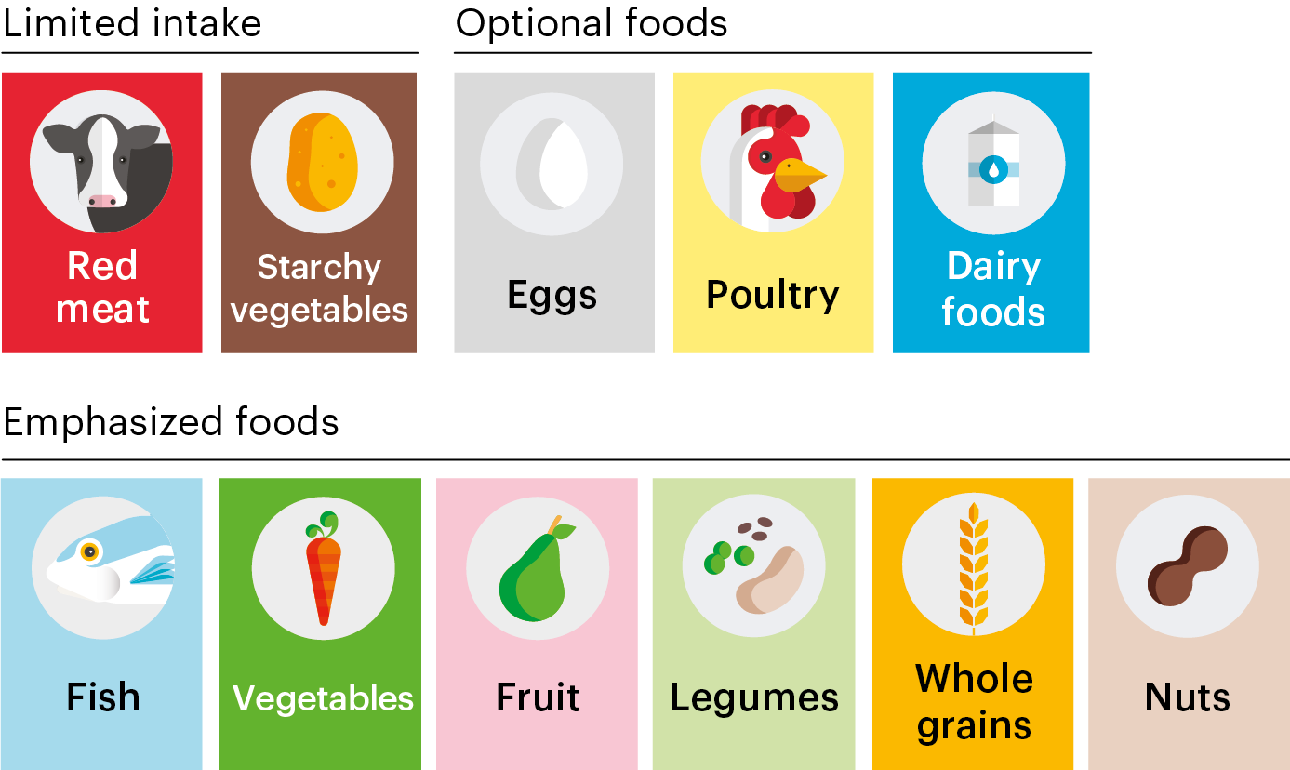
This is the African context
Current Intakes vs
Planetary Health Diet
To do better on these consumption patterns
for better nutrition and health
obtained from sustainable production patterns
soil health is a must!
Source: EAT Lancet Commission, 2019

Slide 10
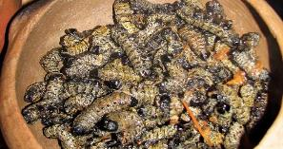
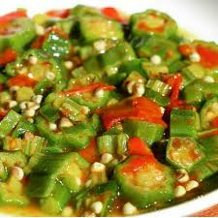

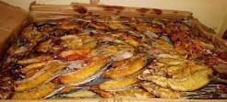
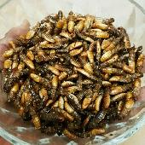
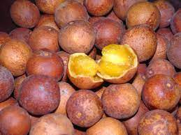
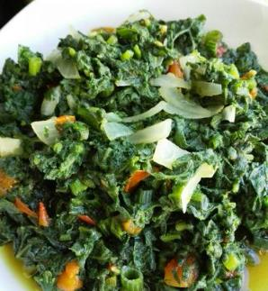
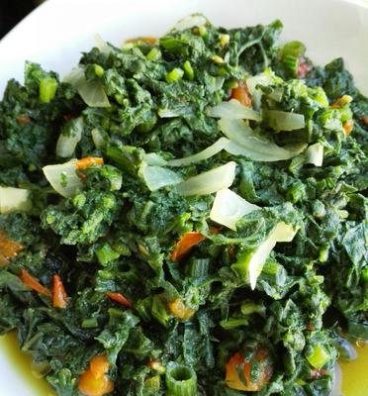
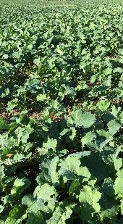
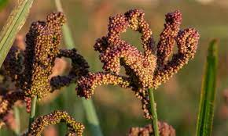
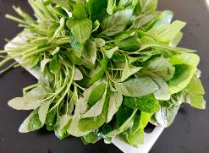
We have a generally rich food biodiversity, but counter intuitively our diet diversity is low.

Slide 11
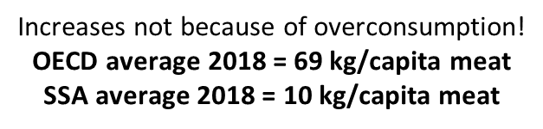
% growth in demand for livestock products to 2030
Beef
Pork
Poultry
Milk
11
Estimates of the % growth in demand for animal source foods in different World regions, comparing 2005 and 2030. Estimates were developed using the IMPACT model, courtesy Dolapo Enahoro, ILRI.
Notes:
FAO. 2011. Mapping supply and demand for animal-source foods to 2030, by T.P. Robinson & F. Pozzi.
Animal Production and Health Working Paper. No. 2. Rome.
IMPACT results generally suggested smaller changes in demand compared to FAO. Among other drivers of the results, the observed differences may be related to the underlying assumptions on how future demand will respond to prices and incomes. FAO projections could for example be assuming big shifts to Chicken Meat consumption (e.g., from pork) as incomes grow in Asia. IMPACT makes the same assumption in terms of direction, but with the expected shifts a bit more dampened.
High income countries include much of Europe. In fact, if one looks at individual European nations in many cases there is a DECLINE in demand (Switzerland for beef (-22%) and pork (-14%) for example)
Figures for meat consumption: https://data.oecd.org/agroutput/meat-consumption.htm

Slide 12
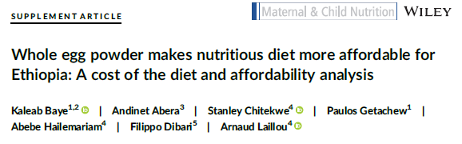
This study in Ethiopia used dried egg powder to reduce the cost of the complementary diet by 14%. The question is – can we be more creative to make nutritious diets more affordable?
Baye et. al., 2021 https://pubmed.ncbi.nlm.nih.gov/34558194/

Slide 13
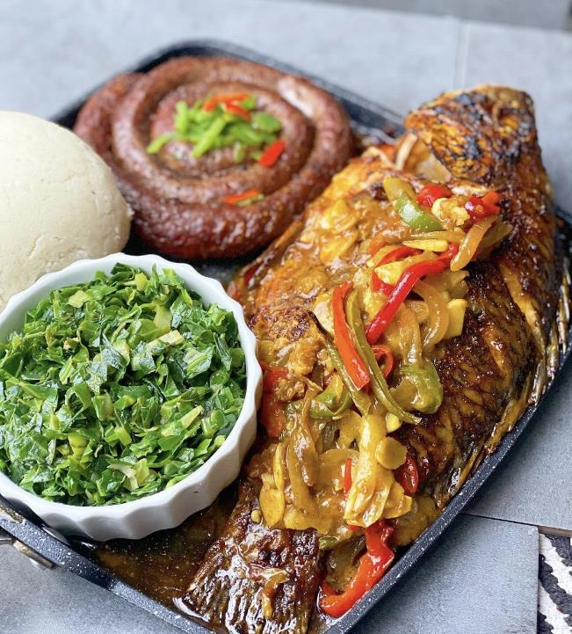

Digital Events
@DigitalEventsZM
Who are you coming with at the food market??
1st May 2021
RT for awareness.
#ZedTwitter #lskFoodiesMarket.
12:38 PM · Apr 21, 2021·Twitter for iPhone
We do have those that are already able to overindulge
Namukolo Covic
@NamukoloC
13h
Yummy Food!
For better nutrition & health, the amount of space taken by the sausage and fish on this plate should be vegetables. The space taken by vegetables now should be the sausage and fish. That would contribute to shifting to sustainable consumption patterns!
@FoodSystems
Quote Tweet

Slide 14
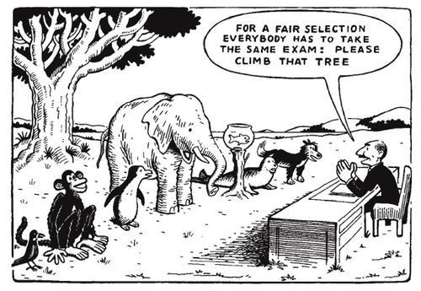
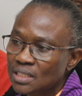
Context is important: Equal treatment is not always what is needed!
But lessons should be learned to chart a more positive direction for Africa, avoiding mistakes that have already been made.
And……there are differences across countries and sub-national settings that must be addressed!
Free images website
Notes:
And so equal treatment is not what is always needed
But within each context lessons that have already been learned can be adopted to chart a more positive direction from what has happened in the global north

Slide 15
We have some opportunities
for positive food systems transformation

Slide 16
There are clear opportunities to align efforts to foster positive and collective momentum across Africa in response to the United Nations Food Systems Summit
UNFSS 2021
Country pathways
Africa common position
Food Based Dietary Guidelines can help align these Efforts
Only 9 countries have Food Based Dietary Guidelines: an unprecedented opportunity to do better!
Notes:
In response to the UNFSS many African countries have developed food systems transformation pathways that recognize the need to address the double burden of malnutrition.
At the same time the African Union has taken common elements of these the country transformation pathways to develop an Africa Common Position to foster collective food systems transformation momentum across the continent.
The above two are opportunities to generate synergy across the continent given our common problem of the double burden of malnutrition.
Only 9 countries have food based dietary guidelines. The opportunity in this is that those countries with no food based dietary guidelines will be developing guidelines within the new context of enhanced attention to food systems transformation.
In summary all the above present an opportunity to generate synergy and positive momentum at country and regional levels.

Slide 17
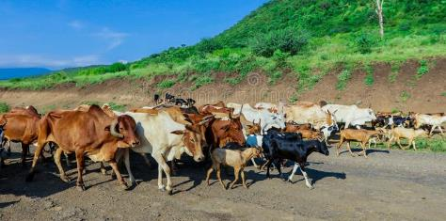
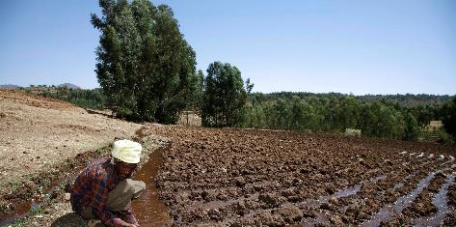
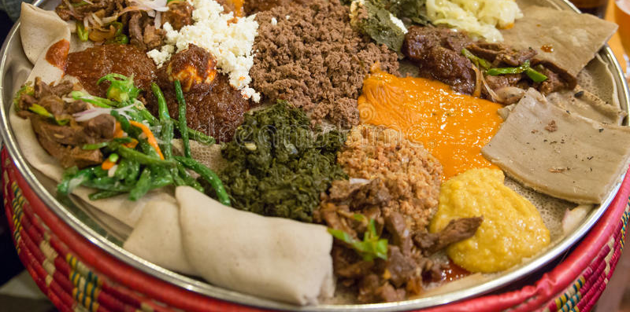
Example: Ethiopia vision
for food systems transformation
could help align efforts
“A holistic transformation of Ethiopia’s food systems
from production to consumption
that promotes enhanced food safety, nutrition and diets,
improved livelihoods,
greater land preservation and restoration
and greater resilience to shocks and stress.”
“We seek to transform our food systems using
sustainable and healthy diet-centered lens that
minimizes tradeoffs through calling for strong collaboration
across all food systems actors,
uniting around a common goal
of heathy and sustainable diets for all.”

Slide 18
The food systems transformation countdown to 2030 initiative has proposed a monitoring and evaluation framework for food systems transformation with attention to better diets and nutrition outcomes
Fanzo, et al., 2021
Crosscutting issues
Outcomes of food systems
Shared vision
Strategic planning
and policies
Effective
implementation
Accountability
Governance
Diets, nutrition, and health
Environment and climate
Livelihoods, poverty, and equity
Diet quality
Food security
Food environments
Policies affecting food environments
Land use
Greenhouse gas emissions
Water use
Pollution
Biosphere integrity
Poverty and income
Employment
Social protection
Rights
Exposure to shocks
Resilience capacities
Agrobiodiversity
Food security stability
Food system
sustainability index
Resilience and sustainability
Some of these are being considered to monitor Agriculture Development Programmes

Slide 19
Key messages
Africa has multiple food systems challenges
But we also have opportunities we can leverage, such as the current food systems transformation momentum to bring about positive change
But this will take all actors being deliberate about generating synergies for collective momentum

Slide 20
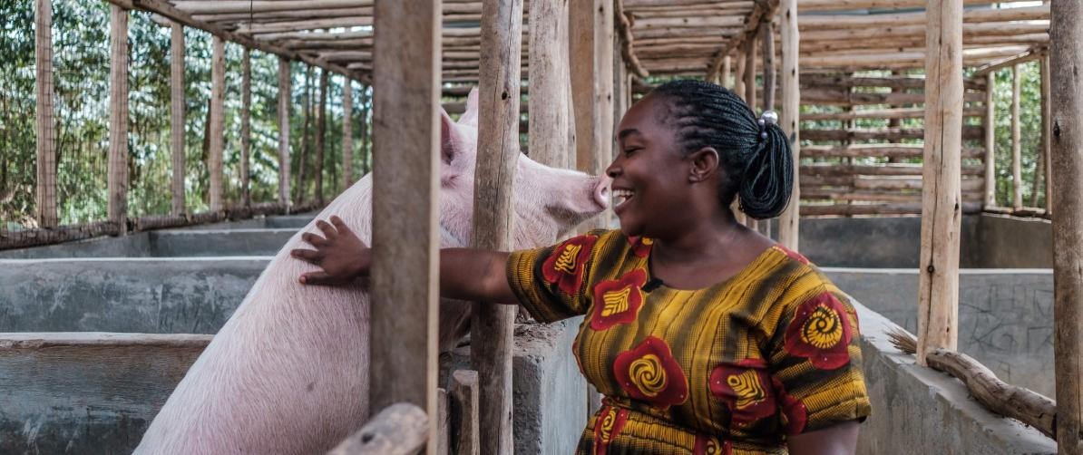
THANK YOU
Thank you!

