Slide 1
Africa RISING project implementation and contribution in Ethiopia
Kindu Mekonnen and Peter Thorne (ILRI)
Africa RISING close out event
24-25 January 2023
ILRI campus- Addis Ababa, Ethiopia

Slide 2

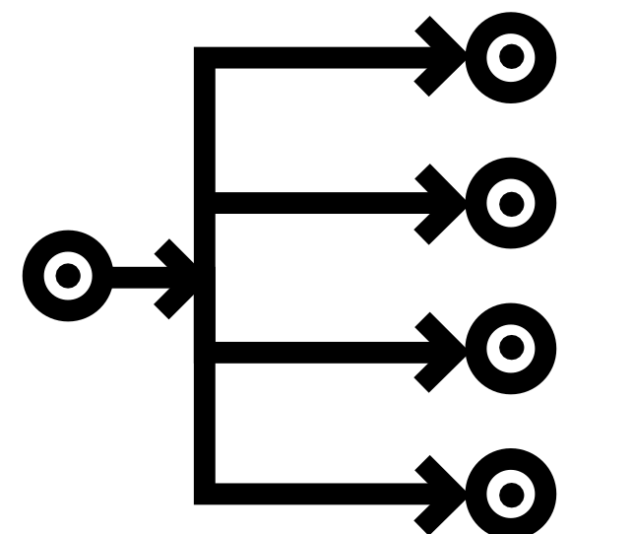


1. Introduction
Africa RISING- Africa Research In Sustainable Intensification for the Next Generation
One Program with four Projects
Funded by USAID through the FtF initiative
Sustainable Intensification (SI), multi-disciplinary action research and facilitation of wider scaling are the core research for development agendas of the program.

Slide 3
AR program managed to operate in six African countries for the last 11 years (two phases)
Legend:
Mixed cereal/legume livestock farming systems
Mixed crop-livestock
farming systems
Mali
Ethiopia
Tanzania
Ghana
Zambia
Malawi

Slide 4
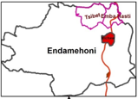
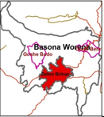
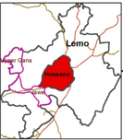
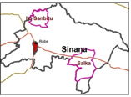
The AR project in Ethiopia worked in Amhara, Tigray, Oromia and SNNP regions
Phase I: 2012 to 30 Sept 2016 (4 zones, 4 woredas, 8 kebeles)
Endamehoni woreda of Tigray
Bosona woreda of Amhara
Lemo woreda of SNNPR
Sinana woreda of Oromia

Slide 5
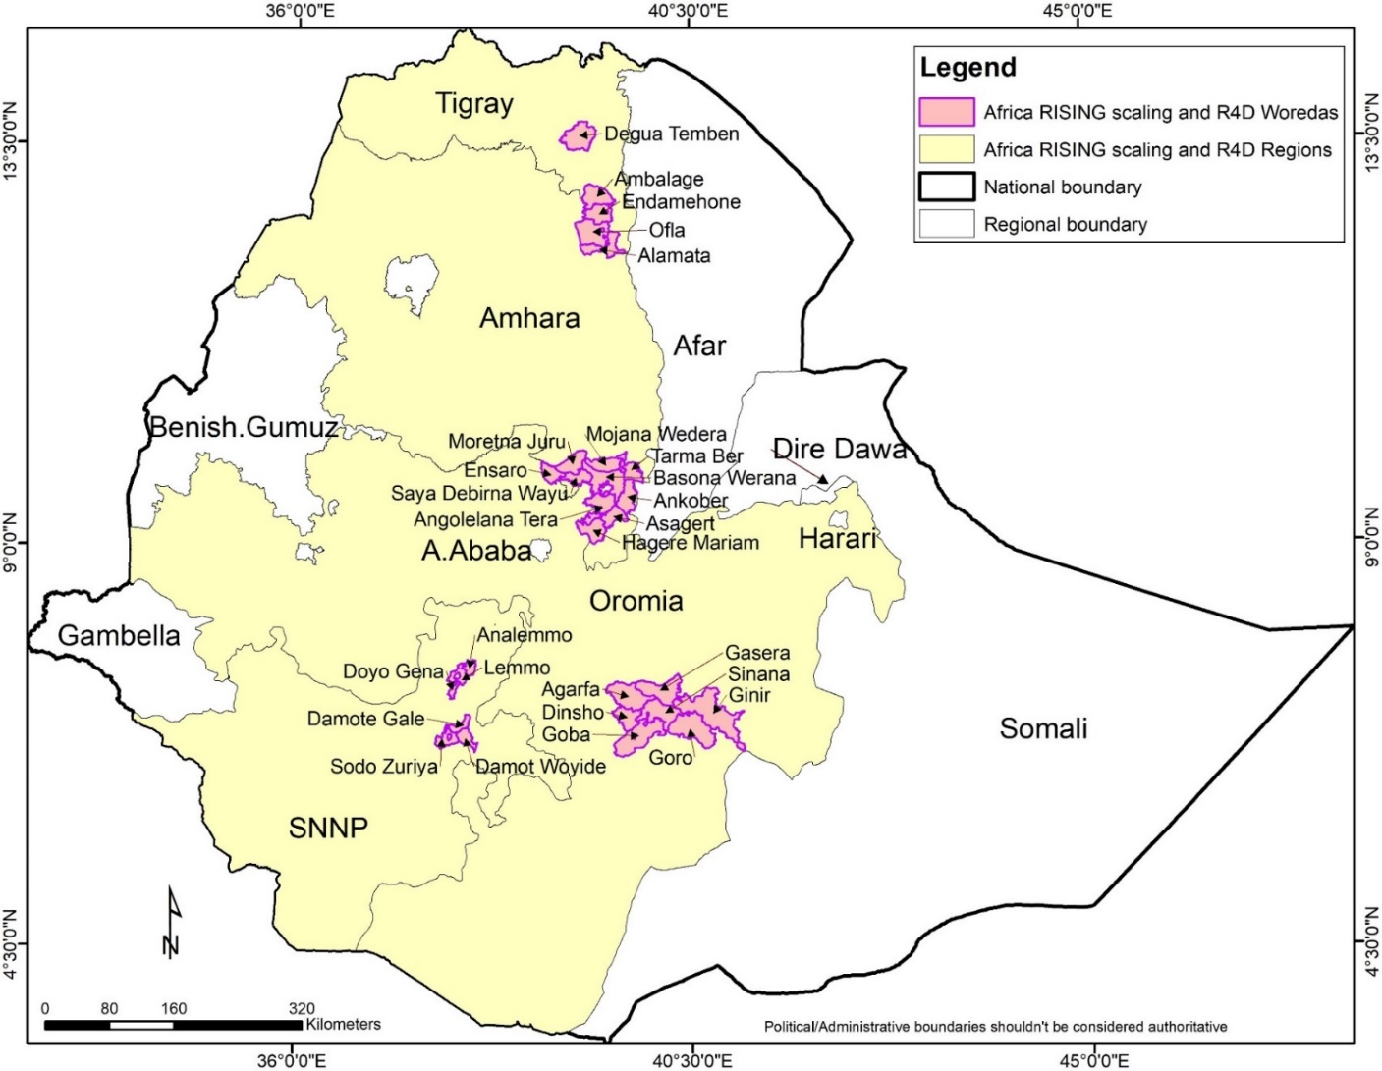
In phase II (Oct 2016-2022 ) the AR project in ETH reached to 11 zones and 36 woredas.

Slide 6











2. Project implementation
Sites selection
Systems understanding (diagnosis)
Formation of
research thematic areas
Identification of
SI interventions
Testing and
validation of SI interventions
Synthesizing evidences of validated interventions
Production of
project legacy products
Diffusion studies of SI innovations
Adoption and
impact studies
Facilitation of wider scaling (DPs, media)
Identification of potential scaling DPs
Cross-cutting: Capdev, IPs, Partnership

Slide 7
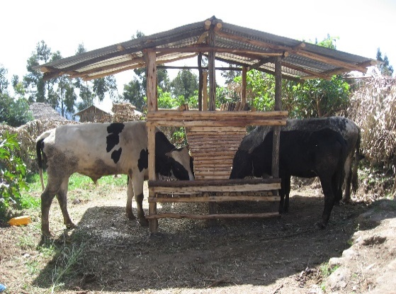
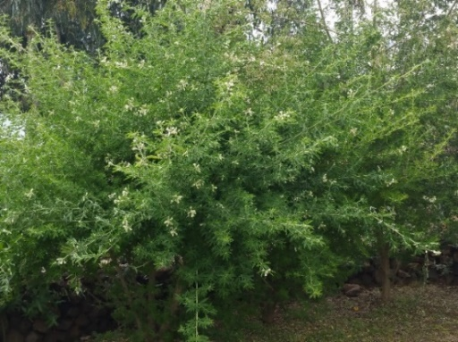
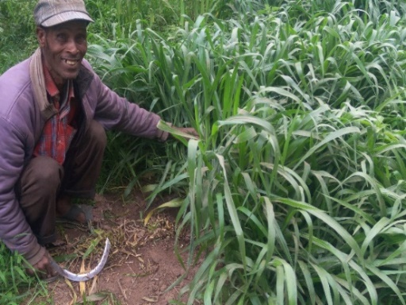
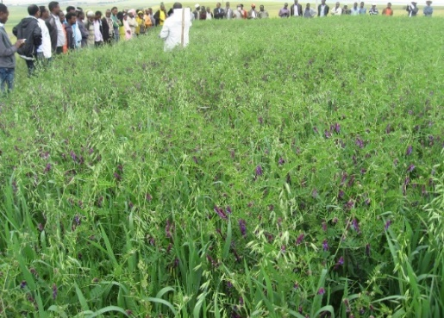
3. Project contribution
3.1. Research
Feed and forage interventions
Fodder tree
Forage grass
Herbaceous legumes /grass mixture
Feed trough
Introduced and validated different feed and forage technologies to improve livestock productivity.
Generated biophysical and socioeconomic data under on-farm environment - example
  Biomass yields from AR validated forage crops are making significant contributions to fill feed gaps (oat/ vetch- 12 t DM ha-1; fodder beet- > 20 t DM ha-1; tree lucerne, 4-7 t DM ha-1).
  Supplementation of oat/vetch mixture and fodder beet have increased milk yield from 30–50%.
  Feeding trough and storage shed have reduced feed wastage from 30- 50%.

Slide 8


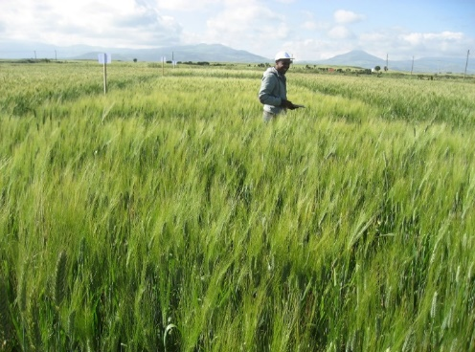
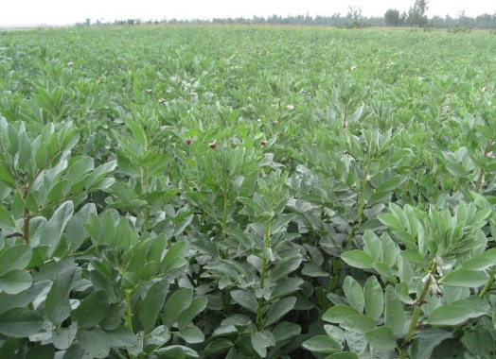
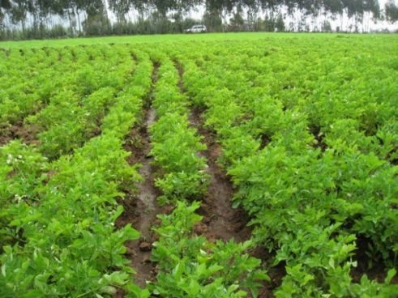
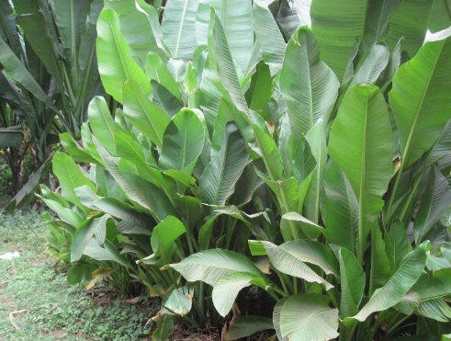
Improved crop varieties and management practices
Crop varieties
  Introduced and evaluated over 127 improved crop varieties (cereal, pulse, oil, potato and enset varieties) through PVS and crowdsourcing approaches.
Yield Achieved
  Obtained significant yield increase (%) under PVS as compared to the national average crop yield (CSA, 2021): bread and durum wheat (52- 89%), faba bean (90%), malt and food barley (120-132%), field pea and lentil (83-111%), check pea and linseed (36-83%) and potato (171%).

Slide 9

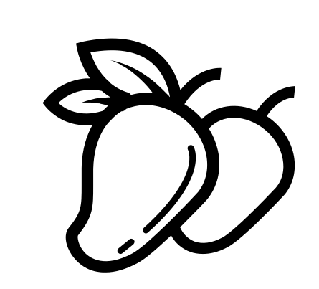
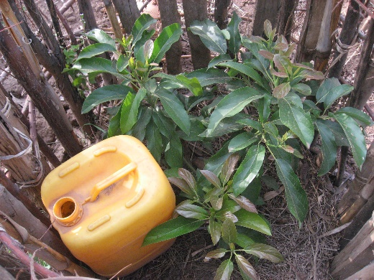
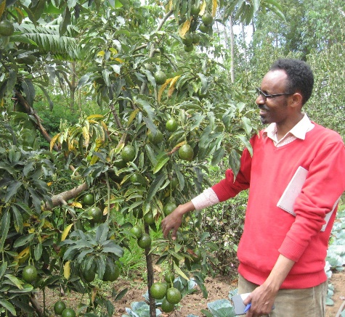
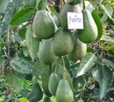
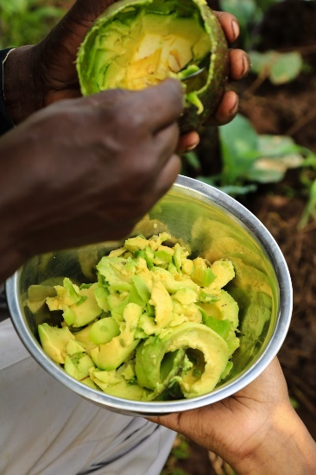
High value fruit trees
Varieties
Fruiting
Yield
Quality Test
Introduced and validated 5 avocado and 2 apple (Anna and Princissa) varieties.
Avocado varieties provide fruits in less than 2 years with variation across varieties and sites.
Fruit yield per avocado tree ranges from 50 kg for Ettinger to 181 kg for Nabal.
Quality (test, shelf life and oil content) for avocado varieties is: Hass > Ettinger > Fuerte > Reed > Nabal.

Slide 10



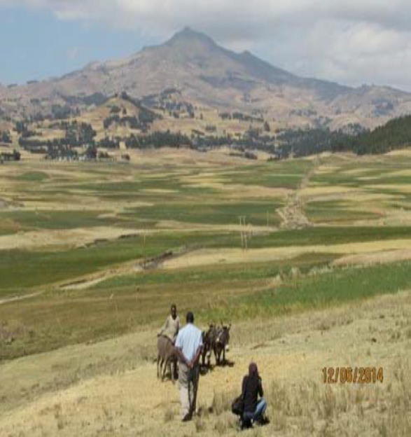
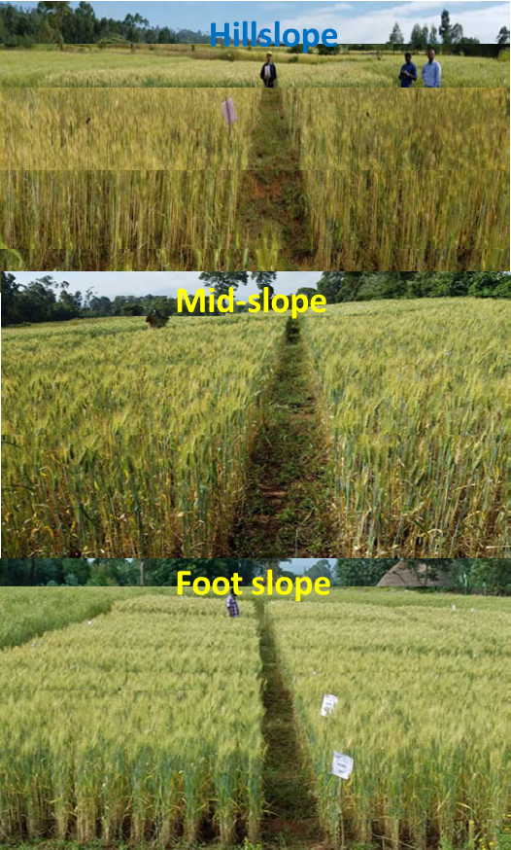
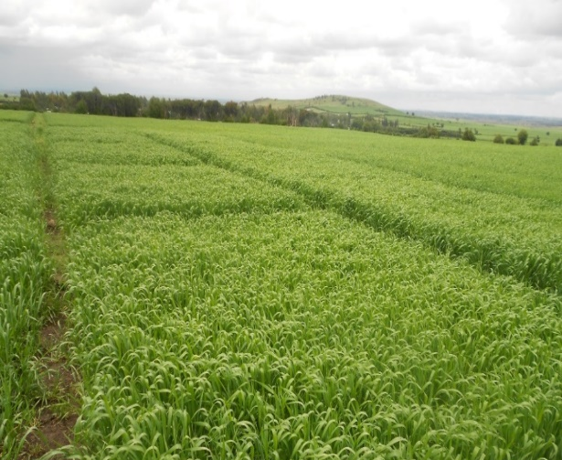
Soil fertility management
Field trials
Conducted landscape based on-farm fertilizer trials and identified site-specific nutrient sources and rates for wheat following the 5R principles of nutrient stewardship.
Validation
Validated the right nutrient sources and rates and ISFM practices for wheat production using a Decision Support Tool (DST).
Catalyzation and Impact
This research has catalyzed a new national initiative to fine-tune previous fertilizer recommendations.
Hillslope (> 15%)
Mid-slope (5-15%)
Foot slope (<5%)

Slide 11

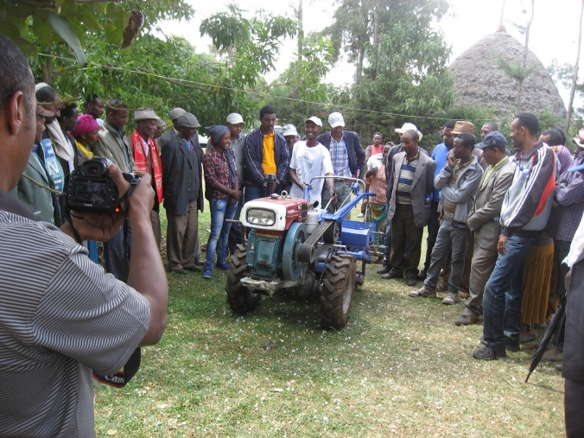
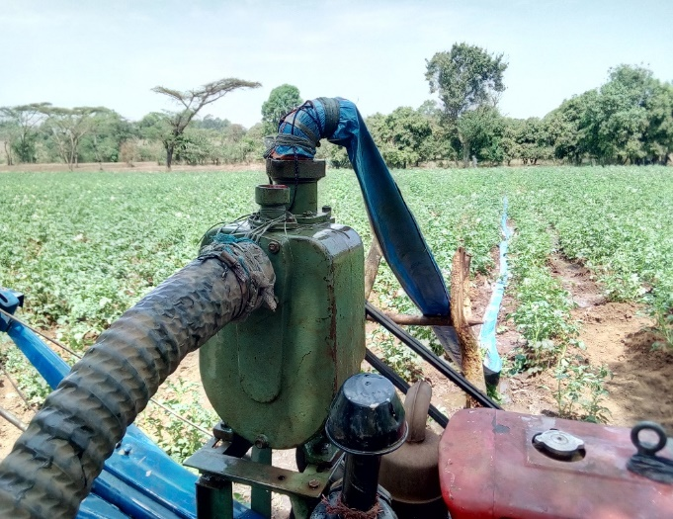
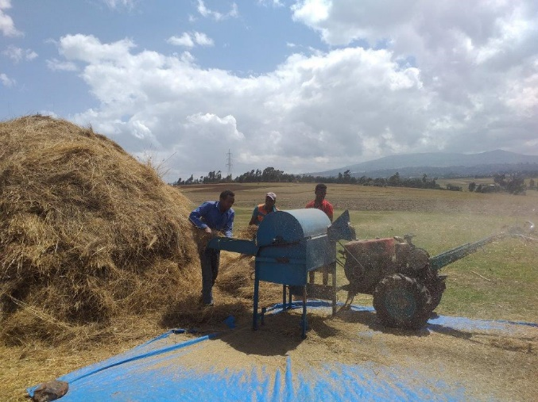

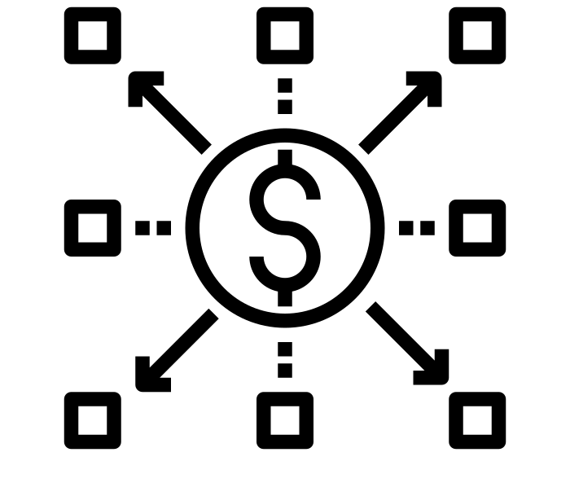
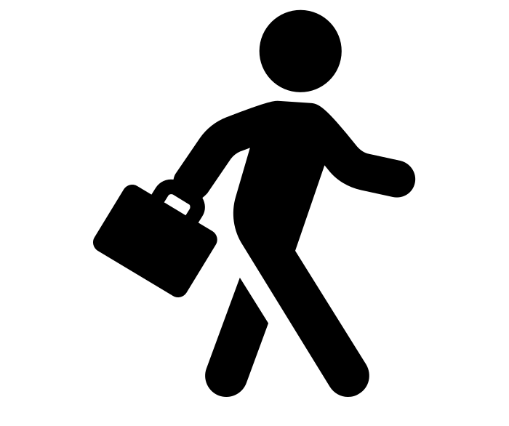
Small-scale based mechanization options
Reduced cost of farm operations as compared to conventional farm practices- Example: Cost for wheat thresher = USD 200 ha⁻¹ without mechanization vs 90 ha⁻¹ with mechanization
Created jobs for service providers in Africa RISING operational areas
Introduced two-wheel tractor and accessories (plough, planter, reaper, thresher, sheller, water pump and trailers)

Slide 12

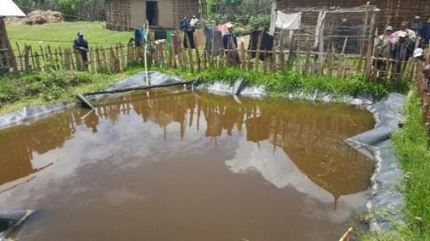
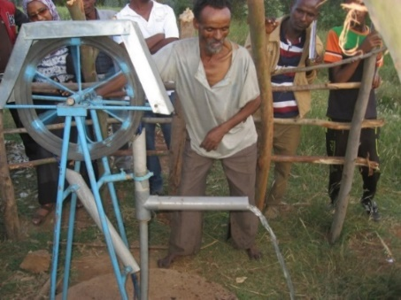

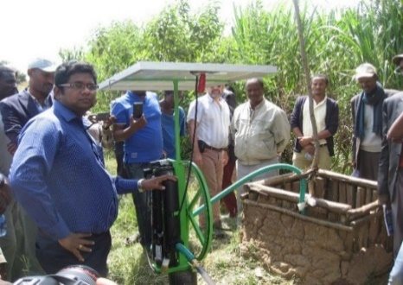
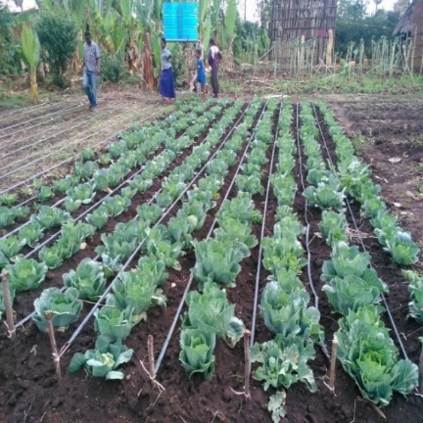

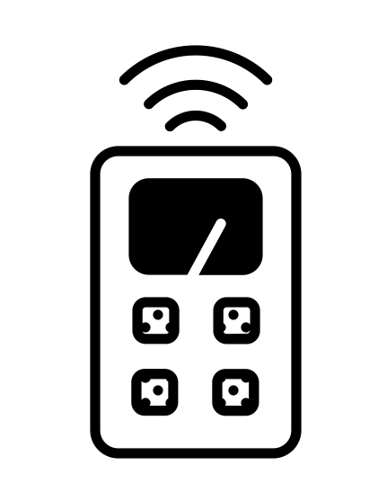
Water management and application
Introduced and validated water harvesting, lifting and delivery technologies in AR project sites.
Rainwater harvesting ponds attracted farmers to diversify high value crops around home- gardens.
Water lifting technologies have enhanced farmers capacity to irrigate high value crops.
Farmers guided by wetting front detectors able to increase irrigated fodder dry biomass by 14%.

Slide 13
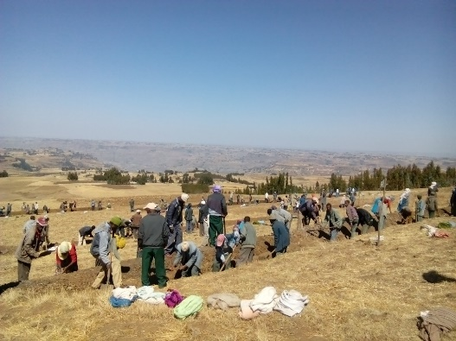
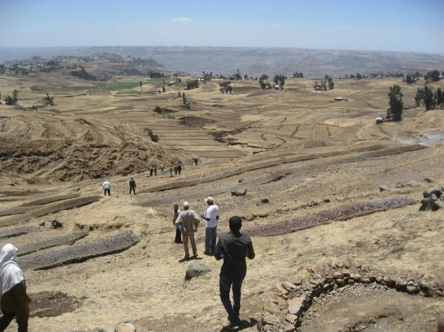
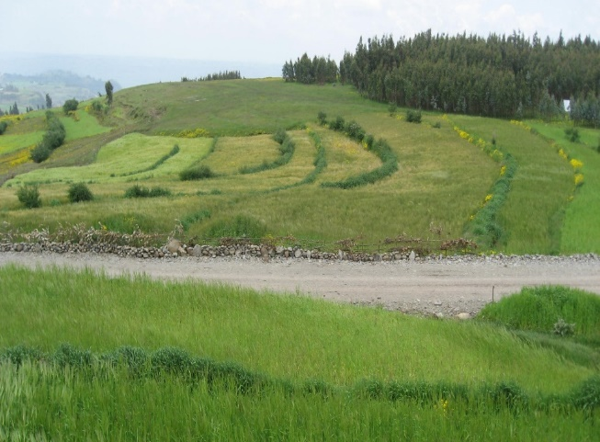
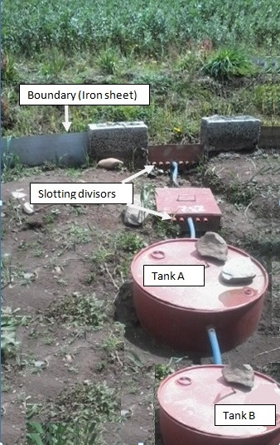
Landscape/watershed management
Implementation of integrated SWC practices at landscape scale have reduced soil loss by over 75% in the AR watersheds.
Management practices implemented in cultivated fields have reduced soil loss by 87% as compared to non-treated fields.
A treated landscape in Basona AR site has shown an increase in baseflow by up to 35%, which improves irrigation in downstream locations.

Slide 14
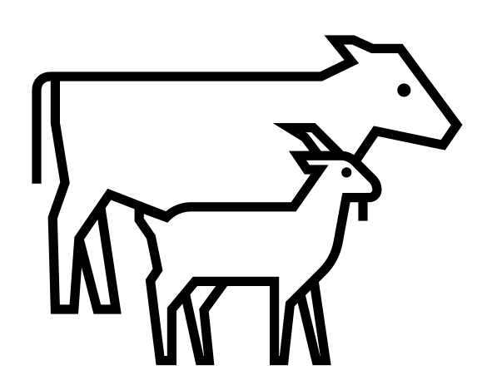



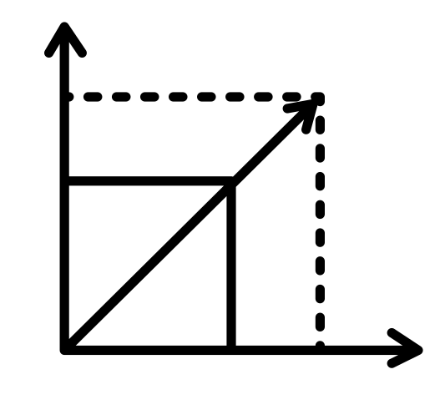
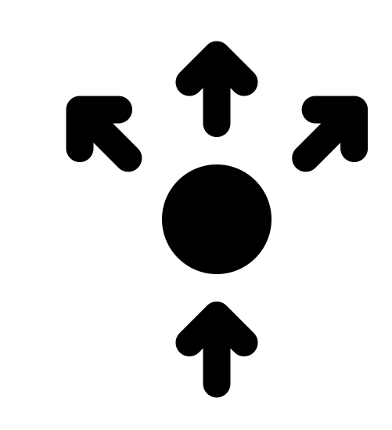
3.2. Studies to evaluate SI in systems orientation
 | Value chain studies on livestock and crop commodities
 | Nutrition (contribution of nutrition education and project interventions) studies
 | Gender studies
 | RHoMIS (Rural Household Multi-Indicator Survey)
 | Scaling studies (scaling scan, spillover)
 | Innovations diffusion studies
1
2
3
4
5
6

Slide 15

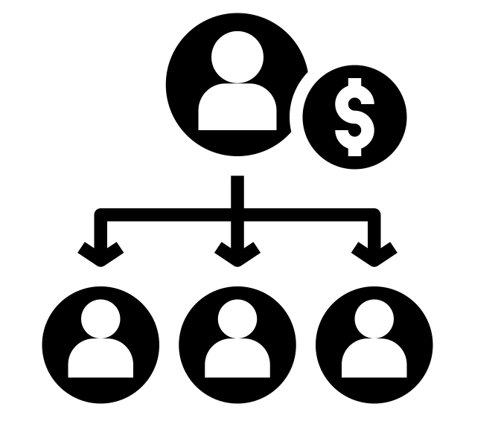
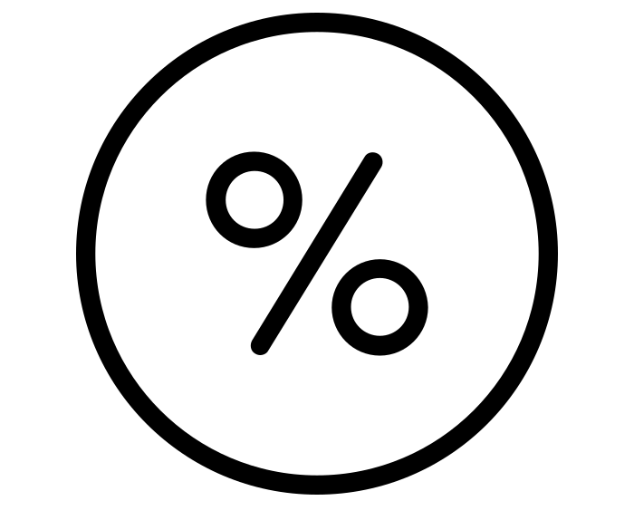
3.3. Scaling of validated innovations
Phase II target= 700,366 beneficiaries
Total beneficiaries from capdev, scaling and others= > 455,648
Reached through AR validated innovations = 396,479 beneficiaries
So far, we managed to achieve over 65% of our phase II target
Reached through spillover, farmers to farmer and private sector agents = 19,014 beneficiaries and from R4D=2,183 beneficiaries

Slide 16
3.4. Capacity development - Short-term capdev initiatives
Documented over 37,972 beneficiaries from the project short-term capdev initiatives.
The capdev program included short-term trainings, field days, visits, workshops, surveys and meetings

Slide 17
3.4. Capacity development - Long-term capdev initiatives
AR Phase | Degree type | Men | Female | Total
Phase I | MSc | 18 | 7 | 25
 | PhD | 2 | 2 | 4
Phase I Total |  | 20 | 9 | 29
Phase II | MA |  | 1 | 1
Agrochemical | MSc | 6 | 4 | 10
Mechanization – O & M¹ | PhD | 16 | 3 | 19
Phase II Total |  | 22 | 8 | 30
Grand Total |  | 42 | 17 | 59
In phase I and II, AR project of the Ethiopian highlands supported 36 MSc and 23 PhD students.
From the total attached students – 29% were female students.

Slide 18

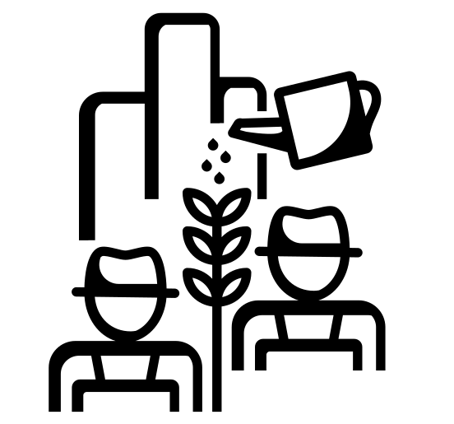
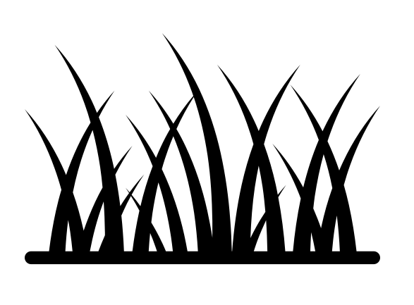

3.5 Publications
Over 600 project outputs have been produced since 2012, of which 51 are journal articles.
Examples of peer reviewed and highest profile journal publications:
Assessing smallholder sustainable intensification in the Ethiopian highlands (Hammond et al. 2021, Agricultural Systems)
Feed and forage development in mixed crop–livestock systems of the Ethiopian highlands: Africa RISING project research experience (Mekonnen et al. 2021, Agronomy Journal).
Multilevel innovation platforms for development of smallholder livestock systems: How effective are they? (Lema et al. 2021, Agricultural Systems).

Slide 19



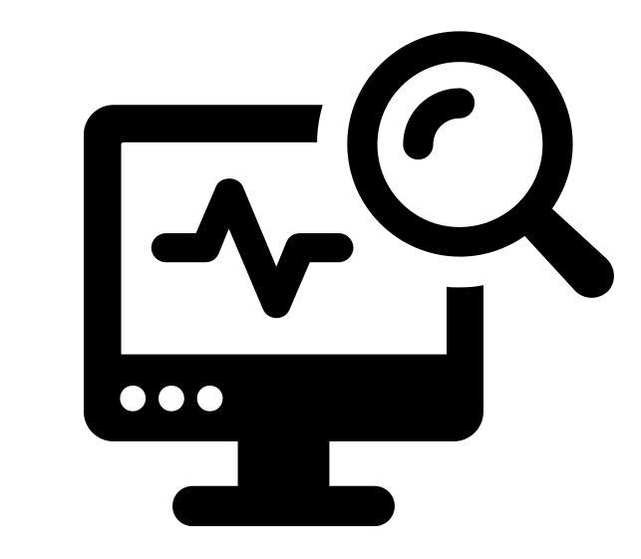
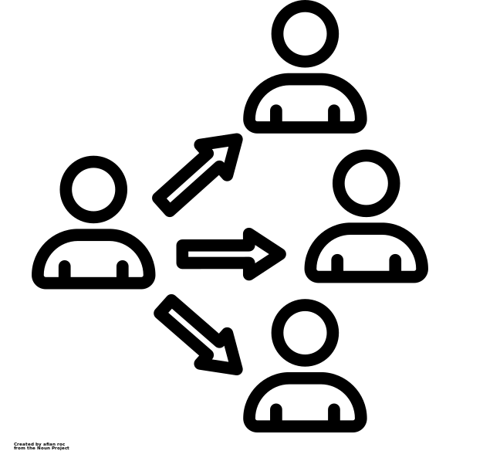
5. Key lessons/messages
Need for integration
SI requires integrated research approaches including co- identification of priority farming system issues, co-designing of protocols, co-implementation of interventions, and systematic evaluation (synergies and tradeoffs) of innovations at scale.
Organizing cross learning events (exchange visits, trainings, field days, monthly meetings, review and planning workshops) are useful to speed up implementation of plans and bring visible impact.
Identification of committed scaling partners and equipping them with knowledge /skill through capdev schemes ensures wider dissemination of SI innovations.
Well planned M&E scheme, data repository system, reporting and presentation templates helps to simplify documentations, communications and performance of projects.
Site level project coordinators are instrumental to facilitate communication with local partners, strengthen partnership and properly implement project plans.
Cross learning
Committed scaling partners
Learning from M&E
Project coordination

Slide 20
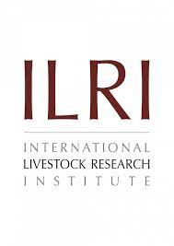




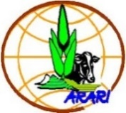


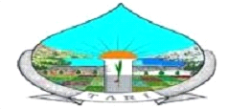



























6. Partners

Slide 21


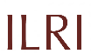



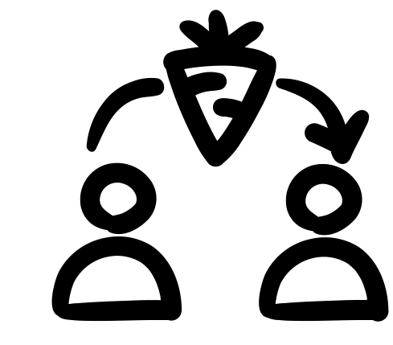

7. Acknowledgements
1
USAID
Funding the two phases of AR program
2
AR site coordinators and drivers
Handling all the groundwork and facilitating partnership
ILRI
Managing the project and providing all the services
3
Local Partners
Engagement and support during implementation of the project
4
5
CGIAR centers
For their collaboration and leading the action research
AR coordination team
Smoothly running the project
6
7
AR sister projects
Experience sharing and joint planning of program level events
8
Program Coordination Team (PCT)
Providing directions to AR program

Slide 22
Thank You

