Slide 1



Improving livelihoods in pastoral systems through an Entrepreneurial Ecosystem approach to Sustainable Sheep and Goat Production
Community group review of rapid assessment survey results for Producers, Inputs and Service Providers, and Market Agents
Community Workshops, Baringo County
10th to 16th November 2024
E. Oyieng¹, W. Sila¹, A. Akivaga², E. Sittuk³, L. Rotich³, J. Wangari³, J.M.K Ojango¹
¹International Livestock Research Institute
²RECONCILE
³Baringo County – Livestock Department

Slide 2
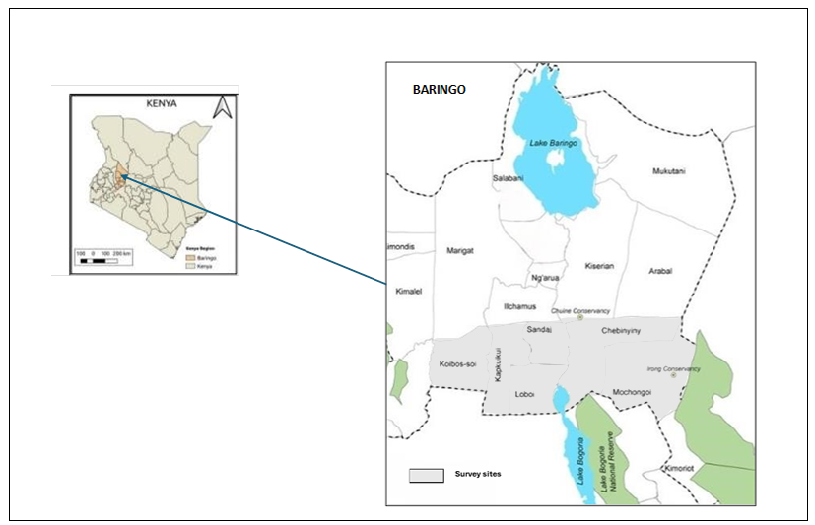
Map of Baringo County highlighting the locations where the feedback activities were conducted

Slide 3
A. RESULTS FOR LIVESTOCK PRODUCERS

Slide 4
Characteristics of household leadership
1. Gender of the household head
Proportion of households

Slide 5
2. Education level of the household head

Slide 6
3. Age group of the household head

Slide 7
Houesholds keeping small ruminants

Slide 8
Flock size for small ruminants in a household
Number of animals kept in each household
 | Sheep |  | Goats
Location/Sub-location | Mininum | Maximum | Mininum | Maximum
Koibos | 8 | 75 | 21 | 71
Koituimet | 8 | 75 | 21 | 70
Majimoto | 8 | 30 | 24 | 71
Koibos Soi | 11 | 44 | 34 | 125
Kaplelwo | 11 | 40 | 30 | 107
Radat | 12 | 44 | 34 | 125
Loboi | 15 | 100 | 25 | 181
Chelaba | 15 | 50 | 39 | 181
Maji Ndege | 20 | 100 | 25 | 150
Grand Total | 8 | 100 | 21 | 181

Slide 9
Small ruminant breeds kept

Slide 10
Main reasons for keeping sheep and goats

Slide 11
Animal health practices by households

Slide 12
B. RESULTS FOR INPUTS AND SERVICE PROVIDRES

Slide 13
Gender and age group of inputs and service providers

Slide 14
Types of inputs, services and trainings provided to farmers

Slide 15

Employment, provision of loans and business expansion

Slide 16
Main constraints and opportunities for inputs and service providers
Constraints | Opportunities
Delayed payments by farmers | Increased livestock keepers
Low quantity and quality of inputs | Increase in farmers awareness
Increased cost of doing business | Good infrastructure

Slide 17
C. RESULTS FOR MARKET AGENTS (TRADERS)

Slide 18
Gender and age groups of the traders

Slide 19
Education level of traders and their nature of trading
Part time traders engage in crop and livestock farming
Trading is sole proprietorship with few (5) working in partnerships
86% don’t belong to any traders’ association

Slide 20
Characteristics of Small ruminant trading
 | Sheep | Goats
Animal categories sold | Mostly rams, ewes then weaners | Mostly bucks and ewes
Important traits when selecting animal for sale | 1. Body size 2. Body conformation 3. Age of animal | 1. Body size 2. Body conformation 3. Age of animal
Prefered buyer, reason | Slaughter house, pays promptly | Slaughter house, pays promptly
Seasons for high purchase of animals for sale | During droughts, opening of schools and ceremonies | During droughts, opening of schools and ceremonies
Mode of payment | Cash-on-delivery, no credit | Cash-on-delivery, no credit
Place of purchase | Farmers households | Farmers households
Mode of transportation of animals | Motorbikes | Motorbikes
Effects of drought and floods | Quantity of sheep available affected during drought but not during floods | Quantity of goats available affected during drought but not during floods

Slide 21
Main constraints and opportunities in trading business
Constraints | Opportunities
Animal diseases | High sale prices of animals
Poor access to some markets | Increase in market days
Seasonality in the markets | High productivity of animals

Slide 22
ACKNOWLEGMENTS
﻿The rapid assessment surveys were implemented with support from the CGIAR Initiative on Livestock and Climate. We would like to thank all the funders who supported this research through their contributions to the CGIAR Trust Fund.
We gratefully acknowledge the time and effort of the Baringo County Livestock and Veterinary Department staff who reviewed and updated information

Slide 23
THANK YOU

