Slide 1
Important!
This module is designed to potentially serve a wide variety of audiences (nutritionists and agronomists, policymakers, extension workers, farmers).
Not all of the material will be relevant to all audiences.
Please refer to the accompanying Facilitator’s Guide for guidance on how to adapt these materials to your audience and facilitation best practices.

Slide 2




Legend
Icon | Description
 | Expected Duration, minutes
 | Quick Review/Survey Questions
 | Brainstorming Session
 | Discussion Session
 | Group Activity
 | Animated Slide
 | End of Animation
Xm

Slide 3
Legal
Unless otherwise noted, all images copyrighted to International Potato Centre.
Attribution-NonCommercial-ShareAlike 2.0 Generic (CC BY-NC-SA 2.0)

Slide 4
Everything You Ever Wanted to Know About Sweetpotato
Topic 6: Sweetpotato Production and Management

Slide 5
Introduction
Sweetpotato Production and Management

Slide 6
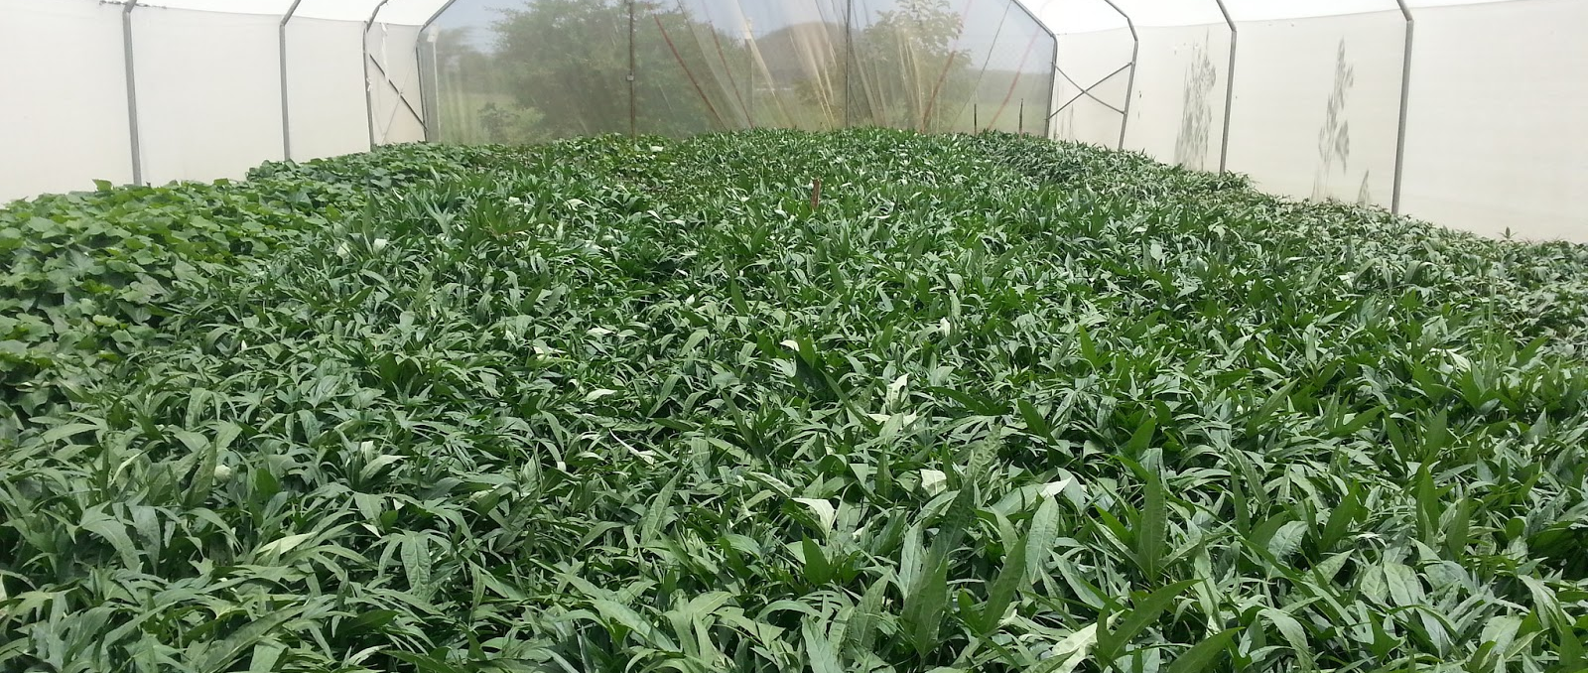
Welcome
During this session, we will examine environmental factors that influence sweetpotato production and production practices that can help to reliably produce good sweetpotato crops.

Slide 7
Planning Sweetpotato Activities for the Farm Operation
Unit 1

Slide 8
Objectives
By the end of this unit, you should be able to:
Explain why timing of operations is critical to farm success.
Name the regional social characteristics and climate conditions that promoters of Orange-Fleshed Sweetpotato (OFSP) must be aware of.

Slide 9
Timing of Operations
Challenges
Solution
Having sufficient planting materials when needed (generally, at onset of rains)
Particularly true for resource-poor households dependent on rainfed production, working with declining soil fertility, and facing increasing climatic uncertainty.
Developing a cropping calendar with farmers, which explores who does each of the sweetpotato activities.

Slide 10
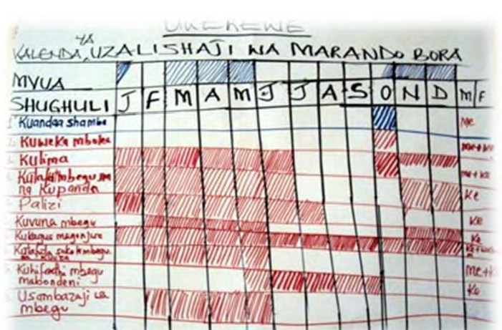
Example: Cropping Calendar
Completed sweetpotato activity calendar from Ukerewe, Tanzania

Slide 11
Important Role of Other Players
Promoters
Production Workers
Understand agricultural calendar of local community
  How OFSP will fit into calendar
Consider the degree of commercialization of OFSP
Factor in gender roles and responsibilities along the OFSP value chain

Slide 12
Different Farming Regions in SSA Show Different Gender Patterns
In most SSA, OFSP grown by women, for subsistence purposes
Men often get involved in production as market demand increases
Sometimes, this trend is reversed:
  For example, in Nigeria men are major OFSP producers, women grow OFSP as commercialization grows

Slide 13
What are the challenges with timing the operations?
Generally speaking, in many parts of SSA, what is the difference between why women and men grow sweetpotato?
Notes:
Answers
Farmers access to planting materials, other players to understand and factor in agricultural calendar and gender roles
It is largely grown by women for subsistence purposes, with men becoming more involved in production as market demand increases. There are exceptions where these roles are reversed, e.g. Nigeria.

Slide 14
Key Points
Promoters of Orange-Fleshed Sweetpotato (OFSP) need detailed knowledge of the farming community’s yearly schedule, the degree of commercialisation in the region, and the local gender dynamics.
It is critical for sweetpotato farmers to have access to planting materials at the right time in order to take advantage of the onset of the rains.
Different farming regions in SSA show different gender patterns, but sweetpotato farming is largely women-dominated.

Slide 15
Selecting and Preparing Land
Unit 2

Slide 16
Objectives
By the end of this unit, you should be able to:
Describe the altitude and soil conditions that are best for growing sweetpotato.
Tell why sweetpotatoes are typically grown on mounds, ridges, or beds. Explain how these beds can be constructed.
Explain why crop rotation and plot separation are important.
Explain why men in the community should be consulted, even when women are the main growers.

Slide 17
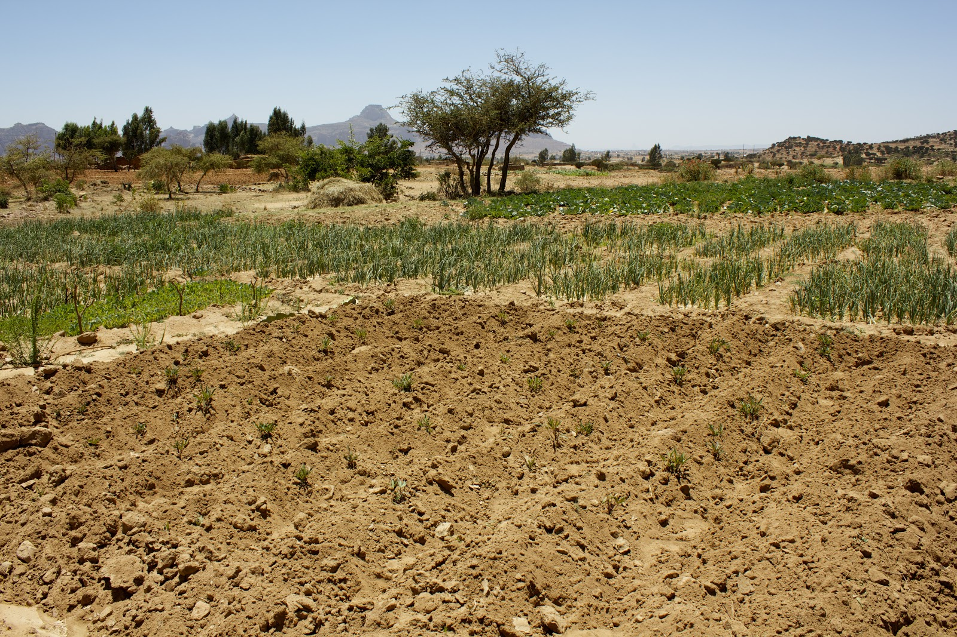
Altitude
OFSP grows well with sea level up to 1,700m above sea level (m.a.s.l.)
Some varieties, up to 2,500 m.a.s.l., however, they have poorer taste and lower dry matter.

Slide 18
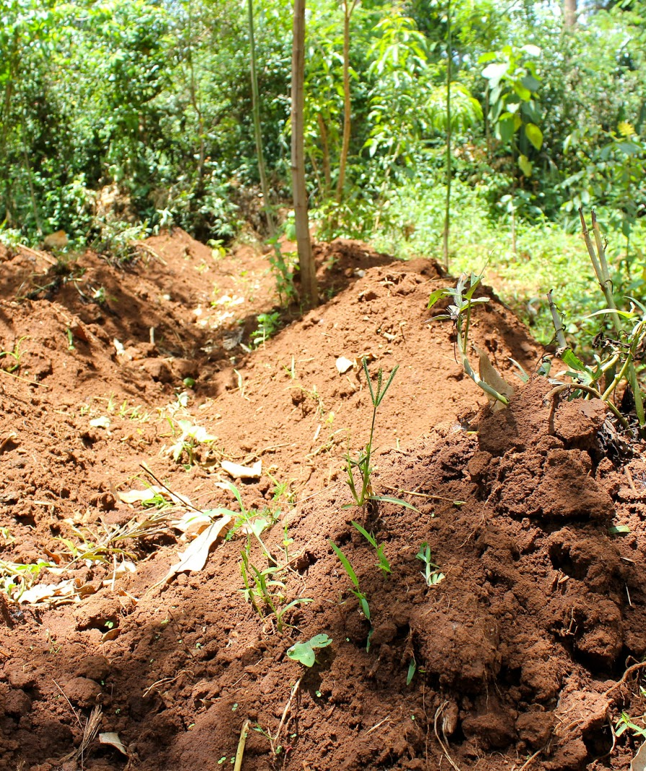
Soils
Grows best on soil that is:
  Deep
  Moderately fertile
  Sandy loam
  Slightly acid soils (pH 5.6-6.6)
Sweetpotato plants like potassium, which can be obtained from ash.
High nitrogen soils are not optimal

Slide 19
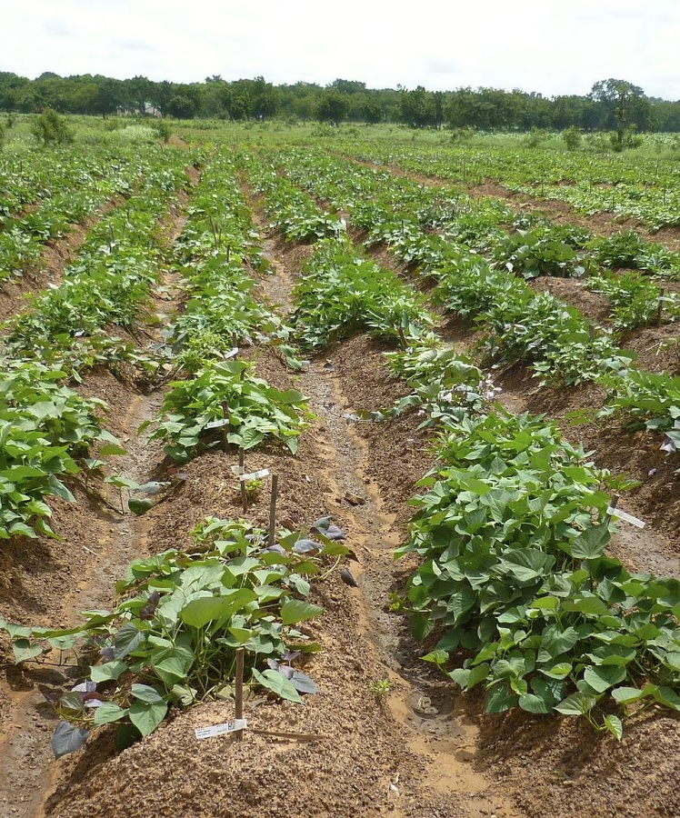
Soils
Land is prepared by constructing mounds, ridges or beds
Benefits:
  Provide fertility to the crop
  Loosen any compressed soil that might hinder root formation
  Adequate drainage
  Soil aeration

Slide 20
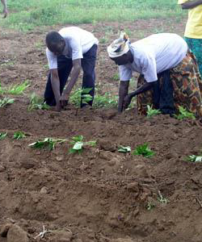
Crop Rotation
Best to rotate with other crops
  Recommended to follow
    Cereals
    Legumes
  Not recommended (due to similar nutrient requirements)
    Other root or tuber crops (particularly cassava)

Slide 21
Plot Separation
Separate new sweetpotato fields from recently harvested or existing fields with a barrier crop to prevent weevils and viruses.
Allow for fallow periods
Only use same plot for OFSP one year out of three

Slide 22
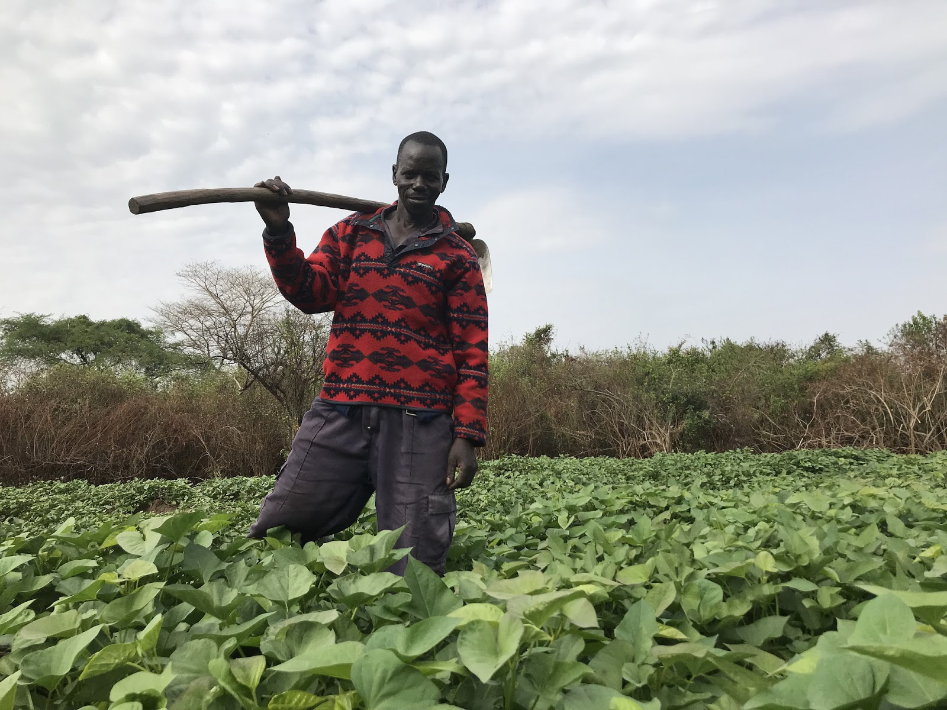
Access to Land
Although women largely grow and control OFSP, in most SSA, men are the land owners and make all land-related decisions. Thus it is critical that men be consulted about project activities.

Slide 23
What type of soil does sweetpotato grow best on?
Is potassium good for sweetpotato?
Does sweetpotato like high altitude locations?
Should sweetpotato be rotated with cassava?
Notes:
Answers
Deep, Moderately fertile, Sandy loam, Slightly acid soils (pH 5.6-6.6)
Yes
No
No (Same nutrient requirements)

Slide 24
Key Points
Sea level up to 1,700 m above sea level are the best altitudes for sweetpotato plants.
Sweetpotato can adapt to different soils, but deep, sandy, moderately fertile loam with a slightly acid pH is optimal.
Sweetpotato plants like potassium, which can be obtained from ash.
High nitrogen soils are not optimal.
Fallow periods and crop rotation fight disease build-up. Using the same plot for sweetpotato only one year out of three is best.

Slide 25
Planting Methods and When to Plant
Unit 3

Slide 26
Objectives
By the end of this unit, you should be able to:
Explain why soil aeration and drainage are important and how to achieve them.
Describe the methods of creating ridges, beds, and mounds for planting.
Tell what part of the plant is used to create new planting materials.
Explain how the cutting is prepared, planted, and spaced in the soil.

Slide 27
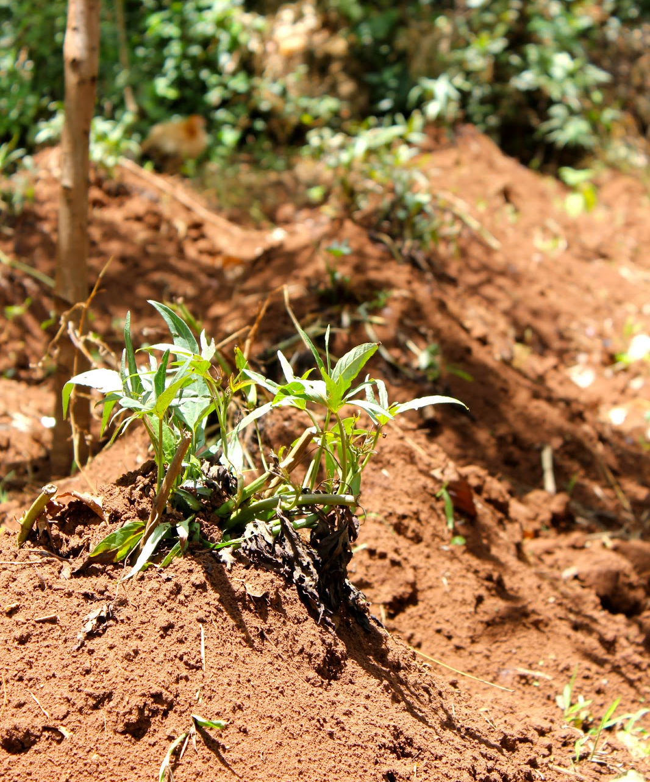
Planting Methods
Best planted in mounds, ridges
  Good drainage
  Easier to harvest mature roots
  Height is important for better soil aeration
Flat beds
  Only used when labour is scarce
  Lower yields

Slide 28
Planting Vine Cuttings or Sprouts
Each cutting or sprout is usually:
  20-30 cm long
  contains 3 nodes

Slide 29
Planting Vine Cuttings or Sprouts
Planting on Ridges
Planting on Mounds
25 – 30 cm between plants
30 - 100 cm between ridges
33,333 cuttings per hectare
3 vines per mound
1 m x 1 m between mounds
30,000 cuttings per hectare

Slide 30
Plant in Mound or Ridge
Create a hole, using stick, machete or hoe
Ensure that most of the plant is under soil (at least 2 notes), only the tip exposed
Firm the soil to ensure good contact
On mounds, the three cuttings are planted towards the top of the mound but equidistant from each other in a triangle configuration.
On ridges, the cuttings are planted either vertically or at a slant along the top of the ridge at the required spacing.

Slide 31
Why is planting sweetpotato on mounds and ridges desirable?
How much spacing should there be between sweetpotato vine cuttings or sprouts when planted?
Is planting on flatbeds preferred?
Notes:
Answers
To ensure good drainage, soil aeration and ease of harvesting of the mature roots.
About 25 to 30cm between plants, and 60 to100cm between ridges.
No, flatbeds have lower yields.

Slide 32
Key Points
Sweetpotato is usually planted in mounds or ridges for good drainage. Flat beds are possible where labour is scarce, but yields are lower.
Land preparation is labour-intensive, and the form and size of the planting areas depends on whether tractors or oxen are available.
Sweetpotato is often harvested piecemeal.
Sprouts or vine cuttings are used to grow new sweetpotato plants. They are planted at a distance of 25-30 cm between plants and 60-100 cm between ridges.
Tighter spacing creates smaller potatoes, which are preferred in some markets.
Hoes or machetes are used to create depressions for planting.

Slide 33
Staggered Planting to Get Yield Benefits and Smooth Supply
Unit 4

Slide 34
Objectives
By the end of this unit, you should be able to:
Name the generally optimal time to plant sweetpotato and tell why it is preferable.
Define staggered planting and explain its benefits and drawbacks.
Explain the benefits of a smooth supply of sweetpotato.

Slide 35
When to plant sweetpotato
Best to plant as early as possible to:
  maximise the growing period
  allow early harvesting for household food consumption or early market sales
However, planting the whole sweetpotato crop at one time may lead to a glut at harvest.
There are differences between varieties in terms of their developmental times.
The root harvest can still be spread over some months, due to the piecemeal harvesting option for sweetpotato.

Slide 36
Advantages of Staggered Planting
Staggered planting is successive plantings made over a period of weeks or months
Larger total area planted through ratoon harvesting of cuttings from multiplication plots;
Spreading of risk of yield loss due to unreliable rainy season initiation and prolonged dry spells;
Less likelihood of labour shortage bottlenecks as the labour requirements are spread across a longer period of time;
A smoother supply of roots over a prolonged period as opposed to a glut of root production across all farms in that area at the same time.

Slide 37
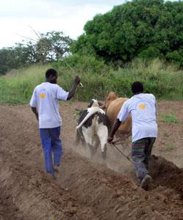
Disadvantages of Staggered Planting
OFSP could be more vulnerable to:
  Decrease of rains (if planted too late in the season)
  Risk of pests
  Theft

Slide 38
Why is planting sweetpotato as early as possible in the rainy season beneficial?
What are some of the advantages of staggered planting?
Notes:
Answers
To maximise the growing period and to allow early harvesting for household food consumption or early market sales.
Larger total area planted; Spreading of risk of yield loss; Less likelihood of labour shortage; A smoother supply of roots over a prolonged period

Slide 39
Key Points
Planting early in the rainy season maximizes the growing period but planting all at once creates a glut of sweetpotato.
Staggered planting creates a smoother food supply for the household.
Staggered planting reduces the effect of risks such as dry spells.
Collecting cuttings from earlier plantings increases available planting material.
With staggered planting and piecemeal harvesting, farmers can wait till the market price goes up to collect crops for sale.
Sweetpotatoes planted later in the season are more vulnerable, due to decreasing rains, risk of pests and theft.

Slide 40
Intercropping Sweetpotato
Unit 5

Slide 41
Objectives
By the end of this unit, you should be able to:
List the advantages of intercropping.
Describe the conditions that favour intercropping.
Point to studies showing the benefits of intercropping.
List species that intercrop well with sweet potato.
Describe the preferred intercropping techniques.

Slide 42
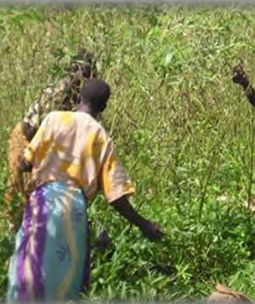
Intercropping
Intercropping is easiest when sweetpotatoes are planted on ridges, with other crops planted in a row alongside.

Slide 43
Intercropping Techniques
The cropping pattern should minimise the competition for light and nutrients between the crops.
Sweetpotato can also be alley cropped between lines of agroforestry trees or shrubs.
  These trees or shrubs are pruned regularly

Slide 44
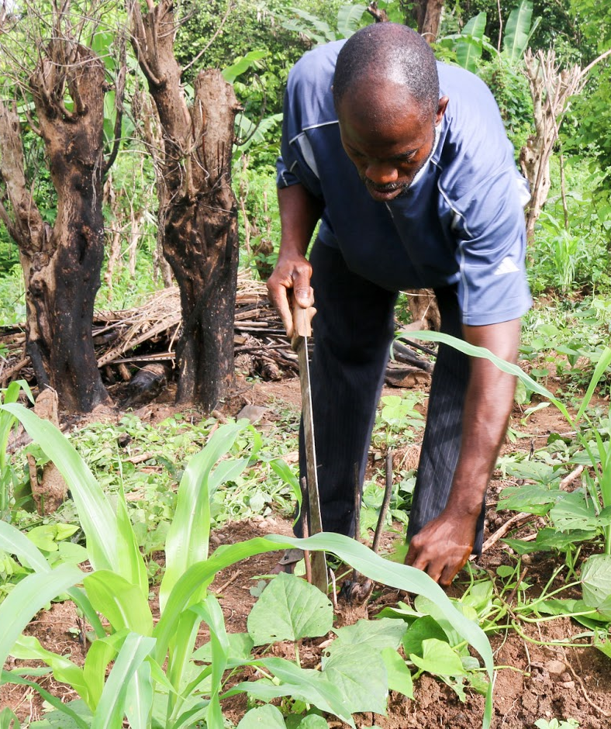
Advantages of Intercropping
Maximises use of land and labour
Increases dietary diversity
Renews the soil
May fight weevils
Reduces weed growth
Increase soil fertility

Slide 45
Studies on Intercropping
Malawi (intercropping with maize)
  Increased yield and profit gains
  Less weevil infestation
East Africa (intercropping with pigeon pea)
  Increased productivity
  Fixes Nitrogen
Cost Rica (intercropping with cassava)
  Beneficial effects on both crops
  No major increase in pests or diseases

Slide 46
What are some of the advantages of intercropping?
What are some of the crops that could be intercropped with sweetpotato?
Notes:
Answers
Maximises use of land and labour; Increases dietary diversity; Renews the soil; May fight weevils; Reduces weed growth; Increases soil fertility
Maize, pigeon pea, cassava

Slide 47
Key Points
Intercropping is easiest when sweetpotatoes are planted on ridges, with other crops planted in a row alongside.
Where there is pressure on land and labour, intercropping maximizes use of both.
Intercropping increases dietary diversity, renews the soil, may fight weevils, and reduces weed growth.

Slide 48
Sweetpotato Requirements and Physiological Disorders
Unit 6

Slide 49
Objectives
By the end of this unit, you should be able to:
Describe the sweetpotato’s required growth season and optimum conditions for growth and harvest.
Discuss the structure and growth cycle of sweetpotato plants and roots.
Analyse the effects of sub-optimal weather conditions, pests, and physiological disorders.
Identify which tasks farmers need to carry out at each stage of growth.
Explain how to control weeds.
List common physiological disorders and tell how to prevent them.

Slide 50
Three Stages of Root Growth:
Initial establishment (SR1) and presence of at least one adventitious root (AR)
  After planting, adventitious roots emerge from pre-formed root primordia at the nodes and become fibrous roots.
Differentiation of storage roots with the development of anomalous cambium (AC) (SR2),
  Storage root differentiation begins, on average, between 4-6 weeks after planting.
The initiation of storage root bulking (SR3)
  By 8-12 weeks after planting all energy is devoted to the bulking of the storage roots.

Slide 51
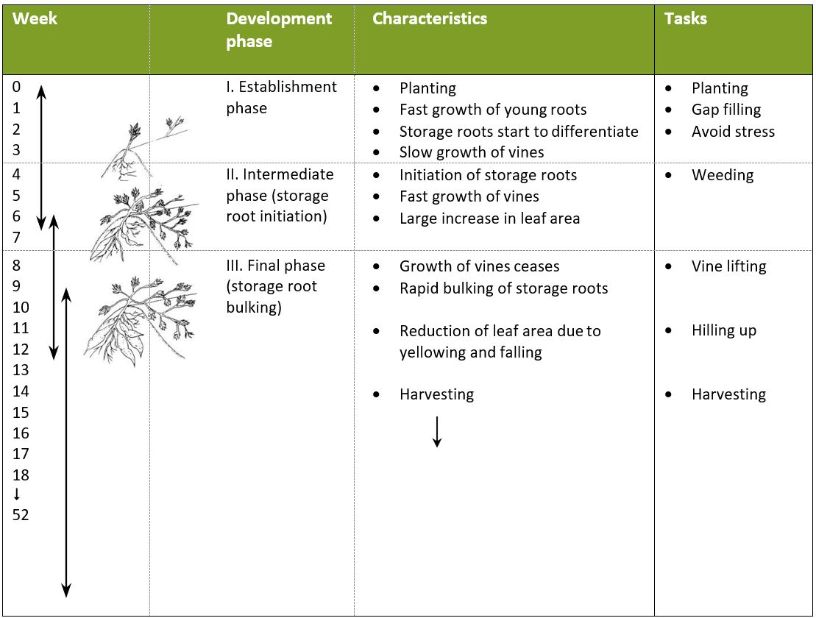
The Different Growth Stages of OFSP

Slide 52
Importance of Early Stage
Favourable conditions during the first month after planting are of vital importance for storage root initiation and will strongly influence yield potential of a plant.
  Under favourable conditions (good water, air and mineral conditions) adventitious roots can differentiate into storage roots.
  Under unfavourable conditions roots may fail to differentiate into storage roots and become lignified pencil roots.

Slide 53
Temperature Effect on OFSP Growth
OFSP typically requires growth season of 4 to 5 months.
The length of growth period and temperature affects the size of roots.
Optimum temperatures is 20°C - 25°C
  25 to 30⁰C daytime
  15 to 20⁰C night time
Early maturing sweetpotato varieties can be harvested 3 to 4.5 months after planting.
If temperatures are low, the growing period has to be extended to 6-7 months.

Slide 54
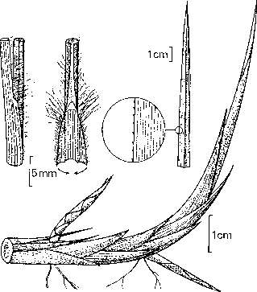
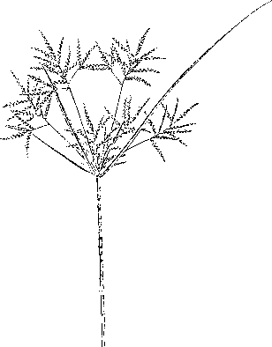
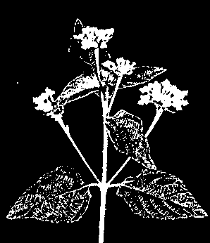
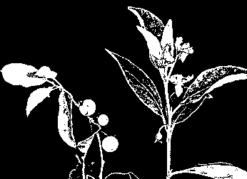
Three Main Weed Categories
Grasses | Sedges | Broad-leafed plants
Imperata cylindrica | Cyperus esculentus | Lantana camara | Solanum incanum

Slide 55
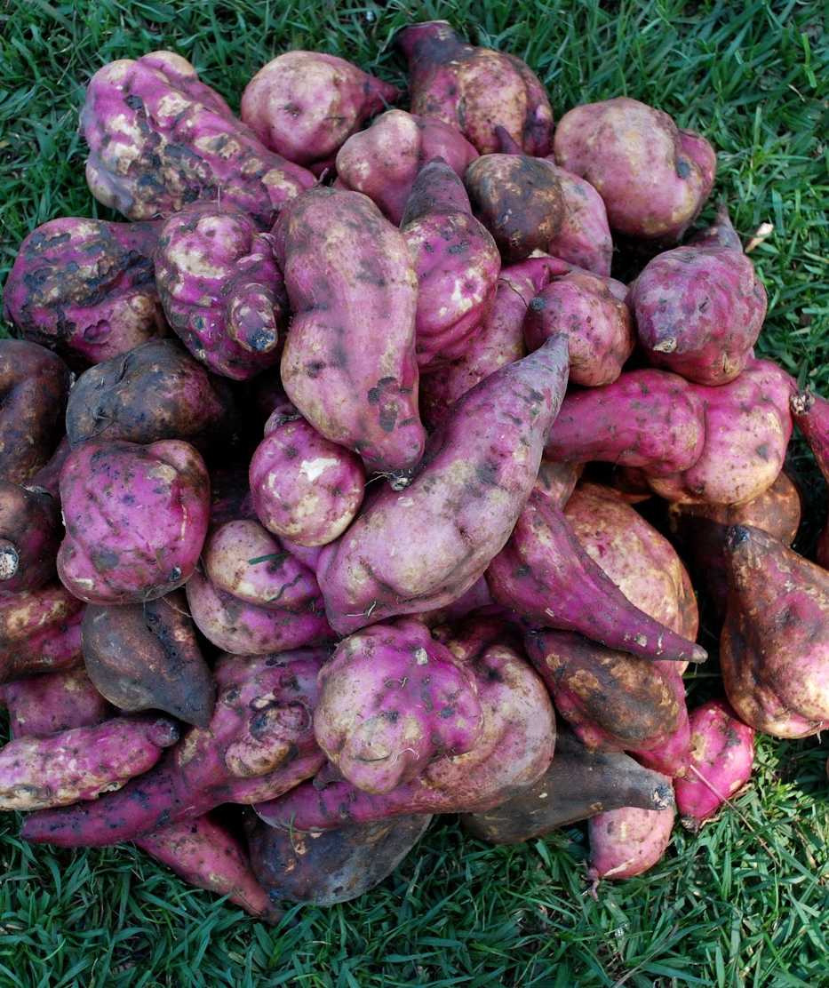
How Weeds Affect Crop
Compete with OFSP for nutrients and water
Harbor pests and diseases
Weed roots can damage OFSP

Slide 56
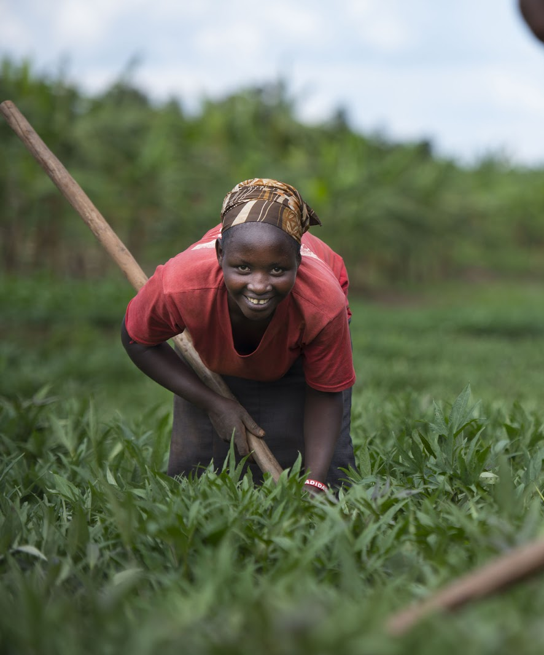
Managing Weeds
Manual removal
  Hand pulling
  Using a hoe
  Best before crop is planted
Mulching
  Reduces weed emergence
Crop rotation
Intercropping
Herbicides

Slide 57
Physiological Disorders
Mutations
  Symptoms
    Different colored flesh or skin
  Causes
    High natural rate of mutation
  Prevention
    Positive selection (decreases future mutation potential)
Water blisters (edema)
  Symptoms
    Small lumps on outside of the roots
  Causes
    Prolonged exposure of roots to wet soils
    Lack of oxygen
  Prevention
    Well-drained soil
    Ridges and mounds should be tall

Slide 58
Physiological Disorders (cont.)
Sun scalding
  Symptoms
    Purplish-brown areas
    Prone to secondary infections
  Causes
    Exposure of roots to direct sun at high temperatures
  Prevention
    Place roots in shade immediately at harvest
Growth cracks
  Symptoms
    Cracks in root skin
    Nematode infested roots more susceptible
  Causes
    Uneven growing conditions
    Inconsistent watering
  Prevention
    Consistent irrigation during dry spells

Slide 59
Physiological Disorders (cont.)
Flattened stem (fasciation)
  Symptoms
    Flattened stem with numerous leaves
  Causes
    Uncertain
  Prevention
    Do not use as planting material

Slide 60
Irrigation
Irrigation is rarely used on sweetpotato crops in Sub-Saharan Africa with the exception of South Africa.
A well-distributed rainfall of 500 mm during the growth cycle is sufficient for high productivity.
If necessary and available, irrigation can be used to ensure that the sweetpotato has sufficient water throughout the growing season.
Most irrigation methods (e.g. furrow, drip, flood, and sprinkler) are suitable for sweetpotato.

Slide 61
What are the three stages of OFSP growth?
Why is early stage important?
What is the optimal temperature for OFSP growth?
What are some of the ways of managing weeds?
What are some of the physiological disorders of OFSP?
Notes:
Answers
1) Initial establishment; 2) Differentiation of storage roots; 3) Storage root bulking
Affects yield size
20-25 degrees Celsius
Manual removal; Mulching; Crop rotation; Intercropping; Herbicide
Mutation, water blisters, sun scalding, growth cracks, flattened stem

Slide 62
Key Points
Sweetpotato can grow at a fairly wide range of temperatures, although the temperature affects root yield.
Low temperatures, lack of sunlight, and dry weather reduce yield and require an extended growing season.
After planting, the root primordia in sweetpotato nodes produce adventitious roots that differentiate into storage roots under good conditions.
The growth cycle includes three main phases, each of which requires farmers to perform specific tasks.
In good growth conditions, normal levels of pests and disease will not greatly reduce the harvest.
Irrigation is not always required, depending on the region, but drip irrigation is most efficient.

Slide 63
Nutrient Needs of Sweetpotato
Unit 7

Slide 64
Objectives
By the end of this unit, you should be able to:
Identify the nutrient needs of sweetpotato.
Explain how farmers can best “feed” their plants.
List the symptoms of plant nutrient deficiencies.
Compare disease symptoms and nutrient deficiency symptoms.

Slide 65
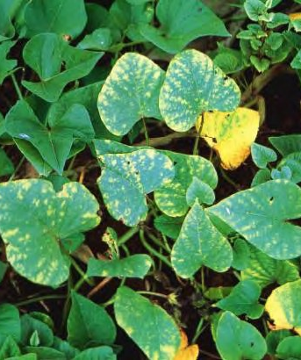
Nutrient Needs
Potassium is the most important element for storage root development.
OFSP needs a 1:3 ratio, potassium and nitrogen
  Too much nitrogen causes poor root development and yellowing of the whole leaf
  Too little creates low yield

Slide 66
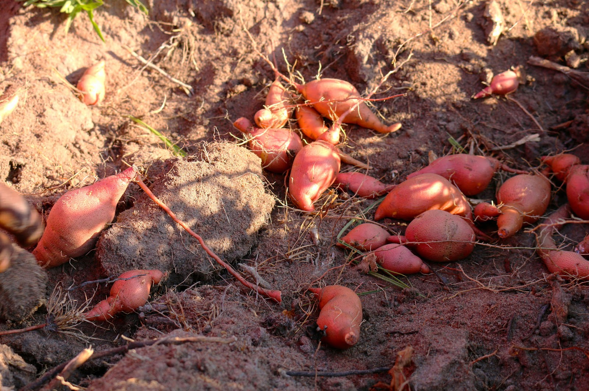
Importance of Soil pH
OFSP likes alkaline soil
Lime should be used on high Ph soils

Slide 67
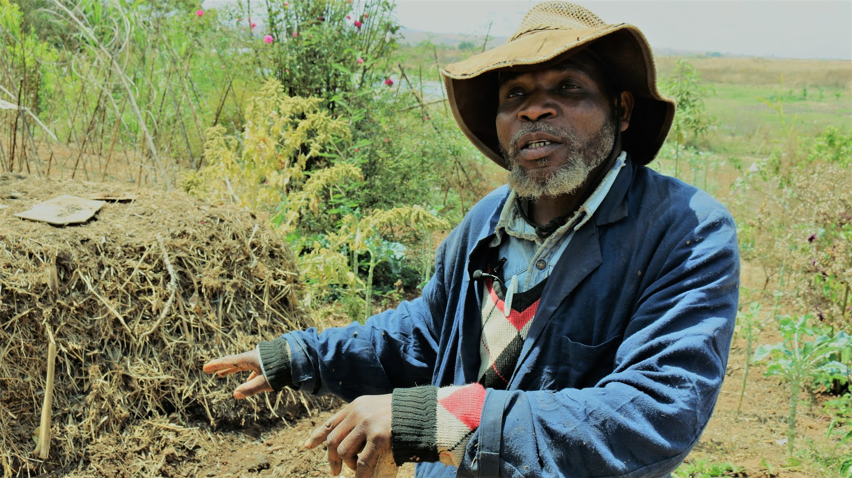
Adding nutrients
Manure
  More readily available than synthetic fertiliser
  Applied a few weeks before planting to avoid weeds
Fertiliser mixtures

Slide 68
Nutrient Deficiency Symptoms
Unusual colours of different plant parts:
  Chlorosis: leaves turn to a light green, yellow colour
  Necrotic spots: dry light brown spots on the leaves where tissue has died
  Purple colouration of leaves
  Browning
Leaves drop unexpectedly
Plants are shorter than normal (stunting)
Deformation of plant parts
  Thin or spindly stems
  Curling leaves
Die-back of stem and root tips

Slide 69
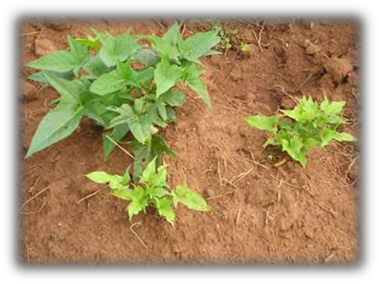
Viruses and Diseases
Do not confuse nutrient deficiency with virus symptoms
Diseases often occur in patchy pattern across field.
Symptoms
  Changed leaf or vein colour
  Stunted growth
  Curly leaves
Most often transmitted by pests, such as aphids or whiteflies.

Slide 70
What is the most important nutrient for storage root development?
What are some typical symptoms of plant nutrient deficiencies?
How are viruses usually transmitted to sweetpotato plants?
Notes:
Answers
Potassium
Unusual colouring of different plant parts; leaves drop unexpectedly; plants are shorter than normal; deformation of plant parts: (e.g. thin or spindly stems); and die-back of stem and root tips.
By insects such as aphids and whiteflies

Slide 71
Key Points
Sweetpotato needs a 1:3 ratio of potassium and nitrogen.
Too much nitrogen causes poor root development, and too little creates low yield.
Manure is more readily available than synthetic fertilizer, but manure must be applied a few weeks before planting to avoid weeds.
All fields and fertilisers require experimentation or soil analysis to find ideal application rates.
Sweetpotato likes alkaline soil; lime should be used on high Ph soils.
Unusual colors, falling leaves, and stunting can indicate nutrient deficiency.

Slide 72
Gender and Diversity Aspects of Sweetpotato Production and Managemention
Unit 8

Slide 73
Objectives
By the end of this unit, you should be able to:
Explain basic gender and diversity issues in sweetpotato production and management.

Slide 74
Roles of those Involved in OFSP Production and Management
Consider the following to understand gender roles:
  When activities are done
  How they are done
  What constraints are typically faced by those doing them
  What activities there are that compete for that labour or the land itself
Critical for development workers to be sensitive to male control over land
  Ensure that men are consulted about project activities, even where they are not directly involved

Slide 75
Key Points
Facilitators and promoters of orange-fleshed sweetpotato (OFSP) must understand the role of each person involved with sweetpotato production, from those who own the land to farm laborers.
Facilitators and promoters must be culturally sensitive to male control of the land.

Slide 76
Field Experiment
If there is a field nearby and there is sufficient time, set up a field experiment. Consult the Topic Manual for details.

