Slide 1


Epidemiology of peste des petits ruminants virus in West Africa: Is lineage IV replacing lineage II in Burkina Faso?
Abel S. Biguezoton¹, Guy Ilboudo², Barbara Wieland³, Rahinata Sawadogo¹, Firmin Dah¹, Adrien Zoungrana¹ and Michel Dione⁴
¹Centre international de recherche-développement sur l'élevage en zone subhumide (CIRDES), Burkina Faso
²International Livestock Research Institute, Ouagadougou, Burkina Faso
³Institute of Virology and Immunology, Switzerland
⁴International Livestock Research Institute, Dakar, Senegal
Peste des petits ruminants Global Research and Expertise Network (PPR-GREN) meeting
Montpellier, France, 7–9 December 2022

Slide 2


Plan
Introduction
Methods
Results and Discussion
Conclusion

Slide 3
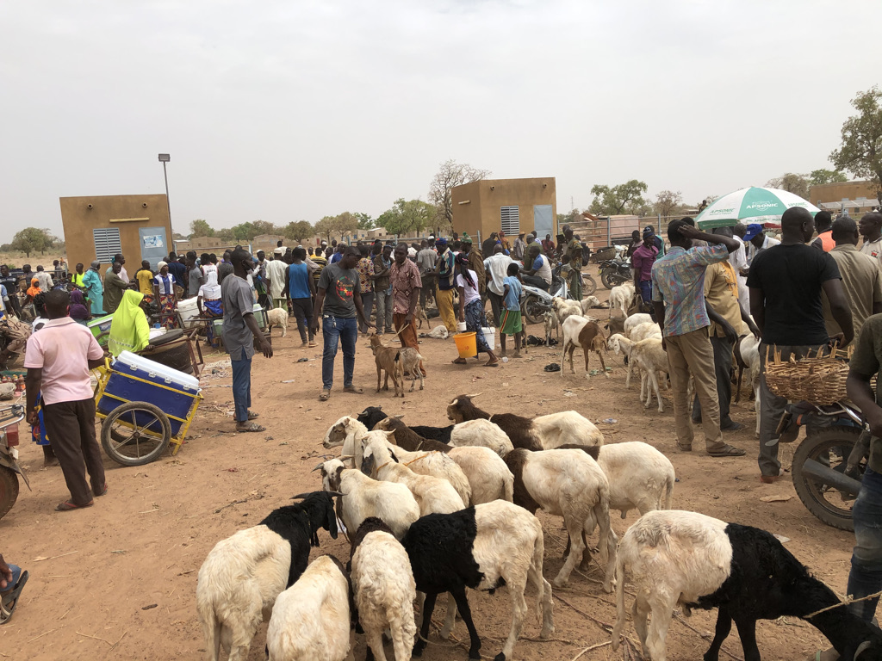
Introduction
The cash income provided by small ruminants in most of African and Asian countries is threatened by the highly infectious transboundary viral disease peste des petits ruminants (PPR).
©Abel BIGUEZOTON
Notes:
Cette maladie est hautement contagieuse. Une fois introduite, le virus peut infecter jusqu’à 90% d’un troupeau, la maladie tuant alors de 30 à 70% des animaux infectés.

Slide 4
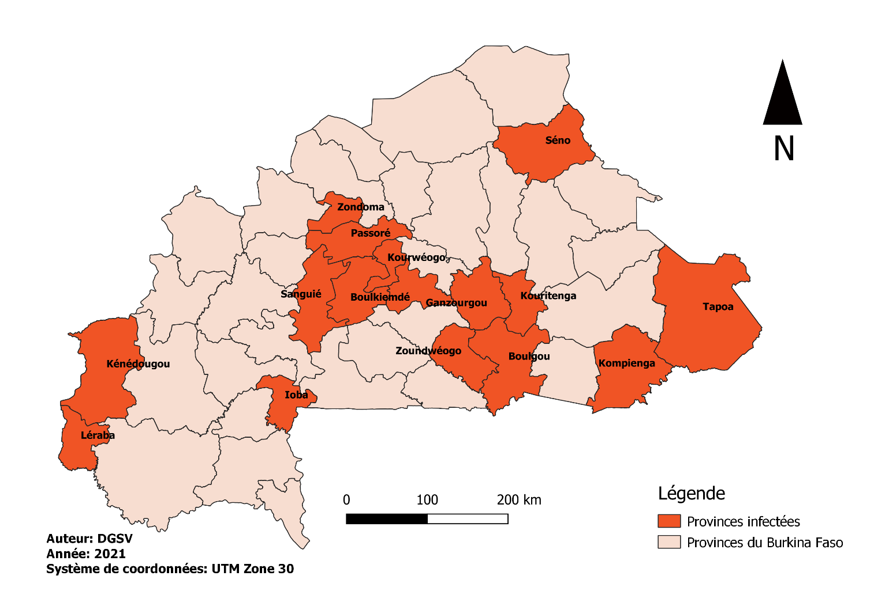
Introduction
Presence of PPR in Burkina Faso has been confirmed in 2008
PPR seems to be endemic now in the country
Outbreaks in 2018
Outbreaks in 2020
Notes:
Cette maladie est hautement contagieuse. Une fois introduite, le virus peut infecter jusqu’à 90% d’un troupeau, la maladie tuant alors de 30 à 70% des animaux infectés.

Slide 5
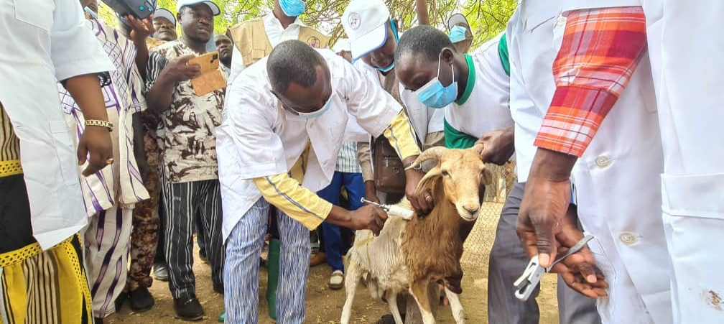
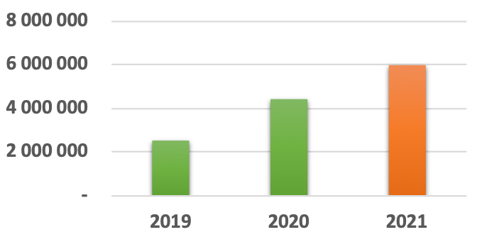
Introduction
As part of the global eradication campaign targeting PPR, the Government of Burkina Faso established a strategic plan in 2018.
Annual vaccination campaign started in 2019.
However, little is known about epidemiology of PPR in Burkina Faso (published data).
Notes:
Cette maladie est hautement contagieuse. Une fois introduite, le virus peut infecter jusqu’à 90% d’un troupeau, la maladie tuant alors de 30 à 70% des animaux infectés.

Slide 6
Introduction
According to previous studies : Lineages I and II
Need to investigate current situation for control and epidemiological studies!

Slide 7
Methods
As part of the Epidemiology and control of peste des petits ruminants (ECo-PPR) project activities in Burkina Faso outbreak investigations were carried out;
Swab samples from eyes, mouth and nose were collected from suspicious goats and sheep after confirmation of PPR through a rapid diagnostic test;
-Tissue samples (spleen, lung, lymph nodes) of suspicious dead animals were also collected.

Slide 8
Methods
Virus confirmation was performed with RT-PCR amplification targeting nucleocapsid (N) gene.
The RT-PCR products of positives extracts were sequenced.
Sequences and phylogenetic analyses were performed to determine the lineages.

Slide 9
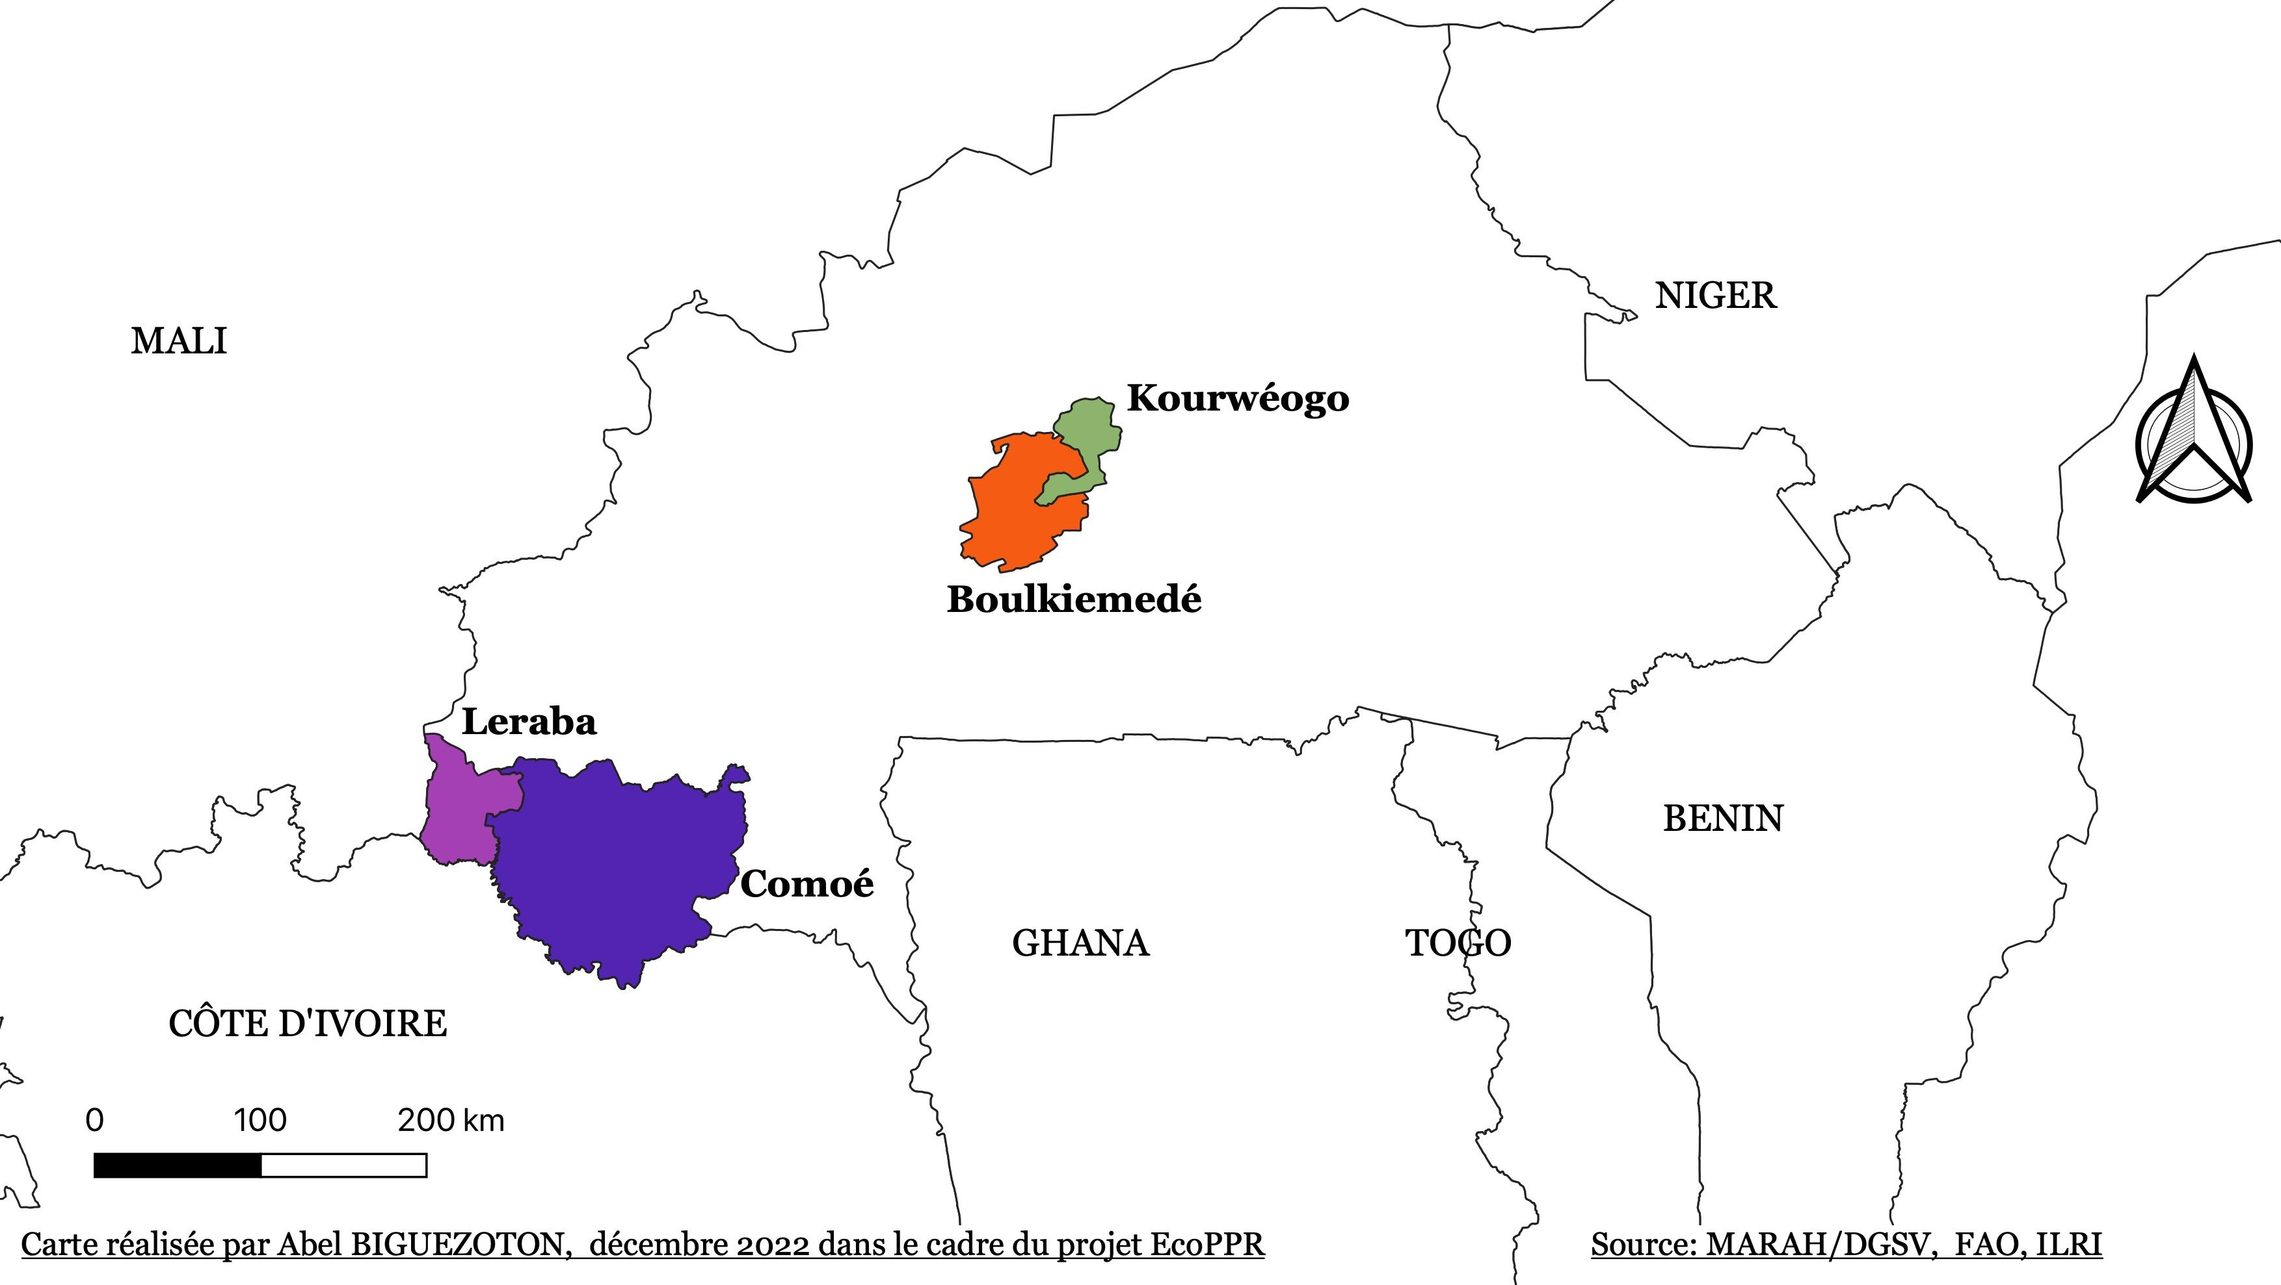
Results and discussion
Nine outbreaks have been identified in four provinces
We certainly lost other outbreaks in these provinces during our study
1
3
1
4

Slide 10
Results and discussion
Pairwise alignment results
95% (333/350 bp) of similarity with lineages IV samples from Nigeria (MN725768) and Cameroon (MH447978).
Same percentage of similarity was also obtained with the lineage IV sequence from Niger but on lower sequence size: i.e. 222/234 bp.
Pairwise alignment with lineages I and II from Burkina Faso published in previous work showed no significant similarity or no more than 87% of similarity on smaller sequences (i.e. 188/218 bp).
Lineage IV is the only one present in our samples from the 4 provinces!

Slide 11
Results and discussion
Phylogenetic relationships (based on partial Ngene sequences)
Lineage IV is the only one present in the samples from the 4 provinces!
Studies sequences have clustered only with those of lineage IV reference sequences

Slide 12
Results and discussion
Potential sources of lineage IV presence in Burkina Faso
Animals’ mobility between bordering countries

Slide 13
Results and discussion
Is lineage IV replacing lineage II in Burkina Faso?
4 of 45 provinces studied
Further investigation is needed!

Slide 14
Conclusion
This study confirms the presence of the PPRv lineage IV in Burkina Faso.
Based on outbreaks investigated, this lineage seems to have replaced lineage II.
Further investigations are thus needed to better understand how PPRv lineage spread in the region and if lineage II is still present and what the implications for PPR control are.

Slide 15






This research was conducted under CRP livestock and the project Epidemiology and Control of peste des petits ruminants (EcoPPR) and continued under the CGIAR Initiative Sustainable Animal Productivity for Livelihoods, Nutrition and Gender (SAPLING). CGIAR research is supported by contributions from the CGIAR Trust Fund. CGIAR is a global research partnership for a food-secure future dedicated to transforming food, land, and water systems in a climate crisis.

Slide 16

THANK YOU

