Slide 1
Writing effective and convincing abstracts: examples
Alessandra Galiè
Team Leader: Gender, and Principal Scientist
ILRI
Online
Gender Platform
June 20 2022

Slide 2
From first presentation…
Therefore, your abstract should give quick – but accurate – insights on:
What your study is about
Why it is relevant
How it contributes to the literature
What methods have been used
What you found out

Slide 3
Abstract 1
Informal milk trading in peri-urban Nairobi plays a key role in supporting
both livelihoods and nutrition, particularly among poor
households. Gender dynamics affect who is involved in and benefits
from milk trading. To better understand gendered constraints
and opportunities in informal, peri-urban dairy marketing,
a qualitative study was conducted in 2017 with 45 men and 50 women
milk traders in Dagoretti, a peri-urban area of Nairobi, Kenya.
The findings show that milk trading is more lucrative for older men
than for women and younger men among the respondents. This
article illustrates the differences between these women’s and
men’s experiences as milk traders and explores the reasons
behind these differences.
It discusses the implications of the findings
for agricultural research and development interventions that
aim to enhance the sustainability and equity of the dairy sector.
What the study is about
+
Why it matters (incl. prob)
Methodology
The findings in a nutshell
Implications of findings

Slide 4
Abstract 2: missing key components and accuracy
This paper proposes an analytical framework that addresses the challenge of assessing food security in households in a contextualised and dynamic manner that takes into account intrafamily inequalities (particularly gender).
We do this through the dual operationalisation of the food securitisation and the capability approaches, conducted in two steps: (1) the conceptualisation of the household food securitisation cycle in the Sub-Saharan context; (2) the proposal of a food securitisation capabilities list.
Thus, our proposal includes key elements of analysis that have not been taken in account by traditional approaches.
What the study is about
+
Why this issue matters ??
Methodology
Findings???
Implications?
Value of paper?

Slide 5
Abstract 3
This paper focuses on identifying the means to tackle climate change as it explores the key role women could play in developing and enhancing innovation.
Based on a systematic literature review (SLR) of 1,275 journal articles,
we explore the impact of a stronger presence of women within institutions, including companies, to take on climate change. We also look at the need to properly align public policies and combat climate change while engaging global companies in the process.
The SLR shows that more women within the technological innovation process promise greater productivity and better results. It also reveals that women tend to adopt innovations that have proven to be efficient.
We argue that more women in science would contribute to accelerating the development of the necessary technological innovation to counter climate change and promote continued awareness about it. We also argue that more female board members in large companies and public institutions would contribute to not only appropriate climate change policies, but also to a move away from “gadget” technologies that fail to effectively fight rising global temperatures.
The article concludes with a discussion of whether we need more women or feminine qualities within innovation processes.
What the study is about
methodology
More details on content
Findings
Discussion/
implications
Wider
implications

Slide 6
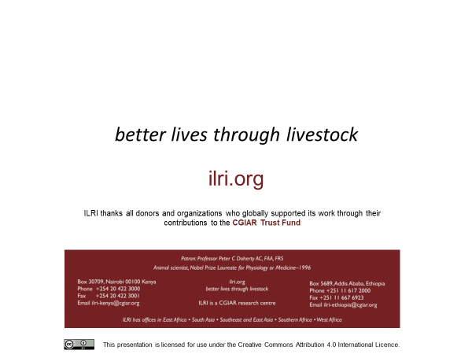

Slide 7

THANK YOU

