Slide 1
ICT MESSAGING AS A PROMISING TECHNOLOGY DELIVERY MECHANISM FOR SMALLHOLDER RESILIENCE
FRED KIZITO¹, PATRICK KIAO², LEONARD SABULA³, HAROON SSEGUYA¹, FREDDY BAIJUKYA¹, CHRISTOPHER MUTUNGI¹, JAPHET MASIGO¹
¹INTERNATIONAL INSTITUTE OF TROPICAL AGRICULTURE, ²ESOKO, ³TANZANIA AGRICULTURAL RESEARCH INSTITUTE - UYOLE
AFRICA RISING - NAFAKA PROJECT ANNUAL REVIEW AND PLANNING MEETING
3 – 4 JULY 2019, DAR ES SALAAM, TANZANIA

Slide 2
ICT PROCESS EVOLUTION

Slide 3
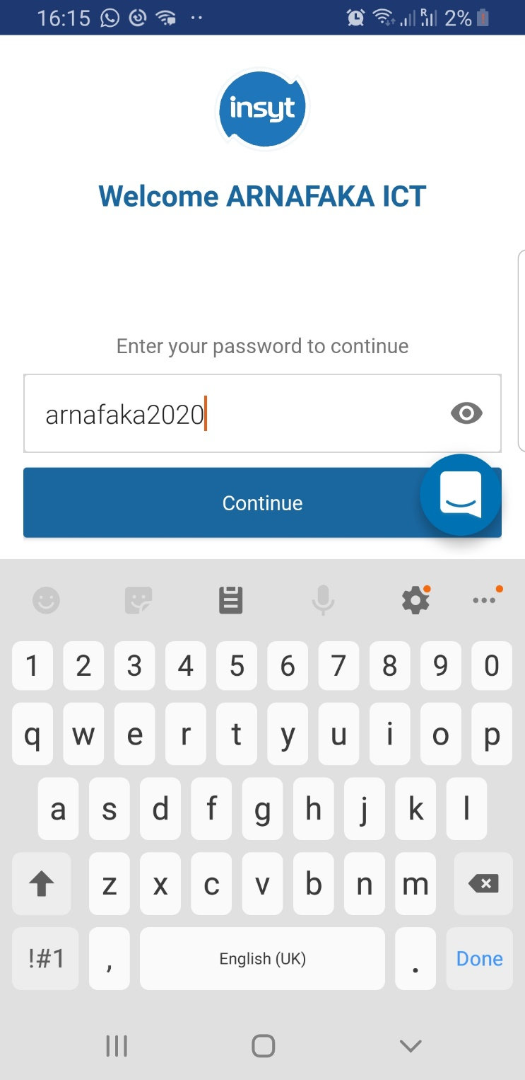
ANALYTICS AROUND FARMER PROFILING

Slide 4
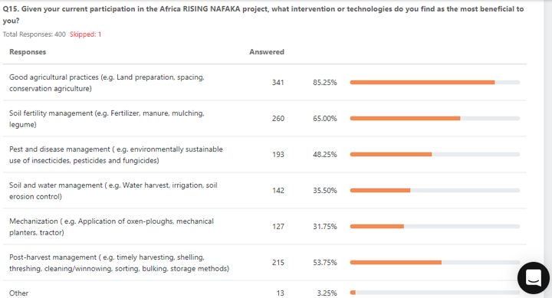
ANALYTICS AROUND FARMER PROFILING

Slide 5
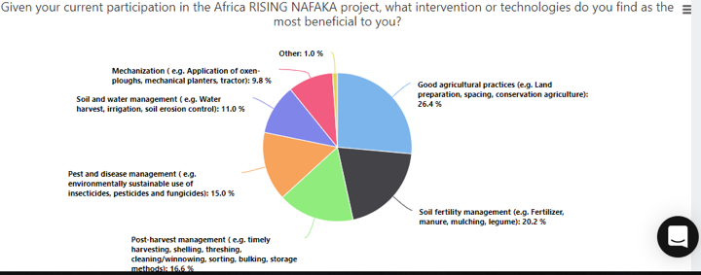
ANALYTICS AROUND FARMER PROFILING

Slide 6
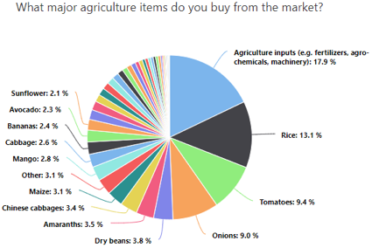
ANALYTICS AROUND FARMER PROFILING

Slide 7
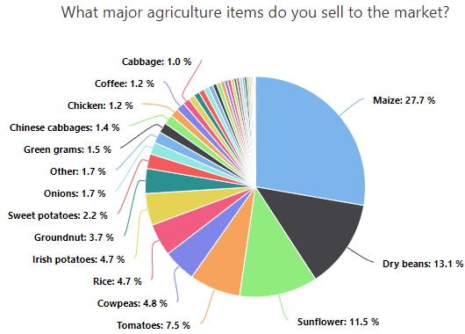
ANALYTICS AROUND FARMER PROFILING

Slide 8
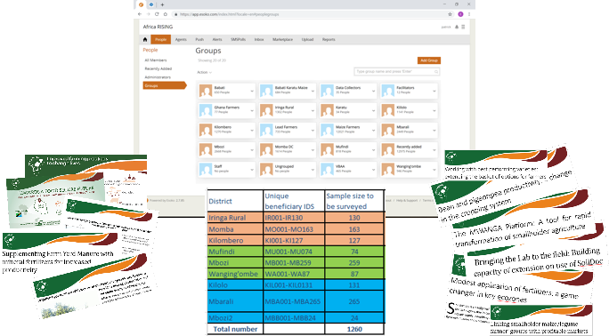
CONTENT DEVELOPMENT

Slide 9
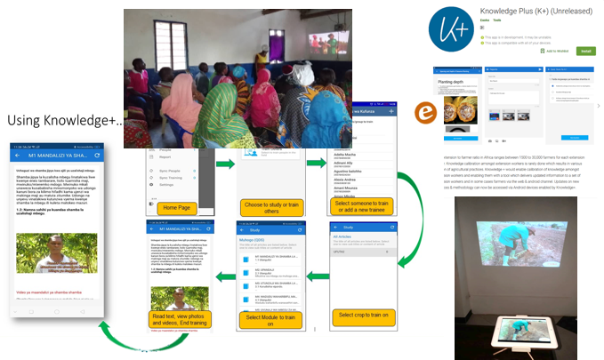
SMALLHOLDER EMPOWERMENT

Slide 10
RE-THINKING SMALLHOLDER RESILIENCE
How best can we capture smallholder preferences while building resilience?
Is it better to target ICT around landscape level interventions or would household level interventions suffice?
What would be the anticipated impact of ICT if we had greater than 70% dissemination?
What is preventing you from sharing your ICT messages.

Slide 11
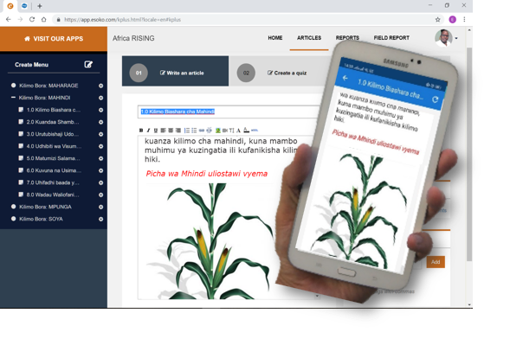
THANK YOU!

Slide 12












PARTNERS
Notes:
ESA Africa

