Slide 1
Important!
This module is designed to potentially serve a wide variety of audiences (nutritionists and agronomists, policymakers, extension workers, farmers).
Not all of the material will be relevant to all audiences.
Please refer to the accompanying Facilitator’s Guide for guidance on how to adapt these materials to your audience and facilitation best practices.

Slide 2




Legend
Icon | Description
 | Expected Duration, minutes
 | Quick Review/Survey Questions
 | Brainstorming Session
 | Discussion Session
 | Group Activity
 | Animated Slide
 | End of Animation
Xm

Slide 3
Legal
Unless otherwise noted, all images copyrighted to International Potato Centre.
Attribution-NonCommercial-ShareAlike 2.0 Generic (CC BY-NC-SA 2.0)

Slide 4
Everything You Ever Wanted to Know About Sweetpotato
Topic 8: Harvesting and Post-Harvest Management

Slide 5
Introduction
Harvesting and Post-Harvest Management

Slide 6
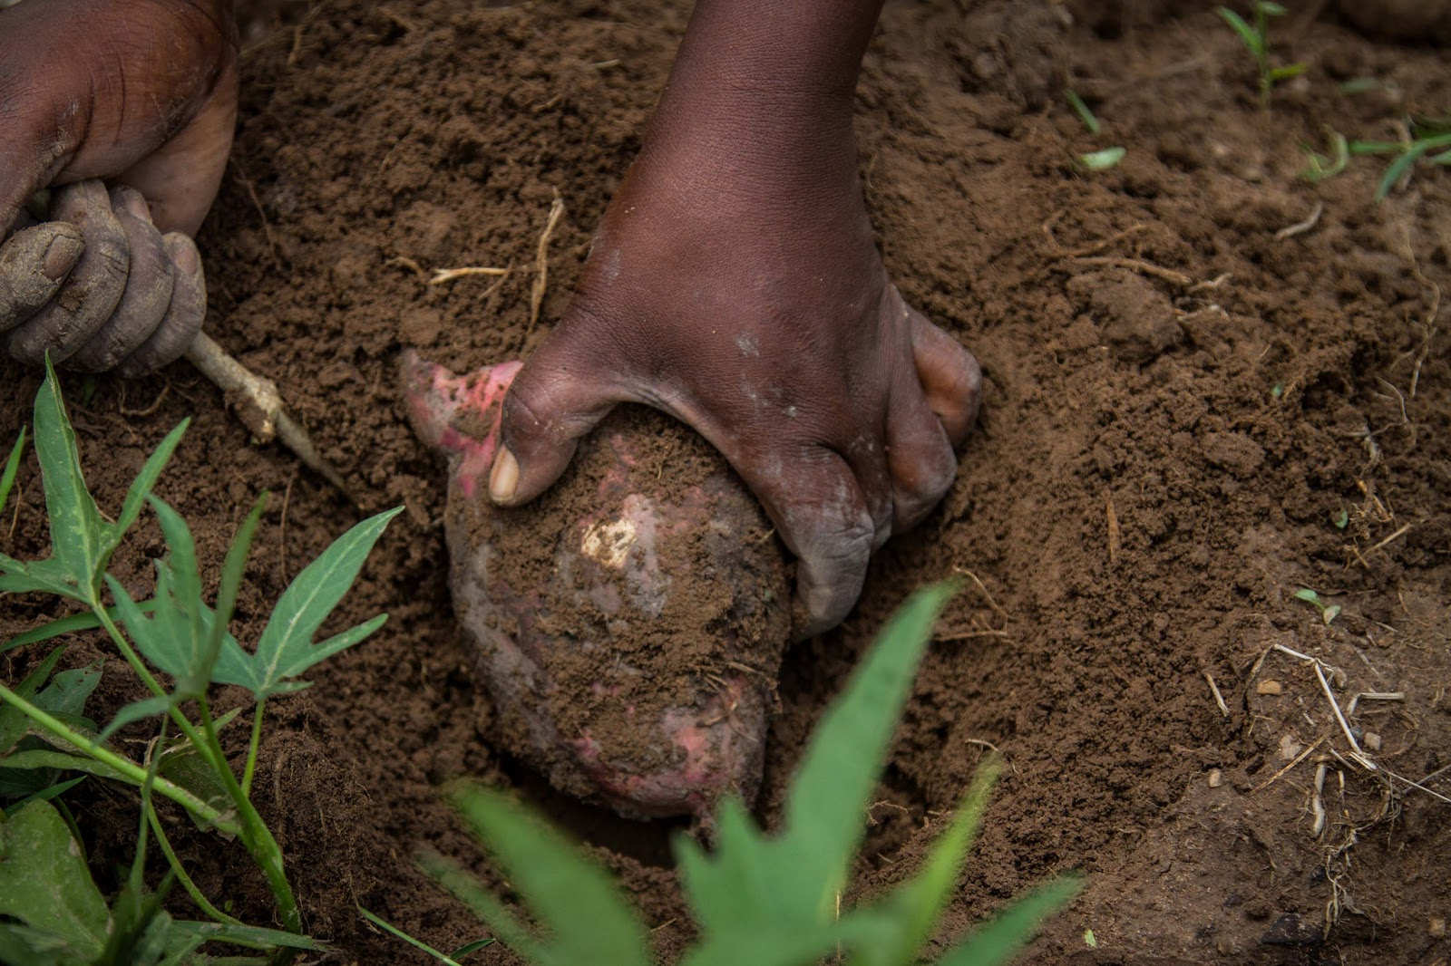
Welcome
During this session, we will discuss postharvest handling and storage practices for dried products, and methods for curing and storing fresh roots to increase their quality, value and availability.

Slide 7
Prolonging the Sweetpotato Harvest
Unit 1

Slide 8
Objectives
By the end of this unit, you should be able to:
Explain why sweetpotato harvest is a flexible process.
List the pros and cons of a prolonged sweetpotato harvest.

Slide 9
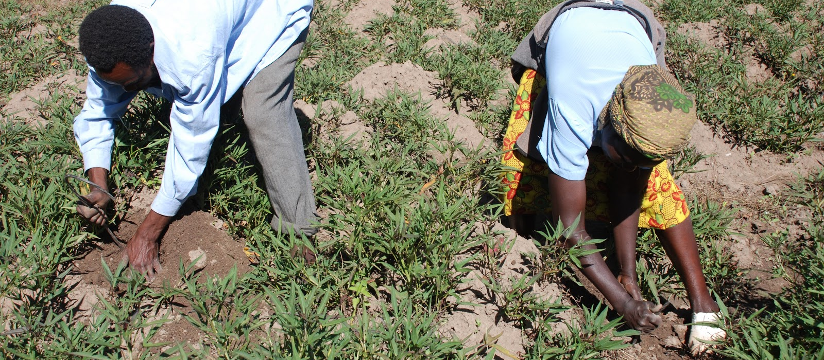
Prolonging the Sweetpotato Harvest
OFSP does not have to be harvested all at once. Many farmers harvest piecemeal. When food is required, just a few roots are dug up.
Staggered planting and varieties with different maturing rates further lengthens the harvest season.

Slide 10
Pros and Cons of Prolonging the Sweetpotato Harvest
Pros
Cons
Crop can create household food stability through a prolonged harvest.
Improving pest management by increasing amount of attention farmers pay to vulnerable roots.
Opportunities to sell roots at high price during the dry season.
May raise risk of weevils
Theft by people or monkeys (dependent on area)
In case of prolonged dry season, long time in the year when no OFSP roots can be harvested.

Slide 11
What are some advantages of prolonging the sweetpotato harvest?
What are some of the disadvantages?
Notes:
Answers
Crop can create household food stability through a prolonged harvest; Improving pest management by increasing amount of attention farmers pay to vulnerable roots; Opportunities to sell roots at high price during the dry season
May raise the risk of weevils; Theft by people or monkeys (dependent on area); In case of prolonged dry season, long time in the year when no OFSP roots can be harvested.

Slide 12
Key Points
Because sweetpotato does not have to be harvested all at once, the crop can create household food stability through a prolonged harvest.
Many farmers harvest piecemeal to take advantage when the market outlook is favorable.
Piecemeal harvesting can improve pest management by increasing the amount of attention farmers pay to vulnerable roots.
Depending on the area, a prolonged harvest may raise the risk of weevils or theft by people or monkeys.
Staggered planting and use of varieties with different maturing rates further lengthens the harvest season.
Learning to preserve fresh sweetpotato creates opportunities to sell the roots at a high price during the dry season.

Slide 13
When and How to Harvest
Unit 2

Slide 14
Objectives
By the end of this unit, you should be able to:
Discuss optimal harvest timing.
List the criteria for deciding when to harvest.
Describe best harvest practices.
Calculate the probable yield of a field that is ready for harvest.

Slide 15
Optimal Harvesting Time
OFSP can be harvested over several months.
Harvesting time is determined by:
  Variety’s maturity period and its capacity for prolonged harvest
  Environmental conditions (e.g. soil condition, weather, water supply etc.)
  Pest and diseases incidence
  Market demand and price
  Field use for planting the next/ consecutive crop
  Economic value of the next/ consecutive crop
  Labour availability

Slide 16
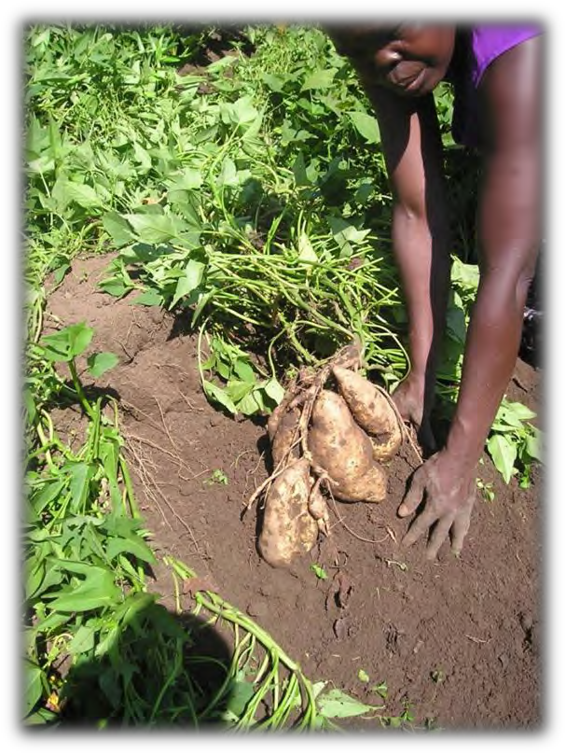
Making Decisions on Harvesting Time
Typically harvested between 3 and 8 months after planting.
Harvesting too late could result in low yields.
Harvesting too early could result in storage roots not having reached maximum size.
Other priorities
  Food requirements
  Need for land

Slide 17
Best Harvest Practices
Use sharp sticks, machetes or hand hoes.
Curing - vines can be cut off 2-4 days prior to harvest
  Skins become firmer and less vulnerable
  Cosmetic wounds reduce market price
Avoid mechanical harvesting, if possible, as it increases potential for harm.
Piecemeal: Harvest just enough for a couple days’ meals
  Although this causes underestimation of yields, it is generally agreed to increase yields by leaving more space for unharvested roots to grow.

Slide 18
Field Probable Yield
Farmers should learn how to calculate field probable yield to best negotiate with traders when harvesting an entire sweetpotato field at once.
Working out the yield of the field:
  Dig up minimum 10 plants randomly
  Record weight of each
  Calculate average weight of roots per plant (Average Yield)
  Add all weights recorded
  Divide by number of plants dug up
  Count how many plants in field
  Multiply by average yield

Slide 19
What are some of the factors to consider when deciding on the optimal harvesting time?
What are some of the recommended best practices for harvesting?
Notes:
Answers
Variety’s maturity period and its capacity for prolonged harvest; Environmental conditions (e.g. soil condition, weather, water supply etc.); Pest and diseases incidence; Market demand and price; Field use for planting the next/ consecutive crop; Economic value of the next/ consecutive crop; Labour availability.
Use sharp sticks, machetes or hand hoes; Curing - vines can be cut off 2-4 days prior to harvest; Avoid mechanical harvesting, if possible, as it increases potential for harm; Piecemeal: Harvest just enough for a couple days’ meals.

Slide 20
Key Points
While the harvest can be prolonged, there are criteria for harvesting particular sweetpotato plants and individual storage roots.
These criteria range from market prices, labor availability, and the onset of pests to weather conditions or the need to clear the field for another crop.
Typical plant maturity falls between 3-8 months.
Harvesting too early or late can reduce the yield.
Sweetpotato skin is delicate, and care must be taken not to wound the roots while harvesting. This can allow disease to enter roots, and it leaves a cosmetic scar that will reduce market value.

Slide 21
Key Points
Mechanical harvesting carries more risk of wounding the roots.
“Curing” the roots by cutting away the vines a couple of days before harvest can thicken their skin and reduce wounds.
Although piecemeal harvesting causes underestimation of yields, it is generally agreed that it increases yields by leaving more space for unharvested roots to grow.
To best negotiate with traders when harvesting an entire sweetpotao field at once, farmers can learn to calculate the field’s probable yield.

Slide 22
How to Safely Pack and Transport Fresh Sweetpotato Roots
Unit 3

Slide 23
Objectives
By the end of this unit, you should be able to:
Explain best practices for packing and transporting sweetpotato roots.
Identify bad packing practices.

Slide 24
Practices for Packing and Transporting OFSP
Do’s
Don'ts
Keep roots in shade after harvest.
Care to not physically damage roots during packing.
  Heaviest roots are on the bottom
Provide adequate aeration.
Use plastic, wooden crates or cardboard boxes.
Sell roots within 3-4 days to avoid rotting.
Do not overfill or underfill sweetpotato sacks, as this can cause damage.
When packing in sacks, beware of rocks as they can bruise roots.

Slide 25
What are some of the best practices for packing and transporting OFSP?
What are the causes of damage during packing and transportation?
Notes:
Answers
Keep roots in shade after harvest; Care to not physically damage roots during packing; Provide adequate aeration; Use plastic, wooden crates or cardboard boxes; Sell roots within 3-4 days to avoid rotting
Overfilling or underfilling sacks; rocks

Slide 26
Key Points
Sweetpotato roots should be kept in the shade after harvest.
Sweetpotato must be packed with care, with the heaviest roots on the bottom.
Overfilling and underfilling sweetpotato sacks both cause damage.
Plastic or wooden crates or cardboard boxes work better than sacks.

Slide 27
Pre-Harvest and Post-Harvest Curing
Unit 4

Slide 28
Objectives
By the end of this unit, you should be able to:
Describe best practices for curing sweetpotato, pre- and post-harvest.

Slide 29
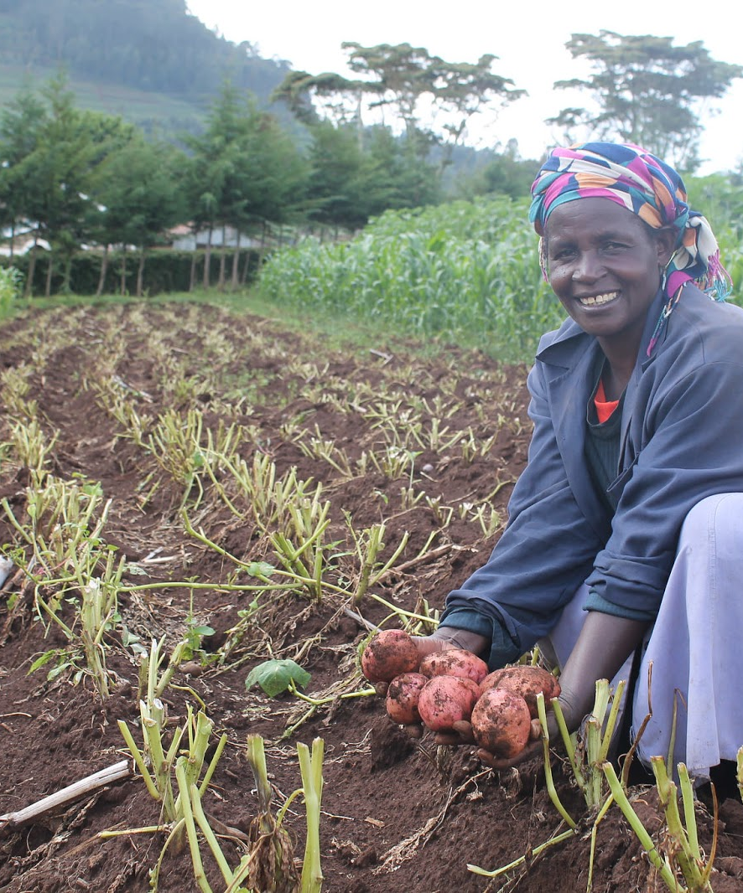
Pre-harvest Curing
Quality of the crop declines soon after harvest.
Rot enters skin wounds caused during harvest.
Conduct pre-harvest in-ground curing by removing foliage (dehaulming), up to 2-4 days before harvesting, to:
  Reduce root loss
  Increase shelf-life

Slide 30
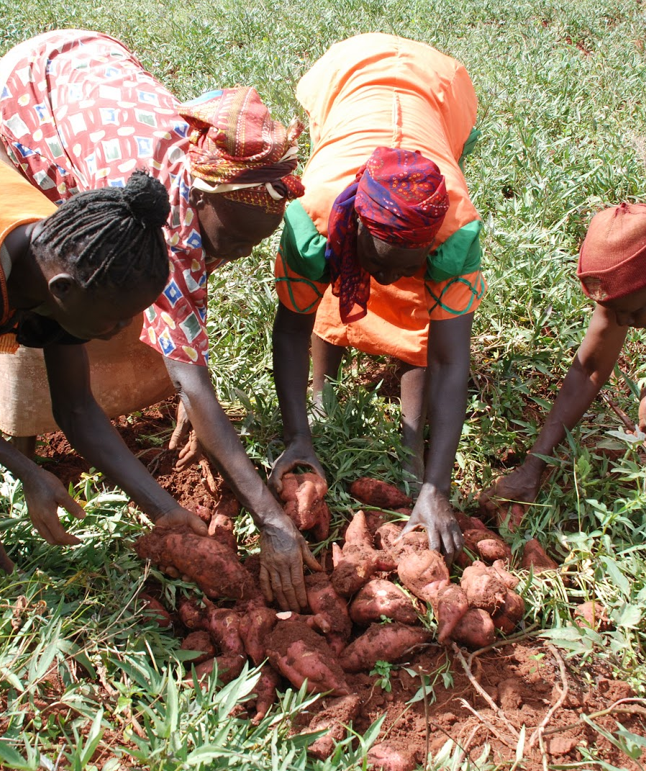
Post-harvest Curing
Exposing the sweetpotato roots for 4-7 days to:
  Temperatures of 25- 30°C
  High humidity
This further toughens the skin

Slide 31
How is pre-harvest curing conducted?
How is post-harvest curing conducted?
Notes:
Answers
Removing foliage (dehaulming), up to 2-4 days before harvesting
Exposing the sweetpotato roots for 4-7 days to: Temperatures of 25- 30°C and High humidity

Slide 32
Key Points
Sweetpotato quality declines soon after harvest.
Rot can enter sweetpotato skin wounds caused during harvest.
Removing foliage 2-4 days before harvest is pre-harvest curing and prevents wounding.
Post-harvest curing consists of exposing the sweetpotato roots to temperatures of 25- 30°C and high humidity for 4-7 days further toughens the skin.

Slide 33
Managing Fresh Storage of Sweetpotato Roots
Unit 5

Slide 34
Objectives
By the end of this unit, you should be able to:
Describe the development of practices for managing fresh sweetpotato root storage.
Explain why fresh storage is underused in Sub-Saharan Africa (SSA).
Describe several economical technologies for cool sweetpotato root storage.

Slide 35
Reasons for Developing Practices of Fresh OFSP Root Storage
Land is made available for other crops.
Family can eat fresh sweetpotato roots for a longer period after harvest.
‘Fresh’ roots can be sold for a higher price during the off season.
Reduces root losses to sweetpotato weevils.
Emergency food and cash supply during dry season.

Slide 36
Managing Storage of Fresh Roots
Traditional and economical methods currently used are:
  Pit
  Clamp
New storage methods (e.g. zero energy cool chamber, large-scale storage facilities) have some challenges:
  Not often used
  Bulky to store
  Many growers perceive price differential does not make it worthwhile
Studies show new methods provide substantial profit increases.

Slide 37
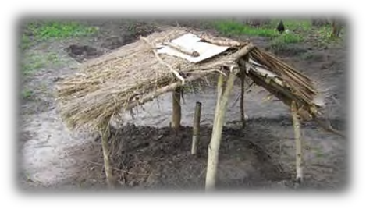
Pit Stores
Hole dug in dry ground area
May or may not have a grass lining
Roots placed in pit
Roots covered with grass (if used for lining) and sealed with dry soil
Bamboo pole inserted for ventilation

Slide 38
Pit Stores Cont.
Covered with raised, sloping roof
Drainage channel added to divert rainwater
Can be used again the following season, but must be sterilised to avoid carry over of pests and diseases

Slide 39
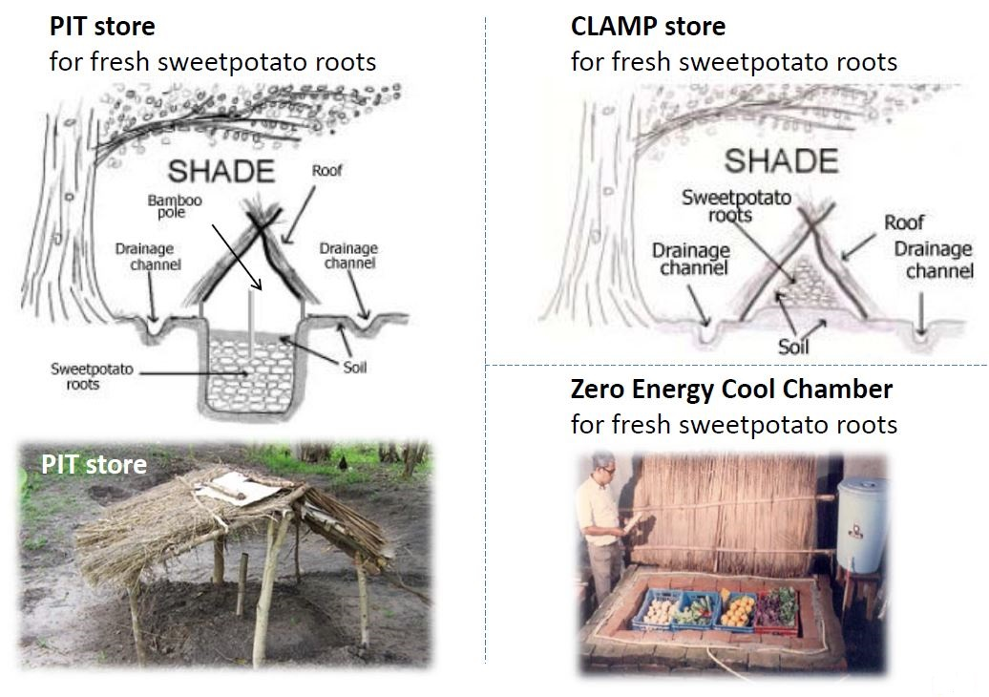
Clamp Store
Flat mound of earth raised 10cm
Mound covered with dry grass
Roots covered with more dry grass and 10-20cm dry soil
Drainage channel added to divert rainwater
Can be used again the following season, but must be sterilised to avoid carry over of pests and diseases

Slide 40
Zero Energy Cool Chamber
Typically stays 10-15°C cooler than outside temperature
Maintains 90% relative humidity
Built of brick, sand, bamboo, straw and sacks
Does not require electricity
Uses evaporation to cool fresh roots
Economical and promising new technology

Slide 41
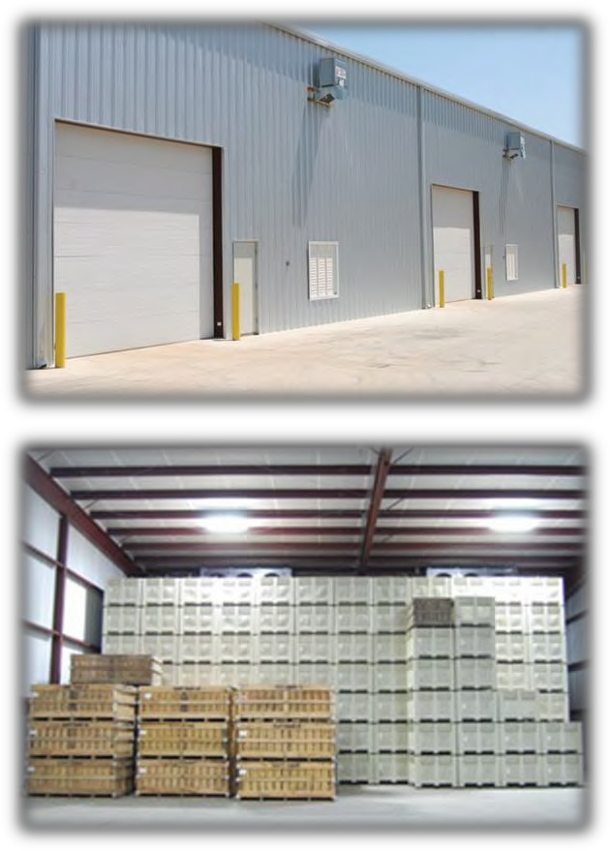
Modern Large Scale Storage Facility
Recommended for sale crops
Maintains temperature and humidity required for curing
Offers negative horizontal ventilation (NHV)
  Uses slight negative pressure to pull ventilation air horizontally

Slide 42
Causes of Post-harvest Losses
OFSP is highly perishable due to high moisture, sugar content, thin skin and high respiratory rate.
The causes of loss include:
  Mechanical damage
  Cracking
  Chilling
  Respiration
  Sprouting
  Pests
  Disease

Slide 43
What are the traditional methods for OFSP storage?
What are the advantages of zero energy cool chamber?
Notes:
Answers
Pit, clamp
Typically stays 10-15°C cooler than outside temperature; Maintains 90% relative humidity; Does not require electricity; economical technology; Studies show new methods provide substantial profit increases

Slide 44
Key Points
Supplying fresh sweetpotato to the market (as opposed to dried product) during the off-season can fetch very good prices in SSA.
However, new storage methods for sweetpotato roots are not often used; sweetpotato is bulky and many growers perceive that the price differential does not often make it worthwhile.
However, studies show that these new methods may in fact provide substantial profit increases.
Pit stores and clamp stores are economical ways of keeping sweetpotato fresh for the off-season, at least for household use.

Slide 45
Key Points (cont.)
Zero energy cool chambers use evaporation to cool fresh roots and are also economical.
Modern storage facilities offering negative horizontal ventilation (NHV) are recommended for sale crops.
Pests, diseases, and the delicate nature, high respiratory rate, and high moisture content of sweetpotato contribute to rapid deterioration without proper storage.

Slide 46
Enhancing Market Value of Fresh Sweetpotato Roots Through Improved Post-Harvest Handling
Unit 6

Slide 47
Objectives
By the end of this unit, you should be able to:
Discuss the series of processes that best prepares sweetpotato roots for market.
Identify good packaging practices to add value for market.
Explain which transportation practices are best and why.

Slide 48
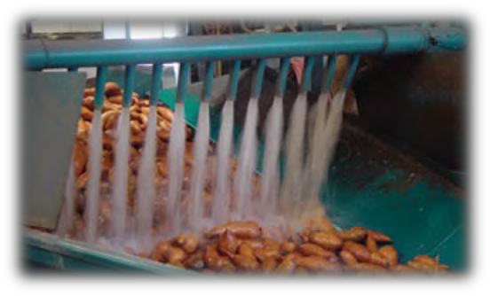
Post-harvest Handling
Washing the roots
  Rubbed not scrubbed
  Adding small amount antimicrobial agent avoids decay
Grading and sizing
  Hand-sorting to remove bad product
  Wearing gloves protects root skins and protects workers from fungicides

Slide 49
Post-harvest Handling
Packaging
  Select the right container design
  Sacks cause loss of product
  Avoid over- or under- loading sacks
  Provide identification information
  Packaging properly adds cost but reduces losses
Transporting
  Only transport quality roots
  Avoid using sacks as this causes bruising
  Use wooden or plastic pallets to lower root loss and improve shelf life

Slide 50
What are some of the practices for post-harvest handling?
Notes:
Answers:
1. Washing the roots; grading and sizing; proper packaging; proper transportation

Slide 51
Key Points
Washing, sizing, grading, packaging, and transportation are essential handling steps in getting sweetpotato to market.
Sweetpotato should be gently rinsed, not scrubbed. Adding a small amount of an antimicrobial agent avoids decay.
Sweetpotato roots should be hand sorted to remove bad product, using gloves to protect the skins and to protect workers from fungicides.
Sacks are a poor transport choice. Avoiding the use of sacks reduces losses and ensures best market value.
Packaging properly adds cost but reduces losses.

Slide 52
Managing Dried Chip Storage of Sweetpotato Roots
Unit 7

Slide 53
Objectives
By the end of this unit, you should be able to:
Explain how slices and small pieces of dried sweetpotato root are produced and used in parts of SSA, both traditionally and commercially.
Identify best practices for handling sweetpotato roots in dried chip storage.
List the steps and best practices for creating well-preserved, home-dried sweetpotato products.

Slide 54
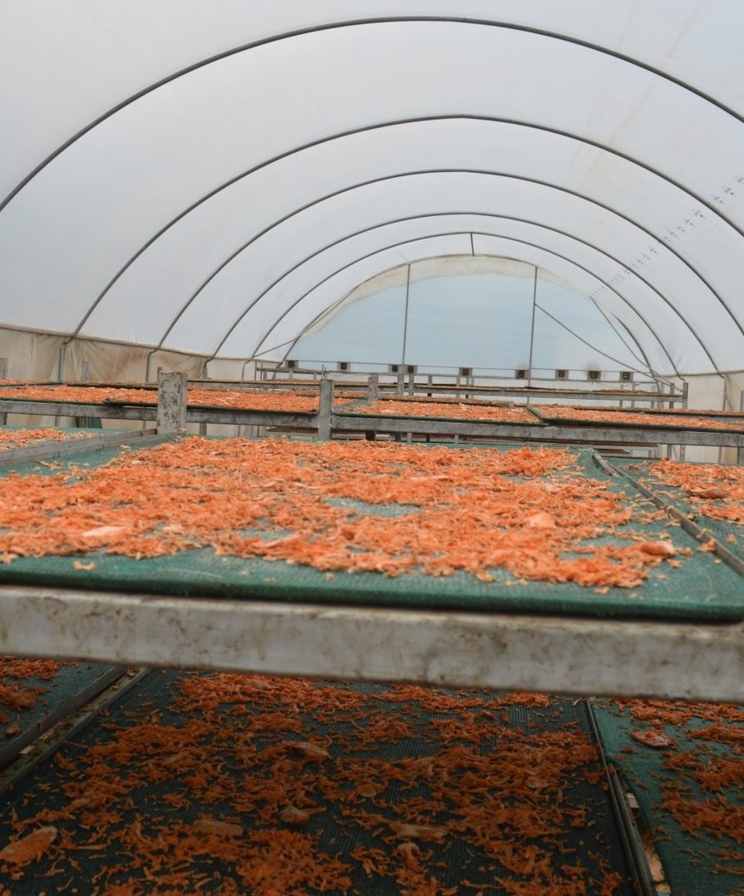
Good Drying Management
Sun-drying destroys beta-carotene, but good drying management can reduce the loss to under 35%.

Slide 55
Best Drying Practices
Steps to prevent beta-carotene loss:
  Chips or slices are regularly (every 2 hours) mixed or turned during drying
  Chip density spread on dryer is not too great (recommended 4kg/m²)
  Remove from rain and place in dry area, return to dryer when sun returns
  Remove from dryer as soon as dried to prevent over drying.

Slide 56
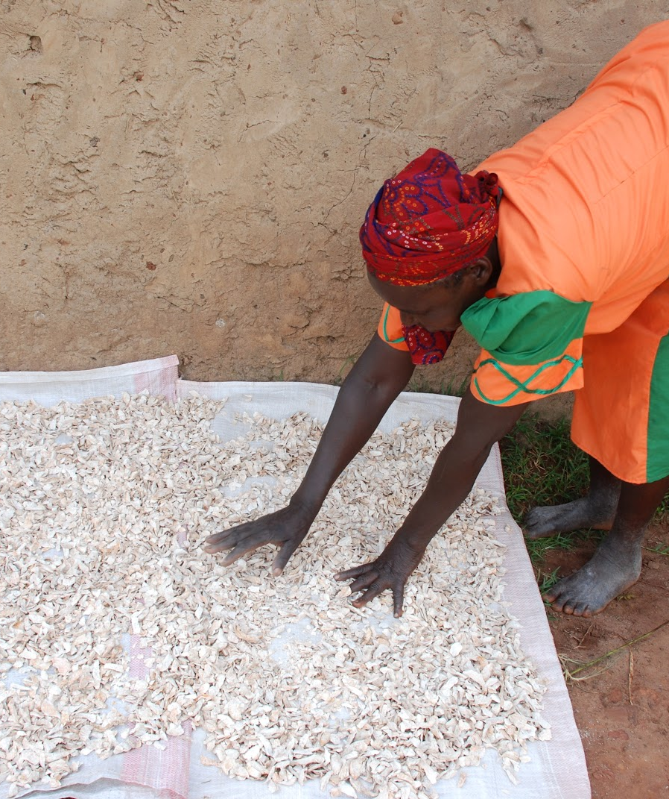
Why OFSP is Dried into Chips
Traditionally OFSP is sun-dried into small slices and stored as food stock for year-round consumption.
Occasionally sold in small amounts to local markets.
Typically rehydrated
  Used in stews
  Made into mixed cereal-root porridge

Slide 57
Processing of OFSP into Dried Chips and Flour
Commercial processing of dried sweetpotato root products in SSA is increasing. This includes flour and chips.
Steps for processing of OFSP into dried chips or flour:
  Select healthy, fresh roots
  Clean and peel roots
  Wash in clean water
  Pre-dry on clean surface in sun 10 minutes
  Cut into 5mm thick slices
  Sun-dry on raised tray
  Store chips in opaque polypropylene sacks
  If milled into flour, store in polythene container

Slide 58
Storage Techniques for Dried Chips
Dried chips should be stored at cool temperatures, as room-temperature storage long term creates extreme beta-carotene degradation.
Storage duration should not exceed 2 months
  Shorter is better for nutrient retention and limit pest damage
Containers should be kept 1m off the ground and cleaned between seasons.
Insect infestation should be prevented by:
  Parboiling, salting, and ash deter insects
  Re-sun-drying

Slide 59
What are some of the best practices for sun drying chips to prevent beta-carotene loss?
What are some of the techniques for effective storage of dried chips?
Notes:
Answers
Chips or slices are regularly (every 2 hours) mixed or turned during drying; Chip density spread on dryer is not too great (recommended 4kg/m²); Remove from rain and place in dry area, return to dryer when sun returns; Remove from dryer as soon as dried to prevent over drying.
Dried chips should be stored at cool temperatures; Storage duration should not exceed 2 months; Containers should be kept 1m off the ground and cleaned between seasons; Insect infestation should be prevented by: Parboiling, salting, and ash deter insects or Re-sun-drying

Slide 60
Key Points
Commercial processing of dried sweetpotato root products in SSA is increasing, including flour and chips.
Sun-drying destroys beta-carotene, but good drying management can reduce the loss to under 35%.
Over drying should be avoided.
Room-temperature storage in the long term creates extreme beta-carotene degradation.
Cool temperatures and opaque containers are optimal.
Dried sweetpotato root products should be consumed within about two months, for nutrient retention and to limit pest damage.

Slide 61
Key Points
Opaque polypropylene sacks are best for dried sweetpotato chip storage.
Flour should be stored in polythene.
Containers should be cleaned between seasons and kept 1m off the ground.
Parboiling, salting, and traditional additives such as ash can deter insects. Re-sun-drying can stop an insect infestation.

Slide 62
Gender and Diversity Aspects of Sweetpotato Harvesting and Post- Harvest Management
Unit 8

Slide 63
Objectives
By the end of this unit, you should be able to:
Explain gender and diversity issues in sweetpotato harvesting and post-harvest management.
Discuss sweetpotato harvesting and post-harvest roles in terms of gender and identity.
Identify issues which may bar those with lower incomes from accessing preservation technologies.

Slide 64
Understanding Gender Roles
Facilitators need to understand current and likely future harvesting and post-harvest roles played by men and women
Consult both members of community who perform harvesting and post-harvest management activities, and those who direct matters and/or control resources to:
  Ensure technologies and tools are appropriate
  Recognise any gender impacts of introductions of new technologies and knowledge
  Assess who has (and will have) access to resources

Slide 65
Why Genders Roles Matter in Harvesting
Access to preservation technologies and labour-saving devices is uneven across socio-economic groups and genders
Example:
  Pit and clamp stores require significant labour to construct and maintain
  If farmer cannot access labour due to availability or finances, these technologies couldn’t be adopted

Slide 66
Key Points
Access to preservation technologies and labour-saving devices is uneven across socio-economic groups and genders.
Facilitators should consult both with members of the community who perform harvesting and post-harvest management activities, and those who direct matters and/or control resources.

Slide 67
Storing Fresh Sweetpotato Roots
This activity is designed to be carried out in the field.
Follow the instructions from your facilitator.

Slide 68
Effect of Sun-Drying and Storage on Beta-Carotene
This activity is designed to be carried out in the field.
Follow the instructions from your facilitator.

