Slide 1
Field visits of the Africa RISING sites in Tanzania (1-12 March 2018): Observations, lessons and suggestions
Kindu Mekonnen, ILRI
ILRI Sustainable Livestock Systems Program, Monday Morning Coffee Presentation,16 April 2018

Slide 2
Objectives of the field visit
The Africa Research in Sustainable Intensification for the Next Generation (Africa RISING) project in east and southern Africa recently organized field visits in Tanzania to share experiences and strengthen collaborations across the three Africa RISING projects (Ethiopian Highlands, East and Southern Africa, and West Africa).

Slide 3
Participants of the field visiting team
Jerry Clover (USAID- Washington), Sieg Snapp (Michigan University- USA), Vara Prasad (Kansas University- USA))
Irmgard Hoeschle-Zeledon (IITA), Mateete Bekunda (IITA), Jonathan Odhong (IITA), Jovin Lwehabura (CIAT-Tanzania)
Peter Thorne (ILRI), Kindu Mekonnen (ILRI),

Slide 4
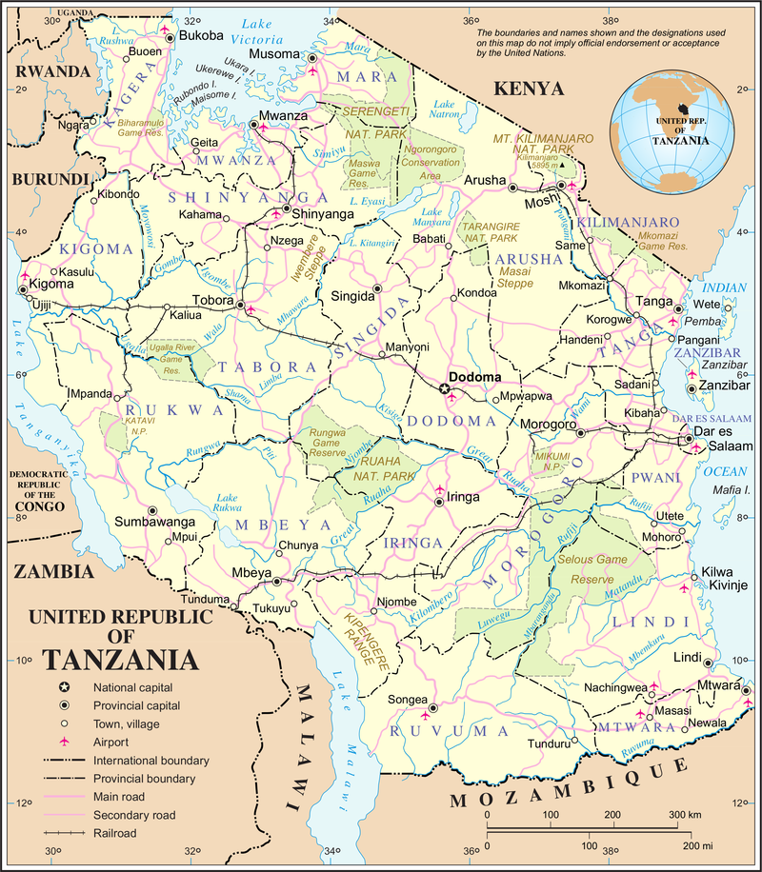
Africa RISING sites visited in Tanzania
Mbeya
Iringa
Kongwa (Dodoma)
Babati
Arusha

Slide 5
R4D and scaling activities
Livestock production interventions (forages and feed processing, poultry housing and feeding)
Mother trials demonstration sites of maize and legume cropping systems
Improved vegetables production (micro-irrigated vegetables in screen houses)
Post-harvest technologies (maize shellers, pick bags and dryers),
Nutrition interventions (food formulations for children).
Soil and water conservation practices (agroforestry, tie-ridging, ‘fanya juu/chini’ terracing)

Slide 6
Lessons learned from the field visit
Strong scaling partnerships:
Africa RISING and the Tanzania Staples Value Chains (NAFAKA) projects:
Facilitating scaling of technologies/ innovations.
Created partnerships with value chain actors such as agro-dealers, manufacturers, farmers, national and international research organizations, extension groups, NGOs and private entrepreneurs.

Slide 7
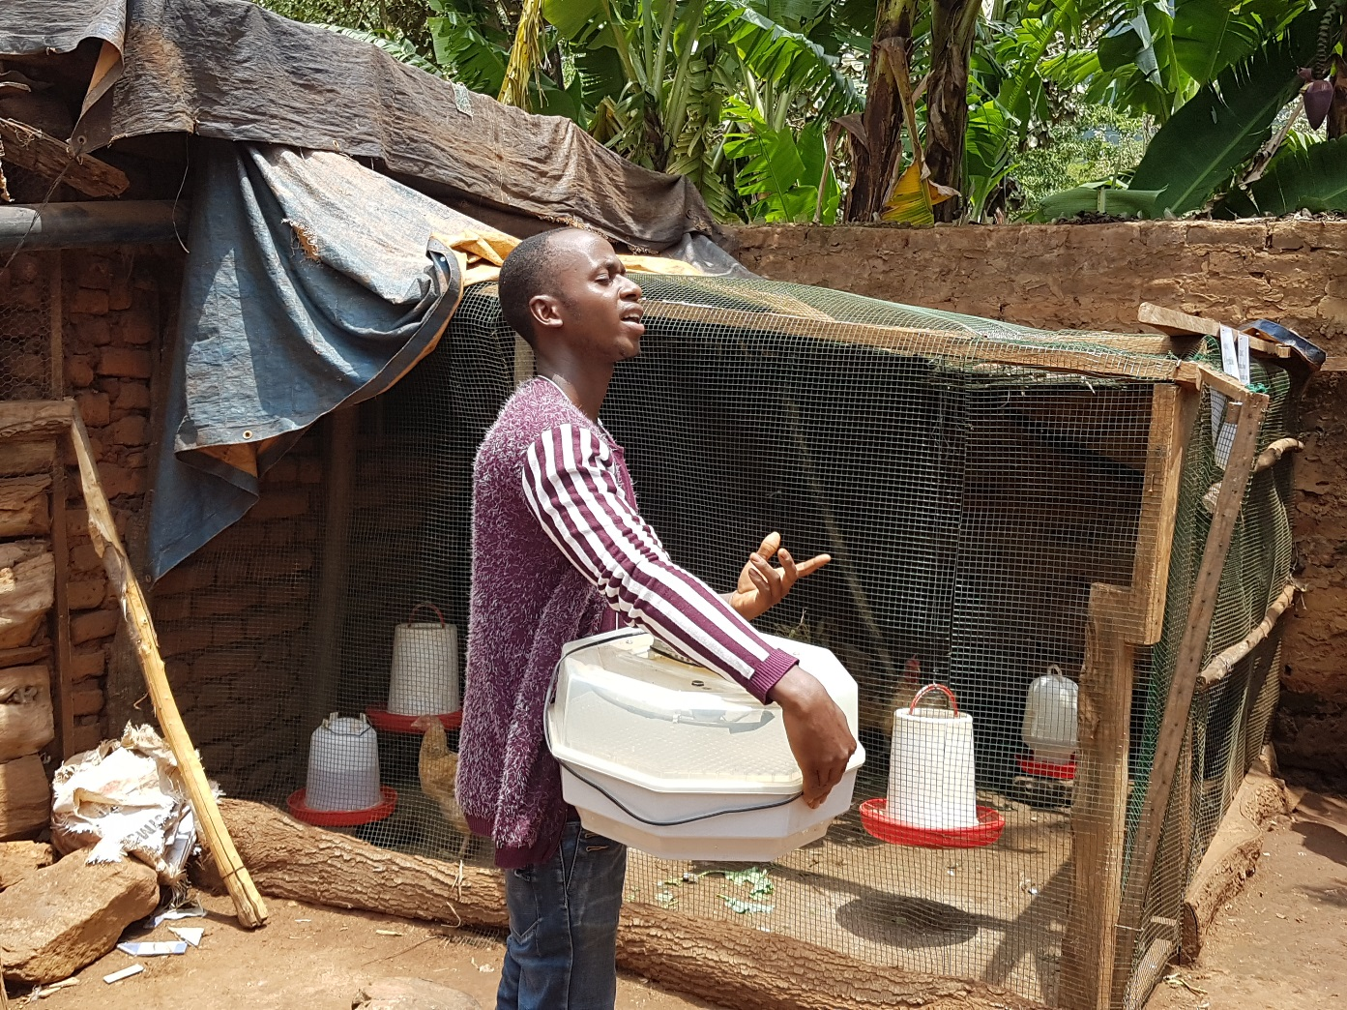
Poultry interventions helping women and youth:
More than 100 hhs in Africa RISING sites in Tanzania and many women and youth are reaping benefits from keeping poultry.

Slide 8
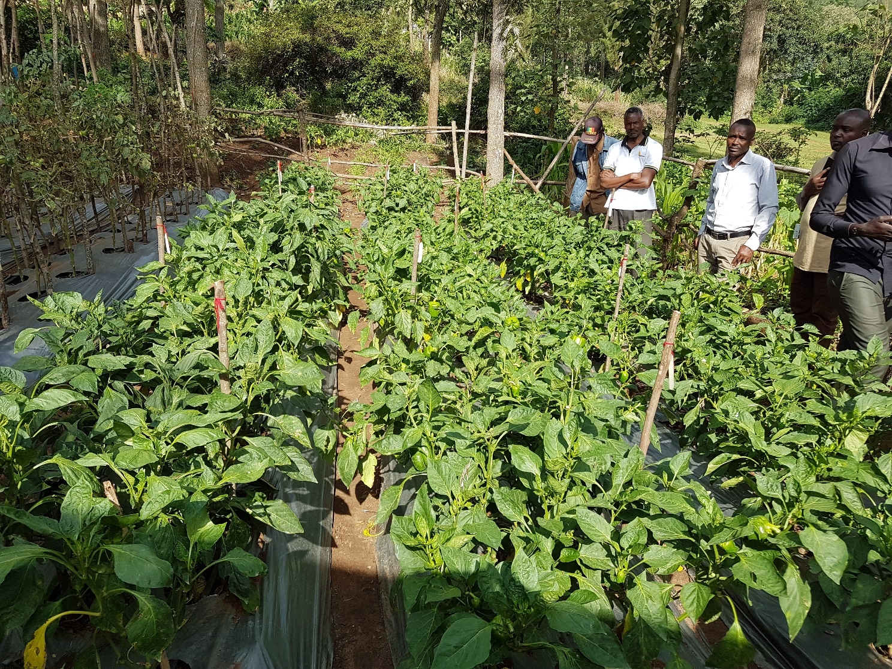
New methods of vegetable farming:
Grouping/clustering farmers to work together and linking them to markets, providing appropriate training on agronomic practices and health-related issues.

Slide 9
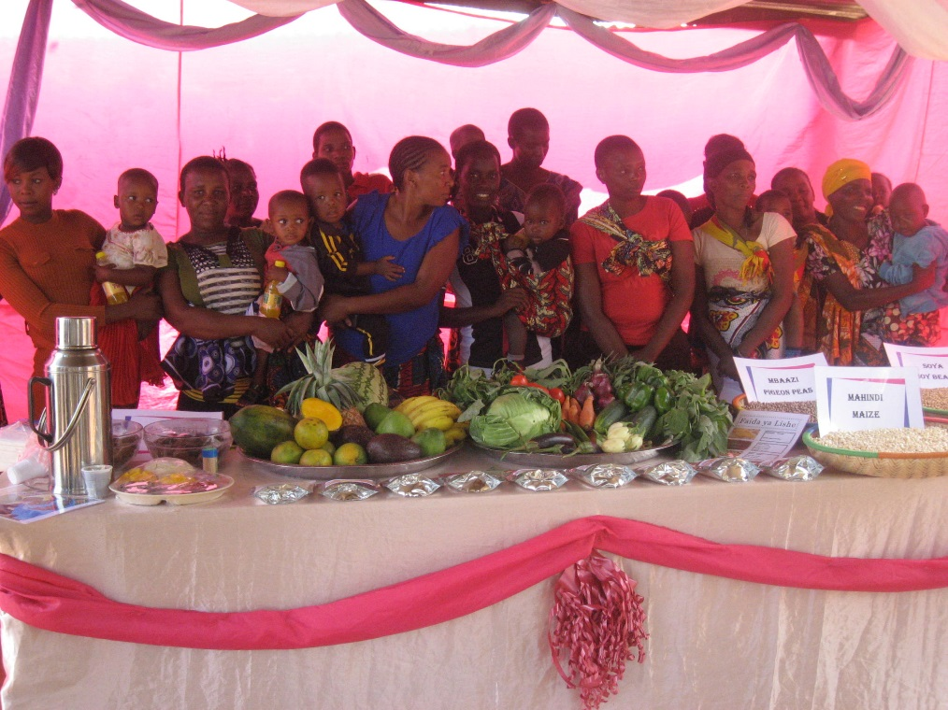
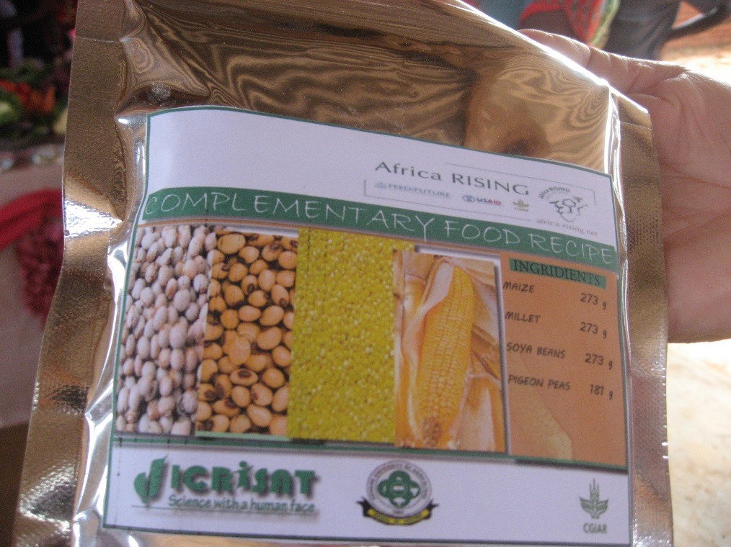
Improving household nutrition:
Nutritious food formulation has helped hhs link production with nutrition.
Mothers with children under five years received training on food safety, hygiene and nutrition.
Studies before and after feeding trials involving children.

Slide 10
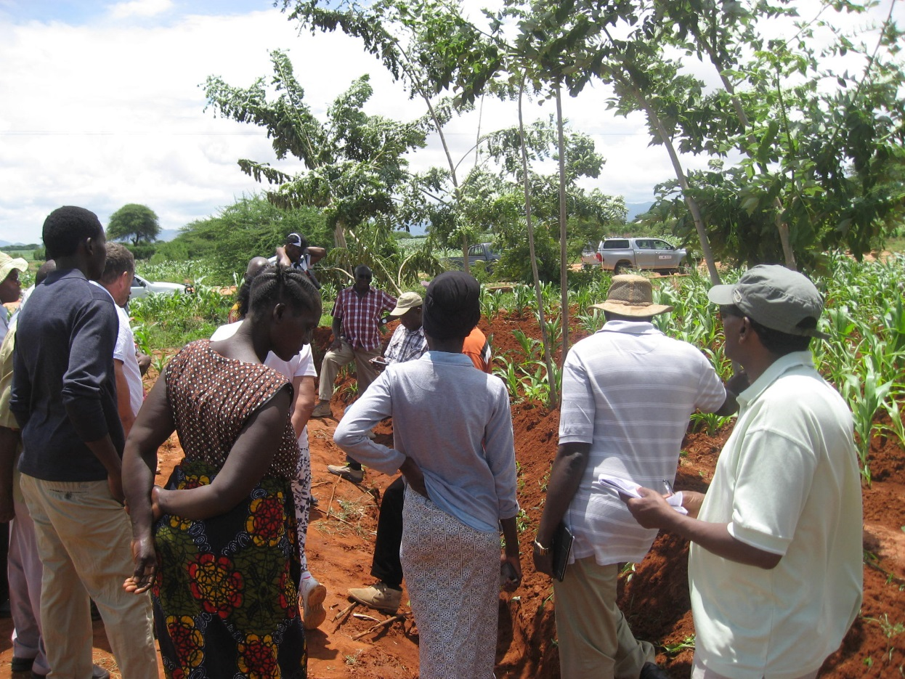
Holistic interventions:
Integrate agroforestry, poultry production and soil and water conversations (SWC) approaches.
Gliricidia sepium- planted along terraces in farms and providing services such as soil erosion control, soil fertility improvement + products such as wood for fuel, and feed for animals including chicken.

Slide 11
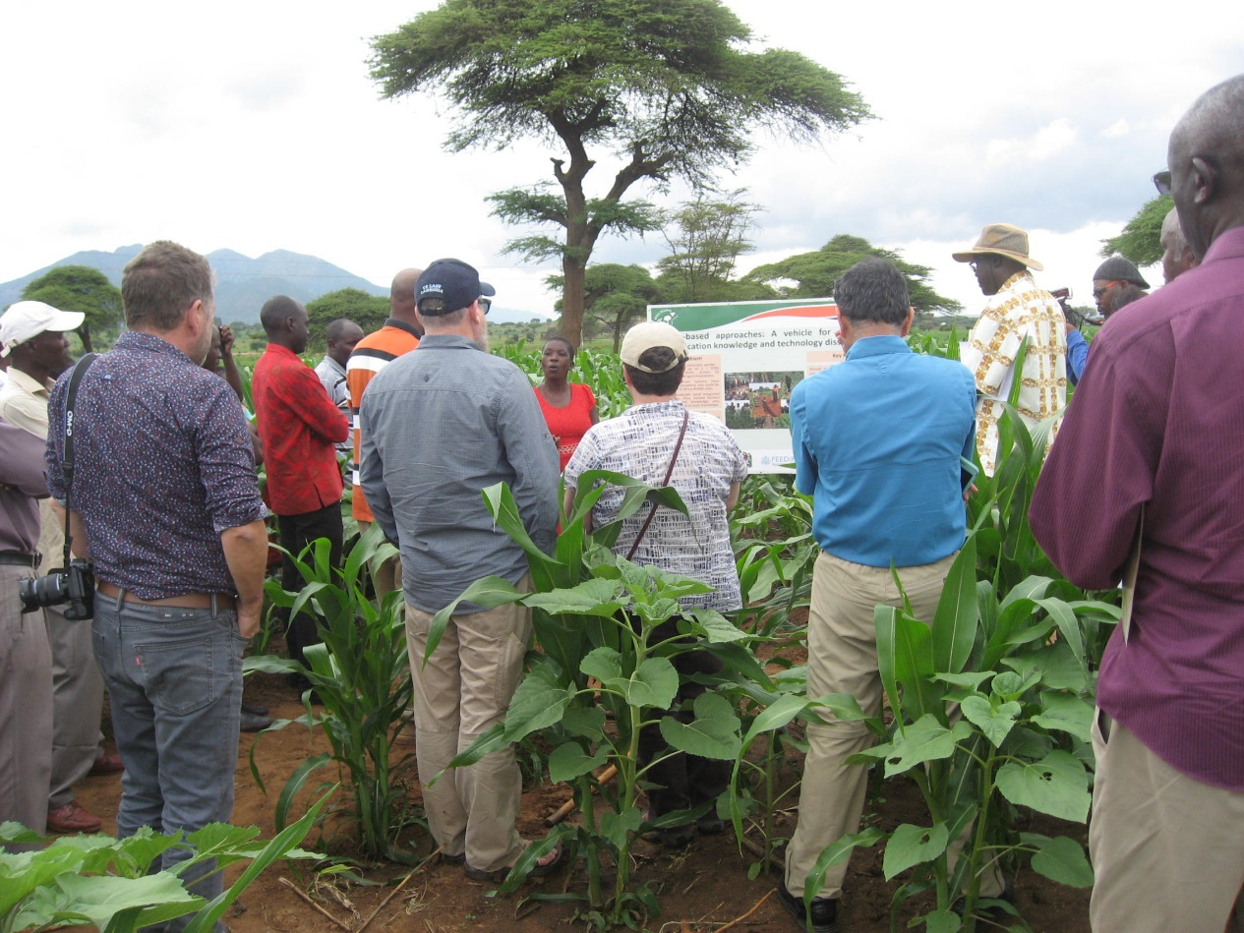
Use of multiple approaches:
Village-based agri advisers (VBAAs), creation of learning villages for scaling good agricultural practices (GAPs) to other farmers.
A farmer-based approach, where lead farmers are selected and trained together with the public extension workers, was found useful to speed up scaling of Africa RISING technologies.

Slide 12
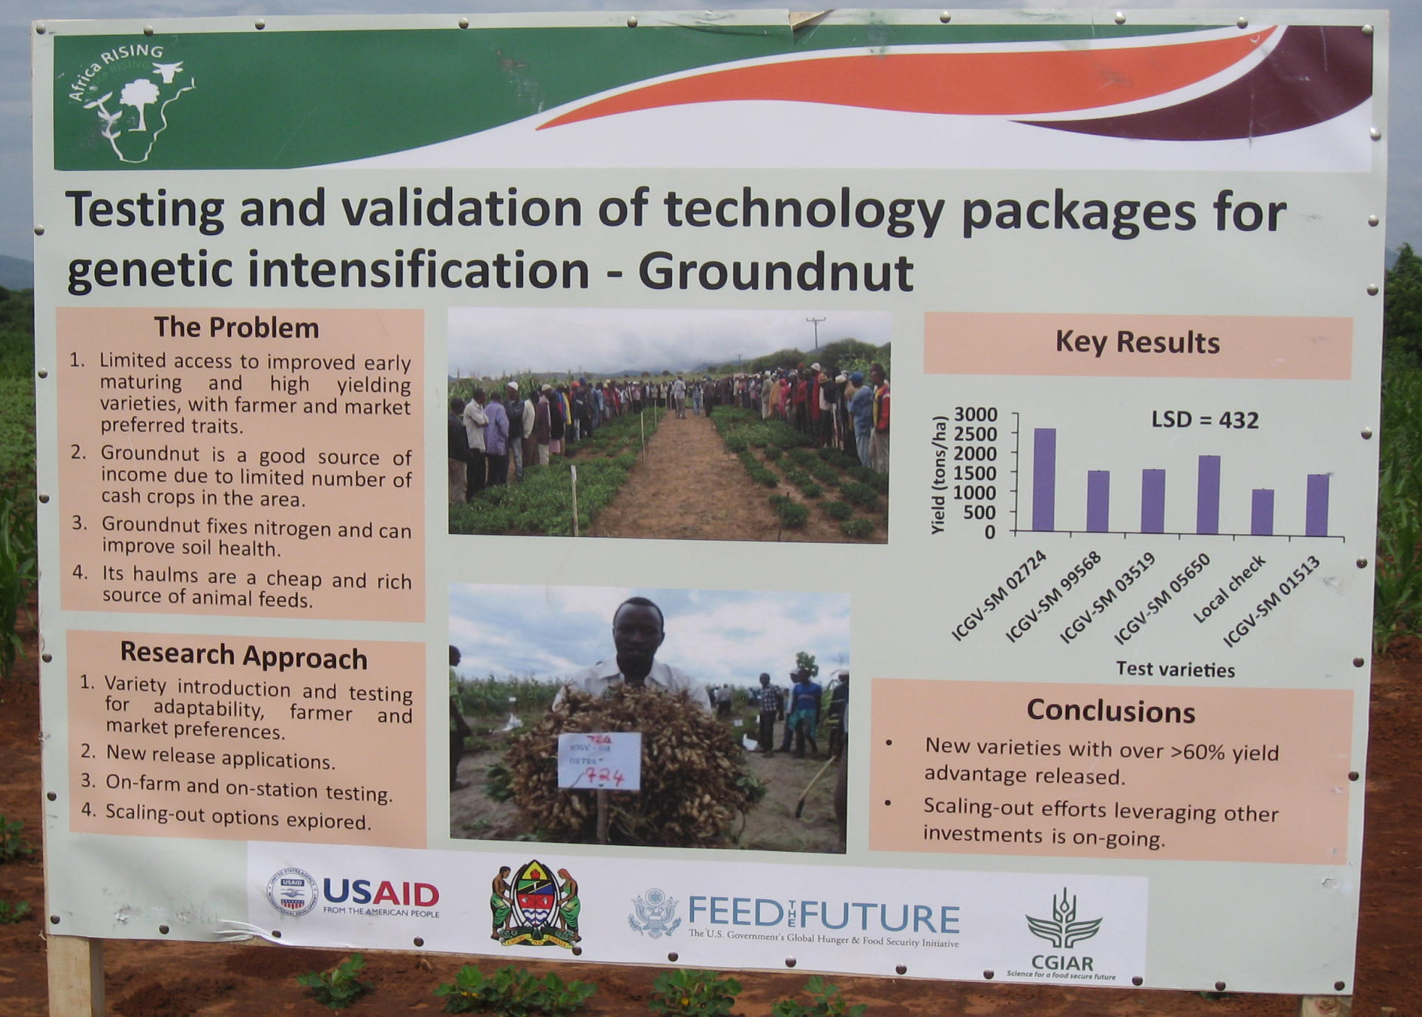
Communication and knowledge sharing:
Informative posters have been prepared to demonstrate research activities in the field.
These posters are brief and clearly show problems, research approaches, key results and conclusions.
The project staff also work with farmers to help them document their observations of the action research interventions.

Slide 13
Suggestions for addressing current challenges
Strengthening documentation:
During the field visit we observed that farmers are modifying technologies introduced by the Africa RISING project, for instance, poultry houses. Documentation of the modifications they are making is necessary because their experiences can help other chicken farmers. Taking photos of modified chicken houses and creating photo galleries could be one way of sharing these lessons with wider audiences.

Slide 14
Sharing and learning visits:
Soil erosion is a serious concern in the Kongwa and Babati project areas. Dealing with the problem requires government support at ward, district and regional levels and collective action by all agriculture sector players. Communities can also play a role in treating gullies using landscape or wide area planning approaches to halt land degradation. To this end, organizing experience sharing visits for agriculture officials, experts and influential farmers both within and beyond areas with SWC success stories, which has proved successful in Ethiopia, can help.

Slide 15
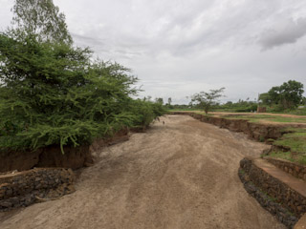
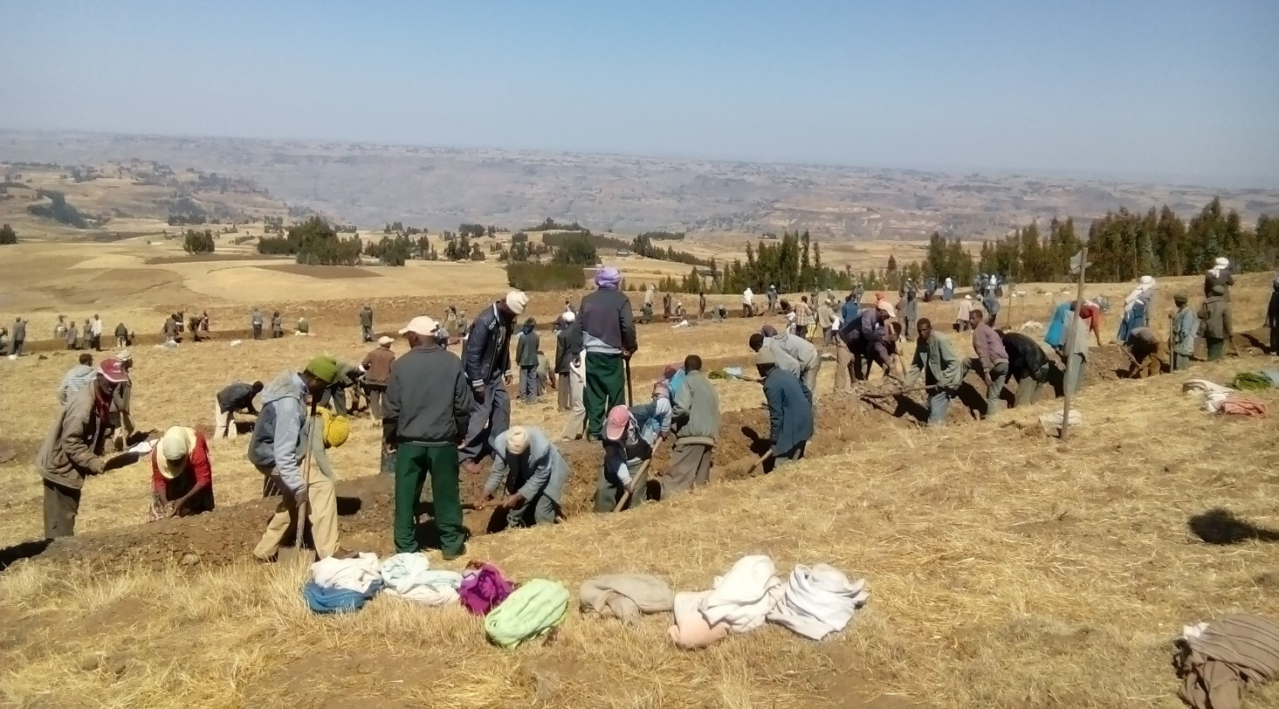
Soil erosion and gully formation in Africa RISING sites in Tanzania
Soil and water conservation with community mass mobilization in Ethiopia

Slide 16
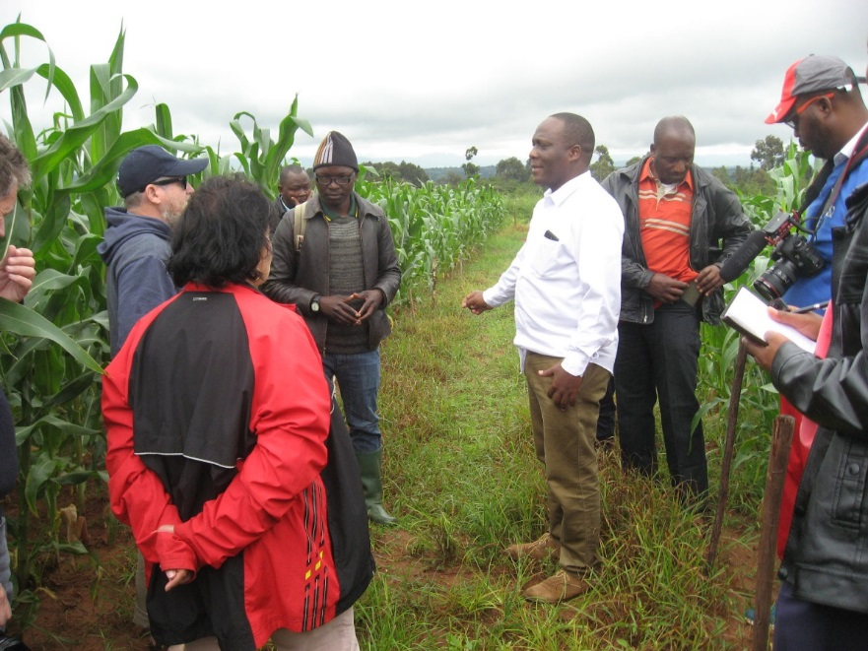
Combating soil acidity:
Liming, or the application to soil of calcium- and magnesium-rich materials in various forms, is one of the interventions implemented to combat the effects of soil acidity. However, the replicability and sustainability of this intervention depends on a precise rate of lime application, access to materials, and frequency and methods of application. Due consideration should be given to combating the soil acidity problem in Iringa.

Slide 17
Enhancing animal feeding technologies:
Farmers in different project sites use crop residues as livestock feed. But feed wastage and contamination is common. For example, the feed troughs that some farmers were using in Babati District lacked shading and were poorly constructed. In Ethiopia, however, the Africa RISING project has introduced a feeding trough technology which has been well received by farmers, which can be customized to the needs of Tanzanian farmers.

Slide 18
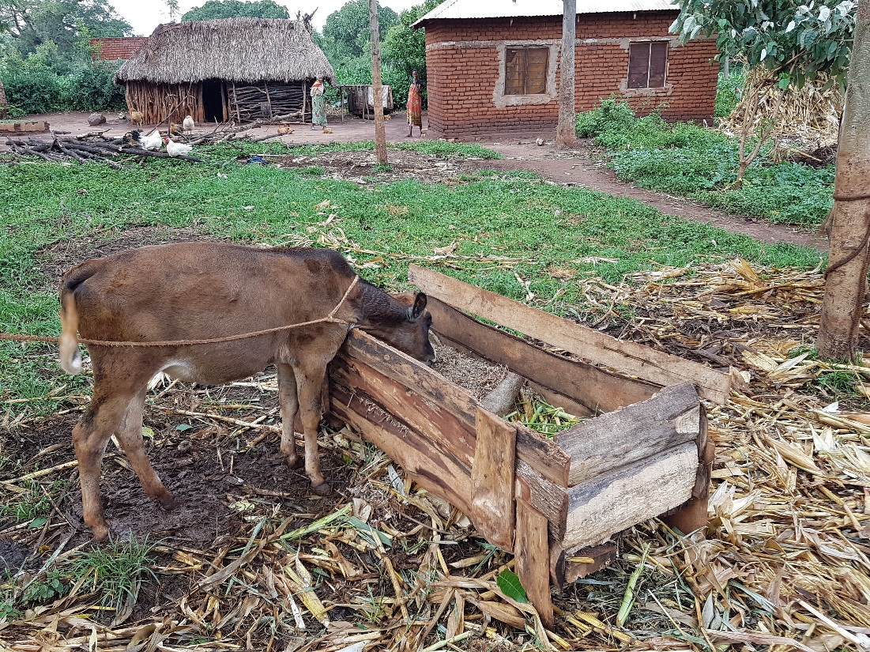
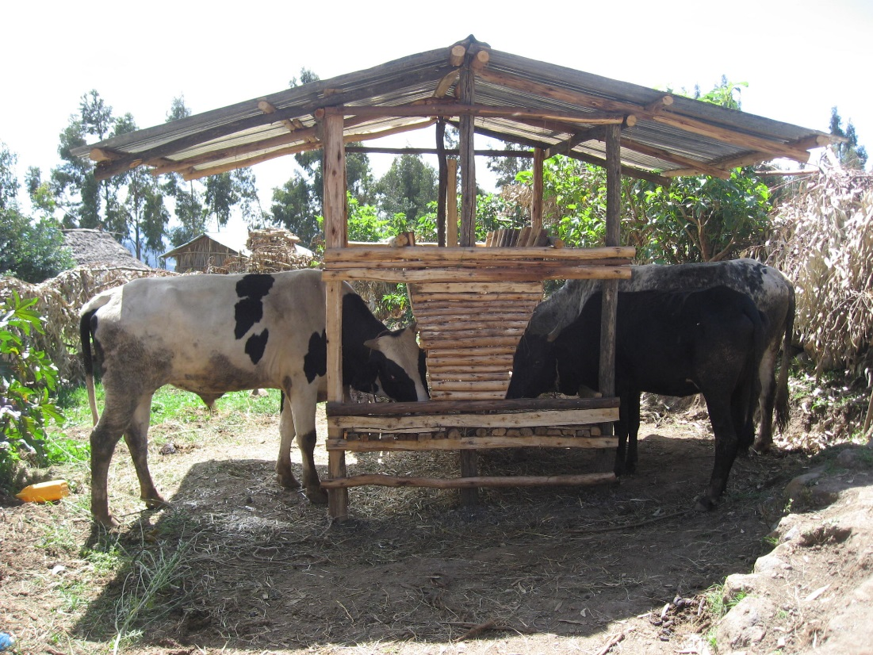
Farmers’ feeding systems in Africa RISING sites in Tanzania
In Basona in Amhara, Ethiopia, farmers use improved feed troughs to feed cattle

