Slide 1

Better food safety solutions in Africa: Understanding the complex social, economic and policy perspectives
Kebede Amenu (DVM, MSc, PhD)
Citation: Amenu, K., Alonso, S., Mutua, F., Roesel, K., Lindahl, J., Kowalcyk, B., Knight-Jones, T. and Grace D. 2022. Better food safety solutions in Africa: Understanding the complex social, economic and policy perspectives. Oral presentation at the 37th World Veterinary Congress, 29-31 March 2022, Abu Dhabi, United Arab Emirates.
Notes:
Citation: Amenu K, Alonso S, Mutua F, Roesel K, Lindahl J, Kowalcyk B, Knight – Jones T, Grace D. 2022. Better food safety solutions in Africa: Understanding the complex social, economic and policy perspectives. Oral Presentation at 37th World Veterinary Congress, 29-31 March 2022, Abu Dhabi, UAE.

Slide 2
Contents of the presentation
The continent of Africa: geography…
Global food safety situations (focus: Africa)
Complexity food systems in Africa (formal versus informal markets)
Research for actions: various case studies
Food safety investment and policy initiatives
Context specific recommended food safety solutions

Slide 3
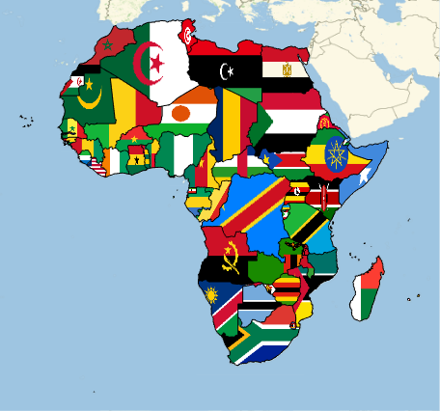
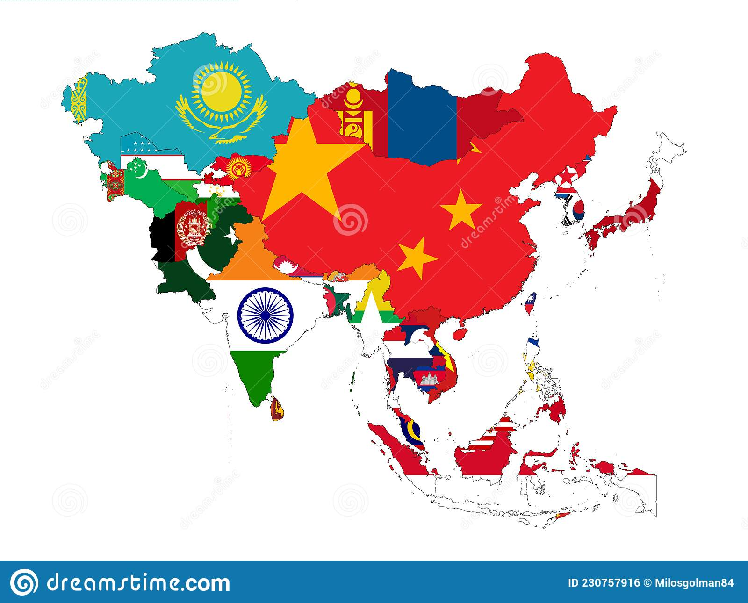
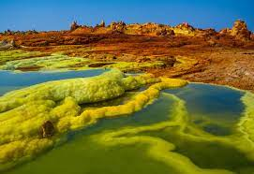
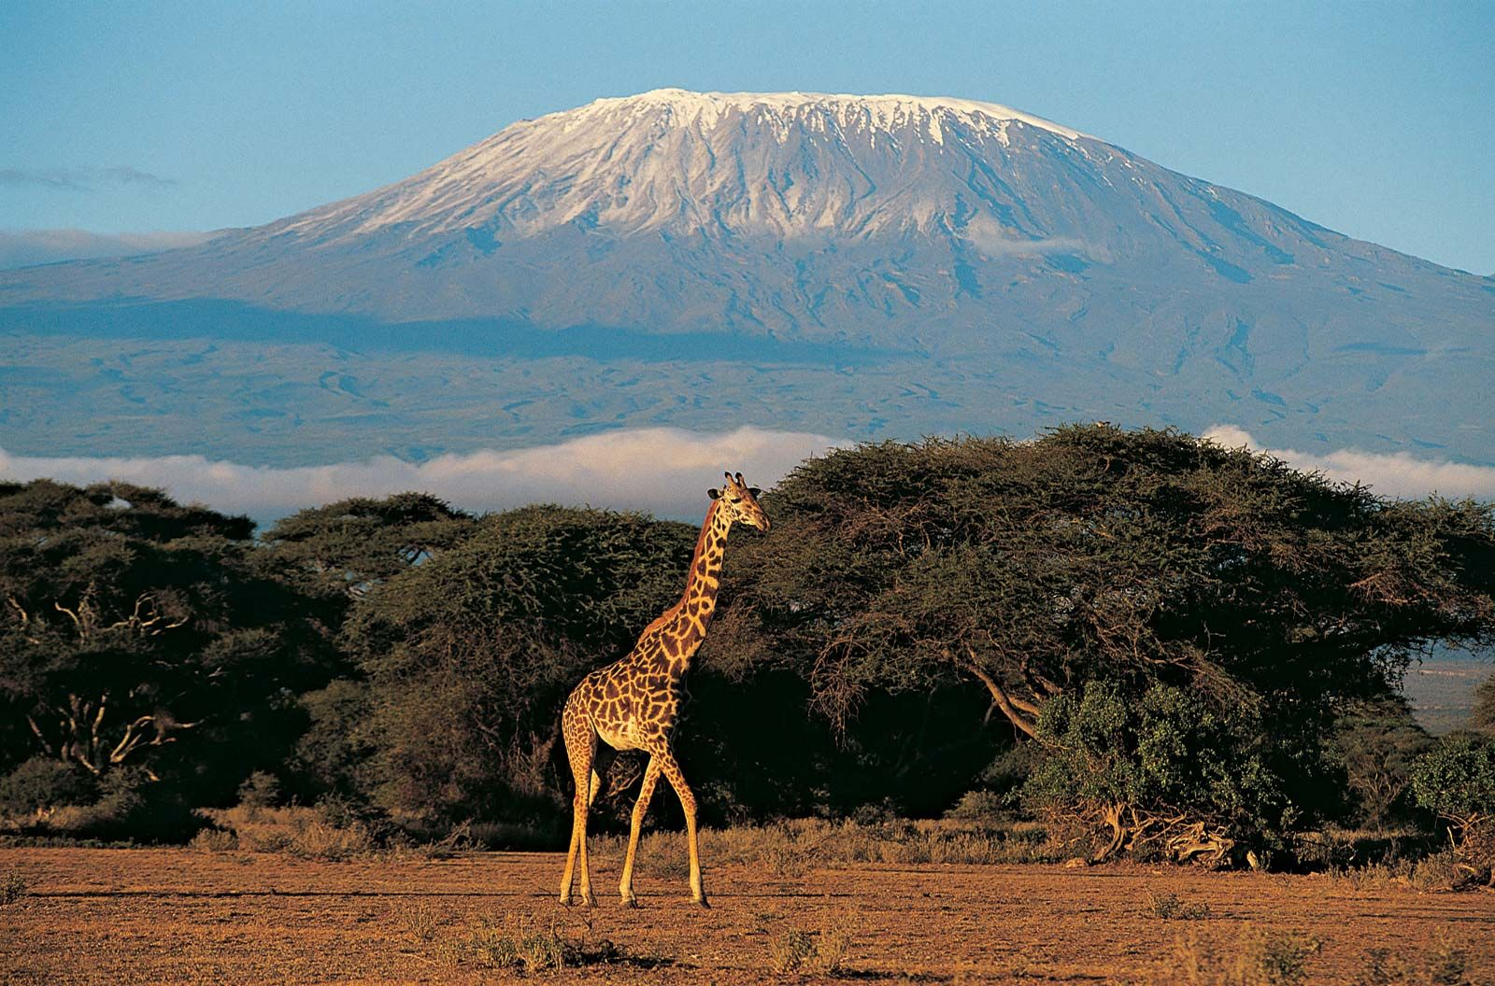
The geographic continent of Africa
The second-largest in area: 30.3 million km² (above Sahara and sub-Sahara countries)
The second-most populous: 1.3 billion (2018), 16% of the world's human population
Agro-ecologically diverse (tropical rainforest to Saharan desert)
Poverty is widespread in Africa, yet growing fast: average of 3.4% GDP
Agriculture is the mainstay of the people (2/3 employment)
Smallholders farmers are dominant of the agricultural systems (about 60%)
https://www.theatlantic.com
https://www.britannica.com/place/Kilimanjaro

Slide 4
Global foodborne disease situation
Foodborne disease (FBD) causes a massive global health burden
  1 out of 10 people get ill from contaminated food
  600 million illnesses
  420 000 deaths
  loss of 33 million healthy years of life
  The poor, with few food choices, and the young are particularly affected
source: Havelaar et al. 2015, WHO-FERG

Slide 5
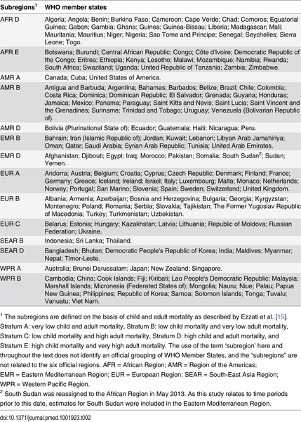
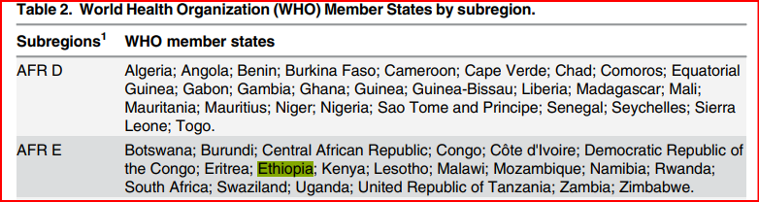
Havelaar AH, Kirk MD, Torgerson PR, Gibb HJ, Hald T, et al. (2015) World Health Organization Global Estimates and Regional Comparisons of the Burden of Foodborne Disease in 2010. PLOS Medicine 12(12): e1001923. https://doi.org/10.1371/journal.pmed.1001923
https://journals.plos.org/plosmedicine/article?id=10.1371/journal.pmed.1001923

Slide 6
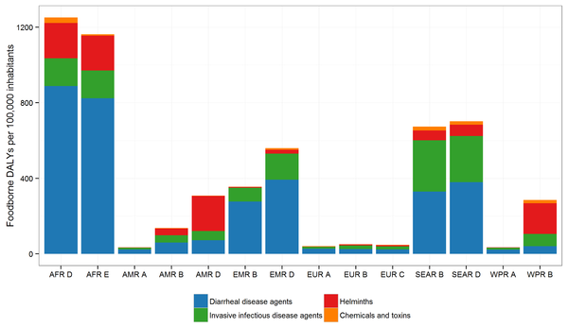
Bacteria and viruses are the most important causes (75% of burden)
About 70% of FBD in Africa is diarrheal
Chemicals about 3% of global burden
Worms about 10%
Havelaar AH, Kirk MD, Torgerson PR, Gibb HJ, Hald T, et al. (2015) World Health Organization Global Estimates and Regional Comparisons of the Burden of Foodborne Disease in 2010. PLOS Medicine 12(12): e1001923. https://doi.org/10.1371/journal.pmed.1001923
https://journals.plos.org/plosmedicine/article?id=10.1371/journal.pmed.1001923

Slide 7
FBD burden in Africa
135 million cases of FBD a year (rate 20% above global average)
140,000 deaths/year) ➔ 2.5 times global average
Cost from lost productivity due to FBD = US$17billion/year for Africa
Cost of treatment US$3.5 billion/year for Africa

Slide 8
Misconceptions around relative causes of FBD
Consumers tend to be very concerned about chemicals in food
Often less concerned about foodborne disease caused by germs, such as bacteria and viruses
Aflatoxins - Often present in food and milk – but at low levels
Risk of disease from milk is low compared with nutritional benefits of drinking milk massively can outweigh aflatoxin risk

Slide 9
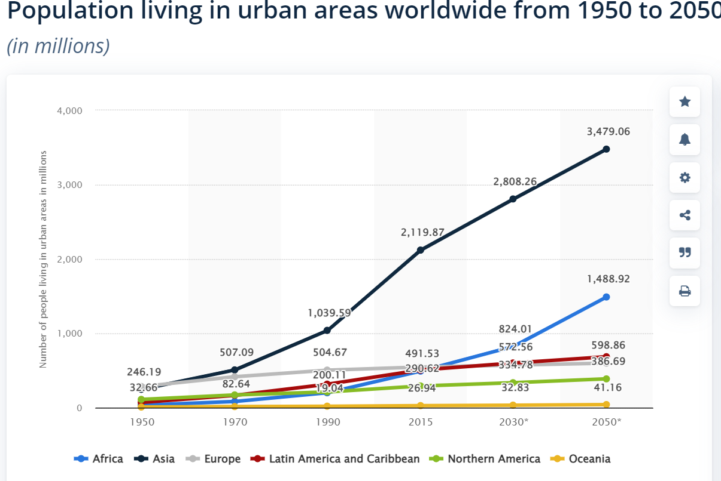
African food systems and challenges
Rapid population growth, urbanization and rising incomes
Gradual changes from traditional to modern (formal) systems along continuum of food value chains, mixed food markets; still informal systems dominant
  Increasing demand for vegetables, livestock based and processed foods = riskiest from a food safety perspective!
https://www.statista.com/statistics/270860/urbanization-by-continent/

Slide 10
Diverse food supply chains
Relative formality
Totally informal
Home grown production
Semi-informal
Micro-retailers
Unofficial markets
Intermediate
Stores
Official markets
Formal
Supermarkets
Grocery chain stores
https://openknowledge.worldbank.org/bitstream/handle/10986/34919/9781464815881.pdf

Slide 11
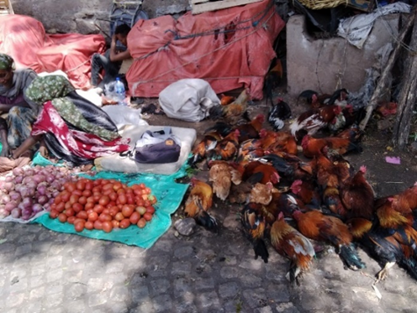
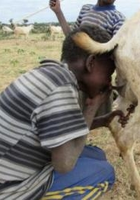
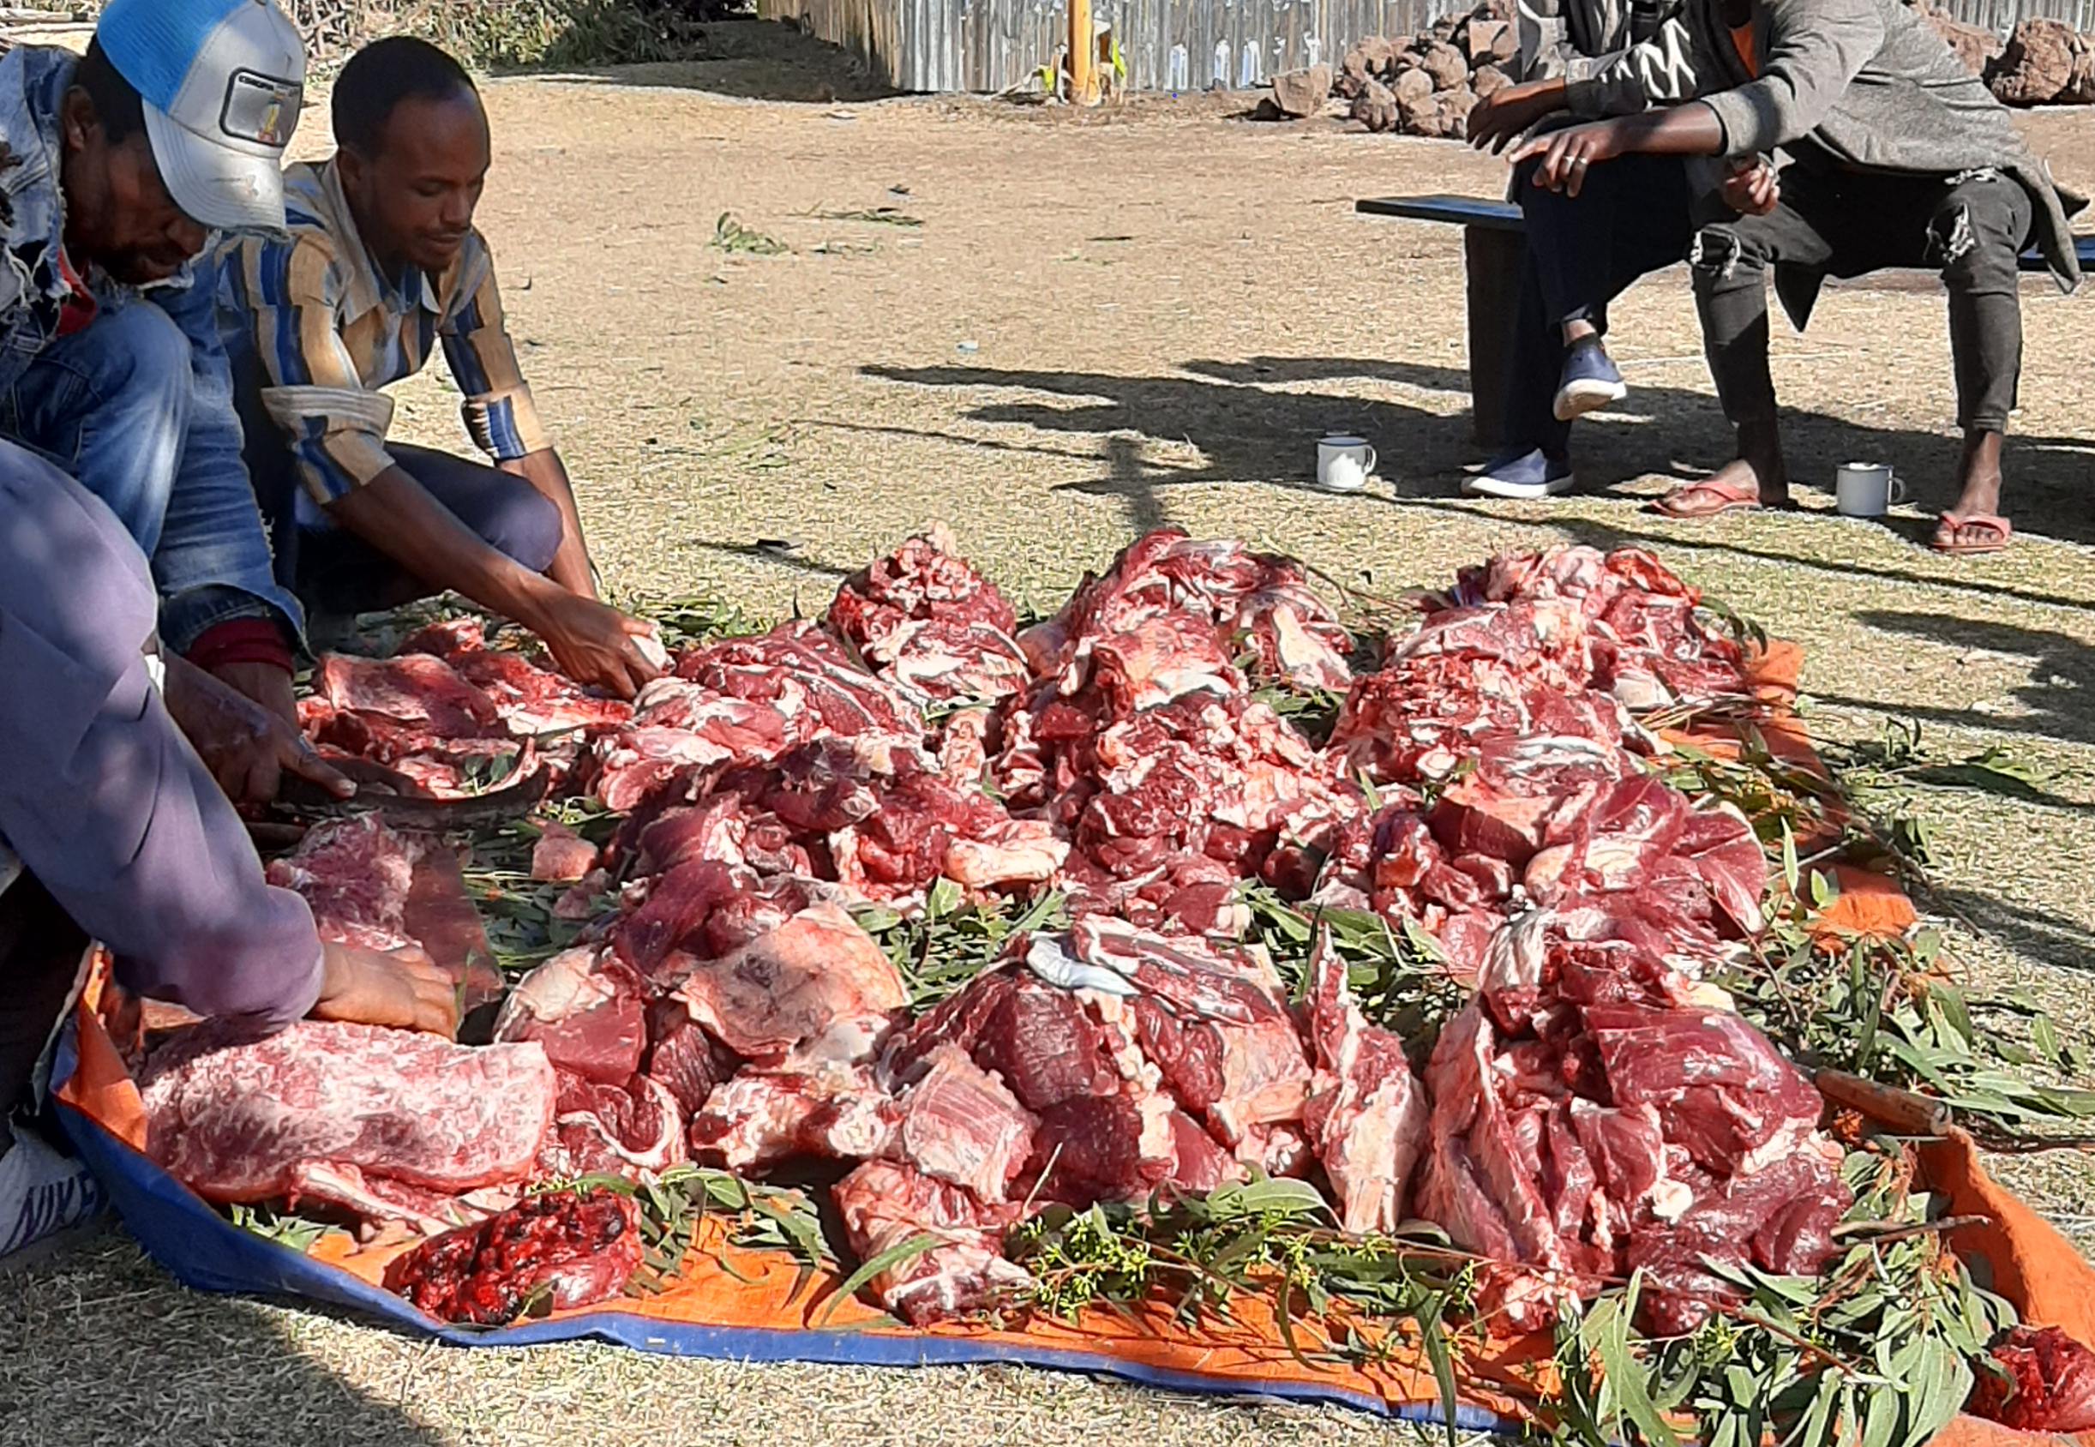
Diverse food supply chains
In informal supply chains are often simple, sometimes short supplying local food, but have limited food safety controls, regulation and monitoring

Slide 12
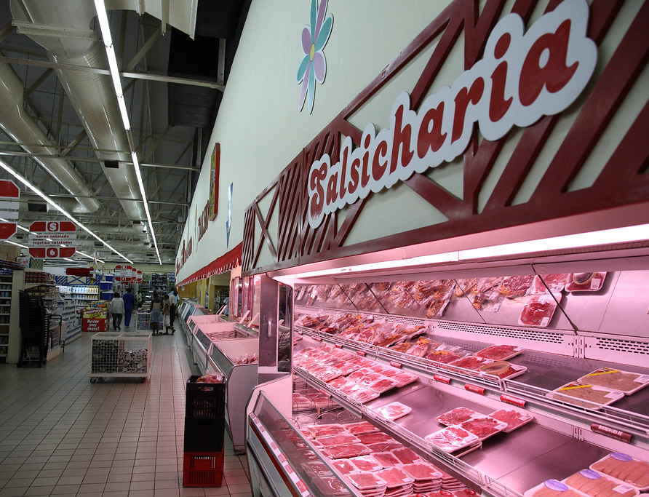
Diverse food supply chains…
A formal system with long, complex but highly regulated and audited supply chains with standards driven by enforcement and more importantly consumer demand
The formal system is not a guarantee to make foods safe (i.e., foods handled through the formal sector are not necessarily safer)
  long complex supply chain with many different suppliers, actors with greater dependency on infrastructure and technology➔ high chance of system failure
Credit: ILRI/Stevie Mann

Slide 13
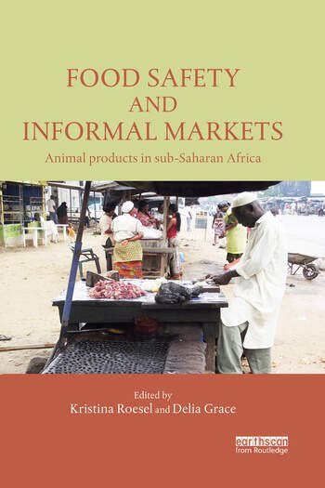
Informal food markets
Traditional markets sell more than 85% of the food consumed in sub-Saharan Africa
The informal food systems play significant roles for food and nutritional security
The informal market is non-transparent (e.g., no food labels, no standards, not law enforcements)
The food handling environment is unhygienic
Apart from this the system is growing
https://cgspace.cgiar.org/handle/10568/42438

Slide 14
On the other hand…
Informal markets are important for food and job security.
Informal markets are not necessarily dangerous and formal markets are not necessarily safe.
Hazards do not always translate into risks.
Participation can improve food safety.
Farmers, traders and retailers are risk managers.
Understanding values and culture is crucial for food safety management.

Slide 15
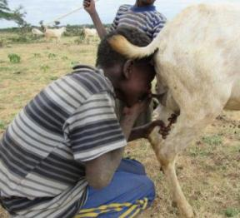
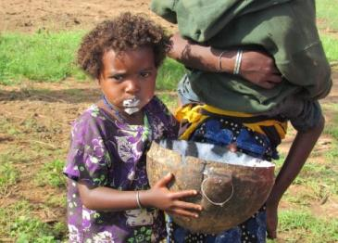
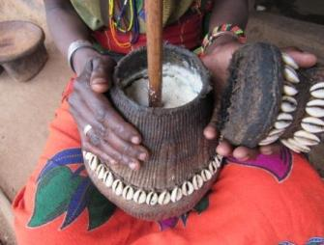
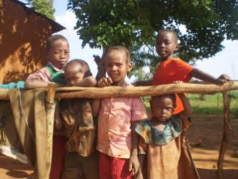
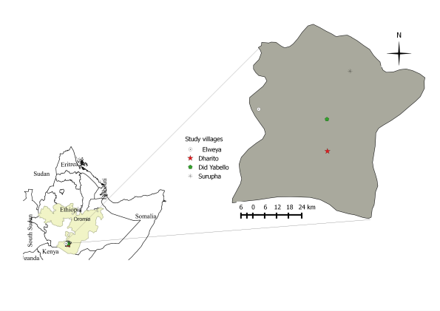
Dairy hygiene study
J. Lindhal
Safety of Traditional Dairy Products in Africa

Slide 16
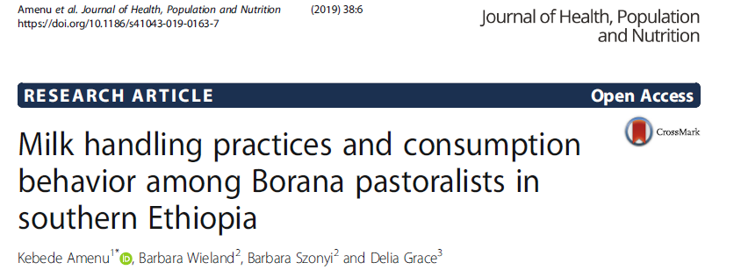
Risky milk consumption

Slide 17
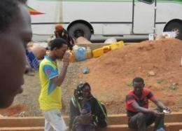
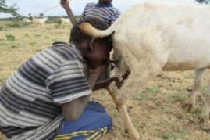
Risky milk consumption…
High raw milk consumption:
-the perception that “boiling of milk destroys vitamins”,
-“boiled milk is considered dead” ➔boiling of milk reduces the nutritional quality of milk
Children consume fresh goat milk during herding directly from udder (luugoo)

Slide 18
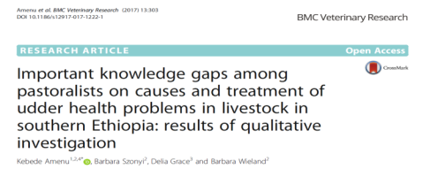
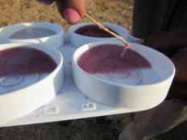
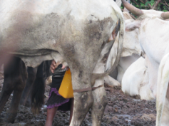
Little understanding of mastitis in dairy animals
Widespread misperception among the pastoral people about causes of acute mastitis as ‘evil eye’
Traditional treatment for mastitis for evil eye was often administered through nostril and follow magical practices
  Poor welfare of the animals
  Continuing mastitis problems

Slide 19
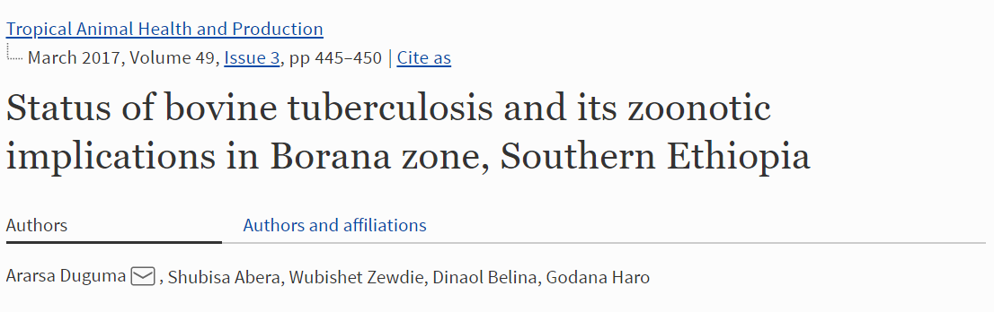
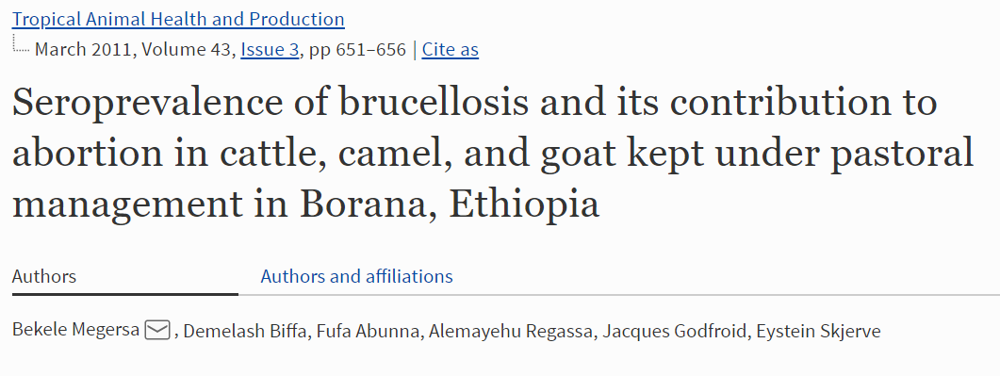
(Potential) health risk of raw milk?
Prev=3.8%
  Endemic zoonoses BTB and Brucellosis
Cattle= 10.6% , camel =2.2% , goats= 1.9%

Slide 20
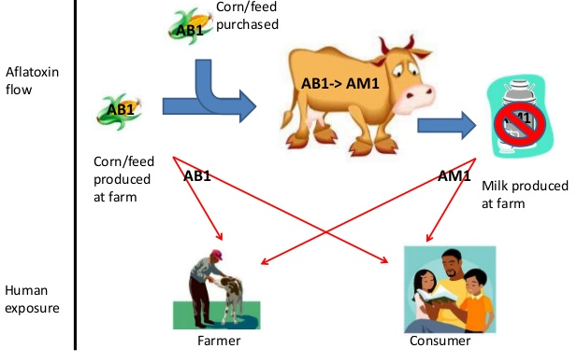
Chemical hazards
Aflatoxin
Different kinds
  Invisible
  Odorless
  Tasteless
  Heat stable
  Credit: Johanna Lindahl

Slide 21
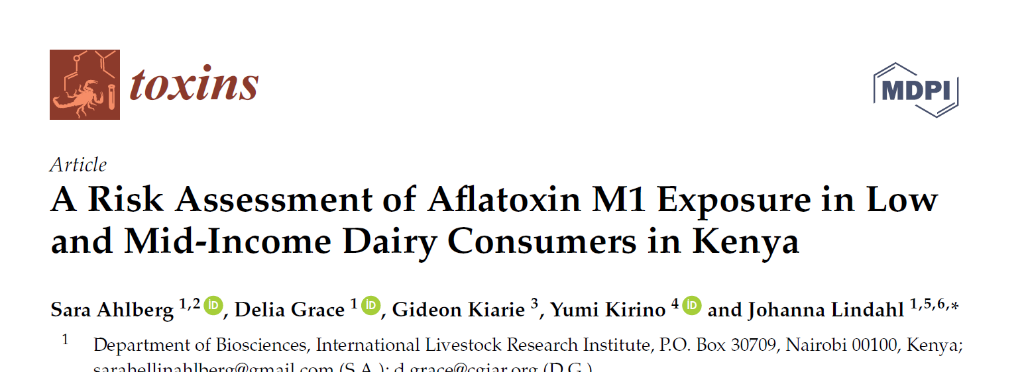
Aflatoxin risk, Evidences?
Uncertainty around the evidences?
Stunting attributed to consumption of milk contaminated with AFM₁:
  2.1% middle-income families
  2.4% in low-income families

Slide 22
Food safety policy
Food safety has been neglected from policy agenda: Misconception about food security and food safety
Food security is a condition under which “all people, at all times, have physical, social, and economic access to sufficient, safe, and nutritious food that meets their food preferences and dietary needs for an active and healthy life”, according to the Committee on World Food Security
Four main elements of food security are the availability, stability, utilization and access

Slide 23
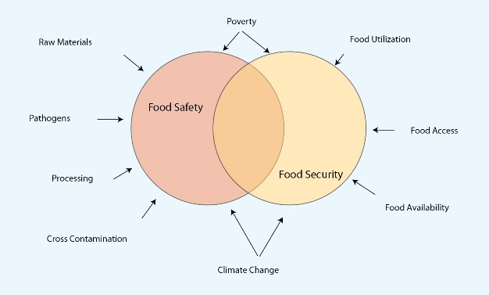
Hanning, I. B., O'Bryan, C. A., Crandall, P. G. & Ricke, S. C. (2012) Food Safety and Food Security. Nature Education Knowledge 3(10):9

Slide 24
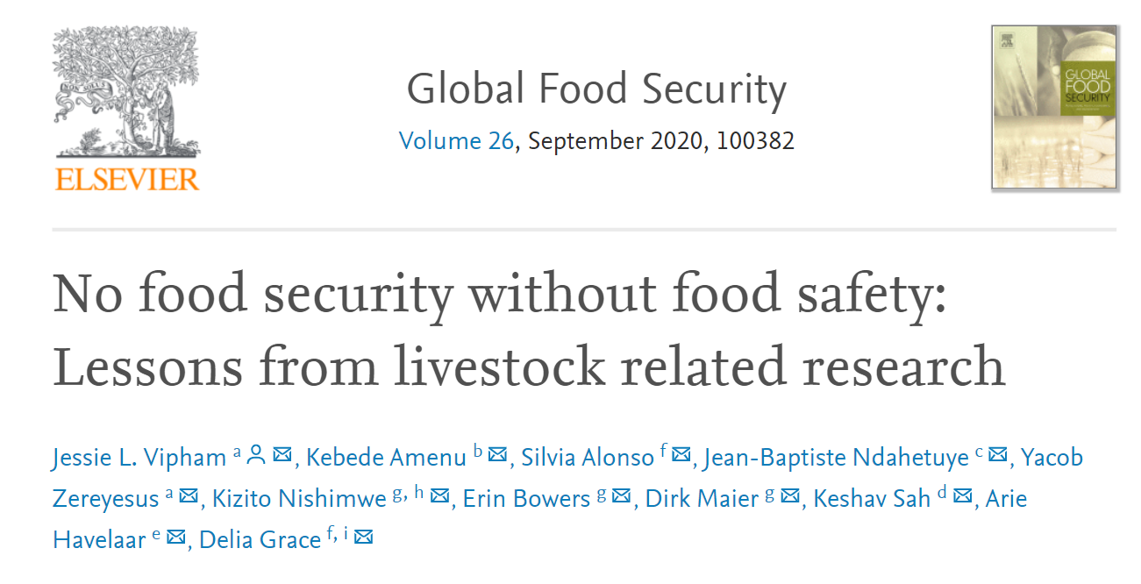
  CANNOT HAVE FOOD SECURITY WITHOUT FOOD SAFETY
  If It Isn’t Safe, It Isn’t Food”, “twin threats”

Slide 25
Summary of food safety situations in Africa
High prevalence of foodborne illnesses, especially contributing to gastrointestinal illness, though surveillance is not well coordinated with potential underreporting
Preference of the community for raw animal source foods/raw milk and raw beef consumption/
Change in food production systems, towards intensification and unplanned urbanization
Outdated laws with high irregularity in the implementation
The domestic food market is dominated by informal settings: dilemma in regulating the informal sector, related to food security
Predominance of food fraud/adulteration/
Lack of awareness for standards and quality
Unreliable infrastructure, most of food establishments start in the form of cottage industry
Limited coordination among national and international organizations dealing or supporting food safety initiatives, for example lack of donors coordination in food safety

Slide 26
Food Safety Interventions
(Integrated approaches)

Slide 27
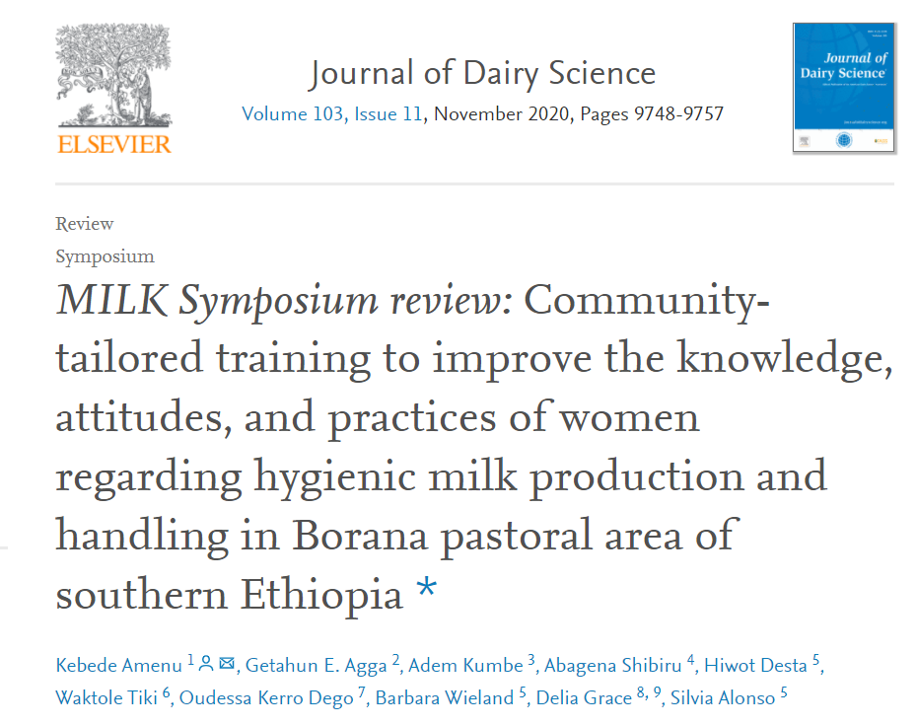
Women training on milk hygiene

Slide 28
Training intervention…
The intervention improved knowledge, attitudes and practices on milk hygiene compared to the baseline.
The intervention improved:
adoption of correct practices and having the appropriate attitudes by a lesser amount than anticipated
several participants still continued to have negative attitudes and wrong practices after the training

Slide 29
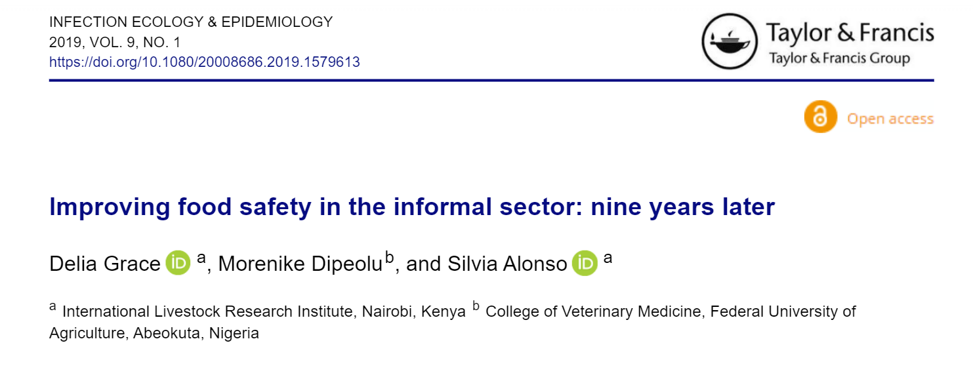
Food safety intervention studies

Slide 30
Role of consumers to make food safe
WHO five-keys
  Keep clean (food, hands, environment)
  Separate raw and cooked
  COOK THOROUGHLY (= can kill almost all germs)
  Store appropriately (at safe temperature)
  Use safe water and raw materials
What if cannot afford quality foods or no refrigeration
  Consume food quickly without extended storage
  Minimize handling
  Cook thoroughly
  Grow your own food

Slide 31
Improve the supply of safe food: Integrated approach
Provide incentives
Making safer food is more expensive and this needs to be covered by developing market incentives for the food sector invest in food safety
with knowledge will more consumers pay for safer food
will this lead to self-regulation as happens in most high-income food sectors
Enabling environment
Regulators support producers and traders to improve standards without shutting down vital supply chains and livelihoods
Increase capacity
Of those in the food sector to supply safe food – knowledge and improved infrastructure is key

Slide 32
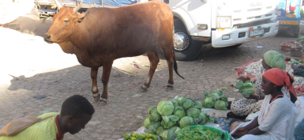
Urban Food Markets in Africa Incentivizing food safety: the Pull-Push-Project

Slide 33
Pull-push approach:
Key innovation
Reduced burden FBD, professionalizing informal sector, appropriate governance
Pull approach (demand for safe food)
Push approach (supply of safe food)
ENABLING
ENVIRONMENT
Consumers recognize & demand safer food
VC actors respond to demand & incentives
Consumer campaign for empowered consumers (Primary Outcome 3)
Build capacity & motivation of regulators
(Primary Outcome 1)
Inform, monitor & legitimize VC actors
(Primary Outcome 2)
Gather baseline information for detailed intervention planning and advocacy

Slide 34
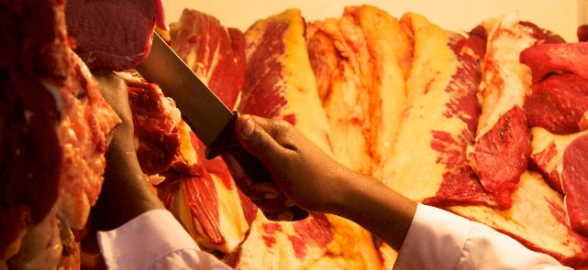
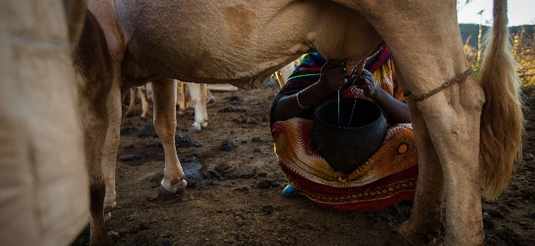
The assessment and management of risk from non-typhoidal salmonella, diarrheagenic Escherichia coli and campylobacter in raw beef and dairy in Ethiopia (TARTARE)

Slide 35
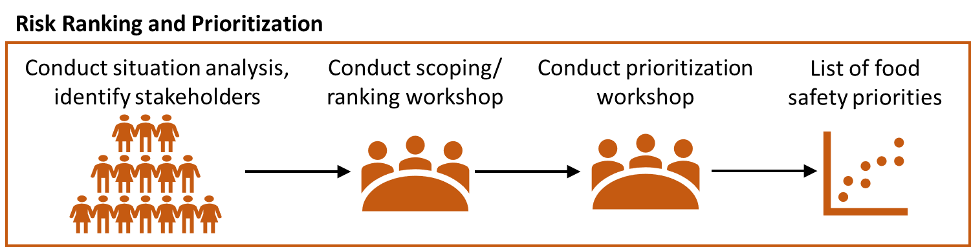


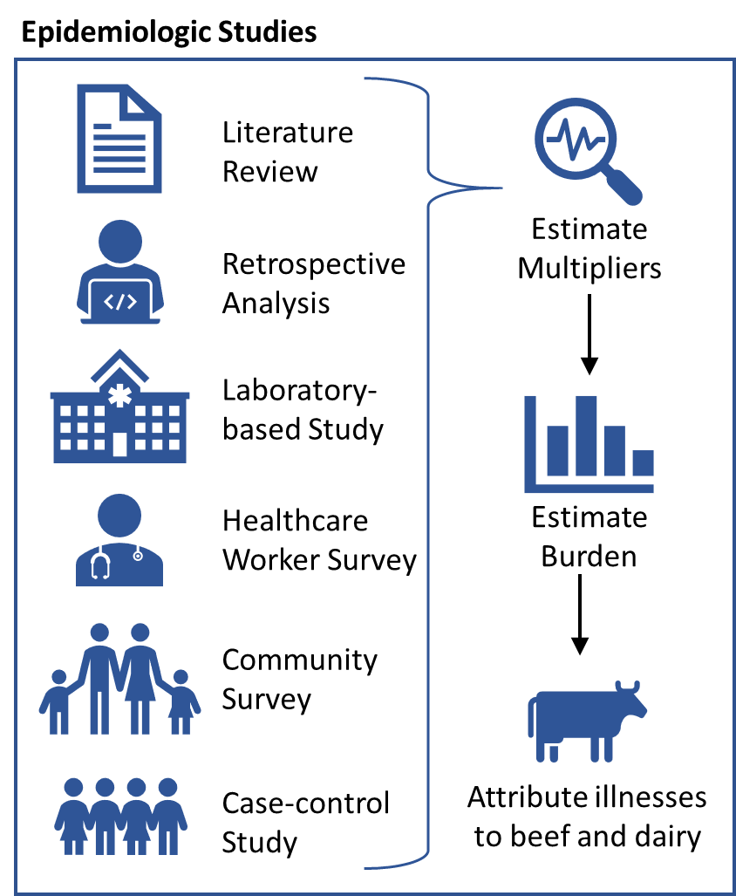
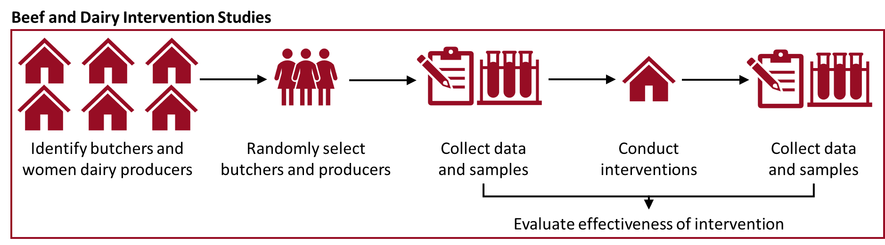
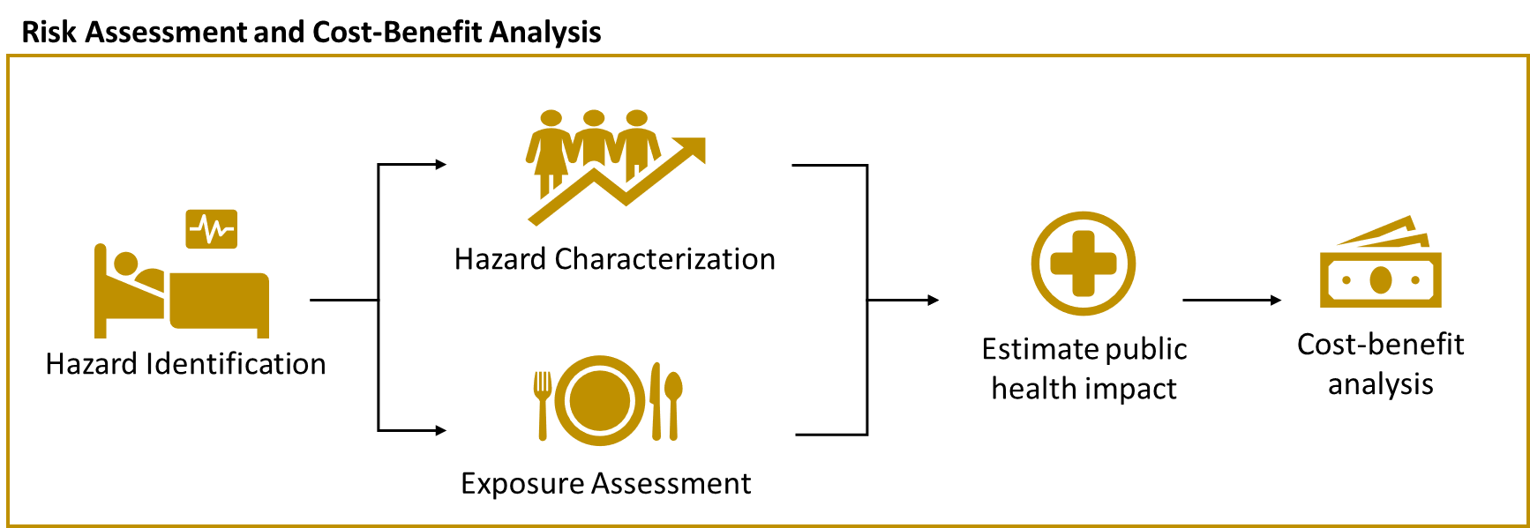
Inform
risk-based decision making

Slide 36
Summary of Interventions
Interventions successful in short term
Long term, wide-reaching impacts likely require:
Training & technology
Incentives
Enabling environment

Slide 37
African level food safety policy, strategy and advocacy

Slide 38
African Food safety Index (AFSI)
Food safety systems index (FSSI)
Food safety health index (FSHI)
Legal framework
Surveillance programs
Laboratory infrastructure
Foodborne diarrheal disease
FBD-related child death
Prevalence aflatoxin-related liver cancer
Export rejections (foodborne hazards)
Food safety trade index (FSTI)
AFSI

Slide 39
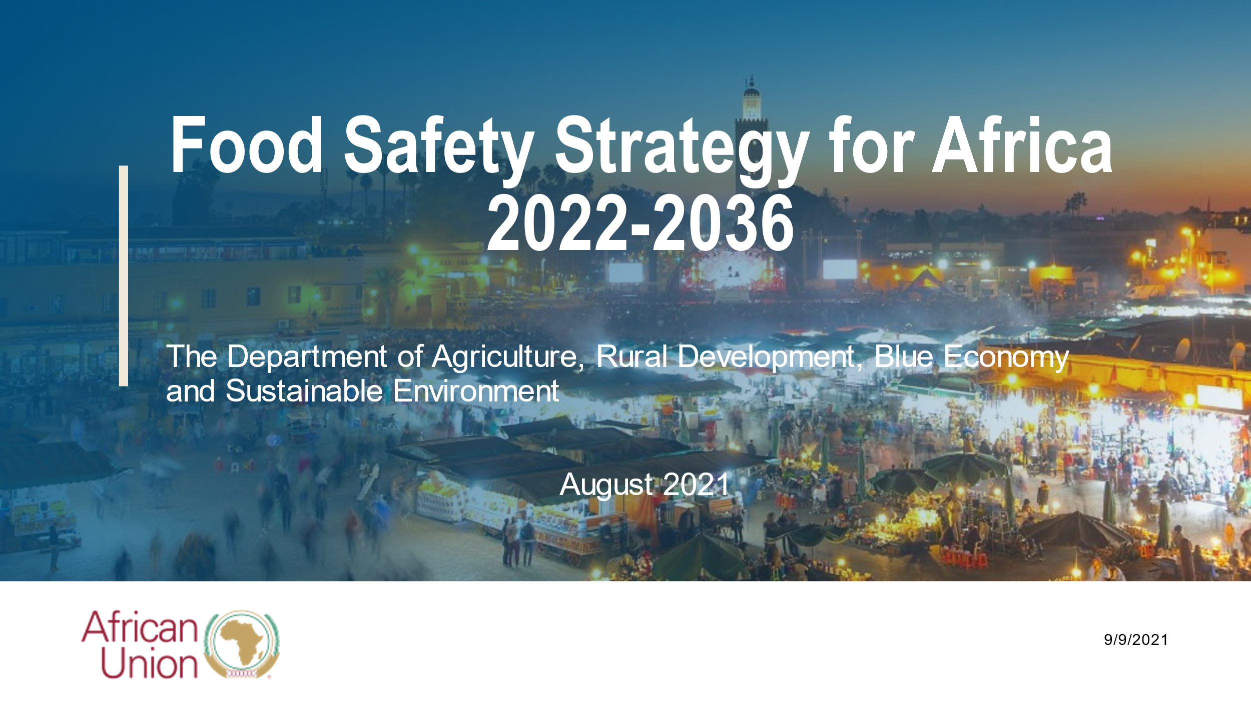

Slide 40
Conference of African Continental Association of Food Protection

Slide 41
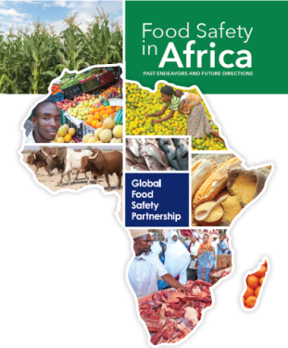
Food safety investment
Size of investment does not match food safety burden
Most investments by few donors
Substantial focus on
  National control systems
  Exports and other formal markets
  Chemical hazards

Slide 42
Broader approaches: invest in food safety
More investment in food safety (by African governments, donors and the private sector) is needed)
Strengthening food safety initiatives as part of Africa level agriculture-led development strategies (e.g., the 2014 Malabo declaration)
Coordination of donor investments in food safety
Equal focus on domestic (formal or informal) markets, in addition to international
Build capacity in risk-based approaches
CITATION: Global Food Safety Partnership. 2019. Food safety in Africa: Past endeavors and future directions. Washington, D.C.: World Bank. https://www.gfsp.org/food-safety-capacity-building-and-africas-food-system-building-foundation-success

Slide 43
Some references
Amenu, K., Grace, D., Nemo, S., & Wieland, B. (2019). Bacteriological quality and safety of ready-to-consume milk and naturally fermented milk in Borana pastoral area, southern Ethiopia. Tropical Animal Health and Production, 1-6.
Amenu, K., Wieland, B., Szonyi, B., & Grace, D. (2019). Milk handling practices and consumption behavior among Borana pastoralists in southern Ethiopia. Journal of Health, Population and Nutrition, 38(1), 6.
Amenu, K., Agga, G. E., Kumbe, A., Shibiru, A., Desta, H., Tiki, W., ... & Alonso, S. (2020). MILK Symposium review: Community-tailored training to improve the knowledge, attitudes, and practices of women regarding hygienic milk production and handling in Borana pastoral area of southern Ethiopia. Journal of Dairy Science, 103(11), 9748-9757.
Amenu, K., Szonyi, B., Grace, D., & Wieland, B. (2017). Important knowledge gaps among pastoralists on causes and treatment of udder health problems in livestock in southern Ethiopia: results of qualitative investigation. BMC veterinary Research, 13(1), 1-13.
Duguma, A., Abera, S., Zewdie, W., Belina, D., & Haro, G. (2017). Status of bovine tuberculosis and its zoonotic implications in Borana zone, Southern Ethiopia. Tropical Animal Health and Production, 49(3), 445-450.
Ledo, J., Hettinga, K. A., Bijman, J., & Luning, P. A. (2019). Persistent challenges in safety and hygiene control practices in emerging dairy chains: The case of Tanzania. Food Control, 105, 164-173.
Megersa, B., Biffa, D., Abunna, F., Regassa, A., Godfroid, J., & Skjerve, E. (2011). Seroprevalence of brucellosis and its contribution to abortion in cattle, camel, and goat kept under pastoral management in Borana, Ethiopia. Tropical Animal Health and Production, 43(3), 651-656.

Slide 44

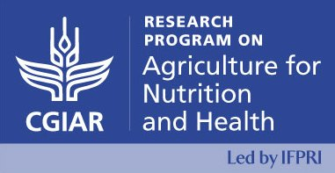

Thank you!
World Veterinary Association (WVA) and Emirates
Veterinary Association (EVA)

