Slide 1






Smallholder Risk Management Solutions (SRMS)
Mezegebu Getnet
ICRISAT
SAIRLA Second National Learning Alliance Workshop
ILRI, Addis Ababa, 23 November 2017

Slide 2
The underlying objective of the SRMS project is to provide strategies to manage risks faced by smallholders – including price risks, coordination risks and risks of opportunism.
By building business model that:
is inclusive,
address systemic risks that hinder commercialization, and
connect the value chain actors effectively through collective marketing

Slide 3
Four Work-streams
WS1. Inception: Scoping of Risk Management Dynamics
WS2. ACTION RESEARCH
Develop Replicable Business Models
WS3. ANALYTICAL PHASE
Developing and Testing Innovative RMS’s
VALUE CHAIN ANALYSIS &
REPLICABLE BUSINESS MODEL DESIGN
Map and analyse Value Chains
Design and pilot an RBM that addresses the systemic risks that hinder commercialisation
ACCESS: INPUT SUPPY STUDY
ADOPTION: SMALLHOLDER RISK PROFILES
INCUSIVENESS: SOCIAL INCLUSION AND MARKET ACCESS STUDY
WS4. STAKEHOLDER POLICY ENGAGEMENT, COMMUNICATION AND LEARNING
Coordination with the National Learning Alliances

Slide 4

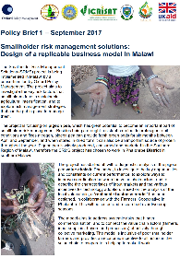
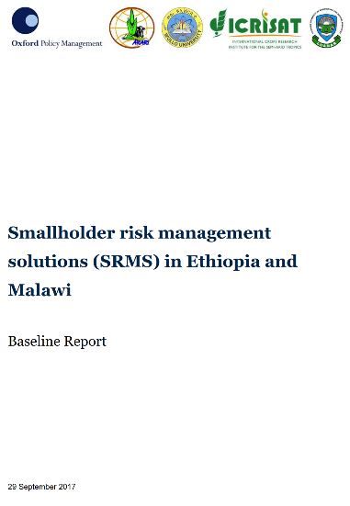

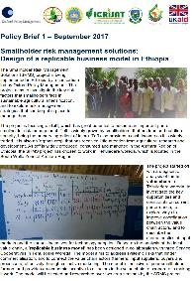

Slide 5
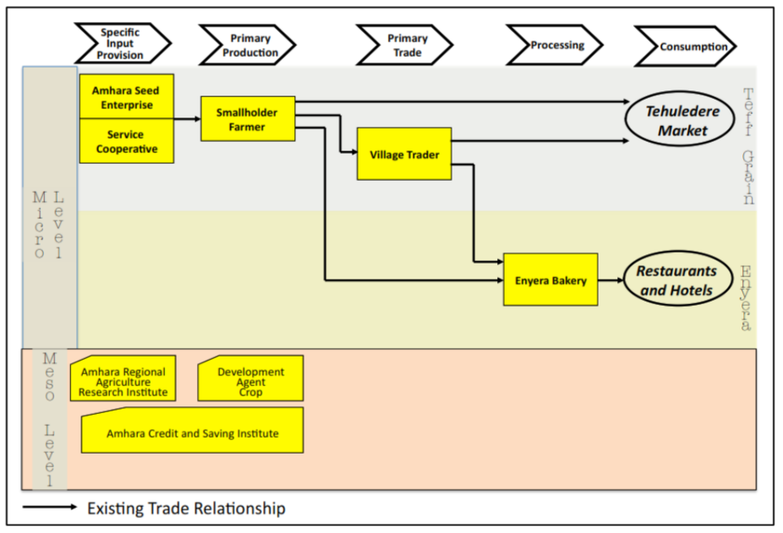
The participants identified five value chain functions that are relevant:
in Tehuledere woreda
for Teff

Slide 6
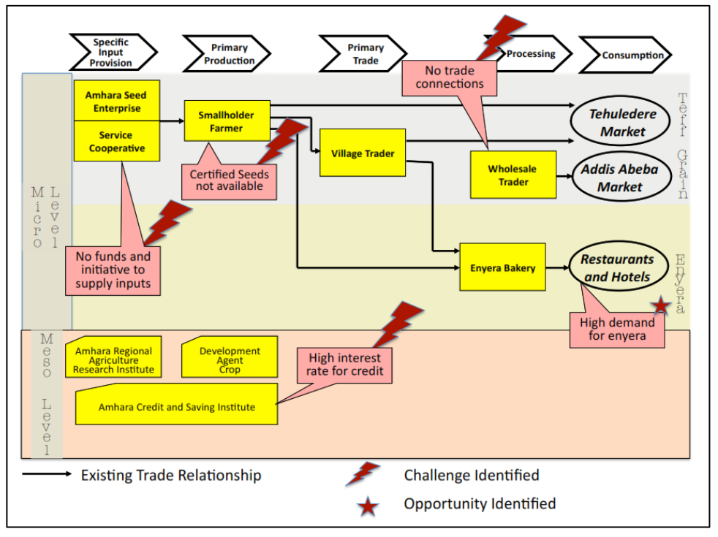
Challenges that hinder the effective functioning of the value chain

Slide 7
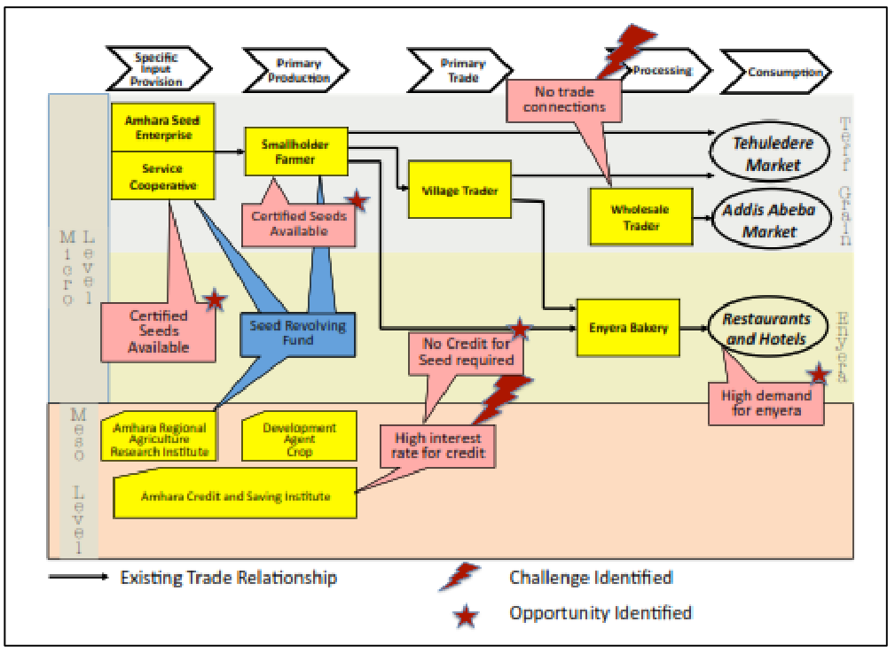

Slide 8
For the growing season 2017/18, the project should target
  300 farmers in three different kebeles: Hitachi, Gobeya and Jari.
  Each farmer will prepare 0.4 Ha of land to produce teff and thus receive 4 kg of certified seeds of the Quncho variety @ rate of 10 kg/Ha.
  Each farmer will plant and manage the agronomy also supported by Development Agents
  Based on the information from the stakeholder workshop the yield of certified seeds planted on 0.4 Ha is between 320 kg and 450 kg.
  Out of this harvest each farmer is expected to deliver 8 kg of teff back to the service cooperative.
  This will allow the service cooperative to purchase at 4 kg of certified seeds for 100 farmers .

Slide 9
