Slide 1

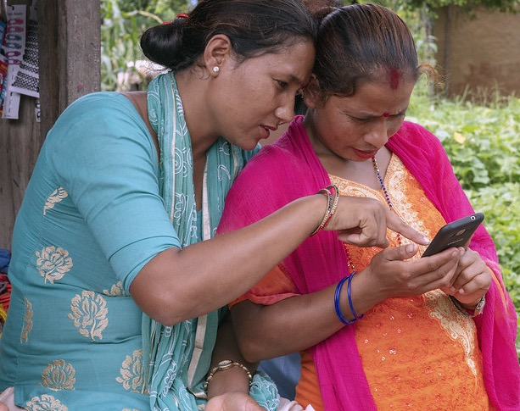

TOWARDS
A DIGITAL ONE CGIAR
ARTICULATING A DIGITAL STRATEGY FOR CGIAR
IN THE CONTEXT OF THE 2030 RESEARCH STRATEGY AND BUSINESS PLAN
Notes:
In April 2019 the System Management Board tasked the Platform for Big Data to “articulate a digital strategy for CGIAR in the context of the 2030 Plan.” The team conducted wide-ranging strategic research, resulting in an extensive and well-substantiated report. This deck is intended to serve as a summary of the report touching on design, findings, and recommendations.

Slide 2
STRATEGIC ANALYSIS
Industry analysis
Consumer/market-based trends
Environmental forecast
Competitor analysis
Assessment of internal strengths, weaknesses, resources
How we will use data and digital technologies most effectively to achieve our objectives?
SUPPORTING ORGANISATIONAL ARRANGEMENTS
Structure
Process
Symbols
Rewards
People
Activities
Functional
policies & profiles
MISSION
Fundamental purpose and values
OBJECTIVES
Specific targets
Domains
Digital strategy
STRATEGY
Central, integrated, externally oriented concept of how we will achieve our objectives
“Science to transform…”
Impacts
Hambrick, Donald & Fredrickson, James. (2005). Are You Sure You Have a Strategy?. Academy of Management Executive. 19. 51-62. 10.5465/AME.2005.19417907.
Notes:
It might be helpful clarify what we mean by digital strategy and where we see it fitting into the One CGIAR process. If strategy is the “central integrated, externally oriented concept for how an organization will achieve its goals,” digital strategy is how we will use data and digital to do that. It flows from mission, objectives/impacts, areas of activity or domains, and it is both part of the integrated concept and part of the organizational capabilities needed to execute it.

Slide 3
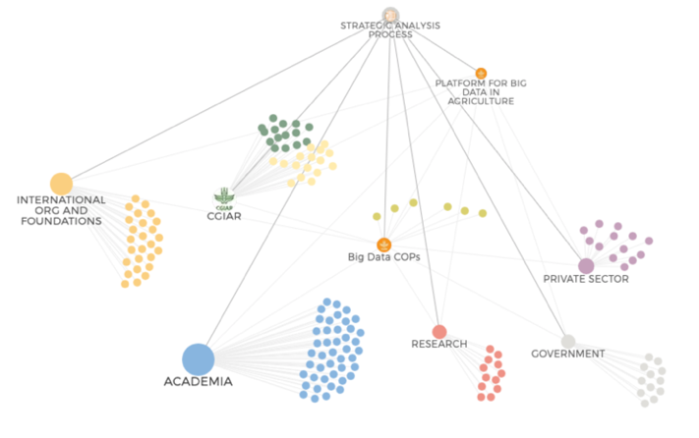
STRATEGIC ANALYSIS
1
What digital trends have the potential to transform agriculture in the next ten years?
2
What should an organization be able to do to navigate or leverage these trends effectively?
ONLINE QUESTIONNAIRE
Internal + external
165
SEMI-STRUCTURED INTERVIEWS
Mostly external
80
FOCUS GROUP WORKSHOPS
Internal
10
LITERATURE REVIEW AND SYNTHESIS
What roles should public interest actors like CGIAR play in digital agriculture?
3
Notes:
To inform the digital dimensions of the central strategy concept we have received over 165 responses to a questionnaire targeting both internal and external participants, conducted 80 semi-structured interviews (to date) with a wide array of external stakeholders—working through our International Advisory Board, Steering Committee, and Communities of Practice and expanding out from there. These efforts are guided by three big questions:
What digital trends have the potential to transform agriculture in the next ten years?
What should an organization be able to do to navigate or leverage these trends effectively?
What roles should public interest actors like CGIAR play in digital agriculture?
The team complemented this with 10 internal focus group workshops with cross-cutting technical CoPs or stakeholder groups (The Genebanks Platform, Monitoring Evaluation and Learning, Communications, Modeling, Geospatial Analysis, Ontologies, Information and Data Management, Socioeconomic Data, Data-driven Agronomy, the Gender Platform).
This was complemented with extensive literature-based research.

Slide 4
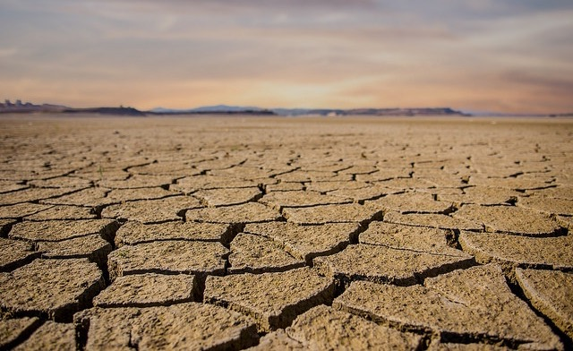
STRATEGIC ANALYSIS | megatrends
We can expect increasingly intense challenges across demographic, natural resource, ecological, and climatic dimensions and the window of opportunity for mitigating these is quickly closing.
Notes:
The biggest trend is of course the reason behind CGIAR’s renewed mission: Science to transform food, land, and water systems in a climate crisis.

Slide 5
STRATEGIC ANALYSIS | megatrends
Global, unequal expansion of internet use and connected devices
Innovation in digital technologies (sensors, machine learning)
Innovation in life sciences (biotechnology and pharma)
Global crisis of trust
Notes:
There are some other mega-trends that intersect with global agriculture that can be expected to shape the digital agriculture landscape over the next decade.
Rapid—though uneven—global expansion of mobile communications and connected devices
Rapid innovation/evolution in digital technologies (such as sensors and ML)
Rapid innovation in life sciences, with biotechnology and pharma leading the way at least in terms of patents
governments, firms, and the media are significantly less trusted today than they were ten years ago—people look to friends, families, employers for trustworthy actions—and increasingly expect this. (Key sources: Edelman Trust Barometer, IBM C-Suite study)
This period will also be characterized by unprecedented rates of innovation at the intersection of digital technologies and life sciences can provide the tools humanity needs to adapt to or mitigate its most pressing food security challenges.

Slide 6
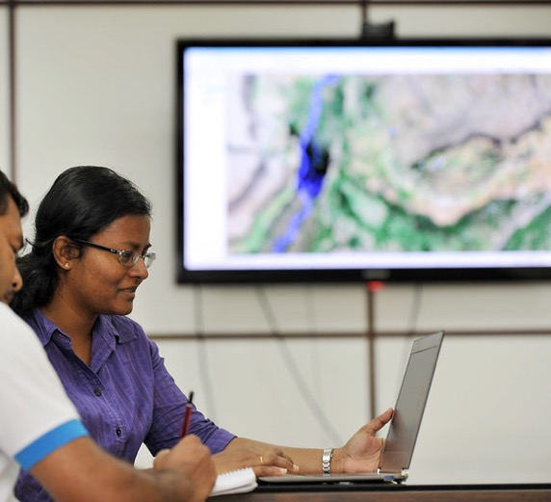
STRATEGIC ANALYSIS | strengths of PUBLIC GOOD ORGANIZATIONS LIKE CGIAR
Global stakeholder networks
Direct engagement with food and farming systems
Domain expertise and credibility
Dissemination and adoption of technology innovations
Notes:
The things CGIAR tends to say about itself are borne out by external interviews and analysis—even by those who do not know CGIAR:
partner networks,
engagement with ‘real’ food and farming systems worldwide,
domain expertise in agriculture development
a key role to play in supporting technology dissemination and adoption
All of which points to a role for CGIAR of fostering responsible innovation at the intersection of the trends and in service of global food security

Slide 7
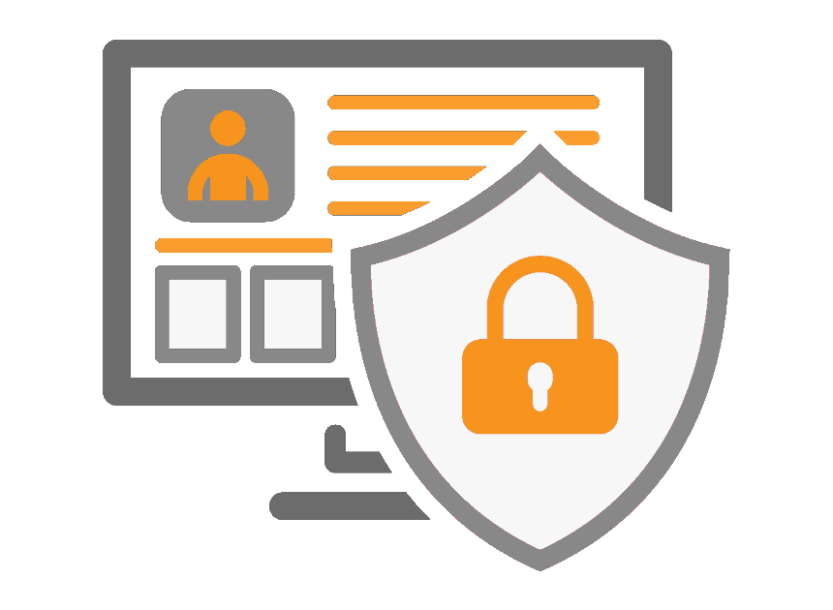
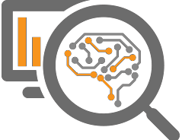


DIGITAL TRENDS
& INTERVENTIONS
DATA
ARTIFICIAL INTELLIGENCE
DIGITAL SERVICES
DIGITAL TRUST
Enable open data and responsible data use and exchange
Develop responsible AI applicable to achieving the SDGs
Enable and validate bundled digital services for food systems
Build trust and enable responsible collective action
Notes:
More specific digital trends intersecting with agriculture and what we can do to leverage them in support of the One CGIAR Research Strategy

Slide 8
DATA SHARING & EXCHANGE
is becoming more critical, and more nuanced
DIGITAL TREND
The internet transformed knowledge and data sharing & enabled the pursuit of a global ‘knowledge commons’ vision
The open and FAIR movement is accelerating yet not meeting the demand for good quality data in the agriculture space
Legitimate reasons to restrict data in many contexts versus legitimate public good uses for restricted data.
intervention
Develop quality data and serve as trusted data intermediary
Help meet the FAIR data demand as much as is ethical/ responsible across our research domains
Continue to use and contribute to wider community data standards
Develop a role as a responsible data intermediary for ethical data sharing
Fully implement our own data standards and policies
Notes:
The internet transformed knowledge and data sharing and enabled pursuit of the vision of a global ‘knowledge commons’. The scientific community embraced the open data vision and built it further to specify Findable, Accessible, Interoperable, and Reusable.
The open and FAIR movement is not meeting the demand for good quality data in the agriculture space, especially as good quality and quantity of data is needed to get good quality results from machine learning models.
Legitimate reasons to restrict data in many contexts versus legitimate public good uses for restricted data. This leads to a sort of impasse in fully leveraging data to develop research and services in the public interest.
We should:
help meet the FAIR data demand as much as is ethical/responsible across our research domains, enabling cross-domain (and pan-CGIAR) research
Continue to use and contribute to wider community data standards—and adopt these more fully in our organization
Develop a role as a responsible data intermediary for ethical data sharing, including technologies for encryption that enable analysis of real data to happen without violating privacy or other sensitive data.
Fully implement our own data standards and policies (Open Access/Open Data, Data Management Maturity Assessment)

Slide 9
DIGITAL TREND
Artificial intelligence
appears poised to radically transform economy and society, yet its responsible use is still poorly understood
AI / ML considered the next ‘General Purpose Technology”
ML is applicable to 80% of SDG targets but researchers note some risks with encoding human biases in automated systems
ML is notoriously difficult to regulate – hard to apply widely-used ethical frameworks
intervention
Develop responsible machine learning for the SDGs
Build cross-domain partnerships to claim the potential of AI in service of our goals
Adopt and continually revise ethical frameworks and policy guidance related to ML in agricultural development
Actively research the emerging risks and opportunities of ML in food security
Notes:
Emergent digital technologies are often met with excitement and poor understanding—a sort of ‘irrational exuberance’ that wears off as the hype subsides. Many analysts and a majority of interview respondents feel that Artificial Intelligence or Machine Learning is different, many of them indicating that it is the next ‘General Purpose Technology” affecting all aspects of economy and society.
Researchers have surveyed ML applications in the literature and mapped their applicability to 80% of SDG targets, and they note some risks with encoding human biases in automated systems, with hyper-efficiency of ML-enabled systems potentially more quickly pushing planetary boundaries, and more. But these risks are still poorly understood and difficult to predict.
ML is notoriously difficult to regulate or even apply widely-used ethical frameworks.
We should:
Build cross-domain partnerships to claim the potential of AI in service of our goals. Both the literature and interviews point to the need to build cross-domain collaborations with subject matter experts, and the importance of research networks in doing this.
Adopt and continually revise ethical frameworks and policy guidance related to ML in agricultural development
Actively research the emerging risks and opportunities of ML in food security

Slide 10

digital services
Expanding opportunity to reach vulnerable populations, but the models and approaches need further development
DIGITAL TREND
Transformational opportunity in agriculture made possible by mobile devices
User adoption, human-computer interface, and access are still an issue on the farmer side
Digital agriculture sectors are still very fragmented and these service deployment is risky
intervention
Enable and validate bundled digital services for food systems
Build the reference data assets, analytics, open algorithms, and evidence to support the development and deployment of large-scale digital services
Facilitate co-design of services bridging public and private partners, food and agripreneurs, and farmers
Notes:
Michael Kremer and Raissa Fabregas’ work on digital extension underscores the transformational opportunity in agriculture made possible by mobile devices. Interactive digital services that can reach farmers and small business owners and engage them with agricultural advisory content, participate in citizen science, and manage complex livelihoods (including beyond agriculture) at a scale and cost-efficiency never possible before. These researchers also point to market failures and low willingness to pay as key bottlenecks to resolve.
User adoption, human-computer interface, human-centered design, and access are still issues on the user side to be addressed.
Digital agriculture sectors are still very fragmented, and there are few mechanisms in place for pre-competitive collaboration or to help lower the risk of deploying these services.
We should:
Build the reference data assets, analytics, open algorithms, and evidence to support the development and deployment of large-scale digital services.
Facilitate co-design of services bridging public and private partners, food and agripreneurs, and farmers and evaluate progress/collate the evidence.
(See: Fabregas, R., Kremer, M., & Schilbach, F. (2019). Realizing the potential of digital development: The case of agricultural advice. Science, 366 (6471). http://dx.doi.org/10.1126/science.aay3038)

Slide 11
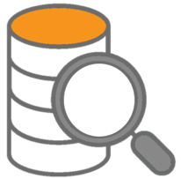
DIGITAL TREND
DIGITAL TRUST AND COLLECTIVE ACTION
Data deluge and digital media proliferation and balkanization make it hard for organizations to get a message through
Digital is a dimension of global erosion of trust: surveillance, monetization of data, privacy breaches…
Increasing demand for ‘data-driven’ transparency, accountability, and sustainability in food systems
intervention
Build sector intelligence for responsible collective action
Link our myriad information and data systems to develop much greater intelligence
Generate more timely, granular, trusted data and data-driven communications; and engage in global forums.
Use this increased sector intelligence to guide responsible collective action
Notes:
Data deluge and digital media proliferation and balkanization make it hard for organizations to get a message through, even as demand for data-driven transparency and accountability (and its visualization) increases. Digital media and use of data have clearly been part of this global erosion of trust: surveillance, monetization of data, privacy breaches… Nevertheless, there is growing demand for ‘data-driven’ transparency, accountability, sustainability in food systems.
We should:
Link our myriad information and data systems to develop much greater intelligence about our own organization, and increasingly equip ourselves to provide greater intelligence to the sector as a whole.
Participating in partner-led efforts to mobilize and apply credible data for action, e.g. the Food Systems Dashboard (Fanzo, J., Haddad, L., McLaren, R. et al. : https://doi.org/10.1038/s43016-020-0077-y) responding calls for more timely, granular data from stakeholders in the sector are a start; CGIAR must continually help build and present critical public information for guiding food, land, water system actors towards sustainability and SDG goals.
Use this intelligence to target and guide innovation (our own and others’) and collective action at the intersection of life sciences, digital, and the mission statement of the refreshed portfolio.

Slide 12
OPERATIONALIZING DIGITAL INTERVENTIONS
in the 2022-2030 CGIAR research portfolio
Digital interventions should intersect naturally with the research cycle and enhance research delivery
Collaborative data standards, management, and sharing
Applied, responsible AI to generate timely analytics
New digital services help meet development challenges
Enhanced sector intelligence fosters collaborations and collective action
RESEARCH DESIGN
ANALYSIS
RESEARCH DELIVERY
SECTOR DEVELOPMENT
Notes:
These intervention areas would intersect naturally with the development and implementation of new programs.
Research design: Collaboration on data standards, management, and sharing can unite regional stakeholders around specific use-cases and objectives in national and regional agricultural sector development strategies;
Analysis: Applied, responsible AI will accelerate efforts to generate timely analytics that balance environmental, socioeconomic, biodiversity, and conservation goals;
Research delivery: Broad engagement to build robust, human-centered digital innovation ecosystems will accelerate CGIAR efforts to help build more sustainable food systems, and new digital services will become a critical tool applied to meeting various complex human needs and development challenges; and
Sector development: Enhanced sector intelligence will help deepen collaborations with CGIAR partners and align public, private, and non-profit actors around the responsible, collective actions and innovations needed for specific, appropriate, and meaningful food, land, and water systems transformations.

Slide 13
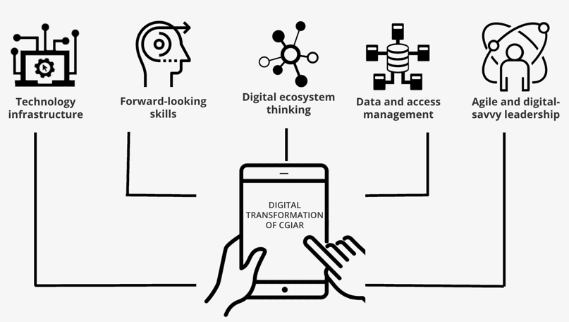

STRENGTHENING KEY
ENABLERS AND CAPABILITIES AT CGIAR
Notes:
Digital strategy research also looked at key capabilities the organization will need to tend to in order to claim the roles indicated through external consultations. CGIAR conducted a wide-ranging assessment of the state of digital strategy in CGIAR that looked at 5 key enablers of digital organizations (applying a framework developed by Accenture and the World Economic Forum that draws on data from around 15,000 organizations).

Slide 14


Provide Agile &
Digital-Savvy Leadership
Finalize, validate, and secure approval of a pan-CGIAR digital strategy and plan for its implementation.
Develop Center digital strategies that reflect the global strategy.
Clarify pan-CGIAR digital governance.
Notes:
Key interventions
The function of a digital strategy is to demystify data and information technology-related decisions for senior management, linking them to specific capabilities the organization needs to deliver on its mission. For CGIAR, these capabilities could be related to organizational functions, conducting and delivering research, or both. The strategy should be intelligible and actionable for decision makers at all levels of the organization and easy to communicate to internal and external stakeholders. Key actions senior leaders should ensure are undertaken include:
Finalize, validate, and secure approval of this pan-CGIAR digital strategy and plan for its implementation. The 2030 Research Strategy notes that a pan-CGIAR digital strategy will be launched by Q2 2021. Senior leadership will need to engage in validating and securing approval of this pan-CGIAR digital strategy from the Board and System Council.
Develop Center digital strategies that reflect the global strategy. Key internal and external actions in a pan-CGIAR digital strategy will require local context and must leverage the diversity of strengths and competencies across its Centers. Those Centers that have not yet defined an explicit digital strategy will need to designate a senior manager with experience leading change initiatives and give them a mandate to develop and execute the strategy. This manager will be responsible for, building on the five core enablers, leading a process of mapping the Center strategy to needed digital capabilities and prioritizing them, and developing the concrete digital engagements needed to enhance research development and delivery in the countries and disciplines in which the Center staff works. Mutually-reinforcing global and regional strategies will ensure action is taken on both global and regional scales, and provide new opportunities for developing CGIAR as a learning organization in the face of rapid technological changes affecting global food security.
Clarify pan-CGIAR digital governance. Several business units across CGIAR--at both the System and Center levels--have a hand in guiding the decision-making processes regarding data and information technology investments. In addition, several cross-cutting, internal communities of practice (e.g. Information and Data managers, Ontologies, and IT manager groups) have the needed technical depth and broad-based participation across the organization to be able to define and continually refine data and information technology standards for the diverse array of research domains in which CGIAR engages. As a result, these and other internal communities have been serving as de facto standards-setters. Senior leadership must clarify the governance processes that will harness this internal technical depth, define the explicit mandates associated with data and IT standards, and clearly define more formal mechanisms for the review and adoption of these de facto standards as organizational standards.

Slide 15
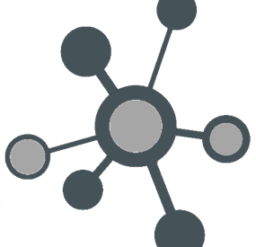

Foster Digital
Ecosystem Thinking
Develop CGIAR-wide digital partnerships
Develop inward- and outward-facing shared data and analytics services.
Cultivate inward- and outward-facing Communities of Practice (CoPs).
Notes:
Develop CGIAR-wide digital partnerships. Digital technology partnerships are currently pursued primarily at the Center level within the organization. One CGIAR presents an opportunity to foster System-level alliances that reinforce the organization’s ability to speak with one strategic voice on key issues at the intersection of digital trends and global food security, and facilitate the aggregation of demand for and spending on key cross-cutting internal services and to access new partners’ capacities for developing products and services leveraging CGIAR data and analysis.
Develop inward- and outward-facing shared data and analytics services. CGIAR digital alliances can be inward-facing, outward facing, or both. Internally, aggregating demand and current spending across the System and Centers on big data services such as cloud storage and computing, or accessing proprietary external data services (e.g. commercial satellite imagery) can help CGIAR reduce costs and negotiate greater access to the varied capabilities of external providers. Externally, for example, the mobile telephony and digital financial services industries have networks and capabilities that would complement CGIAR’s technologies and mission.
In the private sector, the most successful digital platform companies have prioritized the development of services that are both inward-facing and outward-facing, creating a self-reinforcing dynamic that favors continual service improvements. When service providers are also users, they have greater incentive to improve the services they are using and greater ability to improve them for external users. CGIAR is well-equipped to begin developing such multi-faceted digital alliances. The CGIAR Open Access/Open Data Policy is a good example: publishing pan-CGIAR and partner data related to global challenges (e.g. climate adaptation) into open, cloud-based repositories facilitates data discovery and use beyond CGIAR, and enables co-development of new analytic services with impact partners (e.g. mobile phone operators seeking to develop services supporting climate-smart agriculture). Such multi-sided services can facilitate pre-competitive collaboration and collective action across the array of public, private, and non-profit stakeholders needed to drive progress towards the SDGs.
Cultivate inward- and outward-facing communities of practice (CoPs). CGIAR has multiple cross-cutting technical communities focused on key functional disciplines (e.g. IT Managers; Information and Data Management; Monitoring Evaluation and Learning; Communications; Partnerships) as well as on digital research disciplines (Ontologies, Crop Modeling, Socioeconomic Data, Geospatial Analysis, Livestock Data, Data-Driven Agronomy) that formally or informally include outside experts. These groups provide a critical mechanism for interacting with wider communities in these disciplines and ensuring CGIAR is engaged in and helping build global good practices and collective action to advance these disciplines in the agri-food research for development sphere. We will continue to foster these communities and build formal mechanisms for integrating internal and external experts into their governance.

Slide 16
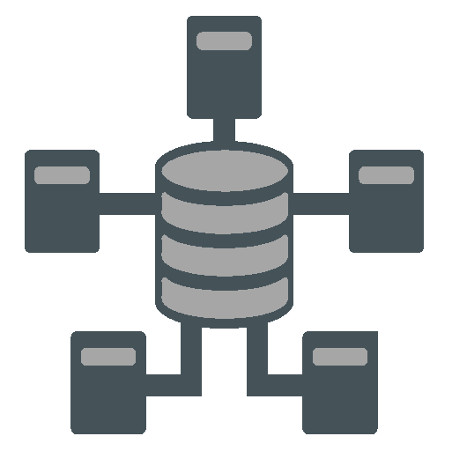
Mobilize
Data & Access Management
Implement recommendations of pan-CGIAR IT Assessments.
Adopt and enforce data policies.
Foster a culture of data sharing and collaboration.
Notes:
Implement recommendations of pan-CGIAR IT Assessments. CGIAR completed pan-CGIAR assessments of data management maturity and information security with concrete recommendations for action. These are high-priorities in the CGIAR digital strategy.
Adopt and enforce data policies. Helping CGIAR become a more data-driven organization will require the development of common standards on data collection, sharing, storage, and use that are consistent across the organization and should be applied to our information systems. The CGIAR Open Access/Open Data Policy was updated in 2020 to reflect evolving global, community-driven standards for scientific data. Its adoption and wide-spread implementation in the organization can drive significant progress towards mobilizing data and data access in CGIAR and help position CGIAR as a technical resource to those partners wishing to see that their data and knowledge products are discoverable and reusable by a wider group of partners.
Foster a culture of data sharing and collaboration. Centers and System leadership will support initiatives that can help foster a data-sharing culture both inside and outside of the organization. This can include development of more integrated, data-driven, pan-CGIAR research efforts on critical global challenges to food, land, and water systems. This will drive a cultural shift toward the recognition that data collected by individual researchers is a key organizational asset that, when managed properly reinforces CGIAR’s position as a global research organization capable of effecting positive change worldwide. Centers and the System will invest in interoperable, interlinked data and consistent data management to effectively translate data into meaningful insights. A key element of these measures will be incentives for researchers to share data, e.g. increasing the recognition of those researchers who actively share data and collaborate across the Center or the System.

Slide 17

Build a
Forward-Looking
Skills Agenda
Upskill, recruit, and retain digital talent.
Incorporate digital strategy into staff job descriptions, roles and responsibilities, and performance metrics.
Develop partnerships and communities of practice on key digital capabilities.
Notes:
Upskill, recruit, and retain digital talent. Center-based talent strategies will be updated where needed—and may include adopting upskilling, recruiting, and retention strategies--to continue building organizational digital capabilities that will equip CGIAR to fully leverage and shape digital trends affecting global food security. Centers and the System will identify or develop training content related to maintaining those core skills that have been identified as being useful across the organization, such as statistical analysis, bioinformatics, and enacting good practices in data management, and in building capabilities in emergent disciplines such as leading-edge computational methods and AI.
Incorporate digital strategy into staff job descriptions, roles and responsibilities, and performance metrics. Broad-based digital strategy adoption throughout the organization will be critical for its success. Senior management, research leaders, information technology units, human resources professionals, legal professionals, and researchers will have specific, defined roles for implementing the digital strategy. Ownership of digital transformation will thus be fostered and encouraged throughout the organization.
Develop partnerships and communities of practice on key digital capabilities. CGIAR personnel have deep expertise across the array of domains that intersect with global food security and can accelerate development of its staff’s digital skills through pursuing new digital partnerships that enable CGIAR to interact with wider technical communities on themes spanning scientific discovery to the uptake and use of research outputs. Leveraging partners’ computational power, complementary expertise, and perspectives on key technical issues to be resolved helps embed CGIAR in wide-ranging technical partnerships that can help accelerate responsible, human-driven innovations and help CGIAR access and co-develop the key capabilities needed to apply them.
Develop alliances with computer science faculties. Digital skills--especially those related to AI--are in high demand. Agriculture is generally unable to match the compensation offered to graduate students by global firms or more digitized sectors such as financial services, but CGIAR can offer them unique and fascinating research opportunities. Young researchers may also be attracted by CGIAR’s public good mission where they can work on pressing global food security issues. Alliances with universities—and particularly those with computer science faculties—will enable CGIAR to cultivate and foster computer scientists’ interest in agricultural research for development early in and, hopefully, throughout their careers.

Slide 18


Design the Right Technology Infrastructure
The One CGIAR organizational redesign process provides an opportunity for CGIAR to build a more unified information technology vision in which digital investments are more directly linked to the over-arching goals of the organization.
Achieving this will require:
adopting common security practices;
designing unified or interoperable digital services for administration and research;
facilitating access to data storage and computational resources for researchers;
and equipping IT departments to be active partners with other units in developing cross-cutting research and organizational digital capabilities.
Notes:
The One CGIAR organizational redesign process provides an opportunity for CGIAR to build a more unified information technology vision in which digital investments are more directly linked to the over-arching goals of the organization.
Achieving this will require:
adopting common security practices; designing unified or interoperable digital services for administration and research;
facilitating access to data storage and computational resources for researchers;
and equipping IT departments to be active partners with other units in developing cross-cutting research and organizational digital capabilities.
CGIAR will engage key internal communities of practice to map the relationship between information technology practices, standards, and investments and the goals of the 2030 Research Strategy.

Slide 19
ORGANIZATIONAL DIGITAL CAPABILITY MODEL
1.2 Digital Governance
1.1 Digital Strategy
1.3 Digital Leadership
1.4 Digital Skills Development
1. Digital Strategy
& Organization
1.1.1 Development, validation, and management
1.1.2 Horizon scanning
1.2.1 Risk management
1.2.2 Compliance monitoring and reporting
2.2 On-Premise Infrastructure Provisioning and Support
1.2.5 Data governance
1.3.1 Research Innovation
1.3.2 Operational Excellence
1.5.1 Assessment
1.5.2 Skills management
2.6 Specialized
Research IT Services
2.8 IT Governance
2.2.1 Support and provisioning for network, applications, storage, and compute
1.2.3 Digital architecture adoption and promotion
1.2.4 Aligning digital investments and organizational goals.
1.2.6 Technology ethics
1.3.3 Digital culture
2.7 Enterprise Applications Support
2.1 Cloud Management
2.3 Data Warehousing
2.4 Operational Innovation
2.5 Cyber Security and Digital Identity
2.6.1 Software engineering review and support
4.3 Research Data Management and Governance
2.8.1 EA design and implementation
2.2.2 Support and provisioning for IT equipment
2.4.1 Process redesign
2.5.1 Enterprise IT security
2.6.2 Provisioning IaaS for research
2.7.1a Enterprise Resource Planning
2. Technology
Capabilities
and Infrastructure
2.1.1 Cloud competence
2.3.1 Data storage
2.8.2 Hardware standards and policies
2.1.2 Cloud migration
2.3.2 ETL
2.4.2 Software engineering/ DevOpps
2.5.2 Cyber defense
2.6.3 Research applications architecture
3.4 Enterprise Data Foundation
2.7.1b Performance Management
2.8.3 Software standards and policies
3.1 Enterprise Data Usage
3.2 Enterprise Data Management and Governance
3.3 Enterprise Data Insights and Analytics
2.5.3 IAM and data security
4.3.1 Policies, processes, and standards for research data
2.1.3 Cloud architecture
4.2 Research Management
5.2 Digital Communication
3. Organizational
Data & Analytics
3.1.1 Data driven business model
4.1 Research Analytics
3.1.2 Data driven organization
3.2.1 Data strategy and governance
3.2.2 Metadata management
3.3.1 Analytics strategy
3.3.2 Analytics and visualization
3.4.1 Data platform
3.4.2 Data architecture
3.2.3 Data quality
3.3.3 Performance monitoring
5.1 Digital Fundraising
5.3 Digital Partnerships Development and Management
4. Research Data &
Analytics
4.1.2 Data sharing
4.3.2 Data Ethics
4.1.1 Data collection
4.1.2 Data sharing
4.1.3 Data mgmt.
4.2.1 Breeding
4.2.2 Agro-ecosystem
4.2.3 Germplasm
4.2.4 Climate science
4.1.4 Data curation
4.1.5 Data analysis
4.2.5 Agronomy
4.2.6 Socioeconomic
4.2.7 Nutrition & Health
4.2.8 Animal science
4.3.1a Socio-economic
4.3.1b Agro-ecosystem
4.3.1c Geospatial
4.3.1d Phenotypic
4.3.1e Genotypic
4.3.1f Nutrition & Health
5.1.1 Proposal and agreement support
5.1.2 Monitoring funding opportunities
6.3 Bundled Digital Services
5.2.3 Research aggregation and promotion
5.2.5 Media aggregation and publication
5. Fundraising,
Communications
and Partnerships
6.2 Responsible AI
5.2.1 Web optimization
5.2.2 Social Media mgmt. and promotion
5.2.4 Media monitoring
6.4 Digital Collective Action
6.5 Digital Technologies and Innovation
5.3.1 Capacity partnerships
5.3.2 Impact partnerships
5.3.3 Product Management
6.1 Data Mobilization and Responsible Data Exchange
6.5.1 Fostering and stage-gating innovations
6.1.1 Public data sharing for research and impact
6.2.1 Analytics for the SDGs
6.4.1 Multi-stakeholder governance.
6.1.2 Responsible use and sharing of restricted data
6.2.2 AI Policy and ethics
6.3.1 Human centered design
6.3.3 Evidence and meta-analysis
6.4.2 Food, land, and water system intelligence
6.5.2 Innovation process and strategy
6. Digital Research
for Development
6.3.2 Digital extension/advisory
6.3.4 Digital financial services
Notes:
Findings from 10 internal focus groups, review of literature, center-level assessments and infrastructure mapping, and survey responses from CGIAR colleagues where structured according to an organizational modeling framework called “Capability Modeling.” Capability models seek to describe what an organization does—or should be able to do—to deliver on its mission. A “Digital Capability Model” looks specifically at digital capabilities. To develop a CGIAR-specific digital capability model, the team defined several broad areas of digital capability comprising the whole of the CGIAR organization, and defined component capabilities in each area.
(A full Powerpoint deck describing the methods, supporting documents, and specific capabilities is published as a companion document to the full report.)

Slide 20
MATURITY OF CROSS-CUTTING DIGITAL CAPABILITIES
1.2 Digital Governance
1.1 Digital Strategy
1.3 Digital Leadership
1.4 Digital Skills Development
1. Digital Strategy
& Organization
1.1.1 Development, validation, and management
1.1.2 Horizon scanning
2.2 On-Premise Infrastructure Provisioning and Support
1.2.1 Risk management
1.2.2 Compliance monitoring and reporting
1.2.5 Data governance
1.3.1 Research Innovation
1.3.2 Operational Excellence
1.5.1 Assessment
1.5.2 Skills management
2.6 Specialized Research IT Services
2.8 IT Governance
1.2.3 Digital architecture adoption and promotion
1.2.4 Aligning digital investments and organizational goals.
1.2.6 Technology ethics
1.3.3 Digital culture
2.7 Enterprise Applications Support
2.1 Cloud Management
2.2.1 Support & provisioning for network, applications, storage, and compute
2.3 Data Warehousing
2.4 Operational Innovation
2.5 Cyber Security and Digital Identity
2.6.1 Software engineering review and support
4.3 Research Data Management and Governance
2.8.1 EA design and implementation
2.4.1 Process redesign
2.5.1 Enterprise IT security
2.6.2 Provisioning IaaS for research
2.7.1a Enterprise Resource Planning
2. Technology
Capabilities
and Infrastructure
2.1.1 Cloud competence
2.2.2 Support &
provisioning for IT equipment
2.3.1 Data storage
2.8.2 Hardware standards and policies
2.1.2 Cloud migration
2.4.2 Software engineering/ DevOpps
2.5.2 Cyber defence
2.6.3 Research applications architecture
3.4 Enterprise Data Foundation
2.7.1b Performance Management
2.8.3 Software standards and policies
3.1 Enterprise Data Usage
3.2 Enterprise Data Management and Governance
2.3.2 ETL
3.3 Enterprise Data Insights and Analytics
2.5.3 IAM and data security
4.3.1 Policies, processes, and standards for research data
2.1.3 Cloud architecture
4.2 Research Management
5.2 Digital Communication
3. Organizational
Data & Analytics
3.1.1 Data driven business model
4.1 Research Analytics
3.1.2 Data driven organization
3.2.1 Data strategy and governance
3.2.2 Metadata management
3.3.1 Analytics strategy
3.3.2 Analytics and visualization
3.4.1 Data platform
3.4.2 Data architecture
3.2.3 Data quality
3.3.3 Performance monitoring
5.1 Digital Fundraising
5.3 Digital Partnerships Development and Management
4. Research Data
& Analytics
4.3.2 Data Ethics
4.1.1 Data collection
4.1.2 Data sharing
4.1.3 Data mgmt.
4.2.1 Breeding
4.2.2 Agro-ecosystem
4.2.3 Germplasm
4.2.4 Climate science
4.1.4 Data curation
4.1.5 Data analysis
4.2.5 Agronomy
4.2.6 Socioeconomic
4.2.7 Nutrition & Health
4.2.8 Animal science
4.3.1a Socio-economic
4.3.1b Agro-ecosystem
4.3.1c Geospatial
4.3.1d Phenotypic
4.3.1e Genotypic
4.3.1f Nutrition & Health
5.1.1 Proposal and agreement support
5.1.2 Monitoring funding opportunities
6.3 Bundled Digital Services
5.2.3 Research aggregation and promotion
5.2.5 Media aggregation and publication
5. Fundraising,
Communications
& Partnerships
6.2 Responsible AI
5.2.1 Web optimization
5.2.2 Social Media mgmt. and promotion
5.2.4 Media monitoring
6.4 Digital Collective Action
6.5 Digital Technologies and Innovation
5.3.1 Capacity partnerships
5.3.2 Impact partnerships
5.3.3 Product Management
6.1 Data Mobilization and Responsible Data Exchange
6.1.1 Public data sharing for research and impact
6.2.1 Analytics for the SDGs
6.4.1 Multi-stakeholder governance.
6.5.1 Fostering and stage-gating innovations
6.1.2 Responsible use and sharing of restricted data
6.2.2 AI Policy and ethics
6.3.1 Human centered design
6.3.3 Evidence and meta-analysis
6.4.2 Food, land, and water system intelligence
6.5.2 Innovation process and strategy
6. Digital Research
for Development
6.3.2 Digital extension/advisory
6.3.4 Digital financial services
High: Digital capability well developed and well-diffused
and adopted through the organization as a cross-cutting capability.
Medium: Digital capability developed somewhere in the organization
but not yet well-diffused or widely adopted as a cross-cutting capability.
Low: Digital capability of limited
development and diffusion across the organization.
Notes:
Drawing from the sources mentioned the team also assessed the maturity of digital capabilities in terms of how well developed and well-diffused they were across CGIAR.

Slide 21
WHAT DIGITAL CAPABILITIES REQUIRE A GOVERNANCE FUNCTION?
1.2 Digital Governance
1.1 Digital Strategy
1.3 Digital Leadership
1.4 Digital Skills Development
1. Digital Strategy
& Organization
1.1.1 Development, validation, and management
1.1.2 Horizon scanning
2.2 On-Premise Infrastructure Provisioning and Support
1.2.1 Risk management
1.2.2 Compliance monitoring and reporting
1.2.5 Data governance
1.3.1 Research Innovation
1.3.2 Operational Excellence
1.5.1 Assessment
1.5.2 Skills management
2.6 Specialized Research IT Services
2.8 IT Governance
1.2.3 Digital architecture adoption and promotion
1.2.4 Aligning digital investments and organizational goals.
1.2.6 Technology ethics
1.3.3 Digital culture
2.7 Enterprise Applications Support
2.1 Cloud Management
2.2.1 Support & provisioning for network, applications, storage, and compute
2.3 Data Warehousing
2.4 Operational Innovation
2.5 Cyber Security and Digital Identity
2.6.1 Software engineering review and support
4.3 Research Data Management and Governance
2.8.1 EA design and implementation
2.4.1 Process redesign
2.5.1 Enterprise IT security
2.6.2 Provisioning IaaS for research
2.7.1a Enterprise Resource Planning
2. Technology
Capabilities
and Infrastructure
2.1.1 Cloud competence
2.2.2 Support &
provisioning for IT equipment
2.3.1 Data storage
2.8.2 Hardware standards and policies
2.1.2 Cloud migration
2.4.2 Software engineering/ DevOpps
2.5.2 Cyber defence
2.6.3 Research applications architecture
3.4 Enterprise Data Foundation
2.7.1b Performance Management
2.8.3 Software standards and policies
3.1 Enterprise Data Usage
3.2 Enterprise Data Management and Governance
2.3.2 ETL
3.3 Enterprise Data Insights and Analytics
2.5.3 IAM and data security
4.3.1 Policies, processes, and standards for research data
2.1.3 Cloud architecture
4.2 Research Management
5.2 Digital Communication
3. Organizational
Data & Analytics
3.1.1 Data driven business model
4.1 Research Analytics
3.1.2 Data driven organization
3.2.1 Data strategy and governance
3.2.2 Metadata management
3.3.1 Analytics strategy
3.3.2 Analytics and visualization
3.4.1 Data platform
3.4.2 Data architecture
3.2.3 Data quality
3.3.3 Performance monitoring
5.1 Digital Fundraising
5.3 Digital Partnerships Development and Management
4. Research Data
& Analytics
4.3.2 Data Ethics
4.1.1 Data collection
4.1.2 Data sharing
4.1.3 Data mgmt.
4.2.1 Breeding
4.2.2 Agro-ecosystem
4.2.3 Germplasm
4.2.4 Climate science
4.1.4 Data curation
4.1.5 Data analysis
4.2.5 Agronomy
4.2.6 Socioeconomic
4.2.7 Nutrition & Health
4.2.8 Animal science
4.3.1a Socio-economic
4.3.1b Agro-ecosystem
4.3.1c Geospatial
4.3.1d Phenotypic
4.3.1e Genotypic
4.3.1f Nutrition & Health
5.1.1 Proposal and agreement support
5.1.2 Monitoring funding opportunities
6.3 Bundled Digital Services
5.2.3 Research aggregation and promotion
5.2.5 Media aggregation and publication
5. Fundraising,
Communications
& Partnerships
6.2 Responsible AI
5.2.1 Web optimization
5.2.2 Social Media mgmt. and promotion
5.2.4 Media monitoring
6.4 Digital Collective Action
6.5 Digital Technologies and Innovation
5.3.1 Capacity partnerships
5.3.2 Impact partnerships
5.3.3 Product Management
6.1 Data Mobilization and Responsible Data Exchange
6.1.1 Public data sharing for research and impact
6.2.1 Analytics for the SDGs
6.4.1 Multi-stakeholder governance.
6.5.1 Fostering and stage-gating innovations
6.1.2 Responsible use and sharing of restricted data
6.2.2 AI Policy and ethics
6.3.1 Human centered design
6.3.3 Evidence and meta-analysis
6.4.2 Food, land, and water system intelligence
6.5.2 Innovation process and strategy
6. Digital Research
for Development
6.3.2 Digital extension/advisory
6.3.4 Digital financial services
Out of Scope
Maturity:
High
Medium
Low
Notes:
The team noted as well specific areas requiring One CGIAR governance.

Slide 22
GLOBAL DIGITAL PRACTICE GOVERNANCE STRUCTURE
Executive Sponsor
Data Governance Lead
(Research)
Digital Innovation Officer (Research)
Data Governance Analyst
Data Governance Analyst
Nutrition, Health, and Food Security Champion
Gender Equality, Youth and Social Inclusion Champion
Poverty Reduction, Livelihoods and Jobs Champion
Environmental Health and Biodiversity Champion
Climate Adaptation and Greenhouse Gas Reduction Champion
NARES
Global Partnerships Interlock
Regional & Country Partnerships Interlock
Organizational
Analytics & Data
Mgmt. Interlock
Digital Procurement Interlock
Digital Solutions Interlock
Infrastructure & Security Interlock
Cross-cutting CGIAR Communities of Practice on technical and functional disciplines
LEGEND:
Research Delivery Organization
Global & Regional Engagement Organization
Institutional Strategy & Systems Organization
Notes:
Digital governance in CGIAR must enable the organization to harness the great technical breadth and depth of our diffuse organization. This will require coordination across impact areas, and the ability to leverage cross-cutting technical communities of practice in an intentional way. The capability to tap technical groups to develop guidance, elevate and validate that guidance, and mainstream or scale it across the wider organization will be key. One potential structure for achieving this would include:
Senior management ‘owners’ of data and digital governance, a governance body spanning the majority of CGIAR research domains, and the ability to formalize the relationship with an array of technical communities of practice in the organization.

Slide 23
HIGH LEVEL GOVERNANCE STRUCTURE
ENTERPRISE DATA
RESEARCH DATA & DATA SCIENCE
5
Digital Services
Executive Sponsor
# | DESCRIPTION
1 | The Data Governance Lead (Research) reports to the Digital Innovation Officer and serves as an interlock with the Governance function of the Global Digital Office. The Research Data Lead and is tasked with ensuring research data of good quality, standards compliant, and well-represented and managed in overall One CGIAR data and information architecture.
2 | Data Governance Analyst(s) report to the Data Governance Lead (Research) and perform day-to-day functional and technical tasks such as data quality monitoring and liaising with domain experts on metadata definition and implementation, as well as data ethics.
3 | A Global Practice on Digital in Research comprised of cross-organizational representation is formed as a key governance body to guide and inform development of digital research innovation, developing supporting digital capabilities, and defining and promoting best practices.
4 | The Digital Innovation Officer (Research) would lead development of cross-cutting One CGIAR digital research capabilities and have shared accountability to the Governance function of Digital Services and to the Executive Sponsor for the Global Practice on Digital in Research. This role would convene the Global Practice and support it in day-to-day operations.​
5 | The Executive Sponsor would be a rotating responsibility among the Executive Management Team, that provides ultimate accountability and sign-off for digital in research-related functions and capabilities.
1
2
4
Global Digital Office
(Strategy, Governance, & Performance Management)
Data Governance Lead (Research)
Data Governance Analyst
Digital Innovation Officer
(Research)
Data Governance Analyst
Business Partnership
3
Digital in Research Global Practice
Infrastructure & Operations
Digital Solutions
Enterprise Architecture
Information Security
Data Management & Analytics
LEGEND
Digital Services Organization
Key Units
Proposed Roles (new)
Proposed Governance Entity
Notes:
Some potential roles and responsibilities for bridging what might be termed “Operational IT” and digital in research.

Slide 24
One CGIAR: a global digital innovation platform with regional dimensions
INTERVENTIONS
STRENGTHENING
ONE CGIAR
=
MULTI-STAKEHOLDER GLOBAL DIGITAL INNOVATION PLATFORM
DATA SHARING
DIGITAL LEADERSHIP
MACHINE LEARNING
DATA MANAGEMENT
DIGITAL SERVICES
SKILLS
SECTOR INTELLIGENCE
PARTNERSHIPS
ACROSS RESEARCH PORTFOLIO, INITIATIVES AND REGIONAL PROGRAMS
ACROSS CGIAR SYSTEM
Notes:
Become a global digital innovation platform with regional dimensions. Through implementation of the digital intervention areas in data, AI, digital services, and sector intelligence in initiatives and regional programs; and internal strengthening of the key digital enablers in leadership, data, infrastructure, skills, and partnerships, CGIAR will build an overarching, global organizational capability for digital innovation strategy and management that equips it to engage with a more unified voice and deliver concrete contributions to global goals—the SDGs.

Slide 25







Challenge: How to ensure that the benefits of the digital revolution reach the millions of farmers, agri-food businesses, and developing economies whom One CGIAR research and innovations are intended to serve?
Theory of Change: Making the digital revolution central to our way of working will enable One CGIAR to more effectively deliver and share the benefits of the digital revolution to ALL
Impact Pathways
Interventions
Outputs
Outcomes
One CGIAR Impact Areas
The WHAT: Integrated Strategies to achieve transformation
The HOW: High-level strategic actions to drive transformation
Deliverables visible to stakeholders across global R4D community
WHO is doing WHAT differently
Nutrition, Health, and Food Security: Improved accessibility and sharing of CGIAR data assets with farmers strengthens the resilience of global agri-food system against shocks
Data
POLICY: Model good data governance, craft ethical frameworks and protocols for AI, spearhead governance system for global collective action, link internal and external information & systems
CGIAR Open Data Policy
Discoverable, accessible One CGIAR data increasingly used by farmers & agri-food SMEs to boost food system resilience
Artificial Intelligence
Genetic Innovation
New standards & ethical frameworks
CGIAR 2030 Research & Innovation Strategy
Digital Services
Hundreds of new data-driven innovation partnerships
New public, private, and non-profit alliances collaborate on CGIAR data-driven innovations to deliver digital services to tens of millions of farmers
Resilient Agri-Food Systems
INNOVATION: Build, manage, and responsibly share One CGIAR data assets and analytics to fuel agri-food innovations
Digital Trust & Collective Action
Poverty Reduction, Livelihoods, and Jobs: Smart digital services bundles delivered to tens of millions of farmers via PPPs improve productivity, adaptation, and resilience, leading to increased poverty reduction and livelihoods
Systems Transformation
Digital services reaching tens of millions of farmers and agri-food sector businesses
One CGIAR data-driven research, AI, & analytics capacity fuels whole system transformation (land, water, food)
CAPACITY: Lead on raising standards and capacity for responsible use and exchange of data-driven digital assets across global R4D sector
Digital-Savvy Leadership
  Approve & operationalize One CGIAR digital strategy
  Upskill, recruit & retain One CGIAR digital capacity
  Establish digital-savvy governance at One CGIAR level
  Improve digital capacity, data capture, and innovation contribution of the COPs
  Develop One CGIAR-wide digital partnerships
  Develop internal- and external-facing integrated data and analytics services
  Adopt & enforce data policy, e.g. open access, FAIR
  Develop cost-effective IT services for One CGIAR
  Meet digital infrastructure needs of the transformative research agenda of the One CGIAR
One CGIAR digital strategy & operation plan in place by Q2 2021
Strong One CGIAR digital governance system enables effective, timely delivery of the research and innovation agenda
Forward-Looking Skills Agenda
Gender Equality, Youth, and Social Inclusion: At least 60% of farmers benefiting from increased access to digital services and analytics capacity are women and young people.
Strengthen Digital Foundations of One CGIAR
One CGIAR digital capacity upskilled
One CGIAR has the internal skills, leadership & analytic capacity required to implement the digital strategy
Digital Ecosystem Thinking
Data Management
New One CGIAR digital partnerships
Healthy culture of digital ecosystem thinking accelerates delivery of digital services both internally and externally
Climate Adaptation and Mitigation: One CGIAR-generated data and analytics on climate, soil, genetic diversity, water, and air is used for climate adaptation and mitigation.
Increased quality & quantity of data assets capture from COPs
Technology Infrastructure
Root Causes & Assumptions
Environmental Health and Biodiversity: Biodiversity of healthy, productive food, land, and water systems is shaped by good data.
Unmet demand for data due to restricted access, slow adoption of data standards and digital agriculture sector fragmentation.
AI advancing more quickly than ethical or regulatory frameworks
Digital revolution benefits not reaching the most vulnerable populations
Demand for data-driven transparency, accountability, sustainability, and resilience across global value chains and food systems will continue to grow.
Appetite, momentum, and capacity to create and deliver digital innovations to low-income farmers remains strong both inside and outside the One CGIAR.
Notes:
Global Theory of Change summing up both the research and corporate pathways to impact

Slide 26
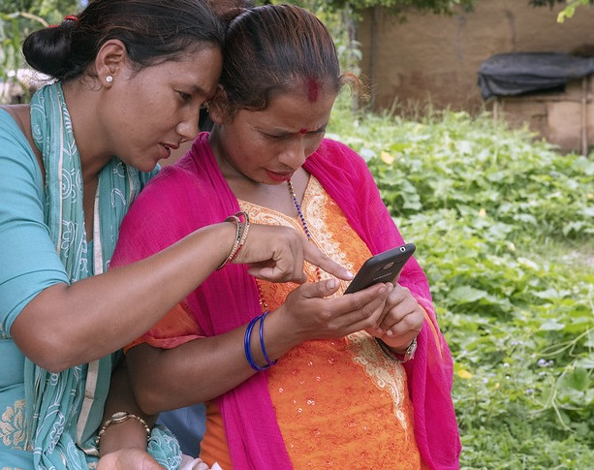
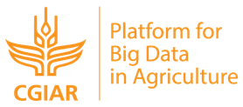
THANK
YOU

