Slide 1



Public private partnership (PPP) in herd health delivery: experience from SAPLING initiative
Wudu Temesgen
(on behalf of SAPLING health team)
International Livestock research Institute
Public-Private-Partnership for delivery of veterinary services
Review and validation of PPP models for scaling out
ILRIETH campus, Azage Auditorium, Addis Ababa 27 March 2025

Slide 2
outline
SAPLING initiative
SAPLING herd health innovations for small ruminants and dairy in Ethiopia
Public private partnership (PPP) in herd health delivery
The process of forming and implementing the PPP
Assessment of the feasibility of the PPP herd service delivery model
PPP assessment results
Conclusions

Slide 3
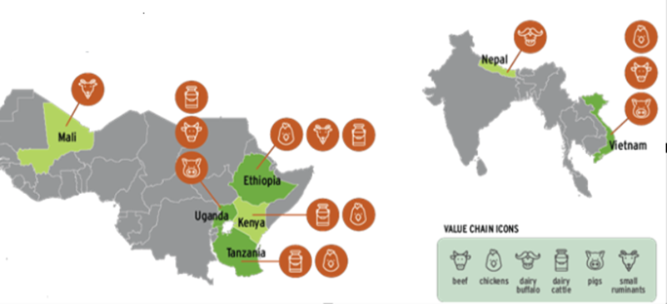
SAPLING initiative
SAPLING was one of the one-CGIAR initiatives that run from 2022-2024.
Sought to contribute transforming livestock sectors to make them more productive, resilient, equitable and sustainable.
It covered seven counties and 6 value chains
One of the work package of the initiative was to develop, adopt, and test innovations in feed, animal health and genetics.
SAPLING Ethiopia animal health component worked mainly on to two value chains
  Small ruminants and Dairy

Slide 4
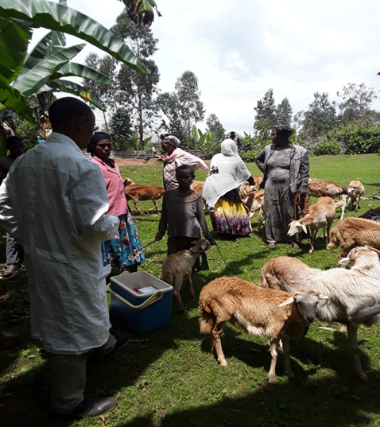
Herd health innovations for small ruminants and dairy in Ethiopia
Small ruminants: flock health and welfare management intervention
The intervention package
  strategic deworming and vaccination for priority diseases
  training and advisory services for farmers on flock health and welfare management
Delivery
  through public private partnership (PPP)
Monitoring and Evaluation
  Baseline and endline surveys
  Qualitative assessment
Implmetned in two districts (Doyogena and Angollelana Tara)

Slide 5
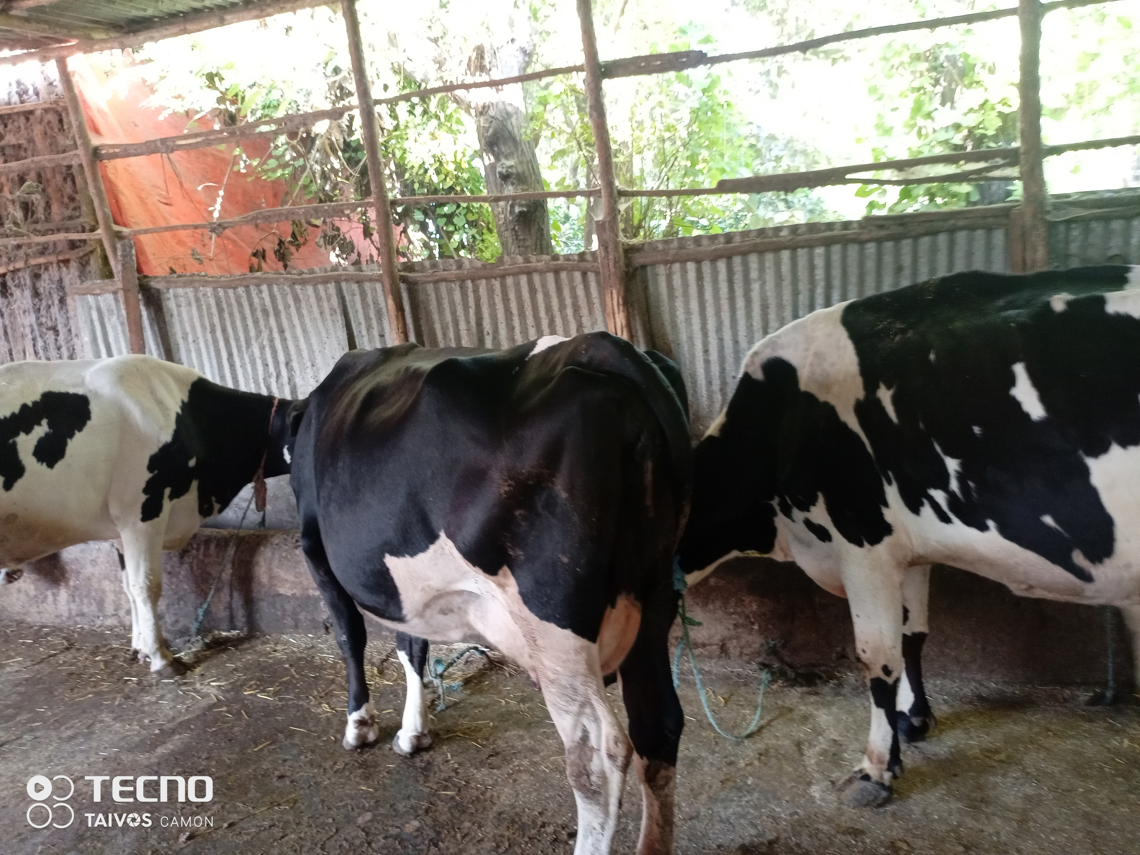
Dairy: herd health and welfare management intervention
The intervention package
  Preventive herd health services (vaccination and deworming)
  Treatment services for critical dairy health problems
  Training on herd health and welfare management
  Regular herd health visit
Delivery
  through private animal health service providers
Monitoring and Evaluation
  Baseline and endline surveys
  Qualitative assessment
Implmetned in two districts (Bahir Dar Zuria and Ada’a)

Slide 6
Public private partnership (PPP) in herd health delivery
Challenge with existing service model:
  Project-based interventions
  Cannot guarantee sustainability when the project support stops
New service model:
  A user-paid implementation of innovations to see their feasibility and sustainability
PPP to introduce the user-paid service
  An arrangement where the veterinary service is provided by private businesses with the support of the public sector for critical components that the private lacks

Slide 7
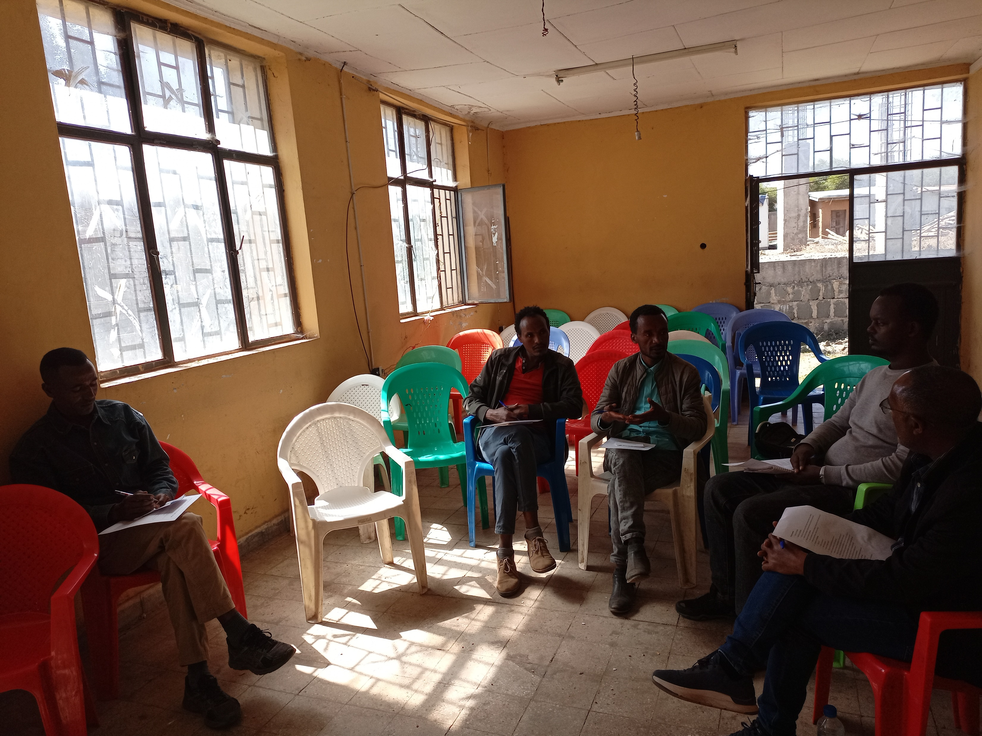
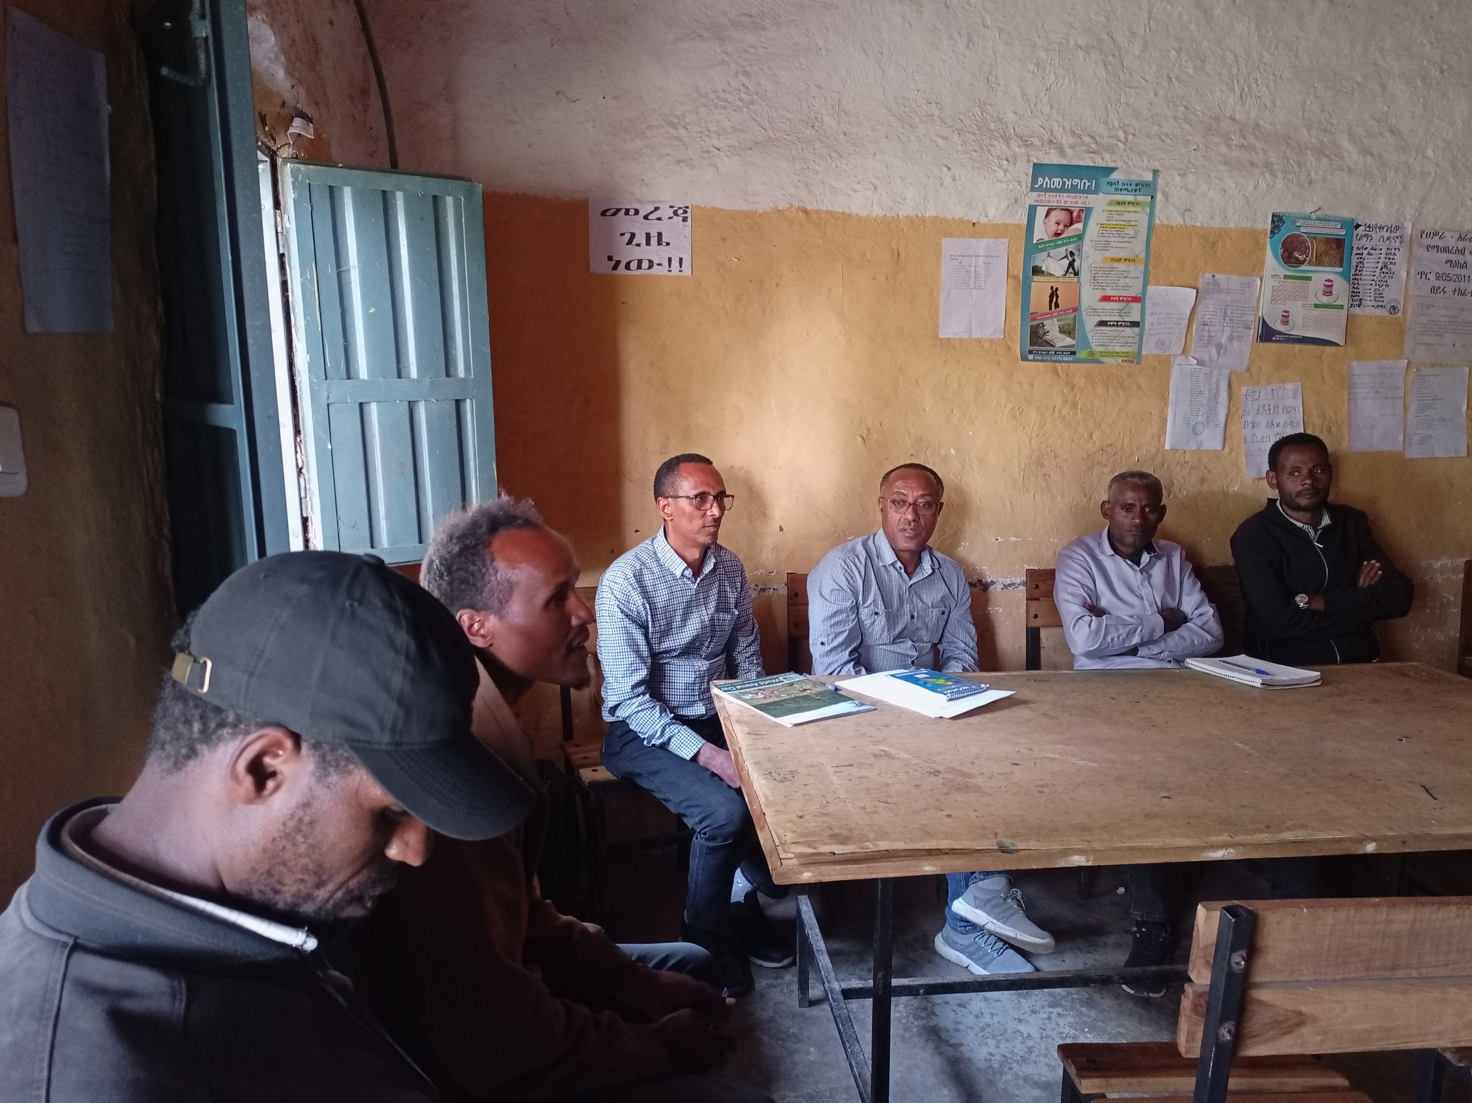
The process forming and implementing the PPP
Stakeholder consultations meetings (public animal health offices and community representatives )
  Explore challenges with the existing service delivery and determine the need for a PPP service delivery
  Explore opportunities and enabling conditions to introduce a fee-based service delivery model
  Identify success factors and conditions for the effective implementation of a PPP service delivery
Selection of private service providers
• Set criteria
• Identify potential private service providers and evaluate their performance
• Select and orient private animal health service providers

Slide 8
Form a PPP service agreement
Agreement between the public and private partners (and ILRI as facilitator and supporter) defining the roles and responsibilities of each party
Public partner (district animal health offices)
  allow the private provider to provide the defined flock health service as set in this agreement
  support the private service provider to provide accessible, quality, and affordable flock health service for the community
  provide the vaccines for diseases included in the flock health package in an amount sufficient to cover the target population in the selected community with the purchase price when the private provider asks for it.
  mobilize the community for the planned flock health interventions
  monitor and control the private service delivery to ensure it is being delivered according to the agreement

Slide 9
Private partner (private animal health provider)
provide flock health intervention as planned in the intervention calendar and with maximum possible quality and convenience for the small ruminant owners
provide the service with the agreed fees which include the drug and service cost (the list of services and fees annexed)
the fees are subjected to revision when decided by the steering committee of the partnership
keep records of all service provided
collect vouchers from users for the service provided according to the agreement for reimbursement

Slide 10
The supportive party (ILRI through local research partner )
Develop and revise the intervention package in consultation with the stakeholders
Provide subsidy vouchers (50% of service fee and drug asked by the private provider) for farmers who are using the flock health package
Reimburse the private provider for the voucher he collected from farmers.
Collect data and sample from the intervention and control flocks

Slide 11
Joint implementation steering committee
The coordination/steering committee composed of district animal health team leaders, private sector service providers, research partners, and end-user representatives.
The Role of committee:
  Create alignment among partners
  Define and agree on working modality and requirement
  Work together to create an enabling environment
  Define services, required quality standards, and delivery calendar
  Set negotiated service fees and adjust them as necessary
  Regularly review performance and address challenges
  Oversee implementation, facilitate communication and solve challenges
  Monitoring and evaluation of the PPP implementation

Slide 12
Assessment of the feasibility of the PPP herd service delivery model
The feasibility of the PPP service delivery model was qualitatively assessed using
  Key informant interview of the private and public partners and
  Focus group discussion of the user community members
The main themes of the assessment were
  Overall attitude towards the PPP and satisfaction on its performance
  Challenges or limitations
  Potential sustainability and scalability of the service model

Slide 13
PPP Assessment results
The users’ perspective
Generally found it better than the existing service provided by the government
  the availability and quality of drugs, the accessibility and responsiveness of the private provider
  The service are quality and faster
  50% fee support by the project
Limitation to be considered for future improvement
  Focused only preventive aspects
  Include only small ruminants
  Expensive (but some argued they pay more for services from other sources)

Slide 14
The private service providers’ perspective
Found it useful
  Moderate business growth (in the existing business) due to involvement in the PPP
  Mobilization of the community by the public partner for getting the animal health services
  Satisfactory support of the public partner in supply of vaccine and cold chain storge for vaccines
Limitations to be considered for improvement
  Increasing cost of veterinary inputs need more frequent adjustment of fees
  Limited geographic scope of the service
  Insufficient mobilization of the community
  Concerns of sustainability as the farmers were supported by a project.

Slide 15
The public partners’ perspective
- The model worked better than the existing service delivery
  Mitigated problem of budget shortage and delay in the government service
  Noted the satisfaction of community with private service
  Appreciated the importance of engaging private sector in animal health delivery
Limitation
  Tendency of private providers to be more profit driven and focus on treatment than prevention

Slide 16
Conclusions
Generally, all three stakeholder in the PPP arrangement: the users, public partner and the private service provider showed positive attitude to the delivery model, and they think this can be sustainable and scalable and with some suggestions for improvement.
One of the major limitations mentioned by all parties was the limited scope of the service mandated to the private provider.
However, the scope was limited only for the project work, which was subsidized, and this complaint implies the demand for expansion of subsided services.
Therefore, further evaluation may be needed with wider application and full cost coverage by users to ascertain the feasibility and sustainability of the model
References
Public-private partnership service delivery model for small ruminant flock health package: Concept and implementation approach: https://hdl.handle.net/10568/130973
Assessing public-private partnerships for small ruminant flock health service delivery in Ethiopia:
https://hdl.handle.net/10568/159801

Slide 17
Thank you!!

