Slide 1
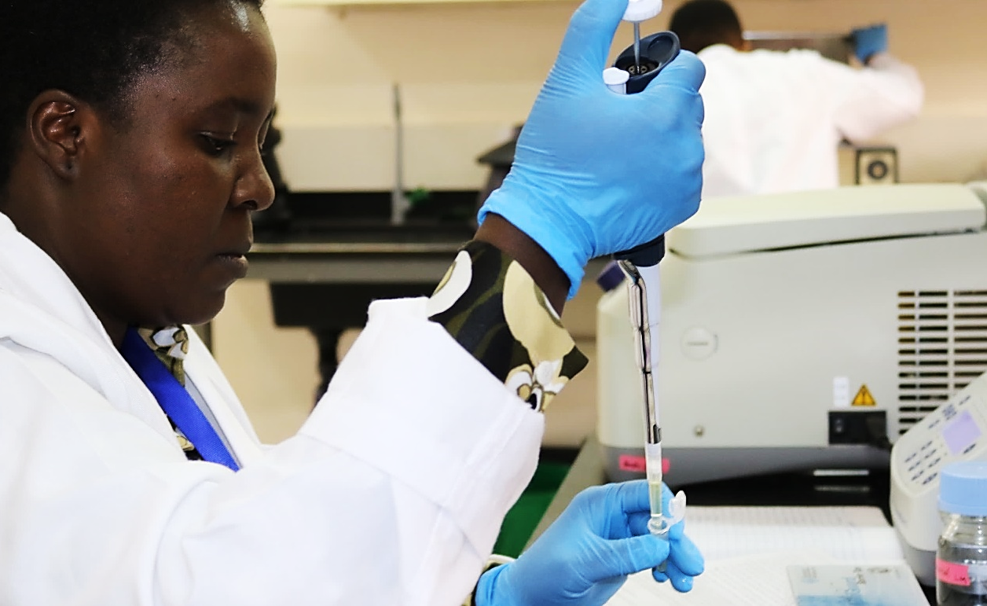
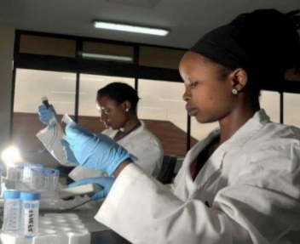
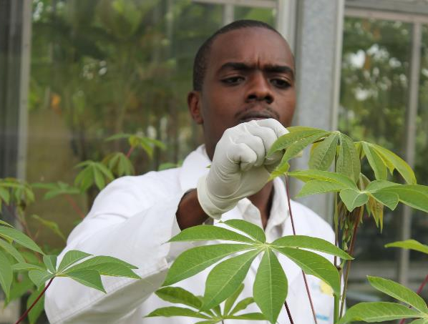
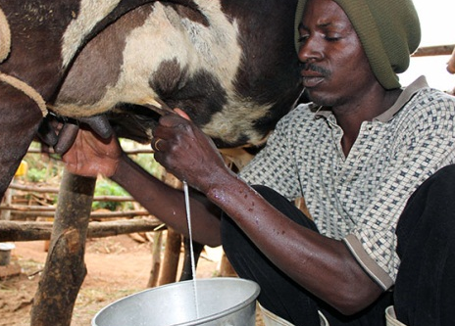



Accelerating Africa’s agricultural
development through biosciences
Background one nice photograph with
Title
Established by the African Union New Partnership for Africa’s Development and the International Livestock Research Institute, the BecA-ILRI Hub is a state-of-the-art shared biosciences facility to accelerate agricultural development in Africa
Why?
Improved accessibility of high-end biosciences infrastructure within Africa accelerates agricultural development
Strengthening capacity of African scientists and institutions to use and apply high-end biosciences tools facilitates the adoption of new technologies
Mobilizing bioscience capacities in Africa and beyond enhances joint actions to increase productivity, sustainability and resilience
70 new scientists using high-end facilities
each year
Over 1,000 African scientists trained
in fellowships and workshops since 2010
Products
Accessible state-of-the-art bioscience research facilities for African agricultural development
Tailored capacity development to enable African scientists and institutions to apply bioscience tools to solve agricultural challenges
Bioscience research solutions to address crop and livestock improvement, food safety and improved nutrition, climate change mitigation and adaptation
Milk production doubled in Kenya and Rwanda where climate-smart Brachiaria forages introduced
We thank all donors that globally support our work through their contributions to the CGIAR system
This poster is licensed for use under the Creative Commons Attribution 4.0 International Licence (January 2018)

