Slide 1
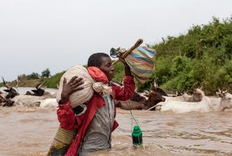
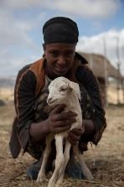
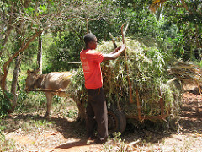
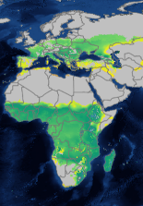





CLEANED tool: Live spatial simulation to develop a shared vision for a sustainable livestock value chain transformation
Catherine Pfeifer (ILRI) , Joanne Morris (SEI) and Victor Mose (LocateIT)
Free and Open Source Software for Geospatial (FOSS4G) Conference, Dar es Salaam, Tanzania, 28 August–3 September 2018
Notes:
There MUST be a CGIAR logo or a CRP logo. You can copy and paste the logo you need from the final slide of this presentation. Then you can delete that final slide
To replace a photo above, copy and paste this link in your browser: http://www.flickr.com/photos/ilri/sets/72157632057087650/detail/
Find a photo you like and the right size, copy and paste it in the block above.

Slide 2
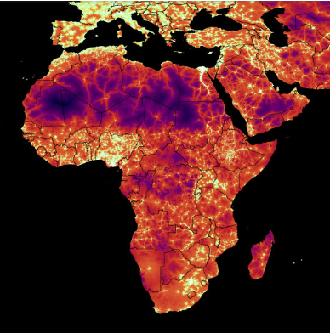
Quiz
Where can you download this map?
A global map of travel time to cities to assess inequalities in accessibility in 2015
Quiz | Intro | Tool general | Set-up | Use | Conclusion

Slide 3
Quiz
Where can you download this map?
A global map of travel time to cities to assess inequalities in accessibility in 2015
https://map.ox.ac.uk/research-project/accessibility_to_cities/
D.J. Weiss, A. Nelson, H.S. Gibson, W. Temperley, S. Peedell, A. Lieber, M. Hancher, E. Poyart, S. Belchior, N. Fullman, B. Mappin, U. Dalrymple, J. Rozier, T.C.D. Lucas, R.E. Howes, L.S. Tusting, S.Y. Kang, E. Cameron, D. Bisanzio, K.E. Battle, S. Bhatt, and P.W. Gething. A global map of travel time to cities to assess inequalities in accessibility in 2015. (2018). Nature. doi:10.1038/nature25181.
Quiz | Intro | Tool general | Set-up | Use | Conclusion

Slide 4

Quiz
How do you interpret the following map?
Crop-specific actual evapotranspiration (mm) for intermediate input level rain-fed maize for baseline period 1961-1990
Source : GAEZ (FAO platform)
Quiz | Intro | Tool general | Set-up | Use | Conclusion

Slide 5
Quiz
Where can you find map of socio-economic indicators at subnational scale ?
Quiz | Intro | Tool general | Set-up | Use | Conclusion

Slide 6
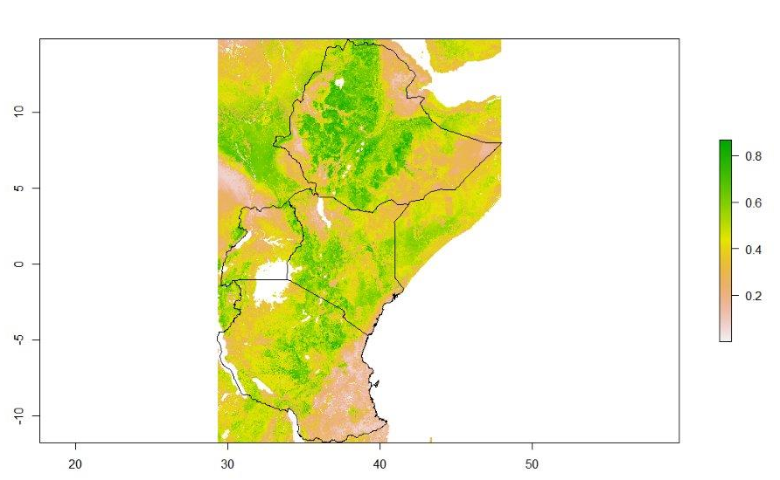
Quiz
Where can you find map of socio-economic indicators at subnational scale ?
Percentage of cattle keepers
DHS data
https://dhsprogram.com/
Standardized household surveys
Geo-referenced
More than 30 African countries
Quiz | Intro | Tool general | Set-up | Use | Conclusion

Slide 7
Introduction
Rarely used open source GIS data for Africa
People don’t know it exists
People lack in GIS skills to work with it – partially addressed with portals
People do not know how to interpret it
Quiz | Intro | Tool general | Set-up | Use | Conclusion

Slide 8

Decision making support tool for African context
What level of detail is “good enough”?
Complex environmental models
Data intensive
Locally relevant results
Long implementation phase
Simple environmental models (single dimension)
Relies on secondary data
Too general for local relevance
Rapidly implementable
Quiz | Intro | Tool general | Set-up | Use | Conclusion

Slide 9
Creating a decision making support tool for livestock value chains
Rarely used open source GIS data for Africa
people don’t know it exists
People lack in GIS skills to work with it – partially addressed with portals
People do not know how to interpret it
Decision making support tools for African decision maker
Are not context specific
Or implement too slowly
CLEANED
TOOL
Quiz | Intro | Tool general | Set-up | Use | Conclusion

Slide 10
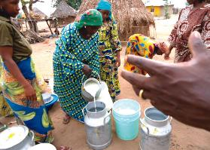
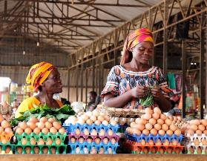

Why a decision making support tool for livestock?
Demand for animal sourced food will double in Africa
Livestock food products improve nutrition (reduced malnutrition)
Livestock production can have significant environmental impacts
Livestock is key to sustainable agricultural transformation
Livestock can be transformational for the livelihoods of the poor
Quiz | Intro | Tool general | Set-up | Use | Conclusion

Slide 11
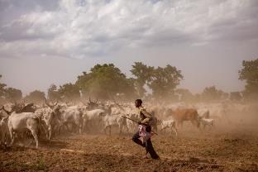

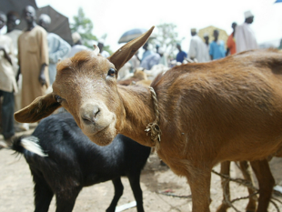
What is CLEANED ?
Decision making support tool for livestock value chains
Spatial rapid ex-ante environmental assessment for decision makers
To understand environmental dynamics from livestock
Raise awareness about spatial planning
Engage a multi-stakeholder dialogue
Provide a neutral base to negotiate trade-offs
Develop inclusive locally relevant livestock transformation plans
Quiz | Intro | Tool general | Set-up | Use | Conclusion

Slide 12

Environmental impacts from livestock
Environmental dimensions :
                Water use intensity from feed and fodder
                Greenhouse gas emissions
                Biodiversity change
                Soil health
Based on user defined livestock keeping systems
Quiz | Intro | Tool general | Set-up | Use | Conclusion

Slide 13
Set-up of the CLEANED tool
GIS pre-processing code
resampled open access data
Water impact
Production and land allocation module
Greenhouse gas
Expert defined livestock systems
Bio-diversity
Land use change module
Soil nitrogen balance
R-shiny online and stand alone interface

Slide 14
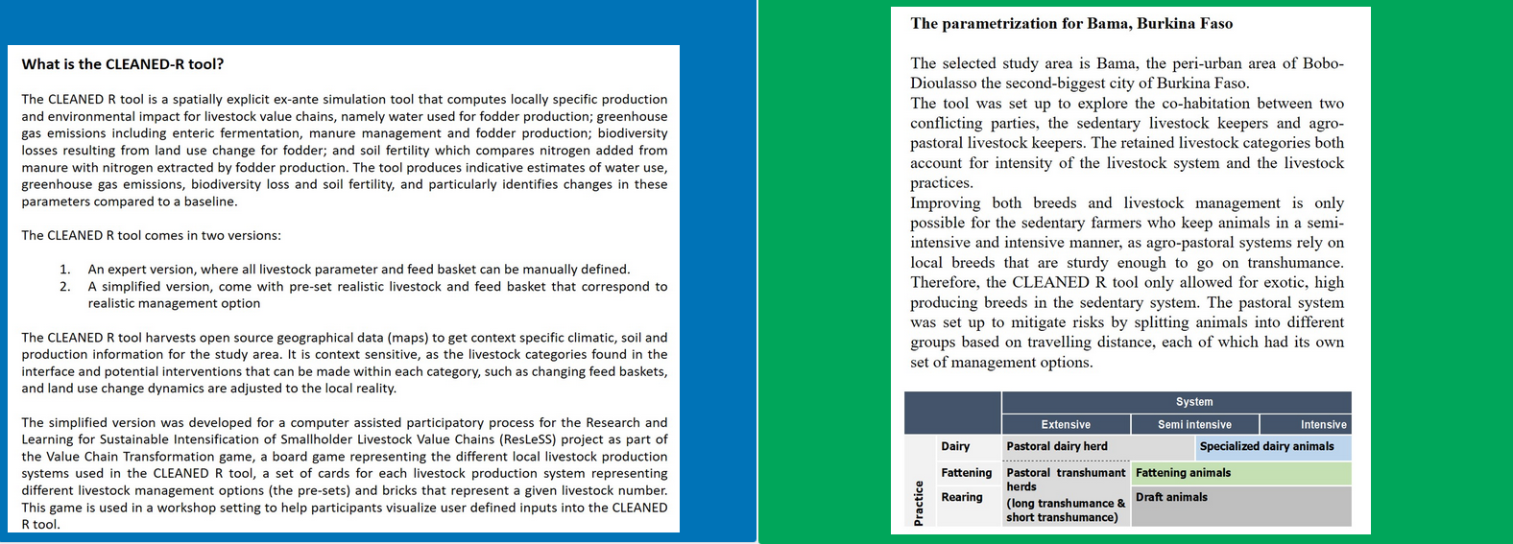
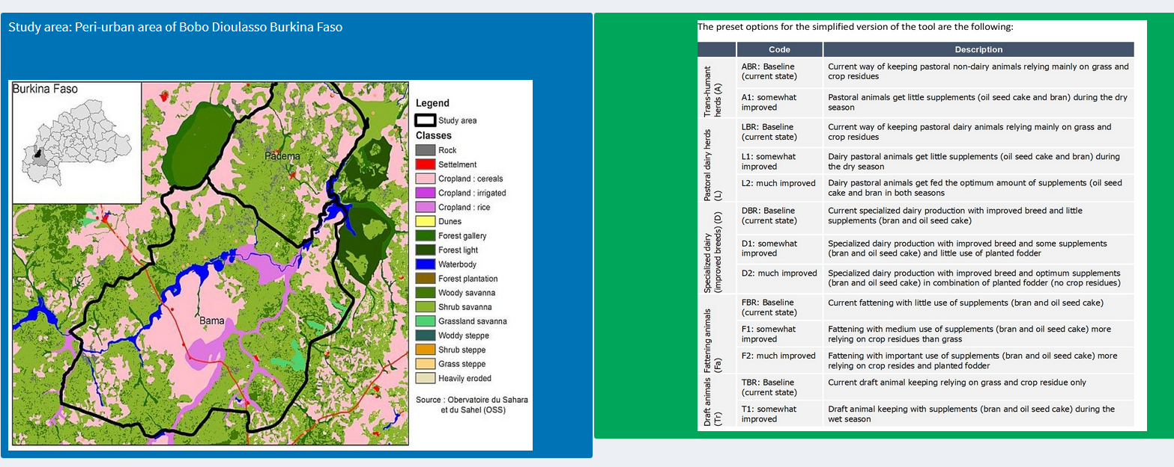
Interface for Bama site in Burkina Faso
Quiz | Intro | Tool general | Set-up | Use | Conclusion

Slide 15
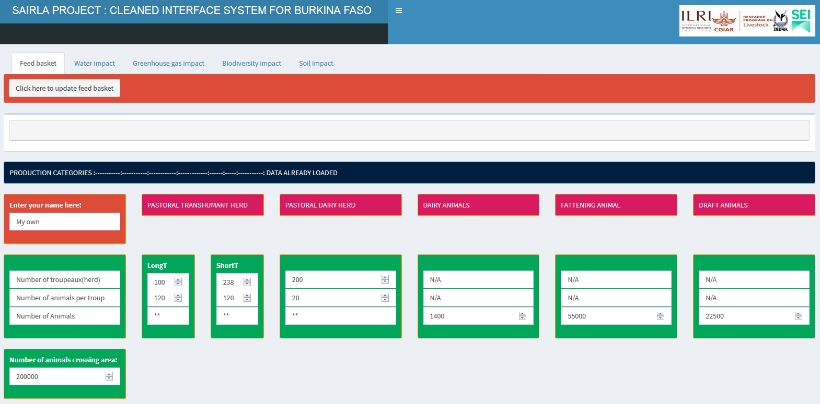
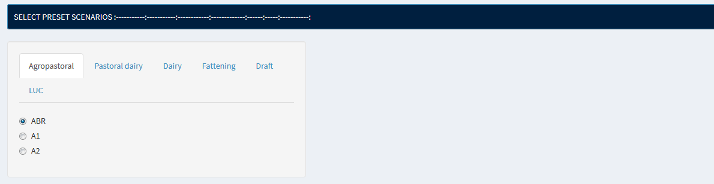
Interface for Bama site in Burkina Faso
Quiz | Intro | Tool general | Set-up | Use | Conclusion

Slide 16
Impact computation in CLEANED
module | Model used | GIS layer
Production and land allocation | IPCC energy requirement per animal in each category Allocates the total energy to land cover based on crop and grazing land | Land cover (OSS) Maize, legume and grass productivity (GAEZ)
Land use change | Grazing land is converted to cropland based on suitability | Suitability for cropland (GAEZ)
Water | Evapotranspiration of the biomass fed to livestock | Evapotranspiration (GAEZ) Rainfall (WorldClim)
Greenhouse gas emissions | IPCC tier II computation | IPCC soil & climate layer Temperature (Worldclim)
Biodiversity | IUCN red list allocated to land cover
Soil nitrogen balance | Nitrogen balance (Smaling 1993) including an erosion model (RUSLE) | Soil characteristics (soilgrids) Elevation (CSI) Soil erosivity factor (A.Vrieling) LAI (modis)
Quiz | Intro | Tool general | Set-up | Use | Conclusion

Slide 17
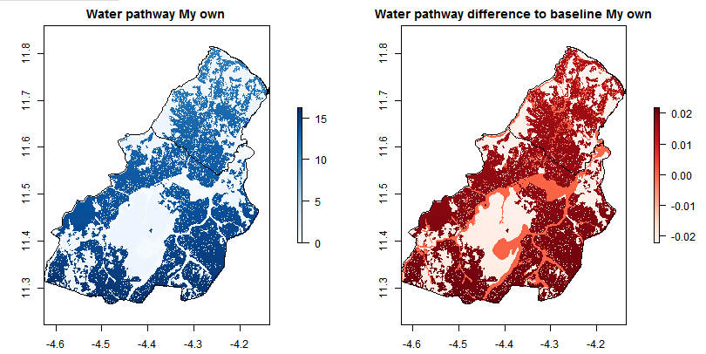
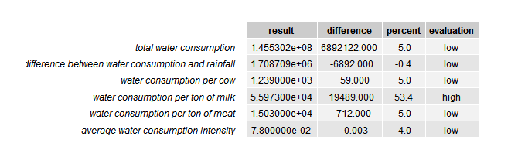
Example of a CLEANED output (Bama)
Quiz | Intro | Tool general | Set-up | Use | Conclusion

Slide 18
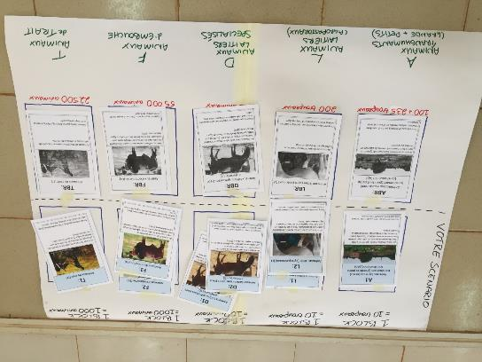
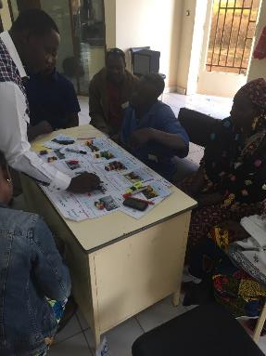

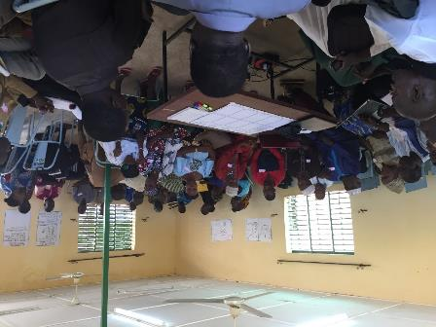
Use of the CLEANED tool for engagement
In Burkina Faso this leads to:
sedentary farmers get dairy breeds and feed them with concentrates
pastoralists can use grass as feed
Quiz | Intro | Tool general | Set-up | Use | Conclusion

Slide 19
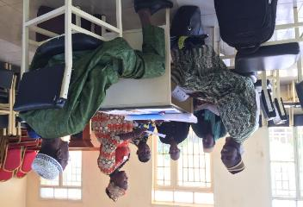
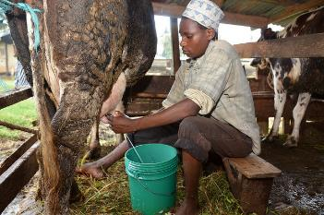
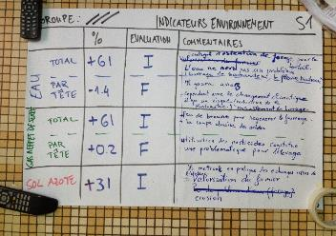
Conclusion
Spatial data can influence learning, policy and decision making
But tools to interpret spatial data are needed
Open data needs to be enhanced with other sources and expert knowledge
Stakeholder engagement is key to results
Quiz | Intro | Tool general | Set-up | Use | Conclusion

Slide 20



Find the tools here :
https://ilri.shinyapps.io/CLEANED_BFA_Bama_ResLess/
https://github.com/pfeiferc/CLEANED-R

