Slide 1
Gender Transformative Approaches in agrifood systems
A course in four modules
Version 1 (2024)
Elizabeth Costenbader, Anjalee Kohli, and Steven Cole

Slide 2
Welcome

Slide 3

Introductions
In chat:
What are you hoping to learn today?
Notes:
Read Slide

Slide 4
OVERALL Learning Objectives
Objective 1
Objective 2
Objective 3
Objective 4
Understand the value of using gender transformative approaches in agrifood systems
Understand concepts important to gender transformative approaches
Understand how gender transformative approaches are operationalized
Understand how to measure gender transformative change
Notes:
Read Slide

Slide 5

Our Roadmap
We are here!
1
2
3
4
Gender transformative approaches
in agrifood systems
Characteristics important to gender transformative approaches
Operationalizing gender transformative approaches
Measuring gender transformative change
Notes:
Read Slide

Slide 6

RECAP
In chat:
Share one thing you learned in Module 3
Notes:
Ask people to share in chat or verbally

Slide 7
RECAP
In chat:
Are there any lingering questions or comments before we dive into Module 4?
Notes:
Ask people to share in chat or verbally

Slide 8
Measuring Gender Transformative Change
Module 4
Notes:
Read Slide

Slide 9
Learning Objectives
1
Become familiar with a framework for measuring gender transformative change
2
Get ideas for how to measure each dimension of gender transformative change
3
Learn about a process to develop gender transformative change indicators and existing resources for gender transformative change measurement
4
Practice developing gender transformative change indicators
Notes:
Read Slide

Slide 10
CONTENTS
1
What and where to measure: A framework for measuring gender transformative change
2
How to measure gender transformative change
3
Stepwise process to develop gender transformative change indicators
4
Case study activity, developing gender transformative change indicators
5
Final points to keep in mind with gender transformative approaches
Notes:
Read Slide

Slide 11
What AND where to measure:
A framework for measuring gender transformative change
Section 1
Notes:
Read Slide

Slide 12
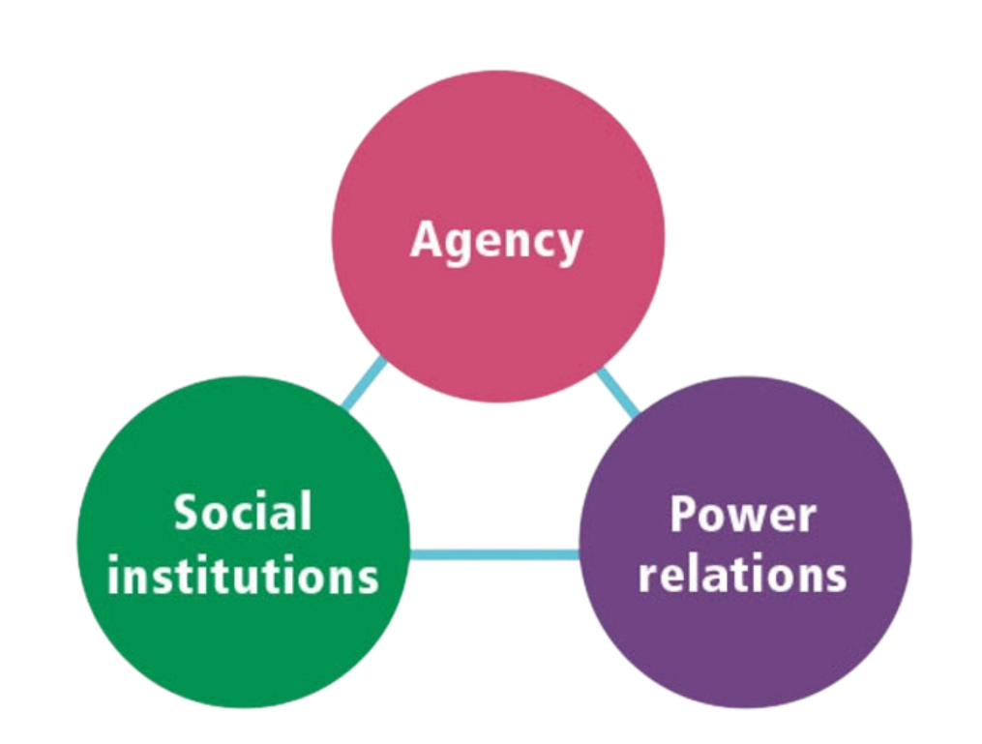
Transformative change:
3 Key Dimensions
The 3 dimensions of GTC are deeply interconnected with the others and all need transformation to achieve GTC.
Critical analysis and awareness of how power inequalities affect relationships and opportunities, network-building to strengthen relationships, and organizing to influence structural change all require individual and collective agency.
The core of measuring gender transformative change is the understanding that discriminatory social institutions and unequal power relations need to change.
Sources: FAO, IFAD, WFP & CGIAR Gender Impact Platform 2023; Hillenbrand 2015; CARE 2018; Martinez 2006
Notes:
As shown, there are 3 core dimensions of GTC, where transformation is needed to advance gender equality. Each dimension deeply interconnected with the others
& there is evidence that programming risks reversibility and harm if it fails to engage with all 3 dimensions
At the core of measuring gender transformative change is the understanding that discriminatory social institutions and unequal power relations need to change, and that there is value in assessing how deep and enduring any changes have been to date. Social institutions that embed and (re)produce unequal power relations between women and men in a circular reinforcing process are the root causes of gender inequality. These institutions comprise formal and informal rules and norms that organize social, political and economic relations. The transformation of social institutions to make them more gender-equitable fosters more cooperative forms of power and relationships, affirming people’s capabilities, aspirations, critical awareness and dignity and requires individual and collective agency, which are at the heart of the empowerment process.

Slide 13


Social Institutions/Structures
Embed and (re) produce unequal power relations between men and women, and are the root causes of gender inequalities.
Structure how social relations play out in the institutional arenas of the household, community, value chain and state.
They consist of both formal “written” and informal rules and norms.
Notes:
Read slide & then note…GTAs seek transformation of social institutions to make them more gender equitable

Slide 14
Power Relations
GTC move away from power over toward building more positive expressions of power—related to agency.
Power over and power with measure differentials within dyads/groups/ organizations whereas power to and power within are more individual.
Measure changes in several of these:
Power with
involves finding common ground among shared and different interests and building collective strength through mutual support, solidarity and collaboration
Power within
involves a person’s capacity to imagine and have hope. Related to a person’s sense of self-worth and self-knowledge
Power to
involves activating a person’s capacity to act (their power within) in the real world
Power over
involves using power to repress, force, coerce, discriminate against, corrupt or abuse others
Source: FAO, IFAD, WFP & CGIAR Gender Impact Platform 2023
Notes:
Gender-transformative change is ultimately about transforming power relations, which can be understood by recognizing different forms of power. Read the slide

Slide 15
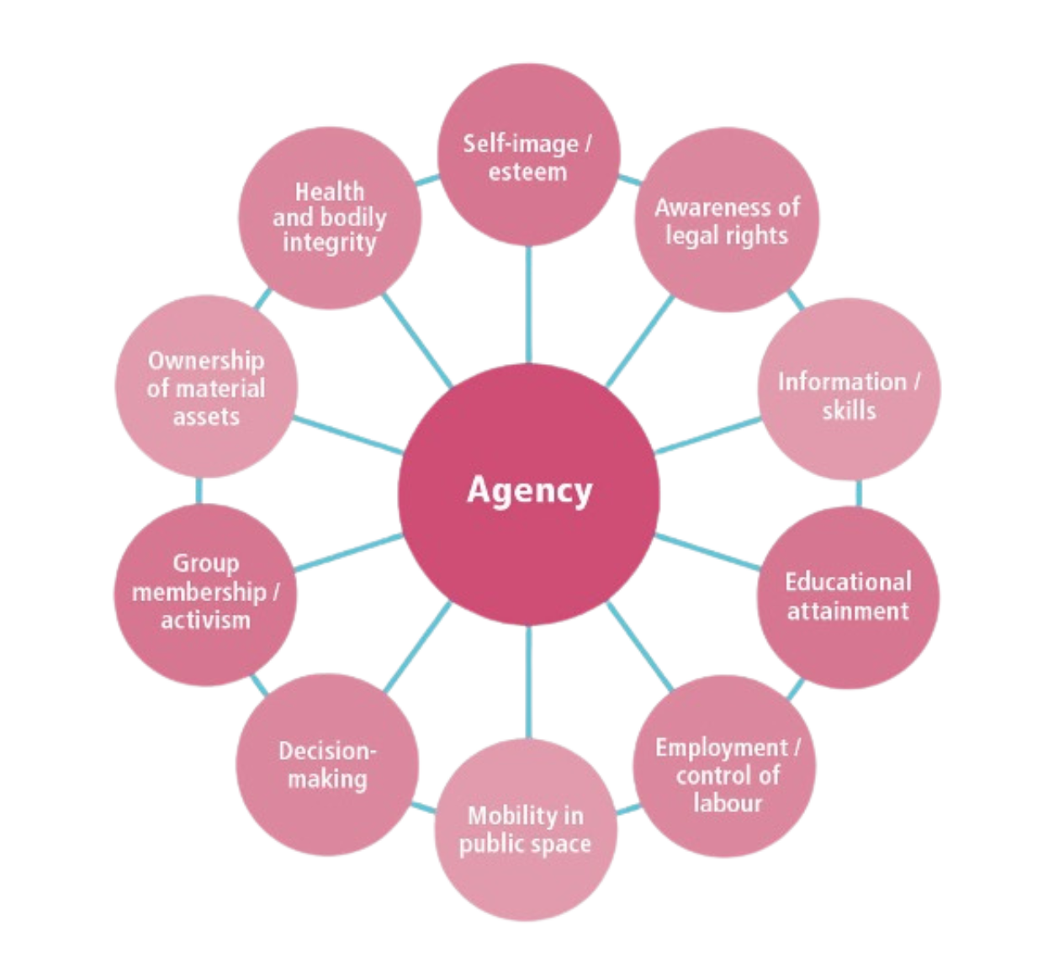
Agency
Ability to define one’s goals and act upon them.
Exercised at the individual and group levels via cooperative relations and collective action.
Entails building confidence, consciousness, aspirations and self-esteem, as well as improving knowledge, skills and capabilities.
Several subdimensions of agency that can be considered when measuring gender transformative change.
Sources: FAO, IFAD, WFP & CGIAR Gender Impact Platform 2023; Kabeer 1999; Mosedale 2005
Notes:
There are different definitions of Agency but agency is the… read slide and explain discuss different subdimensions of agency

Slide 16

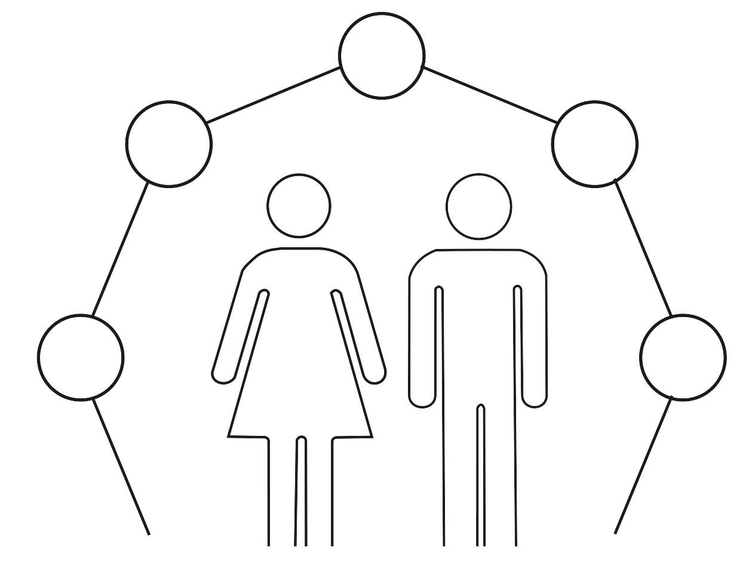
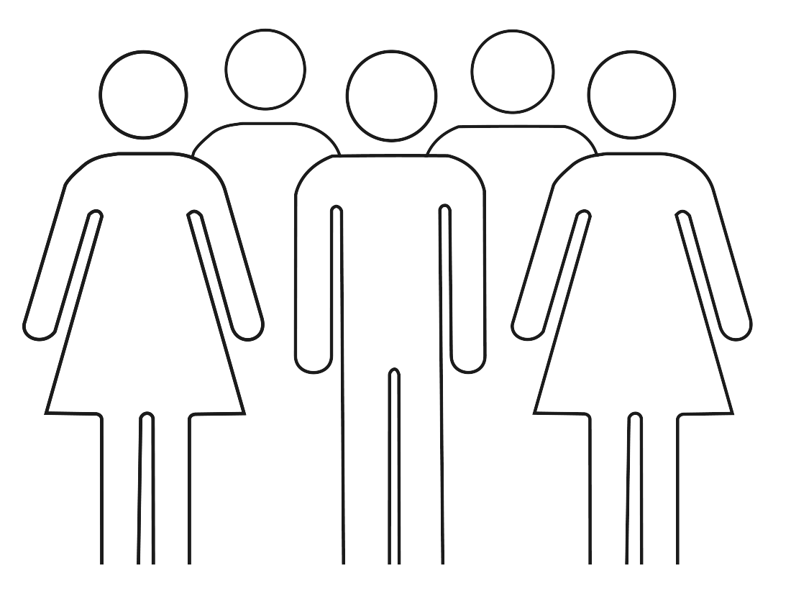
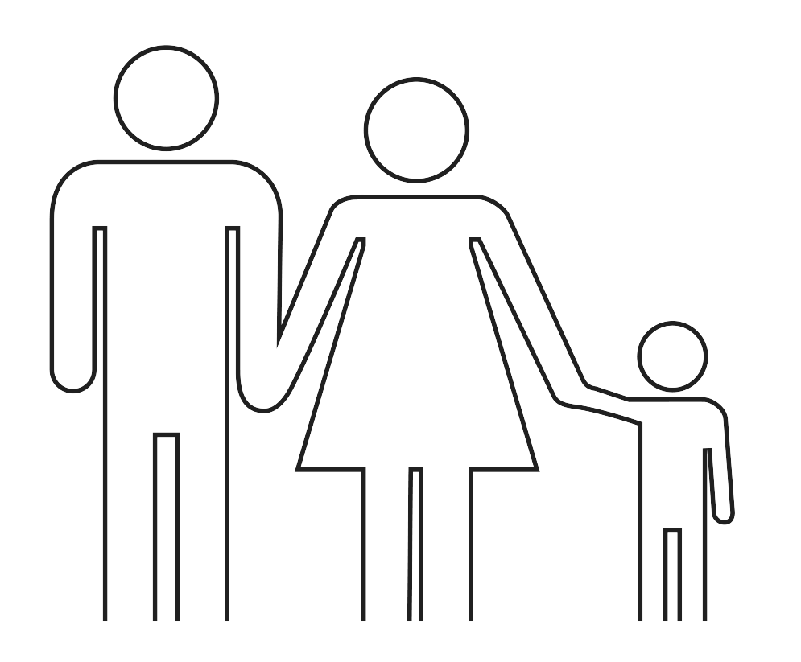

Where to measure change?
Macroenvironmental
(government, donors, development banks)
Organizational
(public/private sector, research and development organizations, civil society)
Gender influences social and power relations at different levels.
Levels of influence are nested not independent: factors at one level can influence factors at another level.
Community
(leaders, local service providers, groups)
Household
(families, intrahousehold relationships)
Individual
(women and men)
Notes:
Read Slide

Slide 17

Macroenvironmental
(government, donors, development banks)
Organizational
(public/private sector, research and development organizations, civil society)
Community
(leaders, local service providers, groups)
LEVELS OF INFLUENCE
Formal social institutions (policies/laws)
Household
(families, intrahousehold relationships)
KEY DIMENSIONS
Let’s discuss: What types of things would you put in these circles?
Individual
(women and men)
Power relations
Agency
(individual and collective)
Informal
social institutions (social and gender norms)
Source: FAO, IFAD, WFP & CGIAR Gender Impact Platform 2023
Notes:
This is a participatory activity to get audience to think about what might go in these circles. Read Slide

Slide 18
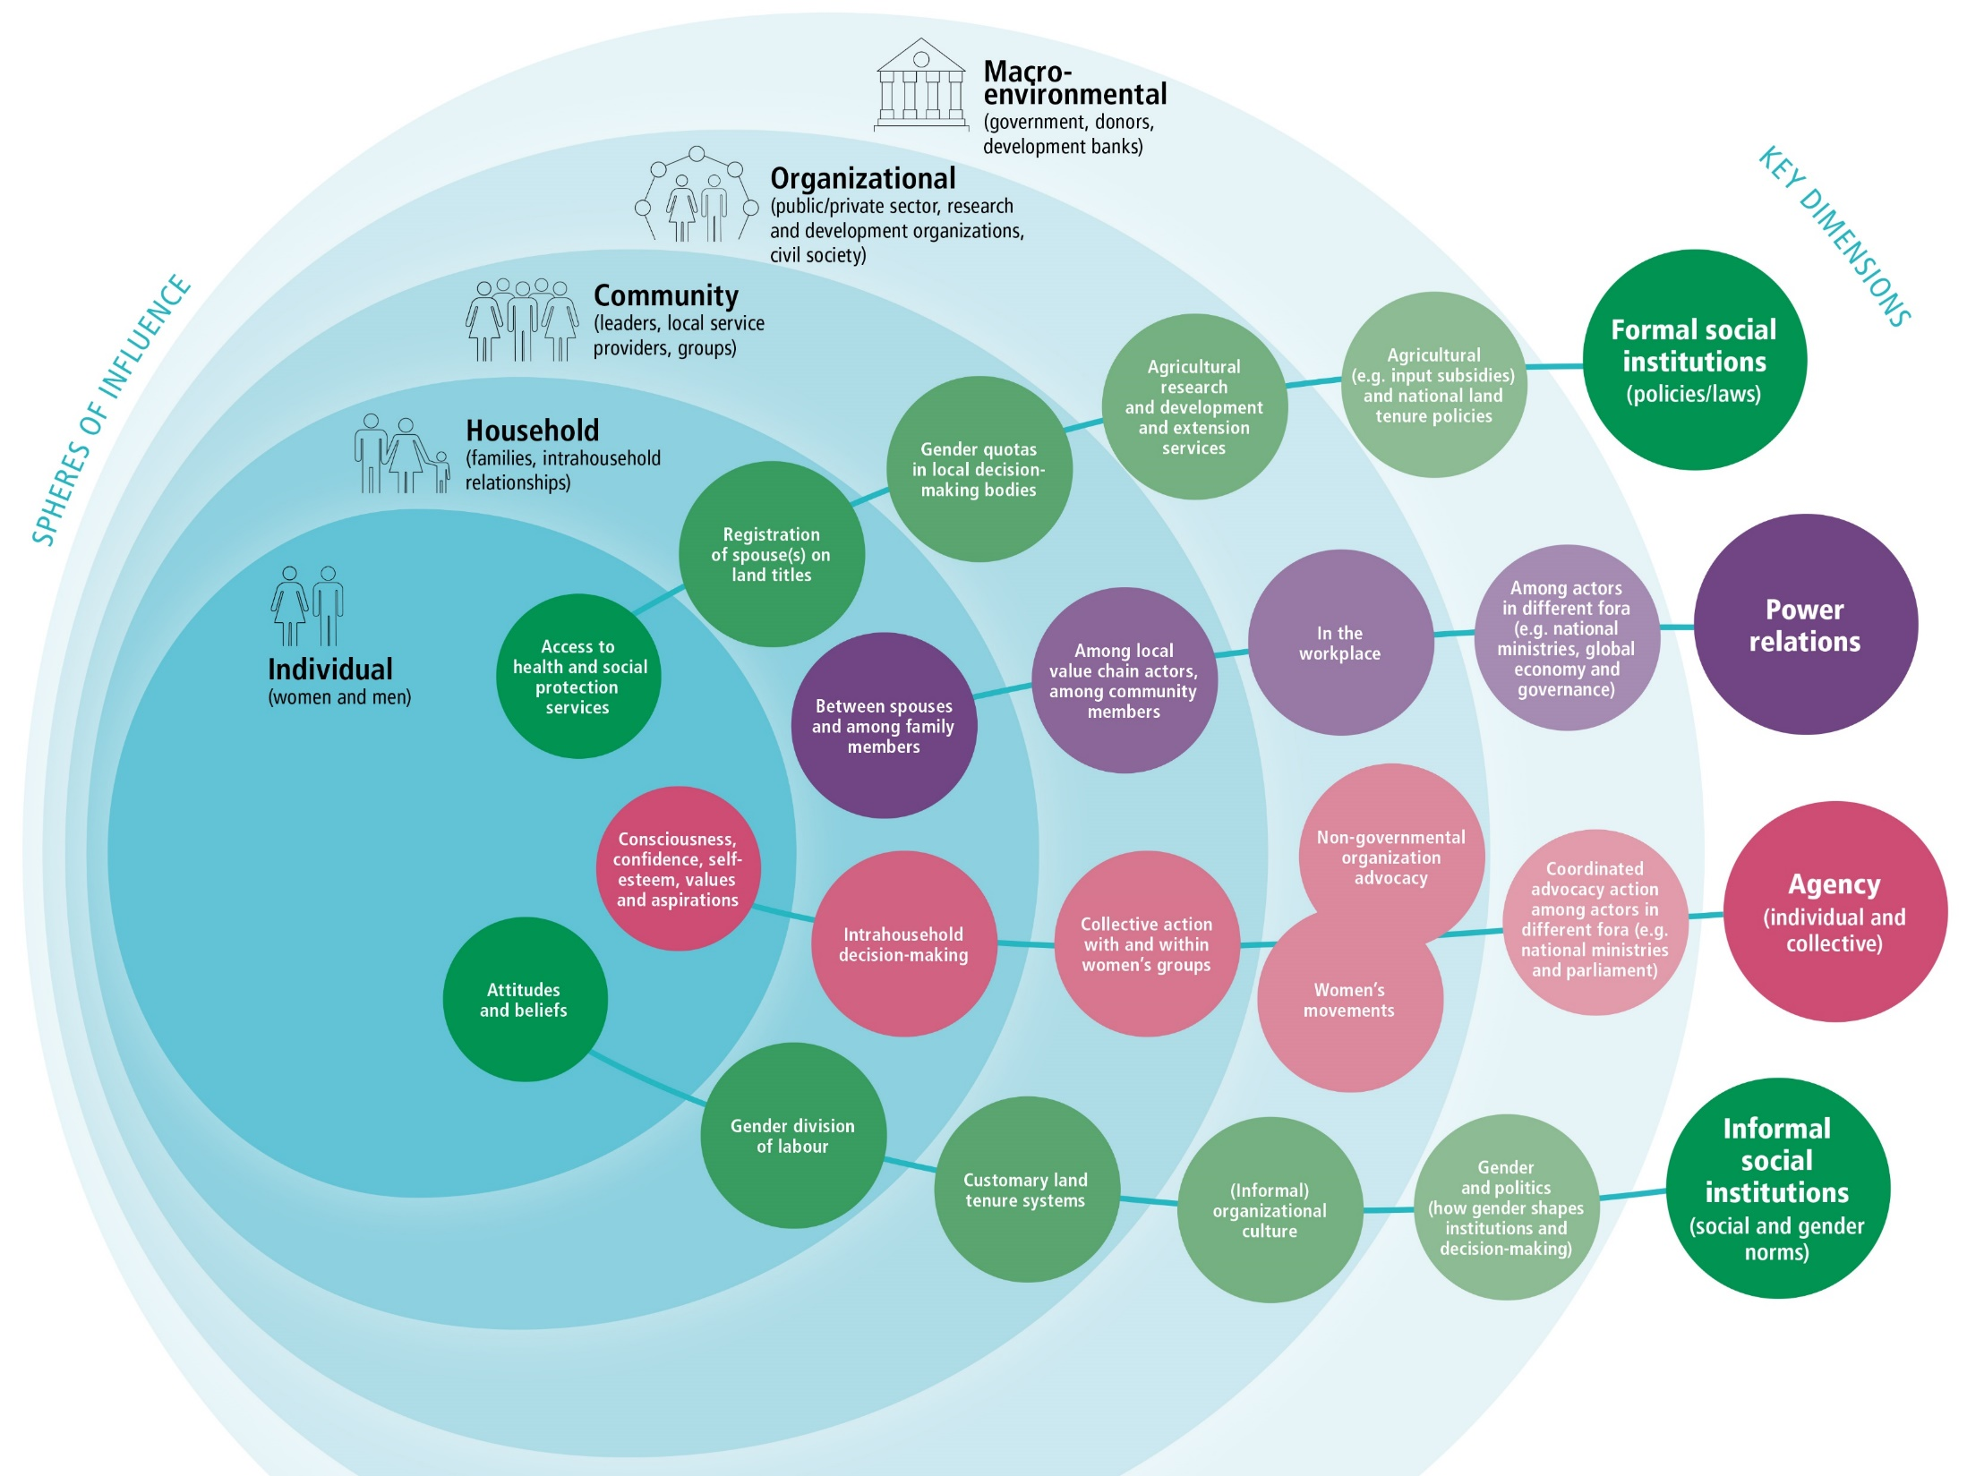
Framework for measuring GTC
Source: FAO, IFAD, WFP & CGIAR Gender Impact Platform 2023
Notes:
Go over what framework includes

Slide 19
How to measure gender transformative change
Section 2
Notes:
This section focuses on illustrations of measurement of GTC dimensions

Slide 20
Social institutions
Notes:
First let’s look at potential indicators of changes in social institutions

Slide 21
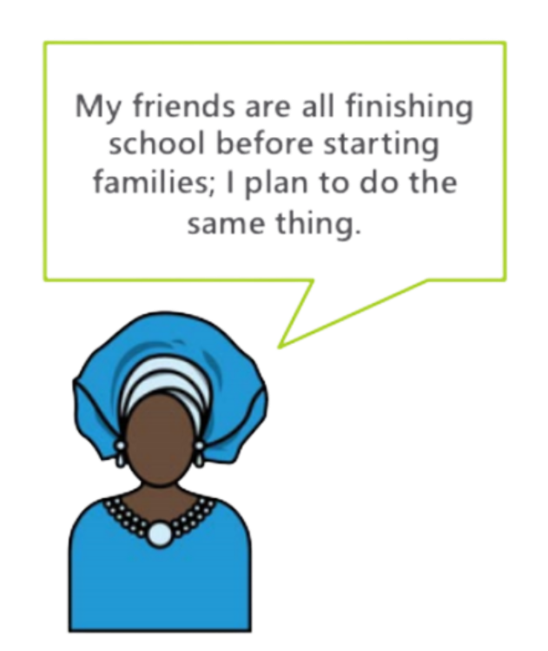

Social Institutions/Structures
    Formal
    Written constitutions, policies and laws, rights and regulations
    Informal rules and norms
    “Unwritten” social norms, customs, values, traditions and sanctions
Image source: law-book-with.jpg
Image source: Social Norm Taxonomy West Africa | Breakthrough ACTION and RESEARCH
Notes:
Social Institutions that influence gender inequality are of two types formal “written” and informal “unwritten” rules and norms. Read Slide
Image source on the left: law-book-with-gavel-860137962-5ada782ba9d4f9003dc76ee5.jpg (3936×2530)
Image Source on the right: New Social Norm Taxonomy Helps Address Family Planning Challenges in West Africa | Breakthrough ACTION and RESEARCH

Slide 22

Formal Social Institutions:
Land Governance example indicators
Macro-environmental
New laws are passed allowing women to inherit land rights; or the government signs on to an international statement of commitment to women’s enhanced land rights.
Organizational
Organizational by-laws are changed to allow women’s and girls’ rights to land.
Organizational
Organizational by-laws changed to allow women and girls’ rights to land
Community
Land rights are socially recognized as appropriate for men and women in the community.
Organizational
Organizational by-laws changed to allow women and girls’ rights to land
Household
Women’s ability to exercise land rights to cultivate, does not require consultation or approval from their husband.
Individual
Women report enhanced agency to act as owners of land parcels.
Source: SBCC and Gender: Models and Frameworks
Notes:
In terms of formal social institutions that could affect gender, here are some examples of formal social institutions at different levels of the SEM that can affect gender equality in land governance. Read Slide

Slide 23


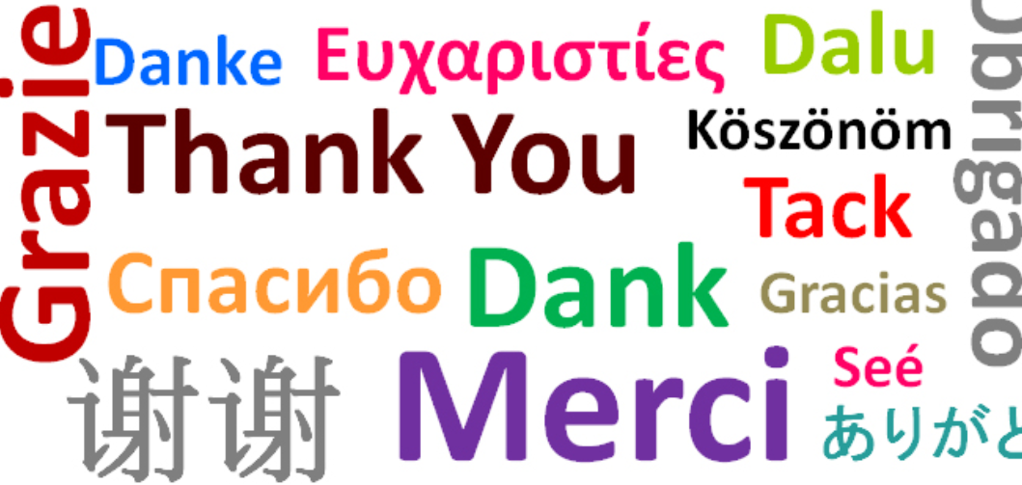

Informal Social Institutions
    “Unwritten” social norms
    “Unwritten” customs, values, traditions and sanctions
None of the women I know in this community go to the market by themselves.
My community members do not approve of women participating in village meetings.
Images source: MS powerpoint stock images
Notes:
In terms of informal social institutions, we are referring to both social norms as well as social and cultural customs, values and traditions such as shown here.. The practice of shaking hands or saying thank you, or the foods we eat and the utensils we use to eat with are just a few of many examples of social and cultural customs and traditions.

Slide 24
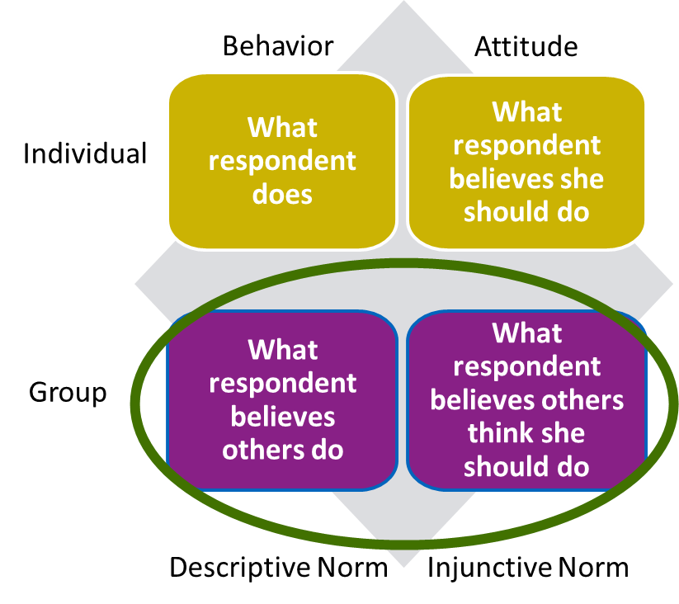
Informal Social Institutions: Social/Gender Norms
Theorists suggest that a social norm may be evidenced through the existence of either or both a descriptive and an injunctive norm.
Descriptive norms: perceptions about whether others do/perform the behavior
Injunctive norms: perceptions of whether others approve or disapprove of a behavior
Sources: Chung & Rimal 2016; Bicchieri 2015; Learning Collaborative to Advance Normative Change 2019
Notes:
As a reminder and as shown in this visual… read slide

Slide 25
Social/Gender Norms: Quantitative measures
    Descriptive norms
    Perceptions about whether others do/ perform the behavior
    Injunctive norms
    Perceptions of whether others approve or disapprove of a behavior
Examples: Of the women who you know who work with [cassava] in this community, how many do you think…
Go to cassava fields without their spouse/partner or a male relative?
Own agricultural land in their own name?
Examples: How many people in your broader community do you think would agree with the following statements?
It is inappropriate for women who work with cassava to go to cassava fields without their spouse/partner or a male relative
It is inappropriate for women who work in cassava to own agricultural land in their own name
Source: Seymour 2024
Notes:
Here are some examples of some questions you might ask to determine the existence of descriptive or injunctive norms. Read Slide

Slide 26
Practice Exercise: Fix My Measure
How can we improve these normative measures?
Do you think most women have a bank account?
How many of your friends and your religious leaders would you say send their daughters to university?
Among girls you look up to, do you think most wear hijab?
Do your community members approve of women running for office?
Would your family members disapprove if you had your own bank account or worked as an engineer?
Should a woman vote the way her husband tells her, even if she does not share his view?
Notes:
The aim of this slide is for the participants to discern and consider practical ways of measuring descriptive and injunctive norms. The measures presented are have common errors, and you’ll ask the participants to fix them. Display one question at a time and ask participants:
How would you improve it?
Which are direct and indirect measures?

Slide 27
Suggested revised measures
Of the women you know in your community, how many do you think have a bank account?*
Of the religious leaders you know in your community how many do you think send their daughters to university?* AND
Of your friends in this community, how many do you think send their daughters to university? *
3. Of the upper-form girls in your school, how many do you think wear hijab? *
How many people in your broader community do you think would agree with the following statements?*
4. It is inappropriate for women to run for office?
5. It is inappropriate for women to have their own bank account? AND
It is inappropriate for women to work as engineers?
6. It is inappropriate for a woman to vote differently than her husband, even if she does not share his view.
* Likert Scale response options: none, few, some, most, everyone
Notes:
Note that Qs 1- 3 asking about descriptive norms and 4-6 are asking about injunctive norms.
Problems with question 1, “most women” too vague needs specification/bounding… which women and written as a yes/no question… better as a likert scale response to get a sense of magnitude of prevalence. Read suggested revision.
Problems with question 2, asking about two different reference groups in one question. better as two questions - Read suggested revision.
Problems with question 3 ““most girls you look up to” too respondent-specific and written as a yes/no question… better as a likert scale response to get a sense of magnitude of prevalence. Read suggested revision.
Problems with question 4 written as a yes/no question… better as - Read suggested revision.
Problems with question 5 asking about two different behaviors in one question. Better as two questions. Read suggested revision.
Problems with question 6 as written “should” asks for personal judgement and written as a yes/no question… better as - Read suggested revision.

Slide 28
Norms sanctions:
Quantitative measure example
If you are given more freedom to move about in public spaces and play sports, how likely is it that the following consequences might occur? There is no right or wrong answer.
Responses:
Very likely: 1, Somewhat likely: 2, Not likely: 3.
A. You will be harassed by local boys or men.
B. You may encounter more arguments/conflicts with your parents.
C. You may find it more difficult to get married.
D. You may be considered uppity and disobedient.
Source: Parivartan – ICRW; Learning Collaborative to Advance Normative Change 2019
Notes:
In addition to measures of social norms, another aspect of informal social institutions/social norms you may want to measure are the existence of social sanctions if individuals do not conform to social norms. Here is an example of a quantitative way that social sanctions were measured as part of ICRW’s Parivartan project, which focuses on empowering adolescents to be active participants in sports, thereby empowering them to claim their own space in public and stand up to gender-based violence. Read question and response options on slide

Slide 29

Social/Gender Norm:
Qualitative measures
Guided storytelling methodology
Simple stories, with characters and scenarios relatable to context
Can minimize response bias and depersonalize discussions of sensitive issues
Vignettes
Source: Barter & Renold 1999; Learning Collaborative to Advance Normative Change 2019
Notes:
Vignettes are another approach to collect information about social norms and related social sanctions. Vignettes are… Read slide

Slide 30
Vignette example:
Women’s Financial Autonomy
Anjimile and Atima have three children ages ten, eight and six. They are both successful entrepreneurs who own grocery stores in the village. While resting at home, Anjimile informs her spouse that she wishes to open a bank account in order to save money. When Atima hears this, she becomes concerned that if Anjimile decides to save her money, whose money will be used in the house? Anjimile responds that it is a shared responsibility. Atima objects, telling her that Anjimile understands the family's needs and that her money should be used to cover household expenses.
In your opinion, how typical is the situation?
What would most spouses think Anjimile should do? WHY?
What would most parents-in-law think Anjimile should do? WHY?
What would Anjimile’s spouse say about her decision?
Are there any circumstances where it would be considered more or less acceptable for Anjimile to save her money? Any examples from this community (inform participants not to mention names but the situation and circumstances) (exceptions)
Whose opinion would be the most influential to Anjimile’s decision? Whose opinion would be the second most influential? (reference group)
Source: JP GTA 2022
Notes:
Here is vignette that was developed by the JP GTA for a project looking to Increase access to Formal Financial Services and Products for VSLA Members in Malawi. Read vignette and all questions as time allows.

Slide 31
Vignette example:
Child Marriage
Rehima is a 16-year-old student who lives with her parents. She attends school and helps her mother with household chores. One day Hindiya, Rehima’s cousin comes over to visit Rehima’s family. They are about the same age. Hindiya announces that she is engaged and getting married in a month’s time. She also strongly suggests to Rehima that she should also marry soon, as she is getting old for marriage. Hindiya reveals that she also knows someone from their village who is interested in marrying Rehima.
What would most adolescent girls in Rehima’s position do in this situation?
What would Hindiya and most other girls expect Rehima to do in this situation?
"But Rehima doesn’t want to marry young. She announces that she does not want marry at this age.”
3. What would Hindiya and most other girls say about Rehima’s decision?
4. Would the opinions and reactions of her peers make Rehima change her mind about refusing the marriage?
5. Are there any circumstances where it would be considered more or less acceptable for Rehima not to get married at her age?
Source: Addis Continental Institute of Public Health and CARE Ethiopia 2016
Notes:
And here is another vignette that was developed by the Addis Continental Institute of Public Health and CARE Ethiopia for a project focused on child marriage in Ethiopia. Read vignette and all questions as time allows.

Slide 32
Vignette responses:
Child Marriage
“Father and mother make every decision about marriage. It is not acceptable that one should marry on her own wish.” (descriptive norm)
“Parents make the decision in order to avoid any bad rumor in the society concerning the girl.” (injunctive norm)
“Her mother tells [her] that if she does that (follows her own wishes), the neighbors would backbite about her and would laugh at [her].” (sanctions on the girl)
“Although a girl has grown enough and is eligible for marriage and she says that she does not want to marry, then we order her to stay inside the house and also order her to not move anywhere outside.” (severity of sanctions)
“Some girls do reject marriage proposals. For example, if the groom’s side comes to see the girl and the girl doesn’t like him, she can reject the proposal.” (exceptions)
Source: Addis Continental Institute of Public Health and CARE Ethiopia 2016
Notes:
Here are some examples of the responses from participants in this 2016 Ethiopian study that were elicited by this child marriage vignette. Read vignette responses on slide.

Slide 33
Power relations
Notes:
Now let’s look at potential indicators of changes in power relations.

Slide 34
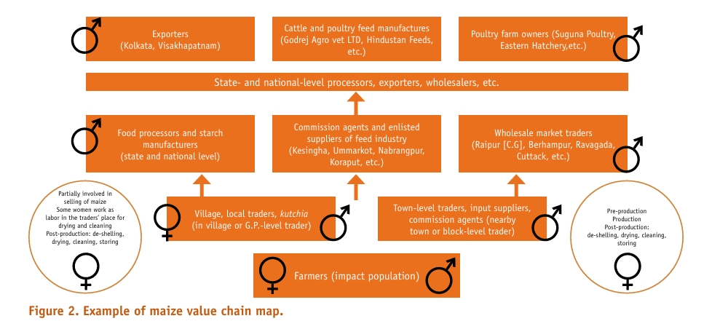
Power Relations: Value chain mapping and analysis
Image source: Hillenbrand 2015
Source: Capelazo 2012; CARE 2014
Notes:
Value chains are hierarchical and therefore inherently create power differentials in relations among those involved in different parts of the value chain. This figure shows results from an analysis conducted as part of CARE’s Pathways project, which mapped involvement of women in different value chains to identify which chains had greater potential for women to move up the ladder and gain more control over their time, production and income. This value chain mapping approach can be used to guide project implementers and to help them periodically measure the progress that women make in moving from being primary producers to the more lucrative and gender- transformative roles of processers and traders.

Slide 35
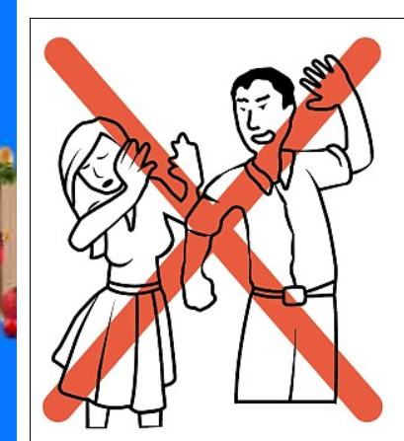

Power Relations within the household
Gender transformative change requires changing power relations within the household that are unequal and correlated with intimate partner violence and inequities in household division of labor and decision-making.
GTC changes them to…
Equitable power relations within the household that contribute to shared decision-making and division of labor
Image source: Global News Canada
Notes:
Read slide

Slide 36

Measures of intimate partner violence
Intimate partner violence takes many forms. A subset of questions are from the WHO’s Multi-Country Study on Domestic Violence and include:
Has your husband/partner (ever/past year)
Slapped you or thrown something at you that could hurt you?
Pushed or shoved you?
Hit you with his fist or something that could hurt you?
Kicked you, dragged you or beaten you up?
Choked or burnt you on purpose?
Threatened to use or actually used a gun, knife or other weapon against you?
Caution:
Any study that includes an assessment of intimate partner violence should contain ethical and safety recommendations for research on violence against women
Sources: Garcia-Moreno 2005; WHO 2016
Notes:
There are a number of validated quantitative measures of IPV. The WHO Multi-country study on DV is a good resource for these measures an example of which is shown here…Read slide

Slide 37

Measures of Communication AND Decision-making
Changes in an individual’s attitudes, values, beliefs and expectations about gender
Individual changes in behavior (expression, negotiation skills)
Increase in spousal/family communication
Increase in joint decision-making between partners
Image source: Communication Between Couples: How to Communicate in a Relationship - Evita Kalofonou
Source: Morgan 2014
Notes:
There are similarly a number of published quantitative measures of household communication and decisions-making. Shown here are some examples of indicators.. Read Slide

Slide 38
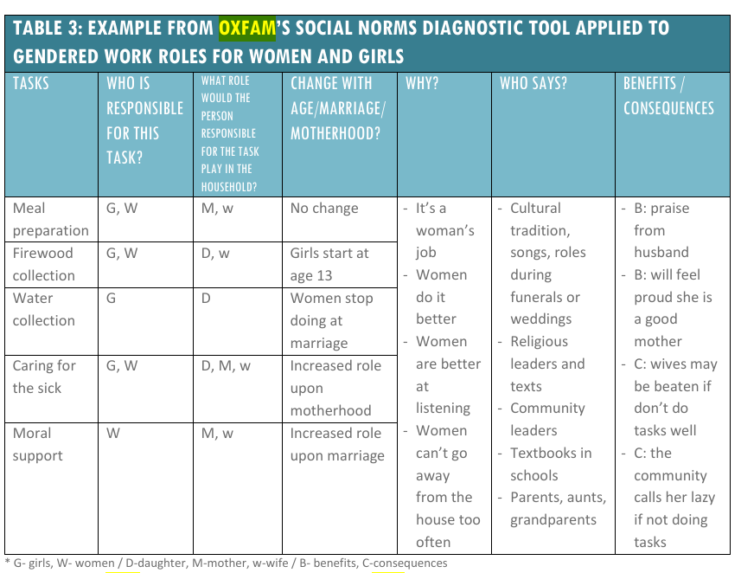
Measures of Women’s Time Allocation and Division of Tasks
Example results using Oxfam’s guide applied to Gendered work roles for women and girls
Sources: WE-Care Programme - Oxfam Policy & Practice; Learning Collaborative to Advance Normative Change 2019
Notes:
And finally there are a number of published quantitative measures to assess household division of household communication and decisions-making but also as shown here there are also qualitative data collection tools such as tool which is designed to be used as a guide in focus group discussions as part of the Oxfam We-Care project. As time allows go over columns in the Table

Slide 39
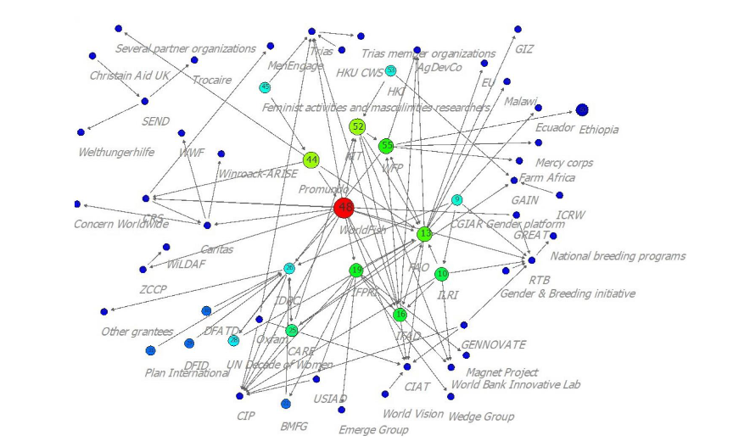
Power Relations:
Social Network Analysis (SNA)
Network size
Expansion could be sign of building collective power
What is exchanged
Information and support
Quality of network relationships
Love, respect: critical to improved communication
Trust: critical factor in determining positive collective change
Where situated in the network
SNA can provide insights into individuals and organizations that have greater influence and access
Source: Hillenbrand 2015; Cornwall 2014; Hillenbrand 2023
Image Source: Hillenbrand 2023
Notes:
Social network analysis can also be a powerful tool to assess the structure of and changes over time in relationships of power. For instance, SNA can look at…read slide
Also note…This picture is a visual of a network analysis undertaken by Hillenbrand, 2023. In the visual one can see that the large red central node based on its location and connections to lots of other nodes/organizations in this network has greater influence and access to the rest of the organizations in this network.
Additional information facilitator could explain…
expansion of social networks (for both livelihoods and political achievements) is important, the number does not capture some of the less tangible factors that give meaning to group association. A multicountry investigation into the “pathways and motorways” to women’s empowerment returned consistently to the vital importance of relationships of solidarity and support to foster collective action in favor of women’s empowerment. The quality of relationships (often expressed in terms of love, respect and trust) appears to be a critical factor in determining positive collective change. The quality of the relationships to monitor may include not only those of group members, but interactions with other direct intermediaries, such as social workers, front-line workers and government agents - Hillenbrand, 2015

Slide 40
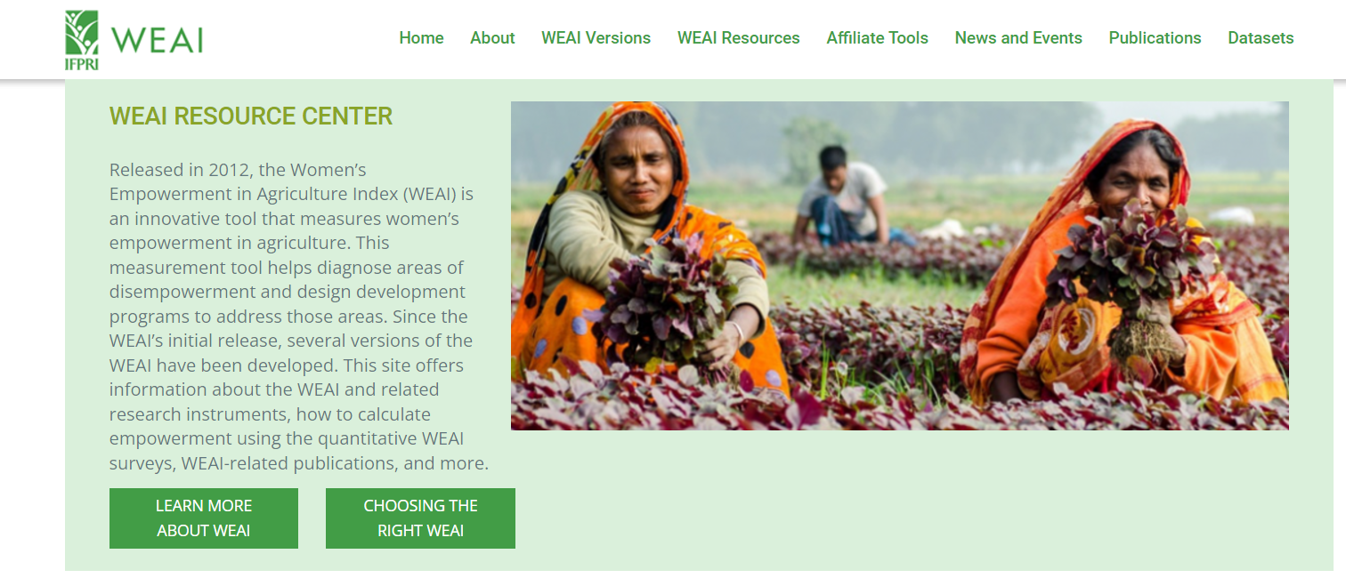
Women’s Empowerment in Agriculture Index (WEAI)
Captures both women’s and men’s absolute levels of empowerment in agriculture and women’s achievements relative to men within the same household
Captures access to productive capital and financial services, group membership and time use
Is decomposable to allow users to track progress on the different dimensions of empowerment
Several versions now exist
Source: Alkire 2013; https:// weai.ifpri.info
Notes:
The Women’s empowerment in agriculture index was first developed in 2012. The WEAI has several advantages. First, it captures both women’s and men’s absolute levels of empowerment in agriculture and women’s achievements relative to men within the same household. Second, the index captures access to productive capital and financial services, group membership and time use and thus incorporates a more holistic perspective of agency than indicators that measure only participation in decision-making. Third, the decomposable nature of the index allows users to track progress on the different dimensions of empowerment, including assessing complementarities and trade-offs among indicators. Several versions of the WEAI now exist.

Slide 41
Agency
Notes:
Finally, let’s look at potential indicators of changes in agency.

Slide 42
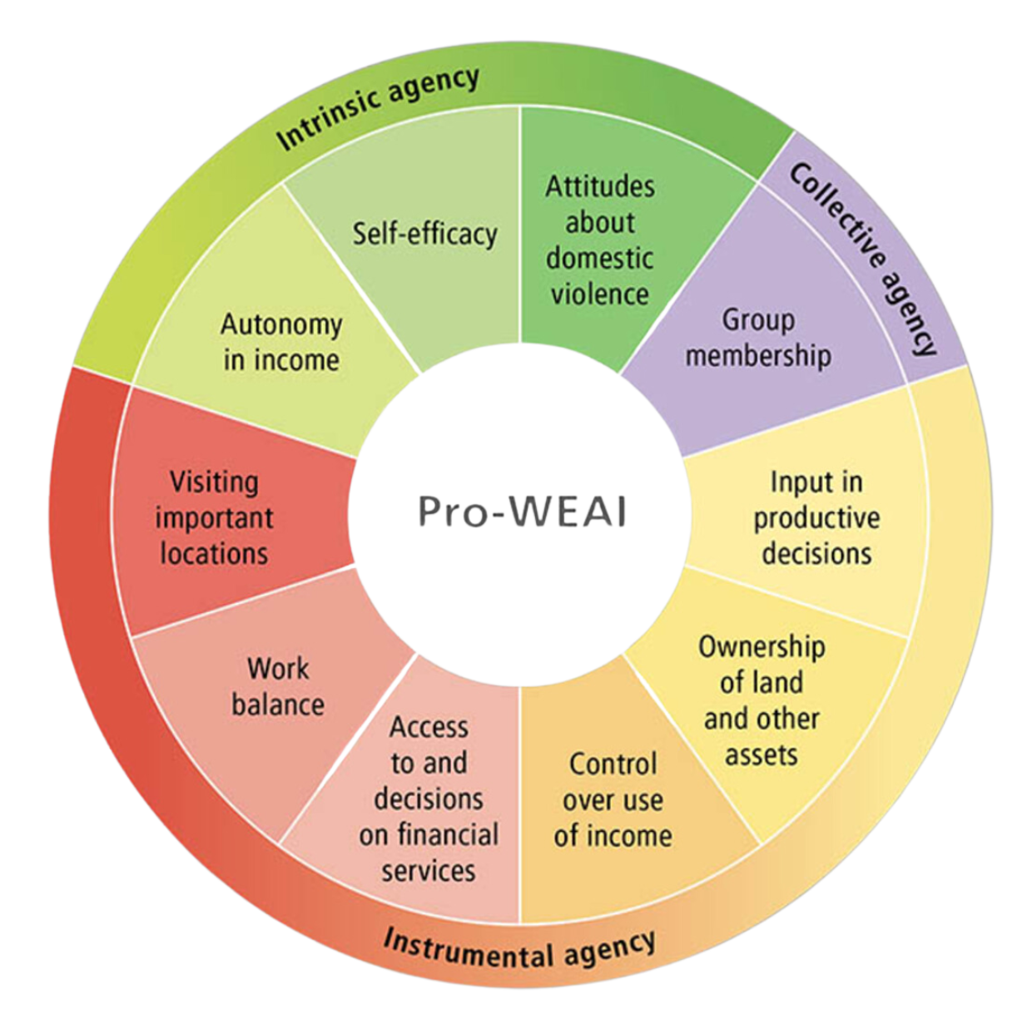
Agency Power
Three types of agency are measured in all versions of the WEAI:
Intrinsic agency, or power within, reflects a person’s internal voice, self-respect or self-confidence.
Instrumental agency, or power to, captures a person’s ability to make decisions in their own best interest.
Collective agency, or power with, is the power individuals get from acting together with others.
Sources: IFPRI Pro-WEAI; Malapit 2019
Notes:
Notably, all of the WEAI indices include measures to assess agency and in particular, three types of agency that are synonymous with types of power. As shown here, one of the versions of the WEAI that has been developed is the project-level WEAI for market inclusion (Pro-WEAI). The Pro-WEAI looks at intrinsic, instrumental and collective agency, which are also known respectively as power within, power to and power with and capture these subdimensions of agency… read slide

Slide 43

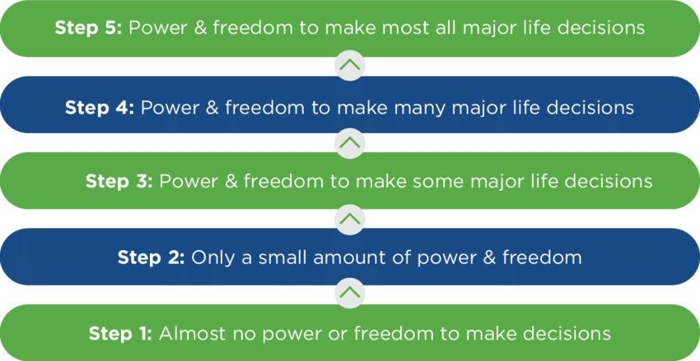
Agency: qualitative approach
Gennovate Ladder of Power and Freedom
Source: https://gennovate.org
Notes:
The GENNOVATE methodology offers a qualitative approach to measuring agency. They refer to this ladder as the ladder of power and freedom. This ladder can be used in either semi-structured interviews or focus group discussions and asks respondents to position themselves or their communities on the ladder by asking:
In semi-structured interviews, “On which step of this ladder would you position yourself today? ____ 1b. And 10 years ago? ____ Q2. What do you think are the main reasons why your rating (increased/ stayed the same/decreased)?”
Or similarly in focus group discussions, “On which step of this ladder would you position the majority of the [sex of FGD] in the village today Q2. Now please imagine the community 10 years ago, when ________________3 happened. On which step of this ladder would you position the majority of the [sex of FGD] in the village 10 years ago? Q3. Why? What has (or has not) changed for the [sex of FGD] in this community?”

Slide 44
Collective Agency
Collective agency refers to a group’s or network’s perceived ability to come together, establish common goals or shared interests, and take action to attain those goals/interests.
Group-related collective agency scale
Intrinsic collective agency (1=Disagree 2= Partly agree 3=Completely agree)
You feel you can personally help to advance your [name] group’s goals.
(When you want to, you feel you can cooperate with your [name] group members to advance group goals.
You are willing to advance your [name] group’s [name] group’s goals with other members because you see value in contributing to the group.
You feel that members of your [name] group can find ways to cooperate with each other to advance group goals.
You feel that your [name] group can achieve group goals when members cooperate with each other.
The members of your [name] group believe they should cooperate with each other to advance group goals.
Instrumental collective agency (1=Low extent 2=Medium extent 3=High extent)
To what extent did you cooperate with members of your [name] Group to advance group goals?
To what extent did the support of your [name] Group members, help you to achieve some of your personal goals?
To what extent did your [name] group members agree on new goals to advance together as a group?
To what extent did your [name] group members cooperate with each other to advance group goals?
To what extent did your [name] group make progress on advancing group goals?
To what extent did you observe other program groups achieve their group goals?
Source: Delea 2021
Notes:
This is an example of a quantitative scale developed to measure collective agency. Read through slide as time allows

Slide 45
Stepwise process to develop gender transformative change indicators
Section 3
Notes:
Now let’s walk through a stepwise process that was developed by FAO, IFAD, WFP & CGIAR GENDER Impact Platform and can be used to develop gender transformative change indicators.

Slide 46
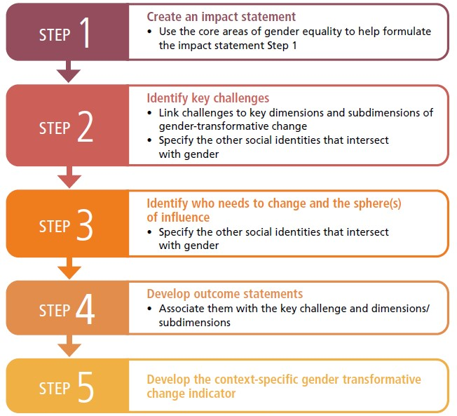
5-step process
Source: FAO, IFAD, WFP & CGIAR Gender Impact Platform 2023
Notes:
FAO, IFAD, WFP & CGIAR GENDER Impact Platform recently published Guidelines for measuring gender transformative change in the context of food security, nutrition and sustainable agriculture. In which they lay out this 5-step process for measuring gender transformative change
Read slide

Slide 47
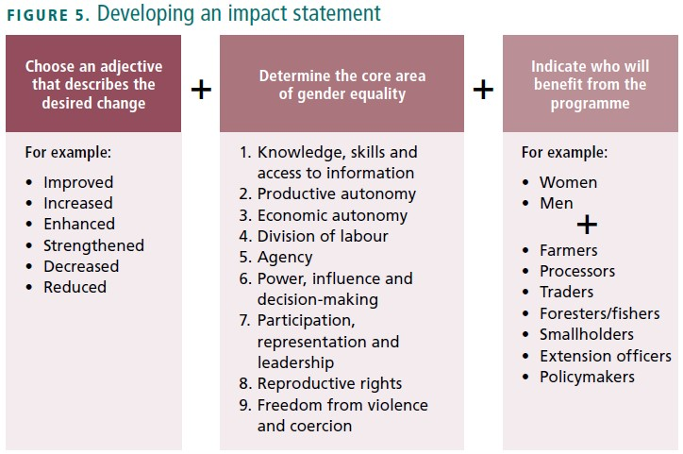
Step 1: Create an impact statement
Determine the longer-term impacts that the research or development program is expected to contribute to, clearly identifying who is intended to benefit from the program and in what way
Example:
Increased participation in decision making on crop production and sales for women farmers
Source: FAO, IFAD, WFP & CGIAR Gender Impact Platform 2023
Notes:
Read slide

Slide 48
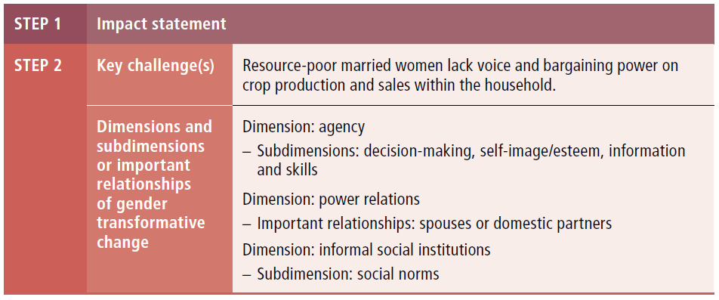
Step 2: Identify Key Challenges
Identify the root causes of gender inequality (i.e. the key challenges or problems) that the program wishes to address to achieve the intended impacts
Link the key challenges to the dimensions of gender transformative change that the program should focus on
Consider how gender intersects with other social identities and axes of power
Determine the subdimensions of agency and formal and informal social institutions and the important relationships on which the program will focus
Source: FAO, IFAD, WFP & CGIAR Gender Impact Platform 2023
Notes:
Read slide

Slide 49
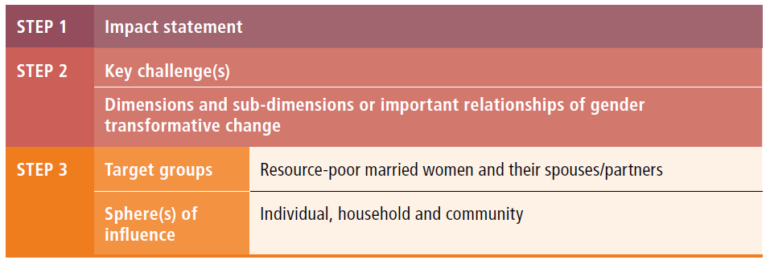
Step 3: Identify which levels of influencers need to change
Determine which groups’ behaviors, attitudes or beliefs create the key challenges to bringing about women’s empowerment and gender equality outcomes
Determine which levels of influence (i.e. household, community, organizational, macroenvironmental) the groups primarily operate in
Sources: FAO, IFAD, WFP & CGIAR Gender Impact Platform 2023
Notes:
Read slide

Slide 50
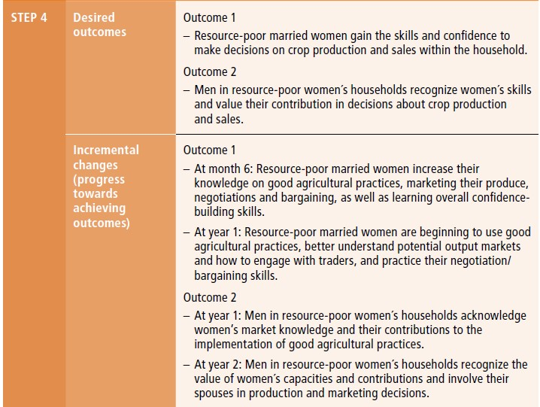
Step 4: Develop outcome statements
Develop outcome statements specifying what each target group could do differently to overcome the key challenges identified in Step 2
Sources: FAO, IFAD, WFP & CGIAR Gender Impact Platform 2023
Notes:
Read slide

Slide 51
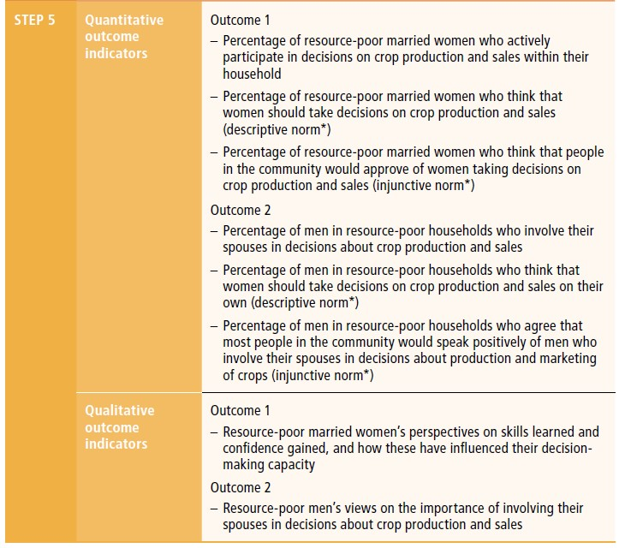
Step 5: Develop context-specific GTC indicators
Develop qualitative and quantitative indicators of gender transformative change using the information in Steps 1–4
Sources: FAO, IFAD, WFP & CGIAR Gender Impact Platform 2023
Notes:
Read slide

Slide 52
Practice developing indicators
Section 4
Notes:
Now let’s spend a few minutes practicing what we learned.

Slide 53
Farmer Field and Business School (FFBS)
Case study
Sources: CARE 2017; FAO, IFAD and WFP 2020; Lau 2021

Slide 54
Case Study: Farmer Field and Business School (FFBS)
BACKGROUND
Developed as part of CARE’s Pathways to empowerment program, which was based on the conviction that women farmers possess enormous potential to contribute to long-term food security for their families and substantially impact nutritional outcomes in sustainable ways
OBJECTIVES
To increase the productivity and empowerment of women farmers in more equitable agriculture systems at scale and to influence debates and policy dialogue on women and agriculture at the local, national and global levels
TARGET POPULATION
Locally defined rural smallholder households = income <USD 2 per day & production goals are consumption focused, little or no land for cultivation
IMPLEMENTER
CARE USA, CARE International
COUNTRIES IMPLEMENTED
DATE
Bangladesh, Ethiopia, Ghana, India, Malawi, Mali, United Republic of Tanzania
2011-2018
Notes:
Read Slide

Slide 55
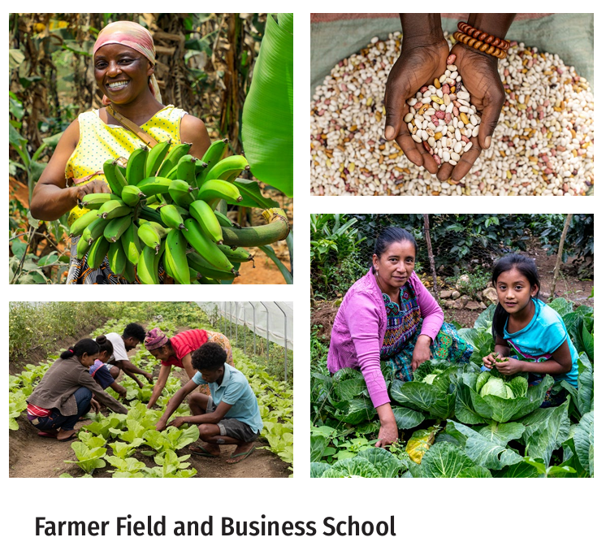
FFBS main components/activities
Demonstration plots: selection and setup; germination tests; manure preparation; soil, water, pest, disease and weed management; harvest and post-harvest management and evaluation; farmer field days
Marketing: marketing concepts and surveys, production estimation and determining profitability, selection of best products and outlets, designing a business plan, conducting a gendered value chain analysis and marketing as a group
Nutrition: understanding undernutrition and a balanced diet; growing nutritious foods/planning a home garden; cooking demonstrations; & exclusive breastfeeding
Gender dialogues: encouraging partners/spouses of women farmers to attend gender dialogue sessions that cover land and input access, household and nutrition decision-making, workload sharing, learning to listen, and income control and role models for men
Image Source: FFBS Toolkit 2nd edition 2023
Notes:
FFBS is a hands-on, learning-by-doing extension approach that integrates gender equality, market engagement, climate resilience and nutrition. The program involves 4 main components as shown here.. Read slide
FFBS-TOOLKIT_SECOND-EDITION.pdf

Slide 56
Practice developing indicators
Review the FFBS case study
Start with Step 4 and draft at least 2 outcome statements
Then move to Step 5 and draft at least 2 related potential indicators that you would suggest to measure
As you develop your indicators, try to think about:
  Where you would likely collect this (i.e., level of influence)?
  When you would want to collect this?
  How might you best collect this indicator?
Notes:
This is a practice exercise.. Read slide

Slide 57
Suggested Indicators
 | Outcome statement | Indicator | Collection thoughts
1
2
3
4
Notes:
Have trainee participants use a table like this to fill in and share what they come up with

Slide 58
Final points to keep in mind with gender transformative approaches
Section 5
Notes:
Read Slide

Slide 59
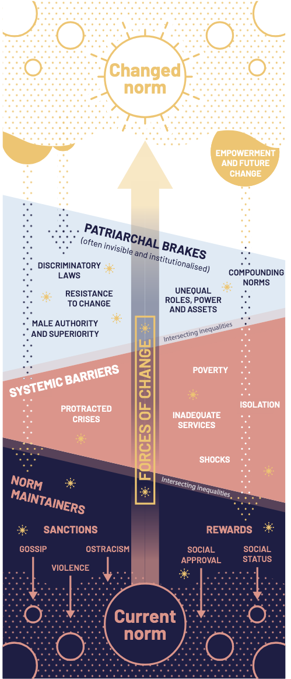
Word to the Wise
Changing gender norms change is slow and takes place at unequal speeds.
Systems and settings are also changing via shocks, crises, poverty, etc.
Changing norms can reinforce patriarchal norms.
As norms change toward equity and equality, this can trigger change in other areas.
Progress often stalls, repeatedly and often at the point when women are poised to achieve significant change or power.
Set realistic expectations, in scope and scale, for what programs can do within project periods.
Sources: Harper 2020, Malhotra 2021
Image source: Harper 2020
Notes:
As you move forward with implementing GTAs, there are some important points that we would caution you to keep in mind… Read slide..

Slide 60

An unfinished agenda
To date, insufficient attention has been given to transforming systems and structures
The most disadvantaged are at risk of being left behind; intersectionality is important
Sustainability and scalability strategies are needed to extend and maintain gender equality achievements after programming ends
An evidence-base is needed on the influence of gender transformative approaches on long-term outcomes
There remain widely varying levels of understanding, gender expertise and funding for GTA efforts
Sources: Harper 2020; Malhotra 2021; McDougal 2021; Hillenbrand 2023
Notes:
Also as you move forward with implementing GTAs, there are some areas where more research and programmatic work is needed …
For instance, much of the GTA work to date has been undertaken at the community level but less attention/work has been done so far on transforming systems and structures which have wider reach, operate at scale, and can counteract change at the individual and community level
Continue to read slide…

Slide 61

Good news!
GTA are flexible, adaptable, not prescriptive
GTA methodologies, tools and guidance exist
GTA are rapidly scaling out across the agriculture research for development ecosystem
There is increased use of and evidence for gender transformative approaches globally and across sectors
GOOD NEWS!
Sources: Harper 2020; Levy 2020; Hillenbrand 2023
Notes:
Finally, though and lest we be discouraging as you move forward with implementing GTAs, there are quite a few good encouraging aspects of the approach and trends in the field to keep in mind…Read Slide

Slide 62
Closing

Slide 63


TakeAways
What is one new thing you learned today?
What are you curious about?
Notes:
Ask participants to share

Slide 64

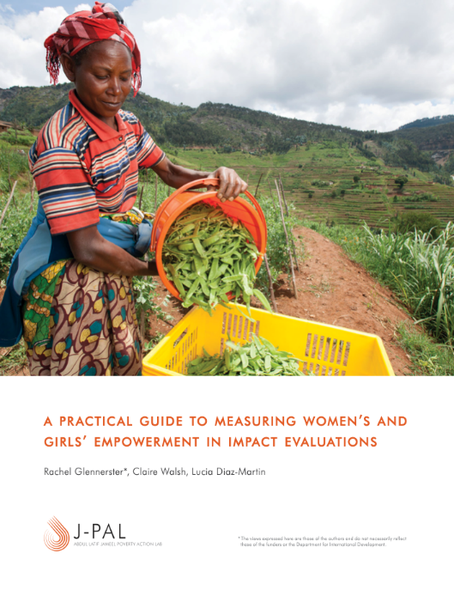

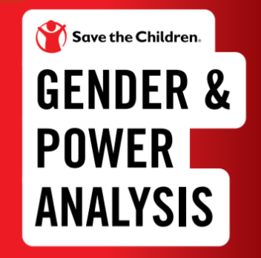
FURTHER READING
Guide to measuring GTC
Practical-guide-to-measuring-womens-and-girls-empowerment-in-impact-evaluations.pdf
SIGI 2019 Global Report
Gender & Power (GAP) Analysis Guidance | Save the Children’s Resource Centre
Notes:
Here are a few documents for suggested further reading on measuring gender transformative change.
Gender & Power (GAP) Analysis Guidance | Save the Children’s Resource Centre
practical-guide-to-measuring-womens-and-girls-empowerment-in-impact-evaluations.pdf

Slide 65

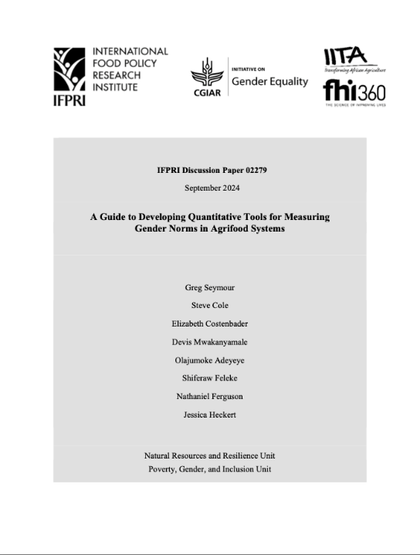
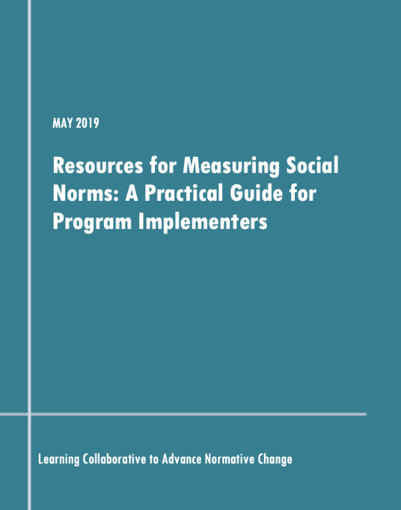
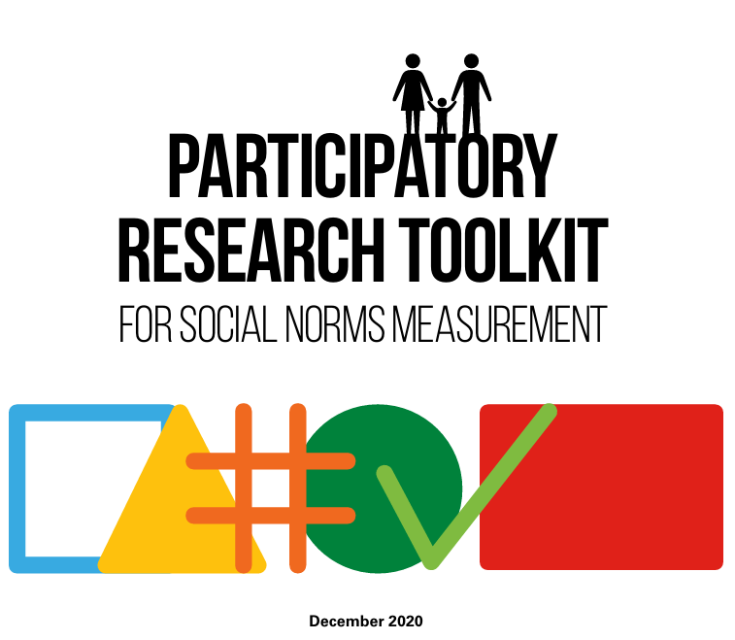
FURTHER READING:
noRms Measurement
Guide to formulating norms indicators
Gender norms in AFSs : guide to developing measures
Resources_for_measuring_social_norms_guide_final.pdf
UNICEF Participatory norms measurement-toolkit.pdf
Notes:
And here are a few documents for suggested further reading specifically on measuring norms.

Slide 66
Glossary
Collective agency, or power with, involves engagement in or leadership of groups or networks with shared goals; it creates confidence in the group’s or network’s ability to act on shared goals and includes influential joint actions in pursuit of shared goals (Yount et al 2020).
Descriptive norms refer to what an individual believes others do (Cialdini et al 1991; Learning Collaborative to Advance Normative Change 2019 in FAO, IFAD and WFP 2022).
Injunctive norms refer to what one believes others think one should do (Cialdini et al 1991; Learning Collaborative to Advance Normative Change 2019 in FAO, IFAD and WFP 2022).
Instrumental agency, or power to, involves the creative power to exercise one’s capabilities; make one’s own strategic choices; pursue one’s rights, goals and aspirations; and affect desired change in one’s life (Yount et al 2020).
Intrinsic agency, or power within, entails a critical awareness of one’s rights and aspirations, confidence in one’s capabilities, and motivation to pursue self defined goals. (Yount et al 2020)
Social network analysis is a methodological approach used to analyze social structures through the use of networks and graph theory. It involves mapping and measuring relationships and flows between people, groups, organizations, computers, or other information/knowledge-processing entities (Blanchet 2012).
Vignettes are short stories about imaginary characters in specific contexts, with guiding questions that invite participants to respond to the story in a structured way. They are often presented to individuals during in depth interviews, or to homogenous groups in focus group discussions, to understand the perspectives of specific groups (Learning Collaborative to Advance Normative Change 2019).

Slide 67
References
Addis Continental Institute of Public Health, & CARE Ethiopia. (2016). Abdiboru Project: The context and social norms on girls’ marriage, education and nutrition – a qualitative study. Addis Ababa, Ethiopia: CARE Ethiopia.
Alkire, S., Meinzen-Dick, R. S., Peterman, A., Quisumbing, A. R., Seymour, G., & Vaz, A. (2013). The Women’s Empowerment in Agriculture Index. World Development, 52, 71-91.
Barter, C., & Renold, E. (1999). Social research update 25: The use of vignettes in qualitative research.
Bicchieri, C., & Penn Social Norms Training and Consulting Group. (2015). Why do people do what they do? A social norms manual for Zimbabwe and Swaziland. Florence, Italy: Innocenti.
Blanchet, K., & James, P. (2012). How to do (or not to do) … a social network analysis in health systems research. Health Policy and Planning, 27(5), 438–446.
Bywater, K., Avakyan, Y., & Lepillez, K. (2021). Gender and power analysis: GAP analysis: A child-centred and intersectional approach. Save the Children.
Capelazo, M. (2012). LINKAGES guide to measuring ultimate outcome indicators: Gathering evidence for gender equality change in access, control and organizational capacity. Unpublished toolkit produced by CARE Canada and funded by Global Affairs Canada.
CARE. (2014). Pathways mid-term review report, Malawi. Atlanta, GA: CARE USA.
CARE. (2017). Farmers Field Business School (FFBS) brief. Retrieved from: https://www.care.org/wpcontent/uploads/2017/03/FFBS_Innovation-Brief-2.0.pdf
CARE. (2018). Social Analysis and Action Global Implementation Manual. Atlanta, GA: CARE USA.
Chung, A., & Rimal, R. N. (2016). Social norms: A review. Review of Communication Research, 4, 1-29.

Slide 68
References
Cialdini, R. B., Kallgren, C. A., & Reno, R. R. (1991). A focus theory of normative conduct: A theoretical refinement and reevaluation of the role of norms in human behavior. Advances in Experimental Social Psychology, 24, 201-234.
Cornwall, A. (2014). Women’s empowerment: What works and why? UN University-WIDER Working Paper 2014. Helsinki, Finland: UN University-WIDER.
Delea, M., Sinharoy, S., Cheong, Y., Heckert, J., Seymour, G., Meinzen-Dick, R., & Yount, K. (2021). The Group-Related Collective Agency Scales (GCAS-23 and GCAS-12) – Full and Short Form Scales for Construct Measurement. SSRN Electronic Journal.
FAO. (2021). Gender transformative approaches. In FAO – Joint Programme on Gender Transformative Approaches for Food Security and Nutrition. Rome, Italy.
FAO, IFAD, & WFP. (2020). Gender transformative approaches for food security, improved nutrition and sustainable agriculture – A compendium of fifteen good practices. Rome, Italy.
FAO, IFAD, & WFP. (2022). Guide to formulating gendered social norms indicators in the context of food security and nutrition. Rome, Italy.
FAO, IFAD, WFP, & CGIAR GENDER Impact Platform. (2023). Guidelines for measuring gender transformative change in the context of food security, nutrition and sustainable agriculture. Rome, Italy: FAO, IFAD, WFP, & CGIAR.
Garcia-Moreno, C., Jansen, H. A. F. M., Ellsberg, M., et al. (2005). WHO Multi-country study on women’s health and domestic violence against women: Initial results on prevalence, health outcomes and women’s responses. Geneva: World Health Organization.
GENNOVATE. (n.d.). Retrieved from: https://gennovate.org

Slide 69
References
Glennerster, R., Walsh, C., & Diaz-Martin, L. (2018). A practical guide to measuring women’s and girls’ empowerment in impact evaluations. Cambridge, USA: J-PAL.
Harper, C., Marcus, R., George, R., D’Angelo, S., & Samman, E. (2020). Gender, power and progress: How norms change. London: ALIGN/ODI.
Hillenbrand, E., Karim, N., Mohanraj, P., & Wu, D. (2015). Measuring gender transformative change: A review of literature and promising practices. CARE USA. Working Paper.
Hillenbrand, E., Obi, C., McDougal, C., & Rossignoli, C. M. (2023). Scaling-out gender transformative approaches in agriculture research for development. Gender, Technology and Development, 28(1), 50–77.
International Food Policy Research Institute (IFPRI). (2020). Pro-WEAI for market inclusion. Washington, DC: International Food Policy Research Institute (IFPRI). Retrieved from https://ebrary.ifpri.org/digital/collection/p15738coll2/id/134345
JP GTA. (2022). Social norms diagnostic study on increased access to formal financial services and products for VSLA members in selected districts in Malawi, inception report.
Kabeer, N. (1999). Resources, agency, achievements: Reflections on the measurement of women’s empowerment. Development and Change, 30(3), 435–464.
Lau et al. (2021). Gender transformative approaches for advancing gender equality in coral reef social-ecological systems: Good practice and technical brief.
Learning Collaborative to Advance Normative Change. (2019). Resources for measuring social norms: A practical guide for program implementers. Washington, DC: Institute for Reproductive Health, Georgetown University.

Slide 70
References
Levy, J. K., Darmstadt, G. L., Ashby, C., Quandt, M., Halsey, E., Nagar, A., & Greene, M. E. (2019). Characteristics of successful programmes targeting gender inequality and restrictive gender norms for the health and wellbeing of children, adolescents, and young adults: A systematic review. The Lancet Global Health, 8(2), e225-e236.
Malapit et al. (2019). Development of the project-level Women’s Empowerment in Agriculture Index (pro-WEAI). World Development, 122, 675–692.
Malhotra, A. (2021). The disconnect between gender-transformative language and action in global health.
Martinez, E. (2006). The courage to change: Confronting the limits and unleashing the potential of CARE’s programming for women. CARE International Strategic Impact Inquiry on Women’s Empowerment. Atlanta, USA: CARE USA.
McDougall, C. et al. (2020). Toward structural change: Gender transformative approaches. In Advancing gender equality through agricultural and environmental research: past, present and future (pp. 215-251). CGIAR Gender Platform and the International Food Policy Research Institute (IFPRI). CGIAR Collaborative Platform for Gender Research.
Morgan, M. (2014). Measuring gender transformative change. Penang, Malaysia: WorldFish.
Mosedale, S. (2005). Assessing women’s empowerment: Towards a conceptual framework. Journal of International Development, 17(2), 243–257.
OECD. (2019). SIGI 2019 Global Report: Transforming challenges into opportunities. Social Institutions and Gender Index. Paris.
Morgan, M. (2014). Measuring gender transformative change. Penang, Malaysia: WorldFish.
Mosedale, S. (2005). Assessing women’s empowerment: Towards a conceptual framework. Journal of International Development, 17(2), 243–257.

Slide 71
References
OECD. (2019). SIGI 2019 Global Report: Transforming challenges into opportunities. Social Institutions and Gender Index. Paris.
Oxfam We-Care. (n.d.). Retrieved from: https://policy-practice.oxgam.org/we-care
Seymour, G., Cole, S., Costenbader, E., Mwakanyamale, D., Adeyeye, O., Feleke, S., Ferguson, N., & Heckert, J. (2024). A guide to developing quantitative tools for measuring: Gender norms in agrifood systems. IFPRI Discussion Paper 2279. Washington, DC: International Food Policy Research Institute.
SBCC and Gender: Models and Frameworks. (n.d.). Retrieved from:
https://sbccimplementationkits.org/gender/sbcc-gender-models-and-frameworks/
Parivartan. (n.d.). Retrieved from: https://www.icrw.org/projects/parivartan
WHO. (2016). Ethical and safety recommendations for intervention research on violence against women: Building on lessons from the WHO publication. Geneva: World Health Organization.
Yount, K. M., Khan, Z., Miedema, S., Cheong, Y. F., & Naved, R. T. (2020). The Women's Agency Scale 61 (WAS-61): A comprehensive measure of women's intrinsic, instrumental, and collective agency.

