Slide 1
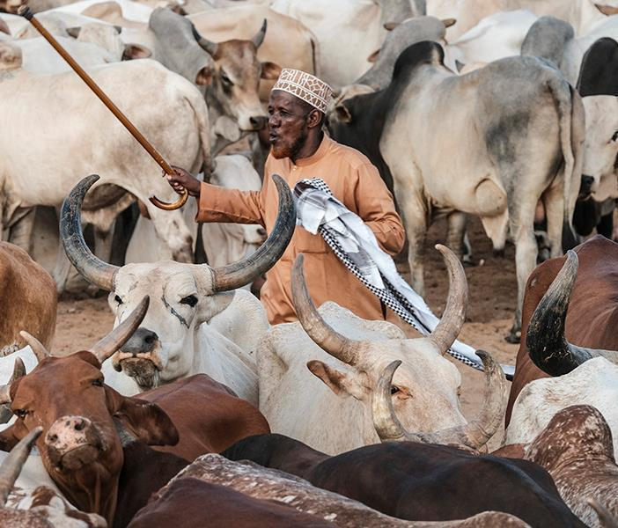
Accelerating sustainable small ruminant value chain development in Ethiopia
Girma T. Kassie and Barbara Rischkowsky, ICARDA
CGIAR Livestock CRP and GASL joint side event on national partnerships for sustainable livestock systems at the 7th All-Africa Conference on Animal Agriculture, Accra, Ghana, 30 July 2019

Slide 2
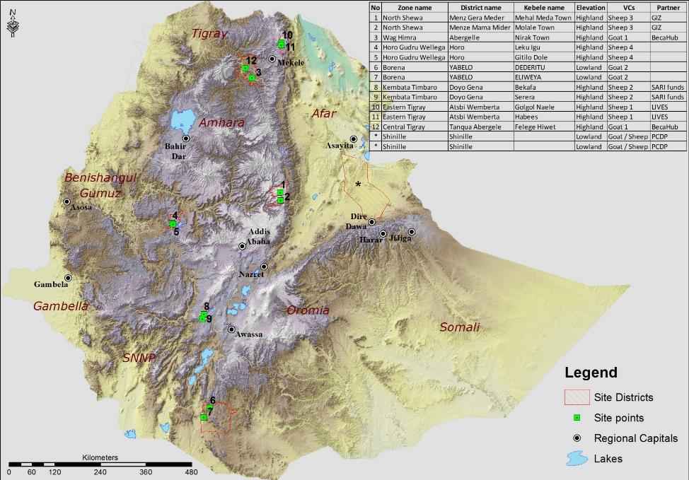
OUR AIMS
Small ruminant value chain R4D activities to
improve the performance of sheep and goat meat value chains in Ethiopia and in doing so:
    Improve the livelihoods, incomes and assets of smallholders, particularly of women, through increased productivity, reduced risk and improved market access along the value chain.

Slide 3
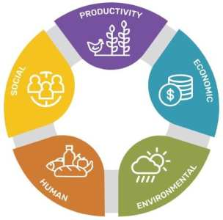
SUSTAINABILITY
The small ruminant value chain is an integral part of the agricultural value chain and hence our R4D activities contribute to overall sustainability in many ways:
Productivity:
  Increasing production, productivity and efficiency per unit of animal per production season.
Economic:
  Increasing profitability of small ruminant production
  Increasing income per unit of animal per production season.
Environmental:
  Increasing the efficiency of feed and forage use in small ruminant production
  Post harvest loss and waste management.
Human:
  Improving the consumption level of animal source foods from small ruminants
  Increasing food and nutrition security through better consumption as a result of improved production and marketing of small ruminants.
Social:
  Development of inclusive value chains
  Communicating with the right set of partners efficiently and timely for fair use of development and policy recommendations

Slide 4
RESULTS
Need based capacity building of extension agents and producers on SR management (input supply and production)
Small Ruminant Health (input supply and production):
Diagnostic and epidemiological studies for key diseases, assessment of economics, capacity building of producers
Community-based control of diseases with capacity development of extension and producers
Delivery services: delivery of quality vaccines, and drugs, organizing delivery of sustainable services
Feeding and Breeding (input supply and production)
Site specific interventions based on available feed resources (adapted forages, efficient utilization of crop residues, improved fattening)
Community-based SR breeding programs to create access to more productive, locally adapted breeding animals
Organization/Institutional Interventions related to marketing:
    Providing market actors, in particular producers, with up-to-date market price information
    Strengthening/Establishing producer marketing cooperatives
    Create market linkages between producers and other actors including awareness of market demand
Processing
    Low cost interventions for safer processing of goat (and cattle) milk
    Capacity building on transport, slaughtering, safe preparation and handling of animal source foods

Slide 5
PARTNERSHIPS
Partner | Role | Why
Local partners
District level offices of Agriculture and administration | Facilitated the implementation of our interventions | Procedural requirements and the need for local ownership of the activities
Agricultural research centers | Involved in the designing of the research portfolio and best-bet interventions | Have tested experience in the locations and dependable human resource to help in adapting our plans
National partners
Ministry of Agriculture EIAR NAHDIC | Involved in the identification of research priorities and implementation frameworks our interventions | The need to integrate our activities with the national agricultural transformation agenda and the institutes’ skill set on agriculture in the country.
International partners
ICARDA/ILRI EMBRAPA, Brazil FAO Africa RISING SNV SFFF LIVES | Designing and implementing the R4D activities in Ethiopia. | Expertise in addressing global challenges in/around agriculture. Designing and implementing best-best required tailored and local level experience, eg: ICARDA: community-based breeding, LIVES: integrated sheep VC sites in Atsbi, ILRI: livestock master plan development, SFFF: Assessment of safety of milk fermentation techniques, SNV/LIVES: MSP in Atsbi Africa Rising - FEAST and TechFit tool improvement.
Universities
Boku, SLU, OSU, CSU, University of Hohenheim | Capacity building for national partners and collaborating on specific research projects

Slide 6
SELF-ASSESSMENT
What did we bring
  SR value chain development approach of CRP
  International expertise on different aspects of SR value chain
  Network of partners with solid interest and experience in livestock value chain development in the developing world
What did the partners bring
  Local level experiences and networks
  Complementary interventions with profound synergies and funding
  Comprehensive capacity building support
How could we do it better
  Development of long-term partnership frameworks
  Allocating meaningful level of resources for developing and sustaining partnerships
  Engage more in developing sustainable capacity in the partner institutes (to address high staff turn-over and lack of maintenance of infrastructure)

Slide 7
RECOMMENDATIONS
Design engagement mechanisms to match the political supra-structure and public institutions.
  The political economic structure of Ethiopia requires that we have strong partnerships with the public sector to ensure that empirical research results are taken up to change lives.
Beyond partnership activities with a public sector focus, devise a visionary framework to empower and engage the private sector.
Formulate interventions that increase the stability of partner institutions for continuity of transformative interventions in agricultural Value chains.

Slide 8
Thank you!

