Slide 1
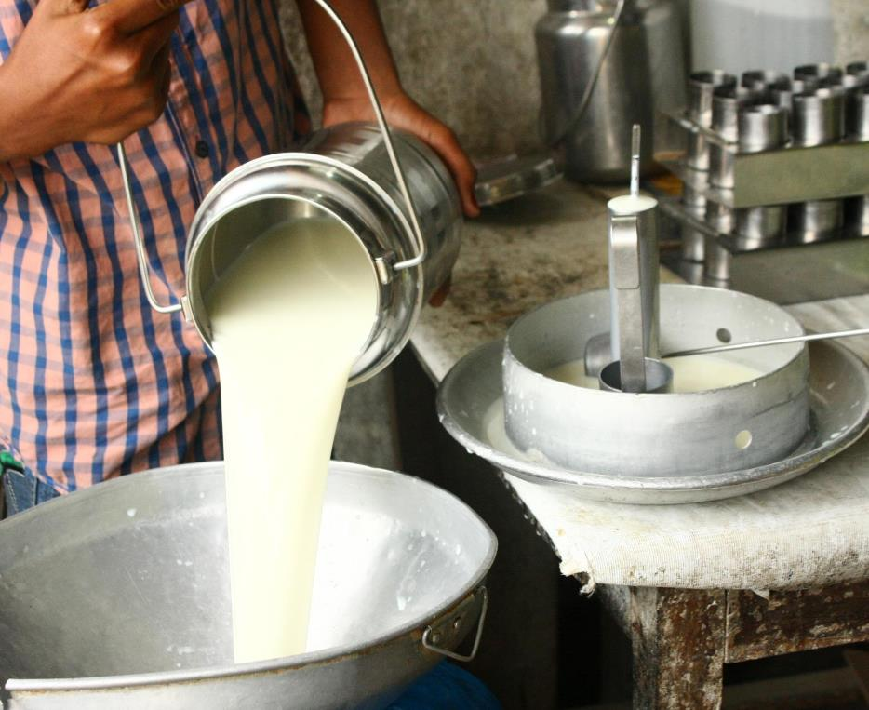
MoreMilk Workshop
Making the Most of Milk
Presentation Book

Slide 2


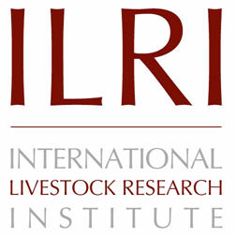


© 2019 International Livestock Research Institute (ILRI)
ILRI thanks all donors and organizations which globally support its work through their contributions to the CGIAR Trust Fund
This publication is copyrighted by the International Livestock Research Institute (ILRI). It is licensed for use under the Creative Commons Attribution 4.0 International Licence. To view this licence, visit https://creativecommons.org/licenses/by/4.0. Unless otherwise noted, you are free to share (copy and redistribute the material in any medium or format), adapt (remix, transform, and build upon the material) for any purpose, even commercially, under the following condition:
ATTRIBUTION. The work must be attributed, but not in any way that suggests endorsement by ILRI or the author(s).
NOTICE:
For any reuse or distribution, the licence terms of this work must be made clear to others.
Any of the above conditions can be waived if permission is obtained from the copyright holder.
Nothing in this licence impairs or restricts the author’s moral rights.
Fair dealing and other rights are in no way affected by the above.
The parts used must not misrepresent the meaning of the publication.
ILRI would appreciate being sent a copy of any materials in which text, photos etc. have been used.
Citation
ILRI (International Livestock Research Institute). 2019. MoreMilk workshop: Presentation book. Nairobi, Kenya: ILRI.
Production of this material has been funded by the Bill & Melinda Gates foundation, the CGIAR Research Program on Agriculture for Nutrition and Health, and UK aid from the UK government. However, the views expressed do not necessarily reflect the official policies of these institutions.

Slide 3
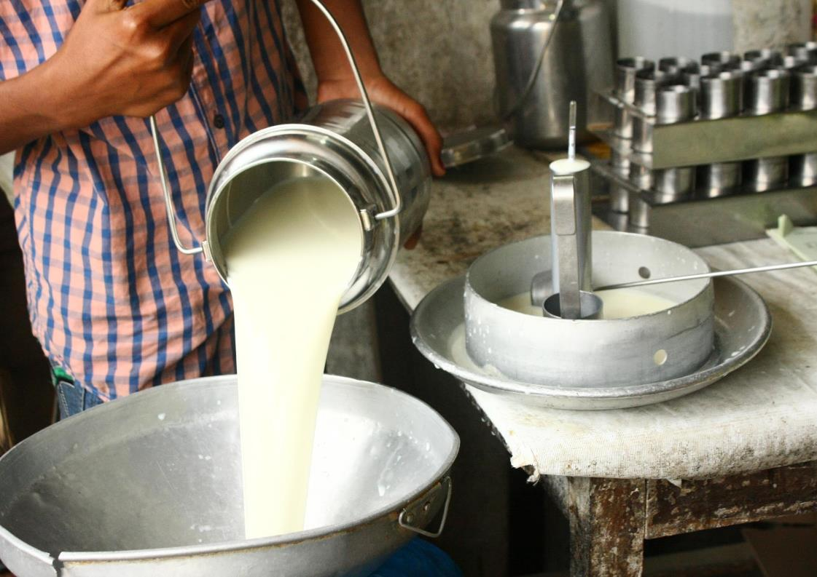
Milk Hygiene
a
1

Slide 4
Series
Series Objectives
At the end of this series, you should be able to:
Buy clean and good quality milk
Conduct milk tests to determine quality
Handle milk hygienically so it does not get contaminated
Identify and use food grade milk handling containers
Make sure your customers handle milk safely, so it doesn’t get contaminated after they buy it
Educate your customers about the health benefits of milk so they’ll want to buy more of it for their families
Run a more profitable business so that you make more money
Promote your business within your community

Slide 5






1.1 Disinfecting with Bleach Solution
1
2
3
Soap
Rinse
1 Part Bleach
9 Parts Water
4
5
6
7
10 min Surface Contact
Rinse Again
Sun-Dry
Dry Upside
Down

Slide 6
1.2 Disinfecting with Boiling Water (No Bleach)
1
2
3
Soap
Rinse
Boiling Water
4
5
Sun-Dry
Dry Upside Down

Slide 7
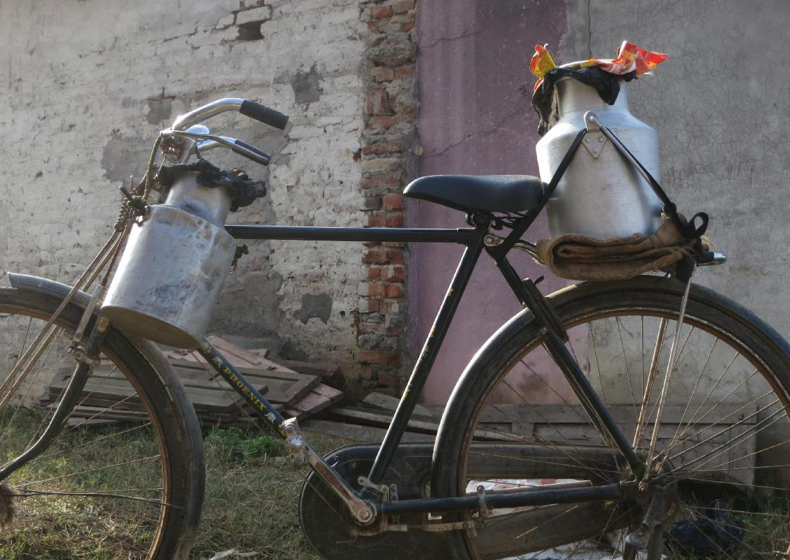
Milk Hygiene in the Supply Chain
a
2

Slide 8





Session Objectives
How to prevent contamination along the supply chain
The Farm
The Distributor
In Transit
In Storage
During Handling

Slide 9
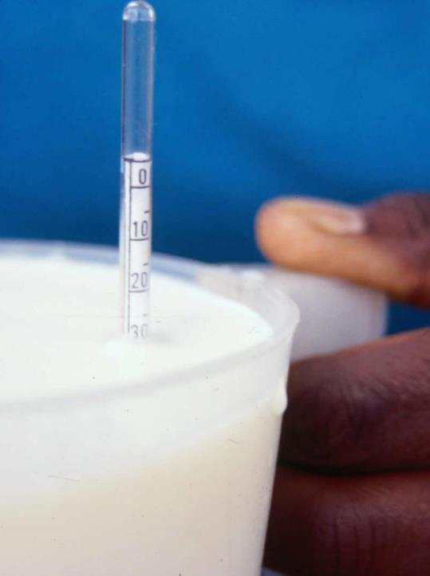
2.1 Lactometer Test
Lactometer measures milk density
Drop lactometer instrument in container of milk and read numbers on side
Depending on how high / low number is, lactometer can tell if there is adulteration
Good milk between lactometer reading of 26 and 32

Slide 10




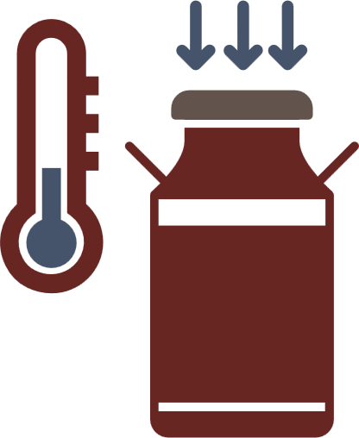


2.4 Checklist for Farmers
Clean hands before milking
Do not milk if sick
Clean, dry shelter for animals
Use appropriate / clean containers
Keep milk cool
and covered
Milk healthy cows

Slide 11

2.5 Checklist for Distributors
Clean hands before handling
Buy from trusted farmers
Clean facilities
Do not handle milk
if sick
Keep milk cool
and covered
Use clean / appropriate containers

Slide 12
2.6 Purchase Record
NAME | VOLUME | DATE | TIME BOUGHT | PRICE PER LITRE | PASTEURISED | TEST RESULT
Aasir's Farm | 5 litres | 20/6/19 | 9:30am | XX.XX | Yes | No clotting

Slide 13



2.7 Maintaining Milk Quality During Transport
Short
Distance
Low
Temperature
Sealed
Containers

Slide 14
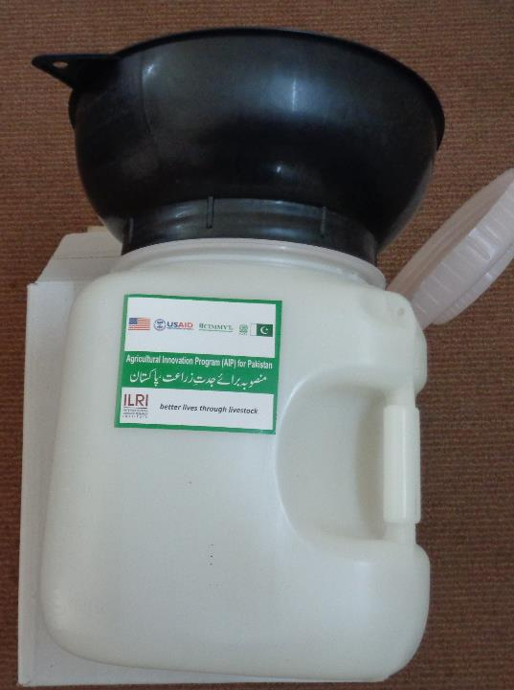

2.8 Mazzican
10 litres
Made of food grade plastic
Comes with milking funnel

Slide 15
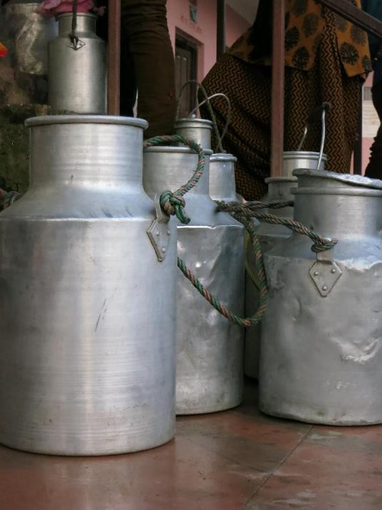
2.9 Other Acceptable Containers (Milk Cans)
Smooth sides
Aluminum or stainless steel
Must have lid that closes all the way

Slide 16
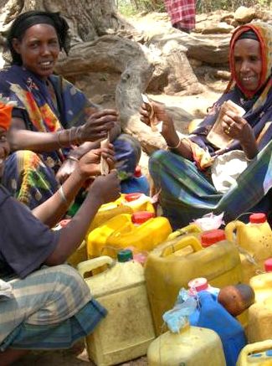

2.10 Unacceptable Container
Non food grade plastic
Container that previous stored something else, possibly chemicals

Slide 17




2.11 Safe Milk Handling
Personal Hygiene and Health
Don’t Smoke
Head Covered
Hands Washed
Trimmed Nails

Slide 18
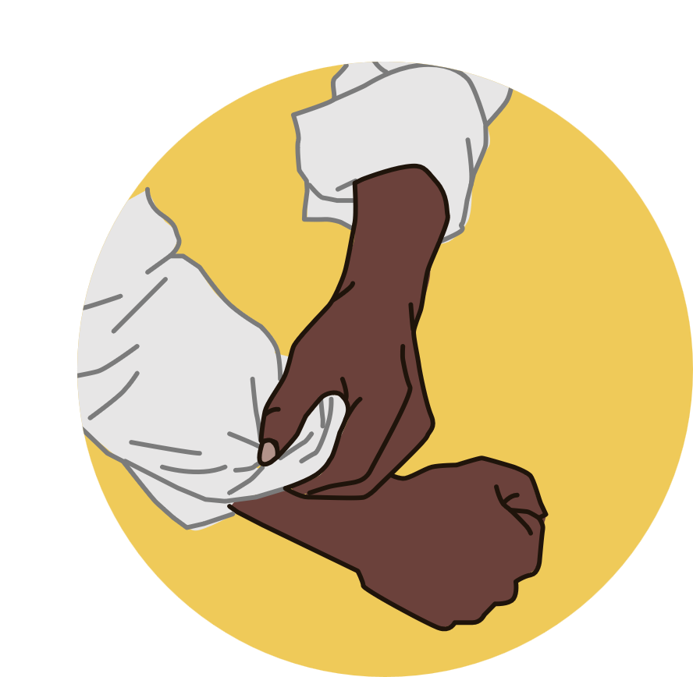







2.12 Correct Way to Wash Hands
1
2
3
4
Pull sleeves up
Rinse
Wash hands
with soap
Wash forearms with soap
5
6
7
8
Brush hands
and nails
Rinse to
remove soap
Dry with paper towel
Use a paper towel
to turn of tap

Slide 19
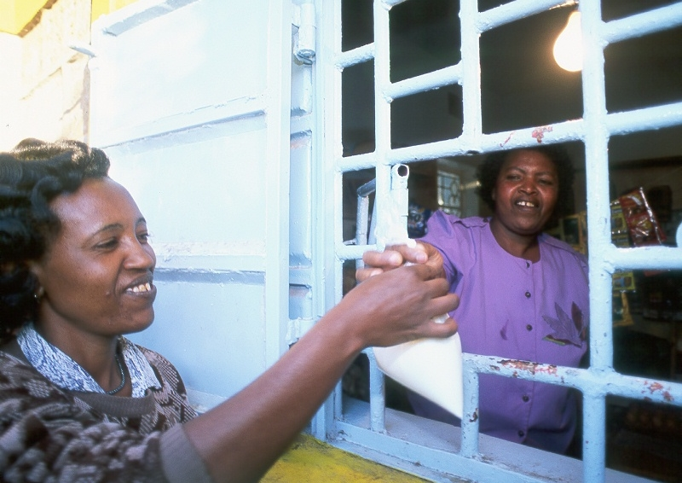
Customers and Milk Hygiene
a
3

Slide 20



Session Objectives
How to ensure your customers are handling your milk hygienically once they leave your shop
Educate Your Customers
Handle Complaints
Hygiene
Action Plan

Slide 21

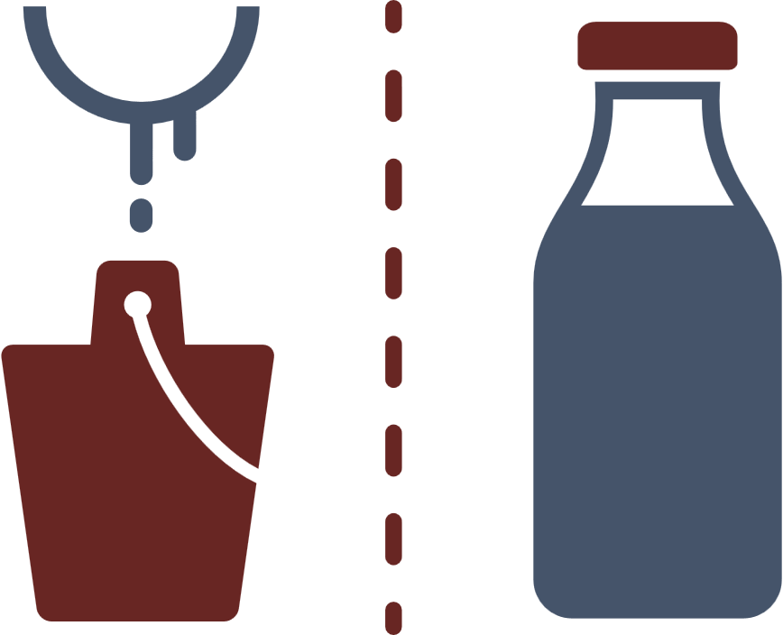



3.1 Five Keys to Safer Milk
1
2
3
Sell unadulterated milk
Separate raw and pasteurised
Maintain cool
temperature
4
5
Track purchase dates
Practice personal
hygiene

Slide 22
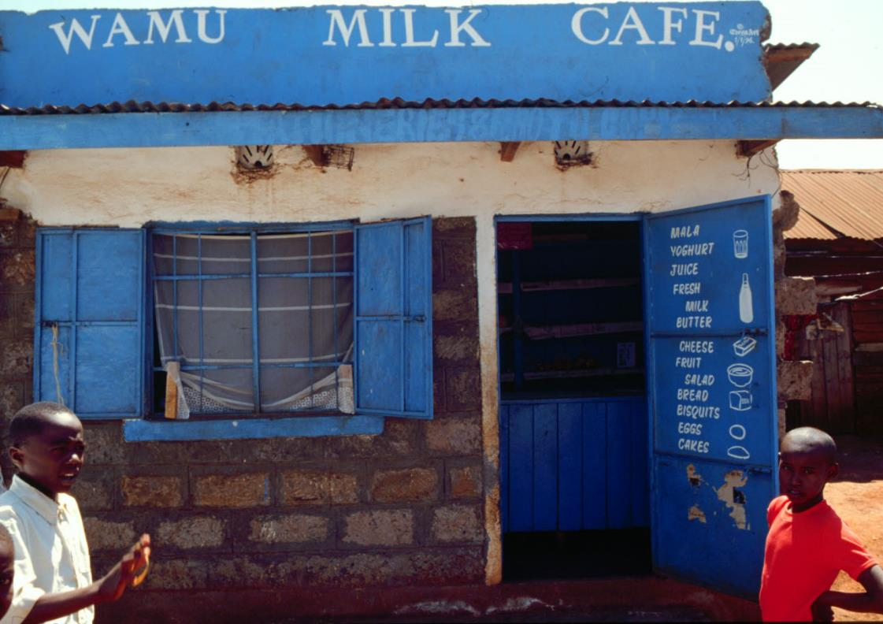
Planning a Business
a
4

Slide 23
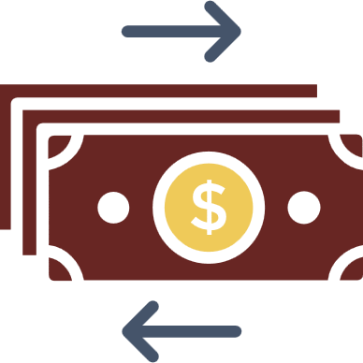






4.1 Business Basics
Manage Money
Keep Records
Have Strategy
Improve Products
Promote Business
Comply Regulations
Aim for Customer
Satisfaction

Slide 24
4.2 Cash In (Sales Record)
MONTH:
DATE | TOTAL SALES
20/6/19 | Sh.XX.XX
TOTAL

Slide 25
4.3 Cash In (Customer Credit)
MONTH:
NAME | CONTACT INFO | DATE PURCHASED | PAYMENT DUE DATE | DATE PAID | AMOUNT OWED
Ashura | +254 701 123456 | 20/6/19 | 27/6/19 | 27/6/19 | Sh.XX.XX
TOTAL

Slide 26
4.4 Cash Out
MONTH:
EXPENSE | DATE | AMOUNT
Milk, other products, supplies | 27/6/19 | Sh.XX.XX
TOTAL

Slide 27







4.5 The Five Forces that Impact a Business
1
Customers’ Power
2
Suppliers’ Power
3
Competitors
4
New Entrants into the Market
5
Alternative Products

Slide 28
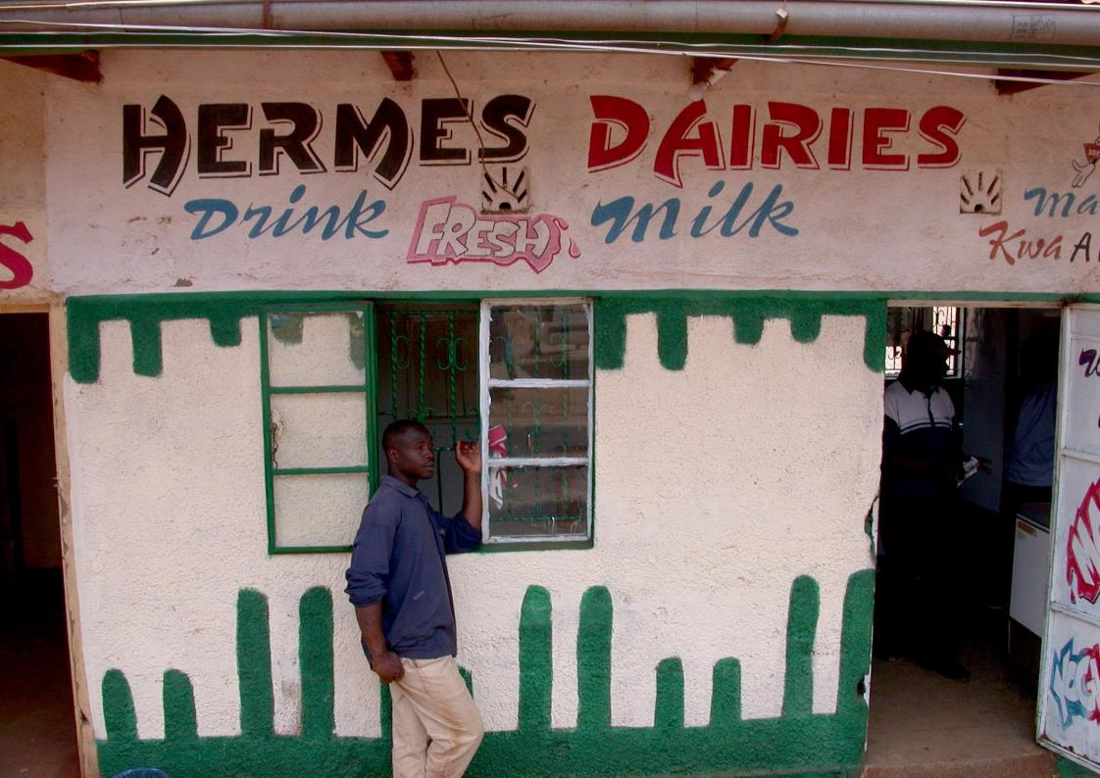
Selling More Milk to Your Customers
a
5

Slide 29



Session Objectives
How to Sell More Milk
Product and Price
Where to Sell
Promotion

Slide 30





5.2 Customer Desires
Quality
Value
Cleanliness
Milk Safety
Trust

Slide 31
Photo credits
Cover: ILRI/Jules Mateo
Slide 3: ILRI/Jules Mateo
Slide 7: ILRI/Susan MacMillan
Slide 9: ILRI/Dave Elsworth
Slide 14: ILRI/Mohamed Ibrahim
Slide 15: ILRI/Susan MacMillan
Slide 16: ILRI/Ranjitha Puskur
Slide 19: ILRI/Brad Collis
Slide 22: ILRI/Dave Elsworth
Slide 28: ILRI/Dave Elsworth

