Slide 1
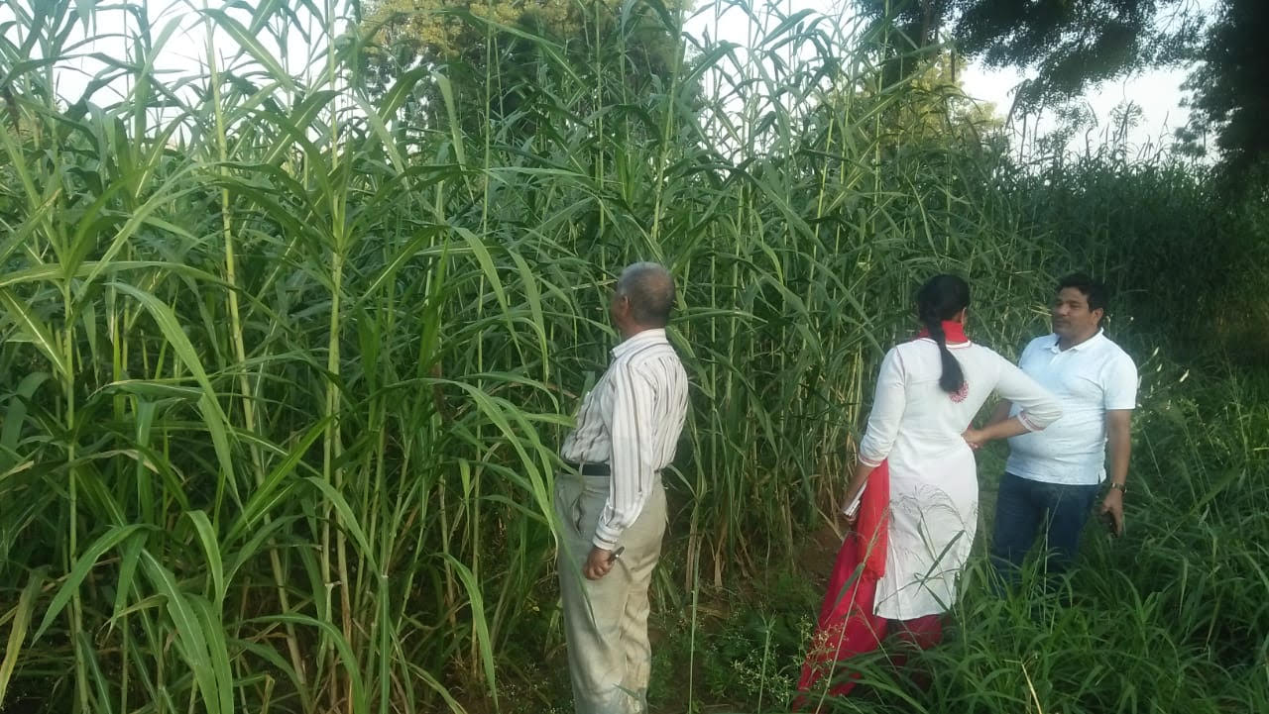
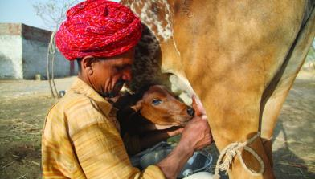
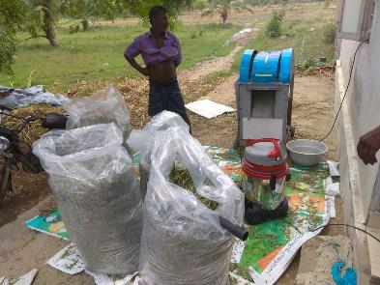


Opportunities for small scale green fodder enterprise in Mulukanoor Women Dairy Cooperative (MWDC), Kareem Nagar, Telangana
Thanammal Ravichandran¹, Andy Hall² and Michael Blummel³
^{1,3}International Livestock Research Institute (ILRI)
²Commonwealth Scientific and Industrial Research Organisation (CSIRO)
Forage as Cash Crop and Opportunities for Green Fodder Enterprise Development Workshop, Kareem Nagar district, India, 4 April 2019
2018 Global Nutrition Symposium, January 2018, Addis Ababa, Ethiopia

Slide 2


Context
Feed and fodder scarcity are the main limiting factor in India for attaining dairy productivity besides genetic potential of animals
The country faces a net deficit of 35.6 % green fodder, 10.95% dry crop residues and 44% concentrate feed ingredients (IGFRI, 2017)
Annual growth of concentrate feed price- 8% but milk price growth rate is 5-6%
Implication: Very high cost of production (70-80%) for marginal and small farmers
Need for improved green fodder with good nutritional quality
How landless/marginal/small farmers get benefit?

Slide 3
Objectives of the study
To find the expenditure pattern of the small, medium and large farmers
To find alternate solutions for green fodder scarcity in lean seasons
Piloting the green fodder and silage enterprise models

Slide 4
Methodology
Household survey- 316 households
  Landless- 9%
  Small (0.1-2 acres)- 26%
  Medium (2.1-4 acres)- 38%
  Large (>4 acres)- 27%
  Random selection of households
  Analysis of variance (ANOVA) to find differences of expenditure pattern between classes of households
Piloting
  Silage as alternate enterprise to conserve green fodder for lean period
  6 farmers according to willingness and availability of green fodder (COFS 29)

Slide 5
Results: Feed & fodder expenditure
Variable | Landless (0 acre) | Small farm (0.1-2 acres) | Medium farm (2.1- 4 acres) | Large farm (>4 acres) | F value | P value
Number of households | 28 | 81 | 121 | 86
Number of milking animals | 1.29 | 1.41 | 1.62 | 1.81 | 3.323 | <0.05
Total adult bovine | 2.25 | 2.01 | 2.93 | 3.42 | 6.585 | <0.001
Total milk litre/day | 6.33 | 7.21 | 8.32 | 10.34 | 3.056 | <0.05
Expenditure- concentrate feed* | 7631 | 8285 | 10326 | 12841 | 6.621 | <0.001
Expenditure- crop residue* | 16821 | 11617 | 9828 | 5948 | 11.530 | <0.001
Total dairy income* | 43040 | 49120 | 60888 | 86412 | 3.913 | <0.01
Land for green fodder (acre) | 0 | 0.11 | 0.16 | 0.17 | 0.4 | 8.636
source: Recent Household survey 2019 (316 households)

Slide 6
Results: Dairy productivity vs improved forage
Fodder variety | Milk yield (Mean | No of animals
COFS-29 | 5.41 | 117
Other green fodder | 3.85 | 156
Feed | Price | Price | DM | DM | CP | CP | TDN
Concentrate feed | 20 | 20 | 90 | 90 | 20 | 20 | 70
Nutrients/ kg feed |  |  | 0.9 | 0.9 | 0.18 | 0.18 | 0.63
Cost per kg nutrients |  |  |  |  | 111.11 | 111.11 | 31.75
Green fodder (COFS-29) | 1 | 1 | 23 | 23 | 8.3 | 8.3 | 45.5
Nutrients/kg fodder |  |  | 0.23 | 0.23 | 0.019 | 0.019 | 0.104
Cost per kg nutrients |  |  |  |  | 52.63 | 52.63 | 9.61
Concentrate Vs Green cost-benefit analysis
Savings (INR/kg nutrients) |  |  |  |  | 58.48 |  | 22.14
Saving (%) |  |  |  |  | 52.6 |  | 69.8

Slide 7
Results: Land use economics green fodder vs other crops
For 6 months- one season
Crop | N | Revenue (INR) | Std. Deviation | Cost of production (INR) | Net income (INR)
Sorghum | 2 | 30,000 | 14,142 | 10,000 | 20,000
Maize | 57 | 26,583 | 18,270 | 12,000 | 14,583
Rice | 316 | 33,378 | 29,842 | 15,000 | 18,378
Cotton | 132 | 28,769 | 18,021 | 15,000 | 13,769
Groundnut | 4 | 15,500 | 23,402 | 10,000 | 5,500
COFS fodder if sold fresh* | 30 | 42,000 | - | 3,000 | 39,000
Milk yield fed with COFS** | 65 | 1,13,300 | - | 39200ª | 74,100

Slide 8
Discussion: Opportunities for institutional innovations
High demand for COFS-29 seeds (farmer to farmer seed sale started) and Super Napier cuttings
Landless and small farmers are spending more cost towards crop residues which is low in nutritional value
Potential for green fodder enterprise development (landless farmers will be benefitted)
Seasonal shortage of green fodder in summer
  Silage enterprise development
  Individual bags/ village level silage pits
Need support for women friendly machineries for fodder cutting and silage making
Seed production, silage making and dairy production will increase income per acre of land

Slide 9
Lessons/challenges/ opportunities
There is fast adoption for any new forage introduction (COFS-29 and Super Napier)
There is issue of machinery- Big load chopper not suitable for small farms <0.5 acre land-
Need innovation for machineries for cutting fodder and chopping (women friendly)
Institutional mechanism/ support/ innovation required for youth and women to take green fodder enterprise
Large farmers are willing to allocate land for fodder production if there is demand and market within village
Landless and marginal spare some money from CR to green fodder which increase productivity- but there need for a platform to initiate this innovation with collective machinery/ renting- digital platform for demand and supply

Slide 10
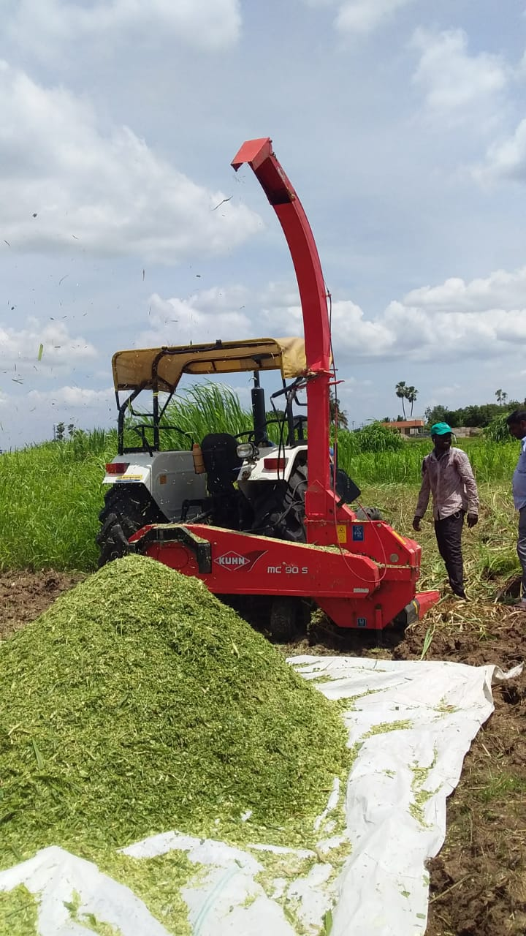
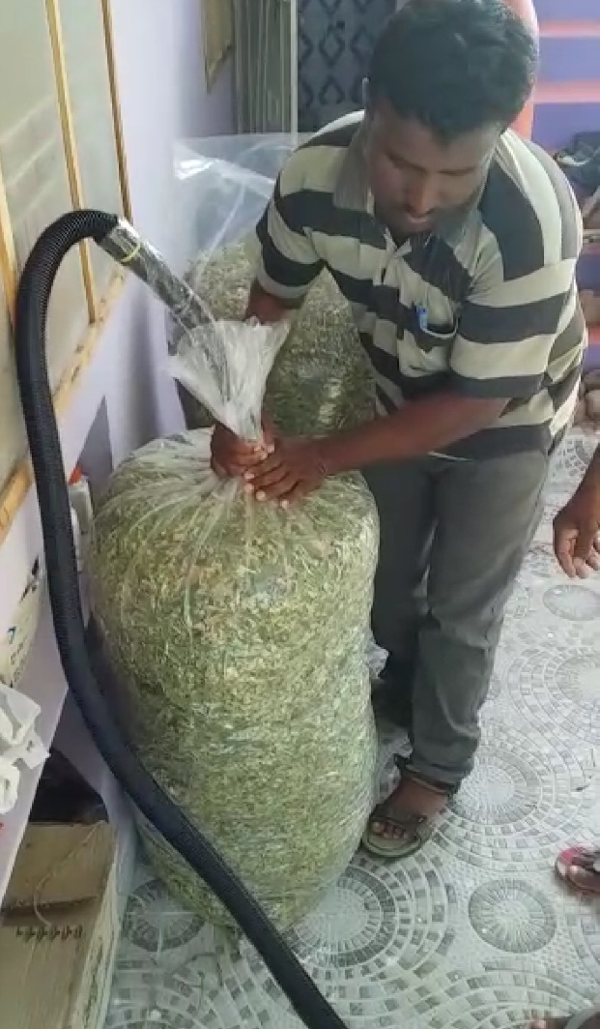
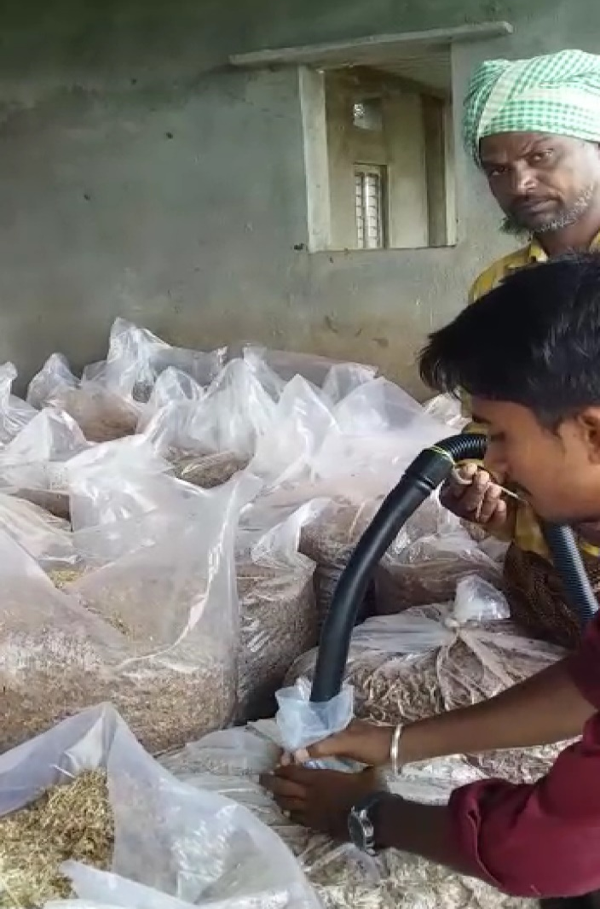
Bag silage method- innovation (6 farmers)

Slide 11
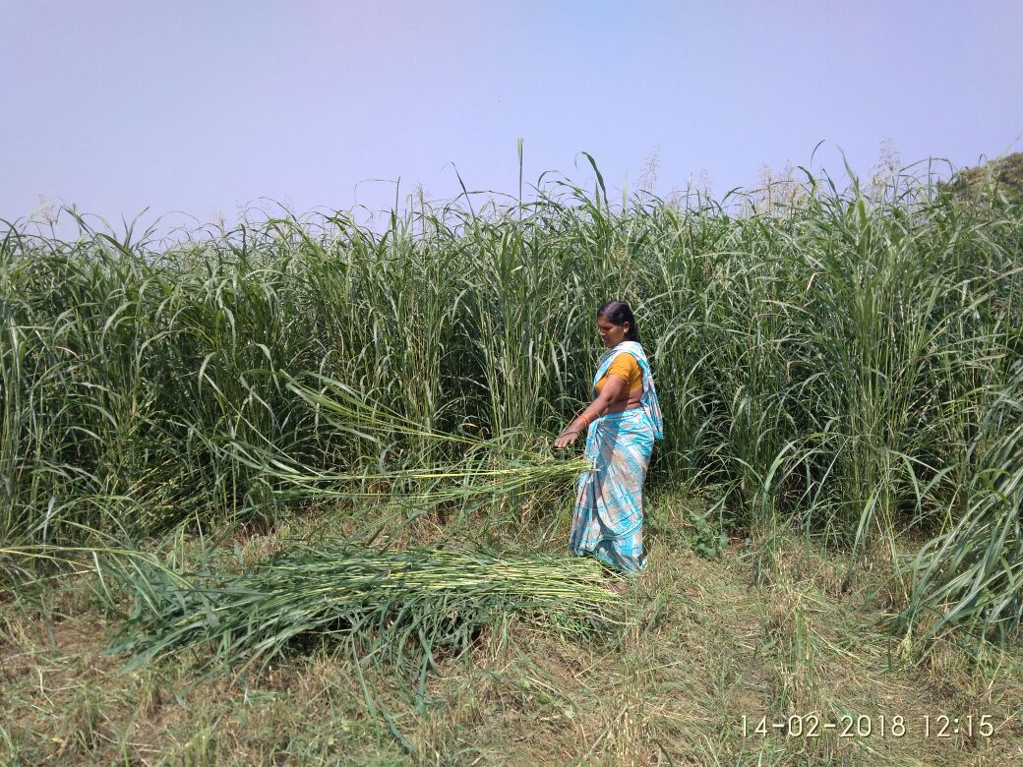
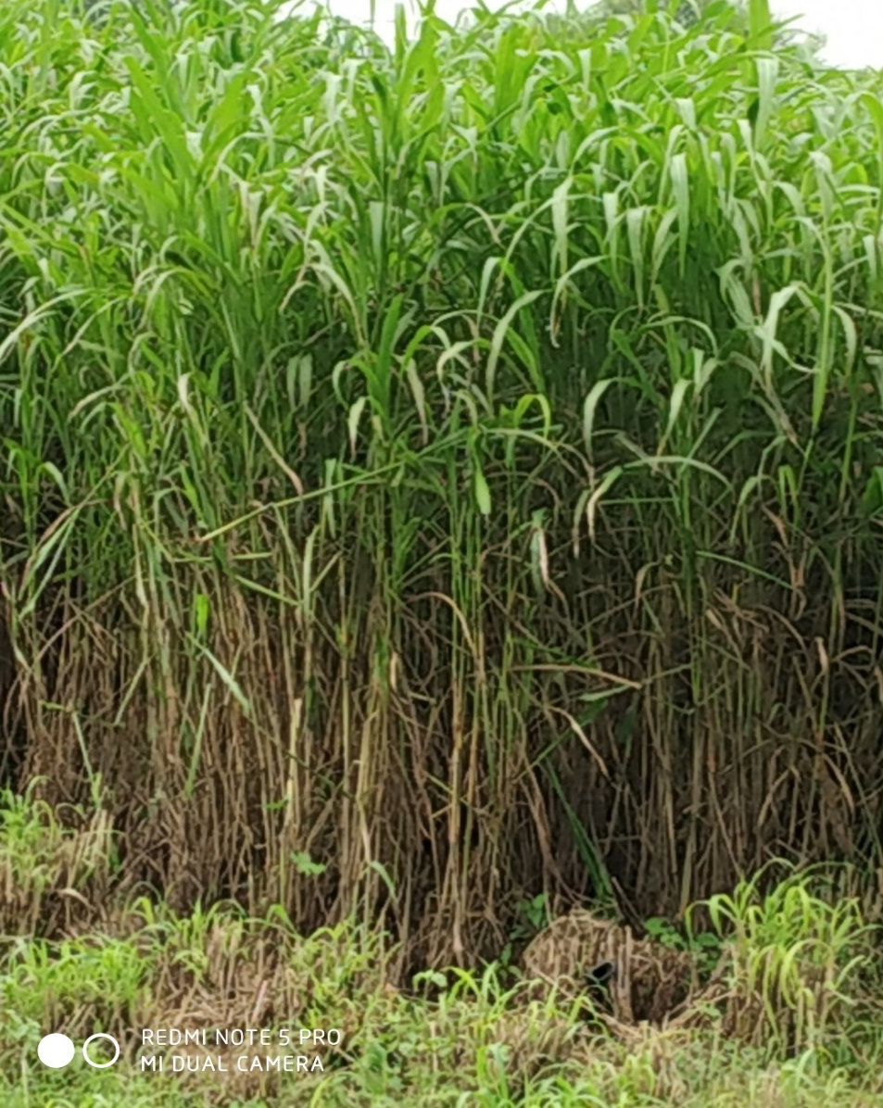
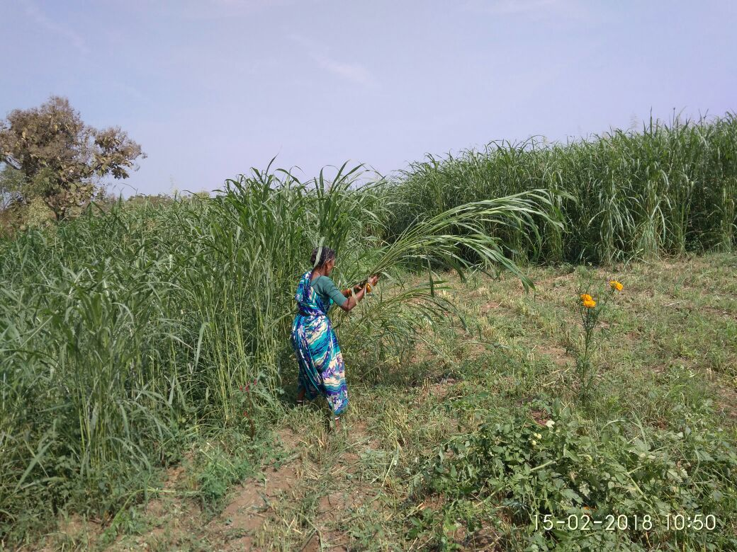
COFS 29 fodder and women harvesting fodder

Slide 12
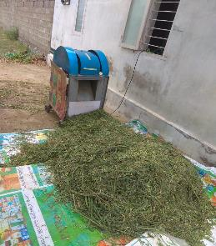
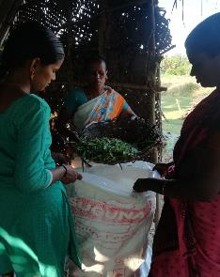
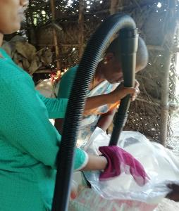
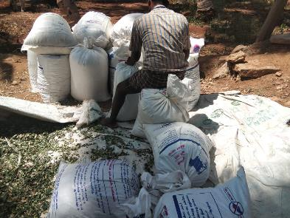
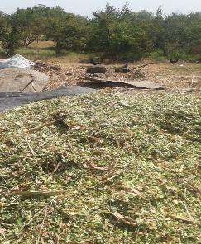
Silage making process
Cutting fodder
Filling
Silage bags
Airtight packing
Silage bags for storage
Drying silage

Slide 13


