Slide 1
Using typologies for technology targeting
Jeroen Groot (WUR), Beliyou Haile (IFPRI) and Carlo Azzari (IFPRI)
Africa RISING ESA project review and planning meeting
12 September 2017
Zanzibar, Tanzania

Slide 2
Using typologies for targeting
We assume that: technologies are suitable for specific farms or farm types, dependent on, e.g.:
  Farm size
  Production orientation
  Farmer perspective and ambitions
To scale out to new farms we have to identify the farm type to propose the most promising interventions

Slide 3
Assigning farms to an existing typology
Steps:
  Statistical typology: 4 farm types in each country
  Identify 10-15 most discriminating variables → RDA
  Collect data on farm for the 10-15 variables
  Calculate probability of belonging to each type → NBC
  Farm is assigned to the type with highest probability
We performed an in-silico experiment following these steps
RDA = redundancy analysis
NBC = naïve Bayesian classification

Slide 4
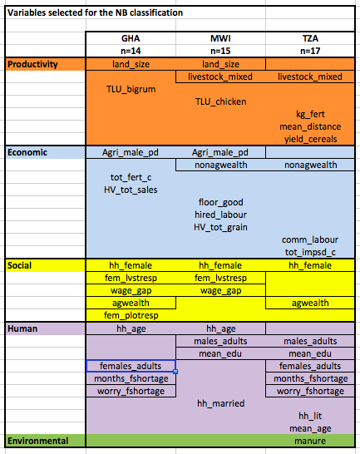
RDA result: selected variables
RDA = redundancy analysis

Slide 5
NBC result: allocated farm types
Used randomly selected 75% of the dataset to train the NBC
Tested allocation of 25% dataset to farm types (115-190 farms, dependent on dataset size)
High percentage of correct allocations to types:
  Tanzania: 83.2%
  Malawi: 82.1%
  Ghana: 88.8%
NBC = naïve Bayesian classification

Slide 6
Next step: allocate technologies to farms
Using similar approaches and statistical techniques
Combining typology (ARBES) databases with spatially explicit socio-economic and biophysical datasets
Using a small set of variables collected on farm by advisors or the farmers
Generating ranked lists of most promising set of technologies for a farm, given its:
  Farm features
  Socio-economic environment
  Biophysical conditions
Move from “suitable for” farm types, to “suitable for” farms

Slide 7
Targeting: dealing with differences
Taking into account:
  Biophysical conditions (using spatial data)
  Socio-economic setting (using multiple datasets, ARBES/typology data)
  Farm structure and endowment and household structure and relations
Biophysical DB
Socio-econ. DB
Farm data
(10-15 variables, problems, prefs)
Handheld
device App
Website
PC
Application
Technology
suitability
ranking
Matching
algorithm
Cloud DB

Slide 8
Thank You

