Slide 1
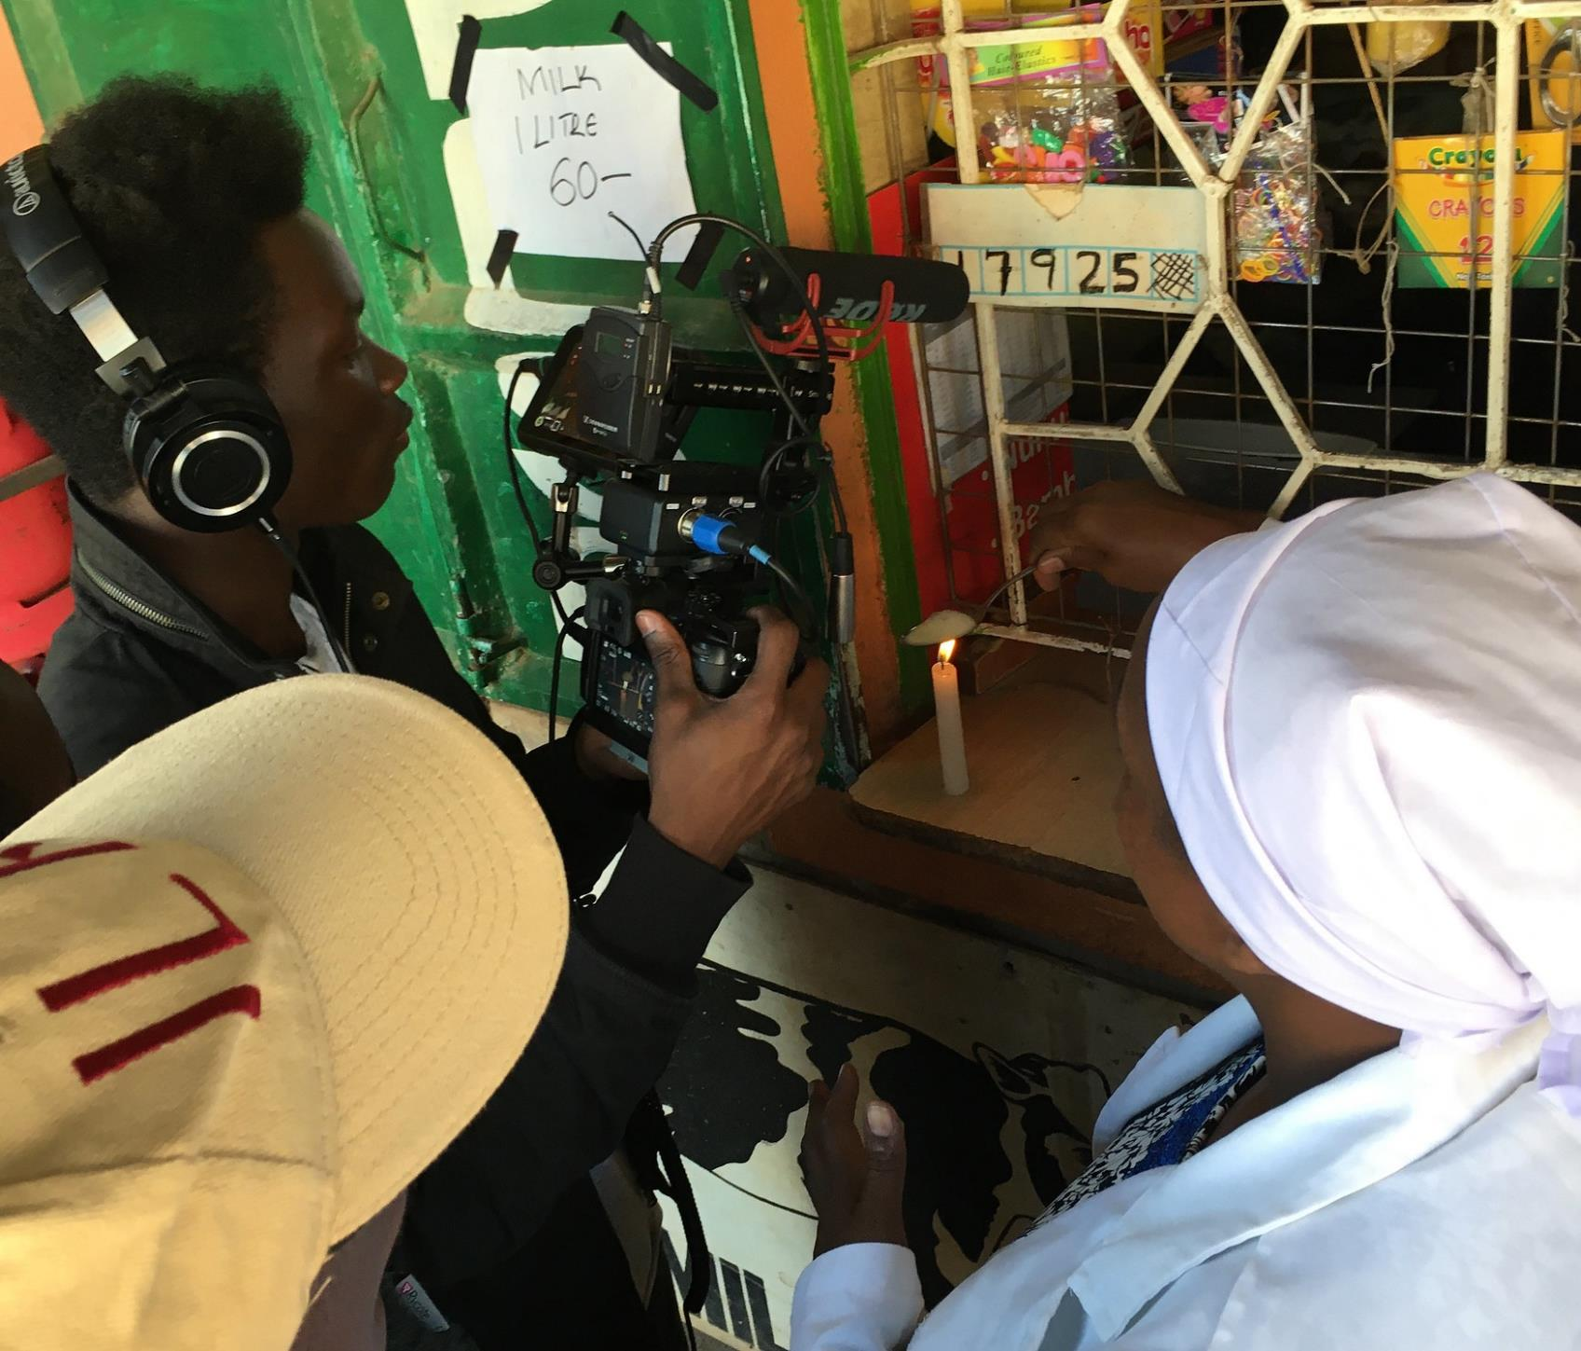
Our ‘not just business as usual’ communications plan
Mireille Ferrari
CGIAR Livestock review and planning meeting, 12 June 2020
Photo David Malouin/ILRI
Notes:
More than ever, we really need to plan with the end in mind – my work also entails real thinking on how we can have impact through the products we decide to produce

Slide 2

Our session today
10 mins Presentation
10 mins feedback session
5 mins back to plenary

Slide 3
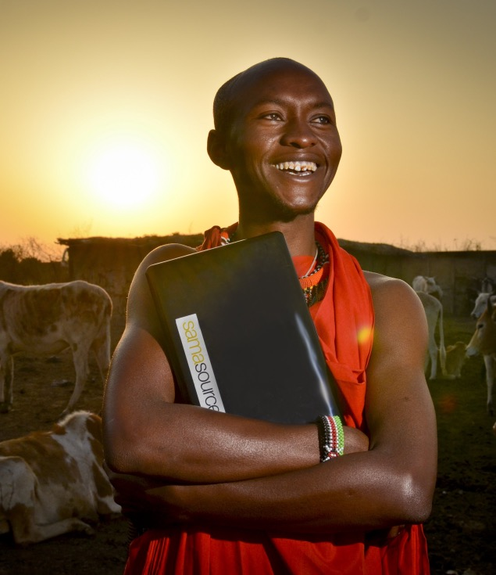
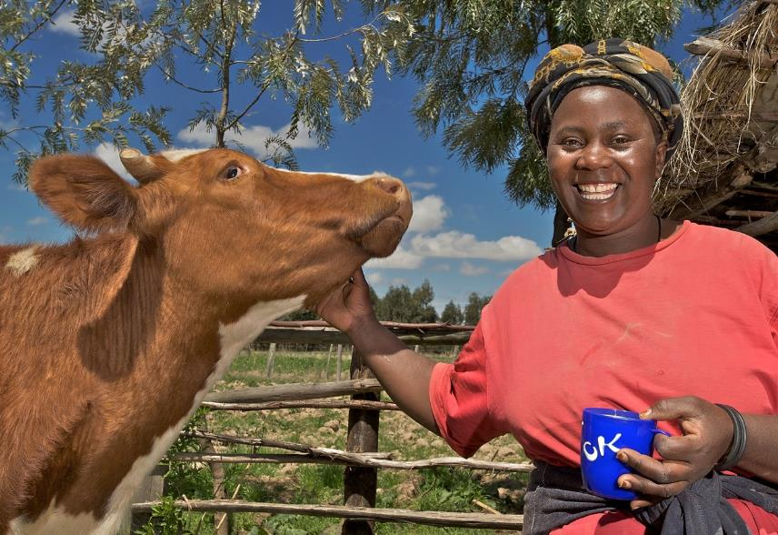

What is our communications goal?
By the end of the 18 months…
Legacy products are completed, and are;
Actively being communicated and disseminated to policy makers, donors and investors through appropriate channels and key moments.
Remember it’s a team process, so let’s get trained up and work with the end in mind!
Photo (above) Ved Chirayath/ Samasource; (below) Neil Thomas/EADD
Notes:
What is our end game
How can we help you with lift off, to help your research take flight, get it into the hands of people who need to see it
Legacy products
Which main research should continue after the CRP, what are the next steps and how and by whom should they be taken up?
What does this mean?
What are your potential legacy products? There are possibly 1-2 main ones coming out of your product lines. Let’s build a catalog of what these are.
How can we train up to articulate what these are?
Let’s identify key moments or events in the next 18 months that can serve as our goals to work towards.

Slide 4
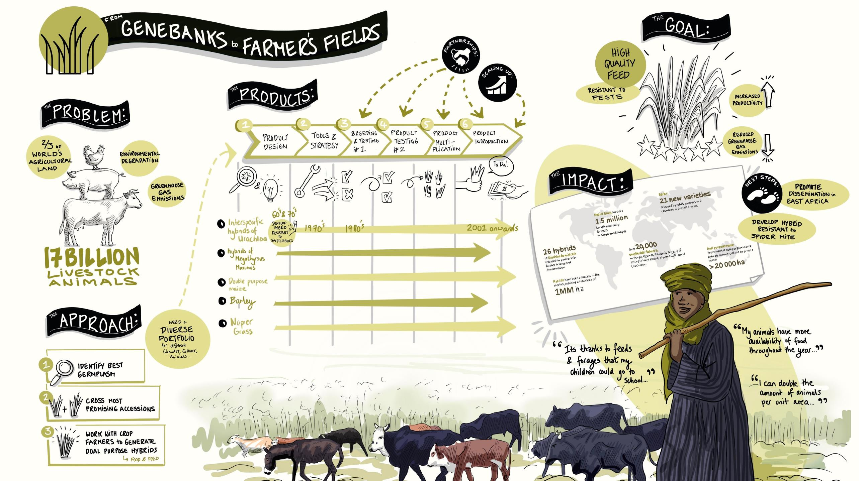
Notes:
- We started doing that this last week. We have begun our articulation exercise during this planning meeting, and we want to continue training ourselves to do best tell the story of our achievements with and how they contribute to outcomes and impacts… One idea that has come up is to go through this exercise for all your product lines, and we will have a graphic harvest of each one.
We would like to go through the same exercise for each of your remaining product lines – a storytelling session, possibly just within your flagship, and we will invite Sonja to join us again and graphically document them.
It’s a quick legacy product that you can build upon.
Internal as well as external comms tool

Slide 5
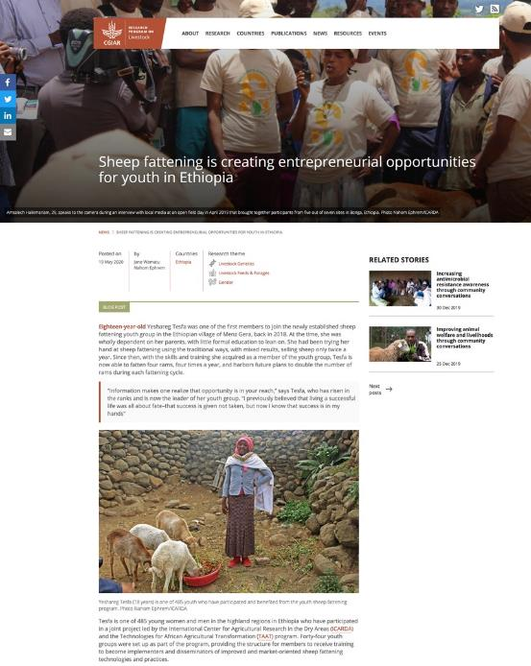


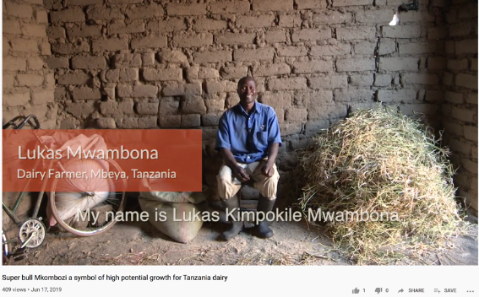
What can we help you with?
1
Celebration of the science
Blog post
Story of what happened
What did we achieve?
How did we do it?
What were the outcomes/impacts?
Outcome story
A video
Notes:
Outcome stories
These are the tangible products that demonstrate your achievements, they form the building blocks of your legacy.
Working on 2019 stories right now
TIP: In your flagship and priority country meetings, you’ve been talking about identifying 2020/2021 stories. Let’s be proactive about developing some initial comms around those, because part of the requirement of the OICRs is to have links of communications stories. Share those with me and I can work with your different center communications teams to get a blog post or some other type of comms product already avaiable. These also go into your overall legacy products.
In this morning’s Vietnam meeting, you spoke about process rather than outcomes – you were spot on, this is very important to document as you may not have specific outcomes to report right away, if at all.
Uganda has been doing a good job of that already, with a blog we put out early this year on the planning meetings that took place, John Mutual and Birthe Paul had a blog recently on heat stress work that they are doing and highlighted the Uganda work.
Priority countries are also implementing some of our technologies and innovations, RHOMIS and CLEANED-R tool, let’s keep talking about that.

Slide 6
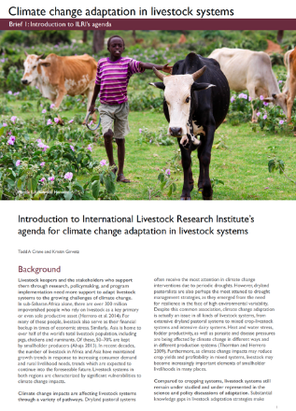
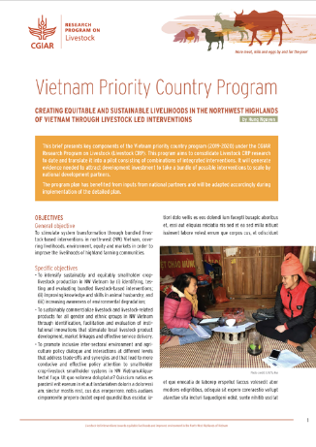

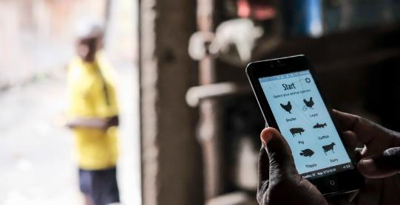
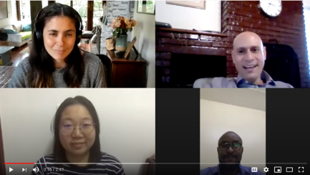
What can we help you with?
2
Building the case for next steps
Outcome/innovation/ policy stories
Which promising research will you take forward?
What stage is it at?
What type of comms products would help position your work?
How will you generate visibility for it?
Briefs, factsheets,
knowledge series
Video
Webinars/podcasts
These are some ideas, share yours with us!
Notes:
Major pieces of work that have a strong case of being funded well after the CRP
We can help you create a legacy comms package to make sure that the work continues and can be picked up
In the health meeting today, I heard that the uncertain environment – activity and funding – is one of their main challenges; so to all flagships, now more than ever let’s start packaging your achievements and find those critical moments to use and present them.
Priority country progress
- Documenting process and learnings
Develop a knowledge series based on specific areas
gender work in the CRP – achievements and tools
capacity development case study series
Country learning (KIT)
Innovations

Slide 7
What are some key moments and activities happening over the next 18 months?
CAADP partnership meeting
CRP dissemination event: deadline for draft legacy products
Develop 2021 POWB
2021 Annual report completed
EAT Forum
CRP closes its doors
WE ARE HERE
2020
2021
JUN
JUL
AUG
SEP
OCT
NOV
DEC
JAN
FEB
MAR
APR
MAY
JUN
JUL
AUG
SEP
OCT
NOV
DEC
CAADP partnership meeting
Independent steering committee meeting
CBBP 10-year celebration in Bonga, Ethiopia
Begin work on 2021 Annual Report
GASL multi-stakeholder partnership meeting
Joint rangelands/ grasslands congress
Setting up a timeline helps us set goals for our legacy products
Notes:
Let us begin thinking about opportunities to push out our work and legacy products.
Remember that expression:
"If a tree falls in a forest and no one is around to hear it, does it make a sound?”
If you are not trumpeting your own horn, publicizing your achievements and plans, people won’t know about them.
Strategically think of who needs to hear about your work, what are the best products that can do that, and where you need to disseminate them
- We will help support by arming you with the comms products you need, disseminate them through the necessary channels to amplify your voice

Slide 8

Today’s task: in Google docs
Identify key events, moments where you'll have an opportunity to strategically position your work.
What type of communications and visibility products would you need for each?
Think about who is going to be at the event or activity, this will help you identify what you need.
Notes:
1) Celebrating achievements: this is the easy straightforward part. ACGG/ADGG
2) Positioning work strategically requires some thinking, ask flagships and countries what that could look like.
Task:
Within your product lines - 2 examples; suggest an example of research you would really like to see next steps funded?
What would it look like, who needs to see it? How do you generate visibility for that, give them appetite?
What kind of comms story would you need that would position you for next steps? To sensitize donors, to give visibility in an area of interest
What would be the key message?
How do we continue that work? Take advantage of what you're doing now, get visibility of that, give that sense of momentum, that gets people interested

