Slide 1
Africa RISING – NAFAKA: POSTHARVEST MANAGEMENT ACTIVITIES AND ACHIEVEMENTS 2018/2019
CHRISTOPHER MUTUNGI, AUDIFAS GASPAR, ADEBAYO ABASS
INTERNATIONAL INSTITUTE OF TROPICAL AGRICULTURE
AFRICA RISING - NAFAKA PROJECT ANNUAL REVIEW AND PLANNING MEETING
3 – 4 JULY 2019, DAR ES SALAAM, TANZANIA

Slide 2
OUTLINE
Activities 2018/19
Achievements
Partners & their roles
Lessons Learned

Slide 3
FOCUS & INTERVENTION AREAS
GOAL: Introduce and promote post-harvest to reduce losses and bring quality to market standards.
Intervention areas:
  Intervention 1: Reduce food waste and spoilage
  Intervention 2: Capacity building for better scaling

Slide 4
ACTIVITIES 2018/19
Intervention 1: Reduce food waste and spoilage
B2B meetings with VBAAs, producer organizations and input suppliers
  Provide support to NAFAKA led B2B meetings by identifying the various PH technology suppliers and offering technical backstopping
Demonstrate improved harvesting, drying techniques, and mechanized threshing of paddy;
Demonstrate improved drying, mechanized threshing technologies for maize; and storage technologies.

Slide 5
ACTIVITIES 2018/19
Intervention 2: Capacity building for better scaling
  Behavioral change communication
    Simplify postharvest trainers manuals to elementary dissemination materials for farmers
    Design and avail ICT- based communication support tools including simple text messages and video clips
  Collective learning and adaptation
    Carry out a follow-up survey to establish spare-part requirements of maize/ rice threshers and inventory parts that require frequent replacement

Slide 6
ACTIVITIES 2018/19
Intervention 2: Capacity building for better scaling
  Product knowledge training
    Train small processors/traders, VBAAs & lead farmers on MAIZE and RICE quality specifications and quality assessment techniques
  Other unique training activities
    Field days / agricultural shows

Slide 7
PROGRESS/ ACHIEVEMENTS
Collective learning and adaptation
Assessment of perceived benefits and constraints associated with maize shellers through farmer groups
12 focus group discussions; 12 villages in Kilolo and Mbozi districts
  Farmer perception of the benefits of the technology;
  Spare-part requirements
  Availability and accessibility of spare parts/ maintenance services.
  Farmer adaptations with regard to use and maintenance

Slide 8
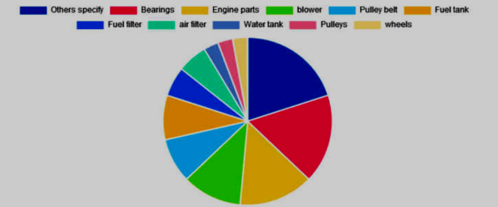
PARTS THAT REQUIRE FREQUENT REPLACEMENT
The category others’ includes bolts, shelling drum/ shelling concave, cone bearings and ring piston (engine parts) and oil filer.

Slide 9
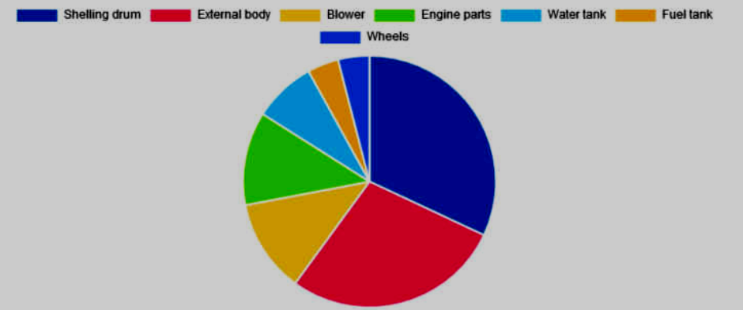
MACHINE PARTS THAT REQUIRE FREQUENT REPAIR

Slide 10
COST OF REPAIR/ REPLACING PARTS AND ACCESSIBILITY OF SPARES
Part | Ever replaced? (%) | Needed to replace but didn’t find spare parts? | Cost (TZS) | $
Water tank | 23.1 | 0 | 4000 | 1.8
Fuel filter | 30.8 | 0 | 1380 | 0.6
pulleys | 7.8 | 0 | 10670 | 4.7
pulley belt | 30.8 | 0 | 4580 | 2.0
Fuel Tank | 23.1 | 7.7 | 10288 | 4.5
Cone bearing (Engine) | 62.3 | 30.8 | 20333 | 8.9
Plunger | 8.3 | 0 | 45000 | 19.7
Ring piston | 8.3 | 0 | 10000 | 4.4
Other Engine parts | 76.9 | 23.1 | 44400 | 19.5
Oil filter | 8.3 | 0 | 9000 | 3.9
Blower | 8.3 | 0 | 6750 | 3.0
Bolts | 16.7 | 0 | 500 | 0.2
Fuel pipe | 8.3 | 0 | 3000 | 1.3
nozzles | 8.3 | 0 | 10500 | 4.6
shelling drum | 25 | 0 | 7500 | 3.3
wheels | 38.5 | 7.7 | 6000 | 2.6

Slide 11
SOURCES OF SPARE PARTS
69% of groups accessed spare-parts away from village-based outlets

Slide 12
WHAT DO FARMERS THINKS ARE KEY BENEFITS OF CONTINUING TO USE MECHANIZED SHELLERS?

Slide 13
ARE THERE DIFFERENCES IN THE WAY MEN AND WOMEN RATE THE BENEFITS?

Slide 14
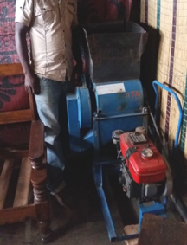
ADAPTATIONS: WHAT ARE FARMERS ARE ATTEMPTING OR RECOMMENDING FOR IMPROVEMENT

Slide 15
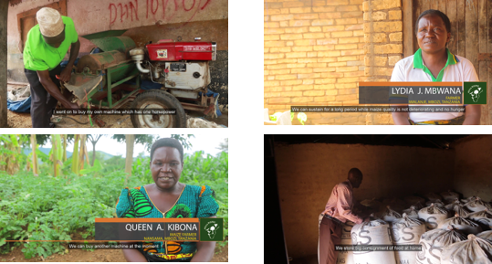
Four (4) videos – farmer voices on mechanization and improved storage recorded (Morogoro/ Mbozi)
Videos used to demonstrate & communicate technology impacts in 4 new districts (Momba, Wagingombe, Mufindi, Mbarali)

Slide 16
Formulated 18 short messages on PH best practices
Currently being disseminated via Mwanga platform

Slide 17
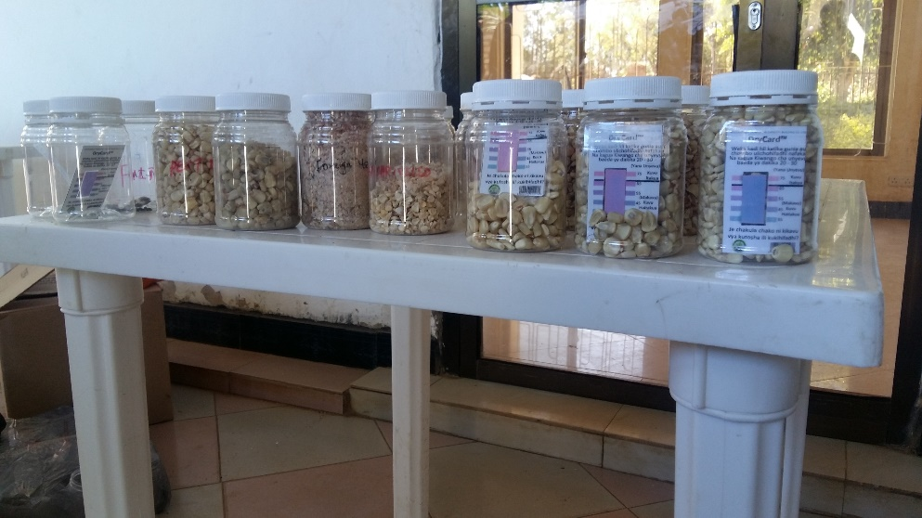
Training on maize and rice quality standards & specifications
Extension workers and PO leaders to be farmer trainers
Grain quality parameters
Sampling and assessment of quality
East African grain standards/ specifications
Grain moisture management
Aflatoxin management
Post-harvest techniques for quality improvement

Slide 18
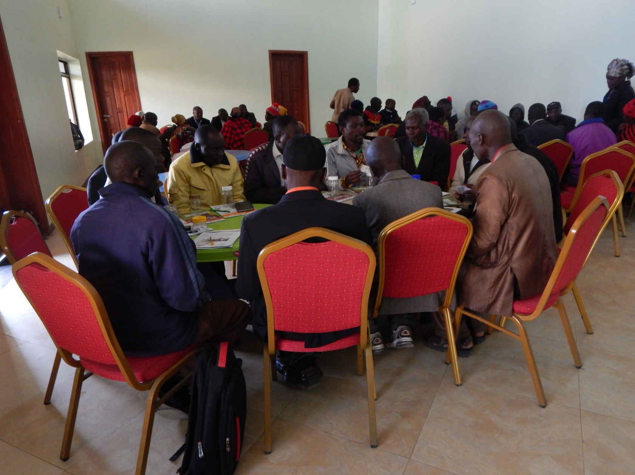
A training session at Mlowo in Mbozi district (Photo: J. Njela Gasper/IITA)

Slide 19
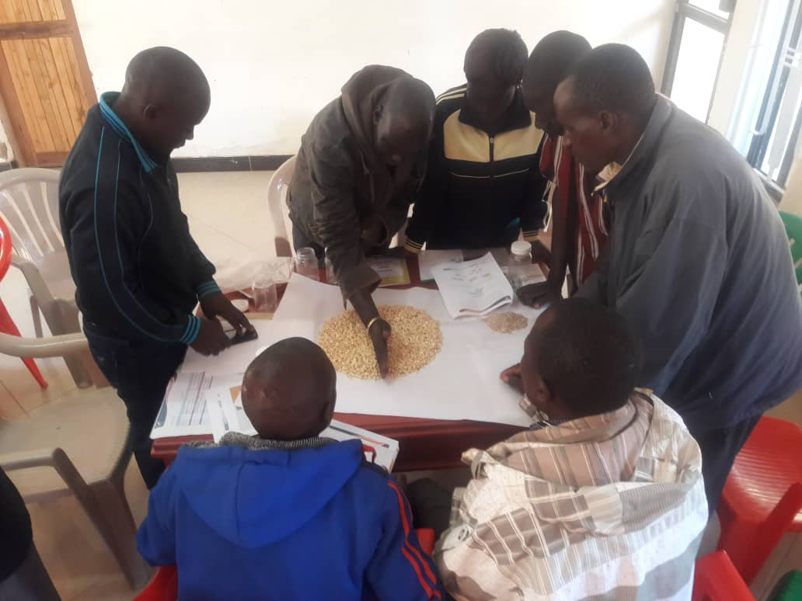
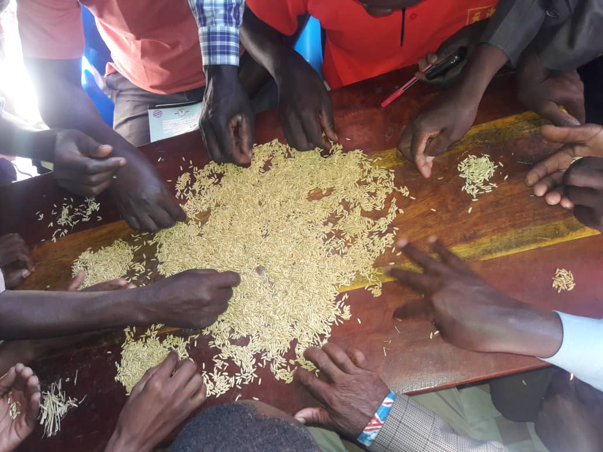
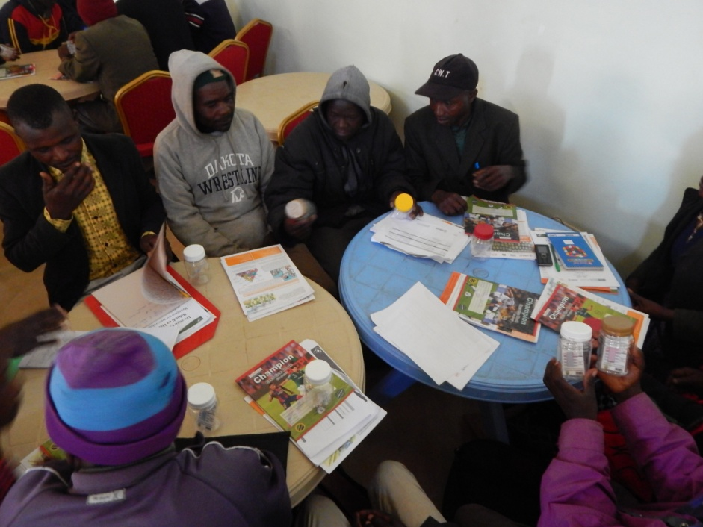
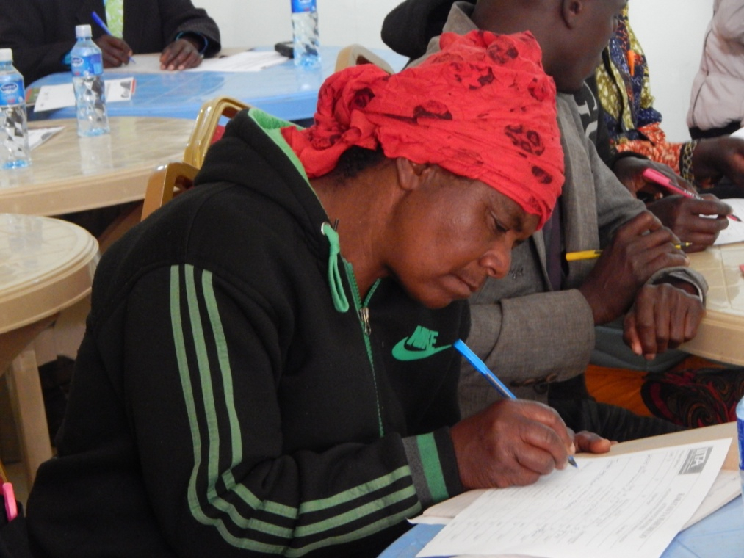
Trainees during in practical sessions in Momba and Mbarali district, respectively (Photo: A. Gasper/IITA)

Slide 20
NUMBERS …..
District | Villages | Govt. staff |  | Lead farmers |  | Private / civil
 |  | (M) | (F) | (M) | (F) | (M) | (F) | Total | Youth
Momba/ Mbozi | 4/6 | 5 | 3 | 23 | 3 | 4 | 1 | 39 | 9
Mufindi | 20 | 10 | 0 | 25 | 10 | 1 | 0 | 46 | 5
Waging’ombe | 12 | - | - | - | - | - | - | -
Mbarali | 25 | 19 | 1 | 33 | 12 | 1 | 2 | 68 | 8
Total |  | 34 | 4 | 81 | 25 | 6 | 3 | 153 | 22
Percentage |  | 22% | 3% | 53% | 16% | 4% | 2% |  | 14%

Slide 21
LESSONS LEARNED
Approaches that worked for scaling of postharvest technologies
  Training of extension officers and lead farmers as trainers worked well but - proper selection is key.
  Training materials were good aids for accurate information transfer to farmers but some improvements have been suggested

Slide 22
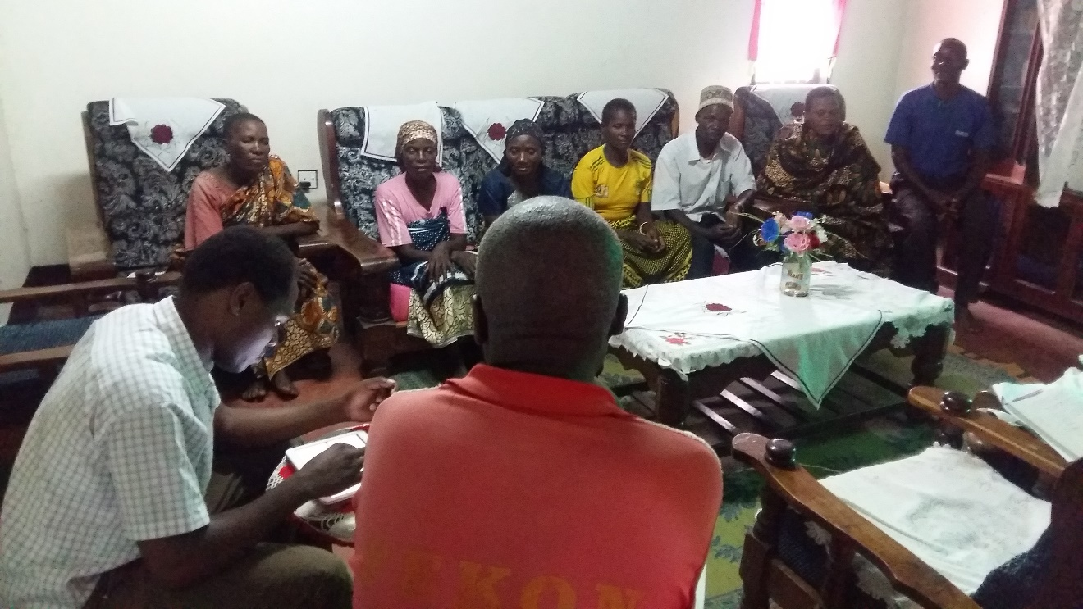
THANK YOU
Getting farmer perspectives: Members of Jitegemee group participate in a focus group discussion in Lyasa village, Kilolo District: Christopher Mutungi/IITA.

Slide 23












PARTNERS
Notes:
ESA Africa

