Slide 1
Gender Transformative Approaches in agrifood systems
A course in four modules
Version 1 (2024)
Elizabeth Costenbader, Anjalee Kohli, and Steven Cole

Slide 2
Welcome

Slide 3

RECAP
In chat:
Share one thing you learned in Module 2
Notes:
Ask people to share in chat or verbally

Slide 4
RECAP
In chat:
Are there any lingering questions or comments before we dive into Module 3?
Notes:
Ask people to share in chat or verbally

Slide 5
COURSE Learning Objectives
Objective 1
Objective 2
Objective 3
Objective 4
Understand the value of using gender transformative approaches in agrifood systems
Understand concepts important to gender transformative approaches
Understand how gender transformative approaches are operationalized
Understand how to measure gender transformative change
Notes:
Read Slide

Slide 6

Our Roadmap
We are here!
1
2
3
4
Gender transformative approaches
in agrifood systems
Characteristics important to gender transformative approaches
Operationalizing gender transformative approaches
Measuring gender transformative change
Notes:
Read Slide

Slide 7
How to operationalize gender transformative approaches
Module 3
Notes:
Read Slide

Slide 8
Learning Objectives
1
Understand the process and practice involved in implementing a gender transformative approach
2
Learn about how some of the key characteristics of gender transformative approaches can be operationalized throughout the project cycle
3
Gain exposure to some gender transformative methodologies
Notes:
Read Slide

Slide 9
Structure of Today’s Session
1
Operationalizing gender transformative approaches
2
Gender transformative approaches: Formative phase
3
Gender transformative approaches: Design and Implementation phase
4
Gender transformative approaches: Monitoring, Evaluation and Learning phase
5
Case study using gender transformative approaches in all project phases
Notes:
Read Slide

Slide 10
Operationalizing gender transformative approaches
Section 1
Notes:
Read Slide

Slide 11
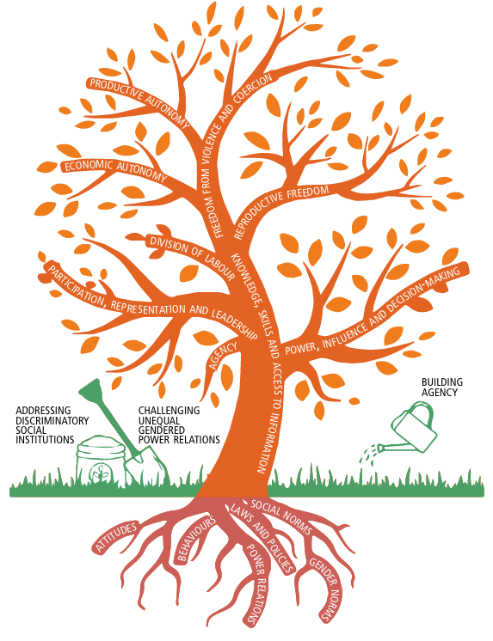
Operational Distinctions of GTA
Gender transformative approaches:
Have an additional focus on the underlying root causes of gender inequality
Are iterative and integrated across the project cycle
Use a strong participatory nature of process
Use gender transformative tools and methodologies
Image source: adapted from FAO, IFAD & WFP 2022
Notes:
There are a few operational distinctions between gender transformative approaches and other gender aware approaches. These include…Read Slide

Slide 12
Gender transformative methodologies
Bring context-specific insights to inform gender transformative interventions
GT methodology GTA
Are suites of participatory methods and tools that help facilitate gender transformative change and can be used at different stages of the project cycle
Help challenge unequal gender norms, attitudes and power relations
Help build critical consciousness
Many are qualitative, but quantitative approaches can be used as well
Generate learning and develop an evidence-base of how change happens
Create opportunities for women, men and stakeholders at various levels to participate
Source: FAO 2021
Notes:
Throughout this module we are going to provide examples of gender transformative tools and methodologies that are out there that can be used in gender transformative approaches. It is important to understand that GTAs are not the tools themselves (gender transformative methodologies are not by themselves gender transformative approaches) but rather they are…Read Slide

Slide 13
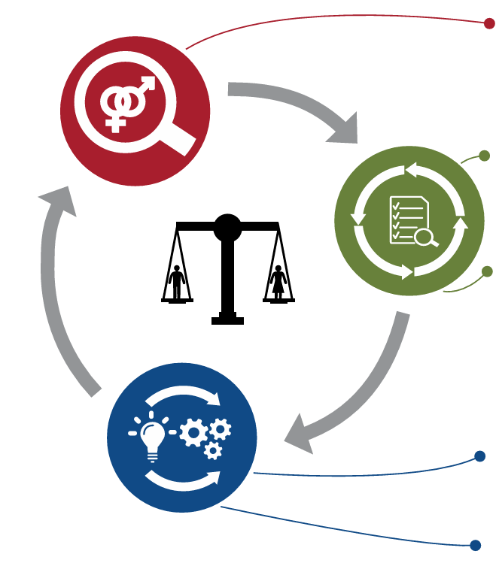
GTA: Iterative AND Integrated
GTA is an iterative process, whereby gender considerations inform and are accounted for during each part of the project cycle. The “doing” provides knowledge that informs learning and further action and reflection.
— Wong 2019
Gender transformative programming refers to taking a GTA to project and program design, implementation, monitoring and evaluation. It involves integrating a gender transformative perspective/lens across the project cycle.
Sources: FAO, IFAD & WFP 2024a; Wong 2019
Notes:
The project cycle in research and development programs is typically depicted in a cycle like this diagram. What we are going to talk about today is how gender transformative approaches are integrated across each phase of this project cycle and that their integration into each phase occurs as part of an iterative process. Read Slide

Slide 14
Integrating gender across all aspects of an organization
Operationalizing gender transformative approaches requires integration of gender across all aspects of an organization*:
Build plans for a formal gender analysis into the current project or program-level workplan. Gender analysis can take place at any phase of the program cycle. Gender analysis is critical to integrating gender into an organization’s work.
2. Explicitly budget resources in new and existing projects for formal gender analysis, integration and related capacity building. This includes finances and time for staff capacity building and ongoing resources for gender analysis and integration.
3. Incorporate gender-related objectives and indicators into the performance monitoring plan.
4. Report and disseminate key gender research and program results.
5. Identify gender-related technical assistance or capacity-building needs and request support from gender experts.
* Often referred to as gender mainstreaming
Sources: FAO 2021; FHI 360 Gender Integration Framework 2012
Notes:
Read Slide and note that - Operationalizing gender transformative approaches across aspects of an organization is often referred to as gender mainstreaming

Slide 15
GTA integrated
Characteristics of a GTA integrated into agricultural research and development
Research process
Understands people and social diversity in their context
Outcomes
Inclusive and sustained socio-ecological transformation
Gender equitable systems and structures (social enabling environment)
More and better life choices for poor women and men
Enables critical learning, reflection & questioning
Multi-scale
Dynamic & iterative
Practice
Engages with both women and men
Addresses unequal power dynamics across social groups
Challenges oppressive norms, practices and structures
Integrates with agricultural systems interventions
Crosses scales
Source: Kantor 2013
Notes:
Here is another visual showing how GTA is also integrated within research, practice and outcomes. Read Slide

Slide 16
Gender transformative approaches: Formative phase
Section 2
Notes:
Read Slide

Slide 17
GTA in Formative Phase
Diagnose: Use a social and gender analysis to develop a deep understanding of the social, historical, cultural, and gender context (e.g. gender norms, power dynamics) of households, communities and organizations that underly gender inequalities.
Notes:
Although this is a cycle if you are first starting out you will want to start by seeking deep understanding of the social, historical, cultural, and gender context (e.g., gender norms, power dynamics in the household and value chain) is an essential first step. To accomplish this, you will want to begin with social and gender analysis. Read Slide

Slide 18
What is a social and gender analysis?
Is the process of identifying and addressing the different impacts of a policy, program, action and initiative on women and men
Details the social processes, gaps, differences and similarities in the situation of those of differing gender identities in a particular sector
Helps ensure that proposed development interventions equally meet the needs of those of differing social and gender identities and have beneficial impact on gender equality in general
Should be planned and budgeted for as early in the project design process as possible
Social and gender analysis
Source: FHI 360 Gender Integration Framework 2012
Notes:
A Social and Gender analysis… Read Slide

Slide 19
Understanding gender inequality
Who does what?
Who has access to what?
Who owns what?
Who decides what?
Who benefits from what?
Source: FAO, IFAD and WFP 2024a
Notes:
These are some questions to ask to understand gender inequality:
Who does what? Distribution of roles and responsibilities among women, men, girls and boys (paid and unpaid work);
Who has access to what? Gendered access to services, technology, knowledge, finance and assets, sexual and reproductive health services (including gender-based violence), social protection services, education, and nutritious and diverse food, all relevant to improving the livelihoods and well-being of women, men, girls and boys in food systems;
Who owns what? Gendered ownership of productive resources and assets, including land, water rights, bank accounts, house titles, transport, etc.;
Who decides what? Gendered decision-making power dynamics regarding assets, resources (e.g. use of water), production (e.g. decisions on implementingclimate-resilient agricultural technologies, decisions on prices for sale or purchase), use of income, physical mobility (e.g. attending public gatherings, visiting friends and family), food and nutrition (choosing what to buy and cook), and political and economic mobility of self and others; and
Who benefits from what? Distribution of social and economic benefits among women, men, girls and boys (e.g. distribution of income and food within the household)
FAO, IFAD and WFP. 2024. Step-by-step guide to integrating a gender transformative approach throughout the project cycle. Rome. https://doi.org/10.4060/cd2629en

Slide 20
Understanding underlying causes of gender inequality
To dig into the root causes of gender inequality, requires additional questions about:
What are prevailing gender norms that delimit the roles and behavior of women, men, girls and boys in agrifood systems?
How do formal institutions influence the well-being of women, men, girls and boys and their opportunities in agrifood systems?
Source: FAO, IFAD and WFP 2024a
Notes:
But to conduct a gender transformative analysis you will want to seek understanding of underlying causes of gender inequality and therefore you will need to further dig into norms and formal institutions… Read Slide

Slide 21

Understanding underlying causes of gender inequality: example questions
How are women, men, girls and boys expected to behave? Which gender norms dictate what they should do or not do?
What are the consequences when they deviate from societal expectations regarding their behavior?
Do these prevailing gender norms differ for women, men, girls and boys of different social class, wealth, ethnicity and ability status?
Are there sanctions and rewards around these expected behaviours?
How do informal social institutions (e.g. norms, religious beliefs) interact with formal institutions (e.g. laws)?
Are there any legal restrictions (within statutory or customary law systems) on women’s property or inheritance rights (e.g. land)?
Source: FAO, IFAD and WFP 2024a
Notes:
These are some questions you might want to ask to find out about underlying causes of gender inequality. Read Slide

Slide 22
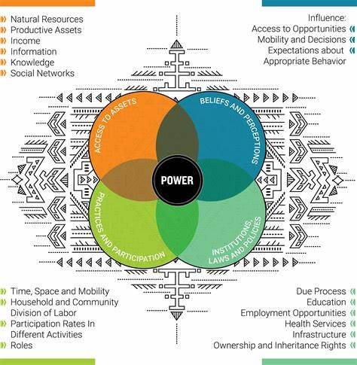
DOMAIN FRAMEWORK
Access to assets and resources
Practices and participation: household and community division of labor
Institutional barriers/facilitators: how people are regarded and treated by formal and informal legal and judicial systems
Beliefs and norms: perceptions and beliefs related to men’s and women’s socially constructed identities and roles
Power: ability to decide, influence, control and enforce decisions
Source: Jhpiego: Gender Analysis Toolkit For Health Systems 2016
Notes:
Here is an example of a Framework that can be used for gender transformative analysis that was developed under USAID’s Capacity Project. It provides a way to systematize areas of inquiry about gender differences and gender inequalities across different domains of social life, and to examine how these differences affect the lives and health of men, women, boys, and girls and what are there underlying causes. Read Slide

Slide 23
How to do gender AND gender transformative analysis
Disaggregate and analyze existing data with a gender perspective
Collect sex-disaggregated data and use gender sensitive indicators
Involve a gender expert
Consult different groups of beneficiaries before and during project
For gender transformative analysis, also use participatory methodologies with communities and stakeholders to explore and uncover deep-rooted norms and institutional structures
Notes:
Here are some suggested approaches to conducting a social and gender analysis and gender transformative analysis. Note that the first 4 suggested approaches here can be used for all gender analyses but as shown by the plus sign to do a gender transformative analysis you will also need to…. Read Slide

Slide 24
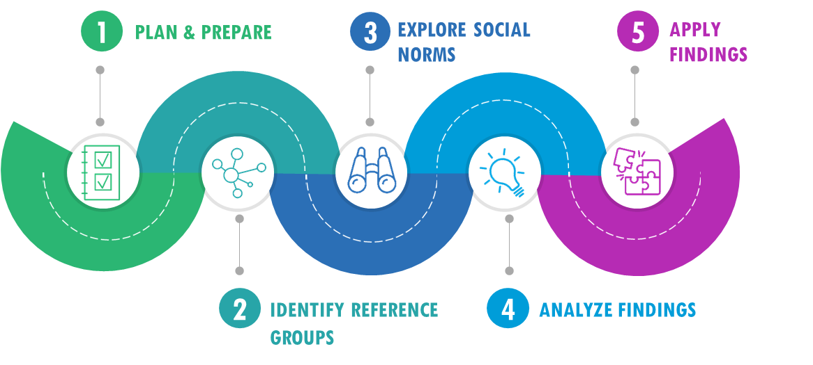

Social Norms Exploration Tool (SNET)
Social Norms Exploration Process
PAGE 7
SNET
Source: IRH, Georgetown 2020
Notes:
In terms of participatory methodologies, a few notable tools include the SNET The SNET is a rapid and participatory learning and action tool for social norms exploration. It provides guidance and exercises to explore social norms that influence specific behaviours within a group or community. It can be used as a starting point to inform new or existing interventions and provides a 5 step process to do so which includes:
Plan and Prepare – this is where the reading, training and planning happens
Identify the Reference groups – this is where field work starts
Explore norms – this is the bulk of the field work
Analyze findings – the SNET includes rapid processes to analyze findings
And Apply Findings – the SNET provides guidance to apply what you’ve learned as your designing or revising your program.

Slide 25
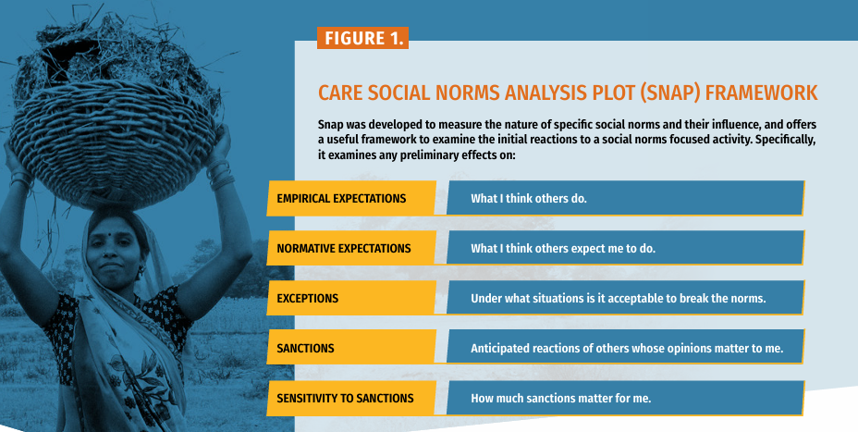
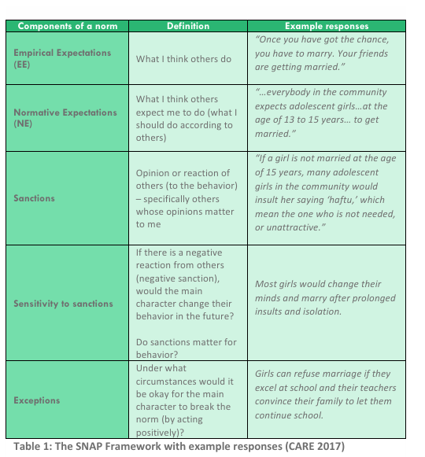
Social Norms Analysis Plot (SNAP) Framework
Source: CARE Sri Lanka 2017
Notes:
Another participatory tool that has been widely used to facilitate exploration of social norms is the Social Norms Analysis Plot (SNAP) framework which was developed by CARE. The SNAP framework provides practical guidance to understand and evaluate the influence and strength of norms. The SNAP framework identifies the key components of a norm to help measure changes over time and inform interventions for greater impact. The five components of the SNAP framework are: 1) empirical expectations, which is the same thing as descriptive norms, 2) normative expectations, which is the same thing as injunctive norms, 3) sanctions, 4) sensitivity to sanctions, and 5) exceptions. The first three components describe the nature of the norm in a given context, while the other two characterize the strength of the norm in question and its current state

Slide 26
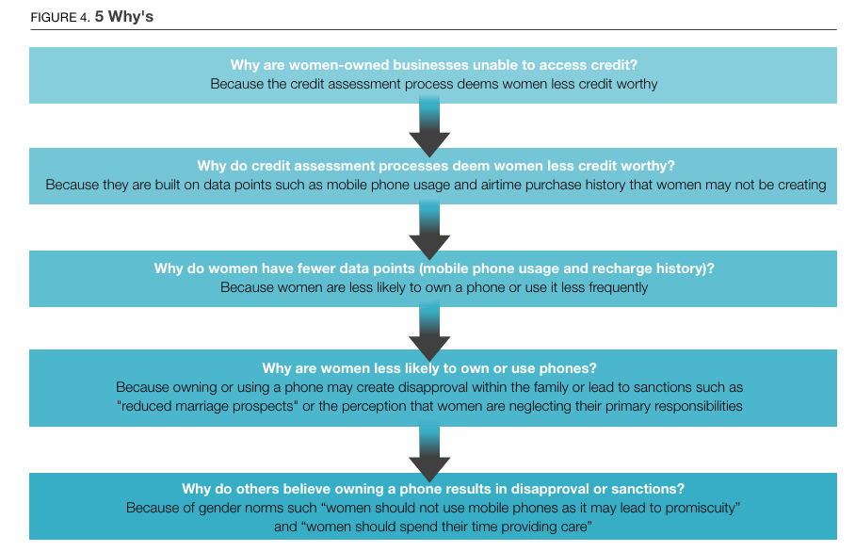
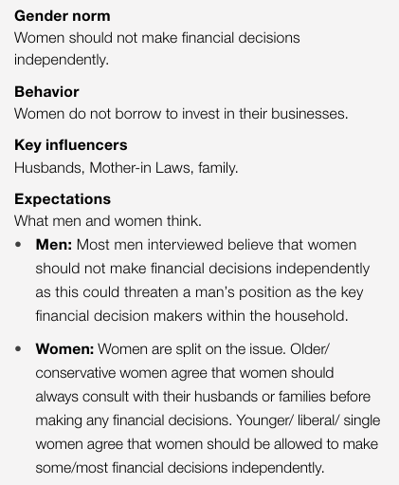
Diagnostic Guidance on gender norms in financial inclusion
Deconstruction of a sample gender norm from diagnostic undertaken in Egypt
Source: Koning, 2021
Notes:
Finally, a third participatory tool that you could consider using if your project has an aim to enhance women’s financial inclusion is the Diagnostic Guidance on gender norms in financial inclusion developed by CGAP and MarketShare Associates. This tool helps to integrate a financial inclusion lens into existing social norms diagnostics and to inform the design of interventions to support women’s financial inclusion. The tool outlines a process to assess the influence of gender norms on the financial behaviours of women and, in turn, their financial inclusion. The process consists of four phases: 1) design and planning, 2) behaviour and gender norms exploration, 3) gender norms deep dive, and 4) analysis and synthesis… As shown here on the right is one exercise included in this tool which uses a series of 5 Why questions to continue to probe into the root causes of an identified normative constraint and on the left is analysis that was undertaken on a harmful gender norm identified in Egypt. Read Slide

Slide 27
Gender transformative approaches: Design AND Implementation phase
Section 3

Slide 28
GTA in Design and Implementation
Design: Design interventions to address the underlying causes of gender inequalities by changing power relationships, transforming structures and norms and building agency. Use a theory of change and participatory approaches.
Implementation: Implement the intervention within different levels of influence over time. Engage men and women, promote participation in project processes and include reflective processes and dialogues.
Notes:
Read Slide

Slide 29
GTA in Program Design
Start with the findings of a gender analysis. Then…
1
2
3
4
5
Identify gender-specific barriers to opportunities for achieving the objectives.
Within the project’s objectives, articulate or strengthen synergy between gender and agrifood systems and development goals.
Identify specific strategies and approaches to address harmful norms, behaviors and structures and to promote the equitable participation of women and men in programs as appropriate.
Incorporate the identified strategies into the project design, activities and workplan.
Identify levels of influencers, and make sure interventions are developed at multiple levels to address underlying causes.
Source: Adapted from FHI 360 Gender Integration Framework 2012
Notes:
Read Slide

Slide 30
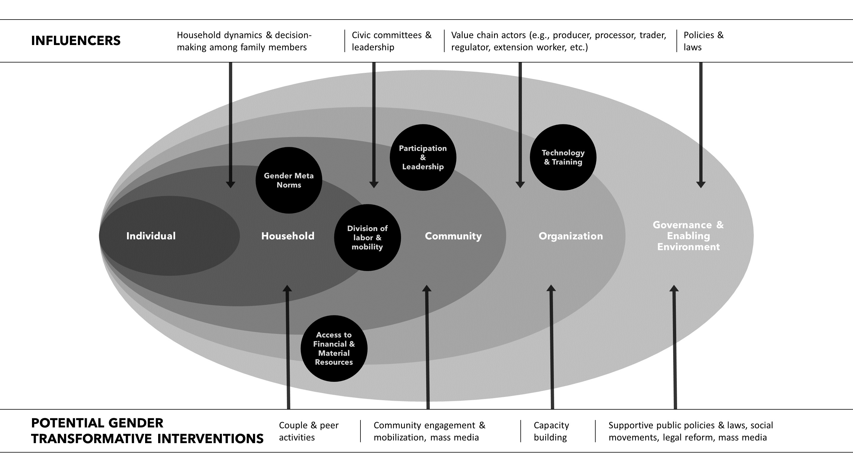
Develop Interventions at Multiple Levels
Develop interventions at multiple levels across the socio-ecological model (SEM)
Notes:
Read slide & draw attention to potential gender transformative interventions at each of the different levels of the SEM

Slide 31
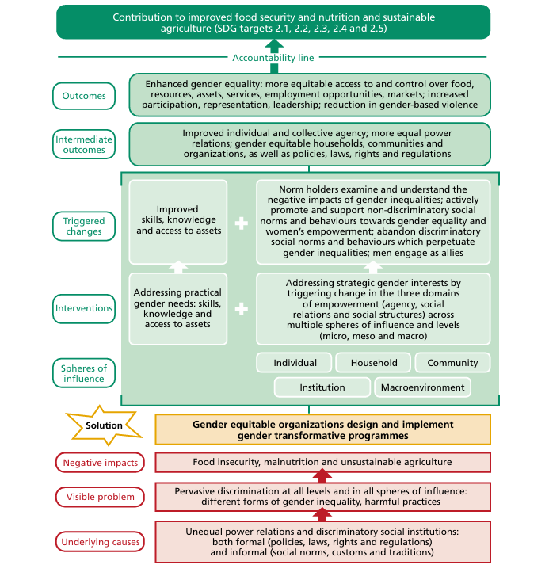
USE A Theory of Change (ToC)
Is a comprehensive explanation and illustration of how and why a desired change is expected to occur in a particular context by defining a systemic and coherent pathway
Identifies long-term goals and then works backward to identify the root causes of an issue and the conditions that need to be in place for change (the achievement of outcomes and outputs) to occur
Maps out how these elements are causally related to each other
JP GTA’s ToC for gender transformative programming for food security, nutrition & sustainable agriculture
Source: FAO, IFAD and WFP 2024b
Notes:
GTAs typically use a ToC, such as the example ToC shown here, because by developing and adopting a ToC the project is making a commitment to addressing the root causes of gender inequalities. A ToC is…Read Slide

Slide 32
Participatory Action Learning (PAL)
PAL is a group of practice-oriented approaches used to engage women and men in discussions and critical reflection around gender norms using set tools, manuals, etc.
When using GTAs, community members and other stakeholders work together to identify, question and begin to shift harmful or unfair gender norms and gendered power imbalances in ways that are locally appropriate.
Meaningful participation of people of all genders requires:
Designing activities, structures and mechanisms that provide real opportunities to participate
Transparent information sharing
Equal and meaningful opportunities to be involved in decision-making across during different stages of the project
Accessible, safe and reliable response feedback mechanisms for complaints or feedback
Sources: Wong 2019; CARE 2019; Hilly 2012; Lawless 2017; Lau 2021
Notes:
Read Slide

Slide 33
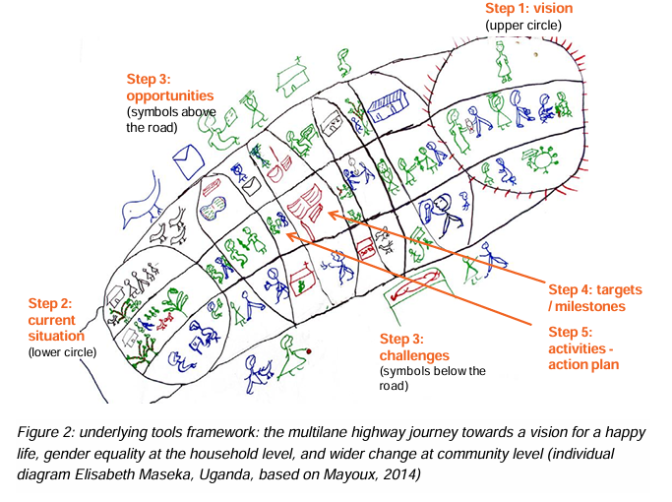
Gender Action Learning Systems (GALS)
Is a participatory action learning tool
Is a community-led empowerment methodology
Uses principles of inclusion to improve income, food and nutrition security of vulnerable people in a gender equitable way
Positions women and men as drivers of their own development rather than victims
Identifies and dismantles environmental obstacles
Challenges service providers and private actors
Strengthens the negotiation power of marginalized stakeholders
Promotes collaboration, equity and respect between value chain actors
Can be used complementary to other value chain development approaches
Source: Mayoux 2019
Notes:
Read Slide

Slide 34
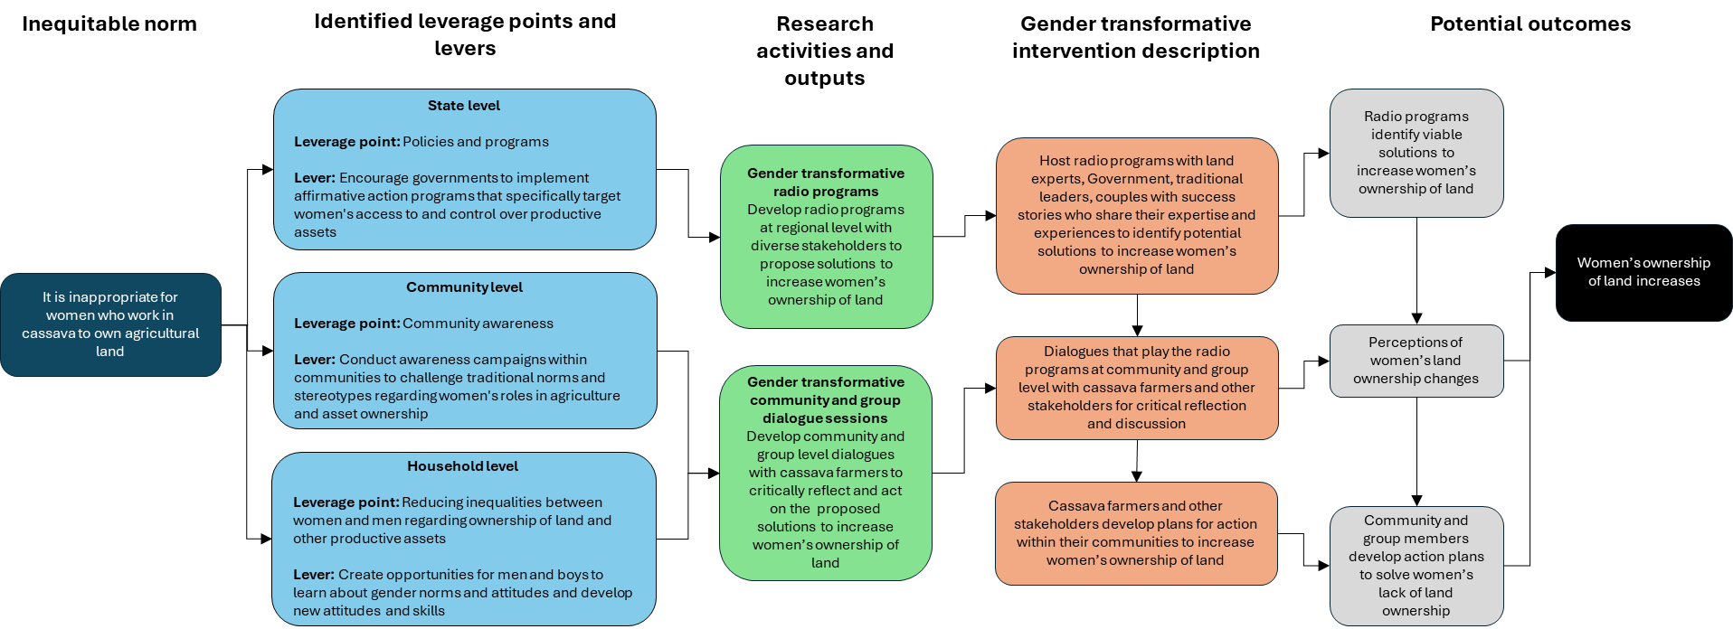
Intervention Co-Design
Example of a gender transformative intervention that was co-designed with a partner using the leverage points and levers identified during the Tanzania stakeholder dissemination workshop.
Source: Seymour 2024
Notes:
This figure illustrates an example of a gender transformative intervention related to land ownership, which was developed in a participatory fashion in collaboration with Kolping Society of Tanzania, using leverage points and levers identified in a prior stakeholder dissemination workshop.

Slide 35
GTA in Program Implementation
Implementers should ask questions such as the following:
Are men, women, girls and boys (as appropriate) able to participate fully in program design and implementation?
Are marginalized voices and perspectives of people of all relevant genders and sexual orientations taken into account as workplans are created, reviewed and updated, and are they heard in meetings and in decision-making?
Is there a balance in representation and leadership between youth, men and women?
Are men, women, girls and boys (as appropriate) able to benefit from the program equitably?
Is the program being implemented in a way that provides safe access for participants? Does participation in program activities put individuals at increased risk of violence, ridicule or other ill treatment?
Source: Adapted from FHI 360 Gender Integration Framework 2012
Notes:
Read Slide

Slide 36
Gender transformative approaches: MEL phase
Section 4
Notes:
Read Slide

Slide 37
GTA in MEL
Monitoring AND Evaluation: Integrate methods and indicators for measuring gender transformative change at multiple timepoints throughout. Use participatory approaches.
Learning: Learn from successes and failures. Improve and adapt.
Notes:
Read Slide

Slide 38
MONITORING AND EVALUATION
Monitoring
Systematic and routine process of gathering information from different parts of a program
Usually focused on short-term outcomes
Usually more focused on implementation process
Generally conducted by people involved in the program
Evaluation
Assessment of an entire program cycle
Usually long-term
Usually more focused on program impact
Often conducted by impartial outsiders with M&E background
Both can also be participatory, with insiders having historical and contextual knowledge and/or implementation experience.
Source: Adapted from Passages Curriculum 2022
Notes:
Just as a brief background reminder, shown here are some key distinctions between monitoring and evaluation. Read Slide

Slide 39
From THE Reach-Benefit-Empower framework
REACH
BENEFIT
EMPOWER
Objective
Include women in program activities
Increase women’s well being
Strengthen the ability of women to make strategic life choices and to put those choices into action
Indicators
Number or proportion of women participating in a project activity
Sex-disaggregated data for positive and negative outcome indicators
Women’s Empowerment in Agriculture Index
Sources: Theis 2016; Johnson 2018; Kleiber 2019
Notes:
In many of our programs, we monitor to ensure that we are reaching potential participants and to ensure that they are benefitting from the program. When using gender transformative approaches, we also want to be monitoring for the program effects on women’s empowerment… Read through examples on slide

Slide 40
To THE Reach-Benefit-Empower-Transform (RBET) framework
REACH
BENEFIT
EMPOWER
transform
Objective
Address the root causes of gender inequality, build agency and change unequal power relations and discriminatory social institutions
Include women in program activities
Increase women’s well being
Strengthen the ability of women to make strategic life choices and to put those choices into action
Indicators
Number or proportion of women participating in a project activity
Sex-disaggregated data for positive and negative outcome indicators
Women’s Empowerment in Agriculture Index
Women’s decision- making power; gender equitable norms; changes in law and policy
Sources: Theis 2016; Johnson 2018; Kleiber 2019
Notes:
But in addition, when using gender transformative approaches you have an additional objective and therefore will also need to monitor for gender transformative change by looking at GTC indicators. Read Transform column on Slide

Slide 41
Measure at Multiple Timepoints
Keep in mind, social processes are often slow to change
You can’t expect to see very large GT changes over the course of your project, especially if the timeframe is short
So, in order to capture GTC, you will need to collect:
  data at repeated points
  over ideally a long period of time
Baseline
Monitoring time
Point 1
Evaluation time
Point 3
Monitoring time
Point 2
Notes:
Read Slide

Slide 42
Measure at Multiple Levels
Remember to measure at multiple levels across the socio-ecological model (SEM)
Measure Changes in…
Couple communication or HH decision-making
Civic committee participation & leadership
Value chain division of labor
Laws & policies
Notes:
Read slide & draw attention to measuring gender transformative change at each level of influence

Slide 43
Measuring gender transformative change = measuring complexity
MEL for GTA should seek to capture the complexity and unpredictable processes of gender transformative change by measuring and monitoring:
Incremental change
Non-linear change
Change occurring at different levels of the SEM
Change occurring outside of the program that effects GTA
Source: Batliwala 2006 and 2010
Image source: Authors
Notes:
Read slide and bring attention to how in figure the change is not straight lines linear, some things changing more rapidly than others and that other things outside of the program like in this case migration may also be changing and having an effect on the process & intended outcomes

Slide 44
Participatory Action Research (PAR)
PAR Similar to PAL but concerned primarily with generating individual and collective understanding and knowledge with those who are supposed to benefit from it.
Aims to create knowledge and address structural inequalities through an iterative cycle where people identify problems, design and implement plans to address them, analyze outcomes, reflect, and learn from them.
Engages stakeholders throughout the MEL process in the development of indicators, in data contribution, data analysis, and interpreting and disseminating results.
Engages to ensure findings are meaningful, relevant and transparent.
Sources: Hillenbrand 2015; Barclay 2021; Cole 2014; FAO, IFAD and WFP 2024
Notes:
Read Slide

Slide 45
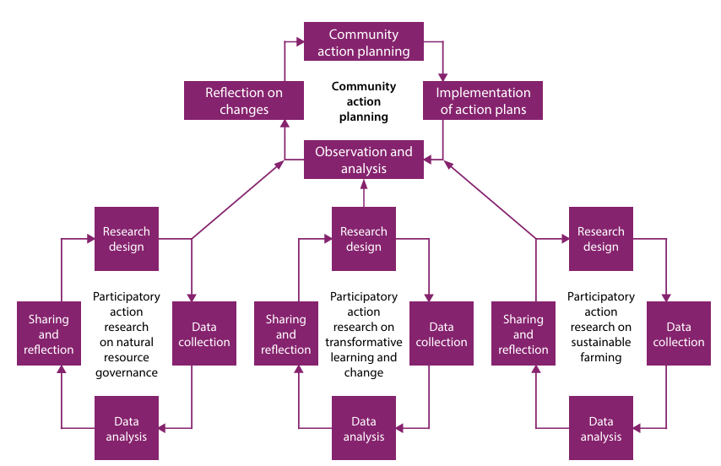
Participatory Action Research (PAR)
Participatory action research cycle:
Identify a practical problem and plan to do something about it
Act on this plan
Observe and document how it went
Reflect on the results and draw lessons
Sources: van der Ploeg 2016; Apgar and Douthwaite 2013
Image source: van der Ploeg 2016
Notes:
Participatory action research generally involves a cycle in which people (1) identify a practical problem and plan to do something about it, (2) act on this plan, (3) observe and document how it went, and finally (4) reflect on the results and draw lessons (Apgar and Douthwaite 2013). This figure depicts multiple PAR cycles that were undertaken in a project that took a gender transformative approach to aquatic agricultural systems in the Solomon Islands and Malaysia

Slide 46
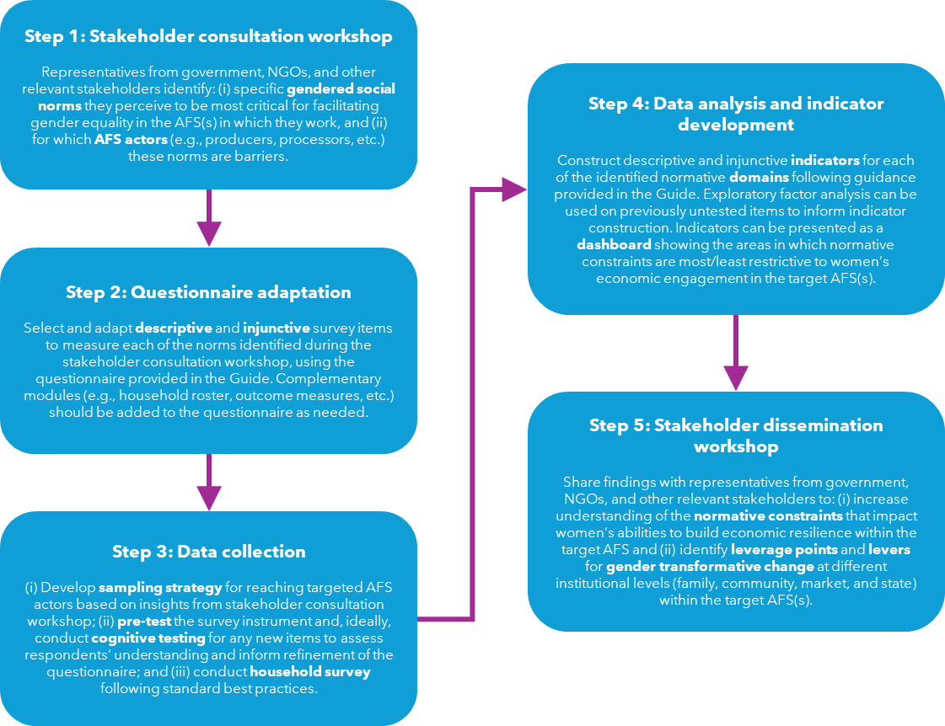
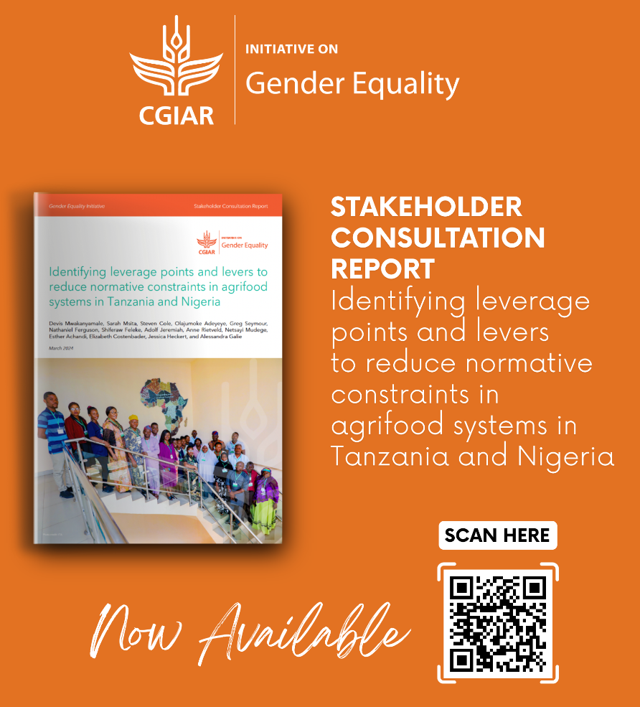
Example of A participatory research process
Source: Mwakanyamale 2024
Notes:
This figure depicts a PAR approach taken in a project seeking to identify leverage points and levers to reduce normative constraints in AFSs in Tanzania and Nigeria. Read steps in Figure

Slide 47
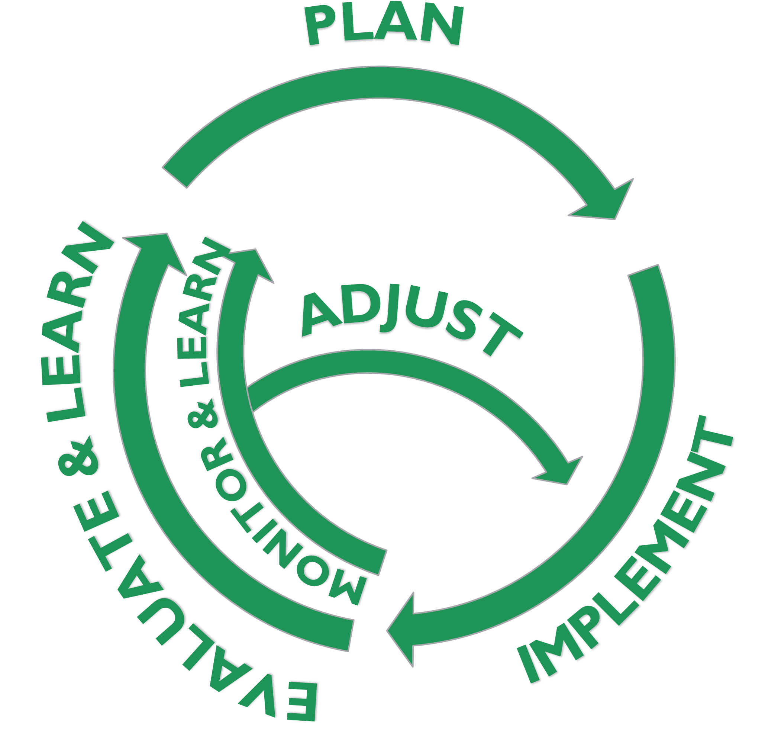
Learning as Part of M&E
Flexible, exploratory, iterative way to integrate observations and emerging knowledge into a program on an ongoing basis
Uses regular cycles of learning
Recognizes that staff close to a program have the best knowledge of circumstances
Uses monitoring and learning to adjust programs as they are being implemented to put learning into program action
Source: Passages social norms curriculum 2022
Notes:
Read Slide

Slide 48

Key considerations of GTA MEL
Process documentation, whether for monitoring or evaluation, is valuable when it remains focused to ensure appropriate and resourced data collection and data use
Use multi-level, multi-dimensional outcomes and indicators
Privilege qualitative and participatory techniques alongside quantitative approaches
Remember that measurement processes should be empowering for participants and project staff alike
Ensure the participant’s voice is heard and elevated
Monitor for changes in agency, structures and relations, and for signs of positive and negative unintended consequences (e.g., backlash, new economic activities)
Notes:
Read Slide

Slide 49
SPICED: Participatory approach to M&E
Subjective: Informants have a special position or experience that gives them unique insights that may yield a very high return on the investigators’ time. In this sense, what others see as 'anecdotal' becomes critical data because of the source’s value.
Participatory: Objectives and indicators should be developed together with those best placed to assess them. This means involving a project's ultimate beneficiaries, but it can also mean involving local staff and other stakeholders.
Interpreted and communicable: Locally defined objectives/indicators may not mean much to other stakeholders, so they often need to be explained. Cross-checked and compared: The validity of assessment needs to be cross-checked, by comparing different objectives/indicators and progress, and by using different informants, methods and researchers.
Empowering: The process of setting and assessing objectives/indicators should be empowering in itself and allow groups and individuals to reflect critically on their changing situation.
Diverse and disaggregated: There should be a deliberate effort to seek out different objectives/indicators from a range of groups, especially men and women. This information needs to be recorded in such a way that these differences can be assessed over time.
Source: Lennie 2011
Notes:
As shown in this slide, the SPICED approach is a qualitative participatory to developing M&E indicators; it appreciates local understandings of change and is a good tool for thinking about why it is important to work with communities. It identifies that different people have different ideas about what change means. It suggests that the process follow the SPICED criterion… Read Slide

Slide 50
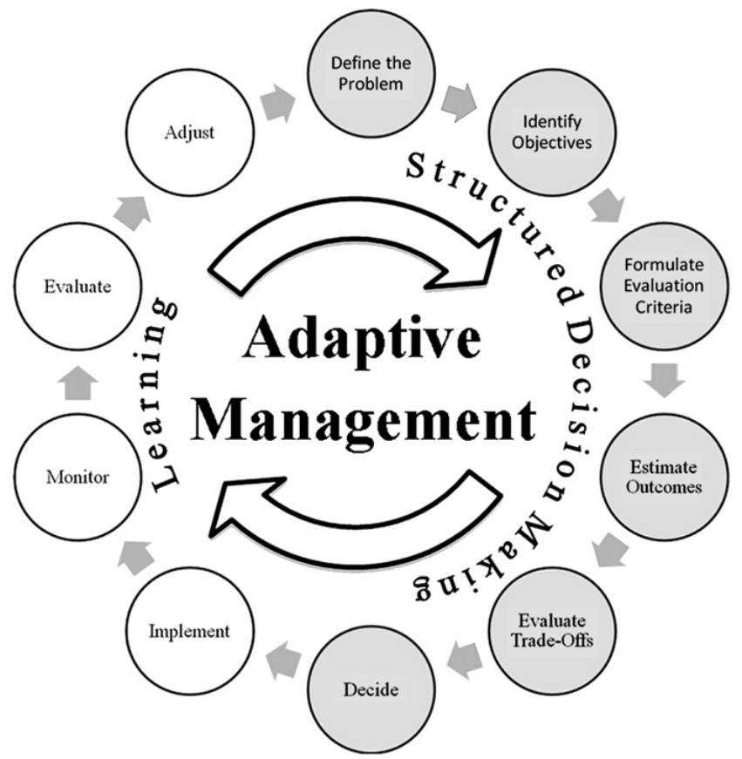
Learning is an opportunity for adaptive management
Adaptive management introduces flexibility in programming
It involves changing to the path used to achieve goals in response to changes or new learnings
The rationale and adaptations should be documented to support learning and future adaptation and scale
Sources: USAID; Allen 2011
Image source: Allen 2011
Notes:
Read Slide

Slide 51
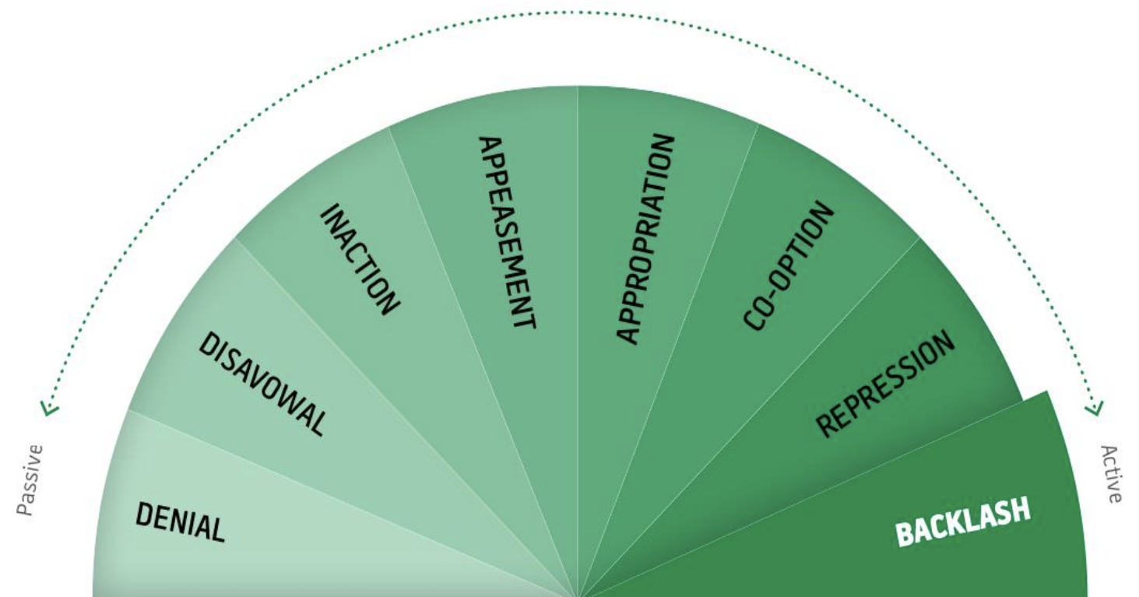
Monitoring for resistance and backlash
Start by mapping norms, practices and structures, and pre-existing manifestations of resistance
Engage those implementing the program as well as allies in monitoring and response
Pay attention to how elements of the system interact to reinforce other parts, including backlash
Identify formal and informal actions that seek to block change. Look for absences and silences
Continually reassess throughout all phases of programming and research
Image source: da Sliva 2011
Source: da Sliva 2011
Notes:
Read Slide

Slide 52
Participatory Evaluation and Learning: Validating and Sharing Findings
Sense-make, validate and share findings and their interpretation with participants, including less powerful ones
Enable gender and socially-inclusive participation, with equitable access, ability to feedback or critique, and to use the information and co-generate implications for action if any
Check that participants and partners have, understand and can use the findings
Sense-make, validate and identify implications for action with participants and partners, strategizing for scaling evidence and gender outcomes
Share with relevant bodies and networks and do so in the relevant languages
Sources: McDougall 2021; Mullinax 2018
Notes:
Also critical to GTA MEL is how participants and stakeholders are involved in the sense-making/validation and sharing and dissemination of findings. We would suggest for Participatory Evaluation and Learning process to do all of the following.. Read Slide

Slide 53
Case study using gender transformative approaches in all project phases
Section 5
Notes:
Now let’s spend a few minutes practicing what we learned.

Slide 54
Barotse Floodplain Fishing Camps
Case study – PART 1
Source: Cole 2014
Notes:
Now we are going to look at a case study example of a project that used gender transformative approaches throughout all phases of the project cycle and we will make this case study participatory and take a pause in the middle to ask you to reflect and suggest ideas for gender transformative approaches they could have embedded in program design and MEL

Slide 55
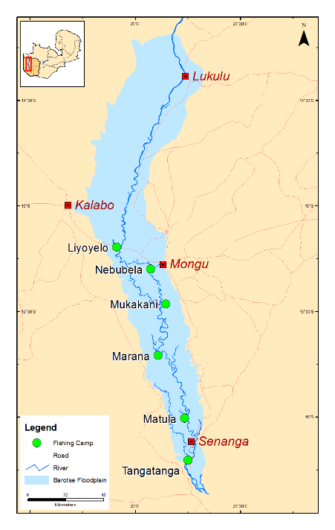
Case Study:
Barotse Floodplain, Zambia
BACKGROUND
An estimated 70,000 people depend on the resources of the Barotse Floodplain for their livelihood, food and nutrition security. However, poor management, increasing fishing pressure and use of destructive fishing gear caused a 2013 Urgent Call to Action regarding rapid declines in fish stocks.
AIM
Reduce post-harvest fish losses, and improve lives and livelihoods of communities.
TARGET POPULATION
Involve both women and men in the fisheries value chain.
IMPLEMENTING ORGANIZATIONS
WorldFish and FISH, AAS with Zambian Department of Fisheries
Map. Fishing camps in the Barotse Floodplain with district towns
COUNTRIES IMPLEMENTED
DATE
Zambia
2014–2017
Notes:
Read Slide and as needed further explain that …The Barotse floodplain comprises a wetland area alongside the Zambezi River as it passes through Western Zambia. Rural communities there have to deal with both the opportunities and constraints of the plain’s seasonal flooding which add extra challenges to biodiversity management. For example, the communities move away from the plains during the flood season to higher ground and then return when the floods recede. Added to this already challenging environment, changes in the predictability of flood patterns, climate change, and increasingly frequent and severe extreme weather events are adversely affecting income and food security.

Slide 56
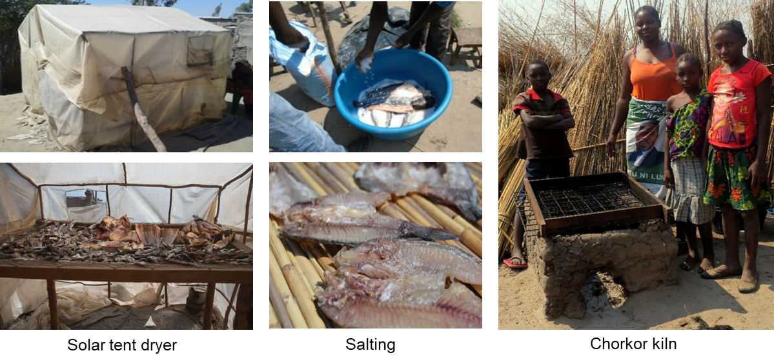
BAROTSE:
Improving fish processing
Regulators
Traders and retailers
Processors
Producers
Piloting different, new, improved fish processing technologies to reduce harvest losses.
Notes:
In the Barotse Floodplain (Zambia), one-third of the total fish catch is lost every year so the project was interested in piloting different, new, improved fish processing technologies to reduce harvest losses. As shown are pictures taken as part of the project of the three primary methods that were being used there to process fish… solar tent dryers, salting and chorkor kilns.

Slide 57
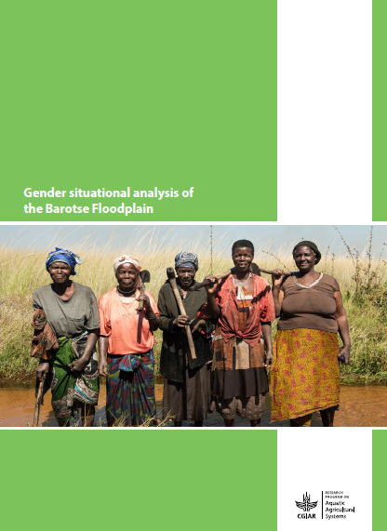
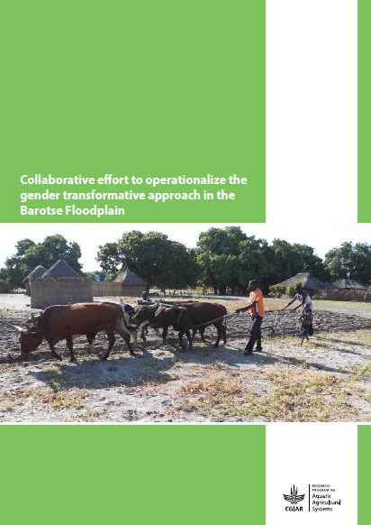
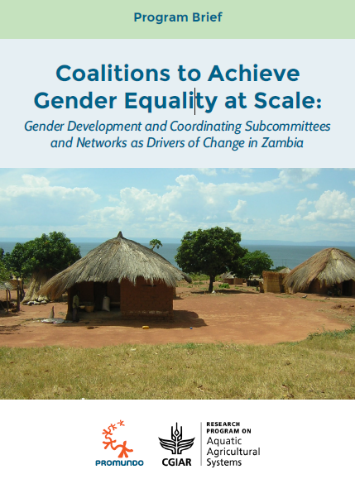
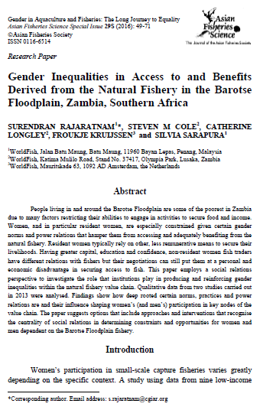
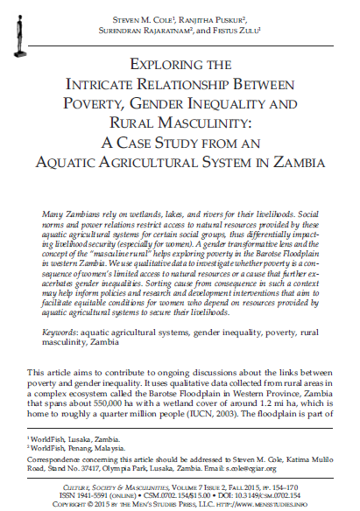
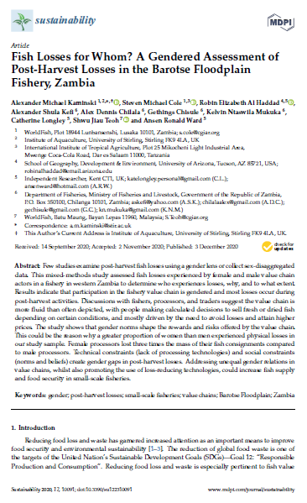
BAROTSE:
Social and gender analyses
Notes:
AAS started by carrying out a number of participatory diagnoses that utilized both qualitative and quantitative methods, including gender and nutrition scoping analyses, fish value chain (FVC) and agro-biodiversity (ABD) studies, a gendered agricultural water management scoping, a comprehensive social and gender analysis (SGA), a seasonal food availability assessment, and a mapping of ecosystem services. All the studies to a varying degree included an analysis of key social and gender issues such as land tenure and kinship, norms, attitudes and practices that create inequalities between and within certain social groups.

Slide 58

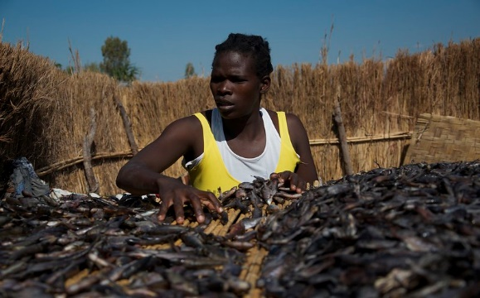
BAROTSE:
Gender Analysis Key Insights
Regulators
Traders and
retailers
Processors
Producers
Processing is where most of the fish
is lost.
Processors are predominantly women because:
It is not seen as acceptable for women to fish
Women don’t own the fishing boats/gear
It is not appropriate for women to have their own market stall
Women processors get lower returns on their financial investment relative to men. Women are forced to lower prices of the fish because they:
Have fewer skills to negotiate prices
Less access to government extension services and training
Less time to attend training as they are responsible for the majority of household labor and childcare
Image sources: A Kaminski; S Cole
Notes:
Some of the key insights obtained from the social and gender transformative analyses they undertook were.. Read Slide

Slide 59

GROUP EXERCISE:
Barotse Floodplain Case Study
Using results from the gender analysis done for the Barotse Floodplain case study:
1. What would be some program design elements we could include to make it gender transformative?
2. What may be some data/ indicators we would want to capture in our monitoring and evaluation to assess our programs’ impact?
Notes:
Read Slide

Slide 60
Barotse Floodplain Fishing Camps
Case study – PART 2
Source: Cole 2014
Notes:
Now that you have all had a chance to suggest ideas for gender transformative approaches they could have embedded in program design and MEL, let’s take a look at what the project actually did.

Slide 61
Barotse: GTA in the design AND implementation (PAR AND PGNA)
252 value chain actors organized into participatory action research (PAR) groups
Used a practical gender needs approach (PGNA) that recognizes that gendered roles, responsibilities, and time commitments shape women’s and men’s abilities to engage in project activities
Explicit attempts to adjust meeting times and venues to ensure that especially women could participate
Notes:
The resulting study design… Read slide

Slide 62
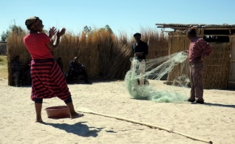
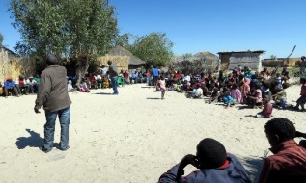
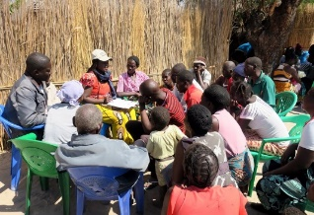
Barotse: GTA in the design AND implementation (GTC)
Drama performed in the fishing camp
Critical reflection at the community and group levels
Actions to address unequal power relations developed at the group level
Also used gender transformative communication (GTC)
Dramas skits on salient gender issues in the value chain
Critical reflection to spark locally-led shifts in gender norms and power relations
Image sources: A Kaminski; S Cole
Notes:
The project … Read Slide
As shown are Photos of participants engaging in the drama skits and critical reflections

Slide 63
Barotse: Project design
Longitudinal comparative design
Practical gender needs approach (PGNA) in all 6 camps
Piloted improved fish processing technologies in all 6 fishing camps
Gender transformative communication piloted in 3 out of the 6 fishing camps
Assessed improvements in fish processing and changes in gender attitudes and women’s empowerment outcomes at baseline and endline in all 6 camps
Test improved fish processing technologies with PAR groups in
all 6 camps
Implement
a PGNA
in all 6 camps
Test GTC
in 3 out of
6 camps
Notes:
Read Slide to explain the project design

Slide 64
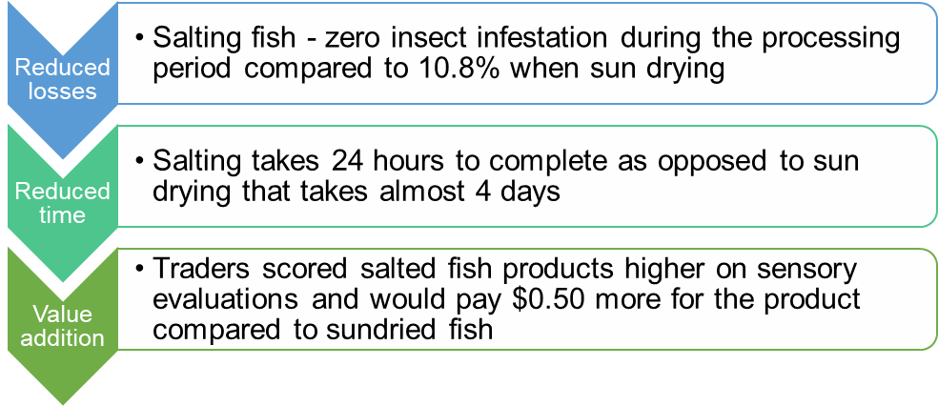
Barotse: Evaluation key results
Participatory technologies assessment
Notes:
The project conducted a participatory assessment of technologies which showed that the technology innovations resulted in reduced losses, reduced time and value addition… Read Slide

Slide 65
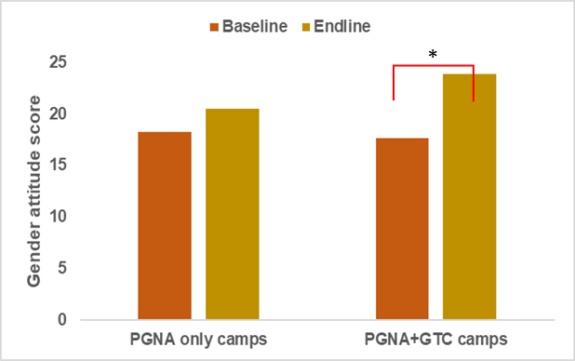
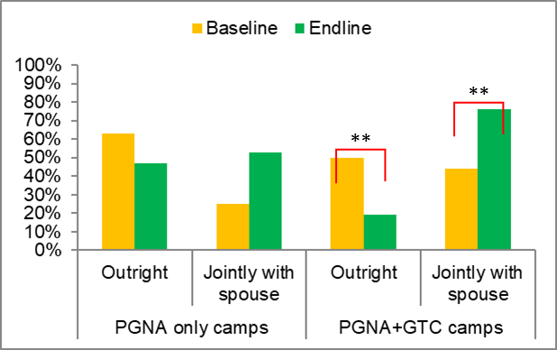
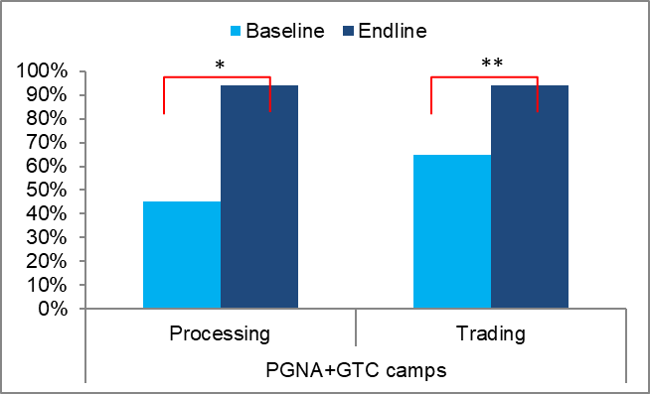
Barotse: Evaluation key results
Figure 1. Changes in gender attitude scores of men
*p < 0.01; **p < 0.05
Figure 3. Changes in fishing gear ownership status of men
Figure 2. Women who made large inputs into decisions about income from processing and trading
Notes:
In addition, the project also showed key results terms of gender transformation.. Review results in each Figure

Slide 66
Closing

Slide 67


TakeAways
What is one new thing you learned today?
What are you curious about?
Notes:
Ask participants to share

Slide 68
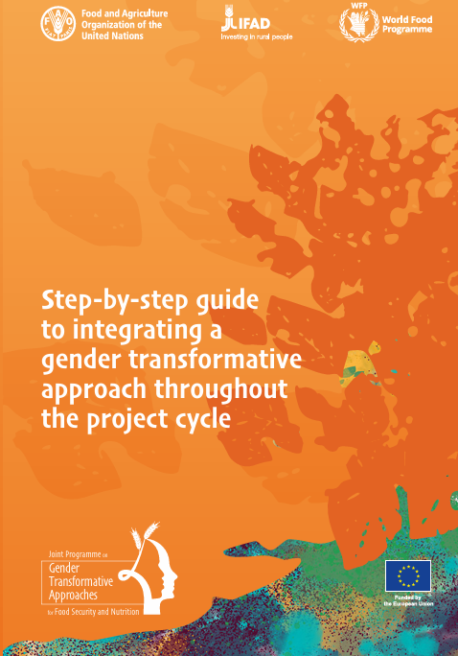

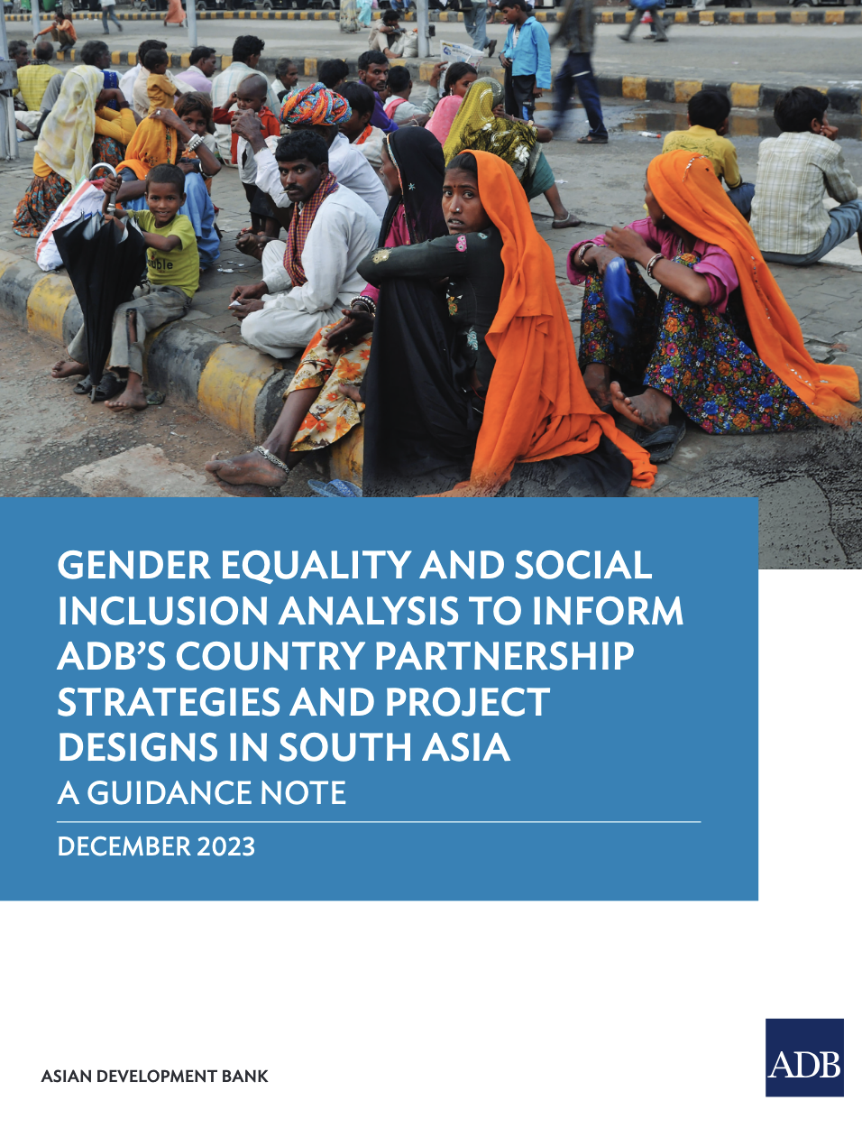
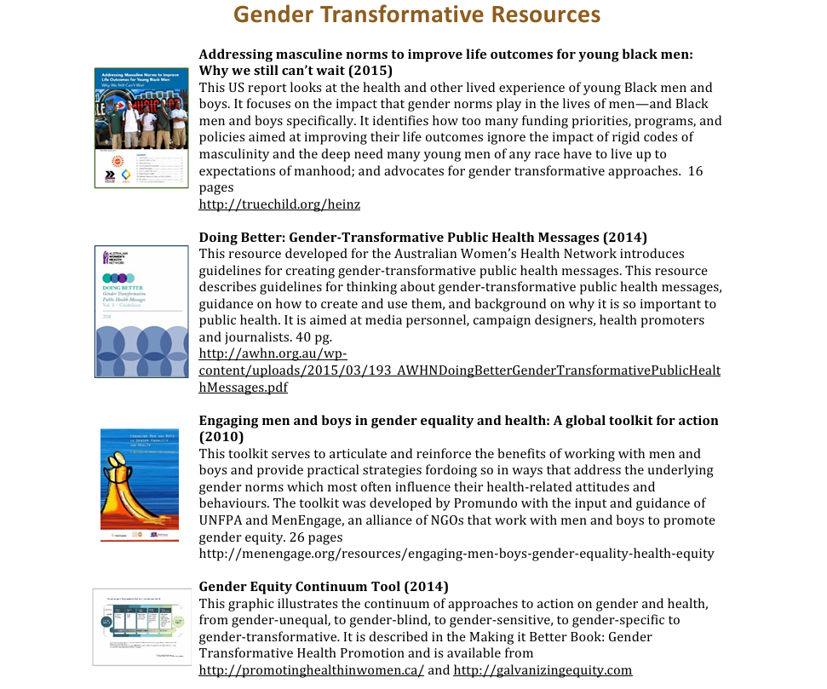
FURTHER READING
Compendium of 15 good GTA practices
Gender Equality and Social Inclusion Analysis Guidance Note
Gender Transformative Resources List.docx
Step-by-step guide to integrating GTA

Slide 69
Glossary
Adaptive management is an intentional approach to making decisions and adjustments in response to new information and changes in context (USAID 2021).
Gender analysis (sometimes referred to more broadly as social and gender analysis) is a methodology that both:
Describes existing gender and social relations in a particular environment, ranging from within households or firms to a larger scale of community, ethnic group, or nation. It involves collecting and analyzing sex-disaggregated data and other qualitative and quantitative information.
Organizes and interprets, in a systematic way, information about gender relations to make clear the importance of gender differences for achieving development objectives (JHPIEGO 2016).
Gender mainstreaming is the process of assessing the implications for women and men of any planned action, including legislation, policies or programs, in any area and at all levels. It is a strategy for making the concerns and experiences of women and men an integral part of the design, implementation, monitoring and evaluation of policies and programs in all political, economic and societal spheres. The ultimate goal is to achieve gender equality (adapted from UN Women 2023, from FAO 2023b).
Gender transformative methodologies are a suite of participatory approaches, methods and tools that encourage critical reflection and examination among women and men of gender norms and power relations (FAO 2021).

Slide 70
Glossary
Theory of change (ToC) is a comprehensive description and illustration of how and why a desired change is expected to happen in a particular context. It is focused in particular on mapping out or “filling in” what has been described as the “missing middle” between what a program or change initiative does (its activities or interventions) and how these lead to desired goals being achieved (What is Theory of Change? - Theory of Change Community).
Participatory Action Research (PAR) is a participatory process of inquiry which seeks to answer questions about real life concerns to improve the wellbeing of those engaged. “It seeks to bring together action and reflection, theory and practice, in participation with others, in the pursuit of practical solutions to issues of pressing concern to people, and more generally the flourishing of individual persons and their communities.” (Reason & Bradbury 2008, 4).
Participatory Action Learning (PAL) is a group of practice-oriented approaches used to engage women and men in discussions and critical reflection around gender norms using set tools, manuals, etc. (see Wong et al. 2019, table A page 15).

Slide 71
References
Allen, C. R., Fontaine, J. J., Pope, K. L., & Garmestani, A. S. (2011). Adaptive management for a turbulent future. Journal of Environmental Management, 92(5), 1339-1345.
Apgar, M., & Douthwaite, B. (2013). Participatory action research in the CGIAR Research Program on Aquatic Agricultural Systems. Penang, Malaysia: CGIAR Research Program on Aquatic Agricultural Systems. Program Brief: AAS-2013-27.
Barclay, K., Mangubhai, S., Leduc, B., Donato-Hunt, C., Makhoul, N., Kinch, J., & Kalsuak, J. (Eds.). (2021). Pacific handbook for gender equity and social inclusion in coastal fisheries and aquaculture (2nd ed.). Noumea, New Caledonia: Pacific Community.
Batliwala, S. (2006). Measuring social change: Assumptions, myths and realities. Alliance, 11(1), 12–14.
Batliwala, S., & Pittman, A. (2010). Capturing change in women’s realities: A critical overview of current monitoring and evaluation frameworks. AWID Working Paper.
CARE Sri Lanka. (2017). Redefining norms to empower women: Experiences and lessons learned. CARE International Sri Lanka.
CARE. (2019). Gender Marker Guidance. Atlanta, GA: CARE USA.
Cole, S. M., van Koppen, B., Puskur, R., Estrada, N., DeClerck, F., Baidu-Forson, J. J., Remans, R., Mapedza, E., Longley, C., Muyaule, C., & Zulu, F. (2014). Collaborative effort to operationalize the gender transformative approach in the Barotse Floodplain. Penang, Malaysia: CGIAR Research Program on Aquatic Agricultural Systems. Program Brief: AAS-2014-38.
da Silva Wells, C., Le Borgne, E., Dickinson, N., & de Jong, D. (2011). Documenting change: An introduction to process documentation. (Occasional Paper 47). The Hague, The Netherlands: IRC International Water and Sanitation Centre.
FAO. (2021). Gender transformative approaches. In FAO – Joint Programme on Gender Transformative Approaches for Food Security and Nutrition. Rome.

Slide 72
References
FAO, IFAD, & WFP. (2020). Gender transformative approaches for food security, improved nutrition and sustainable agriculture – A compendium of fifteen good practices. Rome.
FAO, IFAD, & WFP. (2024a). Step-by-step guide to integrating a gender transformative approach throughout the project cycle. Rome.
FAO, IFAD, & WFP. (2024b). Theory of change for gender transformative programming for food security, nutrition and sustainable agriculture – Technical note. Rome.
FHI360. (2012). Gender integration framework: How to integrate gender in every aspect of our work.
Hillenbrand, E., Karim, N., Mohanraj, P., & Wu, D. (2015). Measuring gender transformative change: A review of literature and promising practices. CARE USA Working Paper.
Hilly, Z., Schwarz, A.-M., & Boso, D. (2012). Strengthening the role of women in community-based marine resource management: Lessons learned from community workshops. SPC Women Fish. Inf. Bull., 22, 29–35.
Institute for Reproductive Health (IRH). (2020). Social norms exploration tool. Retrieved from: https://www.irh.org/social-norms-training-curriculum/
Institute for Reproductive Health (IRH). (2022). Passages social norms training curriculum. Retrieved from: https://www.irh.org/social-norms-training-curriculum/
Jhpiego. (2016). Gender analysis toolkit for health systems. Retrieved from: https://gender.jhpiego.org/analysistoolkit/
Johnson, N., Balagamwala, M., Pinkstaff, C., Theis, S., Meinzen-Dick, R., & Quisumbing, A. (2018). How do agricultural development projects empower women? Linking strategies with expected outcomes. Journal of Gender, Agriculture and Food Security, 3(2), 1–19.

Slide 73
References
Kantor, P. (2013). Transforming gender relations: Key to positive development outcomes in aquatic agricultural systems. Brief AAS-2013-12. CGIAR.
Kleiber, D., Cohen, P., Gomese, C., & McDougall, C. (2019). Gender-integrated research for development in Pacific coastal fisheries. Program Brief: FISH-2019-02. Penang, Malaysia: CGIAR Research Program on Fish Agri-Food Systems.
Koning, A., Ledgerwood, J., & Singh, N. (2021). Addressing gender norms to increase financial inclusion: Designing for impact. Technical Guide. Washington, D.C.: CGAP.
Lau et al. (2021). Gender transformative approaches for advancing gender equality in coral reef social-ecological systems: Good practice and technical brief.
Lawless, S., Doyle, K., Cohen, P., Eriksson, H., Schwarz, A.-M., Teioli, H., Vavekaramui, A., Wickham, E., Masu, R., Panda, R., &
McDougall, C. (2017). Considering gender: Practical guidance for rural development initiatives in Solomon Islands. Penang.
Mayoux, L. (2019). Interview on Gender Action Learning System (GALS). In Game Change Network.
Mullinax, M., Hart, J., & Garcia, A. V. (2018). Using research for gender-transformative change: Principles and practice. Ottawa: International Development Research Centre (IDRC) and Boston: American Jewish World Service (AJWS).
Mwakanyamale, D., Msita, S., Cole, S., Adeyeye, O., Seymour, G., Ferguson, N., Feleke, S., Jeremiah, A., Rietveld, A., Mudege, N., Achandi, E., Costenbader, E., Heckert, J., & Galiè, A. (2024). Identifying leverage points and levers to reduce normative constraints in agrifood systems in Tanzania and Nigeria. Report. CGIAR Gender Equality Initiative.
Reason, P., & Bradbury, H. (Eds.). (2008). The SAGE handbook of action research: Participative inquiry and practice (2nd ed.). London, Thousand Oaks, New Delhi: Sage Publications.

Slide 74
References
Seymour, G., Cole, S., Costenbader, E., Mwakanyamale, D., Adeyeye, O., Feleke, S., Ferguson, N., & Heckert, J. (2024). A guide to developing quantitative tools for measuring: Gender norms in agrifood systems. IFPRI Discussion Paper 2279. Washington, DC: International Food Policy Research Institute.
Theis, S., & Meinzen-Dick, R. (2016). Reach, benefit, or empower: Clarifying gender strategies of development projects. In IFPRI Blog. Retrieved from: https://www.ifpri.org/blog/reach-benefit-or-empower-clarifying-gender%20strategies-development-projects/
USAID. (2021). Discussion note: Adaptive management. Retrieved from: https://usaidlearninglab.org/system/files/resource/files/dn_adaptive_management_final2021.pdf
van der Ploeg, J., Albert, J., Apgar, M., Bennett, G., Boso, D., Cohen, P., Daokalia, C., Faiau, J., Harohau, D., Iramo, E., et al. (2016). Learning from the lagoon: Research in development in Solomon Islands. Program Report: AAS-2016-02. Penang, Malaysia: CGIAR Research Program on Aquatic Agricultural Systems.
Wong, F., Vos, A., Pyburn, R., & Newton, J. (2019). Implementing gender transformative approaches in agriculture. CGIAR Collaborative Platform for Gender Research.

