Slide 1
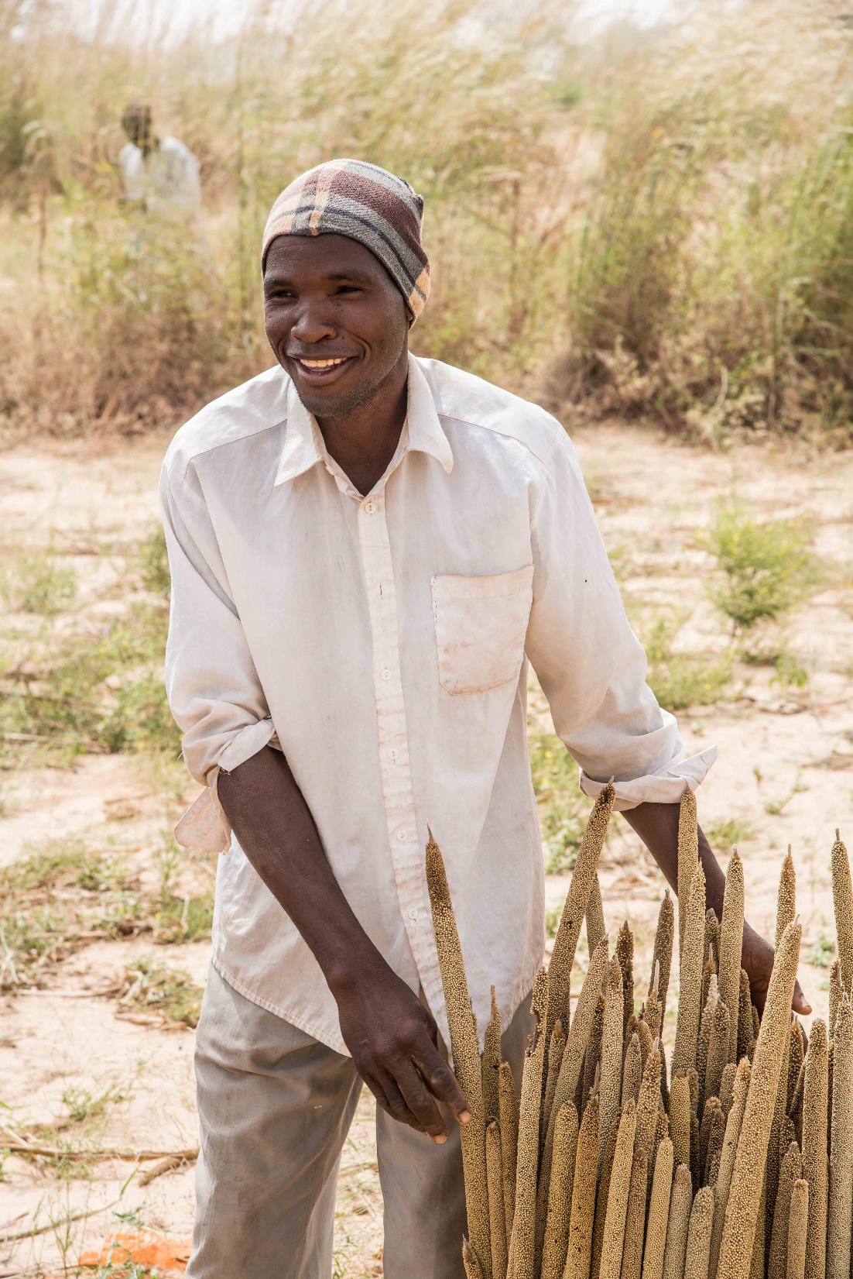

Restoration of Degraded Lands for Food Security and Poverty Reduction in East Africa and the Sahel:
Taking successes in land restoration to scale
Lessons learnt:
what works and for whom?
Presented by Vincent Bado and A. Whitbread at the second in webinar series on Land and Natural Resource Governance, Planning and Management, 13 October 2020

Slide 2
Lessons learnt- ICRISAT, Niger
Farmers understand the causes of land degradation and they have many requests for technologies and training
Participative identification of technologies with farmers is an excellent approach to engage them in the process of scaling
With 4 years contribution of the project, Niger is probably the champion in the adoption of FMNR in West Africa
Bio-reclamation of degraded lands for organized groups of women is an excellent approach to empowering women
Key message: Involving local communities is a key to taking innovations to scale

Slide 3
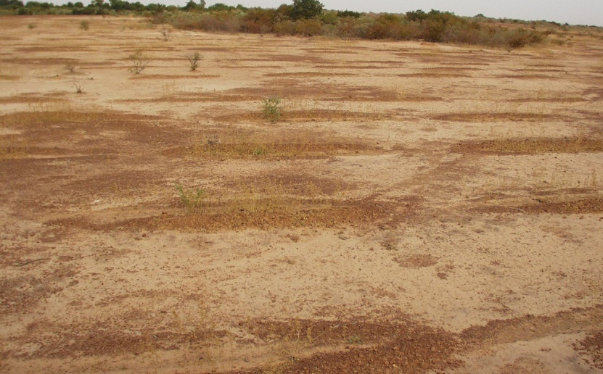
Lessons learnt- ICRISAT, Niger
Farmers understand the causes of land degradation and they have many requests for technologies and training
Decrease of soil fertility (lack of organic and mineral fertilizers, absence of fallow system) are the root causes of land degradation (80-96% of farmers)
  High demand for training on composting
  High demand to access to credit to purchase mineral fertilizer
  Adoption of the technology of micro dosing of mineral and/or organic fertilizers
FMNR

Slide 4
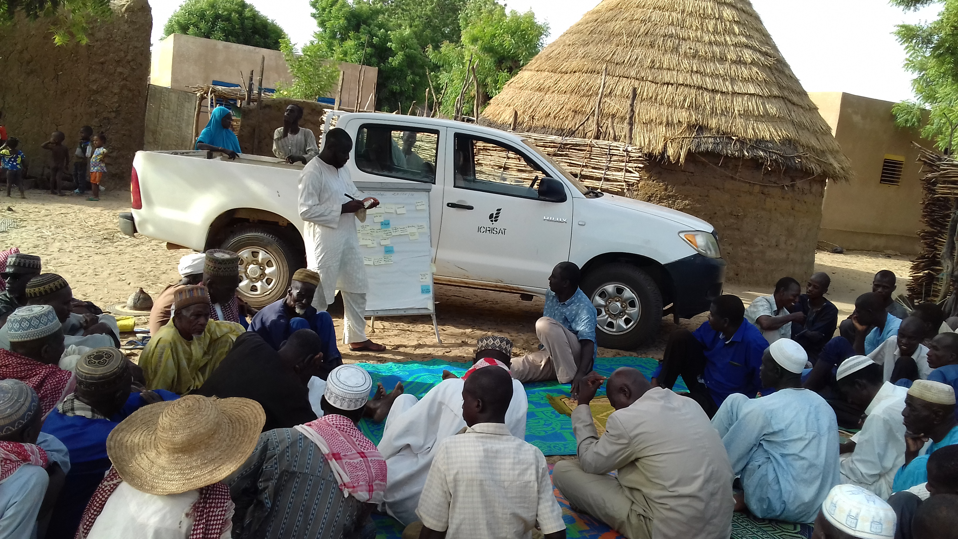
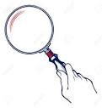
Lessons learnt- ICRISAT, Niger
2. Participative identification of technologies with farmers is an excellent approach to engage them in the process of scaling
Region
ICRISAT
Focal Point
Lead commune
Leader of Innovation
Village
Leader of Local Innovators
Community of Local Innovators
Community of Leader of Local Innovators
Leader of Local Innovators from selected villages

Slide 5
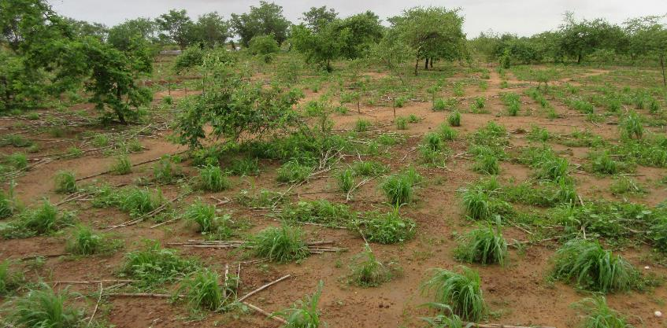
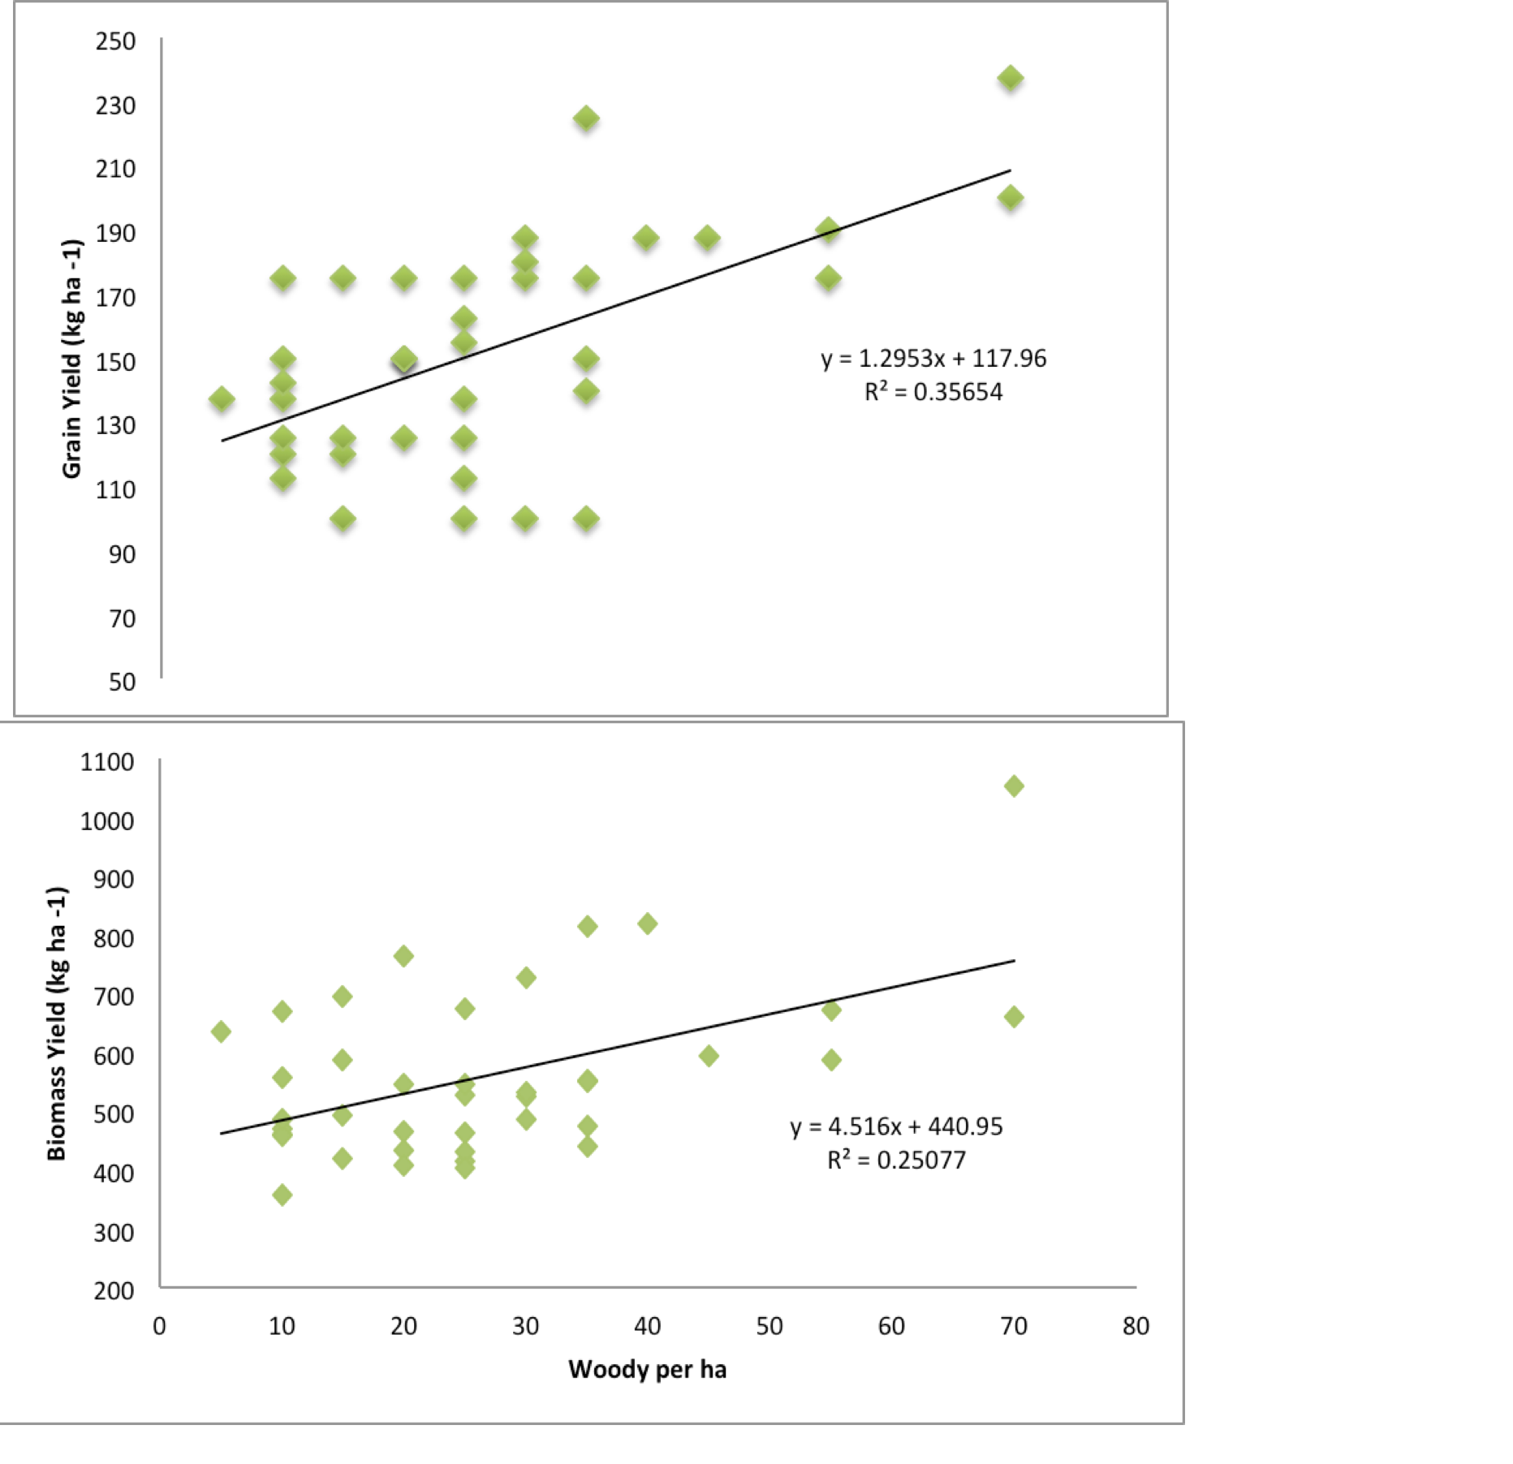
Lessons learnt- ICRISAT, Niger
3. Niger will probably be the champion in adoption of Farm Managed Natural Regeneration (FMNR)
High demand for training on FMNR
Combining FMNR and micro dosing of fertilizers is the best option for farmers
Need for associated research on integrated management of agroforestry system with FMNR (tree and crop densities, fertilizer recommendations on crops)
FMNR

Slide 6
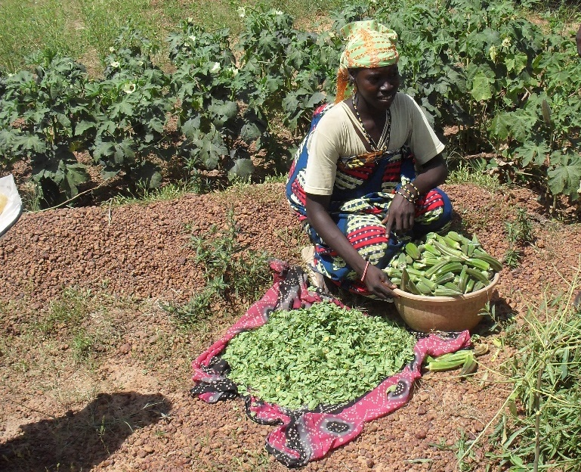
Lessons learnt- ICRISAT, Niger
4. Bio-reclamation of degraded lands for organized group of women is a excellent approach to empowering women
Access of women to lands and
Creating of women association
Generating of incomes

Slide 7
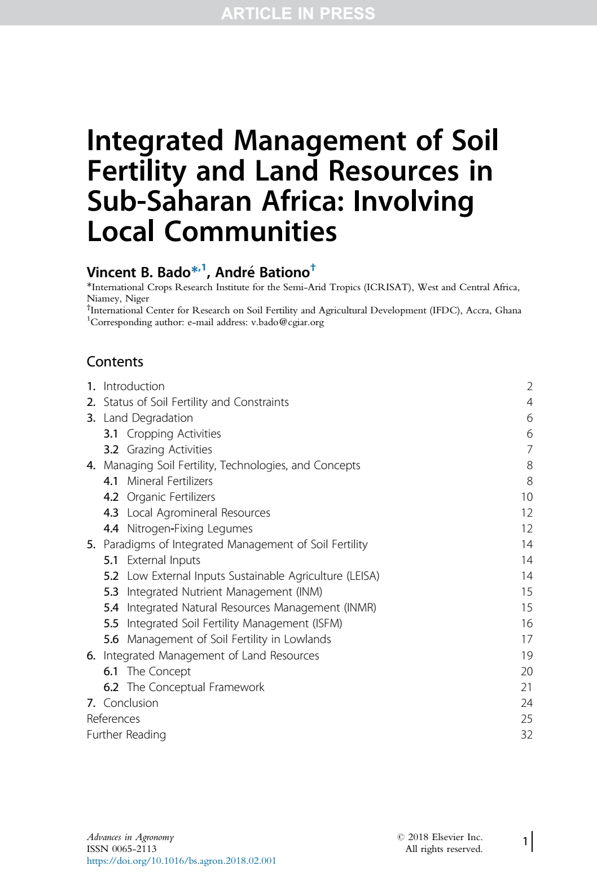
Key message
Involving local communities is a key to taking innovations to scale
Involvement of stakeholders local authorities and farmers in a global strategy for management of land resources
Participative evaluation and refinement

