Slide 1
Photo report on Africa RISING Lemo site visit and SI-MFS field implementation Kebeles selection in SNNP region
24-26 August 2022

Slide 2
Introduction
Africa RISING project of the Ethiopian highlands has been operational in Ethiopia since 2012. The project had two phases. During the first phase, the project focused on prioritization of pressing farming system issues, technology identification, testing and validation. In the second phase, the project identified development partners and facilitated scaling of phase I validated innovations. Currently, the project in the Ethiopian highlands is transitioning to SI- MFS (Sustainable Intensification of Mixed Farming Systems) initiative. The new SI-MFS initiative in Ethiopia is going to be implemented in Lemo and Doyogena districts in the south, Basona and Moretena Jiru districts in Amhara, and Omo Nada and Kersa districts in Jimma, Oromia region. ILRI, ICARDA, CIMMYT and Alliance Bioversity-CIAT planned to jointly operate in those selected districts. The recent field visit in the southern region has been found useful to identify success stories that will lay the foundation for the research and scaling efforts of the new SI-MFS initiative. The experience of innovative Africa RISING farmers in the implementation of integrated crop-livestock-NRM interventions at the farm level will also serve as a learning ground for the farmers that will be part of the SI-MFS initiative.

Slide 3
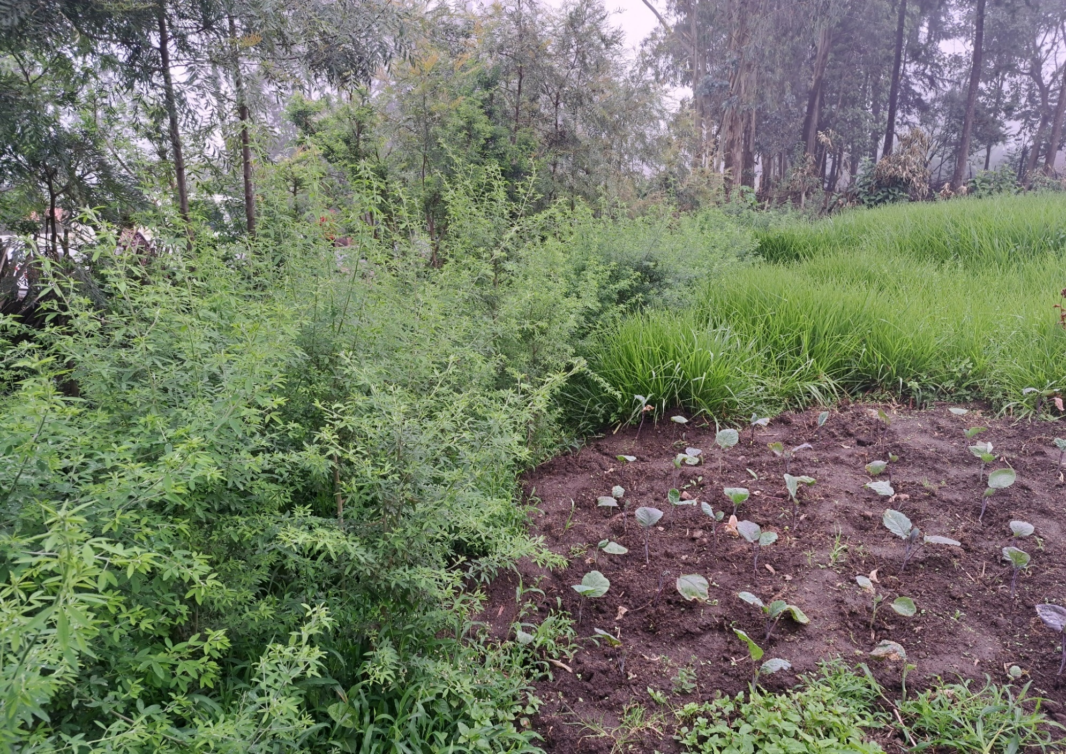
Protein-rich legume fodder tree (tree lucerne) and energy rich desho grass adopted and expanded by farmers for multiple uses in Doyogena woreda, SNNPR in 2022 cropping season.

Slide 4
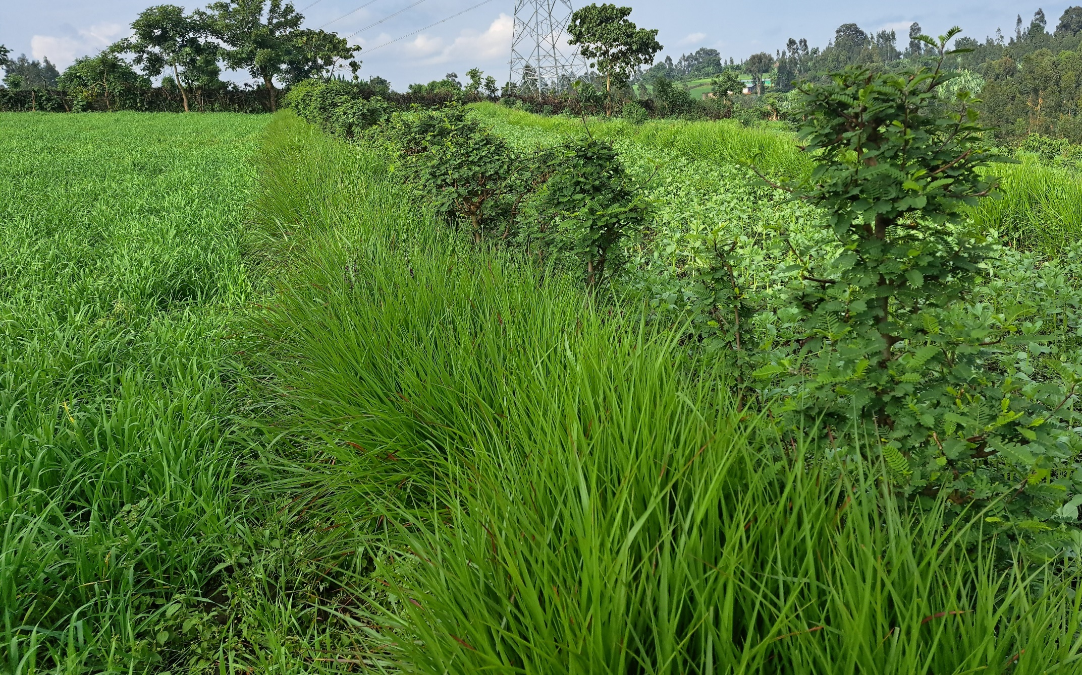
A strip of farmland intensification and management through growing enset, wheat and faba bean together with SWC practices (soil bunds, tree lucerne, desho grass, cordia, sesbania) along the farm in Doyogena, SNNP region in 2022 cropping season. Farm level studies are required to understand synergies and trade-offs for a combination of the different innovations.

Slide 5
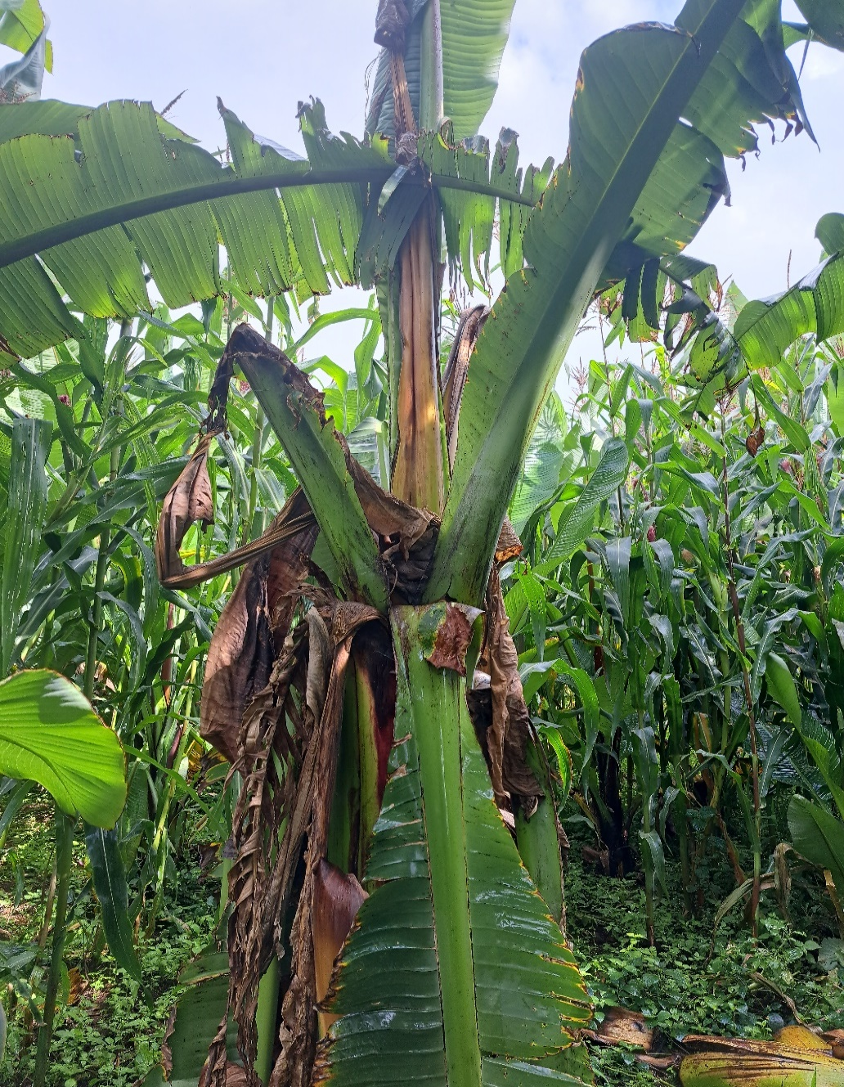
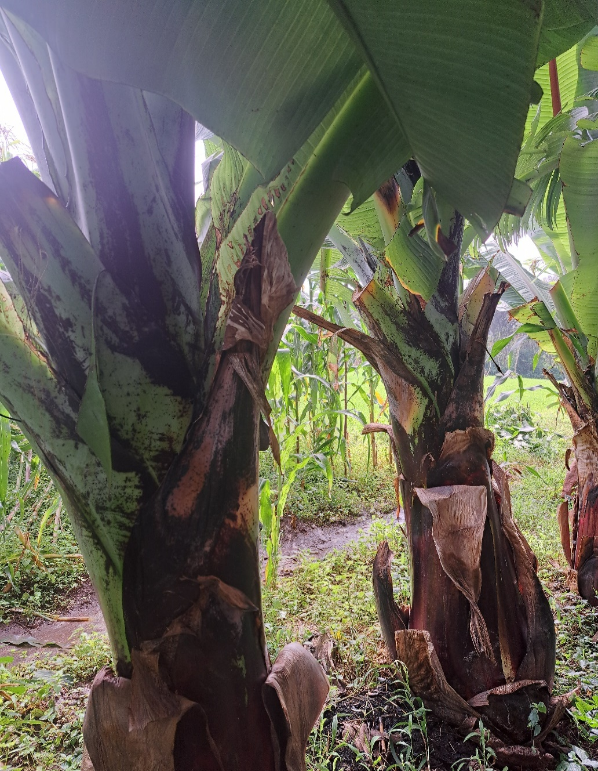
Bacterial wilt has become a threat to enset production in SNNP region. The enset plant on the left side is affected by bacterial wilt and started dying. On the other hand, the enset plant on the right side is tolerating the disease and shows good performance. The bacterial wilt tolerant enset varieties are introduced by the Africa RISING project together with Areka Agri Res Center.

Slide 6
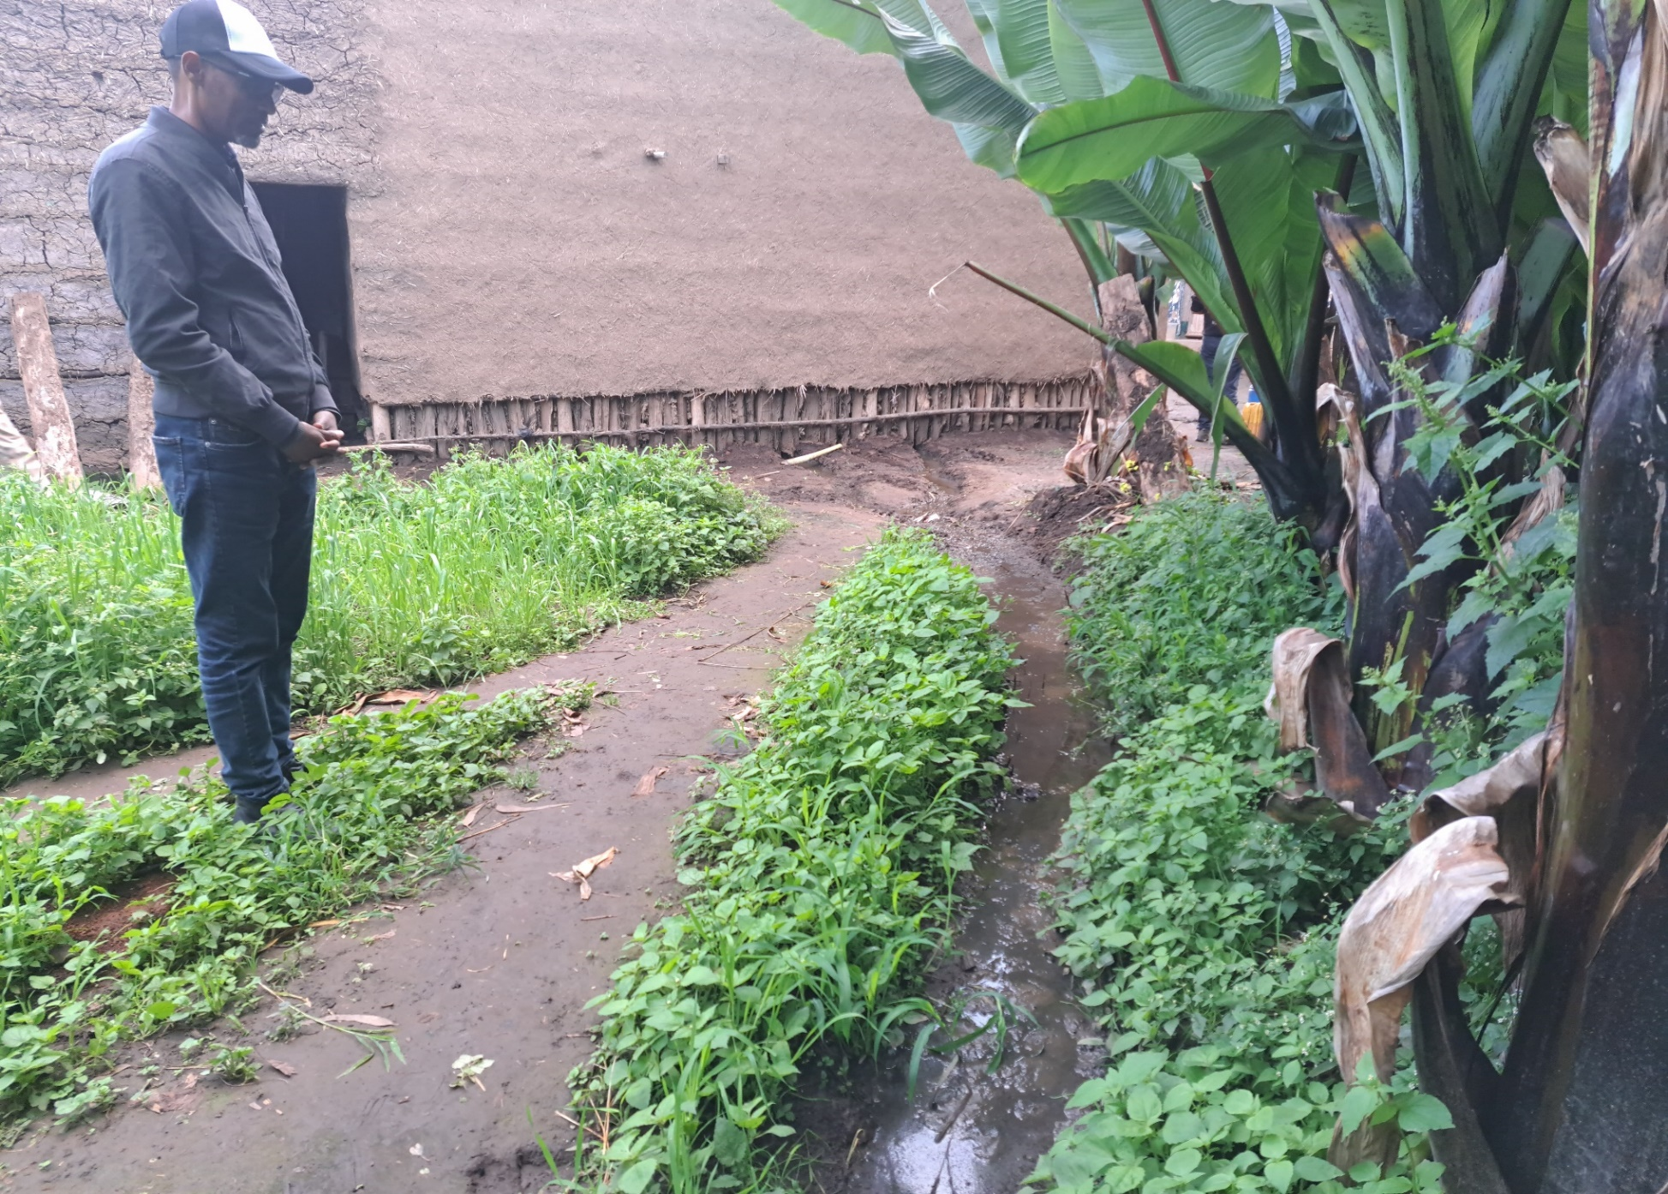
Liquid manure is flowing from a house where animals are kept to enset plantations to improve soil fertility and enhance enset productivity. Enset grows more around homesteads where there is high amount of organic matter. Enset is a food-feed and income source crop.

Slide 7
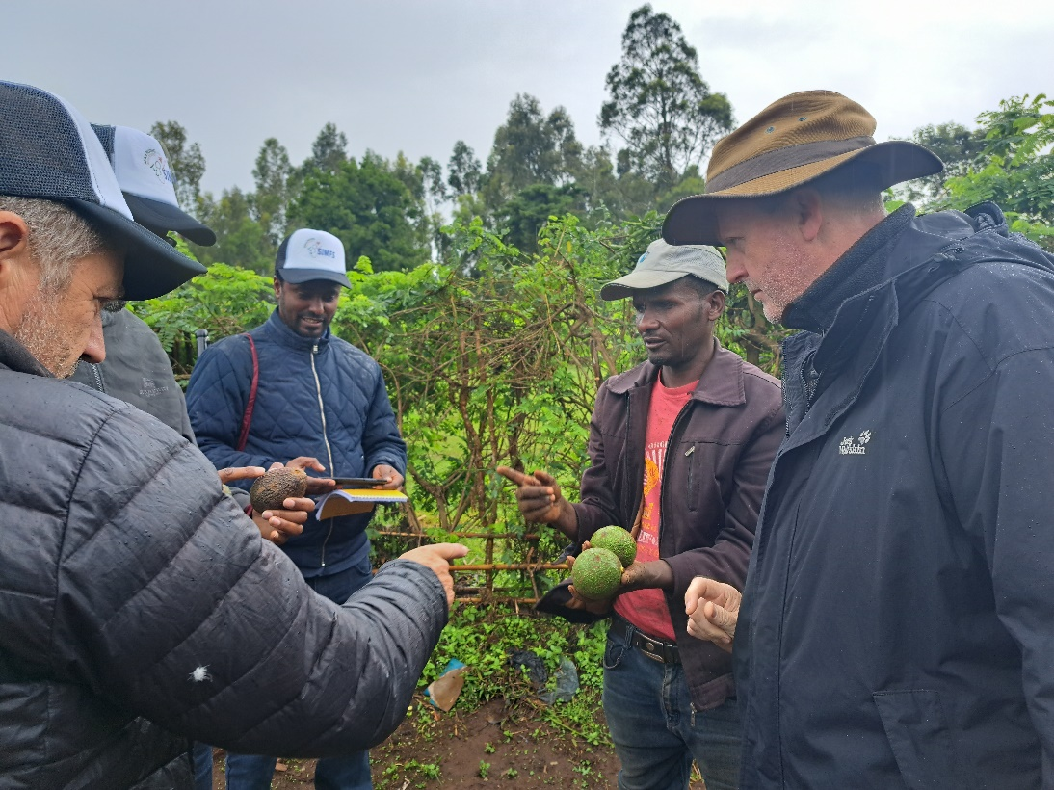
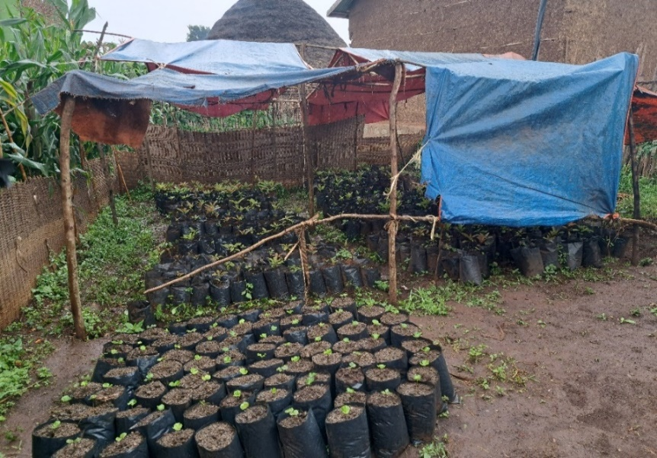
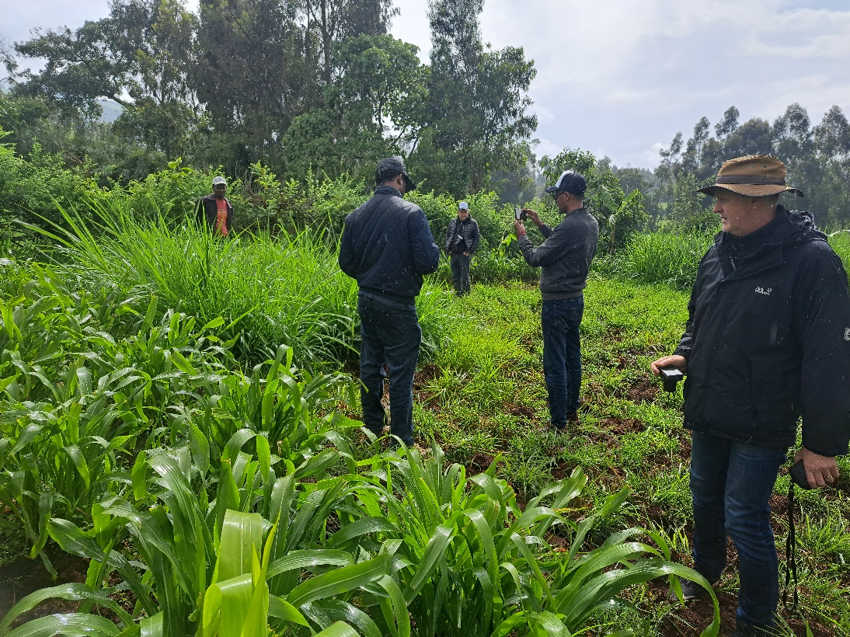
A farmer in Upper Gana Africa RISING kebele has implemented combinations of crop, feed and forage and NRM innovations since phase one of the project period. He has recently received practical training from Africa RISING and managed to graft avocado seedlings for sale and for his own use. However, the water shortage has become a challenge to expanding the grafting and production of healthy seedlings. The local government and extension need to visit him and look for solutions that encourage innovative farmers like him. Good also to think of forming avocado producers and marketers’ associations for sustainable supply and fetching a better price.

Slide 8
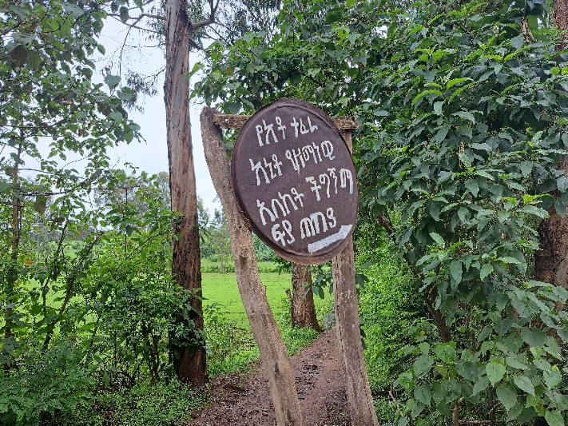
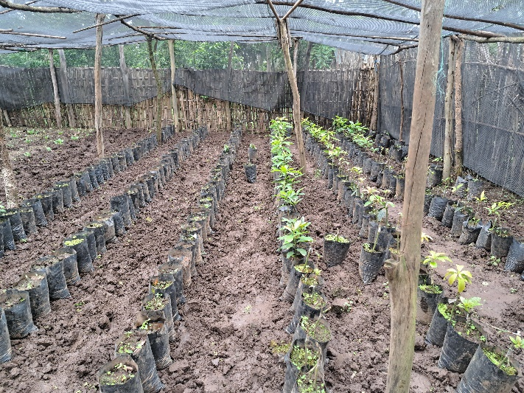
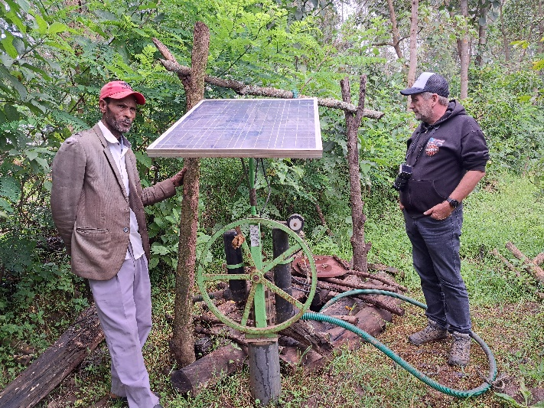
Mr. Tefera is an innovative Africa RISING farmer in Upper Gana. He has worked with Africa RISING for many years and benefited from livestock feed and forage, avocado, vegetables, water lifting (solar pump) and feeding trough innovations. He has become the first farmer who received practical training on grafting avocado seedlings. His grafting skill and volume of grafted seedlings and fruit production increased from year to year. He has already sold grafted seedlings and avocado fruits and earned more than USD 4000 in the last four years. Water and scion supply are critical constraints for him. Long-term research related to scion production from his avocado tree stocks would add value to his effort.

Slide 9
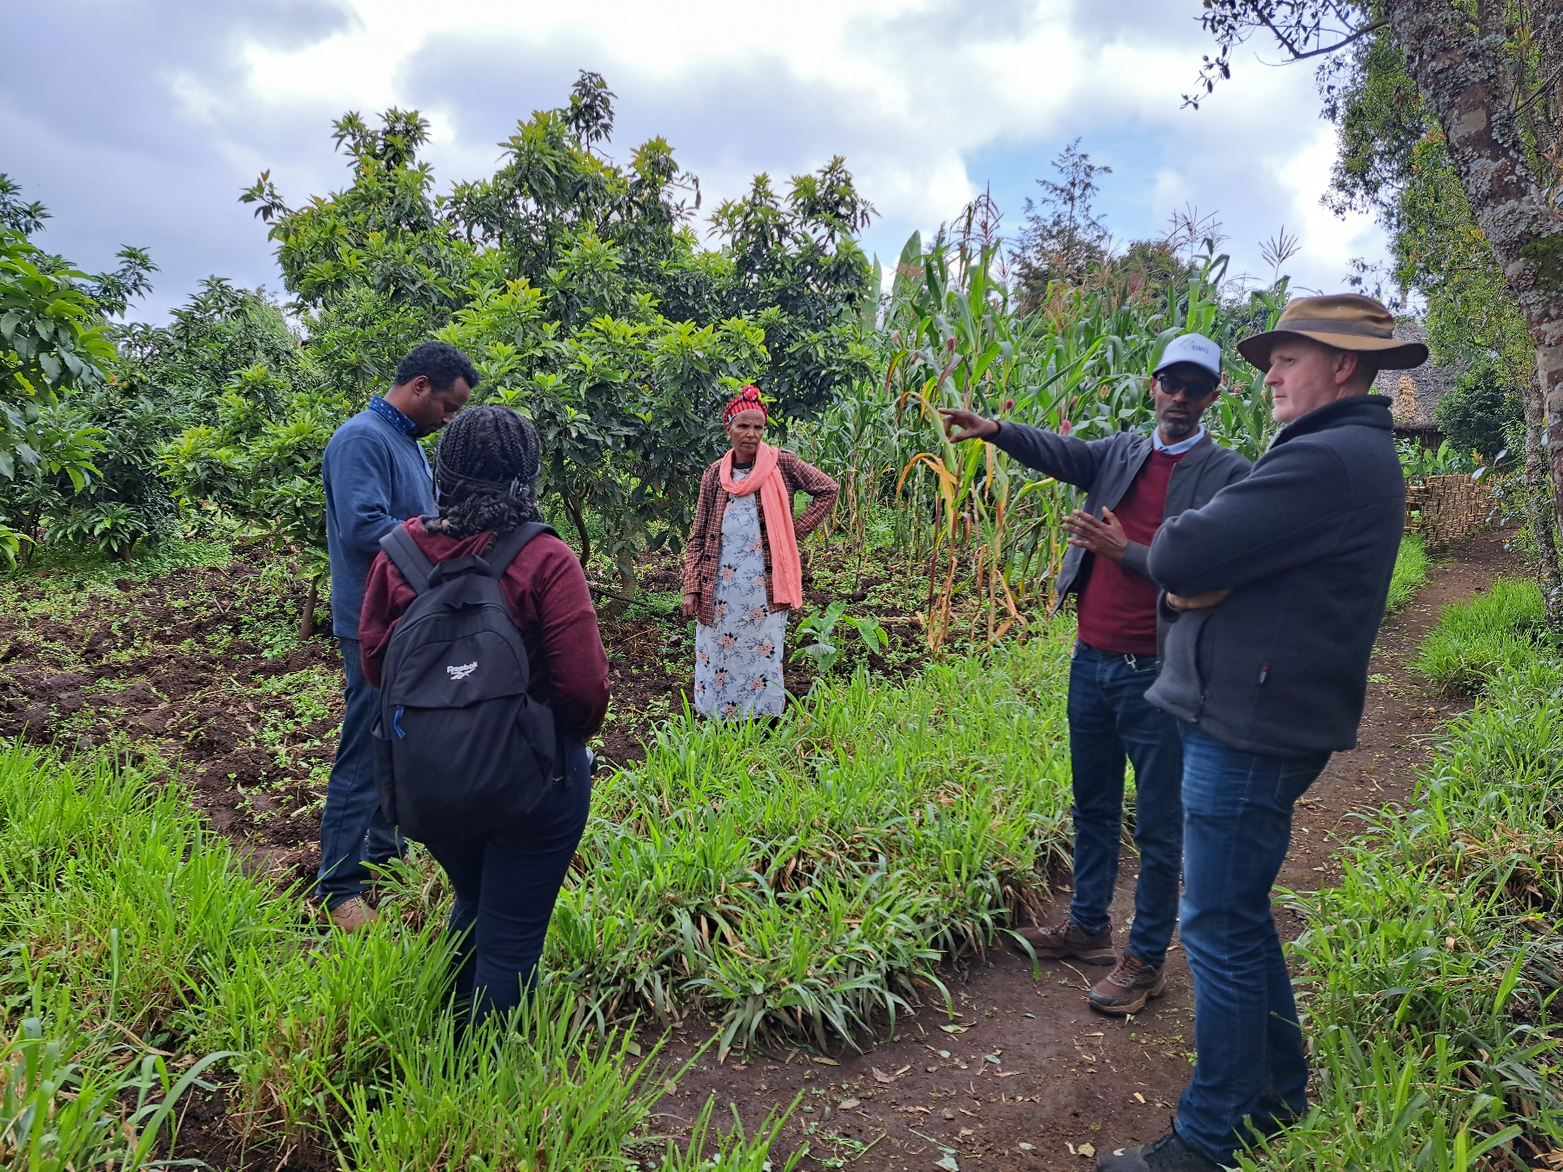
Bekelech is a woman farmer that has been participating in several Africa RISING cross-learning events. She has also adopted water harvesting, water lifting, avocado, feed and forage, feeding trough and crop varietal innovations. Her farm is integrated and serves as a model for many visitors.

Slide 10
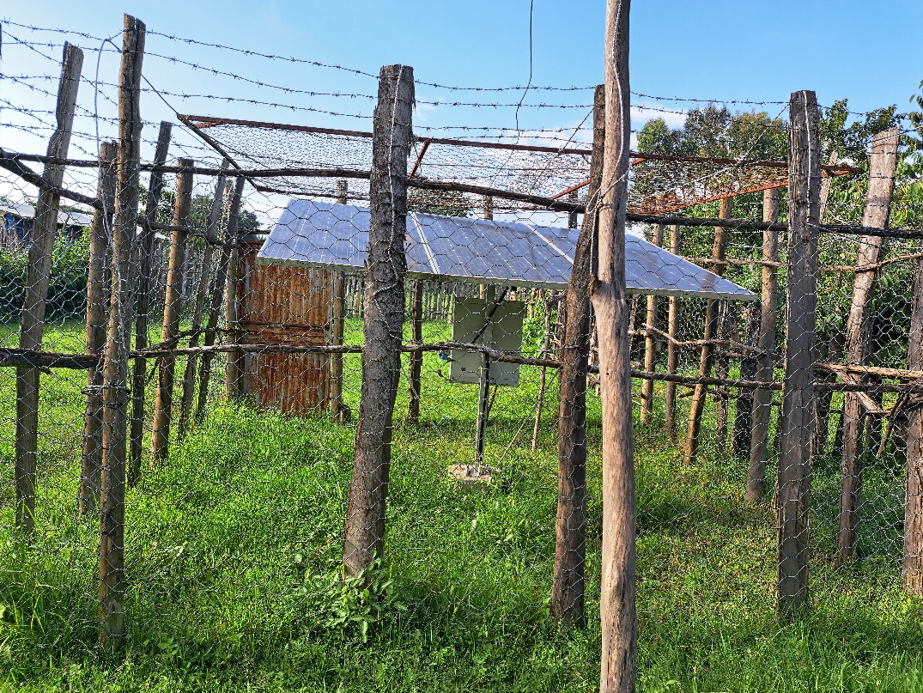
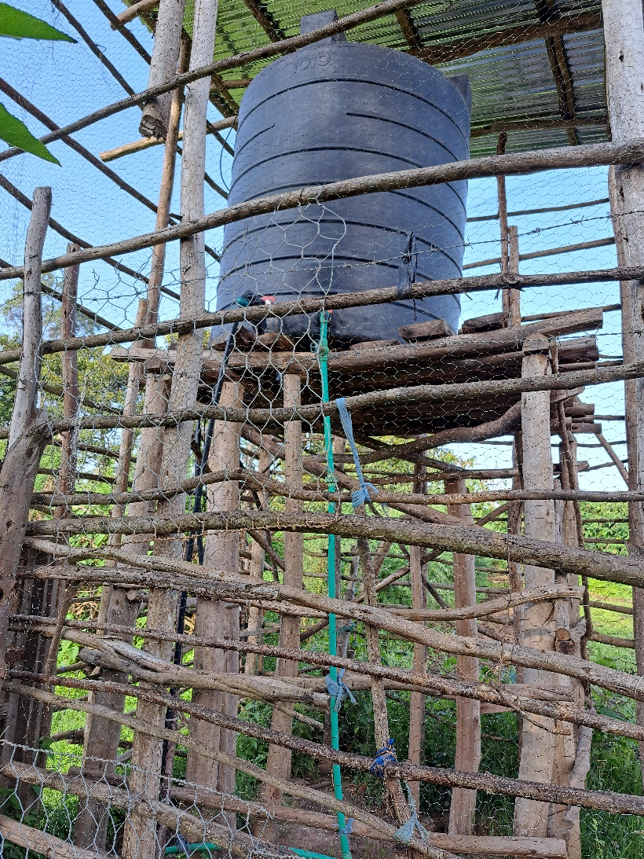
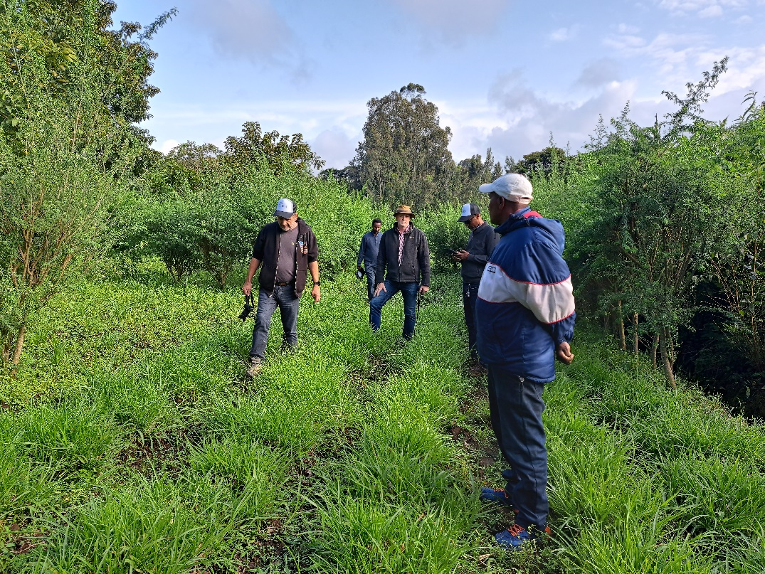
Mr. Adnew is an innovative and successful farmer who worked for long with Africa RISING. He has adopted more than 10 Africa RISING crop-livestock-NRM innovations. He has already allocated a large area for forage production that enables him to feed his improved dairy cows.

Slide 11
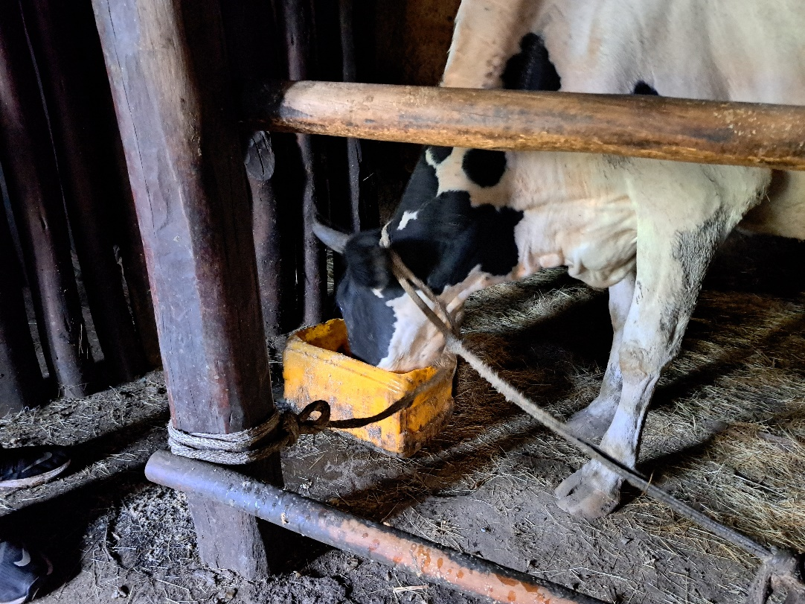
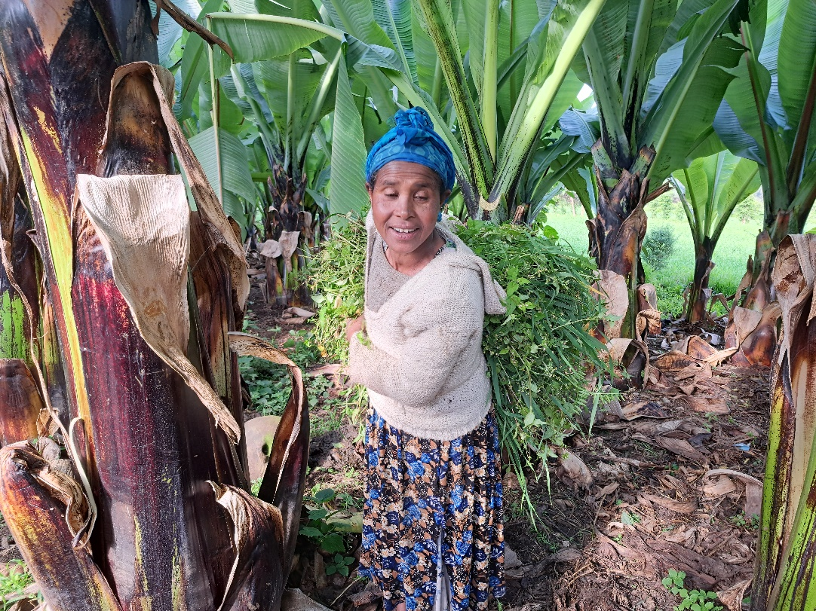
A crossbred cow feeding concentrates in Jawe Africa RISING kebele.
A woman has collected green fodder from a faba bean planted field for livestock feed in Lemo Africa RISING site. Farmers in Lemo deliberately leave weeds in faba bean field and collect them for feed when faba bean reaches at the knee growth stage.

Slide 12
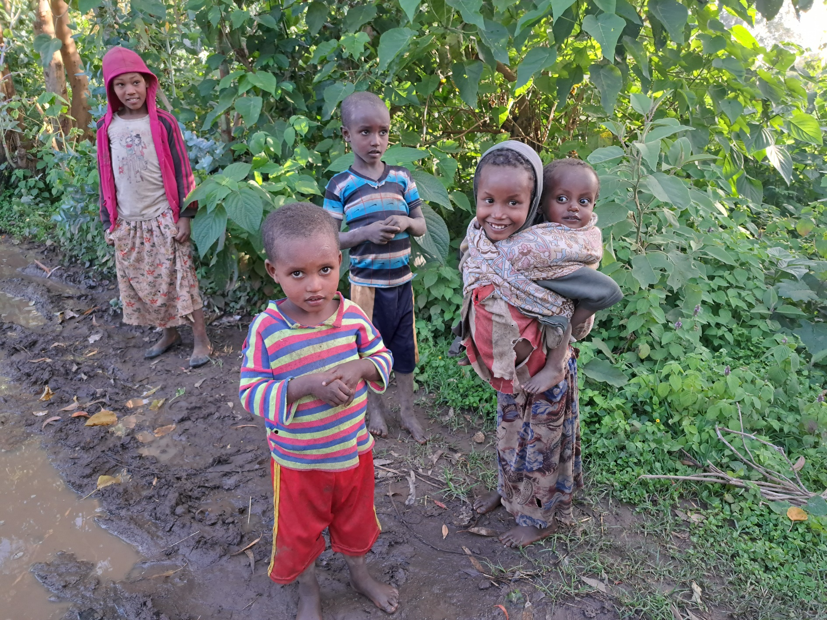
Rural children in Jawe Africa RISING site. A young girl is taking care her brother while her parents are busy in the farm business.

Slide 13
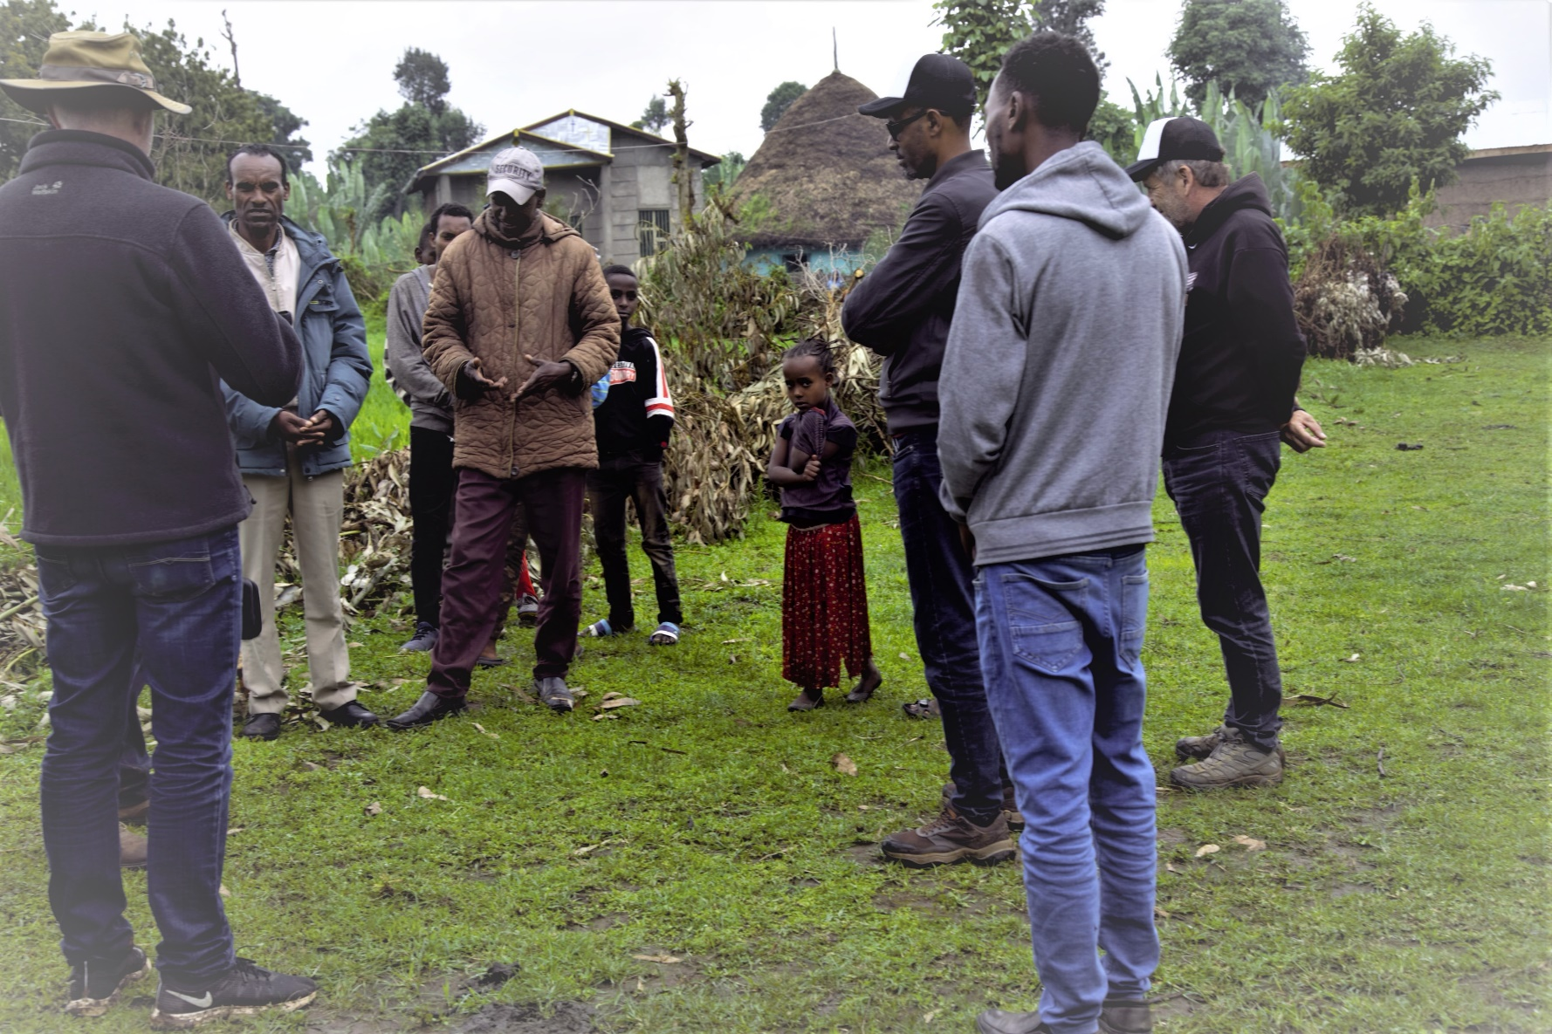
Discussion with local residents in Shurmo Kebele (selected for SI-MFS operation). The kebele has a diversified farming system. Crops such as wheat, maize, barley, faba bean, field pea and enset grow very well. Livestock such as cattle, small ruminants is also common. Dairy association is established in the kebele. Indigenous fodder trees, organic resources for soil fertility improvement and home gardening are potential intervention areas for managing natural resources. The kebele is accessible by roads and markets.

Slide 14










Africa RISING CGIAR partners in Ethiopia
Notes:
Ethiopia

Slide 15

Credits
Produced by Africa RISING Project in Ethiopia
Compiled by Kindu Mekonnen (ILRI)
Authors: Kindu Mekonnen, Peter Thorne, Million Gebreyes, Anthony Whitbread, Workneh Dubale and Haimanot Seifu
Photos: Kindu Mekonnen
Our appreciation goes to CGIAR team members and local partner organizations (Inter Aide France, farmers, extension and Wachemo University) in Lemo and Doyogena, SNNPR.

