Slide 1
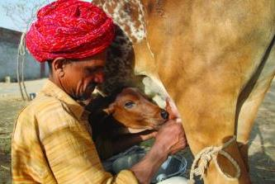
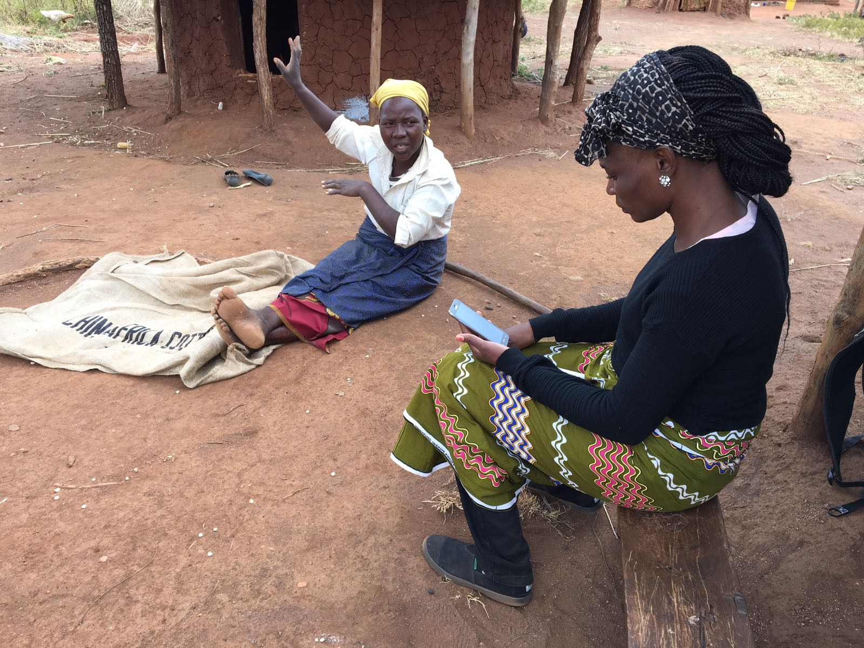
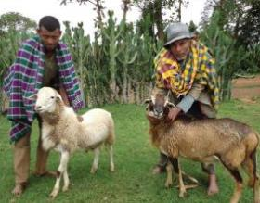


Efficient data collection from rural households – is RHOMIS for you?
James Hammond, Tim Pagella, Todd Rosenstock, Leo Gorman, Sam Adams, Jacob van Etten, Nils Teufel, Mark van Wijk.
Commonwealth Heads of Statistics Conference
23 November 2018

Slide 2


ILRI: the International Livestock Research Institute
Reduced poverty
Improved food and nutrition security for health
Improved natural resource systems and ecosystem services
ILRI’s mission is
to improve food and nutritional security
and to reduce poverty in developing countries through research for
efficient, safe and sustainable
use of livestock —
ensuring better lives through livestock.
Notes:
Aligned to Agenda 2030 and the SDGs.
Part of the CGIAR – one of the major global efforts to address poverty and hunger through agriculture
ILRI: Campuses in Nairobi and Addis, offices in 14 other countries.
ILRI works on issue such as animal genetics, disease and treatment and feed. Also policy, markets, economics, environmental and gender issues.

Slide 3
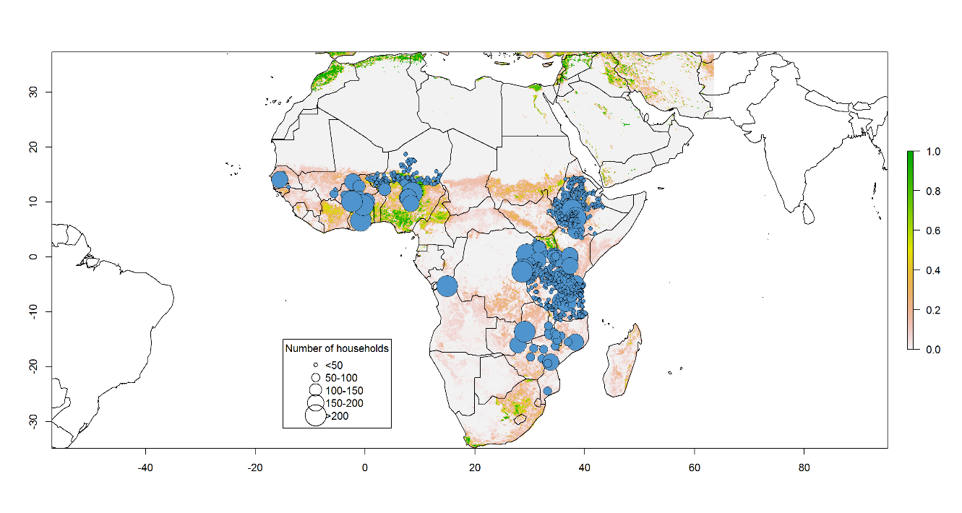
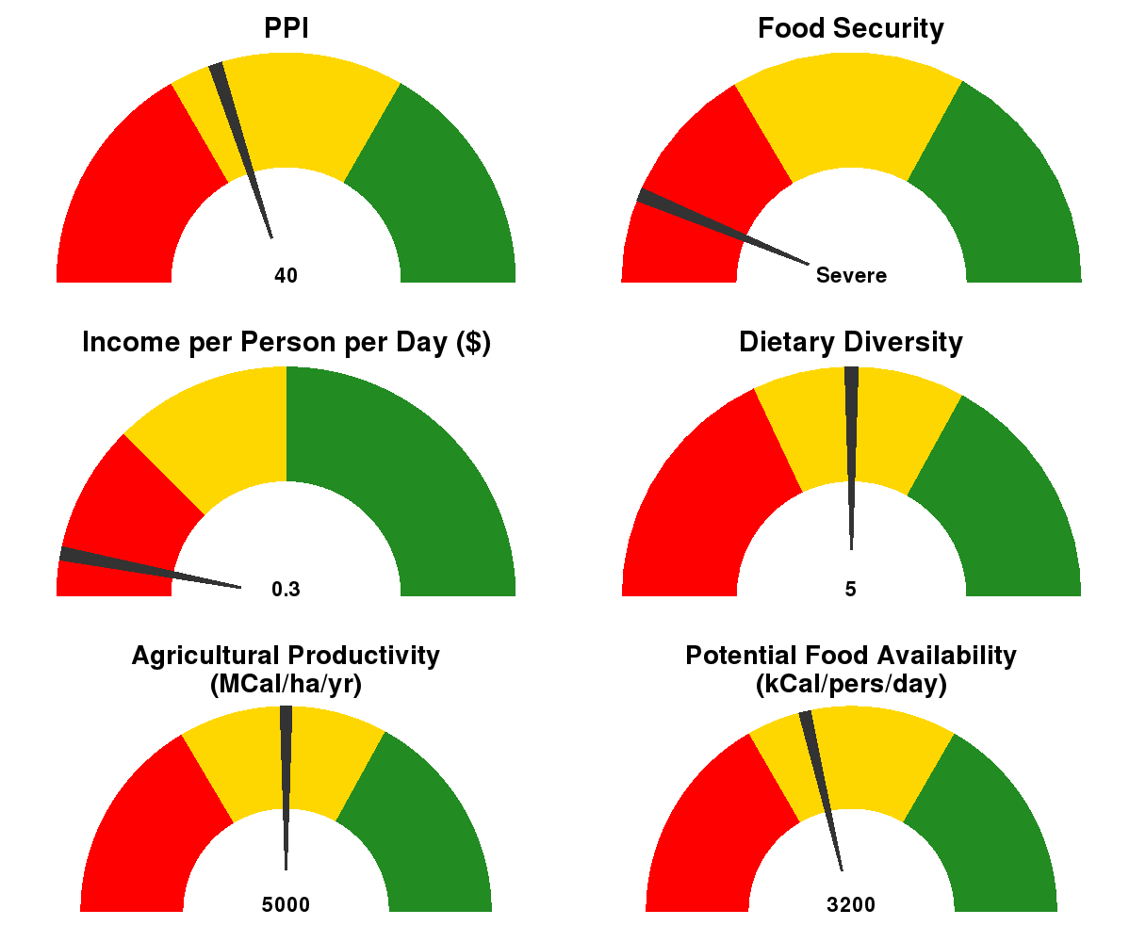
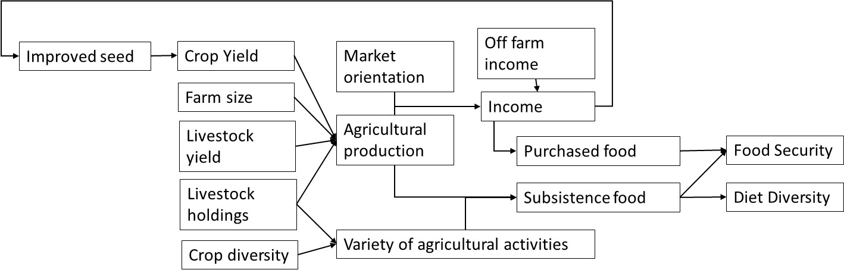
Sustainable Farming Systems

Slide 4
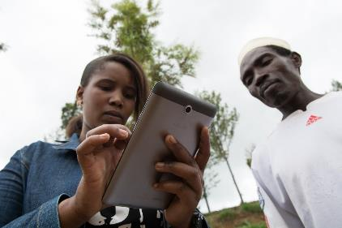
RHOMIS
Rural Household Multi-Indicator Survey
  Use global indicators
  Standardise and harmonise data
  Collect data very efficiently
  Makes use of digital technologies and advances in indicator development; 1 hour per household
  Flexibility and adaptability: a tool that can be used in many locations and settings
Carefully designed and refined over 4 years

Slide 5
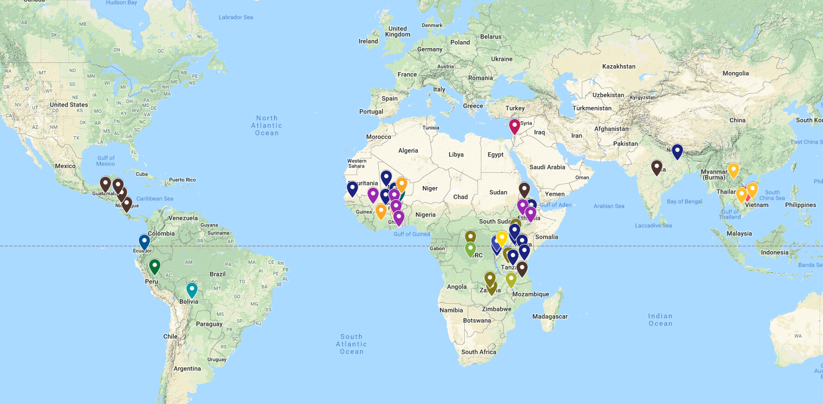
Uptake of RHOMIS since 2015
www.rhomis.org
More than 20,000 interviews in 24 countries
Used by Research Organisations, Major Donors, and NGOs

Slide 6
What Information is Captured?
Drivers & Strategies
Performance
Welfare
Farm HH Characteristics:
Family Size/Composition
Gendered Decision-Making
Food Security:
Calorie Availability
Food Insecurity Experience Scale (FIES)
Household Diet Diversity Score (HDDS)
Economic:
Value and Sales of Farm Production
Off-farm income
Livelihoods:
Market Orientation
Livestock Orientation
Off-Farm Activities
Poverty:
Probability of Poverty Indicator (PPI)
Gross Income ($ per day)
Agricultural System:
Land Allocation
Farm Diversity
Natural Resource Management (NRM)
Intensification Practices:
Fertilization
Irrigation
Integration
Agricultural System:
Farm Productivity
Crop Productivity
Livestock Productivity
Environment:
GHG Emissions
GHG Emissions Intensity
+ Optional Additional Modules
+ Other User-Defined Indicators of Interest

Slide 7

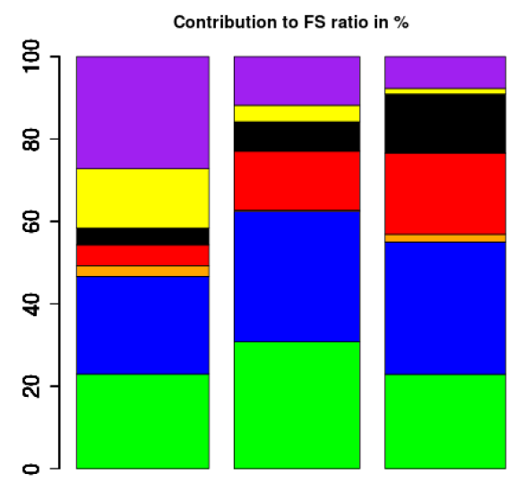
Digital surveys: data processing and basic analyses much quicker and easier
Survey definition
Database
Library of analysis code (linked to database)
Website
Survey template
Completed survey
Visualization of results
Interview farmer

Slide 8
Could RHOMIS be useful for National Statistics Offices?
  Could be an efficient intermediate to Agricultural Census or other very detailed surveys (e.g. LSMS)
  Data processing, reporting, analysis very quick
  Structured data could be valuable for research on agricultural practices, poverty, policy impacts
  Output data could be integrated into reporting platforms
  Global effort for open data

Slide 9

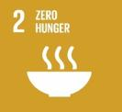
















What SDG indicators are covered?
The RHoMIS tool monitors indicators for 5 SDGs
Can be used as a diagnostic tool to understand progress towards 7 SDGs
Notes:
Monitoring tool:
SDG1: Incomes and vulnerability
SDG2: Experience of hunger, agricultural productivity, and a bit about sustainable land use even
SDG5 – diagnostic but not directly monitor indicators
SDG6 – Water access and sanitation and hygiene practices
SDG9 – transport, value chains, markets, credit
SDG10 – diagnostic for ineqaulity in rural areas
SDG13 – diagnostics for CSA
Diagnostic tool:
AND can help identify which causes, or hotspots where certain issues occur

Slide 10
Co-develop a version of the tool with a National Statistics Office
We invite interested parties to make contact with us and co-develop the RHOMIS tool.
  Needs assessment with NSO
  Adapt questionnaire, user interface, and reporting platform
  Pilot testing of the tool
  Evaluate and refine for large scale use
  Possibly make tool available to commonwealth community

Slide 11
Contact details
J.Hammond@cigar.org
www.rhomis.org
Hammond et al 2017, Agricultural Systems, 151, 225–233
Fraval et al 2018, Agricultural Systems, 160, 87-95
Fraval et al, in press, Experimental Agriculture
Frelat et al, 2016, PNAS, 113 (2) 458-463

