Slide 1

Introduction to Knowledge Management
Unit 1 of the Knowledge management in agriculture and rural development (KM4ARD) course

Slide 2
Introduction to curriculum
Purpose: basic overview of KM in ARD
Overall learning objectives:
  Better understanding of KM concepts
  Better understanding of how KM strategically applies in your work with means and approaches to embed it
  Understand how exchanging and capturing knowledge can lead to a greater development impact.

Slide 3
Curriculum content
8 Units, 24 Sub-units, 4.5-day course
Mix of presentations and interactive group work / exercises
Basic overview, not covering in depth
Not one truth in KM
Context: link to your work in ARD
Notes:
Trainer notes
8 Units…: this is for the full course so adapt to your context - what you will cover and the length.
Not one truth…: emphasize that KM means different things to different people and that there is no wrong or right.
Context…: context is what matters in KM, for e.g. in one organisation, KM can mean something broader than in another organisation, which is fine because they follow their own interpretation of KM.

Slide 4
Curriculum content
Broad overview:
  Unit 1: KM basics
  Unit 2: KM culture and leadership
  Unit 3: Strategic approaches to KM
  Unit 4: KM and M&E/learning
  Unit 5: Collaboration and knowledge exchange
  Unit 6: Harvesting and capturing knowledge
  Unit 7: Emerging KM issues
  Unit 8: The way forward in KM
Notes:
Trainers notes
Adapt to the content you will be covering.

Slide 5
Introduction to KM
What is KM/why KM is important
Information age
Being a “Knowledge worker”
Data, information and knowledge
Nature of tacit/explicit knowledge and multiple knowledge
Elements of KM
KM cycle
Examples of KM frameworks
KM in ARD and development aid
Personal Knowledge Management
Notes:
Trainer notes
This Unit contains the following topics.

Slide 6

What is Knowledge Management?
Proposed definition:
KM is the discipline of enabling individuals, teams and entire organisations to collectively and systematically create, harvest, share and apply knowledge, in order to better achieve their objectives, improve their practices and learn from what they do.
Notes:
Trainers notes
This is the proposed definition for this course but it isn’t the only definition. Make sure that you mention this. It is a purposely broad definition to try to encapsulate what we will cover in the course.

Slide 7

Why KM is important
Improves the ability of individuals and organisations to solve problems better, adapt, evolve to meet changing requirements, and survive disruptive changes
KM approaches can help communities to generate, access, share and employ knowledge to get their collective voices heard
KM is also ultimately linked to longer-term development goals which seek to empower communities in developing and transition countries to participate effectively in development processes
Notes:
Trainers notes
Mention that there are the three different levels: people often think of KM more at the level of the first bullet point but it can have a much bigger impact.

Slide 8
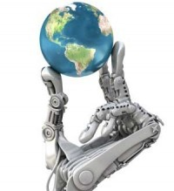
Information Age
Globalization of economy
Digital world
Rapid technological changes
Work is more information and knowledge intensive and less labour-intensive
Laid foundation for KM as a discipline in the 1990s
Notes:
Trainers notes
Link from last slide: it all started with the information age…
Mention that practical knowledge used to be transferred one-to-one, in apprenticeships for e.g. In today’s world, the transfer is now one- to many and many-to many. You can also mention the shift from the knowledge contained in printed book to digital knowledge, taking many shapes.

Slide 9
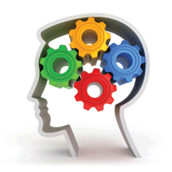
The “Knowledge Worker”
Main capital is knowledge
“Non-routine" problem solving that requires a combination of convergent, divergent and creative thinking
Typology: "controller, helper, learner, linker, networker, organizer, retriever, sharer, solver, and tracker“
Constant change, complexity, overwork
Notes:
Trainers notes
Link from last slide: the Information Age had the effect of creating a new type of worker, the “knowledge worker”.
You can insert a short reflection after covering this slide: to what degree does this apply to you? Which part of it resonates most? Just get a handful of people (3-4) to briefly state what applies to them.

Slide 10
Data, Information, Knowledge
Data
“1855TG313”
Information
“Thai Airways flight 313 leaves Bangkok at 18:55”
Knowledge
“…That’s not a good flight; often busy and delayed.”
Notes:
Trainers notes
Link from last slide: let’s take a step back and take a look at what we mean by knowledge. Often, people use data, information and knowledge interchangeably but they mean different things. Here are examples of what each signify.
Data: just letter and numbers that you could find in a database
Information: gives the data a bit more context
Knowledge: this could be advice from a travel agent or a fellow traveler. It comes from experience.
You can modify/tailor this example to your context. The important thing to say is that it is not a judgment on data or information. Knowledge is not better than data or information, just different. That is the basic idea that needs to come across, that each are different.

Slide 11
Nature of Knowledge - Tacit
Tacit knowledge is experience, insights, skills, concepts, ideas, ways of thinking or working
Highly personal and contextual
Often intangible
Notes:
Trainers notes
Link from last slide: there are two different types of knowledge, first – tacit.
Feel free to add examples of tacit knowledge, for e.g. riding a bicycle or learning a language (a native speaker picks it up at a young age, almost entirely unaware of the grammar which they may be taught later).

Slide 12

Nature of Knowledge - Explicit
Knowledge that has been articulated, codified, and stored
Examples include books, manuals, documents, procedures, and how-to videos
Captured tacit knowledge in a video = explicit
Captured tacit knowledge in a network = explicit
Notes:
Trainer notes
Link from last slide: the second type of knowledge is explicit
Captures tacit…: there are different ways to capture tacit knowledge other than in writing, such as video. Even tacit knowledge shared within a network can be considered explicit.

Slide 13
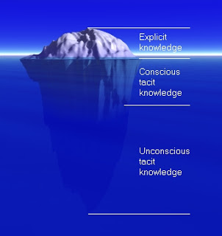
Tacit vs. Explicit Knowledge
Polanyi’s knowledge iceberg
The vast majority of knowledge is tacit
Harder to reach, higher value?
Notes:
Trainer notes
Link from last slide: we try to capture tacit knowledge to make it explicit but the knowledge iceberg metaphor by Polanyi shows us that explicit knowledge is just the tip of the iceberg.

Slide 14
Questions? Comments?

Slide 15
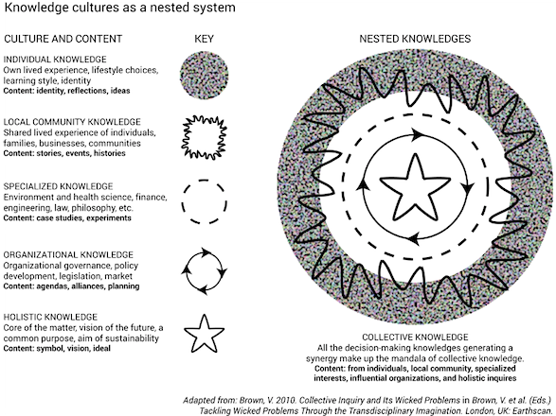
Multiple knowledge
Notes:
Trainers notes
This slide is meant to represent how the multiple knowledge that exist work as a collaborative system, to create collective knowledge. No need to get into any more details on this slide.

Slide 16
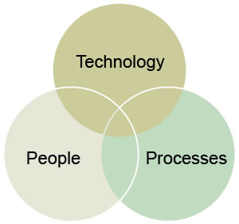
Elements of KM
Knowledge Acquisition
Knowledge Creation
Knowledge Capture
Knowledge Harvesting
Knowledge Sharing/Exchange
Knowledge Reuse
Learning
Notes:
Trainers notes
Link from last slide: along with multiple knowledge, there are multiple elements that represent what we mean by KM.
We will be going over these different elements and what they mean throughout the course. The Venn diagram is to illustrate that in most (if not all) of these KM elements, we are looking at people, processes and technology.

Slide 17
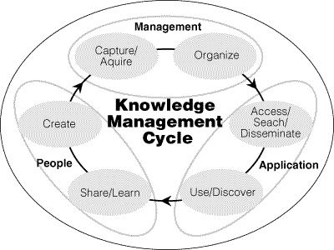
Knowledge Management Cycle
Source: McIntyre, Gauvin and Waruszynski
Notes:
Trainers notes
Link from last slide: this is how these elements can come together in a KM cycle.
Start on the left, with the “People” creating knowledge and go clockwise.
It is important to note that this is ONE example of a KM cycle. There are others but this one show how the KM elements can be linked in a cycle.

Slide 18
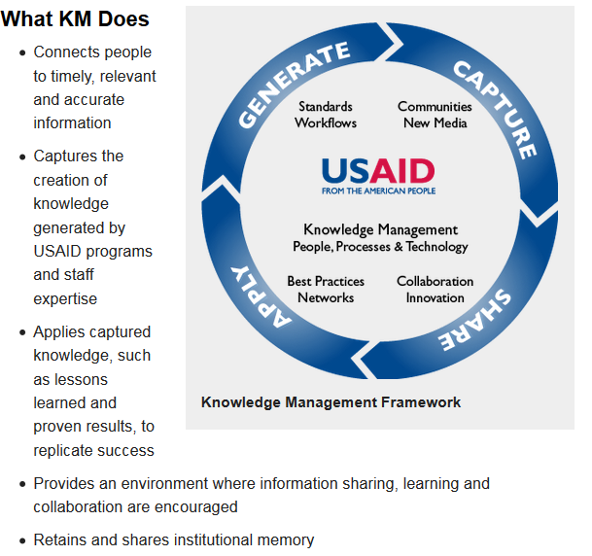
USAID’s KM framework
Notes:
Trainers notes
Link from last slide: the next three slides are examples of KM frameworks. Organisations often illustrate the KM elements that are important to them in a KM framework. This helps to show and explain where their KM focus is and how they explain KM in their own context
This the USAID framework, which focuses on Generate, Capture, Share, Apply.

Slide 19
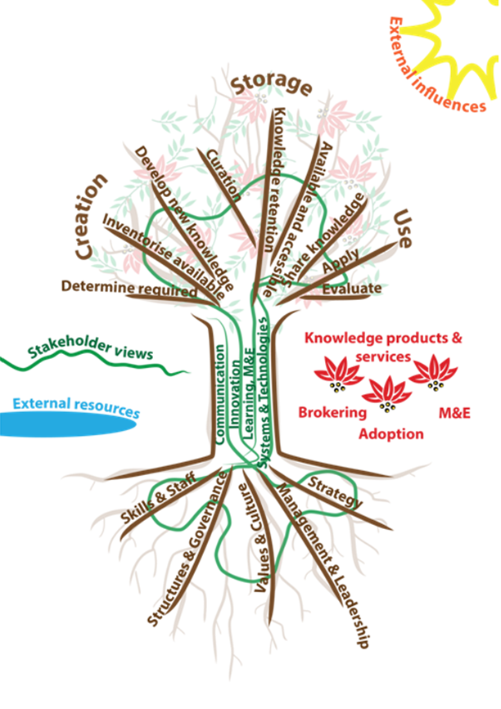
CTA’s KM framework
Notes:
Trainers notes
The CTA framework is used to illustrate their KM focus but is also used as a KM scan (as we’ll see in Unit 3). Highlight the tree metaphor, with what comes from the roots in the soil, through the means in the trunk, through to the KM elements in the branches.

Slide 20
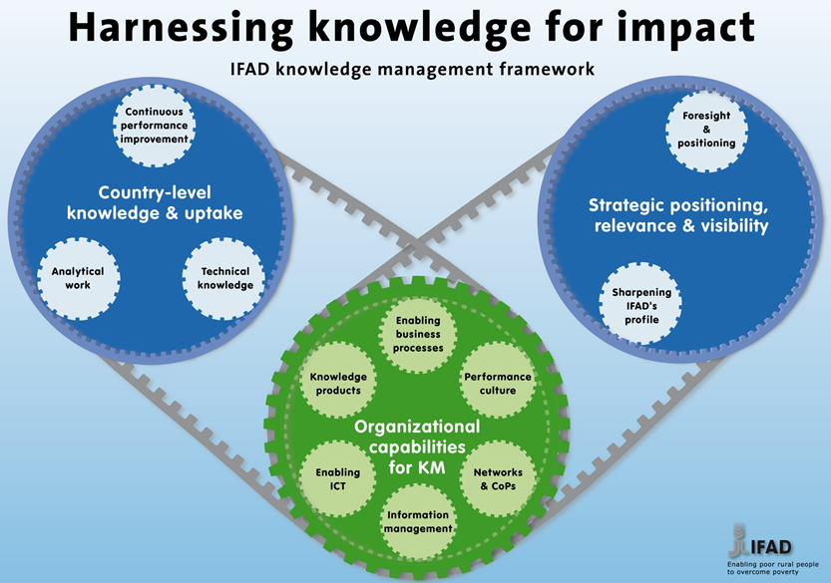
IFAD’s KM framework
Notes:
Trainers notes
The IFAD KM framework is a bit different because it focusses more on the capacity building perspective. KM feeds into the country-level work and enhances their positioning and visibility.

Slide 21
KM roles in organisations
Possible “official” places within an organisation or network:
  Specialized KM roles: CKO or KM Officer. Can have own department or Unit in large organisations. Often reporting to high level management
  KM slash other role: often linked with Communications or M&E
  KM Focal points: in networks, the knowledge nodes
Notes:
Trainers notes
Link from last slide: … KM can be everywhere in an organisation but KM roles may have more official places.
This slide offers examples of the different official KM roles that can exist in organisations. Of course, everyone is a knowledge worker, this is in terms of departments, positions or job titles.

Slide 22
Questions? Comments?

Slide 23
Importance of KM in ARD
For agricultural and rural development, KM can help to:
  Improve on livelihoods - enabling uptake, utilisation and scaling up of improved technologies and innovations along agricultural value chains
  Improve agricultural research, extension and education – better inclusion of existing knowledge and experiences
  Improve regional policy processes - through more sharing of regional agricultural knowledge and creation of integrated regional knowledge acquisition and management systems
Notes:
Trainers notes
Here are some of the examples as to why KM is important in ARD.
Feel free to add examples for each of the bullet points from your experience and in your context.

Slide 24
Importance of KM in ARD
Also, using KM in ARD can help to:
  Encourage more collective action, linking and networking farmer organisations
  Encourage regional sharing of knowledge and experiences that support continuous learning and innovation
  Integrate indigenous and farmer knowledge into mainstream innovation
Notes:
Trainers notes
Link from last slide: more specifically, here is what KM can also do in ARD.
Feel free to add examples for each of the bullet points from your experience and in your context.

Slide 25
KM in international development
International development and humanitarian aid:
KM can bring more recognition of outcomes, multiple knowledge, complexity
KM can build sustainability for learning
But thinking and practice is still trapped in a linear cause -> effect
Maintained by mindsets that seek accountability
Notes:
Trainers notes
Link from last slide: … at an international development level, there is also a lot of potential for KM.
But thinking and practice… : meaning the logframe approach, that “we as an organisation will take this action and it will lead to this consequence”.
Maintained by mindsets… : you can mention that the large donor mindset on accountability unfortunately often stifle the learning aspect.

Slide 26
International development/ARD in a complex world
Nature of systems: interconnected and interdependent
Nature of change: dynamic and unpredictable
Nature of human actors: reacting to each other and evolving new ways of doing things
Notes:
Trainers notes
Link from last slide: … but both ARD and international development are unfolding in complex environments.
Stress that ARD and international development need to move with the systems, the changes and the actors. It need to evolve, we need to find new more adaptive approaches.

Slide 27
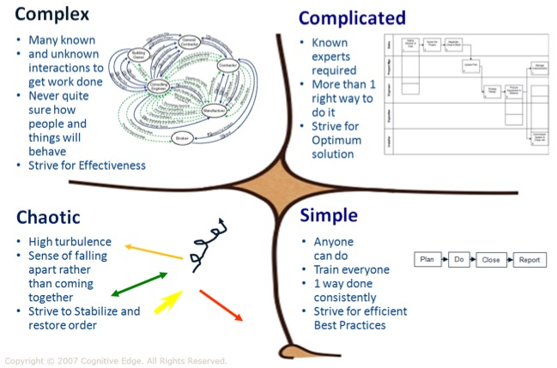
Finding the right balance
Cynefin framework (Dave Snowden)
Notes:
Trainers notes
Link from last slide: Complexity seen from an analytical point of view, with the Cynefin framework. Some things we do are simple, while a lot in ARD or development can be complicated or complex. The point is that you don’t use the same approaches for the simple as for the complex, each needs different interventions. We should not take a “one size fits all” approach.
Start with the bottom left domain, the “Simple”. This where things can be done in the same way consistently, where we can write guidelines or procedures (for procurement, for e.g.). Then move to the “Complicated”, where with a bit of research and expert analysis, you can find an optimal solution (but there are many). An example can be digging wells. The “Complex” involves unpredictability and unknowns. This means experimentation, testing and pilot projects and we only know how it went once its done (e.g. Climate change effects on crops). The “Chaotic” means working through crisis and trying to re-establish some sort of order (e.g. the Japan tsunami and the nuclear fall-out).
The aim is to try new approaches to move it out of a domain, i.e from chaotic to complex, complex to complicated and – if possible – complicated to simple.

Slide 28
Relationship to KM
ARD and international development: not cause and effect
KM: take into account all types of knowledge and specific context
Not one size fits all
KM aims at flexibility and being more adaptive
Notes:
Trainers notes
Link from last slide: the link to KM is that KM approaches work well in a complex environment.

Slide 29
Questions? Comments?

Slide 30
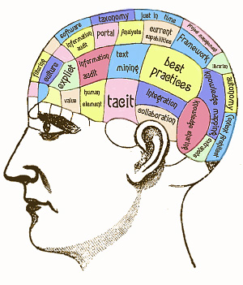
Personal Knowledge Management
What is Personal Knowledge Management (PKM):
“A collection of processes that a person uses to gather, classify, store, search, retrieve, and share knowledge in his or her daily activities and the way in which these processes support work activities” (Wikipedia)
Notes:
Trainers notes
KM starts with one’s self: similar processes but at the personal level. It is important to realize that we are all “doing” knowledge management” to a certain extent.

Slide 31

Skills associated with PKM
Reflection
Information literacy
Organizational skills
Filtering/digital curating skills
Networking
Communication skills
Creative skills
Collaboration skills
Notes:
Trainers notes
Link with last slide: basically as a knowledge worker, you need certain skills.
We need to develop these skills to be effective knowledge workers. You can ask people if some of these sills resonate with them (and if so, which ones).

Slide 32
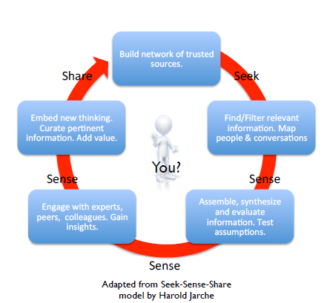
What PKM can look like
KNOWLEDGE WORKERS ALL DO KM!
Notes:
Trainers notes
Link with last slide: here is an example of what PKM looks like.
Make the parallel with the similar cycle of KM in an organisation or project. We have our own personal KM system in place.

Slide 33
Questions? Comments?

Slide 34

Group work – my role in KM
In table groups, reflect and share with each other:
  1. “What are some of my good PKM practices?” and 2. “What could I improve?” – write on cards and discuss, 20 minutes
Share “popcorn style” in plenary – 10 minutes
Notes:
Trainers notes
See Unit 1 Exercise notes.

Slide 35
Credits
This learning material was prepared by Lucie Lamoureux for CTA.
The Technical Centre for Agricultural and Rural Cooperation (CTA) is a joint international institution of the African, Caribbean and Pacific (ACP) Group of States and the European Union (EU). CTA operates under the framework of the Cotonou Agreement and is funded by the EU. For more information on CTA, visit www.cta.int
Disclaimer
This work has been made with the financial assistance of CTA. However, it remains under the sole responsibility of its author and never reflects CTA's nor the European Union's opinions or statements whatsoever. The user should make his/her own evaluation as to the appropriateness of any statements, argumentations, experimental technique or methods as described herein.
Copyright notice
Reproduction and the dissemination of these modules and supporting materials is encouraged under the terms of the Creative Commons Attribution License (https://creativecommons.org/licenses/by/4.0/legalcode), provided that appropriate acknowledgement is made:
  – of CTA's copyright, in accordance with the license Creative Commons 4.0, by including the name and the title of the article or chapter,
  – and that CTA's or the EU's endorsement of authors' views, products or services is not implied in any way, by including the disclaimer.
March 2015

