Slide 1
Sustainable livestock opportunities and future food system realities
[the role of meat/animals in social/economic/culture especially global South]
International Meat Summit: The Societal Role of Meat – what science says
Dublin, Ireland
19, 20 October 2022
Shirley Tarawali
Assistant Director General, International Livestock Research Institute

Slide 2
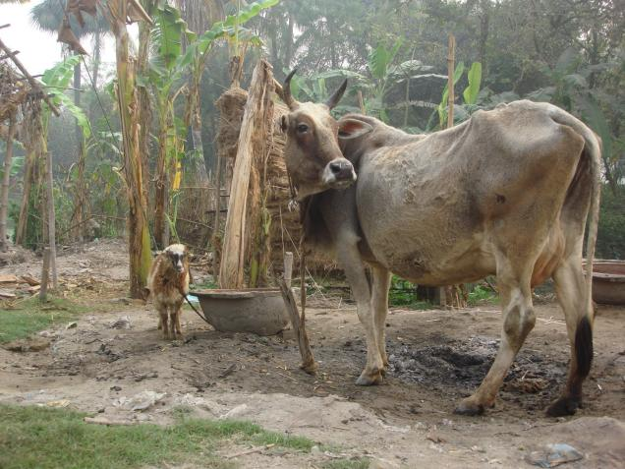
Overview
Context matters
Foods, Jobs, Incomes
Assets, Insurance, Education
Culture, Gender, Economies
Connections, Trade-offs, Synergies
In summary
Notes:
The livestock context, not the livestock interventions, is what is most decisive in the success or failure of livestock development work

Slide 3
Context matters
Notes:
https://www.fao.org/rural-employment/agricultural-sub-sectors/livestock/en/
1.3 billion of 7.5 billion – 1 in 6 …about. Population nears 8 billion now though.

Slide 4
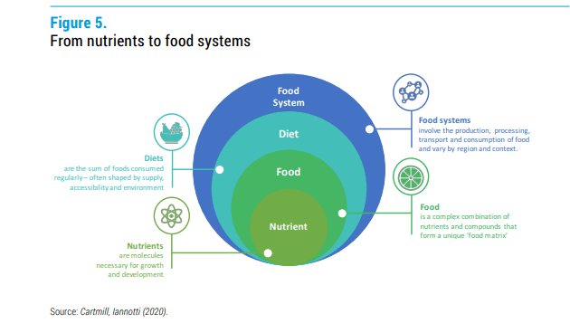
Environment
Health and nutrition
Integral to lives and livelihoods
Greater differences HIC to LMIC
Distant from the supermarket shelf
Lots of food choice
vs
Little food choice
Little dispute…..
Source: Modified from Cartmill, Iannotti, 2020; republished in UN Nutrition Discussion Paper (2021) Livestock-derived foods and sustainable healthy diets.

Slide 5
Terms often used – but not equivalent
Meat
Animals
≠
Meat
Beef
≠
Meat
Protein
≠
‘sustainable diet’
Only GHGs
≠
Intensification
Industrialisation
≠

Slide 6
Where’s the cattle? Where’s the beef?
Just 20% of all meat produced in the world in 2020 was beef
Source: figures from FAOSTAT

Slide 7
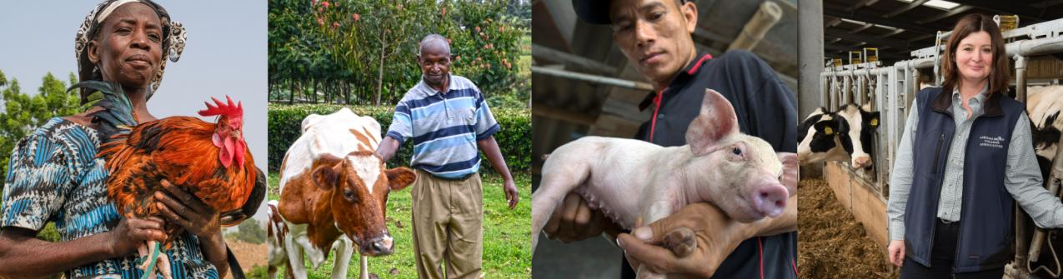
One in six people on the planet derive a livelihood benefit from livestock

Slide 8
Foods, Jobs, Incomes
Notes:
https://www.fao.org/rural-employment/agricultural-sub-sectors/livestock/en/
1.3 billion of 7.5 billion – 1 in 6 …about. Population nears 8 billion now though.

Slide 9
Demand for food
will keep growing,
especially in LMICs
Demand for milk, meat, eggs is increasing fastest in LMICs, driven by rising populations, incomes and urbanization
Most people in LMICs will still not over-consume these foods but increasing attention should be paid to the double burden of malnourishment and over-consumption
70% of livestock-derived foods consumed in LMICs are sourced in informal markets
Percentage changes in demand 2010 to 2030
Projections based on IMPACT model, Dolapo Enahoro (ILRI)
South-Eastern = SE Asia

Slide 10
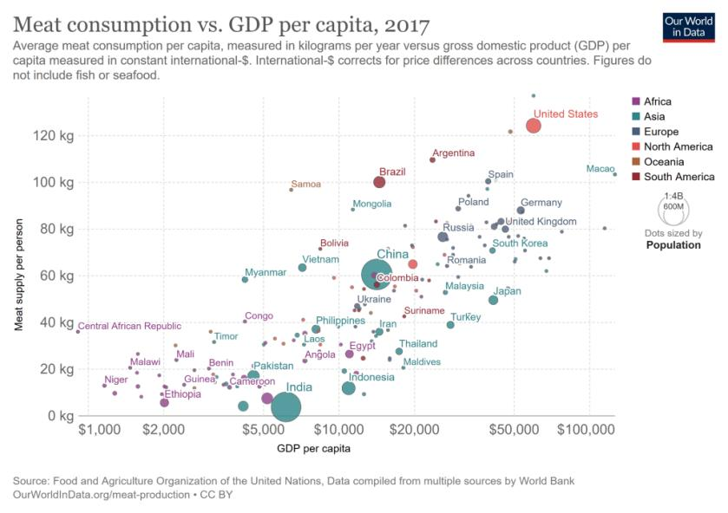
As people get richer, they consume more meat

Slide 11
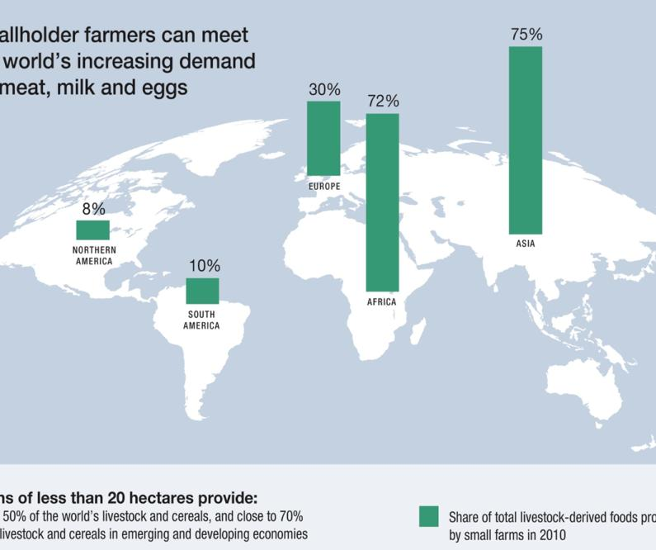
Smallholder farmers (<20ha) currently provide most of the meat, milk and eggs AND most of the staple cereals in LMICs
Share of total livestock-derived foods produced by small farms in 2010
1.7 billion people derive some livelihood from livestock; over half a billion depend on livestock livelihoods
Livestock are fundamental to many economies, providing incomes & jobs as well as food & insurance against shocks
Livestock make small farming sustainable and make growing food crops possible across the Global South.
These ‘mixed crop-livestock farms’ are the circular bioeconomy in action!
Farms of less than 20 hectares provide:
Nearly 50% of the world’s livestock and cereals, and close to 70% of the livestock and cereals in emerging and developing economies
Source: Options for the Livestock Sector in Developing and Emerging Economies
to 2030 and Beyond. World Economic Forum White Paper January 2019

Slide 12
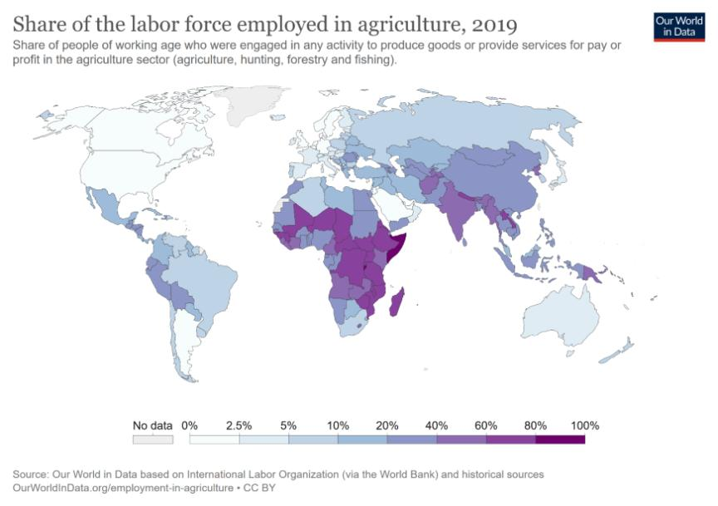
Agriculture dominates employment in LMICs

Slide 13
Quantity and quality of employment in the livestock sector differs between higher and lower income countries
Most livestock sector jobs in HICs are formal (salaried) jobs in livestock processing, retail and trade rather than on farms
Total population
Many livestock sector jobs in LMICs are informal (unsalaried) jobs raising animals on farms & rangelands with some (local) processing of their products
Source: Calculated from World Development Indicators and other sources, www.databank.worldbank.org

Slide 14
How livestock investments improve livelihoods in LMICs
A comprehensive quantitative assessment of livestock investments shows that
Livestock transfers to poor people (e.g. ‘passing on the gift’ projects)
Enhancing livestock markets
Strengthening the resilience of livestock-keeping communities
Incomes
Assets and savings
Insurance/risk reduction
Gender equality
generated lasting benefits in all four of these dimensions of livestock livelihoods
Source: Staal, S., Wanyoike, F. and Ballantyne, P. 2020. Impacts of livestock development investment. Documented positive
Impacts of livestock-related interventions in Africa, Asia and Latin America. Nairobi, Kenya: ILRI.

Slide 15


Slide 16
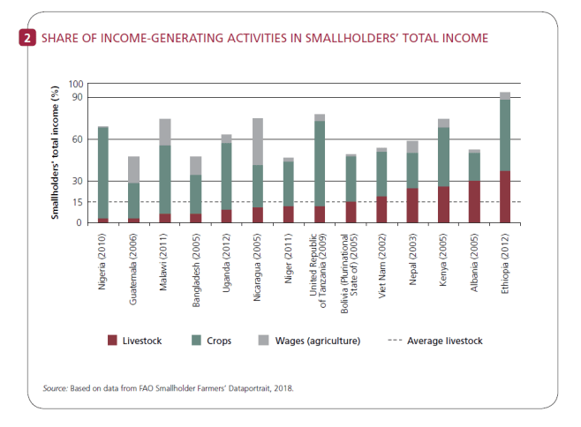
Livestock contribute significantly to smallholder incomes
Across 12 LICs, livestock contributions
to household incomes in 2011 were:
12% on average (2–24% range)
Across 14 LMICs, livestock contributions to household incomes in 2018 were:
15% on average
With a range of highs in Ethiopia (37%), Albania (28%) and Kenya (25%) and lows in Guatemala (3%) and Nigeria (3%)
In pastoral systems, livestock income makes up at least 40% of household incomes
Otte, Joachim et al; https://documents.worldbank.org/curated/en/101271468151472539/Livestock-assets-livestock-income-and-rural-households-cross-country-evidence-from-household-surveys; and FAO. 2018. World Livestock: Transforming the livestock sector through the Sustainable Development Goals. Rome. 222 pp. Licence: CC BY-NC-SA 3.0 IGO.
Notes:
Otte, Joachim;Pica-Ciamarra, Ugo;Tasciotti,Luca;Zezza,Alberto;
Livestock assets, livestock income and rural households : cross-country evidence from household surveys (English). Washington, D.C. : World Bank Group. https://documents.worldbank.org/curated/en/101271468151472539/Livestock-assets-livestock-income-and-rural-households-cross-country-evidence-from-household-surveys
FAO. 2018. World Livestock: Transforming the livestock sector through the Sustainable Development Goals. Rome.
222 pp. Licence: CC BY-NC-SA 3.0 IGO.

Slide 17
Livestock investments improve livelihoods in LMICs
Livestock transfers (‘passing on the gift’ projects)
Increased household incomes in Zambia by 20% over 18 months and by 59% over 42 months
Increased incomes in 6 LMICs by 5%, and livestock revenue by 13%
Increased household dairy income in Rwanda (via a ‘One cow per poor family’ initiative) by 3–6 times
Reduced the number of households living below the poverty line (all studies)
Market-based interventions
Doubled household incomes in Ethiopia via cattle fattening and in Nepal via goat value chains
Increased returns from milk in Kenya via improved dairy hubs by 45% and household incomes by 17%
Strengthened resilience
Livestock-insured pastoral households in Kenya and Ethiopia proved more resilient to drought than non-insured families
Household welfare in Kenya and Pakistan was improved
Households in Tajikistan increased their incomes (about USD300/year) via pasture/fodder interventions
Households in Bangladesh, even the poorest, increased their income via poultry interventions by an average of 49%

Slide 18
Assets, Insurance, Education
Notes:
https://www.fao.org/rural-employment/agricultural-sub-sectors/livestock/en/
1.3 billion of 7.5 billion – 1 in 6 …about. Population nears 8 billion now though.

Slide 19
Livestock investments increase assets & savings in LMICs
Increased asset accumulation (by 125% in Zambia)
Fewer households falling into poverty (Bolivia and Zambia)
9% increased assets, 14% increased savings (across 6 LICs)
14% more assets and 8% more types of assets (Rwanda’s ‘One cow per poor family’ initiative)
Greater savings (in Bangladesh poultry project)
Animal assets are used to:
Prevent families from descending into poverty
Enable families to ‘step out’ of poverty

Slide 20
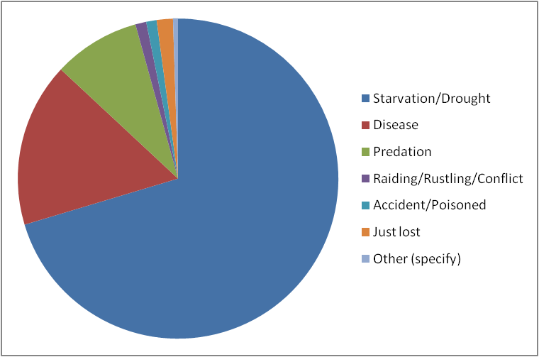
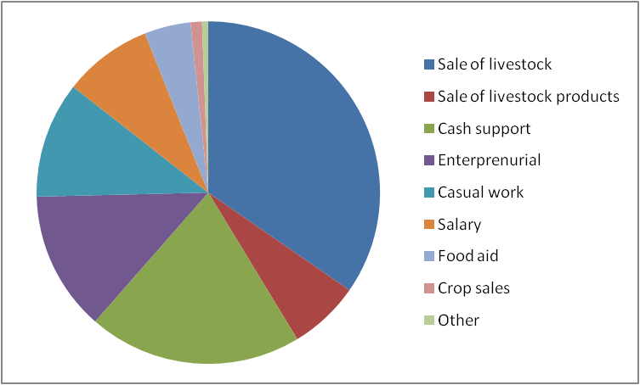
Impacts of Kenya drought on pastoralist livestock assets
Cause of Livestock Mortality
Component Shares of Income
Drought is by far the leading cause of livestock deaths
Disease and predation are likely directly related to drought
Sales of livestock and livestock products constitute 40% of household income
External support (food and cash) makes up nearly 25% of household income
Livestock make up a large share (median 100%, mean 49%) of the productive assets of herders
Notes:
20
Data source: Project baseline 2009 (924 Marsabit Households)

Slide 21
Livestock help insure pastoralist households against shocks
In Niger, most households (60%)n rely on sales of animals to cope with food shortages or unexpected medical expenditures
In Kenya, pastoralist households covered by index-based livestock insurance (IBLI):
were less likely (by 36%) to be forced into distress sales of stock
were less likely (by 25%) to have to reduce the size of their meals
were less dependent (33%) on food aid
Alary V., et al., 2011. Livestock's contribution to poverty alleviation : How to measure it? http://dx.doi.org/10.1016/j.worlddev.2011.02.008
Notes:
Alary, V., Corniaux, C. and Gautier, D. (2011) Livestock’s Contribution to Poverty Alleviation:
How to Measure It? World Development,

Slide 22
Livestock help families to nourish and educate their children
Directly
Livestock-derived milk, meat and eggs are essential for the physical and cognitive development of infants and children—improving their ability both to grow and to learn
Livestock investments can increase the diversity of low-quality diets in poor households, providing essential nutrients and balanced nutrition for all, particularly for vulnerable mothers and children
Indirectly
Livestock sales and incomes enable up to 40% of LMIC households to pay for the education of their children (school fees, books, uniforms)
Negative: when children are involved in labour for livestock
[opportunities for youth?]
Notes:
FAO. 2018. World Livestock: Transforming the livestock sector through the Sustainable Development Goals. Rome.
222 pp. Licence: CC BY-NC-SA 3.0 IGO.
Vella, V., Tomkins, A., Nviku, J. and Marshall, T. (1995) Determinants of nutritional status in
southwest Uganda. Journal of Tropical Pediatrics, 41 (2), pp.89–98. Vella et al. (1995) find that
ownership of a cow is a significant predictor of height for age status in children in south-western
Uganda, even after controlling for other indicators of economic status (for example, occupation,
land owned, years of education).

Slide 23
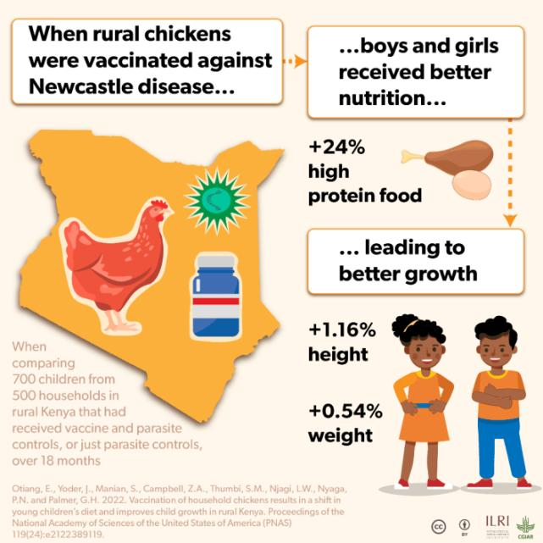
Rural livestock services can directly improve the nutrition of both girls and boys

Slide 24
Culture, Gender, Economies
Notes:
https://www.fao.org/rural-employment/agricultural-sub-sectors/livestock/en/
1.3 billion of 7.5 billion – 1 in 6 …about. Population nears 8 billion now though.

Slide 25
Livestock serve multiple socio-cultural roles in every society………..imagine the world without livestock
Without livestock dowries, many women (in Asia) and men (in Africa) cannot marry—or even think about marrying
Without livestock manure and traction, many farmers cannot grow food or transport it to market
Without milk, meat and eggs, many are unable to nourish their children, to celebrate feast days or to mourn with their communities the passing of a loved one
Without turkey….no Christmas or Thanksgiving feast
Without livestock, no rodeos in US; no Nadam in Mongolia……

Slide 26
Women impact livestock food systems : livestock impact women
Most livestock in LMICs are raised by women, especially in rural areas, where two-thirds of livestock keepers are women
Animals are often the only productive asset that women are allowed to own and manage
Farm animals are instrumental to women’s fundamental roles in household affairs, not only in nutrition and livelihoods but also in managing household risks and the family’s medical care, in educating the children and in tending the sick and elderly . . . .

Slide 27
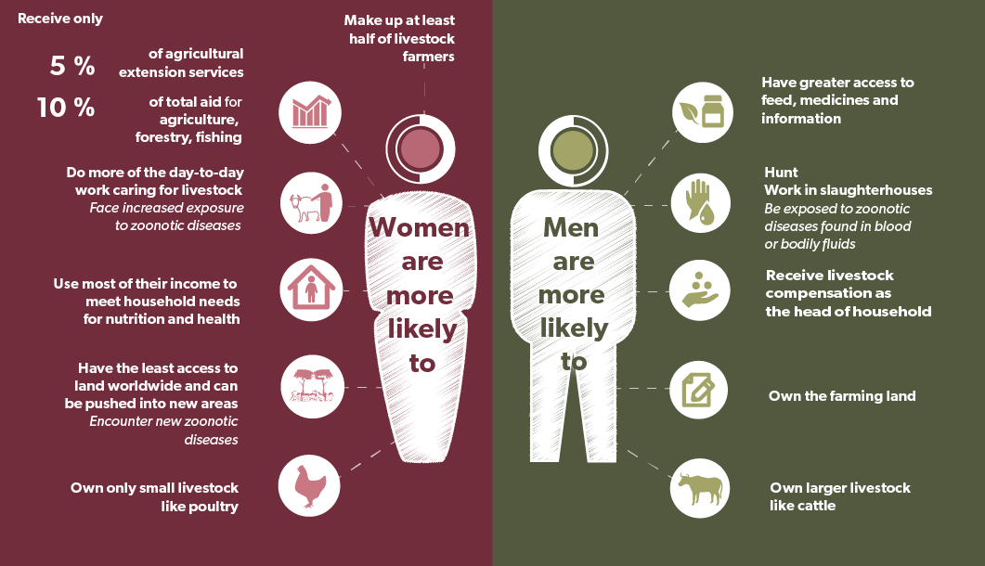
In LMICs…
For most women in HICs, engagement in livestock enterprises is an option
For most women in LMICs,
engagement in livestock enterprises is a necessity
Women’s empowerment leads to healthier people, animals and environment. Livestock Pathways to 2030: One Health Brief 7. ILRI, 2021.

Slide 28
Livestock contributes significantly to agricultural GDP—everywhere
Livestock contributions to agricultural GDP:
Global average: 40%
HIC average: 50%
LMIC average: from 15–80%—and this is growing
As economies grow, the proportion of:
agriculture’s contribution to total GDP shrinks
livestock’s contribution to agGDP rises
And this is notwithstanding that GDP measures exclude many ‘hard-to-measure’ livestock functions (e.g. manure fertilizer, ecosystem services)
Salmon, G. 2018. Fact Check 2: Livestock and Economy. Does the livestock sector make up 40% of total agricultural GDP globally? http://hdl.handle.net/1842/30115

Slide 29
Connections, Trade-offs, Synergies

Slide 30
Nourishing diets
and good health
Social, economic,
and cultural
well-being
Productive and sustainable environments
Livestock livelihoods - social, economic and cultural well-being impact on and are impacted by other dimensions of sustainability
Healthy, nutritious foods
Well-nourished, healthy
Income for a diverse diet
Fit, strong, educated workforce
Livestock
Income, assets, education
Capital to contribute to sustainable production

Slide 31
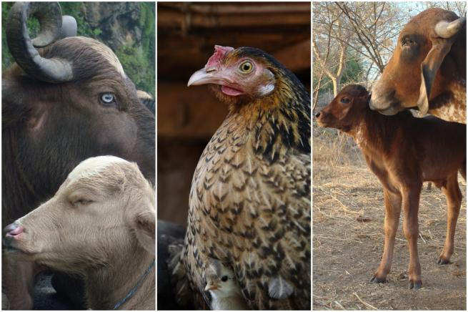
Livestock livelihood connections are often hidden from view
Livestock matters are often bundled within ‘agriculture’
Livestock’s manifold connections to livelihoods, cultures and
societies are hard to measure,
meaning there is little quantitative evidence

Slide 32
Livestock livelihood connections need greater exploration
Livestock are just as intimately connected with people’s livelihoods, cultures and societies as they are with the better-studied (easier to measure?) health, food, nutrition, environment and economic sectors
Important that potential trade-offs as well as synergies are analysed and addressed—
- to jump on emerging opportunities
and
- to avoid unintended consequences

Slide 33
In summary

Slide 34
Multiple pathways will take us to
sustainable and equitable livestock futures
Where and how we step onto those pathways
will differ according to our different contexts
Affordable, accessible, balanced, nutritious diets incl. the choice of milk, meat, eggs
Healthy animals, safe food, healthy people
Every citizen & nation is able to benefit fully from sustainable livestock systems
Inclusive, fair and equitable livestock development
Efficient, low-carbon livestock systems that enhance, not harm, environments
A healthy planet, with rich biodiversity and sustainable water use

Slide 35
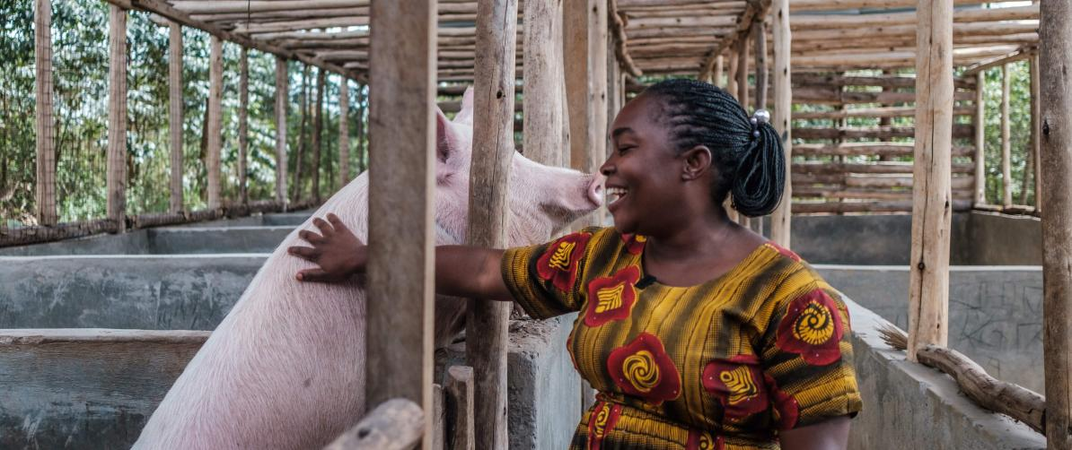
THANK YOU
Thank you!

