Slide 1


Gender and Climate Smart Agriculture:
Co-creating a Learning Agenda
Identifying Effective Communication Products and Strategies
5-6th April
ILRI, Nairobi, Kenya
https://gender.cgiar.org/

Slide 2

Identifying Effective Communication Products and Strategies

Slide 3
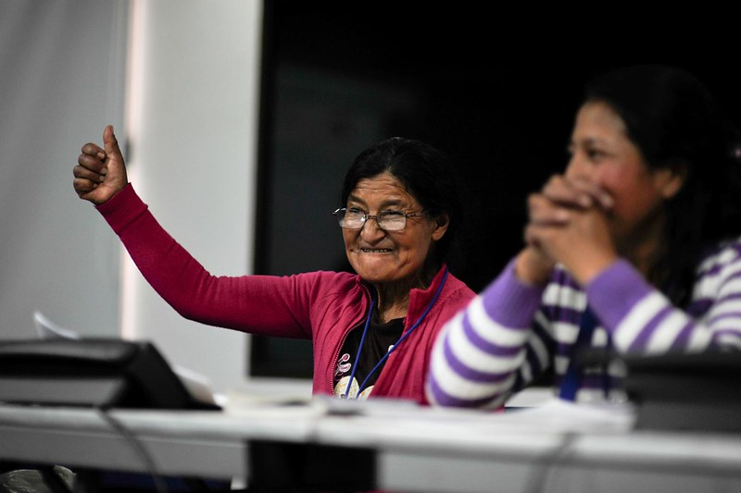
Audiences and messages
Who needs to know?
Why should they care?
What do we want them to do differently?
Notes:
This is about communicating the learning agenda – letting people know what questions to answer and what questions to stop investigating

Slide 4

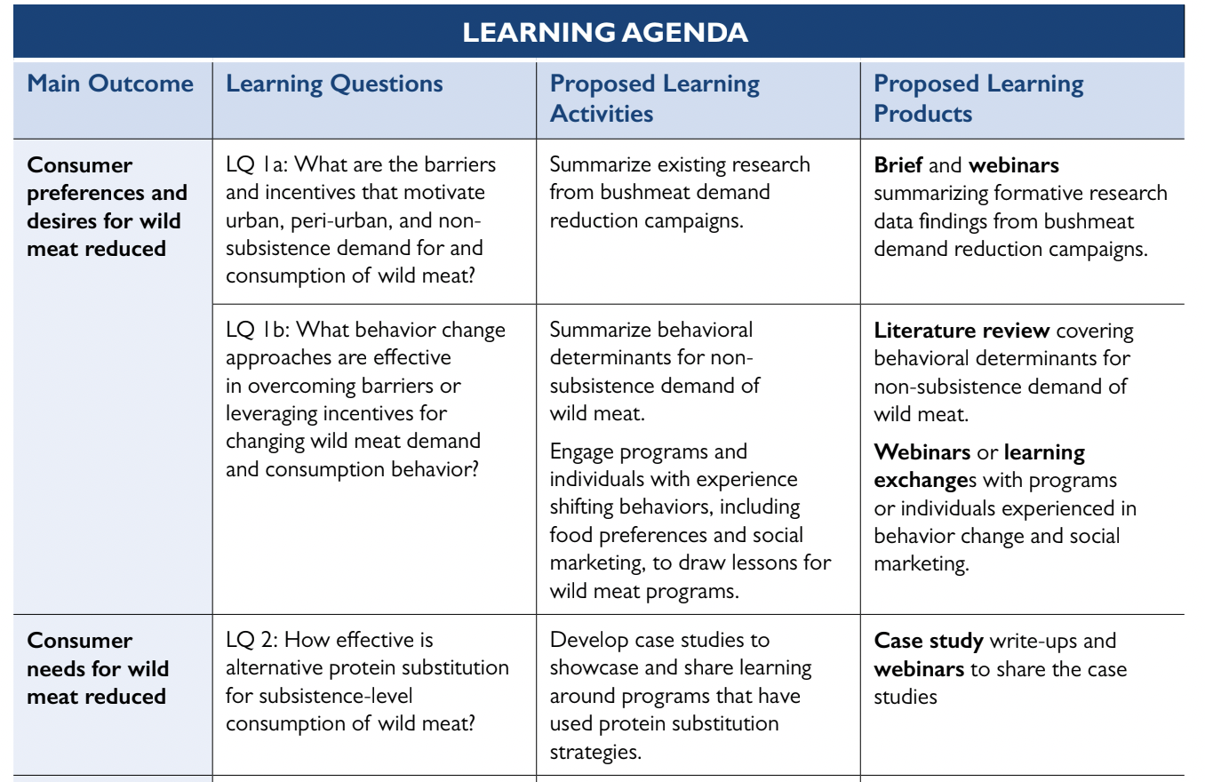
Examples of products and strategies
https://dev.biodiversitylinks.org/learning-evidence/wild-meat-collaborative-learning-group/learning-agenda

Slide 5
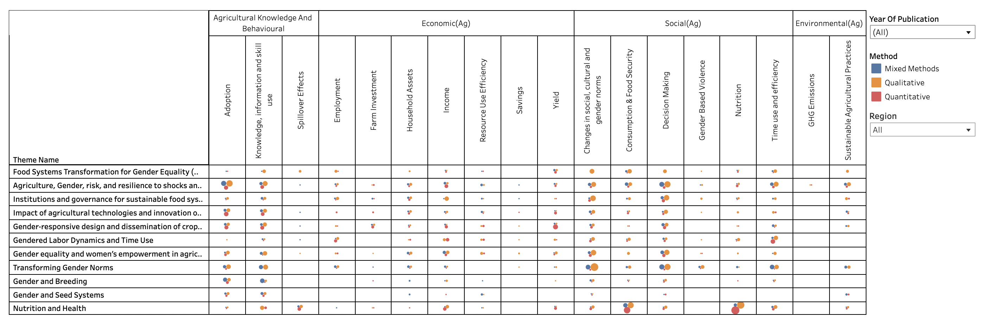
Examples of products and strategies
https://gender.cgiar.org/news-events/mapping-evidence-needed-advance-gender-equality-agriculture-and-food-systems

Slide 6
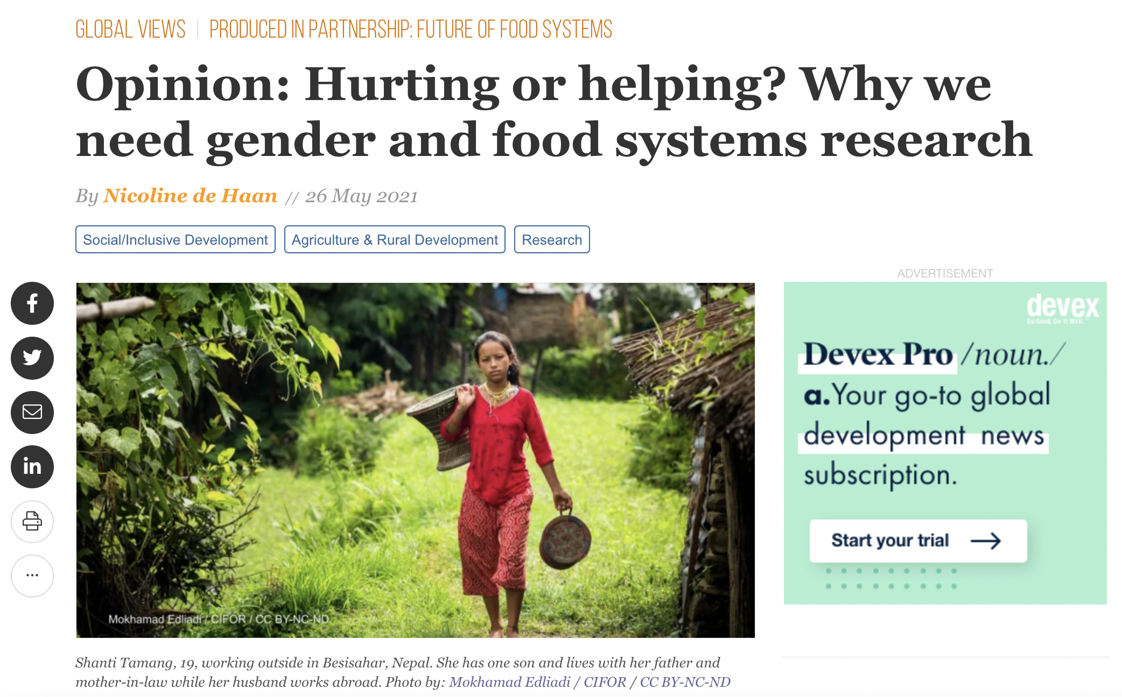
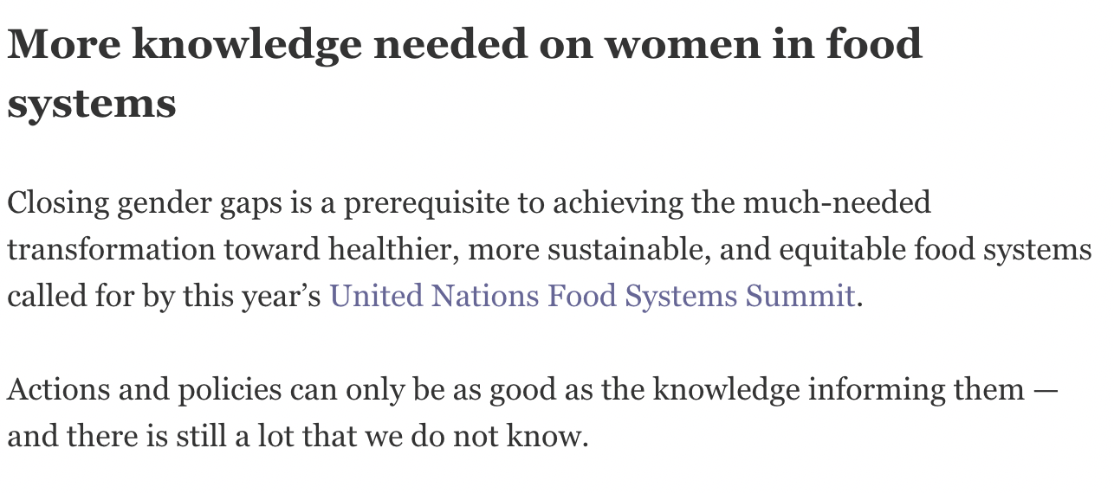
Examples of products and strategies
https://www.devex.com/news/opinion-hurting-or-helping-why-we-need-gender-and-food-systems-research-99922

Slide 7

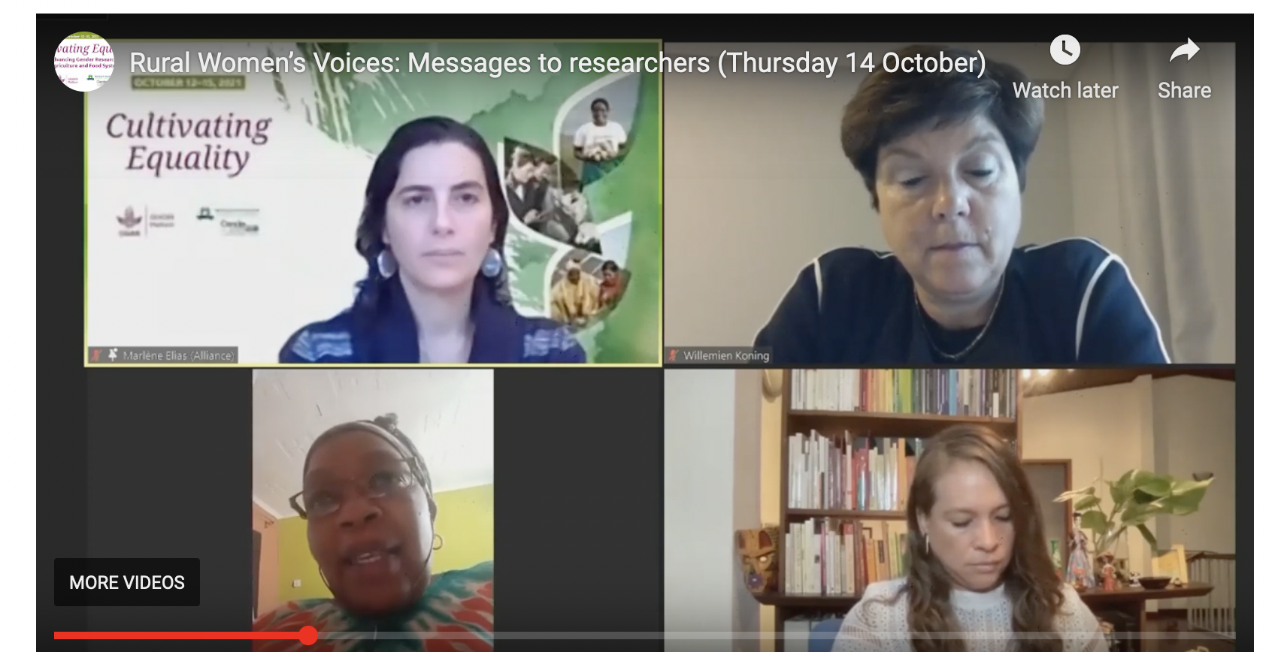
Examples of products and strategies
https://gender.cgiar.org/conferences/cultivating-equality-2021-conference

Slide 8
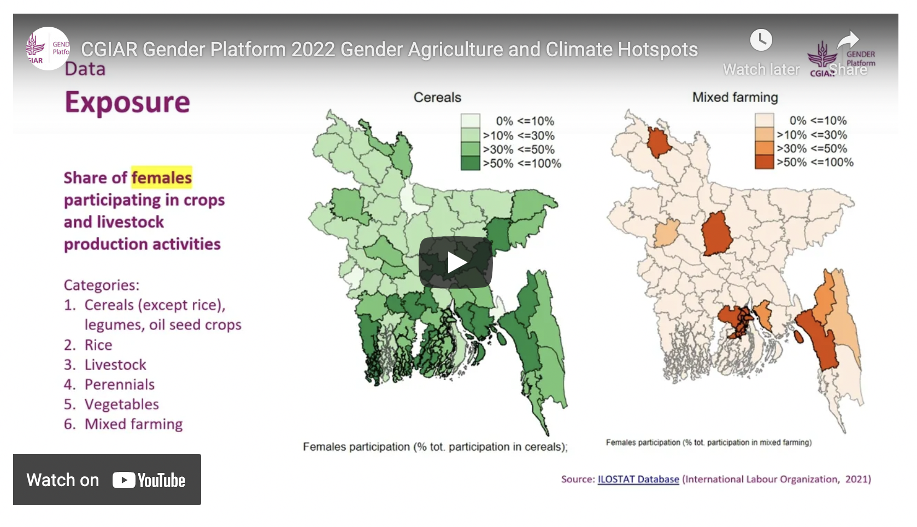
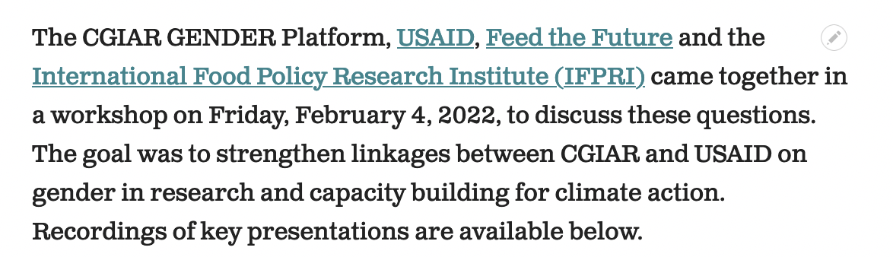
Examples of products and strategies
https://gender.cgiar.org/news-events/new-evidence-and-key-priorities-gender-and-climate-research

Slide 9
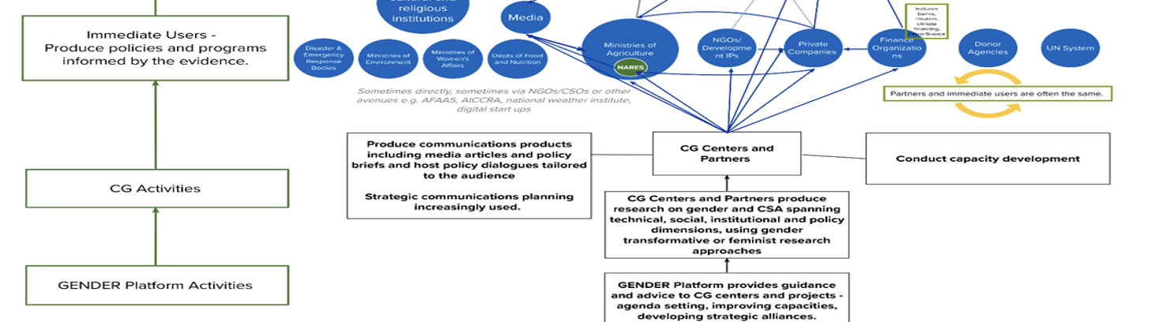
Audiences
Grouped, direct audiences for Learning Agenda
CGIAR+ (universities, advanced research centers)
R4D community+ (donors, UN system, bilateral orgs, private sector, foundations)
Public sector (regional bodies, NGOs, Gov’ts, NARS, ministries)
Notes:
Prioritizing them
Anything missing?
Specific target audiences

Slide 10
Break-out groups
Group 1:
CGIAR+ (universities, advanced research centers)
Group 2:
R4D community+ (donors, UN system, bilateral orgs, private sector, foundations)
Group 3:
Public sector (regional bodies, NGOs, Gov’ts, NARS, ministries)
Answer 4 questions: (40 min)
  Who are the 5-7 specific, top priority audiences in our group (e.g., IFAD, USAID…)
  Why should these audiences care about our learning agenda?
  How can we best reach them?
  What do we want them to change?
Report back from break-out groups (plenary, 20 min)

Slide 11
Report back: Group 1 (CGIAR+)
Top audiences CGIAR initiatives NARS (KARLO, NARO, ZARI, ICAR) Universities (Makerere) Independent research institutions (e.g., South Africa) Donors (World Bank) ASARECA, CARDESA, FARA, CORAF | Why they should care Inform future/ongoing initiatives Building/sourcing partnerships Demand-driven breeding work Remaining relevant Capacity building, curriculum development Uptake of innovative research, tech, R4D Guiding portfolio and research priorities Influencing ag policy
How to reach them Initiatives: GRCs, initiative leads, comms ToCs, webinars, gender strategies NARS: trainings, workshops, partnerships, briefs, brochures, booklets, agricultural fairs, research and science fairs Unis: MoUs, internships, mentorship, CapDev, exchange programs, guest lecturers, videos Donors: briefs, infographics, success stories | What should they change Initiatives: be partners in the learning agenda NARS: budget priority for gender work and innovations Unis: increase capacity in gender and climate Donors: greater investments

Slide 12
Report back: Group 2 (R4D community)
Top audiences BMGF FAO/IFAD WB/ADB/AfDB Bayer/Twiga Food Rockefeller Foundation CARE/Intl Rivers WOCAN Amul (dairy co-op) AGRA | Why they should care Investment decisions Inform programs and priorities Regional/global investments and priorities CSR+ESG/sustainable business Impact and investment decisions Impacts and knowledge Sustainable production, livelihoods resilience Knowledge, impact, evidence, priorities
How to reach them Briefs Targeted ppts Webinars Roundtables Workshops, dialogues | What should they do differently Fund gender and climate research Partner Update strategies and programs

Slide 13
Report back: Group 3 (Public sector)
Top audiences AU, AGRA, ASARECA, FARA, CORAF, ASEAN CARE RUFORUM CRS MercyCorps AGNES Governments and ministries | Why they should care Scaling, effective resource use, informing curricula/education, addressing youth bulge, NDCs, climate security, addressing migration, disaster response, strategic program design, policy design, gender action plan, alignment with existing institutional policies (e.g., of AGRA)
How to reach them Targeted webinars, F2F meetings Co-writing blog posts Connecting w individuals, relationship building, influencing ministers Websites/subsite w info Inviting to CGIAR meetings Providing tech input to AGNES meetings/policy brief series, COP27 side event Policy notes and briefs Op-eds | What should they do differently Build on existing resources Scaling impacts/successes Collecting data on gender and climate, gender disintegrated data Using better indicators Mainstream gender into national policies and action plans Mobilize for climate action

