Slide 1


Unleashing the Power of Data in Transforming Livestock Agriculture in Ethiopia
27 Annual Conference of the Ethiopian Society of Animal Production (ESAP)
EIAR, Addis Ababa, 29–31 August 2019
Fasil Getachew Kebede Graduate Fellow-ILRI/WUR
Setegn Worku Scientist-ILRI
Wondmeneh Esatu Research Officer-ILRI
Tadelle Dessie Principal Scientist-ILRI/Adjunct Professor-BDU

Slide 2
Outline
‘Small’ and ‘Big’ data
Data, Information, Knowledge, Wisdom progression
Data in livestock agriculture
Limitations on utilizing data
Conclusion

Slide 3
Our philosophy …
Substantial investment in data & digitalization is a necessity to transform Ethiopian livestock agriculture:
Transformed livestock agriculture:
Integration with other sectors- in the domestic & international economy
Shift from subsistence-oriented to specialized production
Higher contribution to the GDP

Slide 4
‘Small Data’ (SD): datasets small enough for human comprehension
Useful for finding causation, the reason why
Accessible, understandable, actionable in the present
e.g. daily milk production records on a spreadsheet

Slide 5
‘Big Data’ (BD): high-volume, high-velocity, high-variety information assets that demand cost-effective process automation
Examine the past, present & future
Lead to cost reductions & new product development
e.g. -Data on animal products consumption behavior
-Genomic + geo-spatial data + phenotypes

Slide 6
Big data characteristics:
Volume: requiring large disk storage & processing
Velocity: streaming at unprecedented speed- in near-real time
Variety: coming in all types of formats: structured numeric data, unstructured texts, emails, video, audio, etc.
Variability: inconsistent peak data loads
Complexity: coming from multiple sources

Slide 7
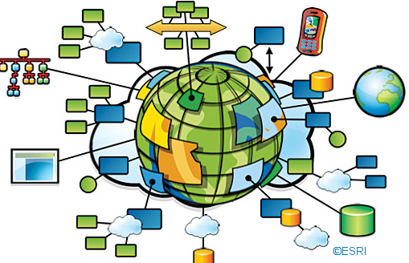
‘Small’ and ‘big’ data
Research and academic institutions
Input suppliers
Service providers
Livestock farms
Ministries, agencies
Donors/NGOs
Traders
Social networking websites
Mobile phones
GIS applications
Sensors
Etc.

Slide 8
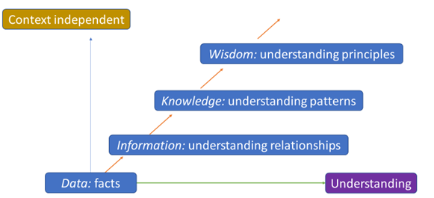
Data, information, knowledge, wisdom (DIKW) progression

Slide 9
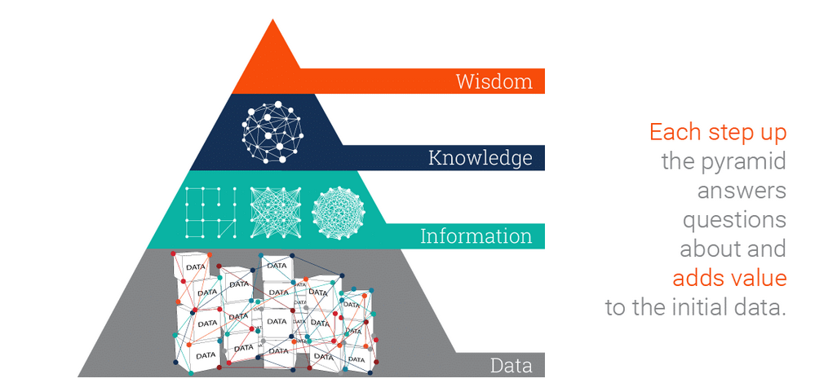
DIKW pyramid

Slide 10
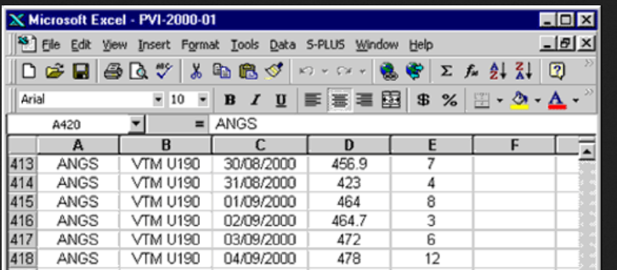
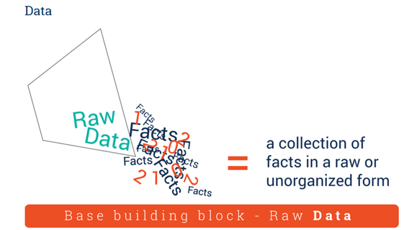
Data: an item or event out of context, with no relation to other things
e.g. live-body-weight of chickens on Excel (which strain, age, context?)

Slide 11

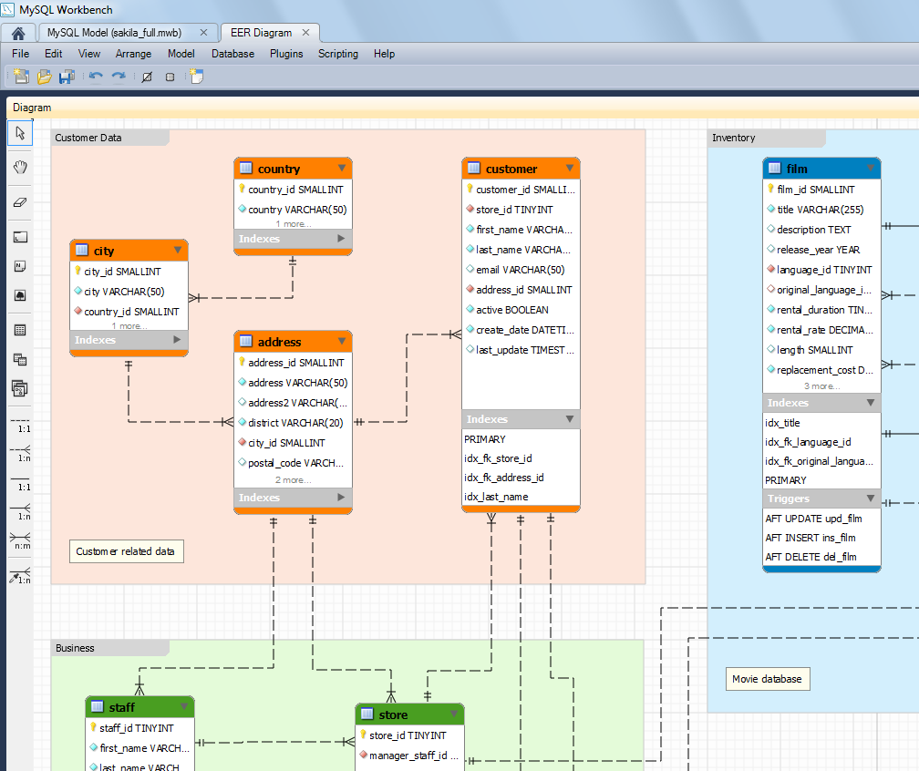
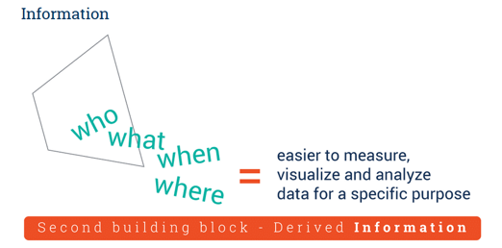
Information: understanding of the relationships
e.g. live-body-weight of chickens across breeds & environments

Slide 12
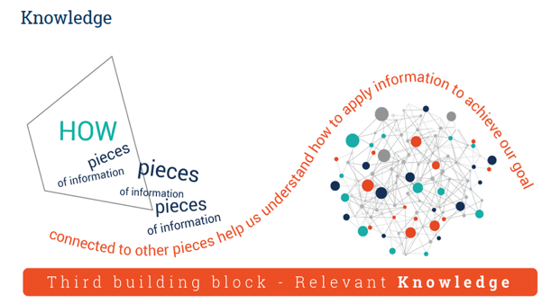
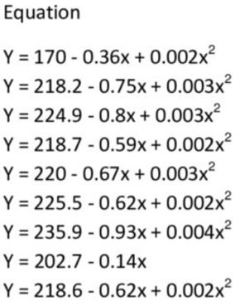
Knowledge: understanding of patterns with high level of predictability
e.g. live-body weight in dual-purpose chicken breeds increases by 20% under optimal conditions (i.e. from modeling, simulation, etc.)

Slide 13
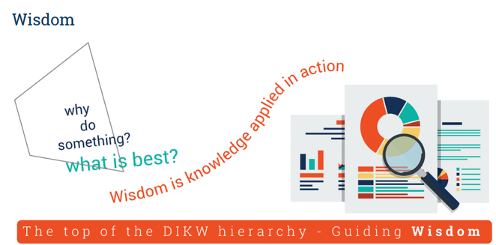
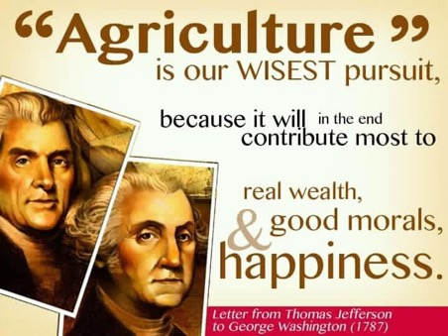
Wisdom: philosophical probing of principles driving a system –the moral, ethical codes, etc. governing livestock agriculture
e.g. What is the ‘best’ chicken breed for Ethiopia?
Linked with enhanced insight
Allows strategic decision making

Slide 14
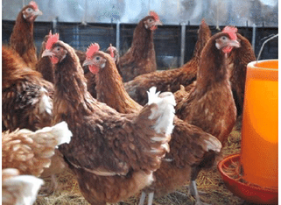
I. Data in livestock genetics and breeding
Attempts on selective breeding of Ethiopia livestock
e.g. Sheep (Menze, Washera, Bonga); chicken (Horro)
Improved Horro chickens (G6) on mass selection:
Egg production at 45-weeks-of-age: 35 80 (128%)
Body weight-at-16-weeks: 621 1215 grams (95.6%)
More data(pedigree, genomic information)
Higher genetic gain (better accuracy of selection)

Slide 15





Animal identification, recording, evaluation and data management should be planned and executed in line with the global standard for livestock data recording (https://www.icar.org/)
The National Animal Genetic Improvement Institute (NAGII) plays key roles.

Slide 16
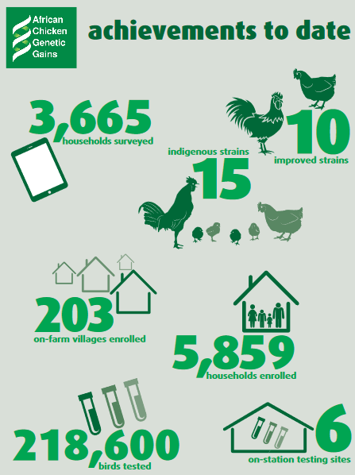
African Chickens Genetic Gains (ACGG)
ACGG (2015-2019) is a platform for testing chicken strains for adaptation, egg and meat production performance & likability in Ethiopia, Nigeria, & Tanzania

Slide 17
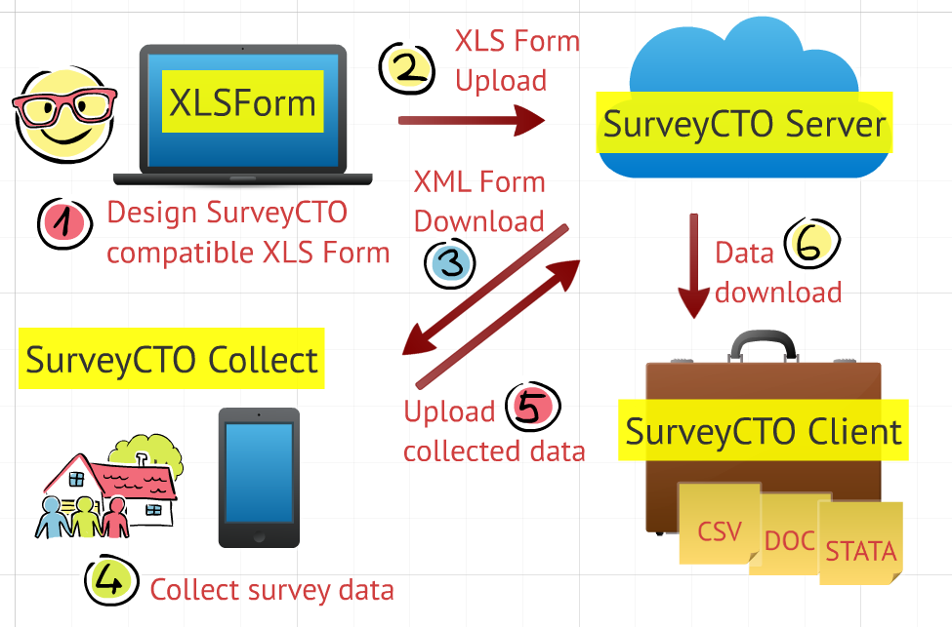
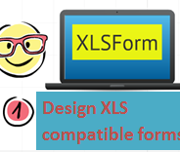
ODK Data Collection & Processing
2
ILRI Cloud Servers
Aggregation Server
MySQL Server
1
Design XLS compatible forms
6
3
Download json data
8
ODK Collect
MySQL Upload
5
MySQL
Data Users
7
Processing json data files to MySQL
4
Notes:
Helped with a SurveyCTO –based architecture
Advantages: Centralized architecture, Data accessible, avoided storing data on local computers

Slide 18
ACGG interactive dashboard:
Performance test results presented on the web in one click
Plots updated automatically with new data
The app is scalable to similar projects
https://setegn.shinyapps.io/Ethiopia/
https://setegnworku.shinyapps.io/Ethiopiaonstation/

Slide 19
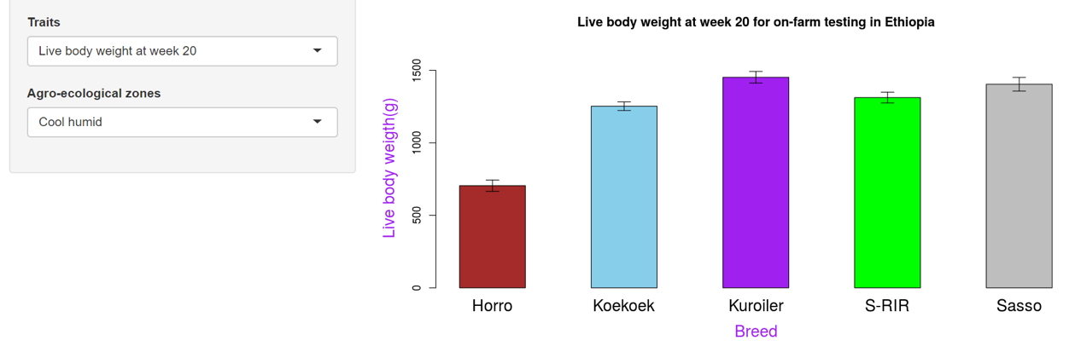
ACGG web presentation on male chicken live-body-weight(on-farm)
https://setegn.shinyapps.io/Ethiopia/

Slide 20










Tropical Poultry Genetic Solutions (TPGS): 2019-2023
Tropical Poultry mortality and inefficiency
Tropical poultry adaptability and productivity
ILRI and CGIAR Crosscutting Programs and Platforms such as policies, Gender, Livestock Master Plans, Capacity Development, & Feed
Hendrix Genetics, World Poultry Foundation, AMO farms & others focused on product development & introduction
CTLGH & Other Centers of Excellence in Poultry Genetics
NARS, local companies, and institutions involved in poultry R&D
ILRI (a CGIAR centre dedicated to research & development of innovative tropical poultry genetic solutions)
TPGS (ILRI partnerships with NARs, WPF, Hendrix Genetics, Amo Farms, & Other Poultry Companies in Africa and Asia)
Genomic Selection and Gene Discovery
Multiplication and Market Development Support
  Output: Identify, define, & characterize (phenotypic & genetic parameter estimation) economically-relevant tropical poultry productivity, adaptability, & resilience traits
  Output: Partner with NARs and companies & facilitate efforts to build database of tropical poultry phenotypes & genotypes
  Output: Deliver genomic and precision breeding tools to accelerate genetic gain in dual purpose poultry products development
  Output: Partner with NARs, private companies, & others to evaluate & register new tropical poultry technologies
  Output: Facilitate scaled adoption and support partner efforts to help close key gaps for impact
Discovery & Translational Research
Phenotyping and Genotyping
Technology Evaluation and Approval
Project Scope:
Identify & define tropical poultry adaptation and resilience traits, & estimate phenotypic and genetic parameters needed for genetic improvement
Work with breeding companies & NARs to develop, test, and introduce better-performing dual-purpose poultry lines through long-term genetic gains
Facilitate phenotyping & genomic selection of alternative combinations of lines that make up the different breeds for use in different agro-ecologies
Results:
Topical poultry adaptation and resilience traits identified & defined, & phenotypic & genetic parameters estimated
Crossbreed & hybrid tropical poultry lines that are more productive and better fit across multiple geographies
Increased adaptability, resilience, & productivity of tropical poultry breeds
Risks/challenges:
No clear definition of roles and responsibilities of partners.
Regulatory impediments to movement of genetic materials between countries
-high disease burden, including
Avian Influenza; Loss of biodiversity
3. Inability to attract qualified staff & adequate funding over projected period
CTLGH & Other Centers of Excellence in Poultry Genetics
AMO Farms
Hendrix
Genetics

Slide 21
II. Data in livestock conservation
Phenotypic and molecular data increasingly available on many livestock species
Set in situ and ex situ conservation priorities on (threat status, breed merits & contributions to genetic diversity)
-strategic conservation utilizing BD saves resources
EBI (preservation of tissue samples, establish databases)

Slide 22
III. Data in livestock marketing & production
Ecommerce opportunities (e.g. payments)
Financial services (e.g. insurance, credit facilities)
Product tracing (e.g. quality)
Information delivery (e.g. AI, vaccination, management)
Record keeping (e.g. milk production, breeding)
Study consumer behavior
Improve agri-business efficiency

Slide 23


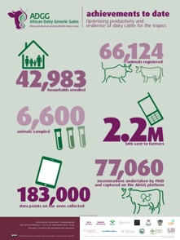
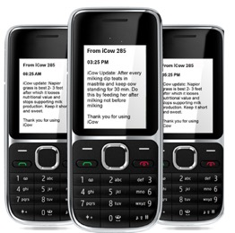

Smart phones to link farmers to markets, information, insurance, credits
‘Big data’ processed to generate farmer-level recommendations to service providers
e.g. better milk = better pay

Slide 24
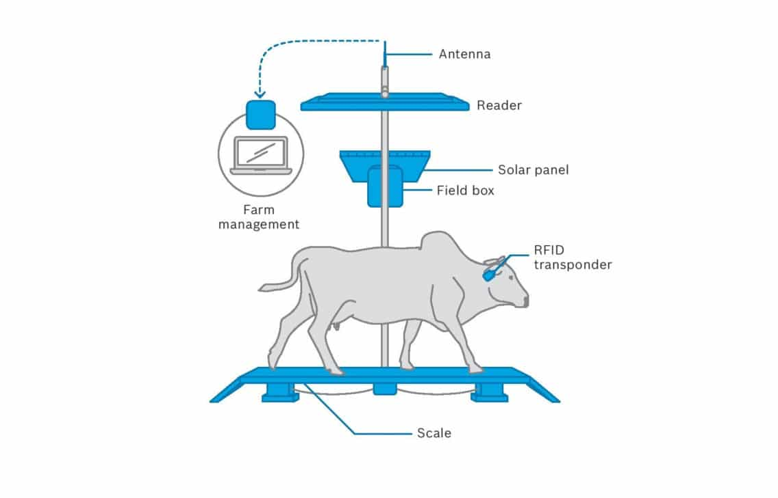
Precision livestock farming
Real-time data collection at individual & flock levels- analysis & modelling (e.g. precision breeding)
Feed consumption
Estrus
Disease
Milk production
Meat composition and quality

Slide 25

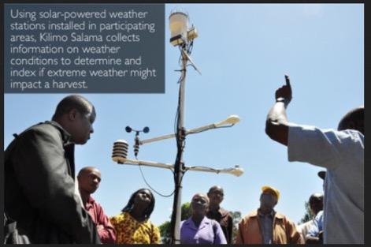
IV. Data in environmental management/climate change
Phenotypic, genotypic, geo-spatial and socio-economic data can be used to predict breed suitability in the present and in the future
Index based insurance considering drought & excess rain:
mobile phone registry & payment systems
Particularly relevant to pastoral communities

Slide 26
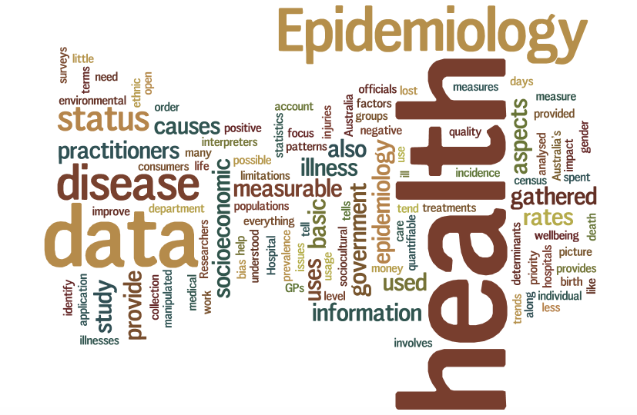
V. Data in livestock health
Forecast epidemiology of disease e.g. prediction, early detection, mapping
Promote transparency among health-care actors

Slide 27
VI. Data in agricultural policy making
Understand contexts of production systems
Prioritize solutions
Track progresses
Accountability

Slide 28
Limitations on utilizing agricultural data
Data are captured by disparate entities
Skill gaps: deficiencies in agricultural curricula to craft small & big data management skills
Lack of consistency in data collection systems
Low use of advanced technologies
Poorly developed telecom infrastructure (14.9% in 2018)
Gaps in legal frameworks (e.g. privacy, CR)
Emphasis on short-term gains
Insufficient understanding by decision makers
Lack of sound business models to capture value from data

Slide 29
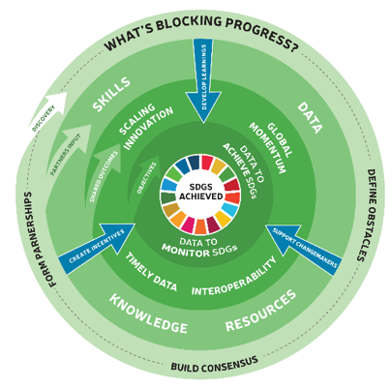
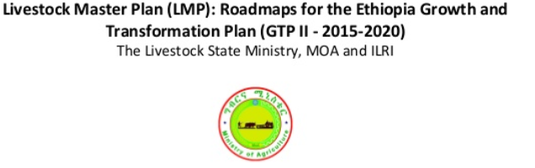
Without data at different levels, progresses towards targets set, to address challenges such as poverty, inequality, and climate change, cannot be measured and hence we will be at risk of not meeting the SDGs by 2030.

Slide 30

Transformative actions are needed to respond to the demands of a complex development agenda by improving how data is produced and used, ...building capacity and data literacy in ‘small data’ and ‘big data’ analytics.

Slide 31
Conclusion
Without significant investment in generation and utilization of data we CANNOT bring transformative changes in Ethiopian livestock agriculture
  Put in place robust data collection and utilization systems
  Generate high quality & timely data
  Enable public access in human and machine-readable formats
  Accompany the data by relevant meta-data to promote transparency
  Create understanding among actors on what, when, where, by whom, how and why data should be collected & utilized

