Slide 1
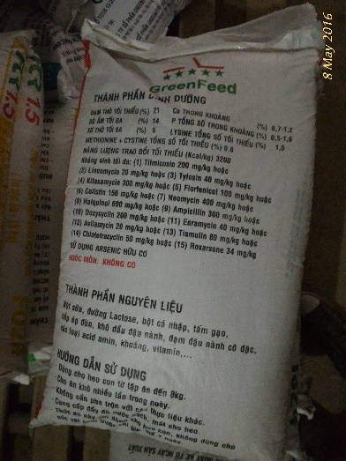
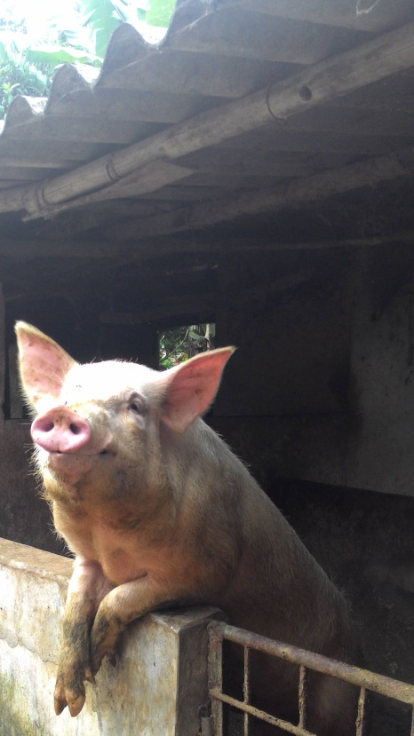
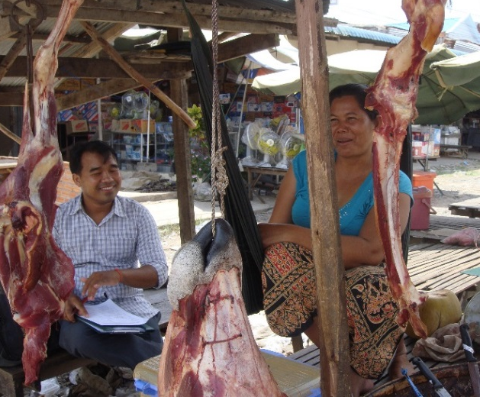
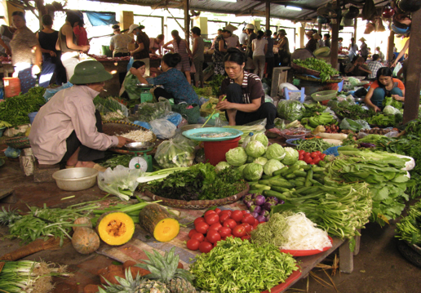

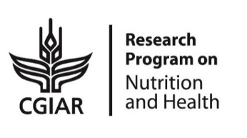

Health and Agri-food systems:
Ensuring safe and fair foods for everyone
Hung Nguyen, regional representative for ILRI E&SEA
International Livestock Research Institute
Emory University Hubert Department of Global Health
29 July 2019, Atlanta, USA

Slide 2
Outline
ILRI and Food systems
Food safety in LMICs including environmental health
Capacity building and policy translation

Slide 3
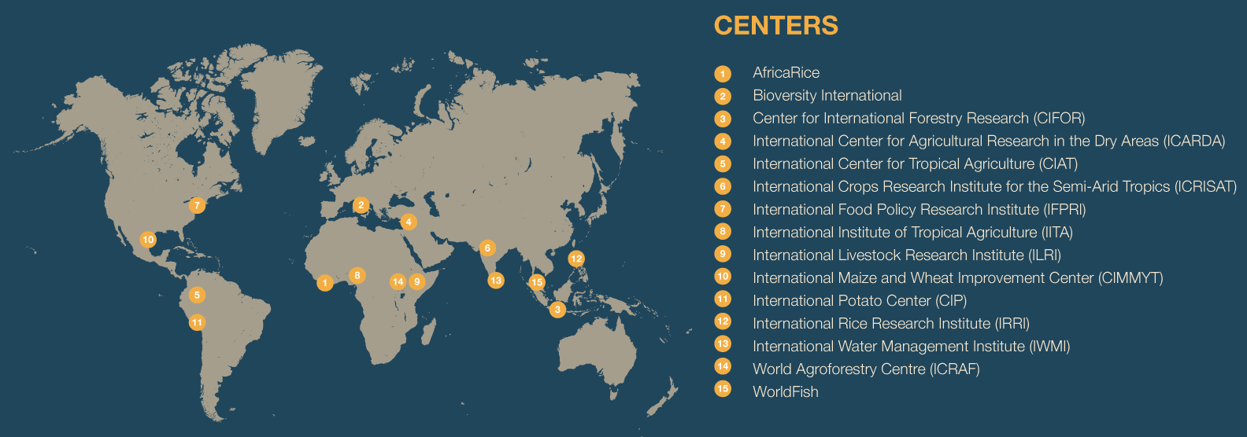
CGIAR Research Centers
CGIAR research is carried out by the 15 Centers, members of the CGIAR Consortium, in close collaboration with hundreds of partners, including national and regional research institutes, civil society organizations, academia, development organizations and the private sector.
REDUCED POVERTY
IMPROVED FOOD AND NUTRITION SECURITY FOR HEALTH
IMPROVED NATURAL RESOURCE SYSTEMS AND
ECOSYSTEM SERVICES
EQUITY, CAPACITY AND ENABLING ENVIRONMENT

Slide 4


International Livestock Research Institute (www.ilri.org)
Reduced poverty
Improved food and nutrition security for health
Improved natural resource systems and ecosystem services
ILRI’s mission is
to improve food and nutritional security
and to reduce poverty in developing countries through research for
efficient, safe and sustainable
use of livestock —
ensuring better lives through livestock.

Slide 5
ILRI programs
Feed and forage resources development
Policies, institutions and livelihoods
Livestock genetics
Food & nutrition security
Poverty eradication
Environment & human health
Sustainable livestock systems
Animal & human health
Impact at scale
BecA-ILRI hub

Slide 6
Food systems for diets and nutrition
HLPE 2017 Food Systems and Nutrition Report
Notes:
Food systems:
The full set of processes, activities, infrastructure and environment that encompass the primary production, processing, distribution, waste disposal, preparing and consuming food.
Multiple actors (producers, food chain actors, consumers) managing
Multiple agri-food value chains in dynamic and interactive environments
Multiple impacts (environmental, economic, social)

Slide 7
Food Safety in LMICs

Slide 8
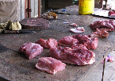
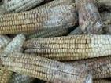
FBD- a new priority – most probably from ASF
Millions DALYs lost per year (global)
Burden LMIC
31 hazards
600 mio illnesses
420,000 deaths
33 million DALYs
Havelaar et al., 2015

Slide 9
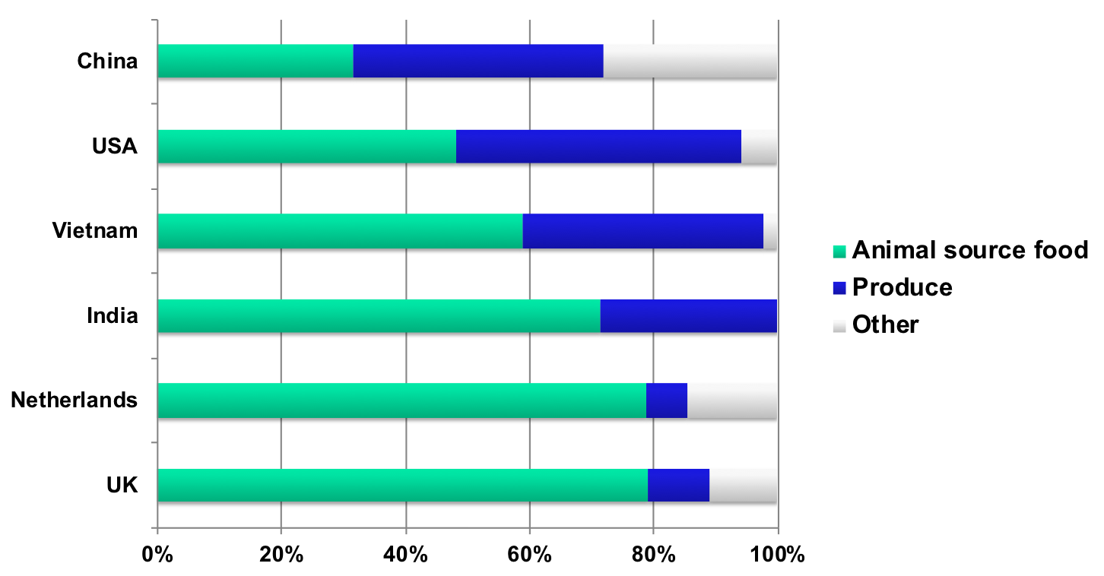
Foods implicated in FBD
Painter et al., 2013, Sudershan et al., 2014, Mangan et al., 2014; Tam et al., 2014; Sang et al., 2014 ; ILRI, 2016
Notes:
Two-thirds of human pathogens are zoonotic – many of these transmitted via animal source food (salmonellosis, EHEC, cryptosporidium)
Animal source food single most important cause of food-borne disease
Many food-borne diseases cause few symptoms in animal host (chicken and S. enteritidis, calf and E. coli O157:H7, oysters and V. vulnificus)
Many zoonotic diseases controlled most effectively in animal host/reservoir
Recent studies shown pre- ‘harvest’ stage most important for controlling food-borne pathogens

Slide 10
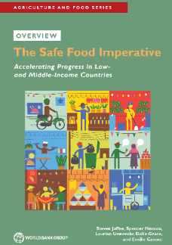
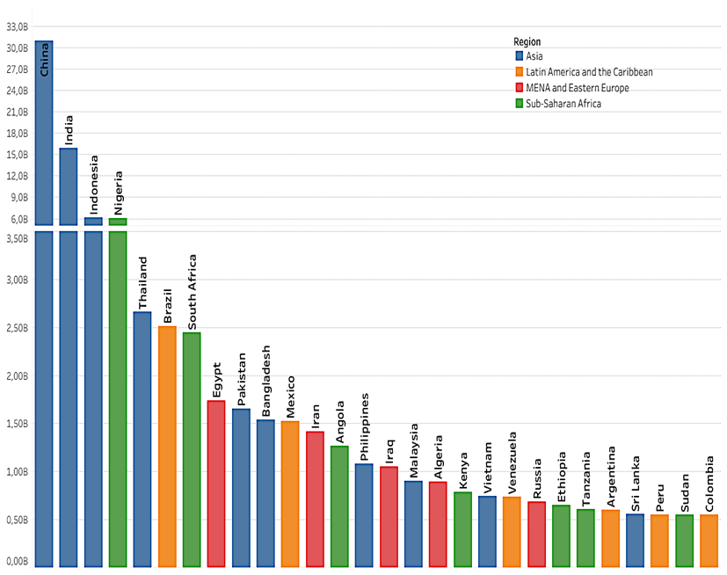
Domestic costs may be 20 times trade costs
Download here
‘Productivity Loss’ =
Foodborne Disease DALYs x Per Capita GNI
Cost estimates for 2016 (US$ billion)
Productivity loss | 95
Illness treatment | 15
Trade loss or cost | 5 to 7
Illness treatment =
US$27 x # of Estimated foodborne illnesses
Trade loss or costs =
2% of developing country high value food exports
Based on WHO/FERG & WDI Indicators Database

Slide 11
Research approach: what do we do to understand and improve food safety?
Situational analyses of food safety
Capacity building on risk-based approaches
Proof of concept: participatory risk assessment
Pilot testing interventions

Slide 12
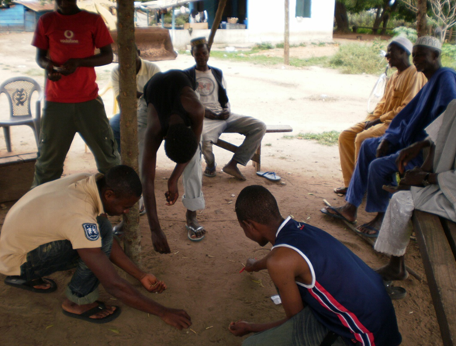
Approach: risk analysis or risk-based decision making
Hazards vs Risk
Can it be present in food? Can it cause harm?
Hazard identification
What harm does it cause?
How does harm depend on dose?
How and to what extent does it get from source to victim?
Hazard characterization
Exposure assessment
What is the harm?
What is its likelihood?
Participatory methods
fit well
Risk characterization
Risk communication

Slide 13
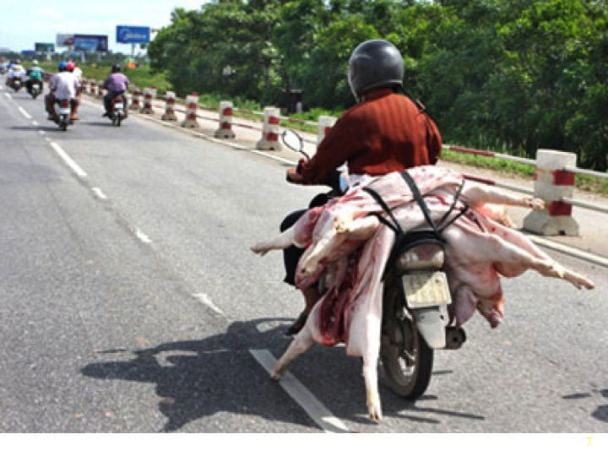
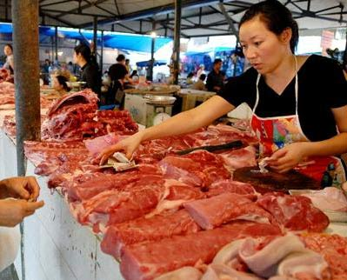
Pork value chain and safety in Vietnam: from research to interventions

Slide 14
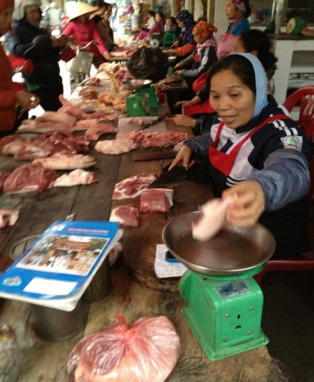

Issue of pork value chain and food safety in Vietnam
Large pig production (30 million heads) mainly produced by 2.5 mio small scale farms (70%)
Pork is the main ASF (60%) in Vietnamese diet “fresh” pork preferred
Food safety among the most pressing issues, more important than education or health care
Modern food safety legislation but weak enforcement
  Risk perception towards chemical hazards is important, issue of risk communication
  Food exports relatively well managed but deficits in domestic markets.
Nguyen-Viet et al, 2017

Slide 15
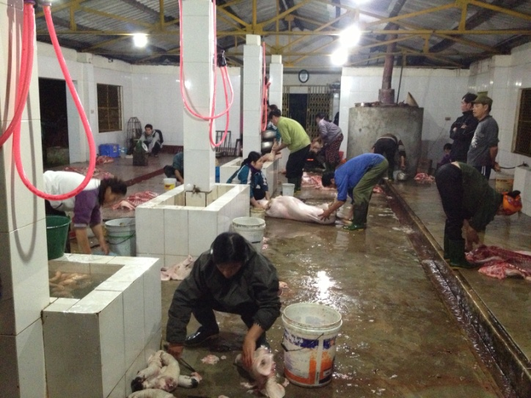
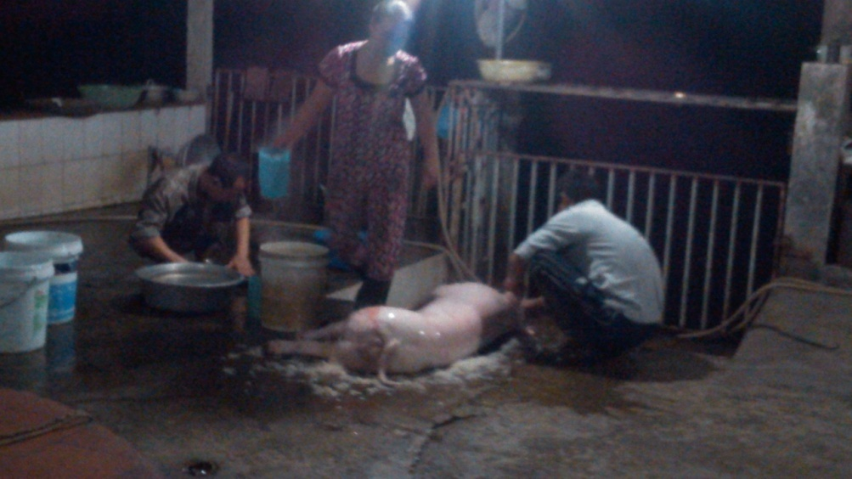
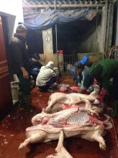
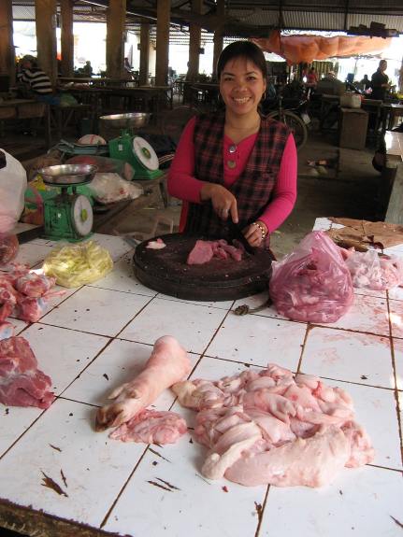

Slide 16
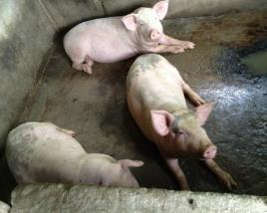
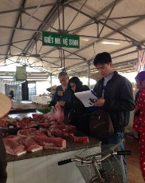
PigRISK: Pork safety in Vietnam (2012-2017)
PigRISK project (2012-2017)
Food safety risk assessment along the pork value chain
Microbial and Chemical Risk Assessment
Salmonella risk pathways developed for producers, slaughterhouse and consumers, quantitative microbial risk assessment (QMRA) risk for consumer
Chemical risk assessment: antibiotic residues, banned chemicals, heavy metals
Farm
Transportation to SH
Slaughterhouse
Retailer
Consumers
Feed in bags, remaining feeds at the cages, environment
Liver
Kidney
Pork
Consumption survey
Sinh Dang et al, 2017

Slide 17
PigRISK - microbial contamination
Actor | Sample type | Prev (%)
Producer | Drink-FA | 19.4
Producer | Floor Swab-FA | 36.1
Producer | Waste Water-FA | 38.9
Slaughter house | CarcassM Swab | 38.9
Slaughter house | Feces | 33.6
Slaughter house | Mesenteric LN | 35.6
Slaughter house | SwabFlo-SH | 22.4
Slaughter house | Water-SH | 20.4
Market | Overall | 34.1
Dang Xuan Sinh et al, 2019

Slide 18
Risk assessment
QMRA for salmonellosis
Age and gender groups | Estimated annual salmonellosis incidence rate (Mean (90% CI)) (%)
Children (under 5 years old) | 11.18 (0 – 45.05)
Adult female (6-60 years old) | 16.41 (0.01 – 53.86)
Adult male (6-60 years old) | 19.29 (0.04 – 59.06)
Elder (over 60 years old) | 20.41 (0.09 – 60.76)
Overall | 17.7 (0.89 – 45.96)
The annual incidence of foodborne salmonellosis in the Asian region including Vietnam was 1% (range 0.2-7%) (Havelaar 2015)
Chemical risk assessment: minimal risks
Dang Xuan Sinh et al, 2017, Hanh Tran et al, 2017

Slide 19
Economic impact of food borne diseases
Costs per treatment episode and per hospitalization day for foodborne diarrhea case were US$ 106.9 and US$ 33.6 respectively.
51.3%: Indirect cost (costs of times to patient, their relatives due to the patient’s illness)
33.8%: Direct medical costs
14.9%: Direct non-medical costs (patient and their relatives)
Hoang Van Minh et al, 2015, JKMS

Slide 20
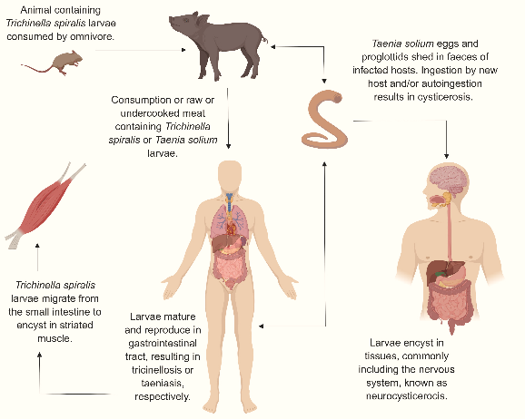
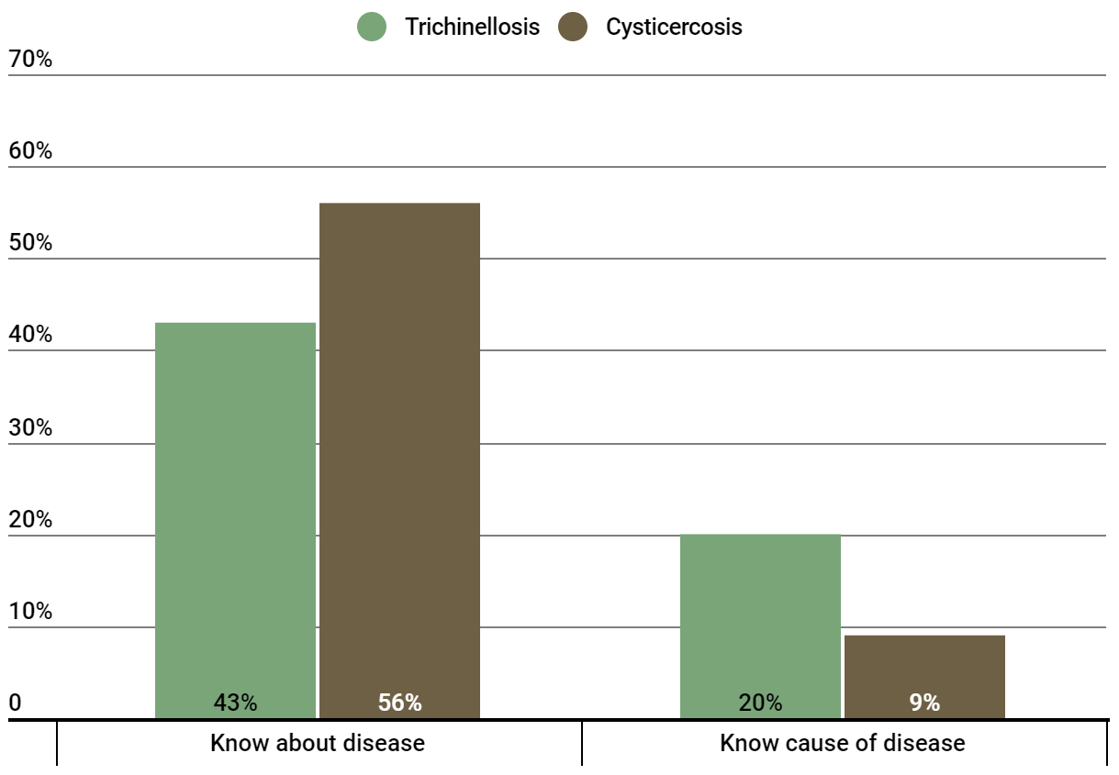




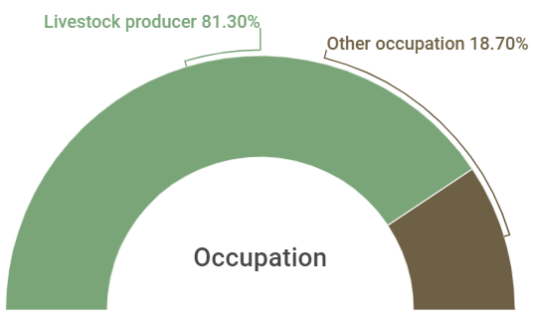
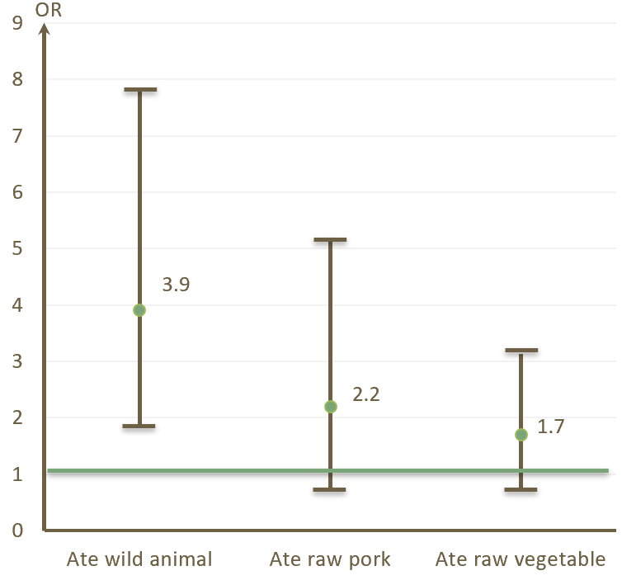
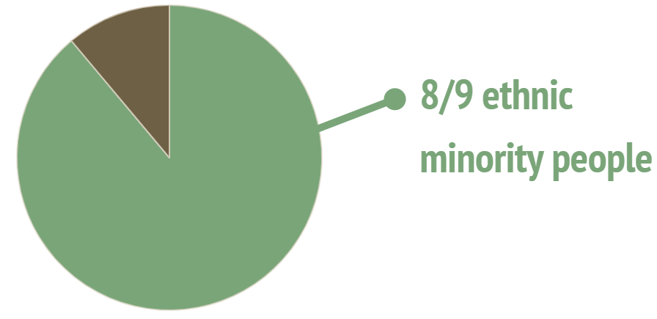
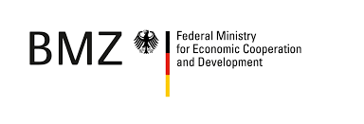
Serological prevalence and factors associated with human trichinellosis and cysticercosis in Hoa Binh Province, Northwest Vietnam
300 participants with blood samples in Hoa Binh.
ELISA for trichinellosis and cysticercosis (Demeditec® and apDia®).
Knowledge of participants about diseases
Trichinellosis
Cysticercosis
Positive case
Suspected case

Slide 21
Interventions

Slide 22
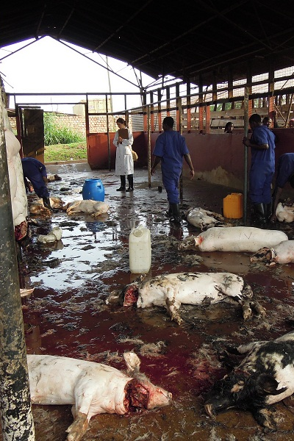
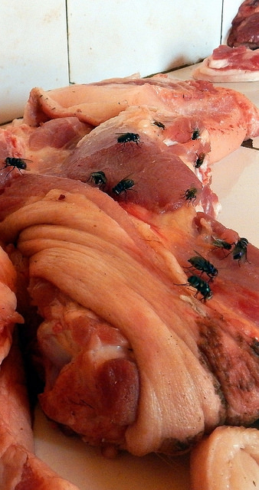
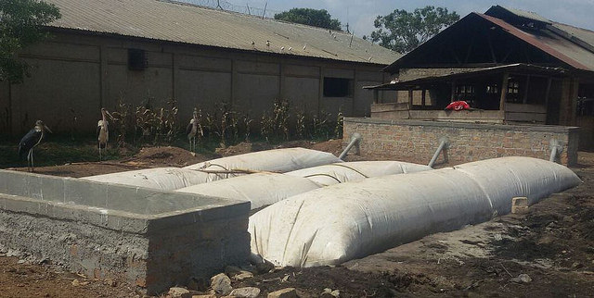
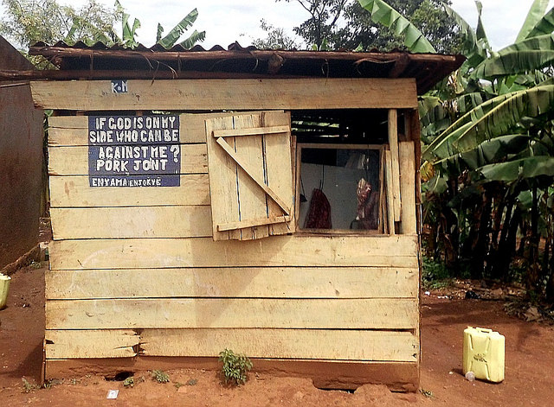
Technological interventions coupled with training of value chain actors
  Reach:
  50% of all pork butchers and
  their 300,000 customers in Kampala
savings on firewood / month
= 900,000 UGX (260 US$) + >100 trees

Slide 23
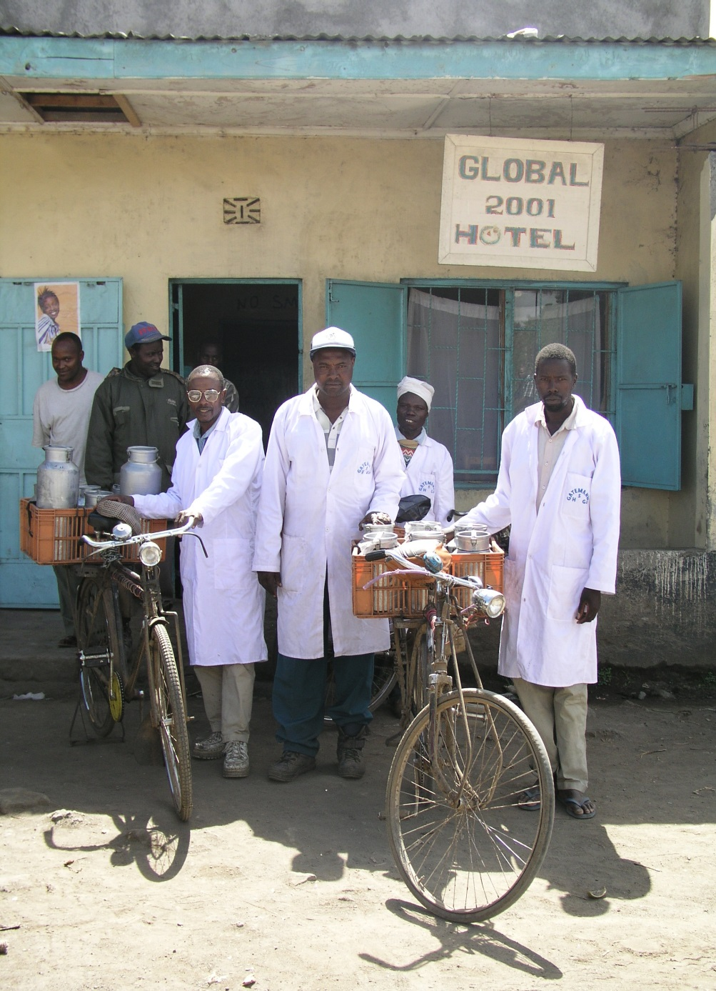


Towards impact at scale
Branding & certification of milk vendors in Kenya & Guwahti, Assam led to improved milk safety.
It benefited the national economy by $33 million per year in Kenyan and $6 million in Assam
70% of traders in Assam and 24% in Kenya are currently registered
6 milllion consumers in Kenya and 1.5 million in Assam are benefiting from safer milk
Notes:
s/h participation in markets
Risk rather than regulatory

Slide 24
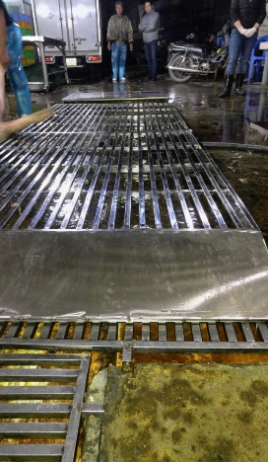
Investments in FS can save lives and $$$
94 million people
Cases of foodborne diseases by Salmonella in pork at 17%: 16 million get sick
Cost $ 107 to treat a case: if 1/3 looks for medical treatment, $570 million (0.26% GDP)
Intervention to reduce 20% burden: $ 340 million SAVED from total population

Slide 25
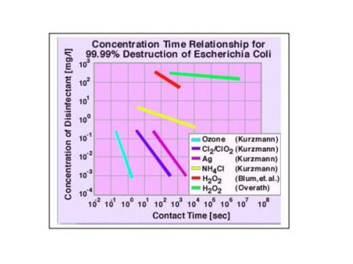
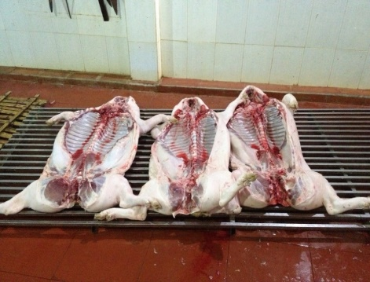
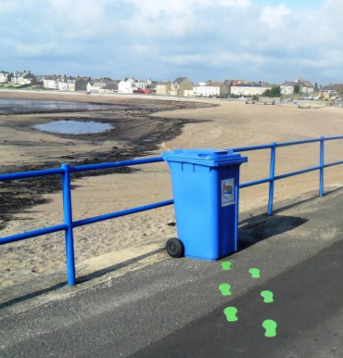
Interventions (Safepork project 2018-2022)
Farm level: Simplified VietGAHP/GAP reduced AMU / AMR
Slaughterhouse: ozone machine, no floor slaughter
Markets: branding, better hygiene
Consumer: reduced cross-contamination, hygiene
Nudges

Slide 26
Safe Food Fair Food for Cambodia
Project objectives
Actionable evidence on FBD burden associated with animal source foods (ASF)
Pilot incentive-based approach to improving food safety among ASF traders
Cambodian-led Theory of Change for improving food safety
Gender and equity research
Building capacity in food safety risk assessment, management, communication

Slide 27
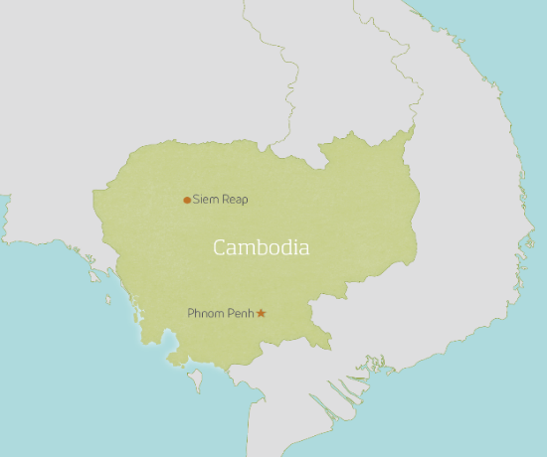

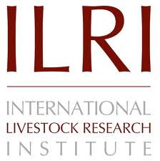




Gender
TOC
1. Risk profiling
Scoping visits
Systematic literature review
Risk profiles
Training in risk ranking
Stakeholder prioritisation
Impact
Nutrition
Markets
QMRA
Household
2. Generate evidence on FBD
Five Urban Survey Study
Cost of Illness
Nutrition
3. Develop & test solutions for wet markets
RCT intervention
Taskforce

Slide 28
Generate Evidence on FBD
Risk profiling
Scoping visits
Systematic literature review
Risk profiles
Training in risk ranking
Stakeholder prioritisation
Five Survey Study
National traders hazard survey
Urban household consumption
Urban household nutrition
Urban hospital COI
Quantitative RISK Assessment

Slide 29

n=25

Slide 30
Approach : Systematic literature review (SLR) aND GREY LITTERATURE REVIEW
which foods???
Foods associated with FBD: noodles, rice, seafood, dog meat, water spinach, rice wine, raw game meat
Foods associated with chemicals: sausage, dry fish, seafood, noodles and meat balls produced from beef and pork;
Catering foods at big events
which hazards???
Vibrio spp., Salmonella spp., Staphyloccus aureus, Bacillus cereus
borax, formalin

Slide 31
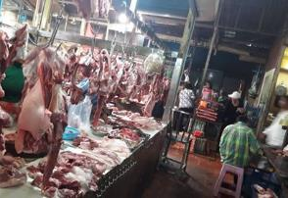
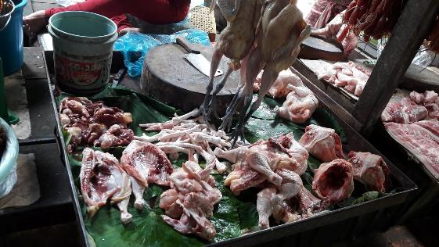
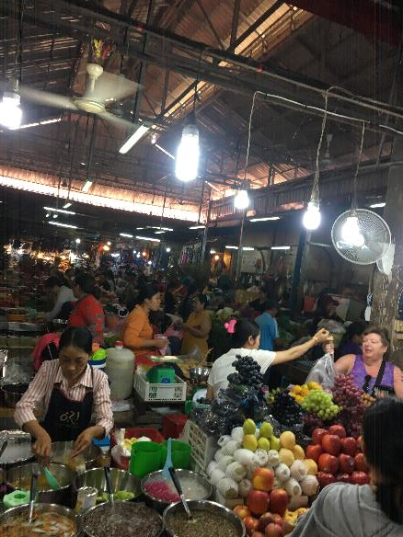
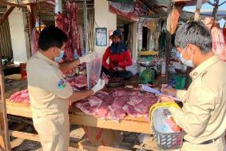
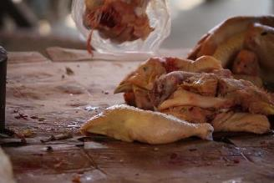
Animal sourced food
Pork
Chicken
In traditional
Market

Slide 32
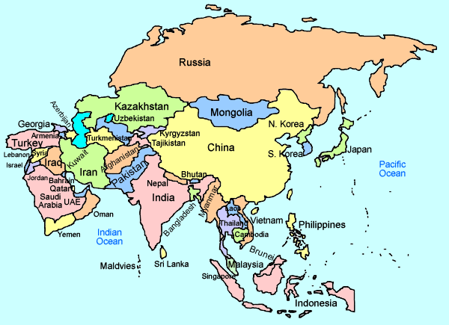
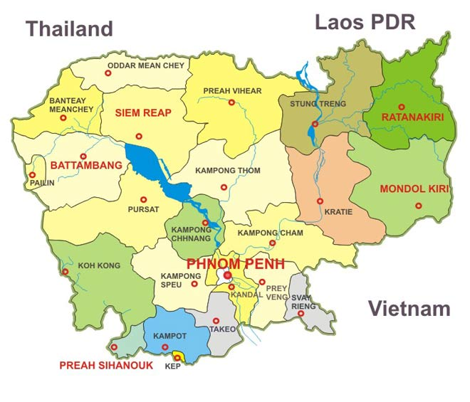
Multi-pathogen survey in Cambodian traditional market
Pork and poultry
Salmonella & Staphylococcus aureus
Traditional markets in 25 provinces of Cambodia 12.2018 -3.2019
Urban focus: Phnom Penh municipal and Siem Reap province, Sihanoukville, Battambang (repeated survey) 7 - 8.2019
Where we work

Slide 33
RESULTS
All samples of the first round was collected for the multi-pathogen survey in Cambodian markets in 25 provinces. In total 416 samples (pork = 156, pork cutting board swabs=52) chicken (chicken meat = 156, cutting board swabs = 52) were collected. 312 shop owners were interviewed during the sampling.
In total of 184 samples positive to Salmonella (36%) and 133 to S. aureus (32%).
Isolates are being kept for further analysis on antimicrobial resistance.

Slide 34
Cost of per episode of hospitalization of FBD by group of health facilities
Cost | National Hospital (n=44) | Referral Hospital (n=60) | Regional Hosp. (n=100) | Community Clinic (n=62) | Overall (n=266)
Direct medical cost
Amount [usd] | 125.77 | 9.42 | 27.85 | 4.19 | 34.38
Direct non-medical cost
Amount [usd] | 40.64 | 8.36 | 26.33 | 0.30 | 18.58
Indirect cost
Amount [usd] | 21.43 | 6.38 | 10.89 | 3.08 | 9.80
Total cost [usd] | 185.88 | 24.16 | 65.07 | 7.57 | 62.76

Slide 35
Wastewater reuse and Food Safety

Slide 36
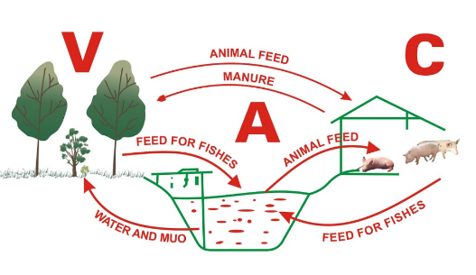
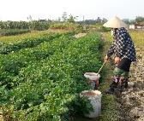
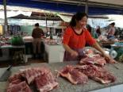
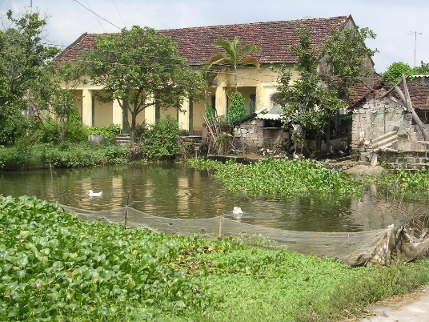
Ecohealth research on human and animal waste management in Vietnam: VAC model
Crop
Livestock
Fishery
Health and environmental issues & livestock?
Nguyen-Viet et al, 2014

Slide 37
Analysis of interrelations between environmental sanitation systems, health status and well-being
Health status
(Water and Sanitation)
Exposure to pathogens (viruses, bacteria, protozoa, helminths)
Health related and help seeking behavior
EPI
QMRA
Health risks-impacts, Affected population
Dynamic interactions
Physical environment
Social, cultural and economic environment
between systems and interventions
Food chain
Excreta, Wastewater, Water
Nutrients: N, P
Chemical pollutants
Structure of society
Empowerment
Economic status
MFA
SSA
Ecological risks and use of resources
Vulnerability, resilience and equity patterns
Critical control points: comprehensive biomedical, epidemiological, ecological, social,
cultural and economic assessment
Interventions (biomedical, systems, engineering, behavioral or in combination):
Efficacy, effectiveness and equity studies measured in relation to risks
Nguyen-Viet – Ecohealth, 2009

Slide 38

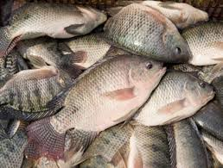
Risk assessment: Vegetable and fish from wastewater in Hanam
High risk from eating morning glory and tilapia (diarrhea risks due to E. coli 13%, G. lamblia and C. parvum: 0 – 23% respectively.
Highly contaminated Pb level, but low risk for tilapia.
Local people knew the risk.
They sold contaminated vegetable and fish to other towns.
Truc et al (2014)

Slide 39
Capacity building and policy translation

Slide 41

Taskforce of Risk assessment for food safety in Vietnam
Linking research to policy
Taskforce: composed by experts from universities, research institutes, policy makers from the ministries (health, agriculture)
Risk analysis capacity development for researchers and policy makers
Taskforce now institutionalized and sustainable

Slide 42
Capacity building impact: curriculum development & trainings
Guidelines on FS risk assessment: more accessible and understandable in use in 17 universities, 7 cities
Curriculum developed to teach 200 students per year: majority of future food safety human resources
Trainings for veterinary and public health staff at ministry level
Hand-on training on risk assessment for researchers, students

Slide 43




Policy impact: translational research for interventions in modernizing food system
CGIAR/ILRI niche - risk assessment and policy / regulatory analysis for fresh foods in domestic markets
World Bank convenes overall support to government: ILRI led technical works
Upcoming projects based on WB report we led will improve food safety for 20 million people in major cities of Vietnam

Slide 44


Stakeholder consultation
Risk assessment training

Slide 45

Savanakhet, Laos
Foodborne parasitic disease research 10. 2017
Decision makers
Public health (MD, army health)
Scientists
Vets

Slide 46


Bangladesh: capacity building on risk-based approaches
Risk assessment workshop in Dhaka 22-24 October 2018: 33 participants

Slide 47
Conclusions
Food systems to achieve nutrition, food safety and health outcomes are complex and challenging.
Informal / wet markers play important role in food security and safety
Microbial vs. chemical risk: role of risk assessment.
Huge health and economic burden of foodborne diseases in LMIC
Capacity to develop food safety research in LMIC is important, risk communication need
Research translation to actions and policy: timely and opportunistic

Slide 48
Conclusions
Interventions: control & command approaches don’t work but solutions based on working with the informal sector more promising.
Previous investments not in line with modern understanding, interventions successful in short term, long term, wide-reaching impacts likely require:
  Training & technology
  Incentives
  Enabling environment

Slide 49
Acknowledgement
Fred Unger, Sinh Dang, Delia Grace, Kristina Roesel, Silvia Alonso, Johanna Lindahl: ILRI
PigRISK and SafePORK team
Sothyra Tum, Chhay Ty, Rortana Chea, Melissa Young, Morgan Brown and SFFF Cambodia team
BMZ project team
Vietnam Food Safety report team
ComAcross project in Laos: Vannaphone Phouthana
Funding: ACIAR, CGIAR A4NH, World Bank, BMZ, USAID through LSIL, IAFP, Emory University

Slide 50


Slide 51
Bibliography
Hung Nguyen-Viet, Tran Thi Tuyet-Hanh, Unger, F., Sinh Dang-Xuan and Grace, D. 2017. Food safety in Vietnam: where we are at and what we can learn from international experiences. Infectious Diseases of Poverty 6: 39. http://hdl.handle.net/10568/79981
Sinh Dang-Xuan, Hung Nguyen-Viet, Meeyam, T., Fries, R., Huong Nguyen-Thanh, Phuc Pham-Duc, Lam, S., Grace, D. and Unger, F. 2016. Food safety perceptions and practices among smallholder pork value chain actors in Hung Yen province, Vietnam. Journal of Food Protection 79(9): 1490–1497. http://hdl.handle.net/10568/77065
Sinh Dang-Xuan, Hung Nguyen-Viet, Unger, F., Phuc Pham-Duc, Grace, D., Ngan Tran-Thi, Barot, M., Ngoc Pham-Thi and Makita, K. 2017. Quantitative risk assessment of human salmonellosis in the smallholder pig value chains in urban of Vietnam. International Journal of Public Health 62(Supplement 1): 93–102. http://hdl.handle.net/10568/77739
Tran Thi Tuyet-Hanh, Dang Xuan Sinh, Pham Duc Phuc, Tran Thi Ngan, Chu Van Tuat, Grace, D., Unger, F. and Hung Nguyen-Viet. 2017. Exposure assessment of chemical hazards in pork meat, liver, and kidney, and health impact implication in Hung Yen and Nghe An provinces, Vietnam. International Journal of Public Health 62(Supplement 1): 75–82. http://hdl.handle.net/10568/77702
Nguyen-Viet, H. et al (2018). Research and training partnership to assist policy and capacity building in improving food safety in Vietnam. Global Food Security

