Slide 1

Improving collaboration between research and the private sector to accelerate livestock innovation for sustainability into use: Purina public-private research experiences
John Ellenberger, Land O’Lakes
Lightning presentation at a parallel session, 9th Multi-Stakeholder Partnership Meeting of the Global Agenda for Sustainable Livestock, Manhattan, Kansas, 9-12 September 2019

Slide 2




Public-Private Research That Worked
Innovation drives Feed:​
​
90+ PhDs and DVMs
95 years of continual animal nutrition research​
$32+MM investment in our 1,200 acre research farm in past 15 years
20,000+ nutrition research studies​
More than 130 patents granted
Land-Grant Universities
&
Purina uses basic research from the public-sector to support it’s new product research.
Bidco Land O’Lakes uses the “know-how” from Purina research to develop products for the Kenyan market
#LivestockAgenda
Notes:
Purina is the primary brand of our animal nutrition portfolio, which is focused on delivering nutrition solutions that enhance animal performance and well-being.
Purina uses basic public research which has been conducted by public-sector/land grant universities to support it’s private research for new product development.
In 2016, Land O’Lakes, Inc. combined forces with BIDCO Africa, a fast-moving consumer goods enterprise, and formed a partnership called BIDCO LAND O’LAKES LTD
Bidco Land O’Lakes uses the know-how gained from the Purina research to adapt products for the Kenyan Market. This also takes advantage of public investments that have been made in the dairy sector in Kenya such as the work by USAID to support livestock producers.

Slide 3
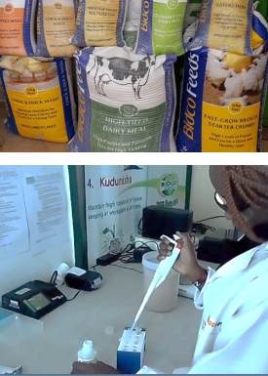
Introducing a new Calf Starter to the Kenyan Market
At Purina, we’re always asking…
What is reasonable? Matching the needs to the local level of management
What economic returns will this innovation provide to a farmer?
How can we deliver consistent formulation at the lowest price?
Education accompanies the Products
How to use the products
How to manage the animals that use the products
#LivestockAgenda
Notes:
Example – a new calf starter is ready to be introduced to the Kenyan Dairy Market. We did not take a calf starter from the US market, we took the know-how from the US and adjusted it to the conditions in the Kenyan market.
We ask ourselves and the market-
- What is reasonable? Matching the needs to the local level of management. This also was compared to our knowledge of the dairy system in Mexico and China. This ensured that a reasonable price was also discovered.
Which takes us into Education-------
Education
Without the know how, gaps develop and producers soon become dissatisfied with your products
Education under Purina and Bidco Land O’Lakes includes overall management practices, and health of the livestock

Slide 4
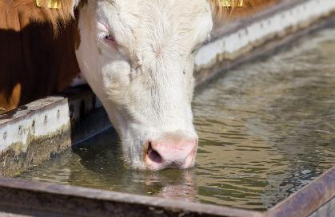
Public-Private Roles That Don’t Work as Well
Often a lack of government funding to support extension activities are the cause.
Extension Struggle
WATER !
Other Public Sector Roles that need attention
Development of support infrastructure (Water points)
Market facilities
Water and power utilities for value-added processing
#LivestockAgenda
Notes:
Ag Extension used to be under the public sector, more and more this support to producers fall to the private sector. It starts with the product support I mentioned in the previous slide.
Another situation we are experiencing with WATER
- Water is often the forgotten nutrient in livestock feeding
Re calf starter example, Just because calves drink milk, producers didn’t understand they need water as well. Therefore, our product information and messaging to farmers includes the need for calves to have access to clean water…”would you drink that water??”
- Water access also includes the need for wells, pumps and holding tanks and , and, and
- Access to hot water to clean equipment, esp in milk business is often overlooked.
Other Public roles that need attention
Develop of support infrastructure like water points or wells
Market facilities such as corrals & loading chutes, or health inspection before mkt trading
Utilities to support value-added processing, public private roles do not have to be ag to livestock, it can be livestock to energy or livestock to transport.

Slide 5
Next Steps to Support
Public-Private Partnerships
“Gems’
The Livestock sector and the resulting Animal Source Foods is complementary to the priorities of many donor agencies and national governments
New uses and forms of agro-processing by-products as animal feeds.
More forages adapted to low rainfall conditions are needed.
Producer level knowledge gaps continue to be a factor, more livestock curriculum in schools and more extension services are needed.
#LivestockAgenda
Notes:
Under the climate and Natural Resources session, the need for improved use of by products was mentioned. Specifically, we need pubic-private research to develop additional alternatives for livestock consumption of agro-processing by-products.
With changing climate conditions, the need for more pubic-private research on forages that have been adapted to low rainfall or limited water needs are needed.
The need for livestock extension continues, producer level knowledge gaps continue to be a factor. Additional livestock curriculum is schools and more public extension services are needed.

