Slide 1
Operationalizing One Health in pastoralist settings

Slide 2
Module 1: Principles and applications of One Health

Slide 3

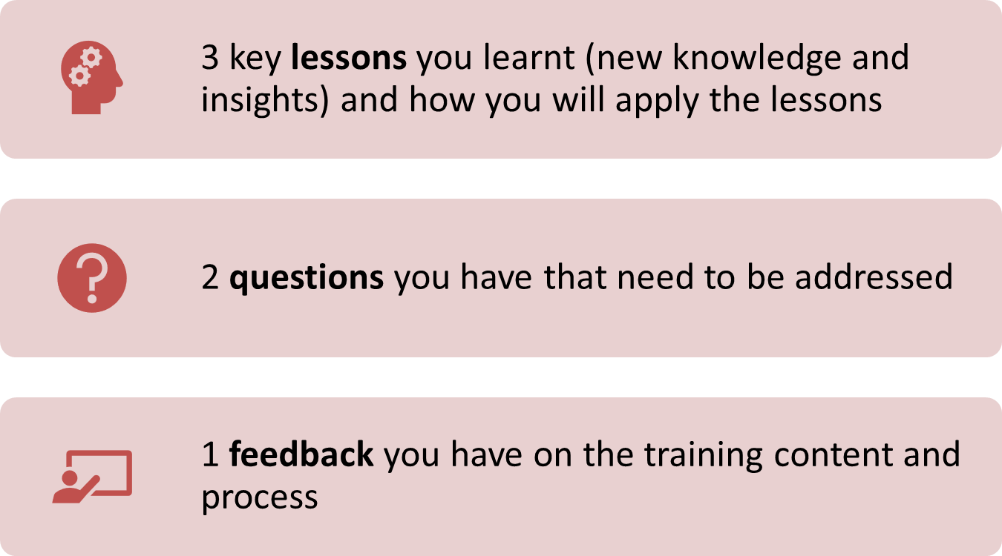
Re-cap Day 1
Reflection
Write down your key lessons from yesterday
Be prepared to share your responses in plenary
30 minutes

Slide 4
Systems thinking in
One Health

Slide 5

Intended learning outcomes
By the end of this session, you will be able to:
describe the features of ‘systems’;
describe the key characteristics of socio-ecological systems;
describe the fundamental concepts in systems thinking;
identify skills and attitudes for systems thinking in One Health; and
apply systems thinking to solve problems at the human-animal-environment interface

Slide 6
Topics
What are systems?
Conceptualising One Health as a complex system
What is systems thinking?
Skills and attitudes for systems thinking in One Health

Slide 7
What is a system?
Interactive plenary discussion
What comes to mind when you hear the word ‘system’
5 minutes

Slide 8
What is a system?
Individual reflection (illustration)
Facilitator will give you a blank piece of paper
Draw a picture that you think represents a system (should be understood by a community member)
10 minutes

Slide 9
What is a system?
Interactive plenary discussion
Your facilitator will play a video
As you watch consider:
  What is a social-ecological system?
  What does ‘resilience’ mean?
Be prepared to share your answers in plenary
Video 2: What is resilience?
https://www.youtube.com/watch?v=6A3SJWr4jXE
15 minutes

Slide 10
Definition of a system
According to Merriam-Webster dictionary a system is:
‘a regularly interacting or interdependent group of items forming a unified whole’.

Slide 11
Systems - examples
A group of body organs that come together to perform a vital function (e.g., heart, veins, arteries, and blood comprising the cardiovascular system) *
A community of organisms and their environment functioning as an ecological unit (i.e., ecosystem) *
An organization with people, equipment and processes interacting to produce a new product (e.g., production system) **
* Natural **Human-made

Slide 12
Systems - similarities
All elements in the system must be present for optimal functioning of the system – removal/addition of a component affects the functioning of the system
Elements must be arranged in a specific way for the system to carry out its purpose – re-arrangement of components would fundamentally alter the ability of the system to fulfil its purpose
Systems have a specific purpose within a larger system – they can’t be combined or subdivided
Systems maintain stability through a process of interaction, feedback, and adjustment – information is transmitted between components inside and external to the system and adjustments are made accordingly
Notes:
Use example of cardiovascular system - heart, veins, arteries, and blood.

Slide 13
Conceptualising One Health as a complex system
As humans have evolved, there has been a tendency to think of humans as being distinct from nature
In contrast, in One Health we recognize that human, animal and environmental health is interdependent
We can conceptualise this interdependency as a social-ecological system comprising:
  Human components and social processes that make up the “human sub-system”
  Ecological components and processes that make up the “natural sub-system”

Slide 14
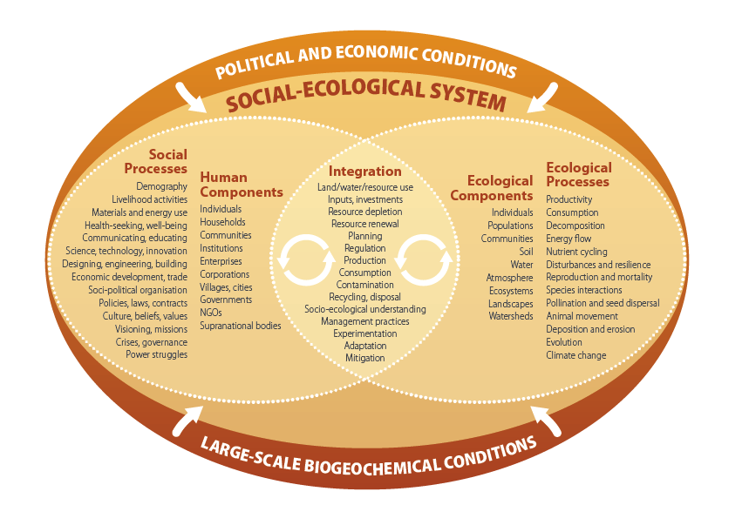

Slide 15
In socio-ecological systems…
Both sub-systems include components and processes that interact to produce outcomes within that sub-system
  Human sub-system: e.g. national economies, health
  Natural sub-system: e.g. clean air, biodiversity
The two sub-systems influence each other via feedback loops
  Human influence on nature, e.g.
    land use changes such as deforestation and cropping
    pesticide use disrupting bee populations and thus pollination
  Nature influence on humans, e.g.
    flooding leading to outbreak of Rift Valley fever in humans and subsequent ban on trade

Slide 16
Key properties of socio-ecological systems
Feedback loops – how one part of the system influences another part
  Consider predator-prey interactions such as between lions and antelope
    Balancing (positive) - number of lions and antelope are naturally balanced to manage food resources
    Reinforcing (usually negative) - lions are removed from the ecosystem, the population of antelope will explode
Adaptive cycles – socio-ecological systems undergo periods of growth, conservation, collapse, reorganization
Resilience – ability of the system to respond to shocks and remain within a given state

Slide 17
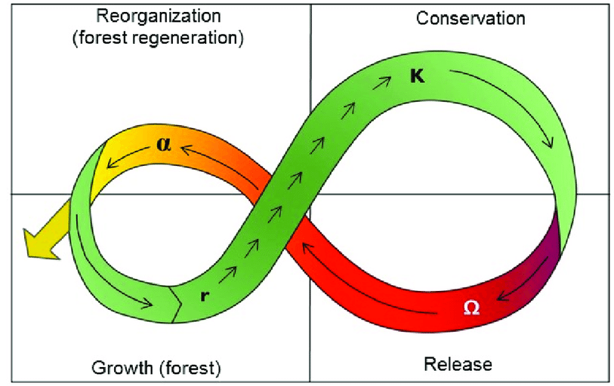
Adaptive cycles in social-ecological systems
Population rebounds e.g. re-growth of pioneer species (flora and fauna), re-stocking of animals
Maximum population size given available resource base
Disturbance,
e.g. drought, locusts, outbreak
Community fails to re-organise e.g. invasive species take over, pastoralist drop out → new cycle
Release of nutrients and biomass into soil (e.g. breakdown of plants, decomposition of animal carcass)
System becomes
productive e.g.
regrowth of plant species; animals give birth to next generations

Slide 18
Case study on socio-ecological systems
Environmental pollution in Karatu District Arusha Tanzania
Facilitator will hand out copies of the case study
In small groups, discuss the case study using the questions on the next slide as prompts
Be prepared to share your discussion in plenary
60 minutes

Slide 19
Case study on socio-ecological systems
Small group discussion
Discussion questions
  What health impacts are described – in humans, animals, and the environment?
  What processes and components make up the “human-subsystem” described in the case study?
  What processes and components make up the “natural-subsystem” described in the case study?
  What evidence is there in the case study that the “human-subsystem” and “natural-subsystem” are interlinked?
  Is pesticide use a problem in your woreda/district? How so?
60 minutes

Slide 20
Introduction to systems thinking
Interactive plenary discussion (video analysis)
Facilitator will play a video
As you watch consider:
  What problem(s) were depicted in the video? Why did they arise?
  What were the consequences?
  What was the solution?
  How might thinking of the problem from a systems perspective have avoided the problem(s)?
Be prepared to share your reflections in plenary
Video 3: Systems thinking: a cautionary tale (cats in Borneo)
https://www.youtube.com/watch?v=17BP9n6g1F0
15 minutes

Slide 21
Introduction to systems thinking
Interactive plenary discussion (video analysis)
Facilitator will play a video
As you watch consider:
  What is systems thinking?
  How is systems thinking different to “conventional” or “linear” thinking in the context of health interventions?
  What does it mean to “zoom out”?
  What are leverage points?
Be prepared to share your reflections in plenary
Video 4: Systems thinking!
https://www.youtube.com/watch?v=GPW0j2Bo_eY
15 minutes
Notes:
Systems thinking is relevant to One Health as it is a framework or philosophy that enables practitioners to develop a broader understanding of the factors which contribute to health problems and how decisions taken in one part of the socio-ecological system (e.g., expansion of grazing or cropping areas) may impact other parts (e.g., encroachment on wildlife habitat leading to spillover of pathogens to people). Systems thinking emphasizes an understanding of the context and connections that exist between actors, and different processes of the system (Figure 12). It helps to appreciate not only the connectedness but also the consequences of actions at the human-animal-environment interface. Viewing problems this way enables identification of different intervention points (leverage points) including more sustainable solutions to health problems in pastoralist settings. It also reduces the likelihood of unintended consequences arising from an intervention that focuses on only one part of the system.

Slide 22
Systems thinking
Way to model, understand and communicate the complexity of systems through identifying how the elements in a system interact and influence one another
In systems thinking, organization/organism and its context are understood to be interdependent
Fundamentally different to “conventional” or “linear” thinking e.g. X causes Y
  Results in partial understanding of problem and partial/temporary solution
  Complexities ignored or “controlled”

Slide 23
Relevance of systems thinking to One Health
Emphasizes an understanding of the context and connections that exist between actors, and different processes of the system
Enables practitioners to develop a broader understanding of the factors which contribute to health problems and how decisions taken in one part of the socio-ecological system may impact other parts
  Enables identification of different intervention points (leverage points) including more sustainable solutions
  Reduces the likelihood of unintended consequences arising from an intervention that focuses on only one part of the system

Slide 24
Fundamental concepts in systems thinking
Interconnectedness – all elements in a system are interconnected and influence one another
Synthesis – refers to the combining of two or more ideas or things to create something new
Emergence – larger ideas or outcomes arise from smaller parts
Feedback loops and causality – tools for graphically illustrating how elements in a system are connected and influence each other
Systems mapping – tool for graphically illustrating the elements in a system and their interaction

Slide 25
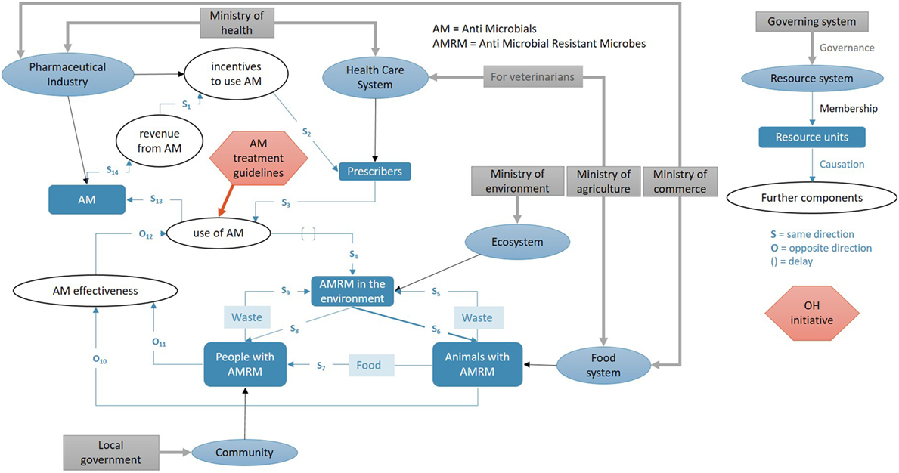
Example of a “systems map” for AMR
Notes:
Explain that the figure depicts the relationship between different components of a system which influences the development of antimicrobial resistance (AMR). This includes components such as actors (e.g., government, healthcare system, prescribers) and resource units (e.g. antibiotics) as well as processes (e.g., policies, guidelines) which link the components. The shape labelled “AM treatment guidelines” is an example of a One Health initiative that targets a particular leverage point i.e., use of antimicrobials (AM).

Slide 26
Applying systems thinking to a One Health problem
Small group activity
At your tables, draw a “system map” for a different One Health problem (i.e. not AMR) that you have encountered in your woreda/district
Consider:
  Human and ecological components (e.g. institutions, resource units) that influence/are influenced by the problem
  Human and ecological processes (e.g. policies, practices, flows) that link the components
  Direction of influence
  Potential leverage points (i.e. intervention points)
Be prepared to present your systems map in plenary
60 minutes group work
+
30 minutes
plenary
Notes:
Divide the participants into groups of 6-8 people and ask them to draw a system map similar to the above for a different One Health problem they have encountered recently in their woreda/district.
If groups are finding it difficult to come up with an example, suggest one of the following:
Rabies outbreak in humans
Anthrax outbreak in livestock
Wildlife die-off due to unknown causes
Response to drought
Pollution of community water source
Increased malnutrition rate in children aged under-5 years
Ask each group to present their systems map in plenary.

Slide 27
Skills and attitudes for systems thinking in One Health
Small group activity (brainstorming)
At your table discuss:
  What skills and attitudes do you need to apply systems thinking to One Health problems in your woreda/district?
  How different are these skills and attitudes from the usual skills and attitudes you use in your workplace?
  How can you develop these skills and attitudes?
Be prepared to share your discussion in plenary
15 minutes
Notes:
Ask participants to form groups of 4-5 participants and reflect on the skills and attitudes needed to practice systems thinking.
Ask each group to share their reflections in a plenary session.
Summarize the points on a flipchart.

Slide 28
Skills and attitudes for systems thinking in One Health
Ability to see the “big picture” – zoom out and look at systems holistically. Don’t get too bogged down by detail. Seeing patterns and trends allows greater anticipation of future events.
Ability to see relationships – analyze the interconnections and interactions between different communities, institutions, and industries engaged in human, animal and environmental health
Appreciate the complexity of cause-and-effect relationships – recognize that cause-and-effect relationships are rarely linear and are influenced by multiple interacting factors. Acknowledge that what is immediately known about a problem may not be the full story.

Slide 29
Skills and attitudes for systems thinking in One Health (continued)
Ability to bring multiple people/perspectives together – accept that no single discipline has the answer. Be open-minded and willing to learn from others. Appreciate diversity and practice inclusivity. Consider different stakeholder perspectives (human, animal, environmental) to develop more comprehensive understanding of the problem
Take a long-term approach (5+ years) – recognize that actions taken now can have impacts on systems for years/decades. This links to the concept of sustainability

Slide 30
Summary of key learning points from Day 2
We can conceptualise the interdependency between human, animal and environmental health as a social-ecological system
We can apply systems thinking to analyse the connections between actors and processes within social-ecological systems to gain a more holistic understanding of health problems
Systems thinking requires specific skills that are not often taught when we train in our respective disciplines – an ability to see the big picture and the complexity of cause-effect relationships

Slide 31
Data-driven decision making in One Health
Coming up:

