Slide 1
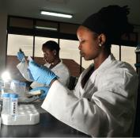
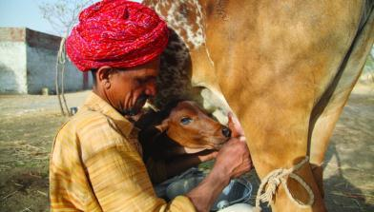
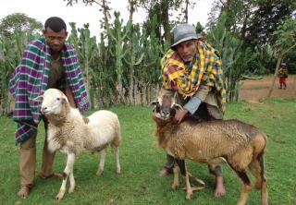


The Rural Household Multiple Indicator Survey
RHOMIS
Mark van Wijk & James Hammond
CGIAR Big Data Platform Convention
Nairobi, 3-5 October 2018
Notes:
There MUST be a CGIAR logo or a CRP logo. You can copy and paste the logo you need from the final slide of this presentation. Then you can delete that final slide
To replace a photo above, copy and paste this link in your browser: http://www.flickr.com/photos/ilri/sets/72157632057087650/detail/
Find a photo you like and the right size, copy and paste it in the block above.

Slide 2
We make use of the advantages of digital collection tools in order to
(Rural Household Multiple Indicator Survey)
  Systematize and harmonize data collection and indicator quantification
  Build up libraries of survey and analyses code
  Process data rapidly and perform key visualizations
  Data quality control
  Survey implementation control

Slide 3
Standardised RHoMIS Content
with Flexibility to Tailor
Drivers & Strategies
Performance
Welfare
Farm HH Characteristics:
Family Size/Composition
Gendered Decision-Making
Cultivated Land
Livestock Holdings
Food Security:
Food Availability
Hunger and Food Insecurity Access Scale (HFIAS)
Household Diet Diversity Score (HDDS)
Economic:
Value and Sales of Farm Production
Off-farm income
Livelihoods:
Market Orientation
Livestock Orientation
Off-Farm Activities
Poverty:
Progress out of Poverty (PPI)
Gross Income ($ per day)
Agricultural System:
Land Allocation
Crop Diversity
Intensification-
Fertilization
Irrigation
Integration
Agricultural System:
Farm Productivity
Crop Productivity
Livestock Productivity
Environment:
GHG Emissions
GHG Emissions Intensity
+ Optional Additional Modules
+ Other User-Defined Indicators of Interest

Slide 4
Additional Modules
FIES (Food Insecurity Experience Scale)
Variations on dietary diversity (MDDW, IDDS etc)
Food Consumption Score
Coping Strategies
WASH (Water sanitation and hygeine)
Debts and Aid
Motivations
Recent Changes
Tree Use
Environmental Resources
Cattle Feed
Cattle Diseases
Household Expenditure
Information sharing
Climate Observations
Subjective Household Vulnerability

Slide 5
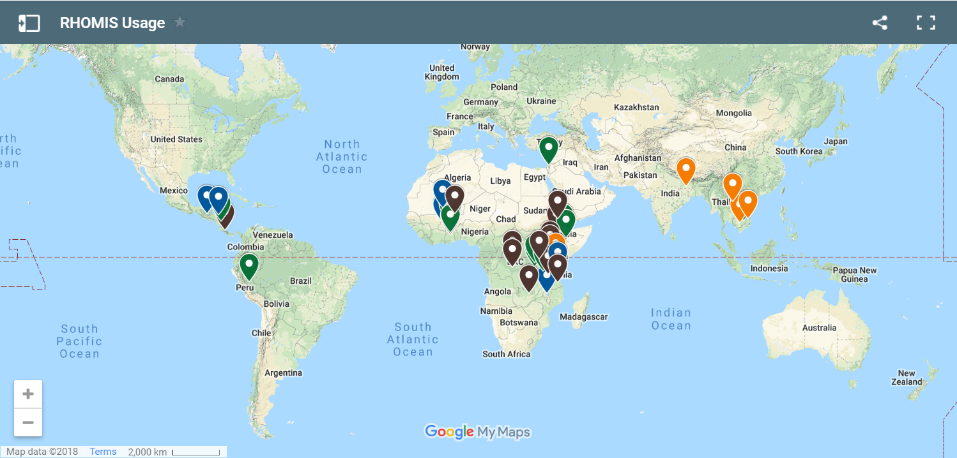

Wide uptake: 22000 households surveyed in 26 countries; for updates see www.rhomis.org

Slide 6
From single site analyses to ‘global’ across site comparisons
Rapid pace of change for rural smallholders in East Africa: prosperity is driven by off farm income, in tandem with agricultural intensification
James Hammond, Tim Pagella, Simon Fraval , Jannike Wichern, Nils Teufel, Esther Kihoro, Mario Herrero, Todd S. Rosenstock, and Mark T. van Wijk

Slide 7
From single site analyses to ‘global’ across site comparisons
Rapid pace of change for rural smallholders in East Africa: prosperity is driven by off farm income, in tandem with agricultural intensification
James Hammond, Tim Pagella, Simon Fraval , Jannike Wichern, Nils Teufel, Esther Kihoro, Mario Herrero, Todd S. Rosenstock, and Mark T. van Wijk
Intensifying Inequity? Gendered Trends in Intensification and Diversification of Farm Systems in East Africa
Katie Tavenner, Mark van Wijk, James Hammond, Nicoline deHaan, Isabelle Baltenweck, David Baines, Pietro Carpena, Tom Skirrow, Todd Rosenstock, Christine Lamanna, Mary Ng’endo, Sabrina Chesterman, Nictor Namoi, Lucas Manda, Nils Teufel, Esther Kihoro, Jacob van Etten, Jonathan Steinke

Slide 8
From single site analyses to ‘global’ across site comparisons
Rapid pace of change for rural smallholders in East Africa: prosperity is driven by off farm income, in tandem with agricultural intensification
James Hammond, Tim Pagella, Simon Fraval , Jannike Wichern, Nils Teufel, Esther Kihoro, Mario Herrero, Todd S. Rosenstock, and Mark T. van Wijk
Intensifying Inequity? Gendered Trends in Intensification and Diversification of Farm Systems in East Africa
Katie Tavenner, Mark van Wijk, James Hammond, Nicoline deHaan, Isabelle Baltenweck, David Baines, Pietro Carpena, Tom Skirrow, Todd Rosenstock, Christine Lamanna, Mary Ng’endo, Sabrina Chesterman, Nictor Namoi, Lucas Manda, Nils Teufel, Esther Kihoro, Jacob van Etten, Jonathan Steinke
The nutritional gaps of rural households in East and West Africa: prevalence based on rapid indicators
Simon Fraval, James Hammond, Augustine Ayantunde, Imke de Boer, Jessica R. Bogard, David Baines, Caroline Bosire, Pietro Carpena, Sabrina Chesterman, Paul Dontsop, Jacob van Etten, Mario Herrero, Esther Kihoro, Christine Lamanna, Mats Lannerstad, Mary Ng’endo, Paulin Njingulula, Chris Okafor, Simon J. Oosting, Tim Pagella, James Rao, Todd Rosenstock, Tom Skirrow, Jonathan Steinke, Clare M. Stirling, Nils Teufel, Bernard Vanlauwe, Katarina Waha, Jannike Wichern, Viviane Yameogo, Mark T. van Wijk

Slide 9
From single site analyses to ‘global’ across site comparisons
Rapid pace of change for rural smallholders in East Africa: prosperity is driven by off farm income, in tandem with agricultural intensification
James Hammond, Tim Pagella, Simon Fraval , Jannike Wichern, Nils Teufel, Esther Kihoro, Mario Herrero, Todd S. Rosenstock, and Mark T. van Wijk
Intensifying Inequity? Gendered Trends in Intensification and Diversification of Farm Systems in East Africa
Katie Tavenner, Mark van Wijk, James Hammond, Nicoline deHaan, Isabelle Baltenweck, David Baines, Pietro Carpena, Tom Skirrow, Todd Rosenstock, Christine Lamanna, Mary Ng’endo, Sabrina Chesterman, Nictor Namoi, Lucas Manda, Nils Teufel, Esther Kihoro, Jacob van Etten, Jonathan Steinke
The nutritional gaps of rural households in East and West Africa: prevalence based on rapid indicators
Simon Fraval, James Hammond, Augustine Ayantunde, Imke de Boer, Jessica R. Bogard, David Baines, Caroline Bosire, Pietro Carpena, Sabrina Chesterman, Paul Dontsop, Jacob van Etten, Mario Herrero, Esther Kihoro, Christine Lamanna, Mats Lannerstad, Mary Ng’endo, Paulin Njingulula, Chris Okafor, Simon J. Oosting, Tim Pagella, James Rao, Todd Rosenstock, Tom Skirrow, Jonathan Steinke, Clare M. Stirling, Nils Teufel, Bernard Vanlauwe, Katarina Waha, Jannike Wichern, Viviane Yameogo, Mark T. van Wijk
The where, what, how and for whom of the production diversity – dietary diversity relation
James Hammond, Simon Fraval, Augustine Ayantunde, Imke de Boer, Jessica R. Bogard, David Baines, Caroline Bosire, Pietro Carpena, Sabrina Chesterman, Paul Dontsop, Jacob van Etten, Mario Herrero, Esther Kihoro, Christine Lamanna, Mats Lannerstad, Mary Ng’endo, Paulin Njingulula, Chris Okafor, Simon J. Oosting, Tim Pagella, James Rao, Todd Rosenstock, Tom Skirrow, Jonathan Steinke, Clare M. Stirling, Nils Teufel, Bernard Vanlauwe, Katarina Waha, Jannike Wichern, Viviane Yameogo, Mark T. van Wijk, Mark van Wijk

Slide 10
From single site analyses to ‘global’ across site comparisons
Rapid pace of change for rural smallholders in East Africa: prosperity is driven by off farm income, in tandem with agricultural intensification
James Hammond, Tim Pagella, Simon Fraval , Jannike Wichern, Nils Teufel, Esther Kihoro, Mario Herrero, Todd S. Rosenstock, and Mark T. van Wijk
Intensifying Inequity? Gendered Trends in Intensification and Diversification of Farm Systems in East Africa
Katie Tavenner, Mark van Wijk, James Hammond, Nicoline deHaan, Isabelle Baltenweck, David Baines, Pietro Carpena, Tom Skirrow, Todd Rosenstock, Christine Lamanna, Mary Ng’endo, Sabrina Chesterman, Nictor Namoi, Lucas Manda, Nils Teufel, Esther Kihoro, Jacob van Etten, Jonathan Steinke
The nutritional gaps of rural households in East and West Africa: prevalence based on rapid indicators
Simon Fraval, James Hammond, Augustine Ayantunde, Imke de Boer, Jessica R. Bogard, David Baines, Caroline Bosire, Pietro Carpena, Sabrina Chesterman, Paul Dontsop, Jacob van Etten, Mario Herrero, Esther Kihoro, Christine Lamanna, Mats Lannerstad, Mary Ng’endo, Paulin Njingulula, Chris Okafor, Simon J. Oosting, Tim Pagella, James Rao, Todd Rosenstock, Tom Skirrow, Jonathan Steinke, Clare M. Stirling, Nils Teufel, Bernard Vanlauwe, Katarina Waha, Jannike Wichern, Viviane Yameogo, Mark T. van Wijk
The where, what, how and for whom of the production diversity – dietary diversity relation
James Hammond, Simon Fraval, Augustine Ayantunde, Imke de Boer, Jessica R. Bogard, David Baines, Caroline Bosire, Pietro Carpena, Sabrina Chesterman, Paul Dontsop, Jacob van Etten, Mario Herrero, Esther Kihoro, Christine Lamanna, Mats Lannerstad, Mary Ng’endo, Paulin Njingulula, Chris Okafor, Simon J. Oosting, Tim Pagella, James Rao, Todd Rosenstock, Tom Skirrow, Jonathan Steinke, Clare M. Stirling, Nils Teufel, Bernard Vanlauwe, Katarina Waha, Jannike Wichern, Viviane Yameogo, Mark T. van Wijk, Mark van Wijk
The Rural Household Multiple Indicator Survey data of more than 11,000 farm households in 20 countries.
Mark van Wijk, James Hammond, Simon Fraval, Nils Teufel, Esther Kihoro, Jacob van Etten, Jonathan Steinke, Sabine Douxchamps, Adrian Bolliger, Randall Ritzema,
Augustine Ayantunde, Viviane Yameogo, Todd Rosenstock, Christine Lamanna, Mary Ng’endo, Sabrina Chesterman, Clare Stirling, Amon Chinyophiro, Ken Chilingulo, David Baines, Pietro Carpena, Tom Skirrow, Jannike Wichern, Caroline Bosire, James Rao, Joseph Auma, Vesalio Mora, Nictor Namoi , Lucas Manda.

