Slide 1
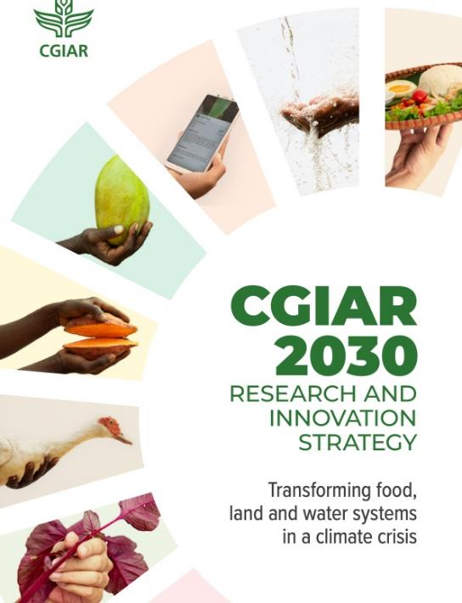


Antimicrobial resistance in the animal sector
Arshnee Moodley, Team leader, Antimicrobial Resistance, ILRI
a.moodley@cgiar.org
ReAct Africa and South Centre 2022 annual conference
Lusaka, Zambia
25–27 July 2022

Slide 2

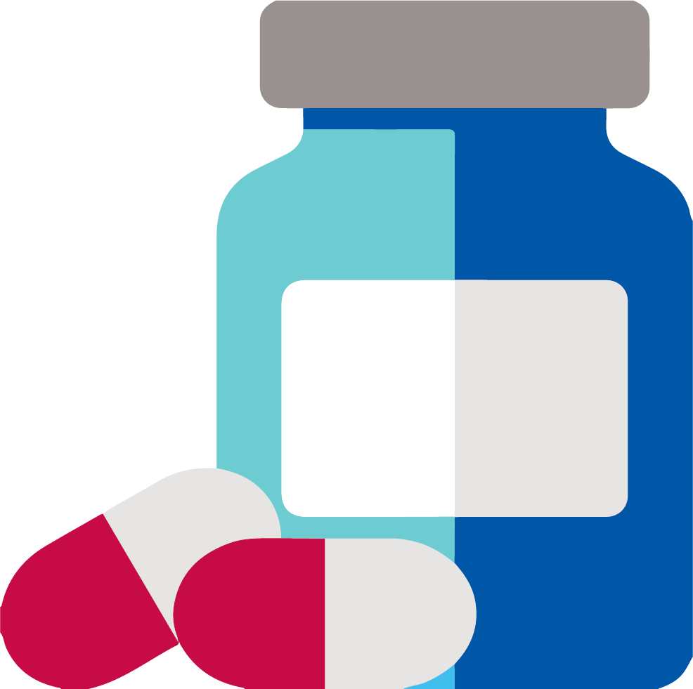
Antimicrobials are essential! But AMR cannot be eradicated
Humans
Environment
Animals
Food safety & security
Water & soil quality, climate change, crop production
productivity, welfare, zoonosis
AMU & AMR

Slide 3
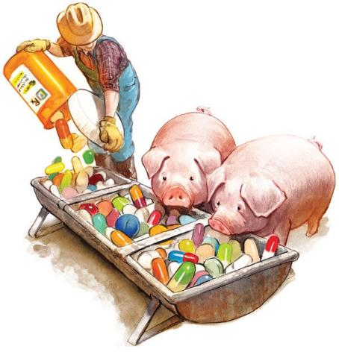
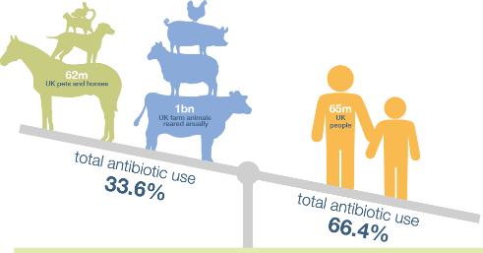
How much antibiotics do we use in animals?
“Two thirds of global consumption of antibiotics is in livestock production!!”
UK One Health report 2019 using 2017 data
https://www.farmantibiotics.org/

Slide 4
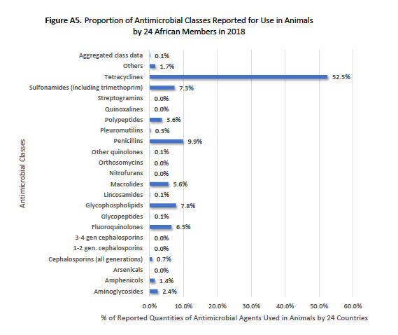
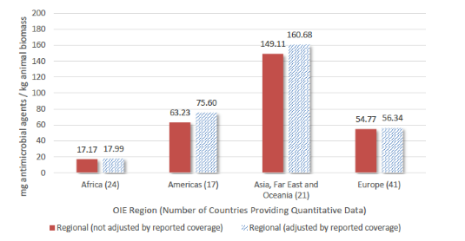
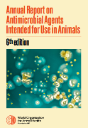
AMU in animals: Little use of human CIAs in Africa
$3/100g
$5/100ml

Slide 5
AMR levels amongst commensal ruminant isolates in a study in Ethiopia

Slide 6
AMR levels amongst clinical poultry isolates in a study in Uganda

Slide 7
AMR levels amongst poultry clinical isolates in a study in Bangladesh

Slide 8
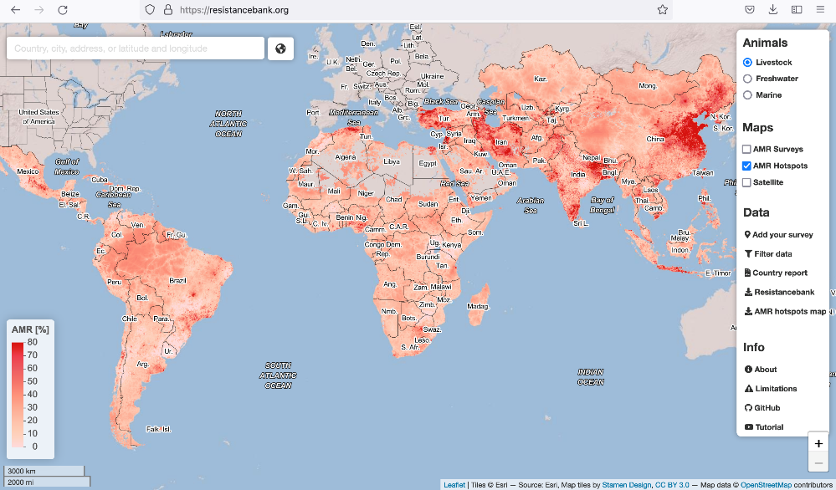
We have AMR in our livestock but what does it mean and to whom?
Becareful how we interpret this data!

Slide 9
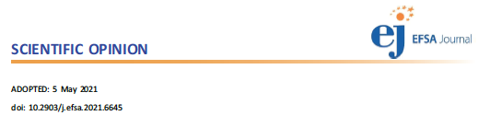

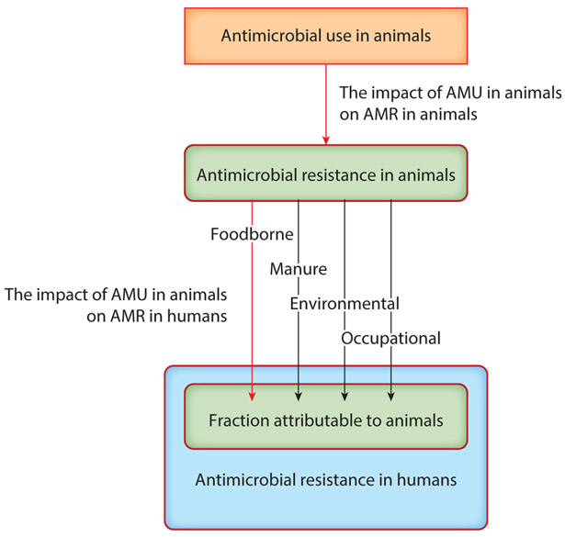
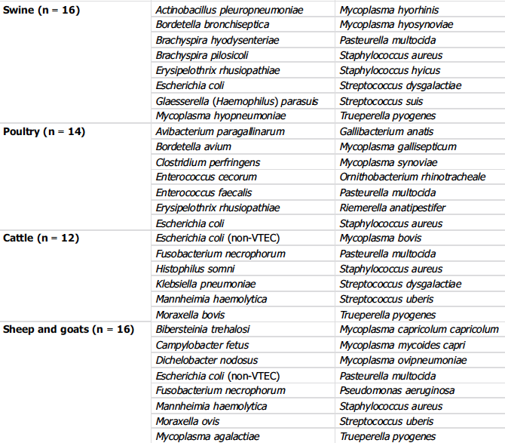
What is the burden of AMR in animals?
?
?
?
?
Innes et al., 2020

Slide 10


How we address AMR in the agricultural sector in LMICs? Be mindful of the unintended impacts
Intensifying food systems
Feed crisis and climate change
Semi-intensive farmers
Poor consumer power
Livelihoods = Household income
Food & nutritional security
Gender and Youth equity
We can’t regulate our way to reducing AMU and AMR: Regulation is needed but it’s not enough
We can’t train our way to reducing AMU and AMR: Capacity building is useful if incentives are in place

Slide 11
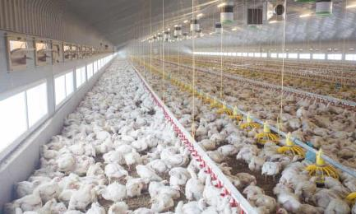
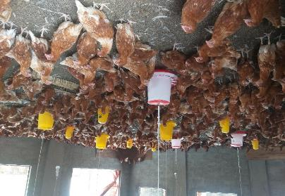
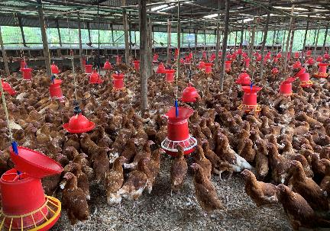
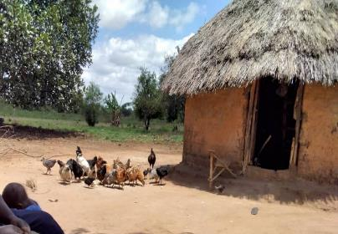
Mindful that animal production systems, resources and capacities are different: Which system are we focusing on?
UK
UG
KE
UG

Slide 12
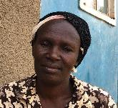
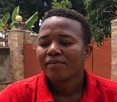
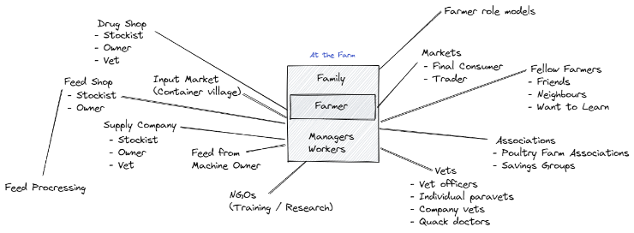
Who has to change their practices?
Many actors and influencers in the production system
Sensitive business affected by internal and external factors instantly
  Clear gender issues
Farmers have different farming profiles with different behaviors but similar priorities and aspirations “take care of my family and grow my business”
Small Semi-Intensive Farmers
Big Semi-Intensive Farmers

Slide 13
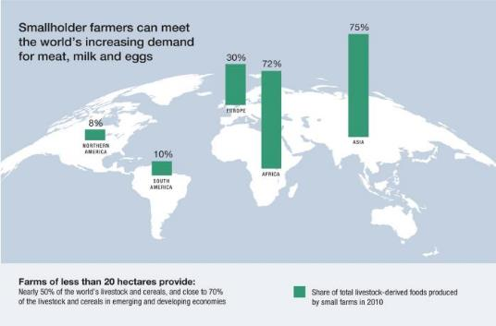
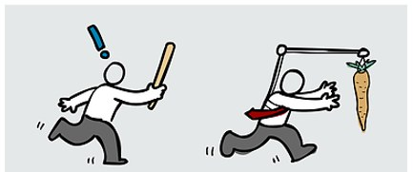
What are the incentives for change? Or the cost-benefits?
Regulate, formalise or modernize vs. informal, dispersed, rural, untraceable & tradition or culture
Consumer/market drive is unlikely to be a major driver

Slide 14
How much would it cost to vaccinate vs. treat poultry?
Tetracycline = $3/100g
  Mix in 150L water for 750 birds (assuming each bird consumes 0.2L/day)
Newcastle Disease Vaccine (subsidized vaccine) = $0.035/dose (mixed in water)
  For 750 birds = $26.25.
  Often give vitamins (additional cost)
Combination vaccine ($0.09/vaccine + $0.05 vet= $0.14)
  For 750 birds = $105

Slide 15
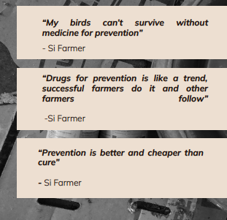
Behaviour adoptions: When do farmers adopt new behaviours?
Motivators
Maximize profits
Fear
By law
Social proof
Barriers
Affordability
High effort required
Lack of knowledge (risks, how to, efficacy)

Slide 16

































Mitigating agricultural associated AMR risks together!

Slide 17
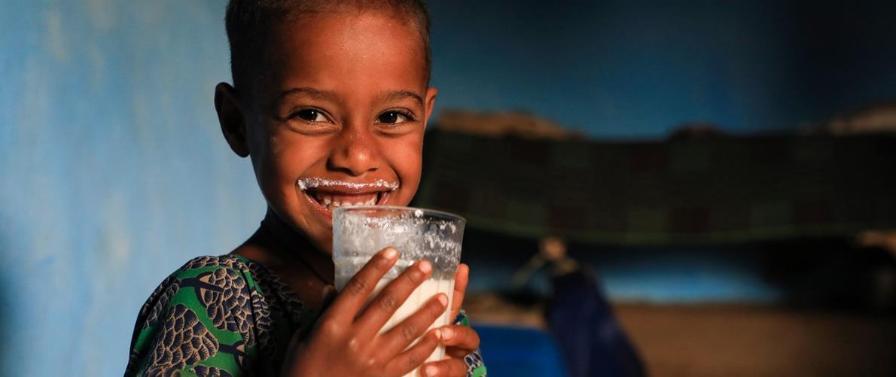
THANK YOU

