Slide 1
Photo report on Africa RISING research for development (R4D) and scaling initiatives field visit in SNNPR, Ethiopia
18–19 October 2018

Slide 2
Introduction
Africa RISING in the Ethiopian highlands has started implementing the second phase program since October 2016. During the second year (2018) of the second phase, the project managed to conduct action research through research for development (R4D) approach and scaling activities through strong development partnership. The R4D activities are mainly on livestock feed resources, improved crop varieties, watershed management, fertilizer studies and small mechanization. The scaling work focused mainly on demonstration of crop, livestock and natural resources management validated innovations/technologies, seed multiplication and facilitating dissemination to reach more areas and farmers.

Slide 3
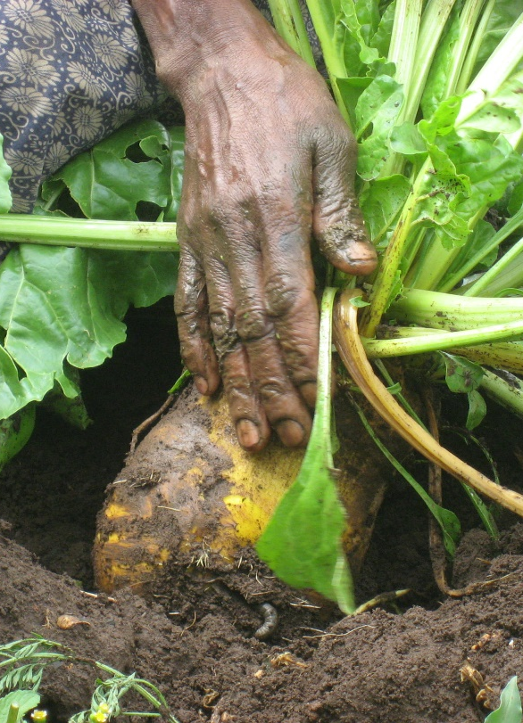
Fodder beet
Farmers in Lemo woreda of the Africa RISING site in SNNPR have started allocating cultivated land to grow fodder beet to feed their livestock. After witnessing the benefits, the demand for fodder beet has attracted many farmers in Africa RISING sites.
Important issues to be addressed through research include:
Seed production and supply system to sustainably expand cultivation and benefit more farmers
Harvesting interval of matured tubers
Protection of cultivated fields from feeding by wild animals

Slide 4
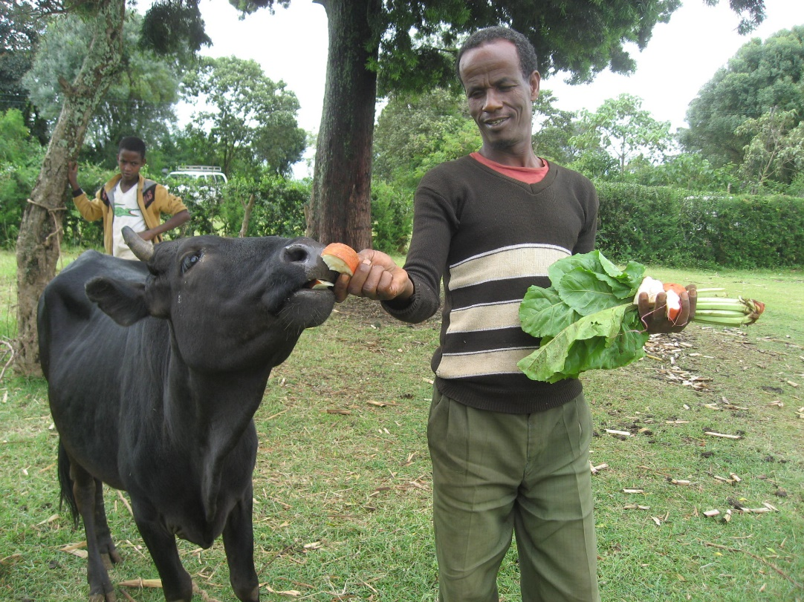

Slide 5
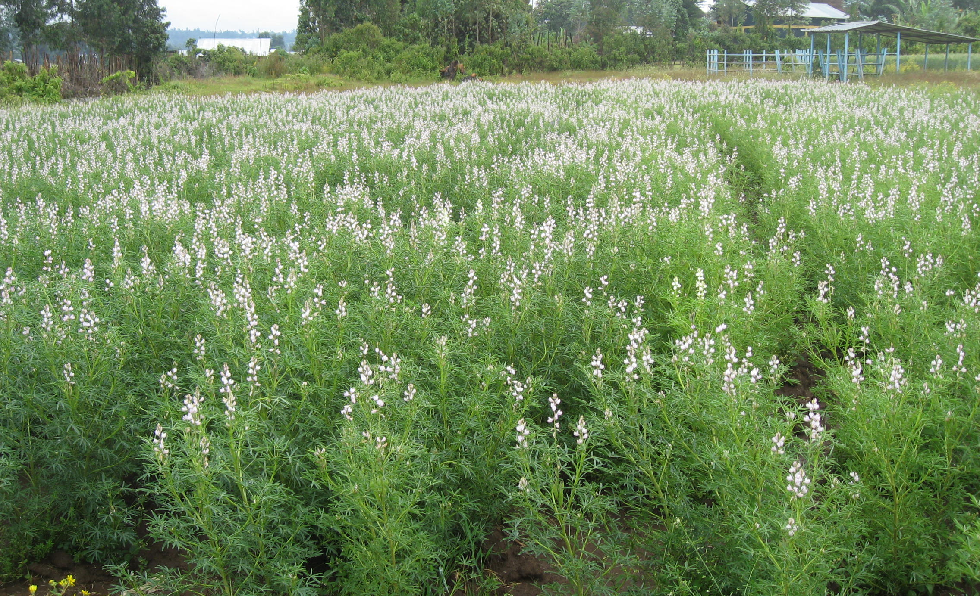
Sweet lupine seed multiplication in one of the farmer training centres in Lemo woreda, Shurmo Kebele. The seed from 2018 will be collected and distributed to more farmers on a revolving seed system arrangements. This will improve scaling of sweet lupin in 2019 cropping season.

Slide 6
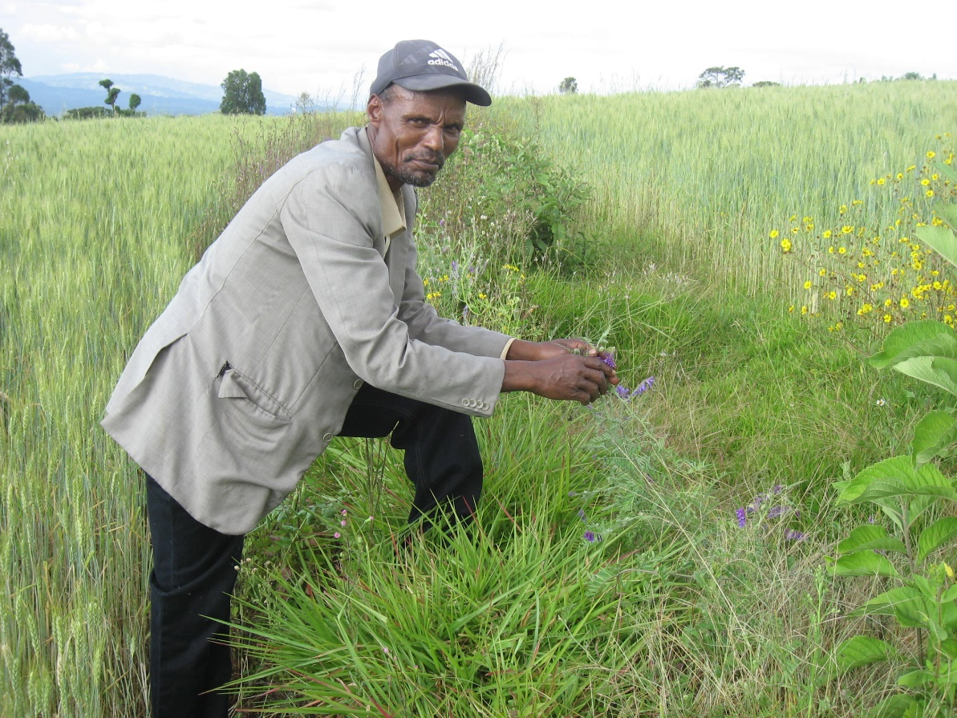
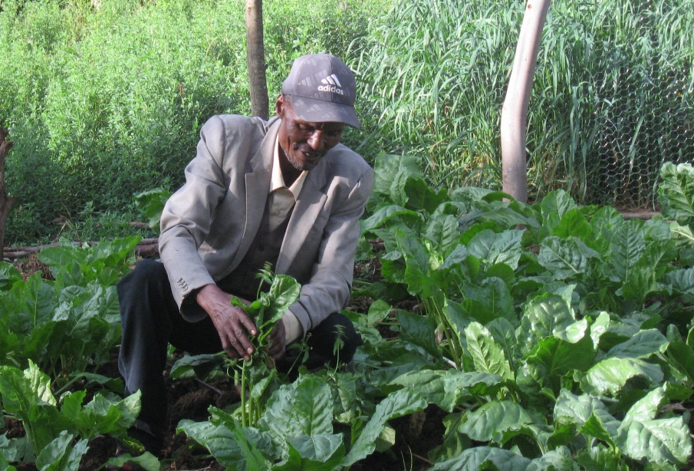
Desho grass and vetch mixture
This is a new research initiative to address farmers concerns of soil fertility depletion effects because of the frequent desho grass harvest on cultivated fields. More research is needed on the planting pattern of desho and vetch, experimental plots setup (desho alone vs desho-vetch mixture) and soil information.
Many farmers in Lemo are being motivated to plant and use more livestock feed sources. Eshetu Delese in Jawe Done kebele of the Africa RISING site participated in different Africa RISING innovations: sweet lupin, oat-vetch mixture, desho grass-vetch mixture, alfalfa, fodder beet, tree Lucerne and water harvesting pond.

Slide 7
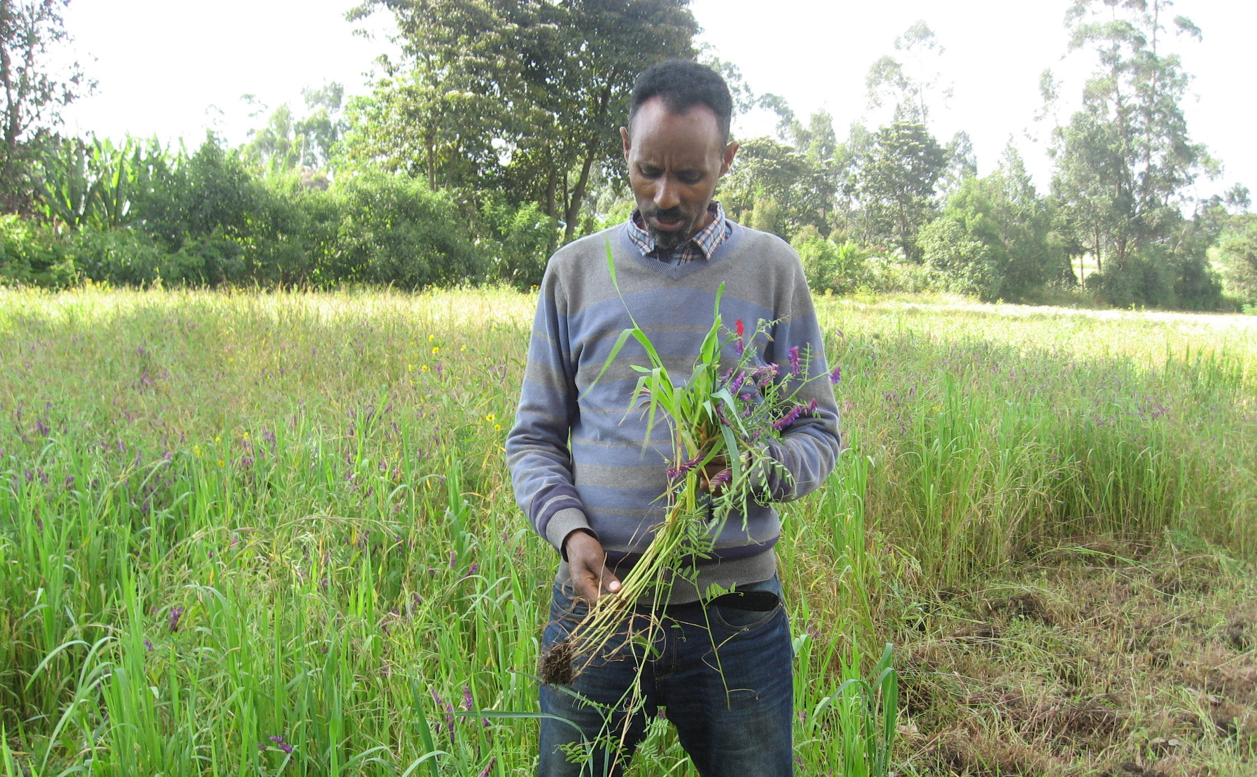
Workneh Dubale, Africa RISING site coordinator in SNNPR, showing how one of the farmers in Jawe kebele is growing oat-vetch-natural grass mixture for livestock feed. According to him, farmers believe that allowing natural grasses to grow in an oat-vetch mixture and feeding to livestock provide more energy and make them healthy.

Slide 8
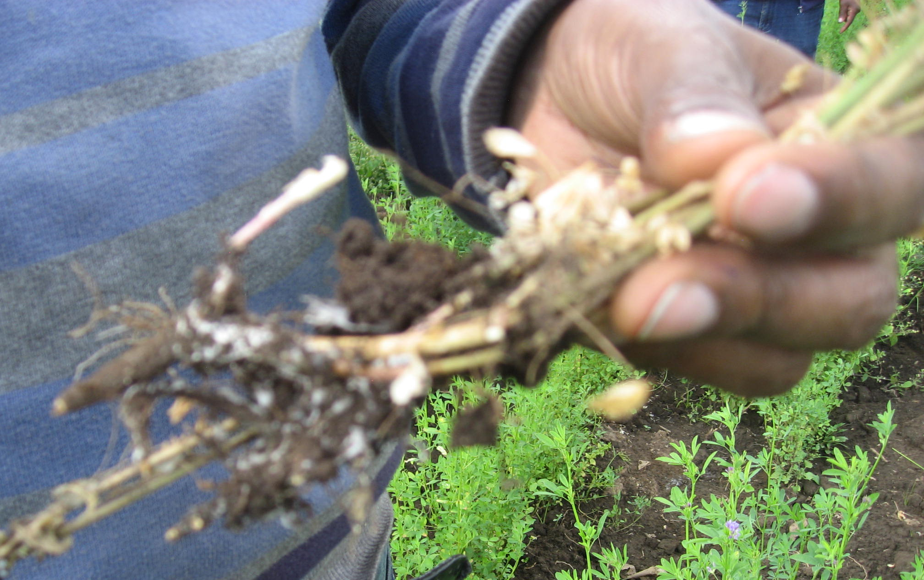
Africa RISING has introduced alfalfa as one of the protein rich feed sources. Some alfalfa plants in few farmers fields are drying. There is a need to quickly collect plant samples and take it to plant health laboratory to identify whether it is caused by a disease or other factors.

Slide 9
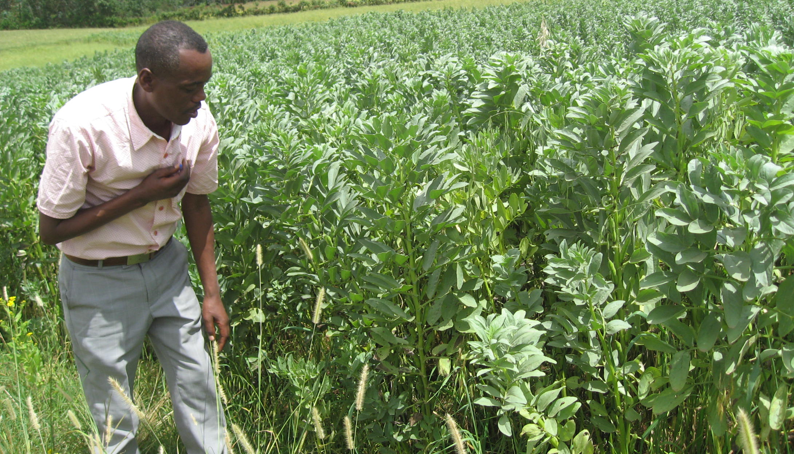
Assefa Abbiyo (Hadiya Zonal crop extension expert, SNNPR) monitoring the faba bean improved seed multiplication in Upper Gana Africa RISING kebele planted during the 2018 main cropping season. Group of farmers, through a clustered approach, have planted more than 10 ha of land with improved faba bean variety. The seed from this multiplication initiative will be distributed to more farmers in the 2019 cropping season through a revolving seed arrangements.

Slide 10
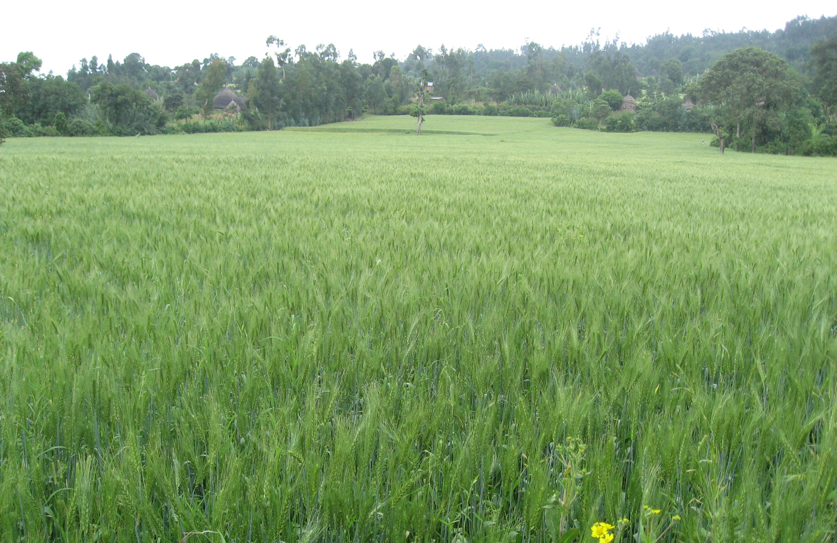
Bread wheat seed multiplication using cluster approach in Analemo woreda, SNNPR. A total of 5 ha of land is covered, and the seed from this season is expected to benefit more farmers and speed up Africa RISING scaling initiatives in the region.

Slide 11
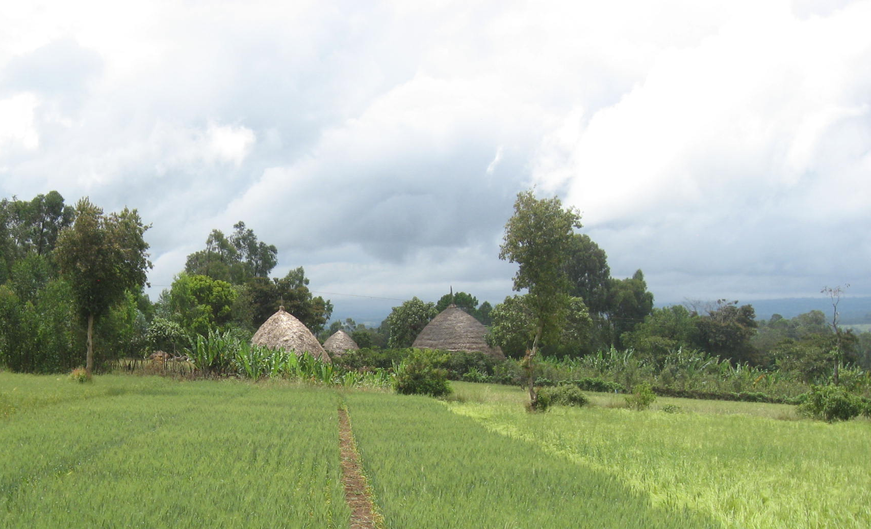
Integrated (organic and inorganic fertilizer) soil fertility management studies in Upper Gana research Kebele. Lupin, Vetch and lablab are used as sources of organic fertilizer. NPS are used as sources of inorganic fertilizer. A total of 12 treatment combinations are evaluated at three replications.

Slide 12
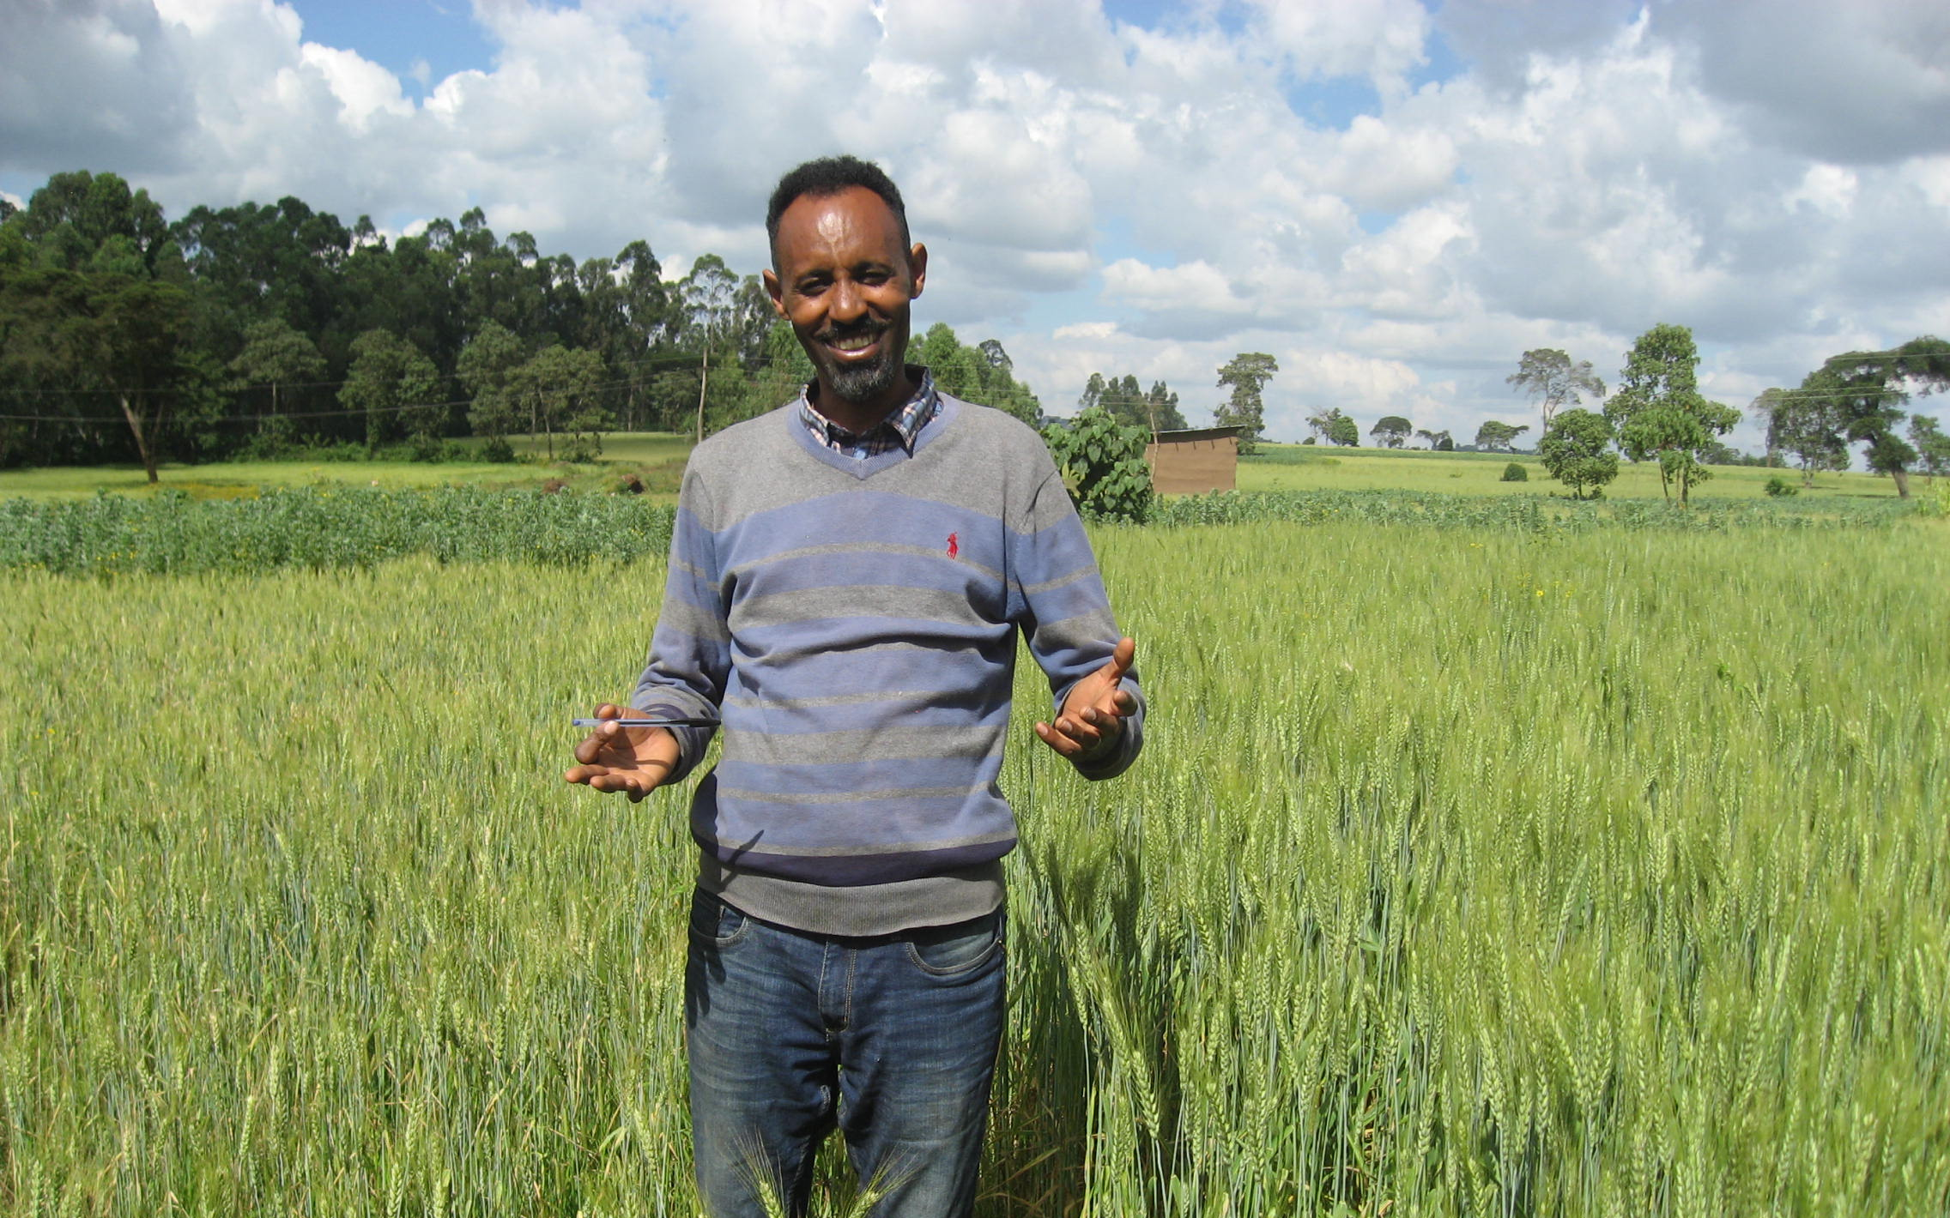
Workneh Dubale, Africa RISING site coordinator in SNNPR explaining the performance of bread wheat planted with minimum tillage and conventional practices as part of small scale mechanization intervention.

Slide 13
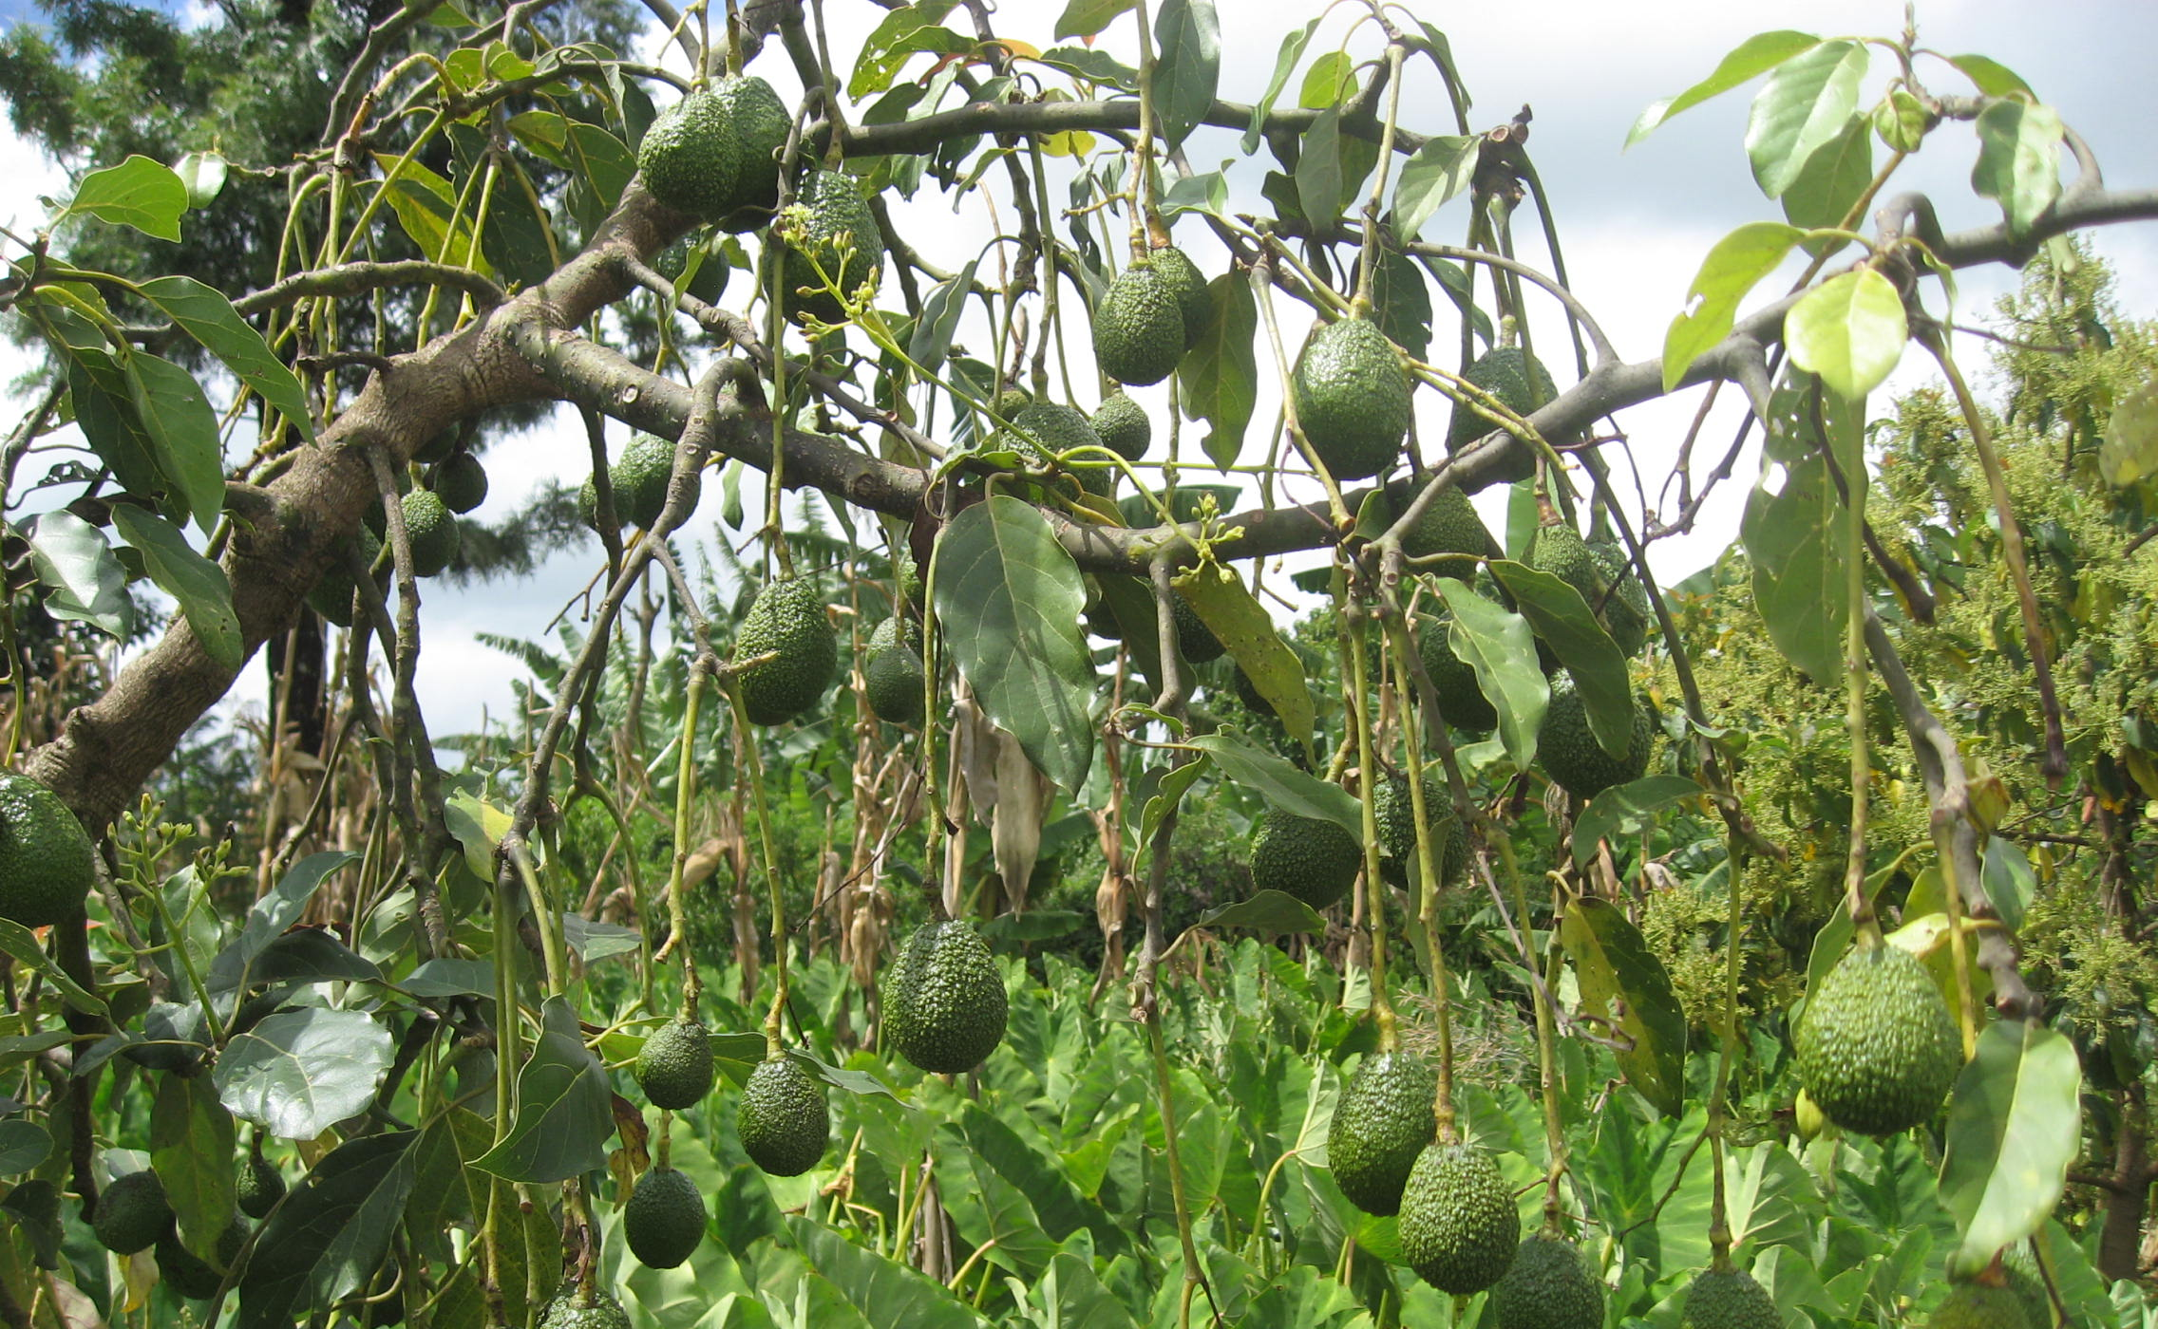
Africa RISING has introduced early fruiting and improved dwarf avocado varieties. These varieties have become attractive to farmers in terms of generating cash and its nutritional value to their families. Demand for grafted seedlings is increasing calling for a locally based seedling grafting schemes and capacity building to benefit more smallholder farmers.

Slide 14
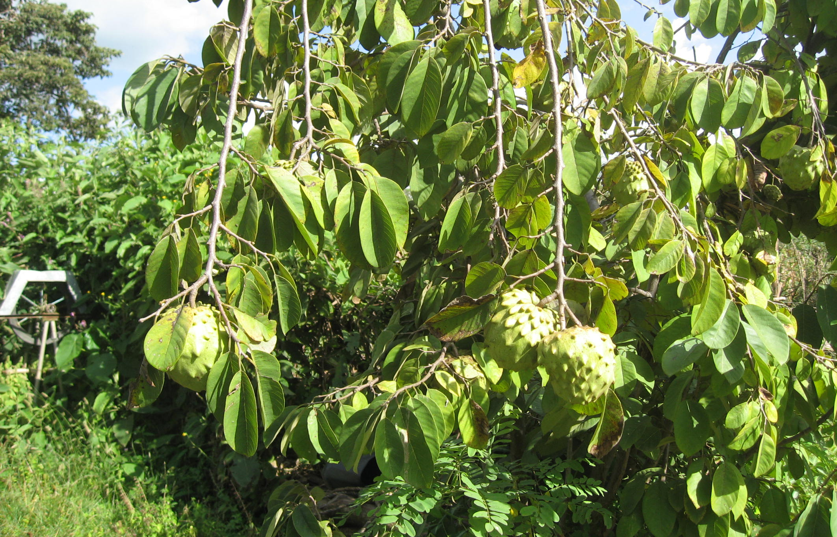
Annona cherimola x squamosa (Casimir), a potential fruit tree in Lemo Africa RISING site. The fruit is very juicy and tasty. It can be an alternative fruit tree to improve nutrition and diversify incomes of smallholder farmers.

Slide 15
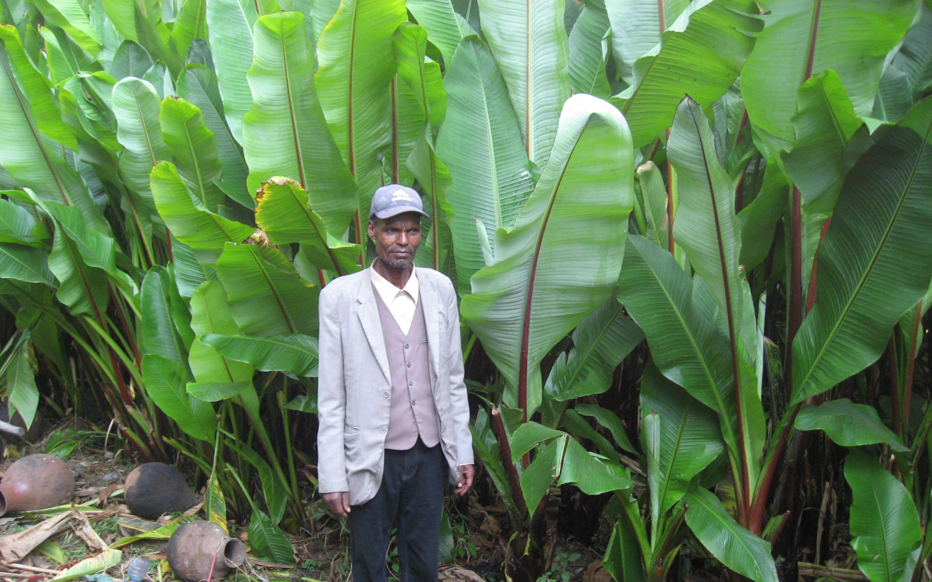
During the first phase , Africa RISING project introduced bacterial wilt disease tolerant Enset varieties. Farmers are already multiplying selected Enset varieties/clones and selling in their localities and beyond. This is helping farmers to generate and diversify incomes.

Slide 16










Africa RISING CGIAR partners in Ethiopia
Notes:
Ethiopia

Slide 17

Africa RISING local partners in Ethiopia
Academic institutions:
  Wachemo, Mekelle, Madawolabu, Debre Berhan and Hawassa universities; Maichew Agricultural College
Regional research organizations:
  Amhara Regional Agricultural Research Institute, Southern Agricultural Research Institute, Tigray Agricultural Research Institute, Oromia Agricultural Research Institute
Offices of Agriculture:
  Endamehonei (Tigray), Basona Worena (Amhara), Lemo (SNNRP) and Sinana (Oromia)
Federal research organizations:
  Ethiopian Institute for Agricultural Research, Ethiopian Health and Nutrition Research Institute and Agricultural Transformation Agency
Non government organizations/projects:
  - inter Aide France, Send a Cow, Ethiopian Catholic Church World Vision, GRAD/REST, Hundie
Private sectors:
  Oromia Seed Enterprise , Fuji Integrated farm, Raya,Dashen and Habesha Breweries
Innovation Laboratories
  SIIL- Sustainable Intensification Innovation Lab, and ILSSI- Innovation Lab for Small-scale Irrigation

Slide 18
Credits
Produced by Africa RISING Project in Ethiopia
Compiled by Kindu Mekonnen (ILRI)
Photos: Kindu Mekonnen
Our appreciation goes to the site coordinator and his team, CGIAR team members, and local partner organizations including farmers, in Africa RISING project site in Lemo and scaling zones SNNPR.

