Slide 1






Food safety risk prioritization: Case studies from Asia
Hung Nguyen-Viet: Co-leader, ILRI Animal and Human Health Program, Kenya
Sinh Dang-Xuan: Postdoctoral scientist, ILRI Animal and Human Health Program, Vietnam
Delia Grace: Professor at Natural Resources Institute and joint-appointed scientist at ILRI, UK

Slide 2
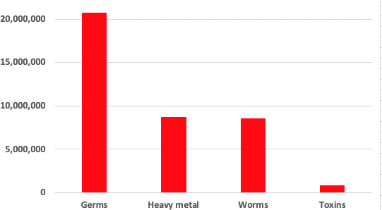
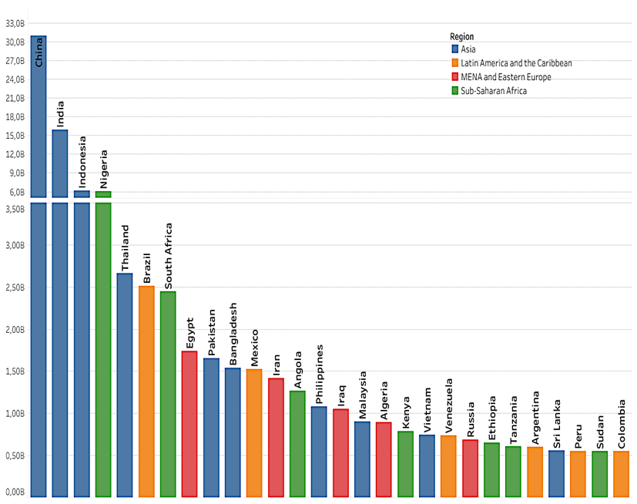
Context of foodborne diseases
Years of life lost annually for FBD
31 hazards
600 mio illnesses
480,000 deaths
41 million DALYs
Domestic costs may be 20 times trade costs
Cost estimates for 2016 : > US$ 115 billion
Productivity loss | 95
Illness treatment | 15
Trade loss or cost | 5 to 7
Burden LMIC
Havelaar et al., 2015
Gibb et al., 2019

Slide 3
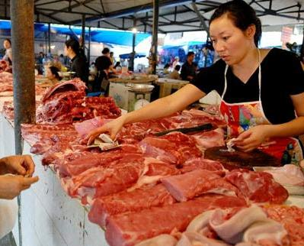
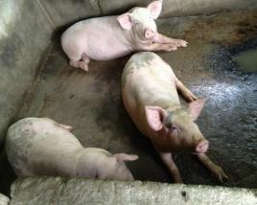
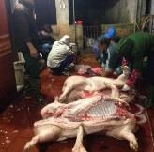
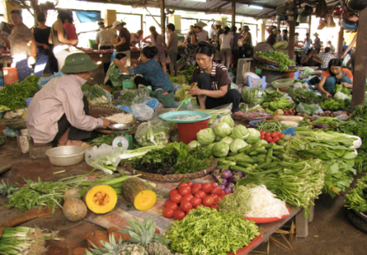
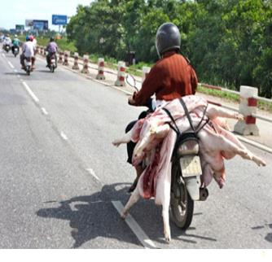
Food value chains and informal markets

Slide 4
Approaches and solutions to food safety in LMICs
Generate evidence: hazards and risks
Develop solutions to improve food safety: technological and institutional innovations
Focus: informal markets, animal source food (ASF: meat, milk and eggs) but also vegetables, pathogens but also aflatoxin and chemical hazards
Consideration: gender, nutrition, animal welfare
Risk assessment
Risk management
Risk communication
Risk analysis framework
Risk-based approach

Slide 5

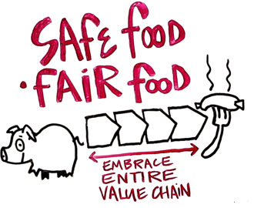
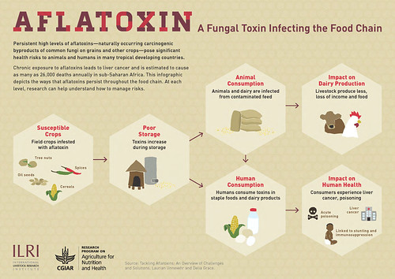





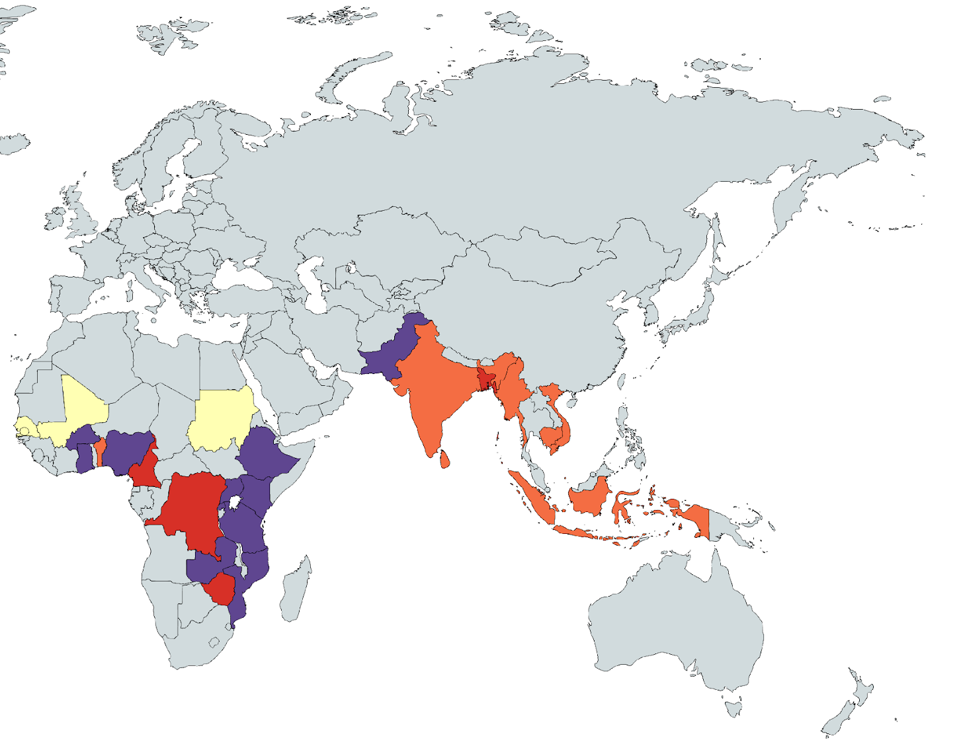










Our food safety work
Hung Nguyen
Delia Grace
1~ 15 scientists
~~ 5 post docs
~~ 10 PhDs
~~ 12 MSc

Slide 6
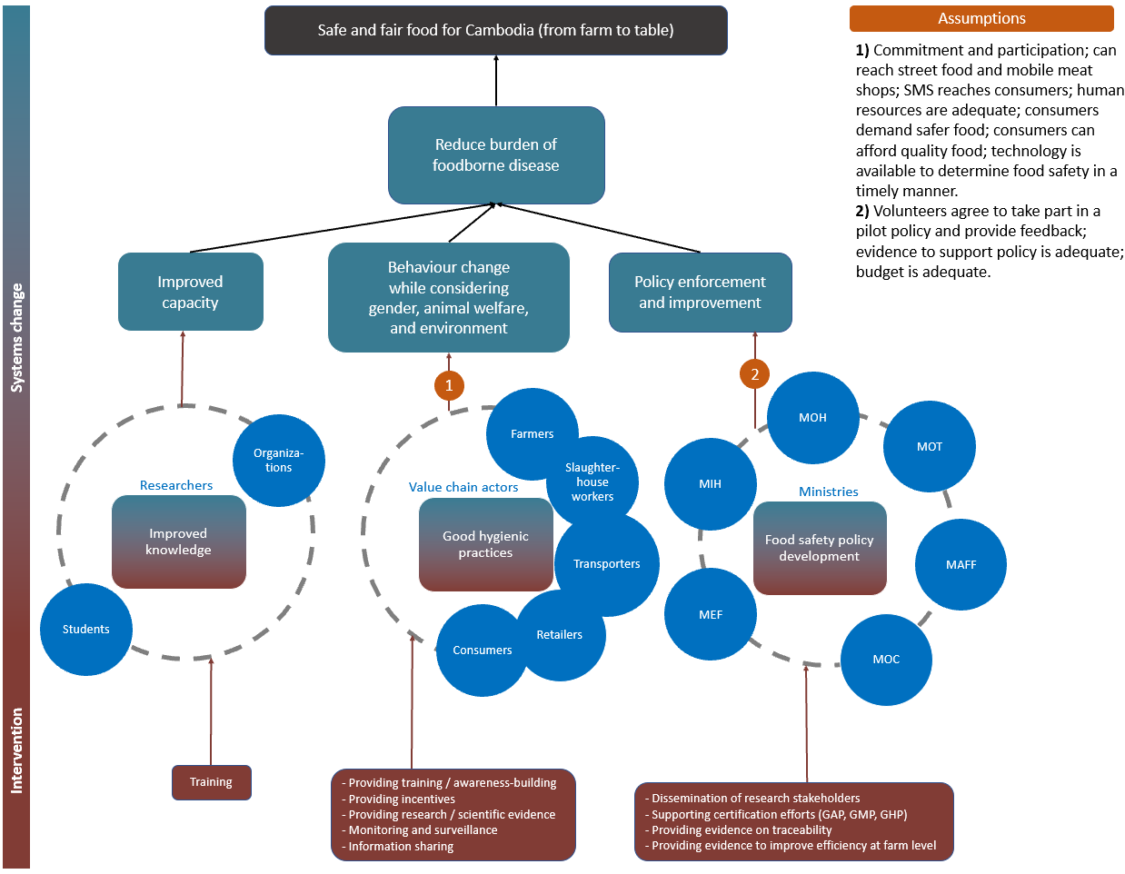
Theory of Change

Slide 7

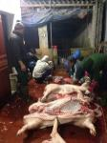
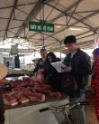
PigRISK: Pork safety in Vietnam (2012-2017)
Microbial and chemical risk assessment
Salmonella risk pathways developed for producers, slaughterhouse and consumers, quantitative microbial risk assessment (QMRA) risk for consumer
Chemical risk assessment: antibiotic residues, banned chemicals, heavy metals
Farm
Transportation to SH
Slaughterhouse
Retailer
Consumers
Feed in bags, remaining feeds at the cages, environment
Liver
Kidney
Pork
Consumption survey
1,275 samples (farms, slaughterhouse, market) collected during 1 year

Slide 8
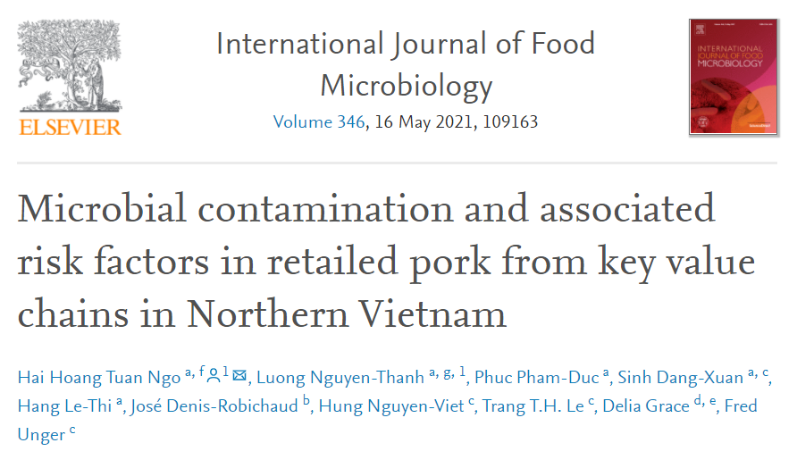
SafePORK - Cross-sectional study
Methodology
Result
 | Salmonella prevalence | TBC exceed standard
Traditional | 60.5% | 97.3%
Modern | 50.9% | 88%
Food service | 80.5% | 94.6%
Overall | 58.1% | 93.8%
Sample size: 671 raw pork samples
  Traditional pork shops: 266 shops
  Modern pork shops: 123 shops
  Food services: 77 stalls
Data collection:
  1-5 pork sample per shop
  Food safety condition
Laboratory testing
  Salmonella presence: 671 samples
  TBC (colony forming units (CFU)/g): 177 samples
Associated factors to microbial contamination:
  Traditional shops:
    Use separate cloths
    Sewage or stagnant water
    Transportation time
  Modern shops:
    Selling many types of meat
    Storage temperature

Slide 9
QMRA for salmonellosis
Age and gender groups | Estimated annual salmonellosis incidence rate (Mean (90% CI)) (%)
Children (under 5 years old) | 11.18 (0 – 45.05)
Adult female (6-60 years old) | 16.41 (0.01 – 53.86)
Adult male (6-60 years old) | 19.29 (0.04 – 59.06)
Elder (over 60 years old) | 20.41 (0.09 – 60.76)
Overall | 17.7 (0.89 – 45.96)
94 million people
Cases of foodborne diseases by Salmonella in pork at 17%: 16 million get sick
$ 107: cost of hospitalization/FBD case
Dang Xuan Sinh et al, 2016, IJPH

Slide 10
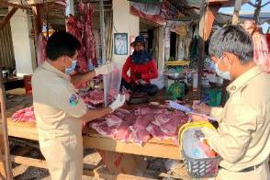
Safe Food, Fair Food for Cambodia (2018-2021)
A nationwide multi-hazard survey in markets in Cambodia found the prevalence in meat (pork and chicken) of Salmonella was 43% and of Staphylococcus aureus was 31%.
The cost of illness of foodborne diarrhea was USD 63 per case.
Cost | National Hospital (n=44) | Referral Hospital (n=60) | Regional Hosp. (n=100) | Community Clinic (n=62) | Overall (n=266)
Direct medical cost
[USD] | 125.77 | 9.42 | 27.85 | 4.19 | 34.38
Direct non-medical cost
[USD] | 40.64 | 8.36 | 26.33 | 0.30 | 18.58
Indirect cost
[USD] | 21.43 | 6.38 | 10.89 | 3.08 | 9.80
Total cost [USD] | 185.88 | 24.16 | 65.07 | 7.57 | 62.76

Slide 11
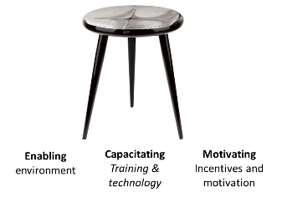
Interventions: the 3 legged stool
Incentives
ENABLING
ENVIRONMENT
Technology & training
Policy,
infrastructure
Moral, Social, Material
Capacitate VC actors
Nudges
Build capacity & motivation of regulators
Innovation
Motivate & facilitate behaviour change
Inform, monitor & legitimize VC actors

Slide 12
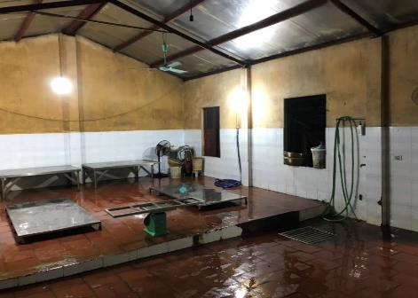
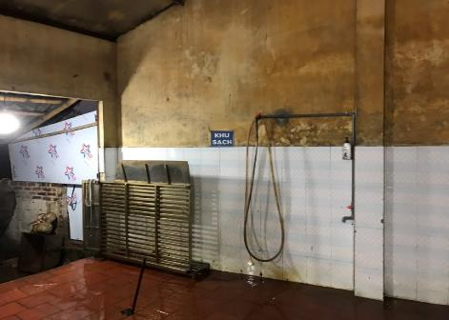
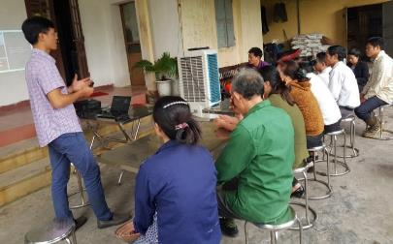
Food safety intervention at slaughter in Vietnam
INTERVENTION
Results at SH
Hand disinfection liquid
Re-organized water and electrical system
Installed grid
Grid
Faucet
Training for SH owners & workers
Photo credit: Sinh Dang Xuan/Chi Nguyen ILRI 2020

Slide 13
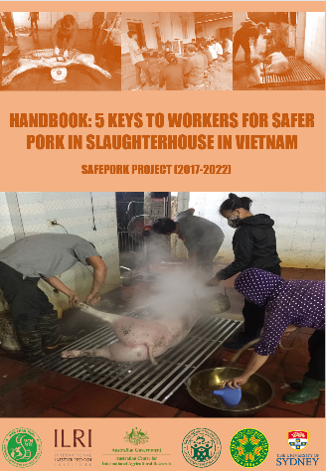
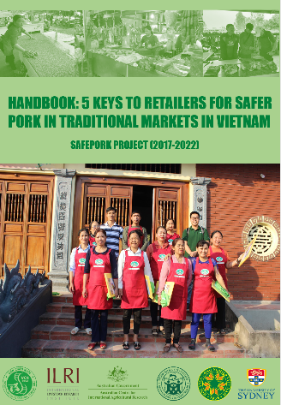
Food safety intervention at slaughterhouse and retail (2018-2022)
INTERVENTION
Development of Instruction & Training materials
Approach:
Participatory risk-assessment
Supportive formative research with model retailers
Risk communication
Key content*:
-Grid slaughter
-Frequent washing (and disinfection)
-Training
-Separation clean/dirty
-Branding
Key content:
-Easy to clean surface
-Frequent washing (and disinfection)
-Separation (fresh/cooked)
-Training
-Hygienic cutting board
-Branding
Handbooks
*only Vietnam

Slide 14
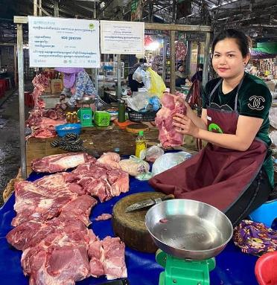
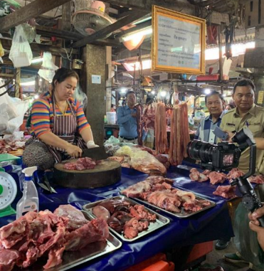
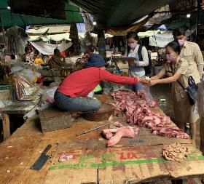
Market Vendors in cambodia
Trial: Vendor who get our incentive and used
Trial retailers:
84% of the trial retailers had a good knowledge of safe meat handling compared to the control group (44%)
The KAP scores of retailers in the intervention significantly improved.
Signpost
And Training certificate
Washing detergent
Control: Vendors who practice and operate their selling as usual
Easy to clean table surface
Apron
Current surface (carton board)
Tray

Slide 15
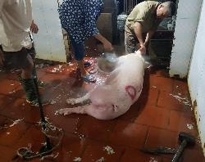
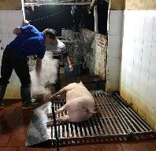
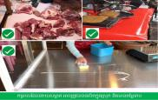
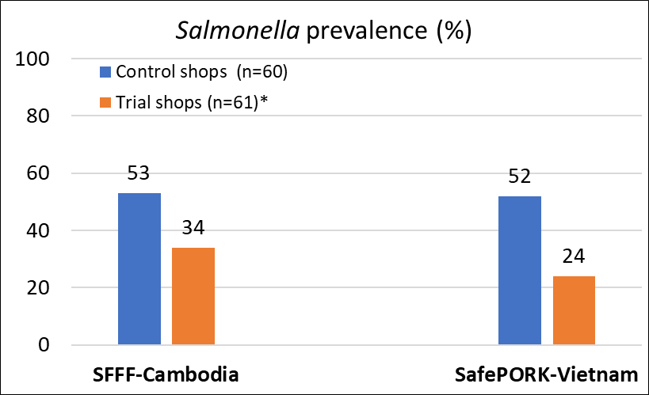
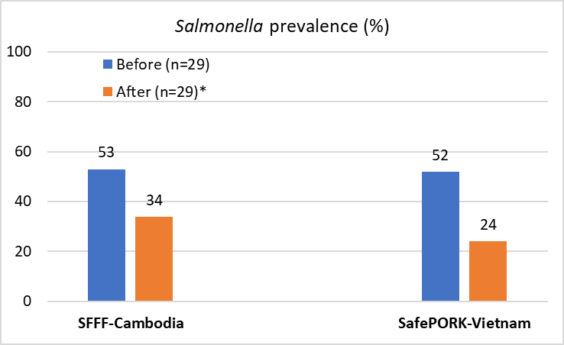
Impact of bacterial reduction from simple interventions at SH & MK
Before
After
Salmonella prevalence (%) in pork at traditional markets
Total bacterial count in pig slaughterhouses and marketed pork
Pig slaughterhouse in Vietnam | Baseline | Middle | Endline
Floor (Log CFU/cm²) | 6.0 | 4.4* | 4.6*
Worker hand (Log CFU/hand) | 7.2 | 7.1 | 7.0
Pig carcass (Log CFU/cm²) | 4.5 | 4.2 | 4.4
Pork shop in SFFF-Cambodia | Control (n=180) |  | Trial (n=180)
Marketed pork (Log CFU/g) | 6.9 |  | 6.3*

Slide 16
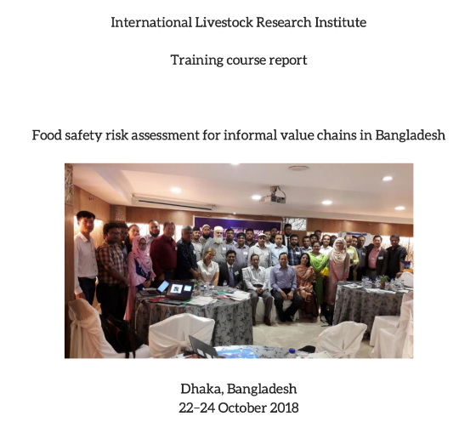
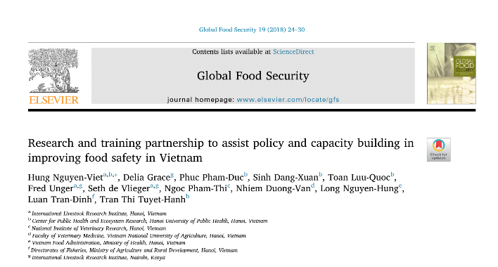
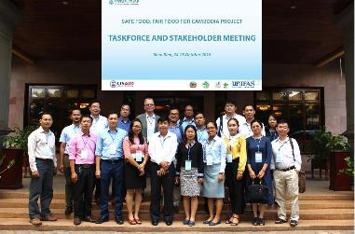




+ Missing ingredient: Enabling Environment

Slide 17
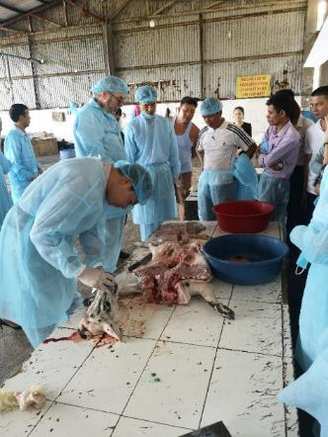
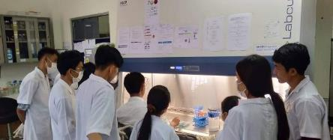
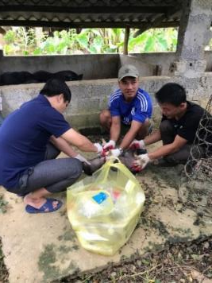
Next generation of food safety workers
Capacity building in meat inspection in Vietnam, Laos, Cambodia

Slide 18
Cost benefit analysis
Net benefit of seller
=
Premium price x Pork sale
–
Cost of intervention x Pork sale
8.98 USD/year
(93%>0)
0.077 USD/kg
1,196 USD/year
(61.2% >0)
14,936 USD/case
6.3%/year
Cost of salmonellosis
for each severity
Reduction of salmonellosis probability
Net benefit of consumer
=
x
Prevalence of severity
x
–
Premium price x Pork consumption
Notes:
Net benefit = 1205 for 59% of cases

Slide 19
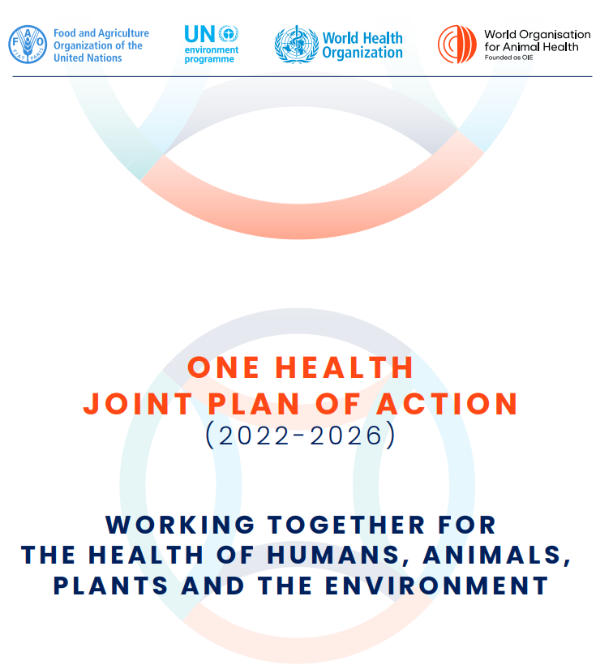
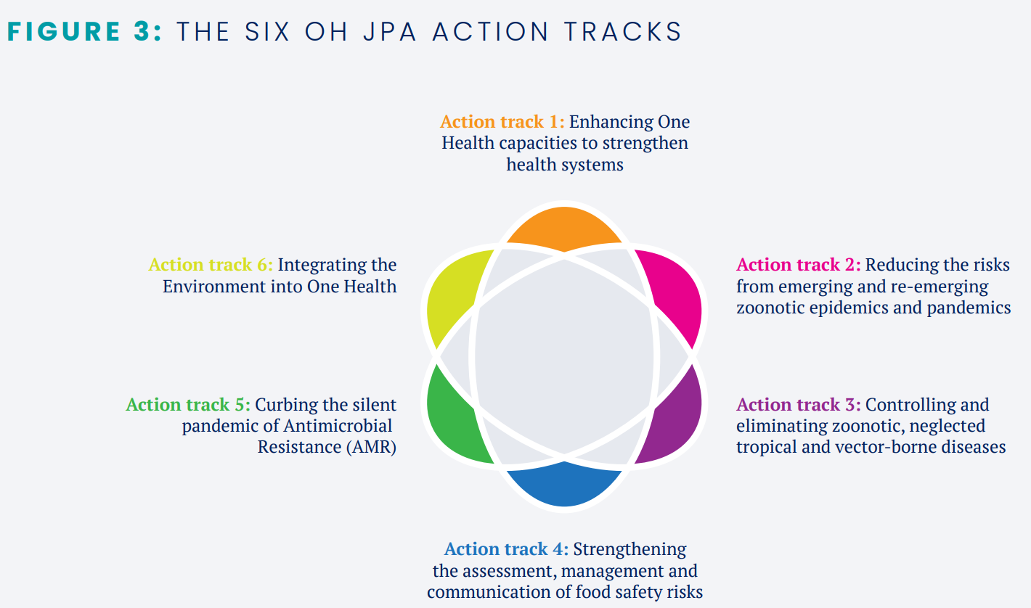
Global One Health: Quadripartite and OHHLEP

Slide 20


World Food Safety Day
7 June 2023

Slide 21
Key messages
Food safety in informal/wet markets: high level of microbial contamination along the value chains and high public concern
Risk based approach (hazard vs. risks) helps identify targeted interventions and key stakeholders to improve food safety
Interventions: 3-legged stool/ECM to improve food safety, it works!
Capacity building: trainings at different levels are key to improve food safety
Strong engagement of high level ‘taskforce’, and other actors (animal health workers, market managers, retailers) made intervention implementation successful

Slide 22

THANK YOU

