Slide 1

Collaboration and Knowledge Exchange
Unit 5 of the Knowledge management in agriculture and rural development (KM4ARD) course

Slide 2
Overview of Unit 5
Purpose:
Understand how KM can help to create a more collaborative environment
Understand how communities of practice can support knowledge exchange
Understand facilitation basics and how four specific facilitated methods can support knowledge exchange
Be able to identify some of the possibilities for web-based technologies to enable collaboration and knowledge exchange

Slide 3

Why collaborate?
Collaboration: “a process through which people who see different aspects of a problem can constructively explore their differences and search for solutions that go beyond their own limited vision of what is possible” (Anecdote White Paper, Callahan et al. )
This resource lists three types of collaboration: team, network and community
Notes:
Trainers notes
Link from last slide:… first, let’s define what we mean by collaboration…
This resource…: collaboration can mean different things depending on the types. We’ll go through each of these in more details in the next slides.

Slide 4

Team collaboration
Clear mandate, defined roles
The members of the group are known
Interdependencies between tasks are clear
Expected reciprocity
Leadership
Explicit time lines and goals
Participants cooperate on an equal footing and get equal recognition
Notes:
Trainers notes
Link from last slide:… let’s start with team collaboration… By “team” we mean “a group of people with a full set of complementary skills required to complete a task, job, or project “(from businessdictionary.com)
Expected reciprocity: “you scratch my back, I’ll scratch yours”, an agreed mutual benefit.

Slide 5

Network collaboration
Steps beyond the relationship-centric nature of team and community collaboration
What starts with individual action and self-interest builds the network as individuals contribute
Membership and time-lines are open
No explicit roles
Mostly internet-based
Notes:
Trainers notes
Link from last slide:… now the network collaboration is slightly different, it…
In this type of collaboration, members most likely do not know all the other members.

Slide 6

Community collaboration
Shared domain or interest
Goal is more focussed on learning rather than on task
People share and build their knowledge rather than complete projects
Members may go to their communities to help solve problems by asking questions and getting advice
Notes:
Trainers notes
Link from last slide:… finally in community collaboration, the focus is on the shared interest, of belonging.
In community collaboration, you can find individuals who are very passionate about the topic, who’s identity is wrapped up in this community.

Slide 7
Specific aspects in collaboration types
 | Team | Community | Network
Pressure to deliver | X
Explicit process and defined roles | X
High volume of information |  |  | X
Appropriate and user- friendly technological base |  | X | X
Voluntary and informal |  | X
Core group of dedicated members |  | X
Notes:
Trainers notes
Link from last slide:… so each type of collaboration has some specificities.This table is to highlight that some aspects that are more likely to occur in some types of collaboration then in others.
(Go through the left-hand column and relate to the specific type).

Slide 8

Common success factors for all types of collaboration
Common purpose or goal
Topic that resonates
Regular interactions to allow member bonding and develop trust
Facilitation / leadership
Basic resources
Notes:
Trainers notes
Link from last slide:… so there are differences between collaboration types but all of them tend to be more successful if they enjoy these factors…
Facilitation…: we will be talking about facilitation a little later
Basic resources: collaboration doesn’t necessarily cost much but human and technology costs can be factors

Slide 9

Link with KM
Knowledge exchange, co-creation and learning are all intertwined in a truly collaborative environment
Collaboration creates shared context which is crucial to KM
Shared context: “common understanding of an organisation’s external and internal worlds and how these worlds are connected” (Fahey and Prusak)
Notes:
Trainers notes
Link from last slide:… so how is collaboration linked with KM?...
Shared context…: KM authors Fahey and Prusak argue that shared context is a fundamental purpose of “managing knowledge”.

Slide 10
Communities of Practice (CoP)
CoP: “Group of people who share a common concern, a set of problems, or interest in a topic and who come together to fulfil both individual and group goals” (Wenger, McDermott and Snyder)
Common interest or domain
Online and/or offline (mix of both)
Internal to organisation, or external (or a mix of both)
Usually learning-focused, solving problems or sharing good practices
Informal in nature
Notes:
Trainers notes
Link from last slide:… in KM literature, Communities of Practice is a term that comes up often, as it is seen by many to be the strongest mechanism for the exchange of tacit knowledge…

Slide 11

Purpose of CoP
Knowledge exchange: access to different experiences and knowledge
Learning from others’ good practices
Joint value creation/co-creation by members
Dynamic repository of state of the art practice and knowledge around a topic
Leverage and strengthen what members know individually
Potentially support mobilization on a scale that is not feasible with individuals
Notes:
Trainers notes
Link from last slide:… so why are CoP useful? What do they bring?...
The strength of coming together is in all these points. Also, participating in a CoP can build capacity and skills in its members.

Slide 12
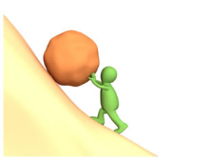
Challenges of CoP
Trust
Participation / motivation
Cultural factors (e.g. language, hierarchy)
“Build it and they will come” fallacy
Lack of resources
Access and connectivity
Notes:
Trainers notes
Link from last slide:… the flipside is that CoP can be challenging. There can be issues linked to…
Build it and they will…: creating a nice platform for your CoP doesn’t mean people will use it or contribute to it.
Lack of resources: again, this can be more human resources rather than financial.
Access…: it is important to know the situation of your members, not everyone enjoys the same level of connectivity and access to computers.
The first four points can actually be addressed with facilitation techniques, which we’ll discuss a bit later.

Slide 13

Example of a CoP in development
KM4Dev
  Over 2000 members
  Knowledge management for development issues discussed
  Mostly questions asked by CoP members
  Encourage them to summarize discussion
  Currently run and facilitated by a volunteer Core group
Notes:
Trainers notes
Link from last slide:… here is an example of a CoP in international development…
The main discussion happens on a mailing list (Dgroup) but there is also a website: www.km4dev.org. If you are interested in KM for development, you should sign up.

Slide 14

Example in ARD
E-agriculture community:
Over 12,000 members from 170 countries
Improving policies and processes around the use of ICT in agriculture and rural development, in order to have a positive impact on rural livelihoods
Knowledge exchange through dialogue in the e-Agriculture Forum series
Demand-driven topics, lead by partner institutions
Notes:
Trainers notes
Link from last slide:… the E-agriculture community is also an open community with…
You can join by going to www.e-agriculture.org

Slide 15
Questions? Comments?

Slide 16

Facilitating knowledge exchange
Knowledge exchange: two-way process where individuals share ideas and experiences
Facilitation:
  Adds structure and process to meet the needs of a group and helps them to accomplish their objectives or outcomes
  Is not the same as moderation, where interactions are controlled and limited, for e.g. presiding a meeting or assembly
Notes:
Trainers notes
Link from last slide:… we are now going to look at knowledge exchange which is…
Facilitation…: it is a very important but often overlooked function in knowledge exchange…
Is not the same…: the terms “facilitator” and “moderator” are often used interchangeably but they relate to subtly different skill sets and applications. Moderation implies greater control and direction over content.

Slide 17
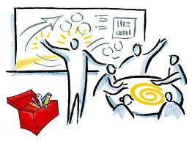
Role of the facilitator in knowledge exchange
Designs an interactive structure and process where there is space for discussion
Engages participants so they actively participate
Is neutral and does not try to influence the outcome towards a specific goal
Ensures that the environment is “safe” and non-threatening
Keeps things moving and sticks to structure
Notes:
Trainers notes
Link from last slide:… so what is the role of the facilitator in knowledge exchange, then?...
Is neutral…: It is often said that a facilitator needs to be well-versed in the topic or content of the exchange. But if a facilitator is also an “expert” on the subject, it makes it more difficult to be neutral. The best situation is when a facilitator has general knowledge of the topic, enough to understand the basics but not get involved in the details.

Slide 18

Basic facilitation skills
Active listening: staying focused to understand full meaning
Drawing people out: encourage participation from more quiet people
Paraphrasing: restating in your own words to clarify
Summarizing: pull together main points
Stacking: when many people want to talk at the same time
Manage time: always be aware of the clock
Herding: moving people around
Problem solving: dealing with unforeseen issues
Notes:
Trainers notes
Link from last slide:… let’s look at what are the basic facilitation skills in order to do all that…
Active listening: for e.g. paying attention to what people are saying, look at people directly, nod occasionally and smile.
Drawing…: asking open questions, address the fact that some people haven’t spoken and offer the possibility to do so.
Paraphrasing: using “if I understand you correctly, you are saying …” when something may not be clear.
Summarizing: wrapping up discussions with “here’s what I think has been said... have I captured most of the key points accurately?”
Stacking: when many hands go up for questions, use the 1-2-3 technique for stacking: “first, I’ll take Mary’s question, then Joe’s, and then Alice’s”.
Manage time: clarify the time available for an exercise or session to participants and remind them at the half-way mark or before the end.
Herding: use gentle “force” or humour to get people to move around, use chimes or subtle sounds
Problem solving: trying to stay positive, not defensive, dealing with situations calmly and with flexibility.

Slide 19
Exercise: facilitation skills
In table groups, we need volunteers to be:
  Facilitator: asks questions, helps clarify the ideas, etc.
  Observer: Just listen. Write down what you observe. At the end you will provide constructive feedback to the facilitator
  Participants: participate actively in the discussion. One of you will get secret cards with instructions.
For 10 minutes, discuss at your table “Specifically, what is the role of a facilitator during a meeting or workshop?”
Notes:
Trainers Notes
Link from last slide:… let’s see how we can put all of these skills to use in an exercise…
See Unit 5 Exercise note

Slide 20
Exercise: facilitation skills
Table feedback time (10 minutes)
Observer:
  You are setting an example
  Balanced list of what the facilitator did well and what you feel they could improve
  If you run out of feedback, others can give feedback too
Facilitator:
  Try to listen (and not be defensive). Absorb what is being said.
Notes:
Trainers Notes
See Unit 5 Exercise note

Slide 21
Exercise: facilitation skills
Now switch roles – participants get to be facilitator and observer (and vice versa)
One of the participant get another secret card
Second round (10 minutes): discuss at your table: “What are the main challenges faced by facilitators? What can they do to overcome them?”
Notes:
Trainers Notes
See Unit 5 Exercise note

Slide 22
Exercise: facilitation skills
Table feedback time (10 minutes)
Observer:
  You are setting an example
  Balanced list of what the facilitator did well and what you feel they could improve
  If you run out of feedback, others can give feedback too
Facilitator:
  Try to listen (and not be defensive). Absorb what is being said.
Notes:
Trainers Notes
See Unit 5 Exercise note

Slide 23

Exercise: facilitation skills
Popcorn plenary debrief (10 minutes):
  What did you think of the exercise?
  What was easy? What was hard?
  Questions or comments?
Notes:
Trainers Notes
(Take a few spontaneous reactions to the exercise).

Slide 24
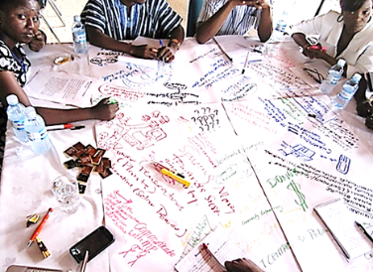
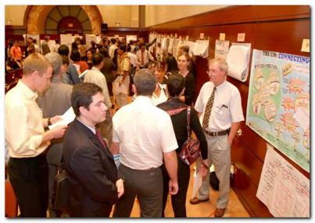
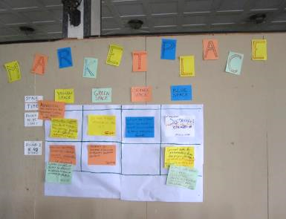
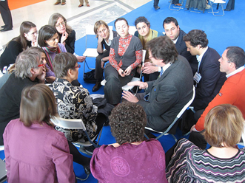
Knowledge exchange methods
Notes:
Trainers Notes
Link from last slide:… now we will be looking at specific knowledge exchange (also often called knowledge sharing) methods.
(Go through the photos, start from top left (World Café), bottom left (Open Space), top right (Knowledge Fair) and bottom right (fishbowl)).

Slide 25

Before using these methods
Need to have clarity on:
Purpose:
  What are you doing this for?
  Define session objectives and make sure the method fits
Context:
  What is most appropriate for the group?
  Think of culture, language, politics, diversity, etc. before picking a method
Notes:
Trainers Notes
Link from last slide:… these methods are really great but before using them, you need to be clear on two things, first…
Purpose: if your objective is to get a decision on something during a session, you wouldn’t use a World Café because it is best for conversations and brainstorming, not decision-making.
Context: if there are issues of politics in your culture and people will not speak out in the presence of others, a fishbowl might not be the best method. But if you know that people really want to put issues on the table, even if this might be somewhat conflictual, a fishbowl WOULD be a good method to use.

Slide 26

When to use these methods
When we want to:
Create a space for dialogue
Share experiences
Tackle collective problems
World Café
Open Space
Knowledge Fair
Fishbowl
Notes:
Trainers Notes
Link from last slide:… so when should you use these methods then?
The methods can be used for different purposes (often more than one) but these are the best uses for each of them, i.e. create a space for dialogue (World Café and Open Space), share experiences (K Fair) and tackle collective problems (fishbowl).

Slide 27
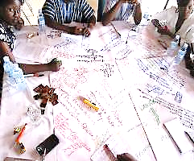
World Café method
For convening conversations around a subject matter through questions
Creative process used for collaborative dialogue and sharing knowledge
People sit 4 to 6 to a table and hold a series of conversational rounds about one or more questions
At the end of each round, one person remains at each table as the host, while the others travel to other tables
By moving in several rounds of conversation, ideas and themes begin to link and connect
Those ideas and links are visualized on a paper tablecloth
Notes:
Trainers Notes
Link from last slide:… so first, let’s start with World Café, we already did a version of the World Café in Unit 2. It is used for…
Three rounds of World Café is usually sufficient and the time allotted really depends on the questions being discussed. There are many debriefing methods, such as the “walkabout”, where people go look at each individual tablecloths (with the host providing a commentary) or “art gallery walk”, where the tablecloth are hung on the walls and people go look at them (more ideas on www.theworldcafe.com).

Slide 28
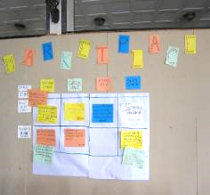
Open Space method
For convening groups around a specific question and giving participants responsibility for creating both their own agenda and experience
The facilitator lays out the Open Space principles and rules, make sure the room is set up but the participants decide what they want to talk about and self-organize in small groups to discuss those topics
Can be challenging for organizations used to controlling interactions
Usually lasts 1-3 days
Small group report and action plans (individual or team) are the main outputs
Notes:
Trainers Notes
Link from last slide:… another method to create a space for dialogue is Open Space, which is good for…
We will be doing a mini-Open Space tomorrow so you will see how it works.

Slide 29

Knowledge Fair
Face-to-face event designed to allow numerous individuals to share their experience at a common venue with the help of visual aids and displays (e.g. posters, videos, etc.)
Everyone has a booth or space to share resources and good practice
The “Fair” concept is open and people move about freely
Usually over the course of 1 day but can be longer
Social media can be used to inform and report back
Notes:
Trainers Notes
Link from last slide:… the next method is useful to provide spaces to exchange experiences. A Knowledge Fair is a…
If there isn’t a lot of people, a knowledge fair can also be done with people walking about as a group and giving each “booth” a certain amount of time to present (for e.g. 5-10 minutes).

Slide 30
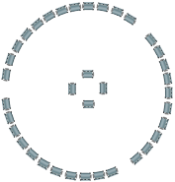
Fishbowl method (open variation)
Involves 3-4 people seated in a circle, having a conversation in full view of a larger group of (silent) listeners around them
The smaller group are the fish, the larger group represents the bowl
One person acts as a facilitator
One or more chairs are open to "visitors" who want to ask questions or make comments
Outside circle participants can stand behind a current speaker as a non verbal request to take their place
Useful to raise issues or controversies
Length depends on topic and number of participants but usually less than 45 min
Notes:
Trainers Notes
Link from last slide:… the last method that we’ll explore is the fishbowl. It…
Only the people inside the fishbowl can speak, the others listen, or come to the center and stand behind someone seated (or gently taps them on the shoulder). The facilitator needs to make sure the situation doesn’t get out of hand, especially if the topic is very controversial.

Slide 31

Exercise: Fishbowl
Move chairs around:
  Small interior circle of 4 chairs
  Rest of chairs around in a bigger circle around them
  Fishbowl discussion topic (15 minutes): Facilitation tips and tricks: what works, what doesn’t?
  Plenary debrief (10 minutes)
    What did you think of the method?
Notes:
Trainers Notes
Link from last slide:… let’s experience a fishbowl right now, I will need you to help move the chairs around…
See Unit 5 Exercise note

Slide 32
Questions? Comments?

Slide 33
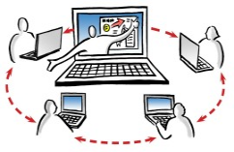
A word on online facilitation
Uses the same skills a face-to-face facilitation
Added challenge that can’t see faces or body language
Bad behaviour is easier so establish online guidelines or etiquette
Take people offline or off-list to have a discussion if there is a problem
Notes:
Trainers Notes
Link from last slide:… we’ve talked mainly about face-to-face facilitation now let’s briefly look at online facilitation.
Bad behaviour…: People can be very different online. Some very quiet people, when met in person, can be loud and obnoxious online! If you are going to have online interactions, always create some guidelines for behaviour and validate them with members.
Take people…: If someone is being rude or disruptive, don’t seek them out “in front” of others, do it in a personal email, or in a Skype call.

Slide 34

Technologies for knowledge exchange
A plethora of tools for collaboration and knowledge exchange
What are you trying to do?
  Share, store and access documents
  Exchange with colleagues working on the same project or externally
  Have a web meeting or conference
  Create an online space for a community of practice
Notes:
Trainers Notes
Link from last slide:… we will now take a look at some of the technology available for knowledge exchange. There is…
What are you trying…: This is the same as with the knowledge exchange methods, there are many to choose from so you need to be clear on the purpose. Not all of the tools are necessarily good for everything. So here are four of the things that you may be wanting to do.

Slide 35
Groupware: bringing the tools together
Multi-purpose software application that enable group members to share documents, synchronize information and communicate with each other
Standard features:
  Document repository with version management
  Shared calendars and task management
  Message boards/wikis/blogs
  Web conferencing/instant messaging
Notes:
Trainers Notes
Link from last slide:… first, there is a type of tool that tries to address all these purposes, which is called groupware. Groupware which offers a lot of functionalities in one package. It is a …

Slide 36
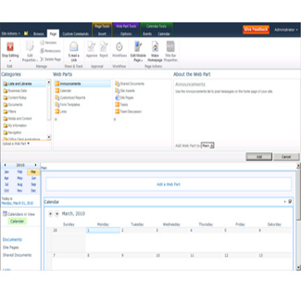
Groupware : bringing the tools together
Mostly internal uses in large organisations (i.e. intranet)
Can be challenging with limited connectivity for external communications
Examples:
  Microsoft SharePoint (cost – lower rates for non-profit organisations)
  Google Drive (free – for basic storage plan)
Notes:
Trainers Notes
Link from last slide:… continuing on groupware, it is mostly used…
Can be challenging…: you need to have IT people who know how to set this up and adapt it to the needs of the organisation.
(You can ask participants if anyone is familiar with either examples and what they think of their usefulness.)

Slide 37
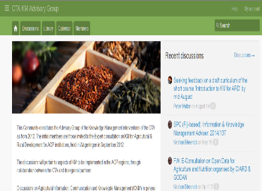
Exchange with colleagues
Simple platform for exchange
Mailing list, calendar and document repository functionalities
Works well with limited bandwidth
Example:
  Dgroups: non-commercial platform for international development organisations only (free – but through a Dgroups partner)
Notes:
Trainers Notes
Link from last slide:… one of the purposes for using a tool might be to exchange with colleagues or partners. And you might need something light and easy to use, a simple…
Example: Dgroups is such a tool but the disadvantage is that you need to find a Dgroups partner in order to get an online space (you can find the list of partners on Dgroups.org).
(You can ask participants if anyone has used a Dgroup before.)

Slide 38
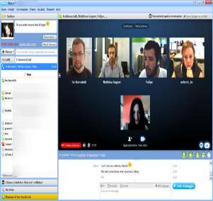
Web meeting/conferencing tools
Downloadable software that allows events to be shared with remote locations, for individuals or groups
Voice, video as well as text-based messages can be shared simultaneously, across geographically dispersed areas
Applications include meetings, training events and webinars
Examples:
  Skype and Google Hangout (free – voice, video and text)
  Blue Jeans and Web Ex (cost – voice, video, text and other content)
Notes:
Trainers Notes
Link from last slide:… another things that you may be wanting to do is a meeting or conference online, to bring in people from different locations.
(You can ask participants who has used Skype? What about other web conferencing tools?)

Slide 39
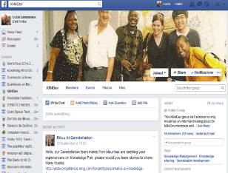
Online space for CoP: social networks
Platform to build social networks among people who share interests or exchange space for community of practice
Typical features:
  Construct a public/semi-public profile where text, links, photos can be posted, by yourself or others
  “Befriending” or connecting with other users
  View their list of connections
Examples:
  LinkedIn (free – professional use)
  Facebook (free – both personal and professional use)
Notes:
Trainers Notes
Link from last slide:… or you might be wanting to create an online space for a community of practice. Social network platforms are often used because they were built for CoP type of activities.
(You can ask participants if anyone uses Facebook?)

Slide 40
Group discussion: web tools for knowledge exchange
At your table, discuss (15 minutes):
  In my context, which of these technologies would most appropriate for knowledge exchange? Why?
  Would some of these technologies not work at all in my context? Why is that?
  Popcorn report back to plenary (5 minutes)
Notes:
Trainers Notes
Link from last slide:… let’s do a short group reflection on the use of technology, at your table…
(Do a quick, spontaneous report back to hear what works best and what doesn’t.)

Slide 41
Questions? Comments?

Slide 42
Credits
This learning material was prepared by Lucie Lamoureux for CTA.
The Technical Centre for Agricultural and Rural Cooperation (CTA) is a joint international institution of the African, Caribbean and Pacific (ACP) Group of States and the European Union (EU). CTA operates under the framework of the Cotonou Agreement and is funded by the EU. For more information on CTA, visit www.cta.int
Disclaimer
This work has been made with the financial assistance of CTA. However, it remains under the sole responsibility of its author and never reflects CTA's nor the European Union's opinions or statements whatsoever. The user should make his/her own evaluation as to the appropriateness of any statements, argumentations, experimental technique or methods as described herein.
Copyright notice
Reproduction and the dissemination of these modules and supporting materials is encouraged under the terms of the Creative Commons Attribution License (https://creativecommons.org/licenses/by/4.0/legalcode), provided that appropriate acknowledgement is made:
  – of CTA's copyright, in accordance with the license Creative Commons 4.0, by including the name and the title of the article or chapter,
  – and that CTA's or the EU's endorsement of authors' views, products or services is not implied in any way, by including the disclaimer.
March 2015

