Slide 1
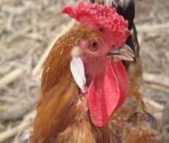
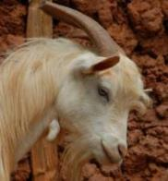
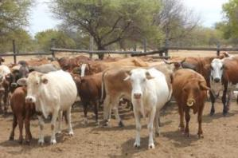
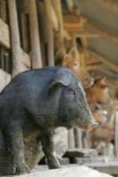
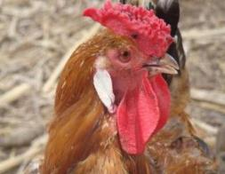


Rift Valley fever in East Africa:
Factors driving emergence, potential interventions and challenges to effective control
Bernard Bett
International Livestock Research Institute, Nairobi
A seminar given at the London School of Tropical Medicine and Hygiene, London, 2 November 2018

Slide 2
Outline
General introduction
Drivers of RVF
Interventions
Concluding remarks

Slide 3


ILRI’s mandate
Reduced poverty
Improved food and nutrition security for health
Improved natural resource systems and ecosystem services
ILRI’s mission is
to improve food and nutritional security
and to reduce poverty in developing countries through research for
efficient, safe and sustainable
use of livestock —
ensuring better lives through livestock.

Slide 4
IHH CGIAR A4NH Flagship
Improving Human Health Flagship:
bridging agriculture and public health research to deliver high quality scientific outputs and to identify new integrated actions that improve human health

Slide 5
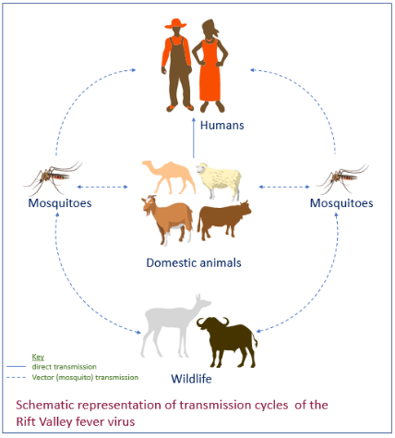
RVF -- Background
Rift Valley fever – mosquito-borne viral zoonosis mainly affecting cattle, sheep, goats and camels
Epidemics -- associated with above-normal, persistent rainfall and flooding
Motivation:
  Overlap select pathogen -- severe threat to human and animal health
  Epidemics – severe socioeconomic impacts

Slide 6
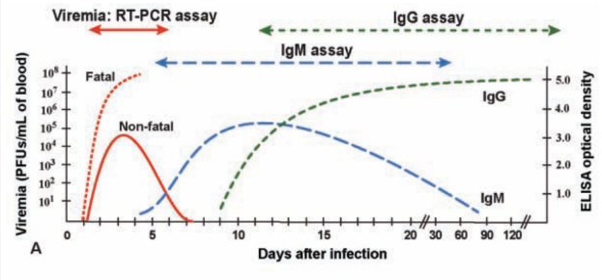

RVF virus
Single stranded segmented genome – L, M, N
Family Bunyaviridae, genus Phlebovirus
Remains infective for several weeks in biological samples stored at 4C
Viraemia and antibody response
Bird et al. 2009

Slide 7
Vectors
RVF virus vectors classified into maintenance/primary vectors, and amplifying/secondary vectors
  Maintenance/primary vectors
  Floodwater Aedes which maintain RVF virus through transovarial transmission
  Amplifying/secondary vectors
  Over 30 species of mosquitoes from 6 genera (Aedes, Culex, Anopheles, Mansonia)
Questions on the maintenance of RVF – endemic verses transovarial transmissions

Slide 8
Hosts
Susceptibility of vertebrates to RVF virus infection (Scientific Panel on Animal Health and Welfare, EFSA, 2005)
Extremely susceptible (70 – 100% mortality) | Highly susceptible (20 – 70% mortality) | Moderately susceptible (<10% mortality) | Resistant | Refractory
New-born lambs | Sheep | Cattle | Equines | Birds
New-born kids | Calves | Goats | Pigs | Reptiles
Puppies | Certain rodents | Camels | Dogs | Amphibians
Kittens |  | African buffalo | Cats
Mice |  | Asian buffalo | African monkeys
Hamsters |  | Monkeys | Rabbits
Certain rodents |  | Baboons | Guinea pigs
 |  | Humans | Certain rodents
Role of wildlife in RVF epidemiology not clear

Slide 9
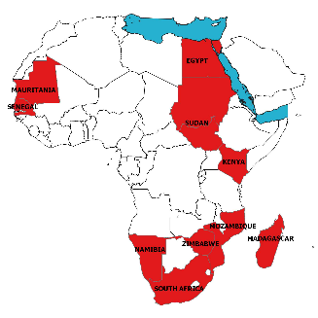
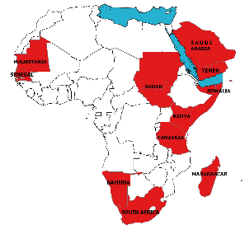
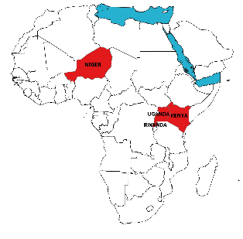
Has there been any changes in geographical range of the disease?
1950s – 1990s
2000 - 2015
2016- now

Slide 10
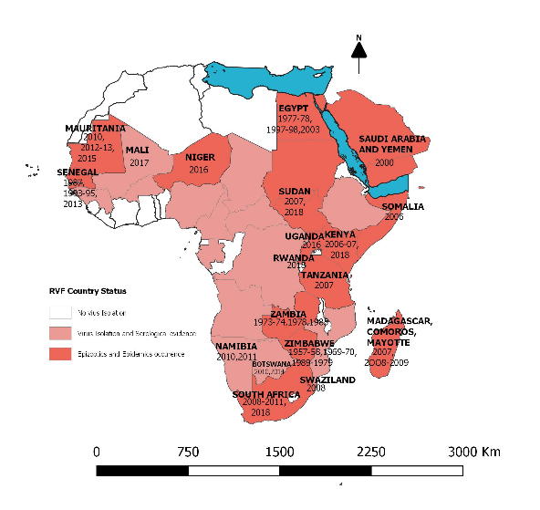
Drivers
1977 outbreak
Suspected to be due to livestock movement or wind-assisted migration of mosquitoes
2000, following heavy rainfall
About 2000 humans infected, 245 deaths
Thousands of sheep and goats affected
RVF virus introduction linked to livestock trade
Evidence of new transmissions 2004
C. tritaeniorhynchus, A. vexans arabiensis
1987, 93, 98, 2003
Heavy rainfall, following a short rainless period
Ae. aegypti, C. nebulosus, A. gambiae, C. quinquefasciatus
Mar 1990 and Jan 2008
Livestock movement from Comoros
Climate variables not clear
Heavy, persistent rainfall

Slide 11
Potential interventions
Livestock vaccination – key intervention
Challenges:
  Vaccine safety concerns
Vaccine | Source | Challenges
Smithburn | Isolated from mosquitoes in 1944 | Attenuated strain passaged in mice – associated with abortions and teratogenicity Formalin inactivated – poor immunogenicity
MP-12 | Isolated from a patient in Egypt and subjected to serial passages | Hepatocellular degeneration and necrosis
Clone 13 | Recovered from infected patient on Central Africa | Crosses ovine placental barrier leading to foetal infections, malformations and stillbirths

Slide 12
New vaccines
Development of new vaccines to address safety challenges
  adenovirus-vectored vaccine for RVF called ChAdOx1-GnGc (Warimwe et al. 2013)
  Vector -- replication-deficient chimpanzee adenovirus, ChAd
  Clones being used code code RVFV Gn and GC envelop glycoproteins
  Vaccine has passed safety tests but more on-farm trials being planned
  Jenner Institute, Wellcome Trust-KEMRI, ILRI and KALRO

Slide 13
Gaps in vaccination strategies
Current strategy – reactive vaccination which often fails to achieve required coverage
RVF vaccines often delivered through state financing – levels of acceptance variable
Activities:
  Stakeholder engagements to design new vaccination strategies e.g. routine vaccination in the high risk areas
  Studies to understand barriers to vaccination uptake – gender, knowledge, attitude and practices

Slide 14

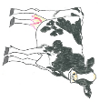

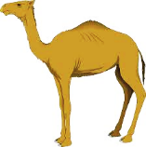
Technical studies to inform vaccination strategies
Smithburn
RVF vaccine
Days post vaccination
Dec 20, 2017
Dec 24, 2017
Feb 7, 2018
Dec 13, 2017
Dec 23, 2017
Jan 10, 2018
Jan 3, 2018
0 7 10 14 21 28 56 84 112 140 168 196 224 252 280 308 336 364
Serum
White blood cells in RNAlater
Serum
Collect WBC at early time-points for transcriptomics
Collect sera at all time-points
  cELISA
  VNT
Study effects of concurrent infections

Slide 15
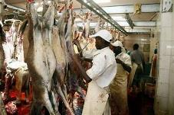
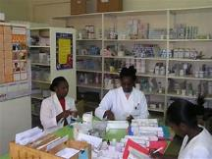
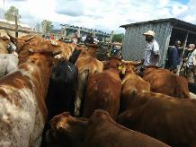
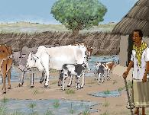
Syndromic surveillance
National DVS
Abattoirs
Agro-veterinary shops
County DVS
Sub-county Vet
Department
No. slaughtered/day
Ante-mortem/PM lesions &parasites
Types of drugs sold
Reported syndromes
Livestock markets
Community Disease Reporter
Livestock owner
Syndromes
Disease outbreaks
Movement patterns
Syndromes/rumours
Disease outbreaks

Slide 16
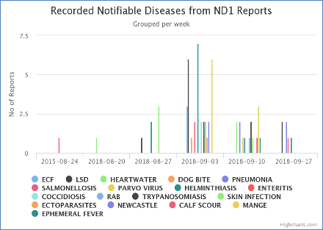
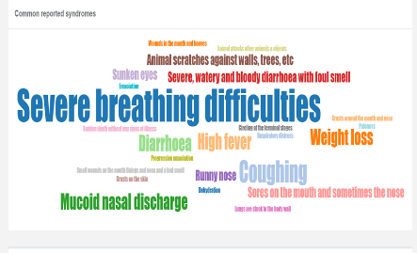
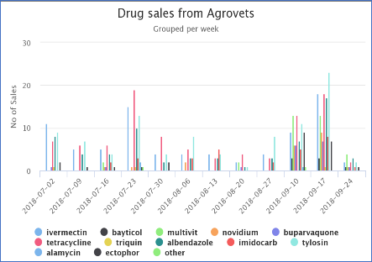
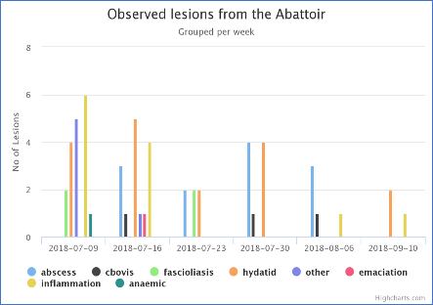
Surveillance data

Slide 17
Gaps in surveillance:
  Sustainability
  Levels of knowledge – variable
  https://ilvac.net/2018/06/22/introducing-english-and-swahili-instructional-videos-on-the-patterns-signs-symptoms-and-control-of-rift-valley-fever/

Slide 18
Statistical and mathematical modelling
A system/tool for forecasting risk and identifying hot spots for targeted intervention
Evaluate effectiveness of interventions
Analyse climate change impacts

Slide 19
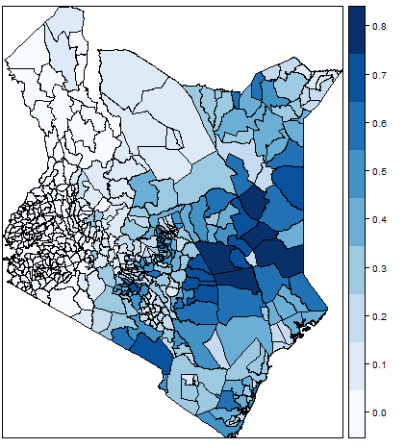
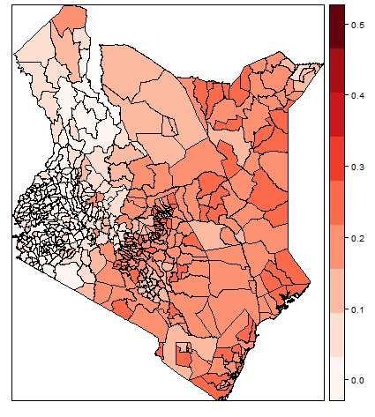




RVF risk
SD (RVF risk)
Sheep
Cattle
Species | Total pop | High risk (%)
Camels | 1,054,319 | 37%
Goats | 12,800,000 | 25%
Sheep | 9,941,564 | 22%
Cattle | 12,400,000 | 27%
Goats
Camels
Robinson TP, et al. Mapping the global distribution of livestock. PLoS One. 2014;9. doi:10.1371/journal.pone.0096084

Slide 20
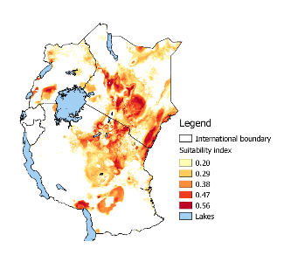
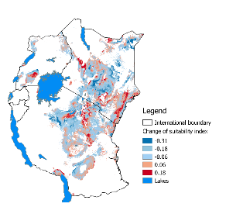
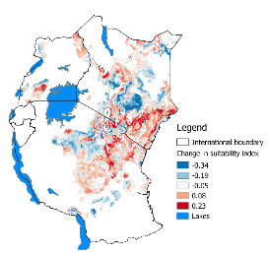
Climate change
Current distribution
Predicted distribution
In 2050 - RCP 4.5
Predicted distribution
In 2050 - RCP 8.5

Slide 21

Concluding remarks
RVF risk likely to intensify in some locations – more studies to predict future occurrence patterns
Strategies for deployment of interventions – this has attracted limited attention
Co-occurrence with other viruses – e.g. Ngari virus
Work more with policy makers to improve effectiveness of response

Slide 22






Acknowledgements
Department of
Veterinary Services
Kenya Medical
Research Institute
Bura Irrigation
Scheme
University of
Nairobi

