Slide 1
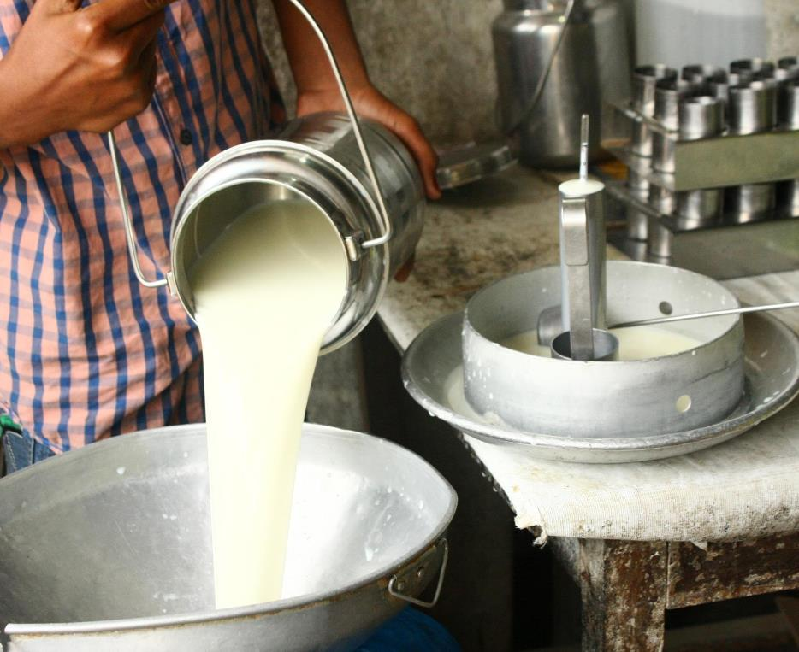
MoreMilk Workshop
Making the Most of Milk
Participant’s Guide

Slide 2


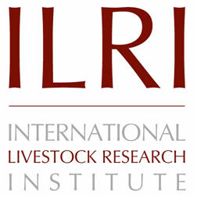


© 2019 International Livestock Research Institute (ILRI)
ILRI thanks all donors and organizations which globally support its work through their contributions to the CGIAR Trust Fund
This publication is copyrighted by the International Livestock Research Institute (ILRI). It is licensed for use under the Creative Commons Attribution 4.0 International Licence. To view this licence, visit https://creativecommons.org/licenses/by/4.0. Unless otherwise noted, you are free to share (copy and redistribute the material in any medium or format), adapt (remix, transform, and build upon the material) for any purpose, even commercially, under the following condition:
ATTRIBUTION. The work must be attributed, but not in any way that suggests endorsement by ILRI or the author(s).
NOTICE:
For any reuse or distribution, the licence terms of this work must be made clear to others.
Any of the above conditions can be waived if permission is obtained from the copyright holder.
Nothing in this licence impairs or restricts the author’s moral rights.
Fair dealing and other rights are in no way affected by the above.
The parts used must not misrepresent the meaning of the publication.
ILRI would appreciate being sent a copy of any materials in which text, photos etc. have been used.
Citation
ILRI (International Livestock Research Institute). 2019. MoreMilk workshop: Participant’s guide. Nairobi, Kenya: ILRI.
Production of this material has been funded by the Bill & Melinda Gates foundation, the CGIAR Research Program on Agriculture for Nutrition and Health, and UK aid from the UK government. However, the views expressed do not necessarily reflect the official policies of these institutions.

Slide 3
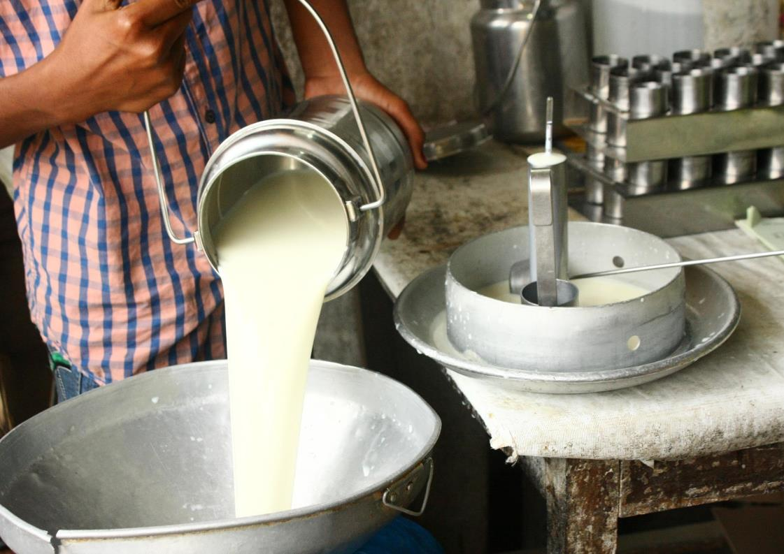
Milk Hygiene
a
1

Slide 4
Series
Series Objectives
At the end of this series, you should be able to:
Buy clean and good quality milk
Conduct milk tests to determine quality
Handle milk hygienically so it does not get contaminated
Identify and use food grade milk handling containers
Make sure your customers handle milk safely, so it doesn’t get contaminated after they buy it
Educate your customers about the health benefits of milk so they’ll want to buy more of it for their families
Run a more profitable business so that you make more money
Promote your business within your community

Slide 5
Session Objectives: Milk Hygiene
Why safety and hygiene matter in the milk industry
Basics of milk hygiene
What happens when milk goes bad
General causes of bad milk

Slide 6
Foodborne Diseases
Foodborne diseases result from consuming food contaminated by bad bacteria or chemicals
If milk is spoiled, does not always mean it carries foodborne illness
Contamination can occur from poor handling by producer, vendor or customer
Symptoms range from mildly uncomfortable to fatal
  Chills / fever
  Dehydration
  Cramping
  Diarrhoea
  Infertility, abortion
  Joint pain
  Liver inflammation

Slide 7
Foodborne Diseases Cont’d
Foodborne diseases transmitted through milk include:
  Brucellosis
  Tuberculosis
  Cholera
  Typhoid

Slide 8
Preventing Foodborne Disease
Foodborne diseases harmful to customers and your business profits
Serious, but preventable by practicing good hygiene
Can’t always tell by looking / tasting / smelling if milk is safe
Must buy from source that practices good hygiene

Slide 9
Bacteria
Bacteria are small organisms, too small to see
All around us, can only be seen with a microscope
Most bacteria good
  In milk, good bacteria makes cheese, yogurt, mala
Some bacteria bad, also referred to as “germs”
  In milk, bad bacteria causes illness, disease, spoilage
Milk is nutritious for people, but bacteria like it as well

Slide 10
Bacteria and Milk
Bacteria grow by diving in two
Some bacteria divide in two every 15 minutes.
When milk first contaminated by bacteria, the amount can be very low for the first few hours
As time passes, bacteria can multiply more rapidly
Growth of bacteria is preventable

Slide 11
Preventing Bacteria Growth
Boiling and pasteurisation kill bacteria
  Bacteria grow back faster in boiled/pasteurised milk than raw milk
Refrigeration, keeping milk cool slow bacteria’s ability to multiply
Freezing milk stops bacteria from growing
  Effective way to preserve milk

Slide 12
Pasteurisation
Pasteurisation is a process in which milk is treated with mild heat
Usually less than 100 degrees C (or 212 degrees F) for a specified length of time
Compulsory by Kenyan law for milk sold in urban areas
Does not affect nutritive value of milk
Less effective than boiling for killing bacteria
Pasteurised milk should be kept separate from raw milk
Pasteurisation usually done by a distributor / hub, should not be attempted at home

Slide 13
Cleaning vs Disinfecting
Hygiene extremely important when handling milk
Good hygiene keeps milk safe / fresh
Customers also judge milk quality by cleanliness of seller and shop
Customers who see a dirty shop may buy elsewhere

Slide 14



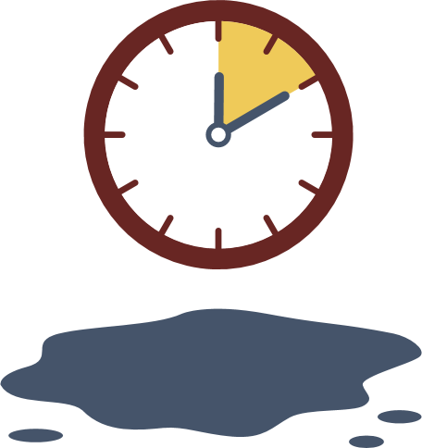


1.1 Disinfecting with Bleach Solution
1
2
3
Soap
Rinse
1 Part Bleach
9 Parts Water
4
5
6
7
10 min Surface Contact
Rinse Again
Sun-Dry
Dry Upside
Down

Slide 15
1.2 Disinfecting with Boiling Water (No Bleach)
1
2
3
Soap
Rinse
Boiling Water
4
5
Sun-Dry
Dry Upside Down

Slide 16
Testing Milk
Can’t always tell if milk is good quality / safe just by looking.
Must be able to test milk ourselves
Testing milk helps determine if milk is contaminated before we spend money on it - and before it ends up in hands consumer
Even if milk is pasteurised, you must test

Slide 17
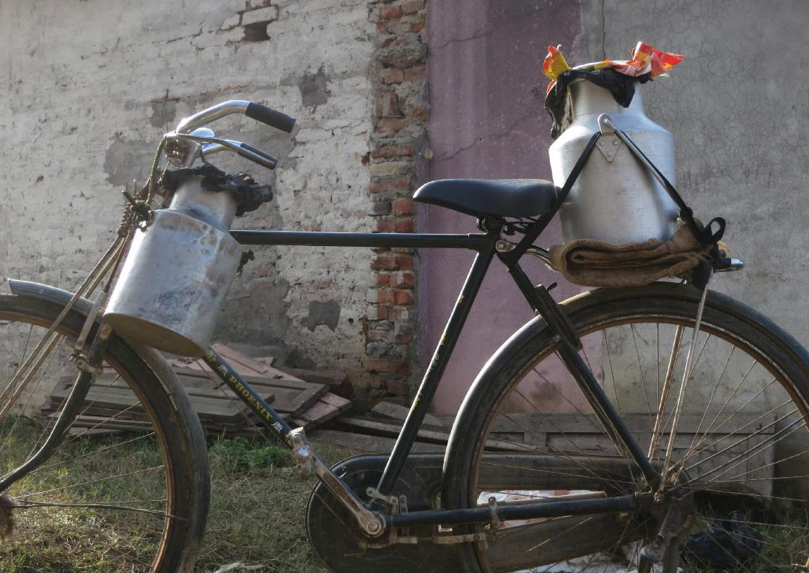
Milk Hygiene in the Supply Chain
a
2

Slide 18
Milk Hygiene in the Supply Chain
Very important to keep milk safe / hygienic during journey from farm to shop
Contamination is serious concern
Contamination caused by bad bacteria / chemicals

Slide 19





Session Objectives
How to prevent contamination along the supply chain
The Farm
The Distributor
In Transit
In Storage
During Handling

Slide 20
Buying Better Milk
Important to sell customers good safe milk
Negotiate with distributors if you think you are not receiving good quality
Work with distributors to make sure milk not contaminated
Good safe milk means customers happy / will buy more

Slide 21
Adulteration vs Contamination
Adulteration is adding another substance to milk to increase volume (flour, water, eggs)
Adulteration not the same as contamination
Adulteration can result in contamination if bad bacteria / germs are introduced
Adulteration robs consumer, is illegal
It is possible to test for adulteration with lactometer

Slide 22
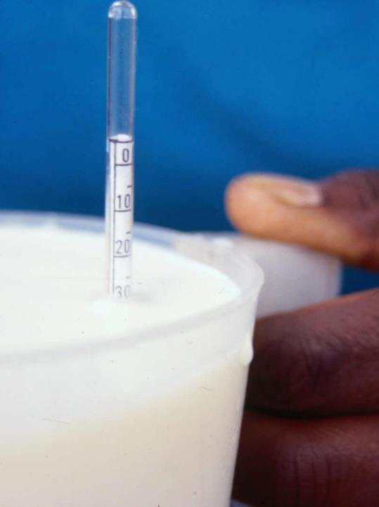
2.1 Lactometer Test
Lactometer measures milk density
Drop lactometer instrument in container of milk and read numbers on side
Depending on how high / low number is, lactometer can tell if there is adulteration
Good milk between lactometer reading of 26 and 32

Slide 23
Farm Facilities
Ideal facility has animals in area that are completely dry and clean
Facility should have clean, dry sleeping area
Animals hooves should be clean
Look for warnings signs that standing and laying areas are wet/boggy with lots of faeces

Slide 24


2.2 Shed Cleanliness (Standing Area)
Completely dry
No faeces/mud on ground
Hoofs remain clean
Mainly dry some wet patches
Less than 1cm faeces/mud on ground
Hoofs on hard ground
Wet
1- 3 cm of faeces/mud on ground
Hoofs sink a little in ground
Boggy
More than 4 cm faeces/mud on ground
Hoofs sink deeply in ground

Slide 25
2.3 Shed Cleanliness (Lying Area)
Completely dry and clean
Mainly dry and clean, some faeces
Damp bedding with trodden in faeces
Wet and filthy bedding area

Slide 26
Communicating with Producers
Negotiate / speak up if you see poor hygiene practices / facilities
Negotiating for better hygiene good for public health / business
If you see poor hygiene practices:
  Reassure producer you want to keep buying milk
  You will source milk elsewhere if problems continue
  Provide producer hygiene checklist
  Offer to walk through checklist with producer
Always test milk
Producers more likely to be motivated to follow hygiene suggestions if:
  We communicate quality requirements
  We pay promptly

Slide 27



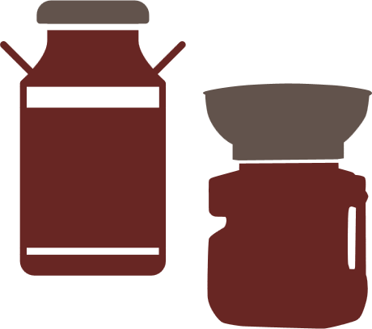
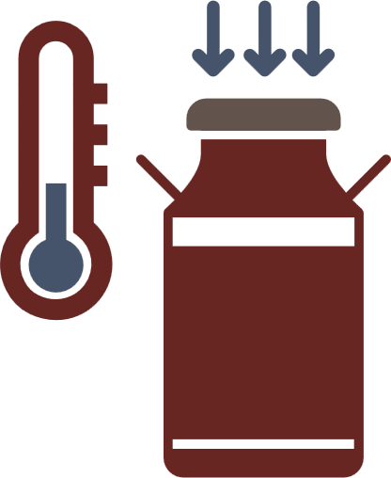


2.4 Checklist for Farmers
Clean hands before milking
Do not milk if sick
Clean, dry shelter for animals
Use appropriate / clean containers
Keep milk cool
and covered
Milk healthy cows

Slide 28

2.5 Checklist for Distributors
Clean hands before handling
Buy from trusted farmers
Clean facilities
Do not handle milk
if sick
Keep milk cool
and covered
Use clean / appropriate containers

Slide 29
Negotiation Skills
Vendor:
Last week you received complaints of illness from customers who bought your milk.
Now you are at the distribution centre to buy milk.
You decide to test the milk before buying with the clot-on-boiling method. You see flakes and clumps in the milk.
The distributor comes to collect payment. What do you say to them?
Distributor:
Vendor is not your biggest customer, but they are regular
You occasionally have vendors complain about the milk, but rarely do they test your milk
When vendors complain, you insist that your milk is very high quality
If the vendor mentions the test, ask to see results
Offer a different container of milk
Accept the flyer if offered

Slide 30
Negotiation Skills
Vendor:
You are at the farm you buy your milk from.
Before buying, you conduct the alcohol test. The milk appears to be high quality, it does not clump or flake.
However, you can see that the cows are lying down in stalls that appear to be full of faeces.
The farmer approaches to collect payment. What do you say to them?
Farmer:
Vendor buys milks from you regularly.
You are very proud of your farm, but this month it has been hard to keep up with the chores.
You see the vendor conducting the test.
You are proud that the test revealed the milk was good.
You don’t understand why the vendor wants to talk about the stalls when the milk was good. You need a good explanation.
Accept the flyer if offered

Slide 31
Keeping Records
Update records every time you purchase milk from a distributor
Keep track of:
Name of supplier
Volume of milk supplied
Date and time milk was supplied
Price paid
Whether or not milk was pasteurised
Results of test conducted

Slide 32
2.6 Purchase Record
NAME | VOLUME | DATE | TIME BOUGHT | PRICE PER LITRE | PASTEURISED | TEST RESULT
Aasir's Farm | 5 litres | 20/6/19 | 9:30am | XX.XX | Yes | No clotting

Slide 33
Maintaining Milk Quality During Transport
Milk travels to get to your place of business
During transport, hygiene and quality must be maintained
  Keep distance as short as possible
  Keep temperature as low as possible (consider time of day and container)
  Use a sealed container with no cracks, rust, etc.
Always test milk before accepting it

Slide 34



2.7 Maintaining Milk Quality During Transport
Short
Distance
Low
Temperature
Sealed
Containers

Slide 35
Acceptable Transportation Containers
Examples in Participant Guide
Containers approved for milk (e.g., Mazzican container)
Containers with no seams, smooth sides, wide opening, no cracks or rust
Containers that close properly (open containers can increase chance of contamination)
Never use improper containers
If you see producers using improper containers, speak up, negotiate

Slide 36
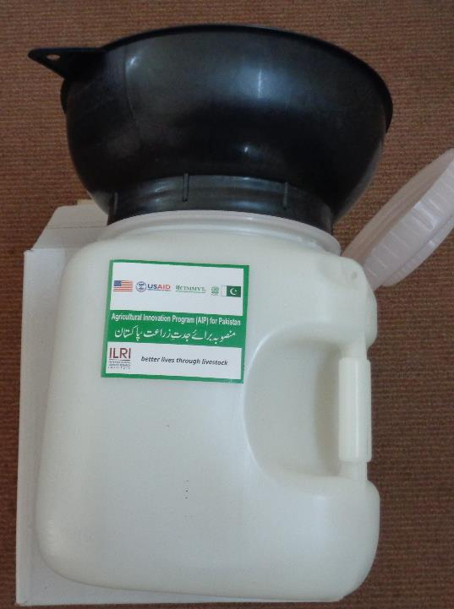
2.8 Mazzican
10 litres
Made of food grade plastic
Comes with milking funnel

Slide 37
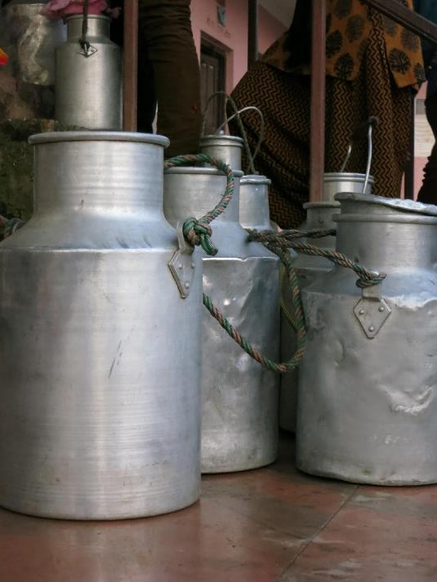
2.9 Other Acceptable Containers (Milk Cans)
Smooth sides
Aluminum or stainless steel
Must have lid that closes all the way

Slide 38
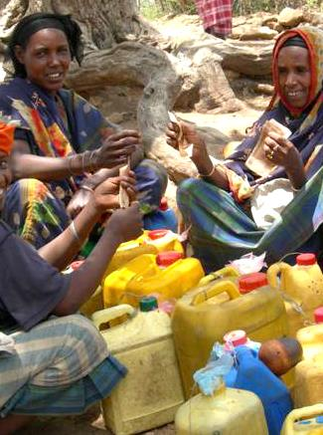
2.10 Unacceptable Container
Non food grade plastic
Container that previous stored something else, possibly chemicals

Slide 39
Milk Storage Best Practices at Your Shop
Keep facilities clean / disinfected, use clean, dry rags
Keep milk cool (refrigerator, out of sun, cool / dark spot)
Use acceptable containers
Address pest problems quickly
If milk left at end day, keep cold / ferment to mala / boil and seal / freeze
Label milk:
  Purchase date
  Pasteurised or no
Keep pasteurised milk separate from raw milk
If milk is purchased in non-hermetically sealed bags, take extra care with temp and cleanliness

Slide 40
Safe Milk Handling – Personal Hygiene
Customers more likely to buy milk from vendor who appears clean / hygienic
Hygienic vendors means safer milk, less chance of illness, less spoilage, less profit loss
  Don’t smoke
  Cover your head or pull back hair
  Wash hands
  Keep nails trimmed

Slide 41




2.11 Safe Milk Handling
Personal Hygiene and Health
Don’t Smoke
Head Covered
Hands Washed
Trimmed Nails

Slide 42
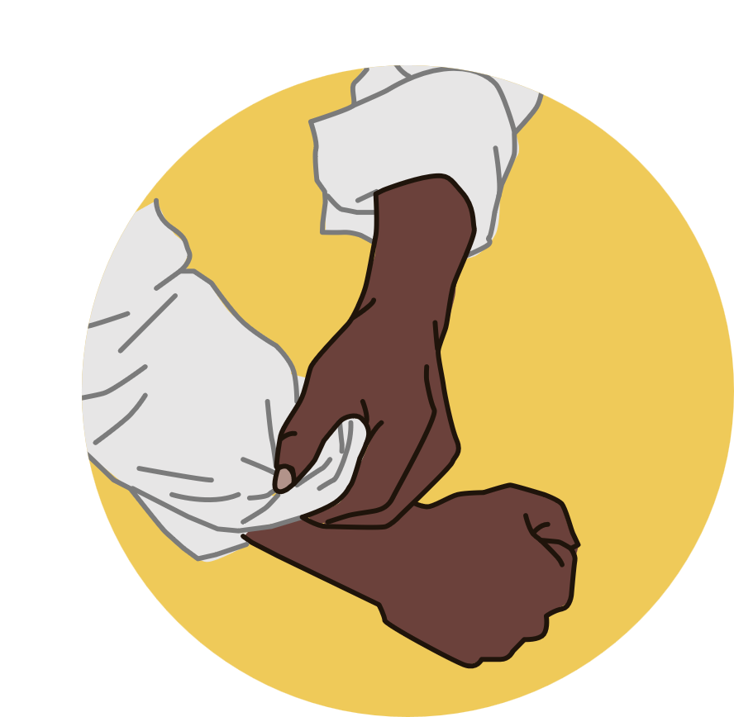
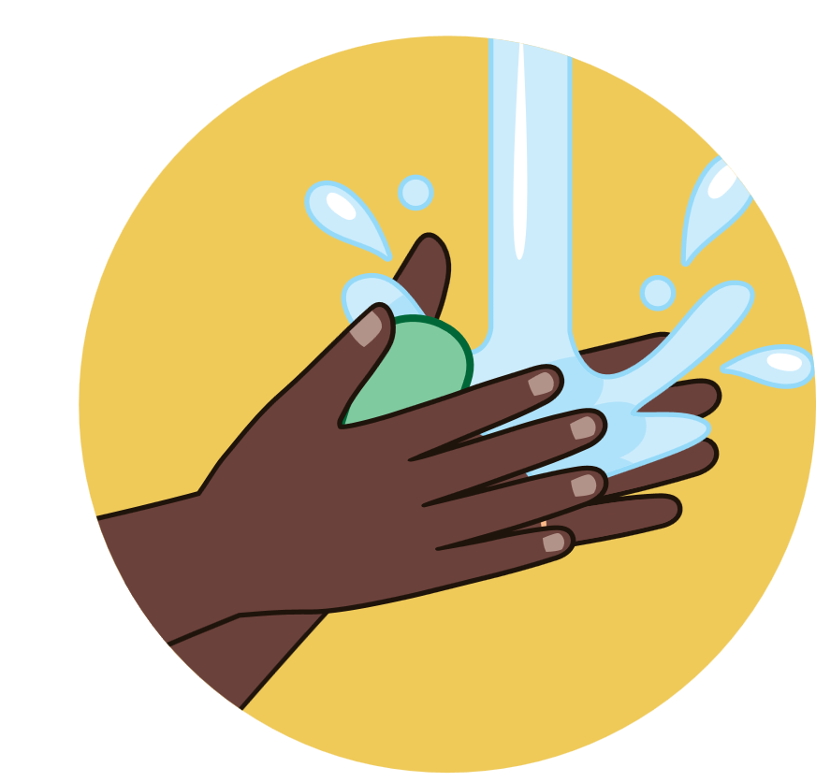





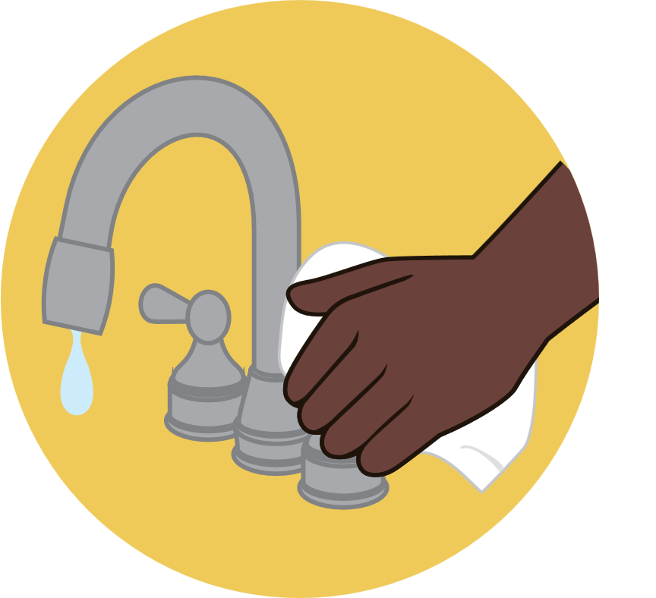
2.12 Correct Way to Wash Hands
1
2
3
4
Pull sleeves up
Rinse
Wash hands
with soap
Wash forearms with soap
5
6
7
8
Brush hands
and nails
Rinse to
remove soap
Dry with paper towel
Use a paper towel
to turn of tap

Slide 43
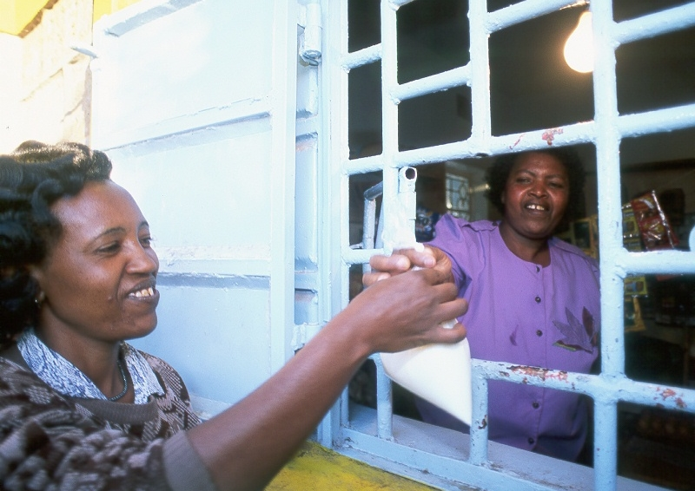
Customers and Milk Hygiene
a
3

Slide 44



Session Objectives
How to ensure your customers are handling your milk hygienically once they leave your shop
Educate Your Customers
Handle Complaints
Hygiene
Action Plan

Slide 45
Case Study: Zawadi and Jaali
Case Study: Zawadi and Jaali
  Zawadi, a milk vendor, has worked very hard to improve the quality of her milk. She has begun testing milk before accepting it and negotiating with her supplier for better product. She has identified containers that need to be replaced to store milk, and has begun being very mindful about cleaning disinfecting containers and surfaces she uses. She washes her hands before and after handling milk, makes sure her shop is swept and very clean. She does not have a fridge, but she always makes sure to store her milk in a cool area, and to keep the containers tightly closed at all times.

Slide 46
Case Study Cont’d
On a hot, sunny day, a new customer, Jaali, comes to purchase milk from Zawadi, because he noticed how nice her shop was looking. Before entering, he opens his container and shakes out the few drops of remaining water from when he rinsed it out that morning with cold water. He enters the shop and Zawadi is quick to help him. She pours the milk into his container. Jaali reaches deep into his pocket to find the right coins to pay her with, and then he purchases the milk. Zawadi thanks him and tells him that she hopes he will become a repeat customer. He leaves the shop and, wanting a taste of the milk, opens the top and dips a finger in for a taste, holding the lid to the container in his other hand.

Slide 47
Case Study Cont’d
As he’s tasting the milk, a friend approaches him in the street. Jaali’s happy to see him, and the two talk for about 15 min. Jaali’s friend eventually says goodbye, Jaali puts the lid back on the container and goes to get his bike. He straps the container of milk to the back of the bike and starts to ride home. Jaali always takes a short cut to get home, which gets him there faster, but takes him over a very bumpy section of the street. Jaali gets home to find his wife putting their new baby down for a nap. He puts the milk on the table, and notices that some has dribbled out the top during the ride. He takes the top off and grabs a rag that’s on the table. He wipes the rim of the milk container with the rag, screws the top on, and goes in to check on his baby son. Jaali and his family do not own a fridge.

Slide 48
Milk Hygiene and Customers
Why it’s important
Promoting good hygienic handling practices good for business
Also good for public health
Customers who believe milk is safe come back, buy more
Even if you practice good hygiene, customers may not
Regardless of fault, customers will have bad impression of your product if they get sick

Slide 49
Demonstrating Hygiene to Customers
Be cleaned, well groomed, wear clean clothes
Keep store visibly clean
  Remember, clean is not the same as disinfected, but it does help!
Display licenses, certifications
Refrigerate or store milk properly
  If you don’t have fridge, keep milk cool in shade, or put container in basin of water
Show you are committed to milk safety

Slide 50
Five Keys to Safer Milk
Displaying checklists / milk safety guidelines increases consumer confidence
Customers who believe you are committed to milk safety more likely to purchase your milk

Slide 51

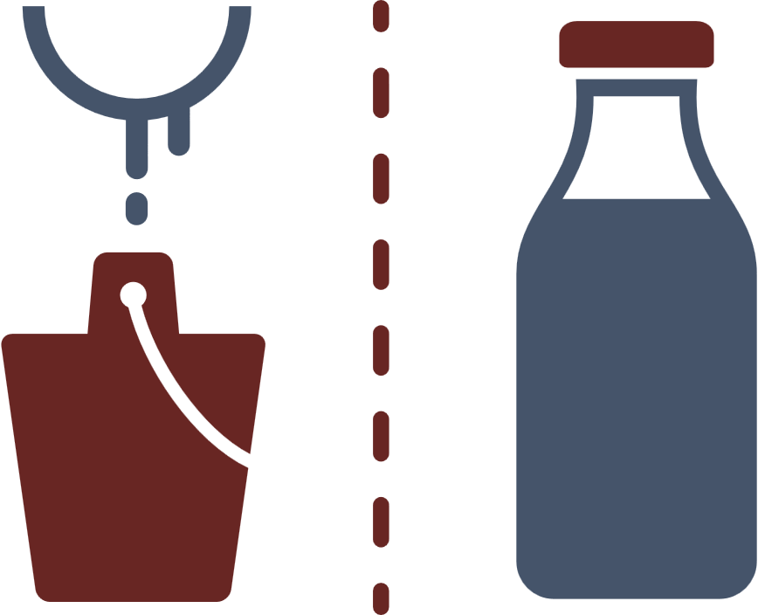



3.1 Five Keys to Safer Milk
1
2
3
Sell unadulterated milk
Separate raw and pasteurised
Maintain cool
temperature
4
5
Track purchase dates
Practice personal
hygiene

Slide 52
How to Improve Customers’ Milk Hygiene
Show customers how to clean / dry their milk containers to prevent contamination
Educate customers on milk safety / hygiene
  Use completely dry and clean containers
  Container should close completely
  Customers should consume milk same day bought
Educating customers on products leaves them with good impression, builds trust
Be respectful, particularly with mothers

Slide 53
Handling Customer Complaints
Acknowledge grievance and determine facts of situation
Assure customer they have right to buy safe milk from your shop
Assure you are committed to quality products
Communicate your milk hygiene / safety practices
If you sold bad milk, replace for free
Be friendly, but assertive if you need to be
Politely tell customers who are harassing you to leave
Easier to prevent problems through educating your customers than dealing with problem after it has happened.

Slide 54
Handling Complaints
Vendor:
A customer comes to your store.
She appears upset.
She tells you that she bought milk from you two days ago and this morning it smelled sour.
What do you say to her?
Customer:
You mostly buy your milk from this vendor, but have used others in the past.
You’ve never been told by any vendor when you should consume your milk.
You are very busy with work and family.
You do not own a refrigerator.
You don’t like wasting money, and discovering that your milk was sour was upsetting.
Respond positively if the vendor acknowledges you grievance.

Slide 55
Handling Complaints
Vendor:
It’s the end of the business day.
A customer comes in who you recognise from earlier that day.
He tells you that he took your milk home and when his wife began to heat it up, the milk clumped.
He tells you that he knows this is a sign of bad quality.
What do you tell him?
Customer:
You know that when milk is heated up, it shouldn’t clot.
You have a young child at home and do not have time to be running back to the store.
Also, your wife is very worried about giving the child unsafe milk.
Respond positively when the grievance is acknowledged.
Accept the offer to get replacement milk.

Slide 56
Being a Smart Businesswoman
Recommendations for Mothers
Common for women vendors to have children at work
If children play near milk, milk may appear less clean to customers
If possible, have someone watch children while at
or
Have children stay away from milk or keep it somewhere they can’t reach
Help child keep his/her hands, face and body clean while he/she is in the shop.

Slide 57
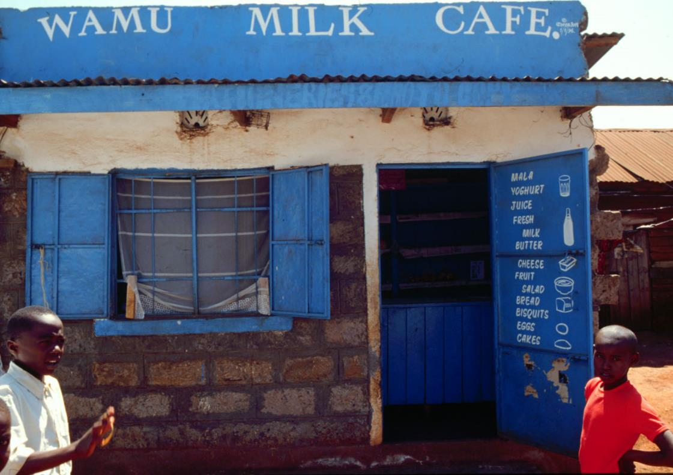
Planning a Business
a
4

Slide 58
Session Objective
How to plan a business

Slide 59
Case Study: Absko’s Shop
  Absko is a milk vendor. He had been selling milk in his shop for about a year, and while he was meeting his basic living needs, he wasn’t making any profit and therefore could not grow his business. Absko knew that he wanted a more successful business and he was willing to put in the work to make it a reality. He began keeping track of every sale he made and compared it to what his costs for operating the business were. He discovered that though he sold a lot of milk, he did not make much profit, because his costs were also high. He knew he had to do something.

Slide 60
Case Study Cont’d
  Absko knew he could not increase the price of his milk because customers would go somewhere else. He decided he needed to sell more and better milk to attract more customers. Then the small profit he made on each sale of milk would add up to a big amount. He began negotiating with his suppliers more and only bought the best milk he could. When customers came in, he was able to tell them that he only sold milk he had tested himself. He tested his milk in front of them to show how clean it was. He made sure his shop is very clean and inviting, he posted his licenses clearly in the business. He was welcoming when people came in the shop. He also began offering a bargain for people who bought a lot of milk at once; for every litre they bought, they would receive a free cup.

Slide 61
Case Study Cont’d
  And so Absko began to develop a reputation for having high quality milk. Soon, more people realised they would like to buy milk from Absko knowing their milk was safe than risk getting sick.
  With Absko’s good record keeping he began noticing that he was more likely to lose money during certain times of the month because he had too much left over milk. He thought about decreasing the amount of milk he bought from suppliers, but he was afraid of what would happen if he ran out of milk. He had worked hard to earn the trust of his customers. He didn’t want to disappoint them.

Slide 62
Case Study Cont’d
  Eventually Absko decided that he would keep his milk order the same but begin fermenting left over milk to make lala made with his two favourite types of lala. He had never made lala but he followed the instructions carefully and made nice lala.
  He got some egg-cups and made sure they were clean. When customers were not in too much hurry he would give them an egg-cup of free lala to taste. Soon, Absko was selling milk and different types of lala. His customers were excited that there were new things in his shop, though when Absko looked at the records, he saw that one of his lala sold much better than the other. Eventually, he decided to focus on selling the lala people liked, since it was more likely to make him money. He also gave people recipe ideas to cook with lala such as ugali-lala, and mango-lala.

Slide 63
Case Study Cont’d
  After a year of keeping records and growing his business, Absko was able to see a record of everything he had sold in a year. He also was pleased to see that there was leftover money. He thought about renting a nicer home, but then decided to invest the money in a good fridge which would extend the shelf life of his milk.
  He also used his records of sales for that year to set a goal to sell more the next year.
  Today Absko has a cooler for his milk, is selling both milk and lala and is considering hiring an employee to help his business grow. Once a month he compares his sales to his goal for the year to make sure he is on track.

Slide 64
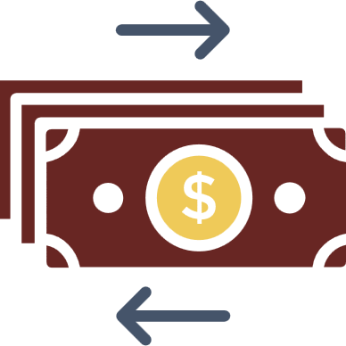




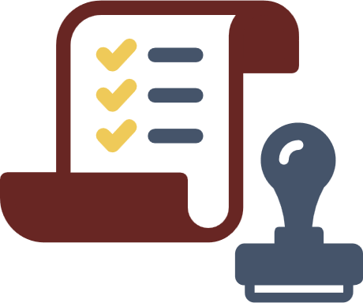

4.1 Business Basics
Manage Money
Keep Records
Have Strategy
Improve Products
Promote Business
Comply Regulations
Aim for Customer
Satisfaction

Slide 65
The Importance of a Budget
What is a budget?
A budget is the amount of money we think we will earn and spend in our business over a given period of time.
A budget can help you:
Manage costs
Grow business
Reinvest profits in the business
Plan for major purchases (e.g., a fridge, storage equipment)
Even if you don’t have one now, it’s never too soon to think about setting goals

Slide 66
The Importance of Record Keeping
Records protect you and everyone else in the supply chain, including customers
Keep records of every purchase / sale made
Records can be used to see available cash your business has
Records allow you to track success of one product over another
Records help you:
  Know how much you are making (cash in)
  Know how much you are spending (cash out)
  Find ways to make more and/or spend less

Slide 67
Financial Records
Cash In
Cash Out
Sales
Customer credit
  Names
  Contact info
  Amount due
Milk, other products, supplies
Employee wages
Debt
Rent
Electricity
Fees to service providers
Licenses and taxes

Slide 68
4.2 Cash In (Sales Record)
MONTH:
DATE | TOTAL SALES
20/6/19 | Sh.XX.XX
TOTAL

Slide 69
4.3 Cash In (Customer Credit)
MONTH:
NAME | CONTACT INFO | DATE PURCHASED | PAYMENT DUE DATE | DATE PAID | AMOUNT OWED
Ashura | +254 701 123456 | 20/6/19 | 27/6/19 | 27/6/19 | Sh.XX.XX
TOTAL

Slide 70
4.4 Cash Out
MONTH:
EXPENSE | DATE | AMOUNT
Milk, other products, supplies | 27/6/19 | Sh.XX.XX
TOTAL

Slide 71
Loans
Loans may help business, but risk involved
You must pay back loan amount plus interest
Interest rate is percentage of loan, accumulates over time
Ask before taking on a loan:
  What is the interest rate?
  When do I have to pay back?
  Is this realistic for my business?
  How will I pay back?

Slide 72
Reasons to take out a loan
Good
Bad
Capital improvements
Expansion
To bridge temporary cashflow problems
To stay in business when you aren’t making money

Slide 73







4.5 The Five Forces that Impact a Business
1
Customers’ Power
2
Suppliers’ Power
3
Competitors
4
New Entrants into the Market
5
Alternative Products

Slide 74
Licenses and Laws
There is one more force that impacts business: government
You must abide by laws and have appropriate licenses

Slide 75
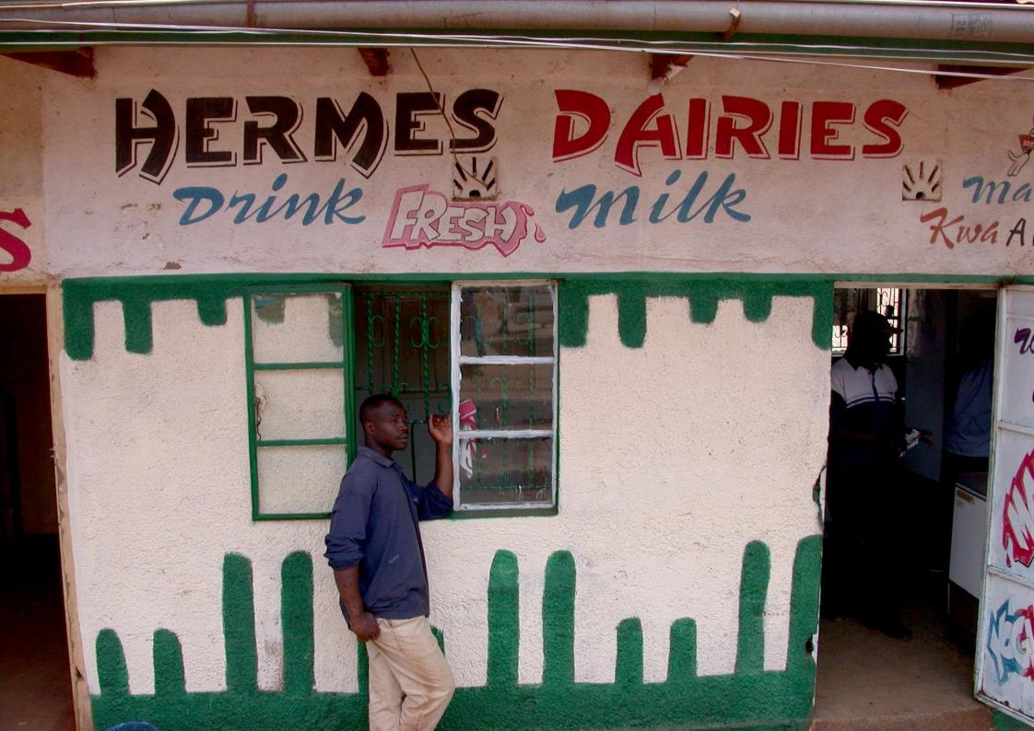
Selling More Milk to Your Customers
a
5

Slide 76



Session Objectives
How to Sell More Milk
Product and Price
Where to Sell
Promotion

Slide 77
Why Customers Should Buy Milk
Milk is highly nutritional
Great alternative to juice / soda, which are high in sugar and don’t have as many vitamins / minerals
Good for strong bones and teeth
Calcium, vitamin D
Helps children grow
Boosts energy, helps kids study (protein and B vitamins)

Slide 78
Why Customers Should Buy Milk Cont’d
Improves skin and vision (vitamin A)
Warm milk helps relax / reduces stress
Fresh milk is less expensive than packaged milk

Slide 79
The Value of Milk
Vendor:
You are selling milk from a cart.
You see a woman and her young daughter eyeing the cart.
You offer to sell her some milk
She tells you that she’s heard that prepackaged milk is safer than fresh milk.
What do you say to her?
Customer:
Your daughter is small for her age and you worry that an illness she had as a baby has affected her growth.
You are very concerned with milk safety, but don’t know a lot about it.
You know that milk is good for children
You’ve heard that packaged milk is much safer than fresh milk.
Respond positively to respectful vendors.
Buy milk from the vendor if they explain how they keep milk safe.

Slide 80
The Value of Milk
Vendor:
A regular customer comes to your milk cart to buy milk.
You ask him how his family is and he tells you that his 10 year old son loves football and is very good at it.
You ask him if his son drinks milk and the father laughs and says that he prefers soda.
What do you say to him?
Customer:
You have been buying milk from this vendor for a long time.
You are proud of your son’s football abilities.
You are worried that he has some trouble studying in school.
Respond positively to respectful advice.

Slide 81
How to Get Customers to Buy Your Milk
Communicate that your milk is safe and of good quality
  Use Five Keys to Safer Milk as reference
Communicate milk safety / hygiene practices to customers
Label products with information about your milk (pasteurised or not)
Maintain hygienic and clean-looking premises
Offer additional products, such as fermented milk products

Slide 82
Making Fermented Milk Products
Helps you get more value from milk
Keeps longer
Gives customers more options from your store
Less waste
Added nutrition

Slide 83
Making Fermented Milk Products Cont’d
There are lots of products that can be made from milk
  Cultured buttermilk (sour milk)
  Yogurt
  Mala (see Participant Guide 5.1 for recipe)
  And much more
Best practices for selling milk products
  Use milk that would otherwise be wasted
  Stock a variety of products
    Attracts more customers, sets you apart from competition
  Keep detailed records of your sales so you can accurately determine how profitable each type of product is

Slide 84
5.1 Mala Recipe
INGREDIENTS:
  1 litre / 4 cups plain dairy milk
  One serving (50-100ml) (1/5-1/3 cup) of other fermented milk drink
  Sugar to taste
STEPS
Clean all containers / equipment according to guides 1.1 and 1.2
Prepare warm place for milk to ferment, away from direct sunlight
Heat milk until steaming, do not boil
Once milk is cool enough to touch side of vessel for 10 seconds, transfer milk to prepared container

Slide 85
5.1 Mala Recipe Cont’d
Do not get milk on rim of container
Add fermented milk to container and close lid, shake, place in warm spot
Leave out to curdle, loosely covered
Let milk incubate 12-14 hours, do not disturb, do not open
Open after 12-14 hours
Fermented milk will be same colour as normal milk, but thicker
Will smell like yogurt with smooth tangy taste
Chill in fridge
Add sugar to taste before serving, 2-4 teaspoons per cup is normal

Slide 86





5.2 Customer Desires
Quality
Value
Cleanliness
Milk Safety
Trust

Slide 87
Offering Credit to Customers
Consider offering credit to customers
Customer might be able to buy more milk if they can pay later
Consider charging different rate for buying on credit
Refer to Participant’s Guide (4.3)
  Name
  Contact info
  Date of purchase
  Amount owed
  Payment due date
  Date paid

Slide 88
Amenities
Making your place of business a clean, comfortable place will attract more customers and give you a good reputation
Turn your business into a community hub - a place where people can relax, gain information, and socialise while finding good products
Consider:
  Benches
  Extended Shade
  Music
  Have newspapers

Slide 89
Communication Tips
Be friendly
  Talk to customers and get to know them
  Smile
Be knowledgeable, helpful and honest
Ask customers what milk products they’d like to buy that you don’t have
If you have employees who work for you, make sure they practice your standards for customer service
Happy customers are your best marketing tool.

Slide 90
Promotion
Promotions can encourage customers to buy from you
Promotions can include:
  Loyalty programs (e.g., punch cards)
  Free items
  Sales
  Coupons
  Sampling of new products
Before offering promotion, determine if financially possible
Might offer a promotion 1x a month, everyday might be financial burden

Slide 91
Why Your Milk Matters
Importance of milk in national development
Four important aspects of Kenya’s national development
Food security
Affordable healthcare
Affordable housing
Expand manufacturing sector

Slide 92
Photo credits
Cover: ILRI/Jules Mateo
Slide 3: ILRI/Jules Mateo
Slide 6: ILRI/Dave Elsworth
Slide 16: ILRI/Mohamed Ibrahim
Slide 17: ILRI/Susan MacMillan
Slide 18: ILRI/Ranjitha Puskur
Slide 42: ILRI/Jules Mateo
Slide 54: ILRI/Susan MacMillan
Slide 66: ILRI/Brad Collis
Slide 74: ILRI/Dave Elsworth
Slide 82: ILRI/Dave Elsworth

Slide 93
MoreMilk Handouts
a
A

Slide 94
1.1 Disinfecting with Bleach Solution
1
2
3
Soap
Rinse
1 Part Bleach
9 Parts Water
4
5
6
7
10 min Surface Contact
Rinse Again
Sun-Dry
Dry Upside
Down

Slide 95
1.2 Disinfecting with Boiling Water (No Bleach)
1
2
3
Soap
Rinse
Boiling Water
4
5
Sun-Dry
Dry Upside Down

Slide 96
2.2 Shed Cleanliness (Standing Area)
Completely dry
No faeces/mud on ground
Hoofs remain clean
Mainly dry some wet patches
Less than 1cm faeces/mud on ground
Hoofs on hard ground
Wet
1- 3 cm of faeces/mud on ground
Hoofs sink a little in ground
Boggy
More than 4 cm faeces/mud on ground
Hoofs sink deeply in ground

Slide 97
2.3 Shed Cleanliness (Lying Area)
Completely dry and clean
Mainly dry and clean, some faeces
Damp bedding with trodden in faeces
Wet and filthy bedding area

Slide 98
2.4 Checklist for Farmers
Clean hands before milking
Do not milk if sick
Clean, dry shelter for animals
Use appropriate / clean containers
Keep milk cool
and covered
Milk healthy cows

Slide 99
2.5 Checklist for Distributors
Clean hands before handling
Buy from trusted farmers
Clean facilities
Do not handle milk
if sick
Keep milk cool
and covered
Use clean / appropriate containers

Slide 100
2.6 Purchase Record
NAME | VOLUME | DATE | TIME BOUGHT | PRICE PER LITRE | PASTEURISED | TEST RESULT
Aasir's Farm | 5 litres | 20/6/19 | 9:30am | XX.XX | Yes | No clotting

Slide 101
2.7 Maintaining Milk Quality During Transport
Short
Distance
Low
Temperature
Sealed
Containers

Slide 102
2.11 Safe Milk Handling
Personal Hygiene and Health
Don’t Smoke
Head Covered
Hands Washed
Trimmed Nails

Slide 103
2.12 Correct Way to Wash Hands
1
2
3
4
Pull sleeves up
Rinse
Wash hands
with soap
Wash forearms with soap
5
6
7
8
Brush hands
and nails
Rinse to
remove soap
Dry with paper towel
Use a paper towel
to turn of tap

Slide 104
3.1 Five Keys to Safer Milk
1
2
3
Sell unadulterated milk
Separate raw and pasteurised
Maintain cool
temperature
4
5
Track purchase dates
Practice personal
hygiene

Slide 105
4.1 Business Basics
Manage Money
Keep Records
Have Strategy
Improve Products
Promote Business
Comply Regulations
Aim for Customer
Satisfaction

Slide 106
4.2 Cash In (Sales Record)
MONTH:
DATE | TOTAL SALES
20/6/19 | Sh.XX.XX
TOTAL

Slide 107
4.3 Cash In (Customer Credit)
MONTH:
NAME | CONTACT INFO | DATE PURCHASED | PAYMENT DUE DATE | DATE PAID | AMOUNT OWED
Ashura | +254 701 123456 | 20/6/19 | 27/6/19 | 27/6/19 | Sh.XX.XX
TOTAL

Slide 108
4.4 Cash Out
MONTH:
EXPENSE | DATE | AMOUNT
Milk, other products, supplies | 27/6/19 | Sh.XX.XX
TOTAL

Slide 109
4.5 The Five Forces that Impact a Business
1
Customers’ Power
2
Suppliers’ Power
3
Competitors
4
New Entrants into the Market
5
Alternative Products

Slide 110
5.1 Mala Recipe
INGREDIENTS:
  1 litre / 4 cups plain dairy milk
  One serving (50-100ml) (1/5-1/3 cup) of other fermented milk drink
  Sugar to taste
STEPS
Clean all containers / equipment according to guides 1.1 and 1.2
Prepare warm place for milk to ferment, away from direct sunlight
Heat milk until steaming, do not boil
Once milk is cool enough to touch side of vessel for 10 seconds, transfer milk to prepared container

Slide 111
5.1 Mala Recipe Cont’d
Do not get milk on rim of container
Add fermented milk to container and close lid, shake, place in warm spot
Leave out to curdle, loosely covered
Let milk incubate 12-14 hours, do not disturb, do not open
Open after 12-14 hours
Fermented milk will be same colour as normal milk, but thicker
Will smell like yogurt with smooth tangy taste
Chill in fridge
Add sugar to taste before serving, 2-4 teaspoons per cup is normal

Slide 112
5.2 Customer Desires
Quality
Value
Cleanliness
Milk Safety
Trust

