Slide 1
2024
BREAKTHROUGH
AGENDA REPORT
AGRICULTURE
Presented by Dr Aditi Mukherji, CGIAR Climate Impact Platform, on behalf of the CGIAR writing team

Slide 2
01
Background
The Agriculture Breakthrough Agenda

Slide 3
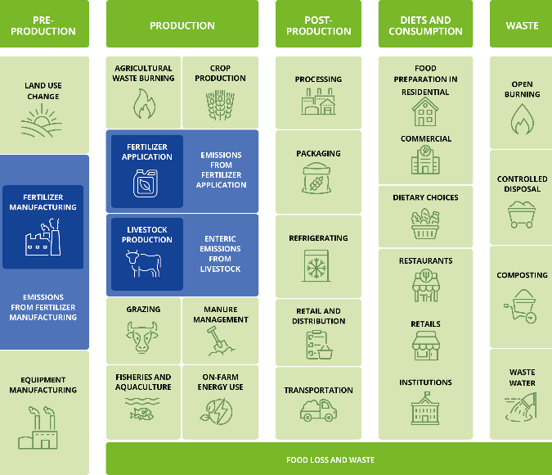
Why agriculture?
Agrifood systems account for approximately one-third of all greenhouse gas (GHG) emissions globally, when food production, transport, processing, and retailing are considered (Crippa et al. 2021; IPCC 2022).
Sources of GHG emissions from various components across the entire value chain of the agrifood system. Adapted from Balasubramanian et al. 2021 and Rosenzweig et al. 2021.The sectors where we do a deep dive are marked in blue.

Slide 4



Agrifood system emission sources
Production, processing, distribution, consumption of food, and management of food system residues: estimated 21–33% of all global GHG emissions
Agriculture
Land-use change
Energy, industry, waste
Direct emissions from livestock and crop production systems: 6.3 Gt CO₂-eq
Land use, land-use change, and forestry, including peatland drainage: 4.0 Gt CO₂-eq
Processing, transport, storage, preparation, food waste: 6.5 Gt CO₂-eq
The share of energy, industrial process, and waste emissions occurring as part of the food system has grown from ~28% in 1990 to ~38% in 2018

Slide 5
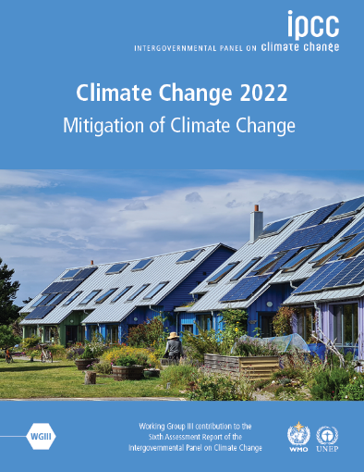
Unless there are immediate and deep emissions reductions across all sectors (including agrifood systems), 1.5°C is beyond reach.
Notes:
In the next 20 minutes we will set out our key findings, showing where we are in terms of greenhouse gas emissions, where we are headed, and what action we can take to limit global warming.
[CLICK]
The reality is that greenhouse gas emissions, which are causing global warming, are at their highest levels in human history.
[NEXT SLIDE]

Slide 6
However, stringent mitigation to keep within 1.5–2°C may lead to severe food insecurity in sub-Saharan Africa and South Asia
Research has found that by 2050, stringent climate mitigation policy, if implemented evenly across all sectors and regions, would have a greater negative impact on global hunger and food consumption than the direct impacts of climate change (Hasewaga et al. Nature Climate Change, 2018).
Land-based mitigation actions like energy crop expansion, non-CO₂ emissions reduction in agricultural sector, and afforestation could lead to lower available calories, increased food insecurity, and higher agricultural commodity prices (Fujimori et al. Nature Food, 2022).

Slide 7
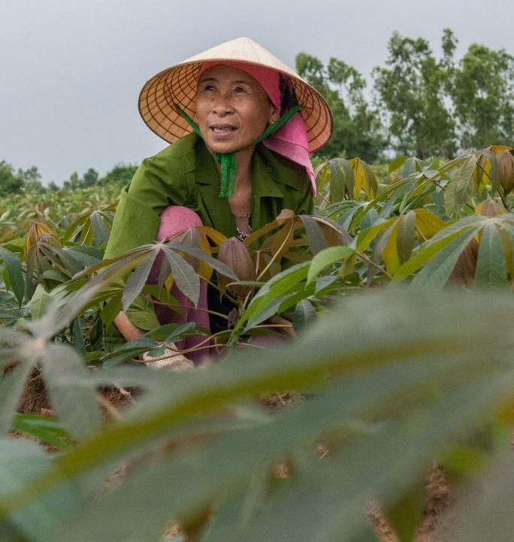
A catch-22 situation
To mitigate climate impacts and keep them to a minimum, we must keep global warming levels within the Paris Agreement goals of 1.5 to 2°C.
But mitigation at the necessary scale may lead to hunger and food insecurity for people in the global South, unless it is done carefully and by understanding the trade-offs and synergies well.
All of us need to play an important role in ensuring:
“That technological and policy breakthroughs lead to just transitions in the agrifood sector”

Slide 8
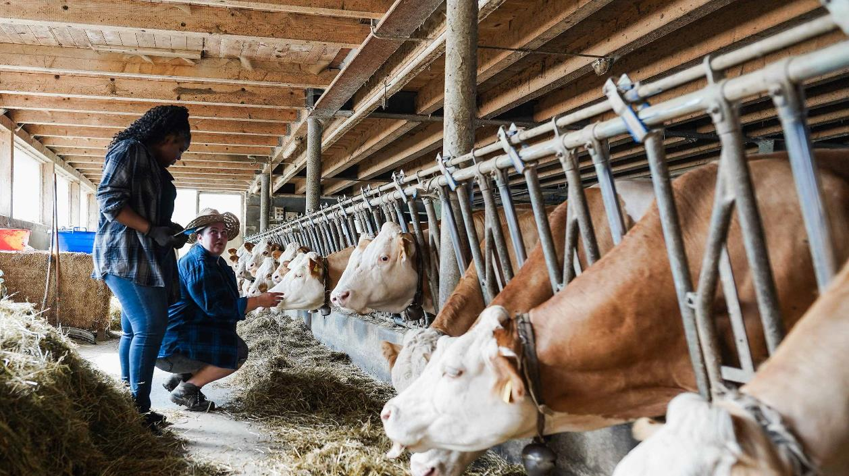

The Agriculture Breakthrough goal
“To make climate-resilient, sustainable agriculture the most attractive and widely adopted option for farmers everywhere by 2030” ​
17 participating countries:
Australia, Belgium, Cambodia, Denmark, Egypt, Germany, Ireland, Japan, Latvia, Morocco, Nigeria, Sweden, UK, UAE, Canada, Kenya, New Zealand​
Co-leads:
UK, Egypt

Slide 9
Four principles of the Agriculture Breakthrough
Reduced GHG emissions from agrifood sector
Improved adaptation and resilience to climate change particularly for vulnerable smallholder producers
Sustainable increases in agricultural productivity and incomes, particularly in LMIC contexts
Improved soil, water resources, and natural ecosystems

Slide 10
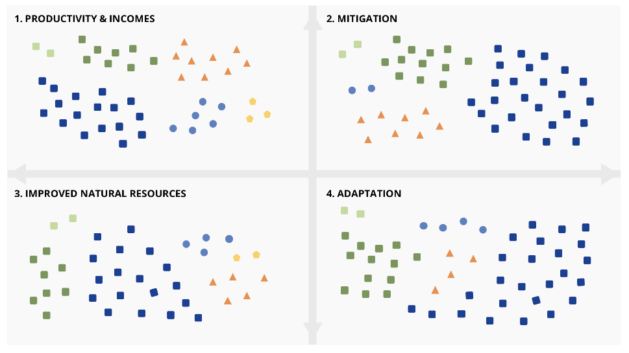
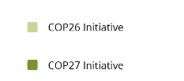
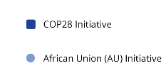
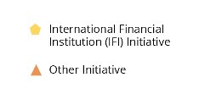
Since COP26 in 2021, international collaborative initiatives have increased substantially, showing greater interest in climate action in the agrifood sector, yet gaps remain
Mapping of various agriculture and agrifood systems initiatives launched since 2021 against the four breakthrough principles. Note: Not exhaustive (Source: Authors).

Slide 11
Five pathways for achieving Agriculture Breakthrough
Pathway 1
Reduce unsustainable consumption where such consumption has harmful effects on health, climate, and the environment
Reduce fertilizer use by improving NUE in high-use areas
Reduce unsustainable intake of ASF in HIC contexts by partial replacement with alternative proteins
Pathway 2
Increase production of sustainable, healthy and nutritious food, particularly in LMICs, without expanding agriculture into new lands
Increase production through optimal application of low emissions fertilizers in areas of underuse
Increase production through crop breeding in areas of low productivity
Pathway 3
Reduce damage to natural resources such as soil, water, and biodiversity
Improve NUE of fertilizers allowing less pollutants to leach into water bodies
Reduce food waste & loss
Pathway 4
Reduce emissions, either absolute emissions or emissions intensity with the ultimate aim of reducing absolute emissions
Adopt low external input agroecological & other sustainable approaches
Pathway 5
Prioritise the needs and interests of smallholder producers
Use digital services to aid all above
Reduce food waste & loss
Use digital services to aid all above
Use digital services to aid all above
Reduce food waste
Use digital services to aid all above
Increase production through climate-smart livestock practices & agroecological & other sustainable approaches
Improve NUE & adoption of low emissions fertilizers
Reduce methane emissions from livestock sector; & promote adoption of alternative proteins
Invest in social safety nets for smallholder producers
Digital services, e.g. climate advisory & indexed based insurance for smallholder producers
Increase productivity & incomes through crop & livestock breeding for smallholder farmers
Improve resilience of smallholder production systems by adoption of agroecological & other sustainable approaches
Promote sustainable healthy diets with low carbon footprint
Improve agricultural water management
Reduce methane emissions from rice paddy

Slide 12
Since COP21, most initiatives have undertaken actions in line with the Breakthrough Report's areas of recommendations
Assessment of international cooperation in the agrifood sector November 2021–October 2024

Slide 13
ASSESSMENT OF INTERNATIONAL COOPERATION IN THE AGRI-FOOD SECTOR NOVEMBER 2021 - OCTOBER 2024

Slide 14
02
Deep dive into two highly emitting sectors of the agrifood system
Enteric methane emissions from livestock – one of the greatest contributors of methane emissions globally
Emissions from fertilizer production and application – both significant sources of nitrous oxide emissions

Slide 15
Livestock

Slide 16
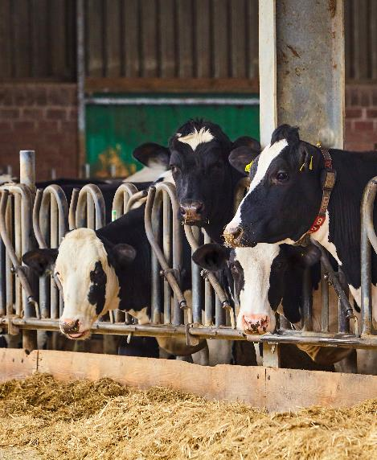
Reducing enteric methane emissions from livestock
Why is it important?
Methane emissions account for 35% of agrifood system GHG emissions (expressed in CO₂e) consistently across developed and developing countries (Crippa et al. 2021), with livestock being the most significant contributor.
Livestock emissions from manure and enteric fermentation represent 32% of all global anthropogenic emissions of methane (Global Methane Assessment 2021).
To be 1.5°C-aligned, emissions from agricultural must fall by 39% by 2050 relative to 2017 (Climate Action Tracker 2023).
As global population and food demand are projected to continue growing through at least the year 2050, the emissions intensity of agricultural production per calorie of food produced will need to fall even faster than this 39% absolute target. Rapidly reducing the emissions intensity of livestock is therefore critical by 2030.
One way to reduce methane emissions from ruminant animals, such as cattle, sheep, and goats, is through feed additives that interfere in the digestive processes that generate methane.

Slide 17


Reducing enteric emissions via methane inhibitors
These are compounds that inhibit methane-producing enzymes and can reduce methane production by 30–95%, depending on type, dose, and duration of use (Cornell CALS 2024).
In the last five years, there has been significant progress in the development of methane inhibitors, with the most significant market capture from DSM’s 3-NOP or Bovaer®. On average, 3-NOP decreases methane production in beef and dairy herds by 30% (Dijkstra et al. 2018; Kim et al. 2020), although decreases of 80% or greater have been obtained in some studies with high-concentrate diets (Yu et al. 2021).
DOWNLOAD FACTSHEET
Notes:
In the last five years, there has been significant progress in the development of methane inhibitors (GRA, 2021), including DSM (dsm-firmenich), 3-Nnitrooxypropanol (3-NOP,— trade name Bovaer®®), made by DSM (dsm-firmenich), Agolin Ruminant (a blend of plant extracts), Mootral Ruminant (garlic and citrus extracts), SilvAir (a nitrate-based additive), and red seaweed extracts produced by CH₄ Global, Symbrosia, Future Feed, Dulabio, and Volta Greentech (red seaweed extracts). - could include some logos, or too messy?
Include one or both images from Dennis in this slide – attributed to dsm-firmenich

Slide 18





Barriers to scaling methane inhibitors
Insufficient investment and global cross-sector collaboration in product development.
Higher production costs when using methane inhibitors reduce incentives for adoption.
Insufficient information on meat and dairy consumers’ willingness to pay.
Current inappropriateness for extensive pasture-based systems.
Limited collaboration on regulatory frameworks, sharing of data, and metrics, reporting, and verification (MRV).

Slide 19
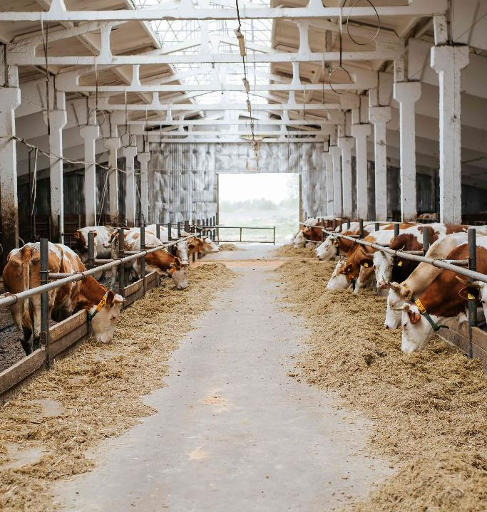

Reducing enteric emissions via low-methane forages
Improved forages, including legumes and grasses enriched with anti-methanogenic compounds, offer a potentially cost-effective solution for reducing methane emissions (Bratta 2015).
These compounds inhibit methanogenic microbes in the rumen and alter the microbial community to favour alternative fermentation pathways without affecting animal productivity (Molina-Botero et al. 2024; Arndt et al. 2022; Jayanegara et al. 2019).
Low-methane forages could also improve carbon sequestration in soil and enhance soil health, with the potential for developing land-based GHG removal projects (Costa Jr et al. 2022; Paul et al. 2020).
DOWNLOAD FACTSHEET
Notes:
If this is too text-heavy, we could also pull out just the key features, e.g.:
Legumes and grasses enriched with anti-methanogenic compounds (WHAT?)
Inhibit methanogenic microbes in the rumen and alter the microbial community to favor fermentation pathways that produce less methane (HOW?)
Cost-effective - no negative impact on animal productivity
Other benefits: e.g., improved carbon sequestration and soil health

Slide 20




Barriers to scaling low-methane forages
A one-size-fits-all approach would not be effective, because solutions need to be tailored to specific regions, e.g., for adaptation to local soil and weather conditions.
Lack of supportive public policies and agreements between governments (Micol & Costa Jr 2023; White et al. 2013).
Insufficient climate finance (e.g., grants, credit lines, impact funds, and carbon markets). More is needed to de-risk investments and incentivize farmers (Gerber et al. 2021).
Farmers may also require training to effectively manage new systems involving low-methane forages.
High upfront costs, including: (i) working capital for planting improved forages and purchasing animals; (ii) capital investments in infrastructure, such as corrals, barns, and fencing; and (iii) opportunity costs of land and labor, which could limit adoption by some resource-poor farmers (Micol & Costa Jr 2023; White et al. 2013).

Slide 21
An update on international actions in the livestock subsector
2021
The Global Methane Pledge (GMP) was launched at COP26.
The dairy industry is quantifying its environmental, social, and economic impact via the Dairy Sustainability Framework, with the aim to reduce its carbon footprint.
2023
The Global Methane Hub launched the Enteric Fermentation R&D Accelerator Initiative at COP28 with US$200 million in funding.
2023
Launched at COP28, Dairy Methane Action Alliance is a global initiative to accelerate food industry action to reduce dairy methane emissions.
2024
Within the last year, some governments have shifted to a more regulatory approach, albeit with financial disincentives/incentives. The first scheme to tax methane emissions from livestock was launched by Denmark in June 2024
With support from a diverse coalition, including agricultural and environmental groups, the US Enteric Methane Innovation Tools for Lower Emissions and Sustainable Stock (EMIT LESS) Act aims to integrate emissions-reducing practices into US Department of Agriculture conservation programs and providing financial incentives to farmers that voluntarily adopt them.
Several initiatives have enhanced research and development in the livestock sector. For example, the Livestock Research Group of the Global Research Alliance on Agricultural Greenhouse Gases (GRA) and the FAO’s Livestock Environment Assessment and Performance Partnership (LEAP).
Following COP28, there have been several conferences and awareness-raising events to strengthen international partnerships, including the launch of the Expert Panel on Livestock Methane.

Slide 22
Fertilizer

Slide 23
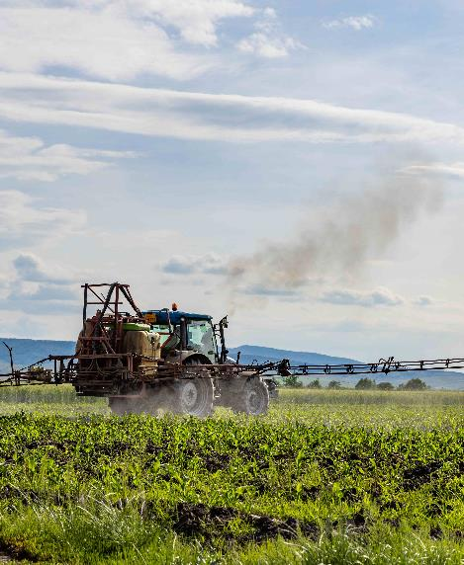
Reducing emissions from fertilizers
Why is it important?
Fertilizer use has increased since 1960s, with commensurate food security benefits
Fertilizer use unequal across regions
Higher global warming potential of N₂O than CO₂
More efficient use of fertilizers in high-use regions will allow for optimum use in low-use areas

Slide 24
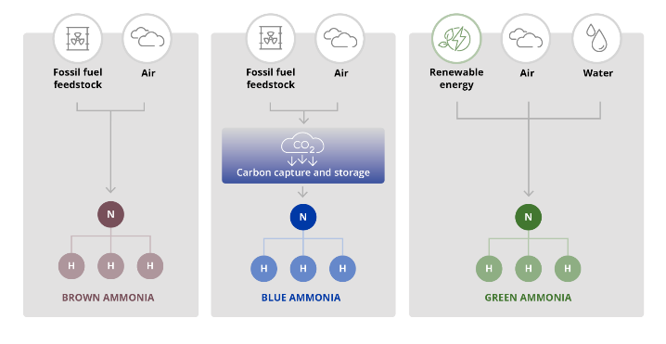

Reducing emissions from fertilizer production via green ammonia
Green ammonia has the potential to eliminate all carbon dioxide emissions from ammonia production
The Haber–Bosch process, the primary source of ammonia from hydrogen and nitrogen, is highly energy intensive: it relies on hydrocarbons as a feedstock for producing hydrogen through steam methane reforming (or coal gasification) and for powering the ammonia synthesis process, which fixes nitrogen from the air with the hydrogen obtained from steam methane reforming (called brown ammonia).
Zero carbon ammonia, or “green ammonia,” uses renewable energy to power electrolysis to produce hydrogen from water and the subsequent ammonia synthesis.
Numerous green ammonia pilot plants have been set up, and large-scale green ammonia facilities may come online in the next five years.
Production process of brown, blue, and green ammonia (Source: https://www.nature.com/articles/s44160-023-00362-y).
DOWNLOAD FACTSHEET

Slide 25



Barriers to scaling green ammonia
Given that between 10 and 15% of global ammonia production is traded, countries may be hesitant to impose regulations mandating emissions reductions so as not to disadvantage their producers.
Cost is still higher than for blue ammonia.
As fertilizer plants can operate for more than 40 years, operators of existing plants may not feel incentivized to switch to green ammonia production.
Safety and security considerations in the ammonia production process, storage, and transport, as well as at the level of on-farm application of fertilizers.
Further processing would be required to produce multinutrient fertilizers (nitrogen, phosphorous, potassium, and other micronutrients). These considerations imply that setting up green ammonia plants alone is not sufficient, and additional processes and costs would be required to provide fertilizer products that farmers prefer and that provide for more balanced plant nutrition.
Notes:
The cost of producing green ammonia is still higher than for blue ammonia – although, over time, with an ongoing decrease in the price of renewable energy and electrolyzers, this barrier could be overcome.
Given that between 10 and 15 percent of global ammonia production is traded, countries may be hesitant to impose regulations mandating emissions reductions so as not to disadvantage their producers (noting that the EU only recently announced a plan to gradually phase out free emission allowances provided to EU fertilizer producers, but at the same time introducing carbon border tax adjustments).
As fertilizer plants can operate for more than 40 years, operators of existing plants may not feel incentivized to switch to green ammonia production, preferring instead to pursue blue ammonia because it does not require any changes to their existing plants and operations except for securing access to carbon dioxide sequestration infrastructure.
There are important safety and security considerations in the ammonia production process, storage, and transport, as well as at the level of on-farm application of fertilizers. Anhydrous ammonia, the end product of green ammonia plants, requires careful handling and specialized equipment for transportation and application at the farm level. Ammonia codes of practice and government regulations can mitigate against such risks, as can proper equipment, but this implies additional costs for value chain players, including farmers. This can be particularly significant for smallholder producers.
Balanced fertilization is important for agricultural productivity, soil health, and sustainability, and further processing would be required to produce multi-nutrient fertilizers (nitrogen, phosphorous, potassium, and other micronutrients). These considerations imply that setting up green ammonia plants alone is not sufficient, and additional processes and costs would be required to provide fertilizer products that farmers prefer and that provide for more balanced plant nutrition.

Slide 26
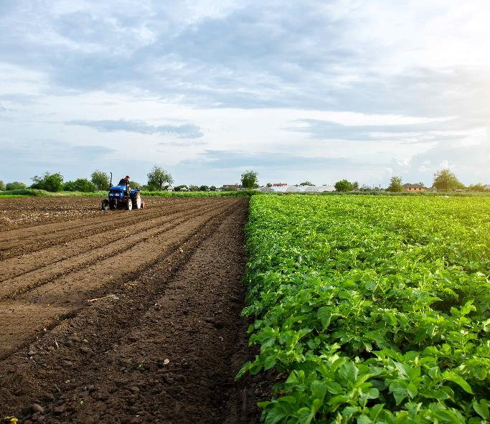

Reducing emissions from fertilizer application via site-specific nutrient management (SSNM)
SSNM aims to increase nitrogen use efficiency (NUE) through the precise application of balanced fertilizer inputs, leading to higher crop productivity and other environmental benefits (Dobermann and White 1998; Dobermann et al. 2002).
SSNM is an important axis of integrated soil fertility management (ISFM), a set of soil fertility management practices adapted to local conditions that aim to maximize the agronomic use efficiency of the applied nutrients and improve crop productivity (Vanlauwe et al. 2010).
Supported by advances in big data science, crop modeling, and geospatial analytics, and with the increasing availability of remote sensing products, SSNM is supported by decision tools that guide the right source of nutrients, at the right rate, the right time, and in the right place, i.e., the 4Rs (Johnston and Bruulsema 2014).
Efficiently used fertilizer means that available nitrogen in the soil is minimal, reducing the potential for nitrous oxide emissions (Tian et al. 2020).
DOWNLOAD FACTSHEET
Notes:
Many studies have demonstrated GHG emission reductions with SSNM: Gupta et al., 2022; Pampolino et al., 2007; Sapkota et al., 2014; Zhang et al., 2018; Huang et al., 2021; Sapkota et al., 2021. However, when SSNM tools recommend increased fertilizer input due to low baseline conditions (as in much of Africa), an increase in GHG emissions will ensue. That said, the land-sparing effect of closing yield gaps can counteract the effect of the increased emissions from agricultural inputs; Africa is the region that witnessed the largest cropland expansion between 2003 and 2019 (Potapov et al. 2022) and is also projected to have the largest agricultural expansion to 2050 (Searchinger et al. 2019).

Slide 27




Barriers to scaling site-specific nutrient management
SSNM decision support tools are heavily dependent on data availability – the lack of standardized and open data hinders accuracy. There is minimal data on robust GHG measurements at present.
There are inadequate policies and incentives to encourage and facilitate the adoption of digital tools to support SSNM. Government support and subsidies can play a crucial role in promoting these practices.
The initial investment in SSNM decision tools such as GPS-guided machinery, plus fluctuating crop and fertilizer market prices, reduces the cost-effectiveness and incentives for adoption.
The lack of sustainable business models, including revenue generation options, limits the sustainable deployment of decision support tools at scale.
There is limited bundling of decision support tools with other agro-inputs (e.g., seeds, mechanization), limiting the achievement of agronomic gains in terms of yields and other key performance indicators, which in turn makes it harder for farmers, often with limited digital skills, to adopt these tools.

Slide 28
An update on international actions in the fertilizer sector
2019, 2022
A resolution on sustainable nitrogen management was adopted at the United Nations Environmental Assembly (UNEA) in 2019, followed by a second resolution in March 2022 encouraging Member States to accelerate actions to significantly reduce nitrogen waste globally by 2030
2019
15 UNEP Member States launched the Colombo Declaration on Sustainable Nitrogen Management, which called upon countries to develop national roadmaps for sustainable nitrogen management
2019
The FAO The International Code of Conduct for the Sustainable Use and Management of Fertilizers
The Code of Conduct was developed to support the 2017 Voluntary Guidelines on Sustainable Soil Management
The Efficient Fertilizer Consortium was established by the Foundation for Food & Agricultural Research as a multistakeholder collaboration to invest in solutions to reduce the environmental impacts from fertilizer use
The Croplands Research Group of the Global Research Alliance on Greenhouse Gases established the Integrated Nutrient Management Network
2022
The US Global Fertilizer Challenge was launched at COP27 to support innovative research, demonstrations, and training to help countries with high fertilizer usage and loss adopt nutrient management and alternative fertilizers
2021
The International Energy Agency put out an Ammonia Technology Roadmap
Decarbonization of fertilizer production and use is also a top priority of the International Fertilizer Association (IFA)

Slide 29
03
5 recommendations for international collaborative action

Slide 30
Five recommendations for international collaborative action
A1
Increase climate finance directed toward sustainable agricultural technologies and approaches
A2
Encourage international knowledge sharing on policy and technology implementation
A3
Develop common metrics and indicators to track the adoption of sustainable agricultural solutions
A4
Increase support for research, development, and demonstration to scale promising approaches
A5
Support international efforts to enable the private sector to scale up solutions through global markets

Slide 31
A1. Increased international climate finance should be directed toward unlocking the potential of sustainable agricultural technologies and approaches with proven effectiveness
Ensure that green ammonia, feed additives, enhanced efficiency fertilizers, and low-methane forages can benefit from green finance, particularly in high-income countries, by being included in Climate Bonds Initiative Agriculture Criteria, which will make these investments a part of country taxonomies and regions.
Encourage multilateral development banks and donor countries to provide concessional loans and grants for the two technologies that are particularly appropriate for LMICs, namely low-methane forages and fertilizer application with SSNM, where there are large opportunities for productivity improvement as well as reducing emissions, but upfront costs are a barrier.
Seek and obtain international consensus on “repurposing” the more than US$600 billion spent annually by governments on agricultural support, as much of the support provided is market distorting and incentivizes unsustainable production.
The Breakthrough Agenda should make stronger linkages to G7 and G20 agendas where parallel decisions are taking place to direct investment for broader development and environment objectives in agrifood systems.

Slide 32
A2. Promote international sharing of knowledge on policy and implementation to create demand for and facilitate faster uptake of proven technologies
Encourage governments to sign NUE Pledges along the lines of the Methane Pledge. Such an NUE pledge will help reduce nitrous oxide emissions, as nitrogenous fertilizer is the top source of nitrous oxide emissions.
Countries should work together within Codex Alimentarius of the FAO-WHO to establish a food safety maximum residue limit of inhibitor compounds in livestock products. Such standards will help facilitate the trade of products containing inhibitors.
Countries should take advantage of the existing Methane Pledge and incentivize demand creation globally for methane inhibitors and low-methane forages through specific technology use pledges and targets. These will be supported by financial incentives to encourage producer uptake of technologies and consumer purchase of low-methane dairy and meat.
Countries should take advantage of existing platforms to engage in intensive exchanges of knowledge on questions such as which policies are most effective for encouraging and supporting farmers’ adoption of SSNM and low-methane forages.

Slide 33
A3. Develop common metrics and indicators to track the adoption of sustainable agricultural solutions
Specific recommendations for the fertilizer sector:
Encourage fertilizer companies to expand their GHG accounting to include the GHG emitted from fertilizer application (Scope 3 emissions). Greater scrutiny of Scope 3 emissions can incentivize efforts to reduce nitrous oxide emissions from application and enhance NUE.
Governments could set deployment targets for existing and planned ammonia facilities.
Governments should also set a target of deploying 80 GW of new renewables-powered electrolyzers, of which Green Hydrogen Catapult members have already committed 45 GW.
The industry should also undertake a complete reporting structure or certification mechanism for the full production CO₂ equivalent footprint and the captured carbon of an associated ton.
Specific recommendations for the livestock sector:
Set up globally aligned regulatory frameworks and MRV requirements to ensure credible reporting, to deliver immediate methane reductions in zero-grazing and grazing with feed supplementation livestock production systems. Further, we recommend collaboration among research institutions, international organizations, the private sector and carbon market to standardize cost-effective methodologies for evaluating standards.
Overall, we recommend that:
Countries should come together and develop “Codex Planetarius” along the lines of Codex Alimentarius, which develops internationally agreed food safety standards.

Slide 34
A4. Increase support for food system research, development, and demonstration (RD&D) to support the uptake and scaling of promising technologies and approaches
Support global knowledge exchange by expanding and strengthening The Nutrient Management Network of the Global Research Alliance on Agricultural Greenhouse Gases –particularly for reducing emissions from the field application of fertilizer.
The fertilizer industry must be mandated by governments to report on R&D spending and commit to higher spending levels on green innovations, as it is increasingly evident that increased spending on R&D underpins innovation.
Taking advantage of the active livestock research group of the Global Research Alliance on Agricultural Greenhouse Gases, invest in the continued research on methane-inhibiting technologies and low-methane forages by documenting early success stories and increasing farmer options and market competition.

Slide 35
A5. International efforts should work toward enabling the private sector to scale up solutions through global markets
Revive the moribund WTO Agreement on Environmental Goods and Services, started in 2014 to promote trade in essential environmental products, i.e., solar panels and wind turbines. In future negotiations, the list of green goods and services should include low-carbon fertilizers like green ammonia and livestock feed additives, among other emissions-reducing technologies.
This would involve advocating for harmonized standards, certifications, and accounting methodologies with multilateral organizations such as WTO and various UN agencies and is related to the previous recommendation on Codex Planetarius, where such standards would be agreed upon, and once agreed upon, products that meet the Codex Planetarius would be conferred the presumption of compliance by the WTO, facilitating trade in green and low-emission agricultural products.

Slide 36
Thank you on behalf of CGIAR’s author team
Whole report
Aditi Mukherji, CGIAR Climate Impact Platform
Suzie Marshall, CGIAR Climate Impact Platform
Livestock-related sections
Jacobo Arango, Alliance of Bioversity – CIAT
Fiona Flintan, International Livestock Research Institute (ILRI)
Ciniro Costa Jr, Alliance of Bioversity – CIAT
Fertilizer-related sections
Charlotte Hebebrand, International Food Policy Research Institute (IFPRI
Job Kihara, Alliance of Bioversity – CIAT
Cargele Masso, CGIAR Biodiversity and Environmental Health Platform
Patrick Molloy, Rocky Mountain Institute
Leonard Rusinamhodzi, International Institute of Tropical Agriculture (IITA)
Tek Sapkota, Centro Internacional de Mejoramiento de Maíz y Trigo (CIMMYT)
Bernard Vanlauwe, International Institute of Tropical Agriculture (IITA)
Acknowledgment: Funding support
FCDO
Mukherji, A., Marshall S., Arango, J., Costa Jr, C., Flintan, F., Hebebrand, C., Kihara, J., Masso, C., Molloy, P., Rusinamhodzi, L., Sapkota, T., Vanlauwe, B. (2024). 2024 Breakthrough Agenda Report: Agriculture, CGIAR, Montpellier, France. https://hdl.handle.net/10568/152247; pp: 44

Slide 37


Digital report:
CGIAR is a global research partnership for a food-secure future dedicated to transforming food, land, and water systems in a
climate crisis.

