Slide 1
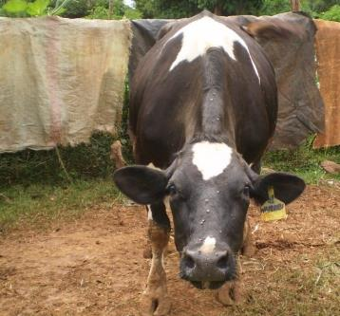
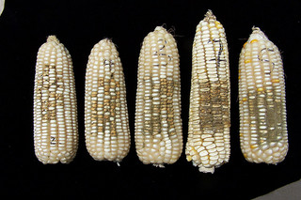
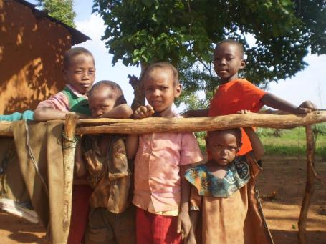




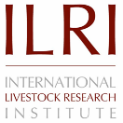


Measuring and mitigating the risk of mycotoxins in maize and dairy products for poor consumers in Kenya
Johanna Lindahl, Delia Grace, Vesa Joutsjoki, Hannu Korhonen and Vivian Hoffmann

Slide 2
Presentation outline
Food safety
Aflatoxin contamination
  Globally
  Our work in Africa
What do we do about it?
  Mitigation strategies at different levels

Slide 3
Food safety- more than aflatoxins
Disability adjusted life years (DALY)
Havelaar et al., 2015

Slide 4
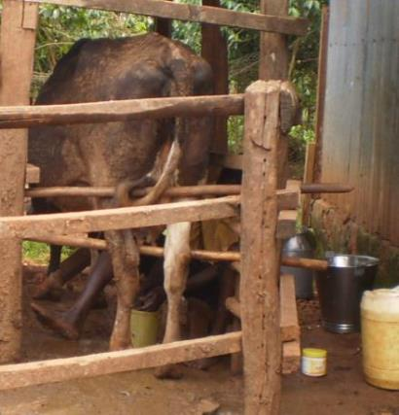
Milk safety
Pathogens from the cow and from the milk
Mycobacterium bovis
Brucella spp.
Bacillus anthracis
Salmonella
EHEC
Streptococcus spp.
Staphylococcus aureus
Clostridium spp.
Listeria spp.

Slide 5
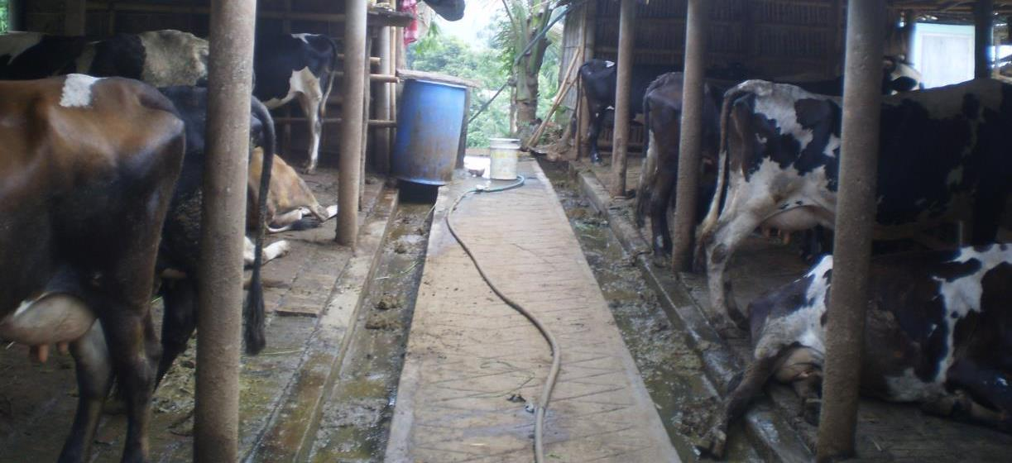
What else is in the milk?
Microbial load
Adulterants

Slide 6
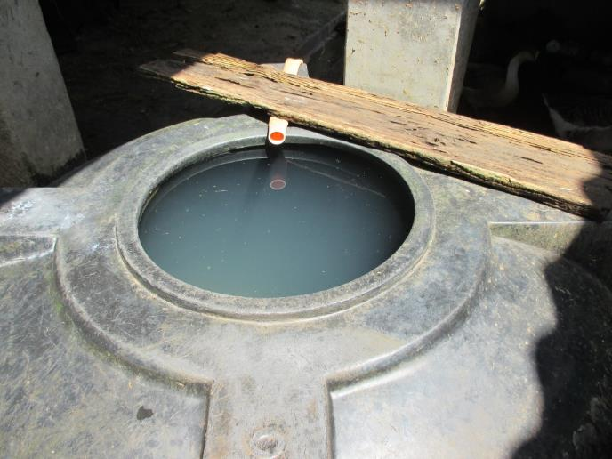
What else is in the milk?
Antibiotic residues
Pesticides
Mycotoxins: aflatoxins

Slide 7
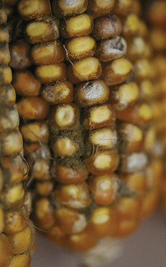
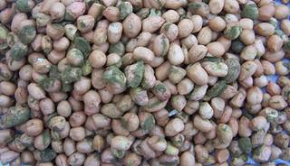
What are mycotoxins?
When some moulds grow on crops, they produce toxic substances that can remain in the crops
Moulds are ubiquitous
Photo by IITA. Aspergillus naturally infected groundnuts in Mozambique.
Photo by CIMMYT.

Slide 8
Aflatoxins
Toxic byproducts from Aspergillus fungi
  Mainly Aspergillus flavus
  Not all toxigenic
  Preference for maize, groundnuts, but also other cereals
  Staples!

Slide 9
Aflatoxins
Different kinds
  Invisible
  Odourless
  Tasteless
  Heat stable
We feed it to our children

Slide 10
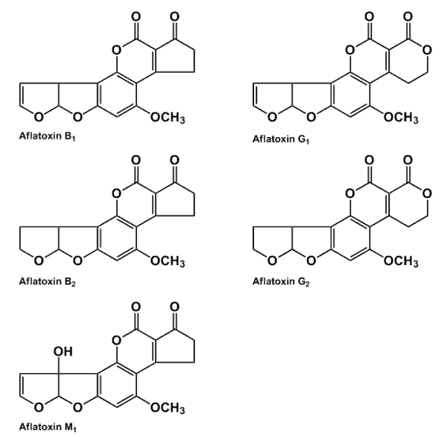
The health concerns
  Acute outbreaks can claim 100s of lives (Kenya outbreak 2004-2005 125 known fatal cases)
  4.5 billion people chronically exposed (estimate by US CDC)
    Cancer
    Immunosupression
    Stunting

Slide 11
Stunting?
Low height for age
Why?
  Leaky gut
  Immunity

Slide 12

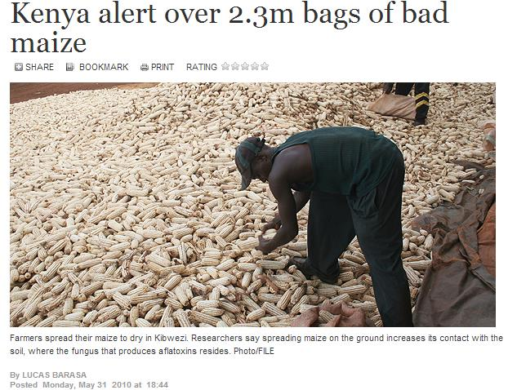

Slide 13
Global issue
Estimated that total mycotoxin losses in the states are 1.4 billion USD annually
Some years farmers are forced to dispose of half their crops of corn and peanuts

Slide 14
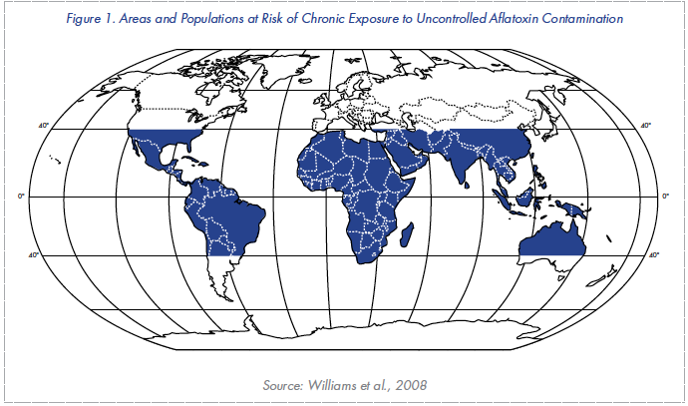
Aflatoxins are a global issue

Slide 15
CGIAR are global institutes
International Maize and Wheat Improvement Center (CIMMYT)
International Food Policy Research Institute (IFPRI)
International Crops Research Institute for the Semi-Arid Tropics (ICRISAT)
International Center for Tropical Agriculture (CIAT)
International Institute of Tropical Agriculture (IITA)
International Livestock Research Institute (ILRI)

Slide 16
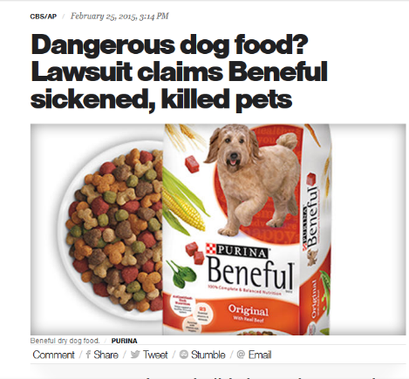
Why bother about aflatoxins and animals?
Animals are susceptible to aflatoxins: some more, some less
Animal suffering; an animal welfare issue
Reduced animal productivity
Aflatoxins in animal-source foods

Slide 17
Health effects observed
Liver damage
Gastrointestinal dysfunction, decreased appetite
Immunosuppression
Decreased reproductive function, decreased growth, and decreased production
Carcinogenicity?
Feeding sheep 1,750 ppb aflatoxins for 3.5 years caused liver/nasal tumours

Slide 18
Interactions
Mycotoxin | Main fungi | Impact on animal health
Aflatoxins | Aspergillus spp | All livestock susceptible to different degrees. Acute toxicity, hepatotoxic and nephrotoxic. Carcinogenic and mutagenic. Growth impairment. Immunosuppression.
Ochratoxin A | Aspergillus spp, Penicillum spp | Nephrotoxic Immunosuppression Possibly carcinogenic
Fumonisins | Fusarium spp | Toxic to liver and central nervous system Possibly carcinogenic
Zearalenone | Fusarium spp | Swine highly sensitive, cattle less sensitive. Endocrine disruption. Estrogenic effects, reduced reproduction, feminisation, malformations.
Trichotecenes | Fusarium spp | Gastrointestinal disturbance. Reduced feed intake. Ill-thrift. Immunosuppression.

Slide 19

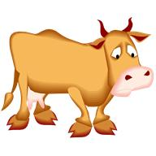

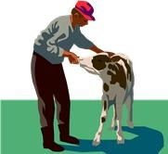

Agricultural services
Veterinary services
Economic flow
Feed producer
Feed seller
Milk retailer
Farmer
Consumer
Corn/feed purchased
Treatments
AB1
Aflatoxin flow
AB1-> AM1
AB1
AM1
Corn/feed produced at farm
AB1
AM1
Milk produced at farm
Human exposure
Farmer
Consumer

Slide 20
Animal source food
Aflatoxins are transferred to animal products
1-7% of aflatoxins in feed is metabolized and transferred to milk
Some studies show no transfer to eggs, other show low levels (5,000:1 -125,000:1)
Meat intermediary transfer: around 1000:1 ?
  Reduced if stop feeding

Slide 21
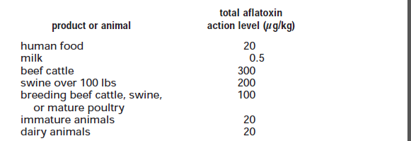
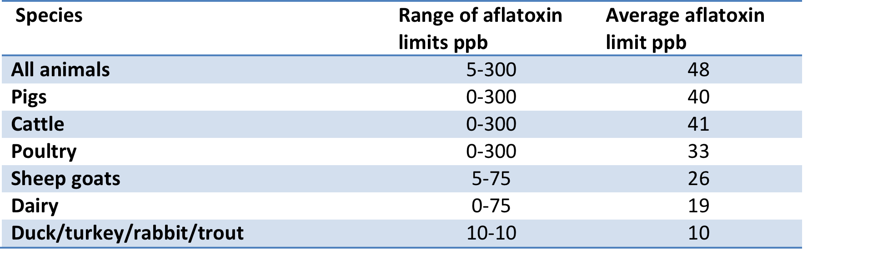
Standards and policies
FDA limits
Ref: Wu. VOL. 38, NO. 15, 2004 / ENVIRONMENTAL SCIENCE & TECHNOLOGY

Slide 22
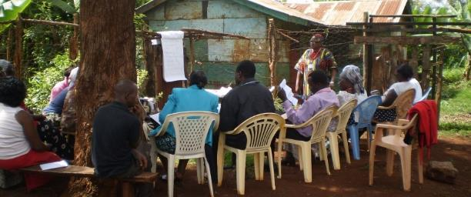
Understanding behaviour
Qualitative study
9 districts, 27 villages, 54 FGD, 206 women & 199 men
Pilot screening for aflatoxins: most feed samples <20 ppb (n=81 mean 10.1 ppb)
Women greater role in deciding what to feed cattle
Common to feed mouldy food to livestock
Women are more dependent on observation for knowledge of moulds
Women more likely to report taste of maize as an indicator of moulds
Men and women share more decision making than literature suggests
Men and women disagree which gender has responsibility

Slide 23
Kenya dairy value chain
Feed collected from 5 countiesª
  From farmers: 0.02 ppb to 9,661ppb and the positive samples ranged from 75% to 100%
  Milk samples: Up to 6999ppt, up to 26% of samples
  Samples exceeding 5ppb
    25% to 100% of the feed in farms
    85.7% to 100% of the feed from feed retailers
    20% to 100% of the feeds from feed manufacturers
  Estimate cost of feed discarded if enforced: >20 billion USD
  Estimated impact of this on lost milk production>30 million USD
  ª Mugangai et al. 2016, submitted

Slide 24
One-year survey

Slide 25
One-year survey

Slide 26
Producer | Number | Mean price KES/litre (range) | Mean aflatoxin M₁ levels (ng/kg) | Standard deviation | Min | Max | Geometric mean
Farmers | 75 | 65 (45-110) | 116.5 | 153.3 | <LOD | 1069.5 | 65.6 ª
Company A | 74 | 155 (80-610) | 57.0 | 43.9 | 7.6 | 272.3 | 46.4
Company B | 12 | 101 (90-120) | 296.9 | 206.1 | 59.0 | 743.3 | 226.9
Company C | 51 | 128 (60-233) | 37.2 | 33.9 | <LOD | 166.1 | 22.7 ^{b}
Company D | 37 | 125 (86-233) | 38.9 | 33.5 | <LOD | 156.1 | 23.7 ^{b}
Others | 42 | 176 (76-660) | 111.3 | 169.9 | 7.3 | 1078.5 | 68.0 ª
Table 2. Aflatoxin M₁ levels in milk samples of different origins purchased in Nairobi, Kenya
Geometric means with the same superscript were not significantly different
LOD: Limit of detection (2 ng/kg)

Slide 27
Kenya: urban milk
Milk collected from milk retailers
  Informal dairy traders in Dagoretti
  58% knew about aflatoxin, but only 6% thought milk was not totally safe after boiling
  Milk samples: mean AFM1 was 128.7 ppt, up to 1675 ppt. 55% of samples exceeded 50 ppt and 6% 500 ppt
  Women consume 1 litre per day!
  Kiruni et al. 2016, Afr J Food, Nutr Ag Dev

Slide 28
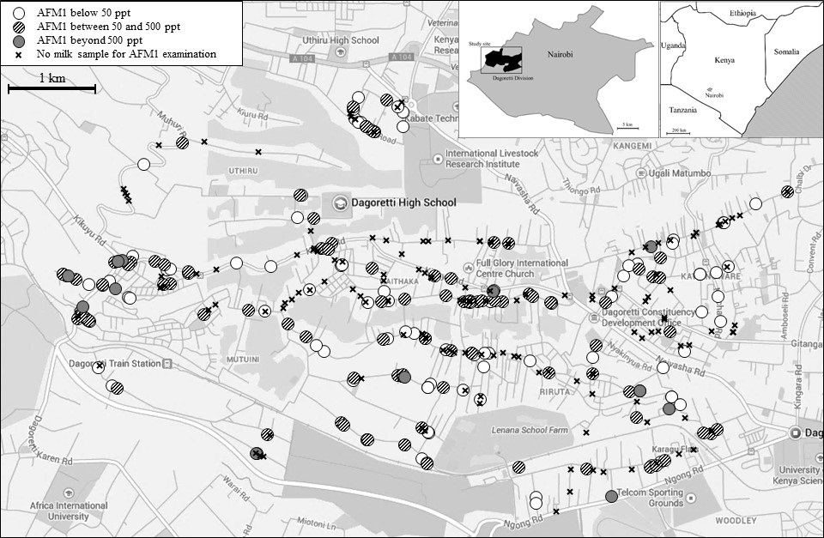

Slide 29
Kenya: urban milk
Child exposure study
    Korogocho & Dagoretti
    41% of children were stunted
    98% of foods contained aflatoxin
    AFM1 exposure associated with decreased Height for Age score
  Kiarie et al. 2016, Afr J Food, Nutr Ag Dev

Slide 30
Urban consumers
Completed and results
Willingness to pay study: 600 consumers
Dagoretti:
  55% know of aflatoxin (45% of these believe it can be transferred to milk)
  53% think aflatoxin is a serious threat.
CBD and Westlands:
  80% know of aflatoxin(51% of these believe it can be transferred to milk)
  32% think aflatoxin is a serious threat
All income willing to pay a premium aflatoxin assured milk

Slide 31
Some studies in Africa
Location | Samples | Positive | >50 ppt | >500 ppt | Max level detected | Reference
Dar es Salaam, Tanzania | 37 | 92% |  | 24% | 855 ppt | (Urio et al. 2006)
Nairobi, Kenya | 128 | 100% | 63% |  | 2,560 ppt | (Kiarie et al. 2016)
Rural Kenya (4 AEZ) | 512 | 40% | 10% | 0.6% | 6,999 ppt | (Senerwa et al. 2016)
Libya | 49 | 71% |  |  | 3,130 ppt | (Elgerbi et al. 2004)
Addis Ababa, Ethiopia | 110 | 100% | 92% | 26% | 4,980 ppt | (Gizachew et al. 2016)
Cameroon | 63 | 16% | 9.5% |  | 527 ppt | (Tchana et al. 2010)

Slide 32
Mitigation options
Aflatoxins can be mitigated all along the dairy value chain
Costs
Implementation
Side effects

Slide 33
1. Stop aflatoxin production
Corn/feed purchased
AB1
Aflatoxin flow
AB1-> AM1
AB1
AM1
Corn/feed produced at farm
AB1
AM1
Milk produced at farm
Human exposure
Farmer
Consumer

Slide 34
In the field: storage
Improved varieties- more resistant crops
Bio control: AflaSafe™, AflaGuard™
Improved drying
Improved storage
Good Agricultural Practices (GAP)
Reduces aflatoxins for both humans and animals
Costly?

Slide 35
2. Stopping the bad feed
Corn/feed purchased
AB1
Aflatoxin flow
AB1-> AM1
AB1
AM1
Corn/feed produced at farm
AB1
AM1
Milk produced at farm
Human exposure
Farmer
Consumer

Slide 36
Objectives of feed standards
Protect humans from harmful aflatoxins in animal source foods
  Milk is the most high risk animal source food because relatively large amounts of aflatoxins are carried over, and milk is consumed especially by infants
Safeguard the benefits people derive from livestock
  Income, food and nutrition security, draft power, manure and social/cultural benefits
Protect value chain actors from fraudulent or defective products
Encourage fair trade, and economic growth through promoting standards and credibility
Safeguard the welfare of animals

Slide 37
2. Stopping the bad feed
Feed regulations
Implementation
What do you do with illegal feed?
Costs?
Market incentives
Poor people?
Not sustainable

Slide 38
3. Within the cow
Corn/feed purchased
Binder
AB1
Aflatoxin flow
AB1-> AM1
AB1
AM1
Corn/feed produced at farm
AB1
AM1
Milk produced at farm
Human exposure
Farmer
Consumer

Slide 39
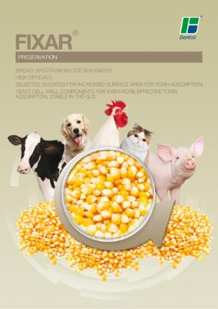
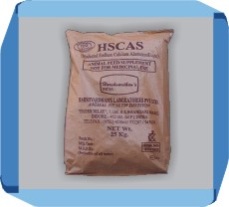
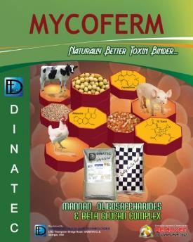
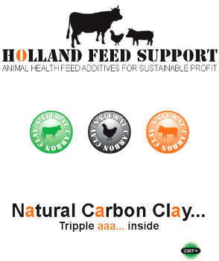
Standards for Anti-Mycotoxin Additives (AMAs) in Feeds
Clays (aluminosilicates)
Most effective binder but different clays vary in effectiveness. Up to 90% reduction.
Yeast/bacterial cell wall extracts
Provide other useful nutrients, but evidence on effectiveness is mixed
Other binders
Some are promising but less evidence of effectiveness
Over 100 companies offering AMAs
In the Brazilian market, where approximately 100 AMAs for poultry and swine were evaluated, only about 30% were effective

Slide 40
The case for binders
Multiple benefits:
Increase animal productivity
Reduce aflatoxins in animal-source foods
Create safe “sink” for aflatoxin
Improved animal welfare
Food safety/security tradeoff → win-win opportunity
Current trial will provide evidence on effectiveness

Slide 41
Feeding livestock contaminated feed
Aflatoxin contaminated feed given to livestock instead of humans
Less aflatoxin contaminated crops reach humans- less crops reach food market
Livestock produce less because of toxic effects
Less animal-source food produced, reduced livelihoods of farmers
Animals metabolize toxins
A reduced amount of aflatoxins may reach humans through animal-source food

Slide 42
Reducing aflatoxins in milk using binders
Baseline survey to collect data on:
  Levels of aflatoxins in milk
  Feeding practices
  Farmer awareness
  Farmer willingness to use mitigation methods
  Farmer willingness to pay for binders or other mitigation methods

Slide 43
Study sites
Urban/Peri-urban
  Kasarani
  Kisumu

Slide 44
The trial
  20 trial farms and 10 control farms recruited in each site
  Trial farms gets
    Training
    Binders to last for 6 months
    One mazzican

Slide 45
Training
A training package about food safety, microbes and aflatoxins
General training on milk production animal health and animal feeding

Slide 46
Follow up
Regular follow up and endline survey of farmers
Preliminary results:
  High dosing of binder reduces aflatoxin
  Farmers perceive improved production

Slide 47
4. In the milk?
Corn/feed purchased
AB1
Aflatoxin flow
AB1-> AM1
AB1
AM1
Corn/feed produced at farm
AB1
AM1
Milk produced at farm
Human exposure
Farmer
Consumer

Slide 48
4. In the milk
Biological control??
Research still ongoing
Pasteurization not working

Slide 49
5. Stopping consumption of contaminated milk
Corn/feed purchased
AB1
Aflatoxin flow
AB1-> AM1
AB1
AM1
Corn/feed produced at farm
AB1
AM1
Milk produced at farm
Human exposure
Farmer
Consumer

Slide 50
5. Stopping consumption
Legislation
Awareness and market incentives
Implementation
What do you do with illegal milk?
Costs?
Poor consumers?

Slide 51
Food security
Food safety
Change:
To:
Improved food security
Improved food safety
Better health

Slide 52
Take-home messages
Fungi are everywhere; we can’t avoid them completely
Aflatoxins are one of many serious hazards transmitted by foods
Livestock is affected by aflatoxins, and so are animal-sourced food
Livestock feed sector + binders can suck contaminated grain out of human food chain
Potential for regulation to cause harm (burden on agricultural sector, concentrating contaminated among poorest)
Need to research what works in Pakistan

Slide 53
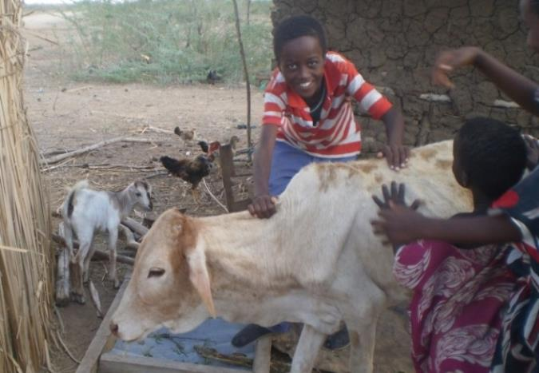
Conclusions
There is no silver bullet to eradicate aflatoxins
A battery of interventions to provide safer food in a world full of food safety hazards!
Animals may be both part of the problem and part of the solution

Slide 54

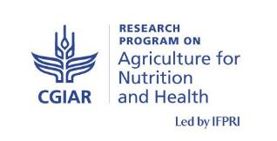
Acknowledgements
The Kenya work is financed by the Ministry of Foreign Affairs, Finland in partnership with the International Food Policy Research Institute, Luke Finland, Biosciences eastern and central Africa (BecA) hub at the International Livestock Research Institute
It contributes to the CGIAR Research Program on
Agriculture for Nutrition and Health

