Slide 1
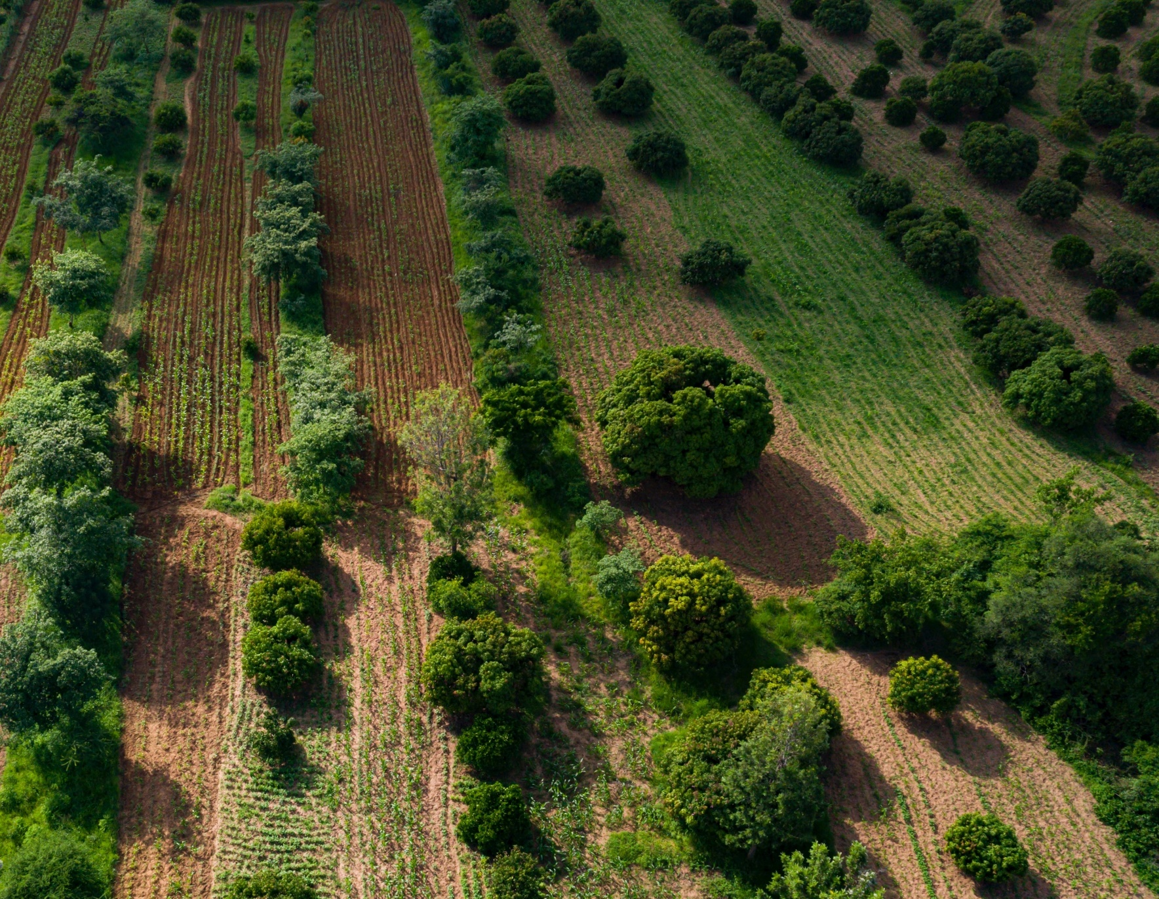
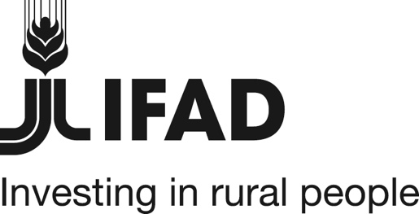




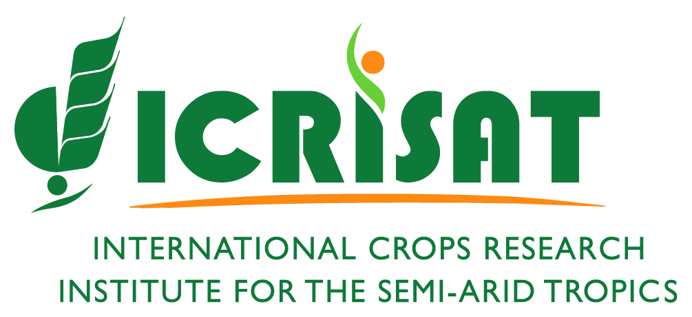
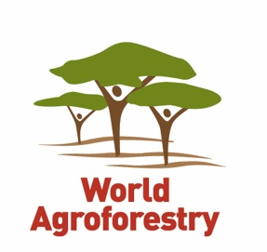
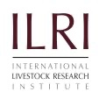

Applying the Research in Development Approach to Scale Ecosystem Restoration
Presented by Leigh Ann Winowiecki and Fergus Sinclair at the second in webinar series on Land and Natural Resource Governance, Planning and Management.
13 October 2020
Photo: Kelvin Trautman
photo: Kelvin Trautman

Slide 2
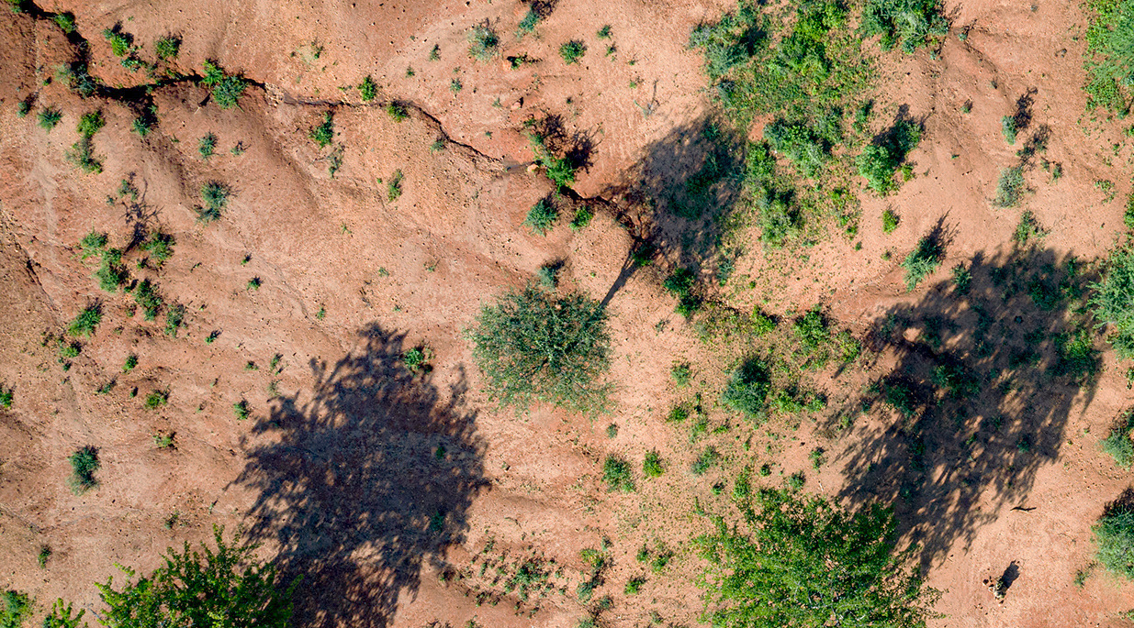
Land degradation threatens the livelihoods, food and nutrition security of the poorest, most vulnerable smallholder farmers and pastoralists in Africa.
Photo: Kelvin Trautman

Slide 3
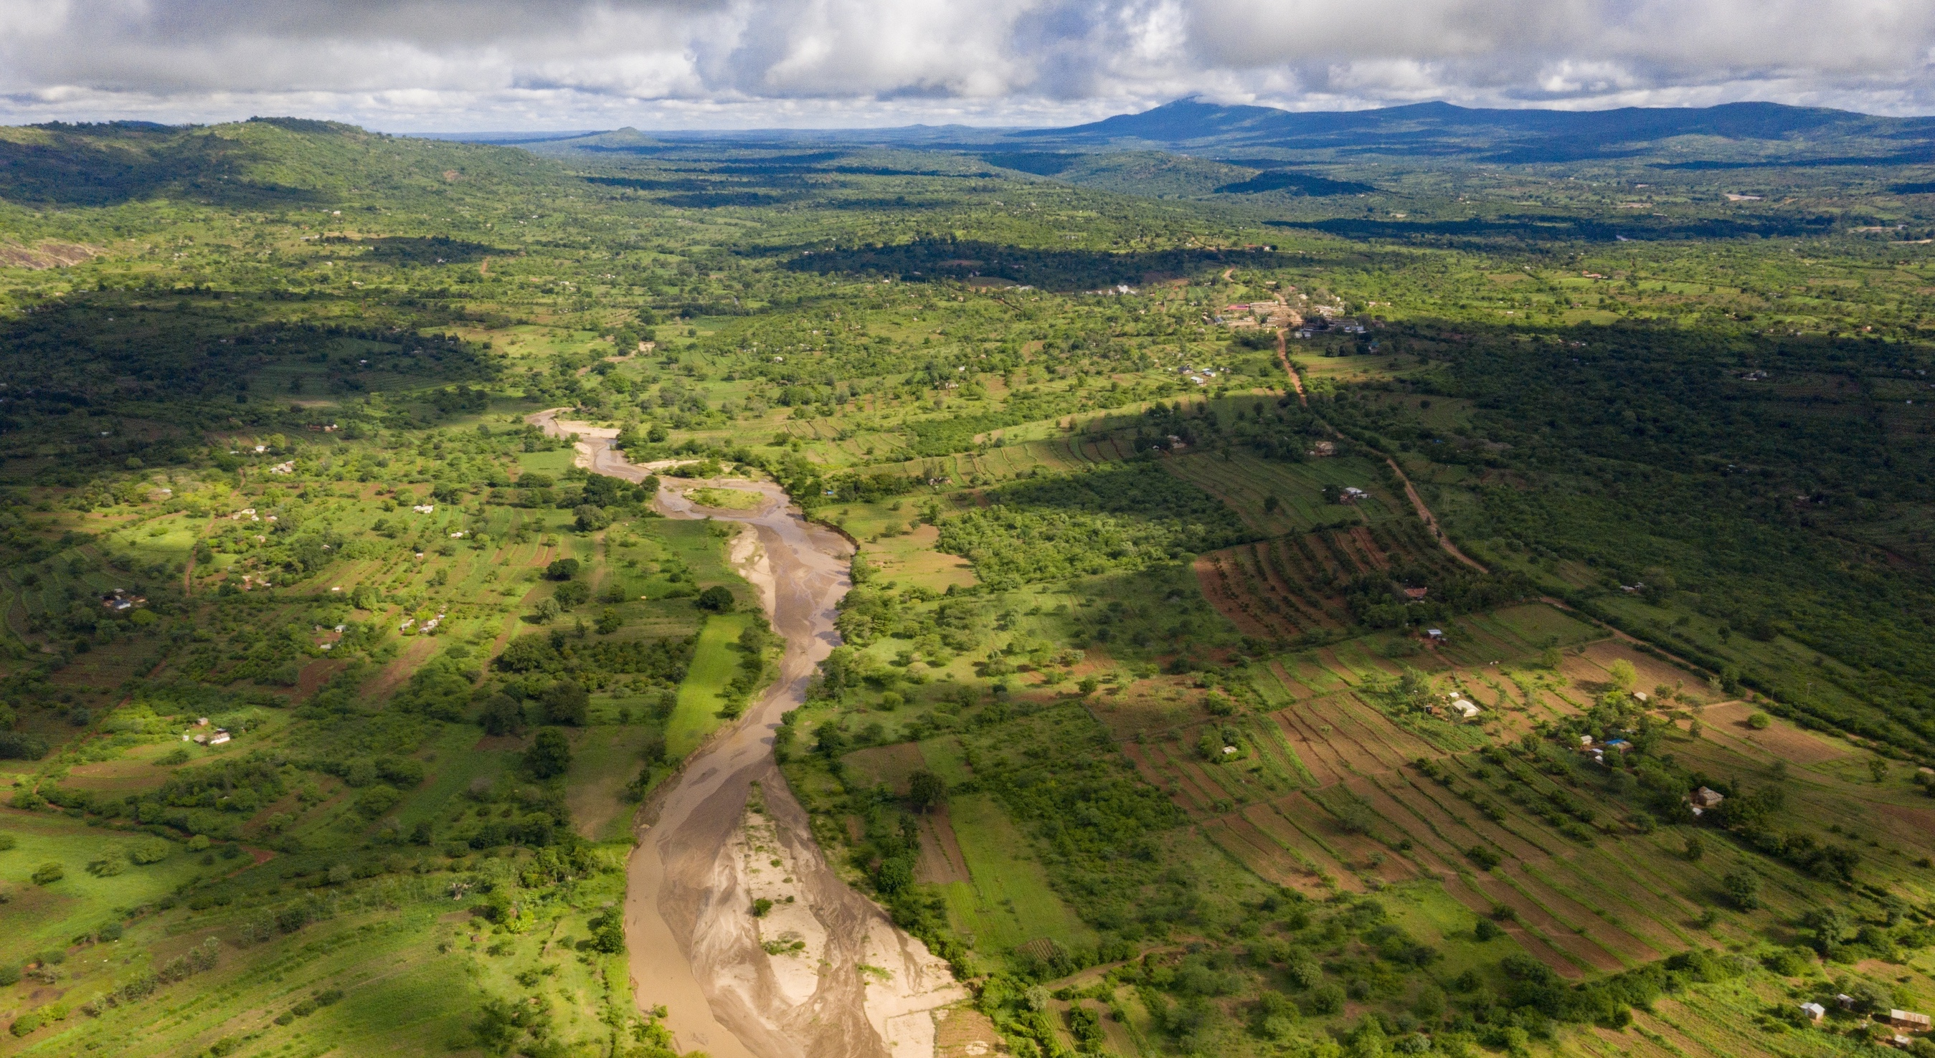
The challenge is to scale locally appropriate options with large numbers of farmers to ensure sustainable land restoration.
Photo: Kelvin Trautman

Slide 4


By partnering with (large-scale) development programmes we can reach the restoration targets.
“Business as usual” has not produced the desired outcome of improved food and nutrition security, reversed land degradation, job creation, and conservation of biodiversity.

Slide 5





The Research ‘in’ Development approach
Understanding variations in context and drivers of adoption
Co-learning to share knowledge and Influence development projects
Farmer- led innovation of the options
Simple to use tools matching options to context
Assessment of performance to improve interventions
By embedding co-learning we can accelerate development impacts
Closing the learning loop between scientists, development actors, farmers and other stakeholders with nested communities of practice.

Slide 6




Scaling: Link with IFAD Country Programmes
Mali
Projet d’Adaptation de la Petite Agriculture Paysanne aux Changements Climatiques au Mali/ Agricultural Productivity/Adaptation for Smallholder Agriculture Programme (PAPAM/ASAP)
Kenya
Kenya Cereal Enhancement Programme/ Climate Resilient Agricultural Livelihoods (KCEP-CRAL)
Upper Tana Nairobi Water Fund (UTNaWF)
Upper Tana Natural Resource Management
Ethiopia
Community-based Integrated Natural Resources Management Project’ (CBINReMP) - in Gonder
Participatory small-scale irrigation development project (PASIDP II) in Amhara, Tigray, Oromia, and SNNP Regions
Niger
Programme d’amélioration de la productivité et de la résilience de l’agriculture dans les Régions de Maradi, Tahoua et Zinder (PASADEM, RUMAWU)
Programme de Développement de l’agriculture familiale (ProDAF)
GEF-IAP - Resilient Food Systems
Cross-cutting capacity building, knowledge services and coordination project for the Food Security Integrated Approach Pilot Program
Notes:
“Employing the Research in Development approach requires collaboration across large-scale development programmes. For Example, the project collaborats with are the IFAD Country Programmes listed here)” (no need to read them) However, if you do not have time, delete this slide.

Slide 7
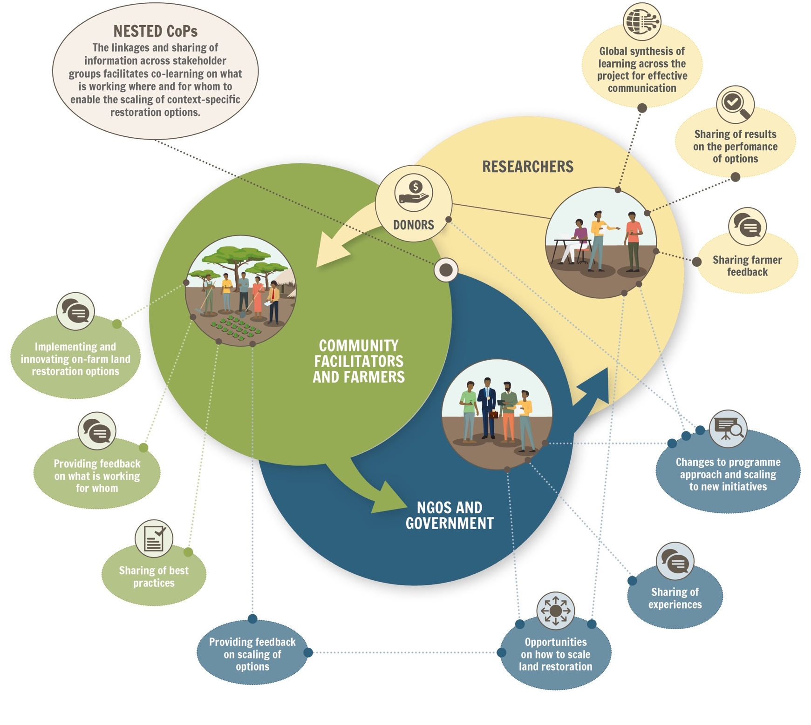
Co-learning with nested Communities of Practice
Facilitating co-learning across multiple stakeholder groups.
http://www.worldagroforestry.org/output/nested-communities-practice

Slide 8
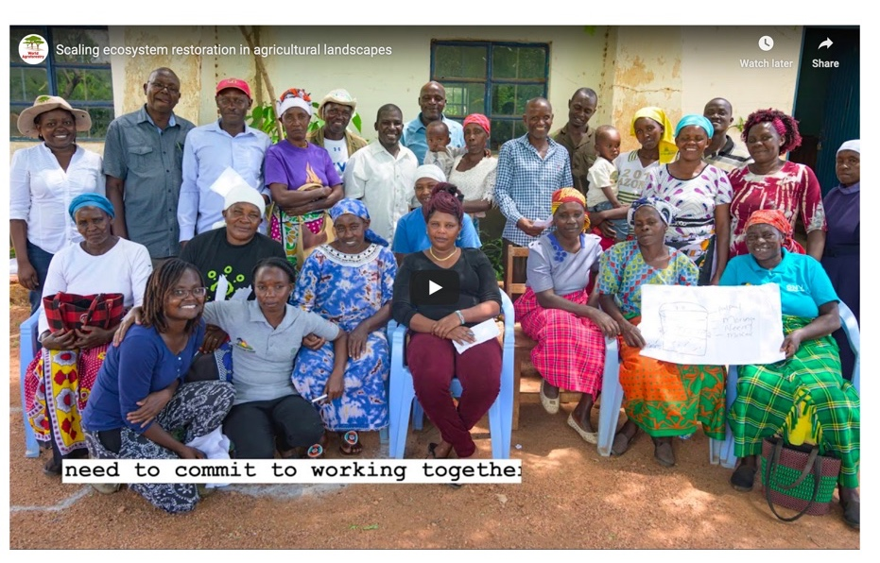
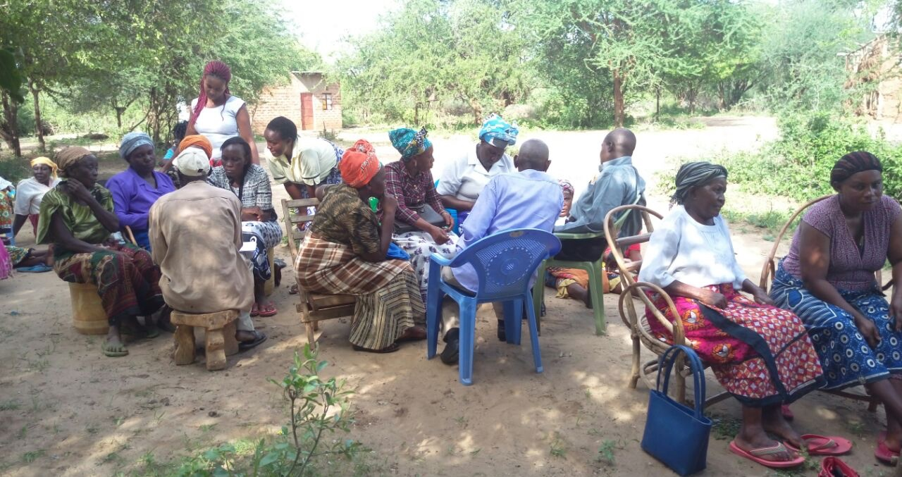
Co-learning with nested Communities of Practice: Farmers
‘Kenyan farmers adopt new agroforestry strategies through
research in development program’
https://forestsnews.cifor.org/65934/kenyan-farmers-adopt-new-agroforestry-strategies-through-research-and-development-program?fnl=en
Facilitated farmer workshops with over 700 participants, across two-three weeks every year to share knowledge and innovations.

Slide 9
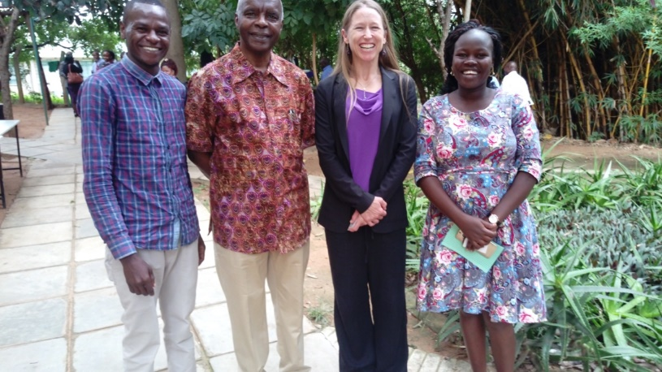
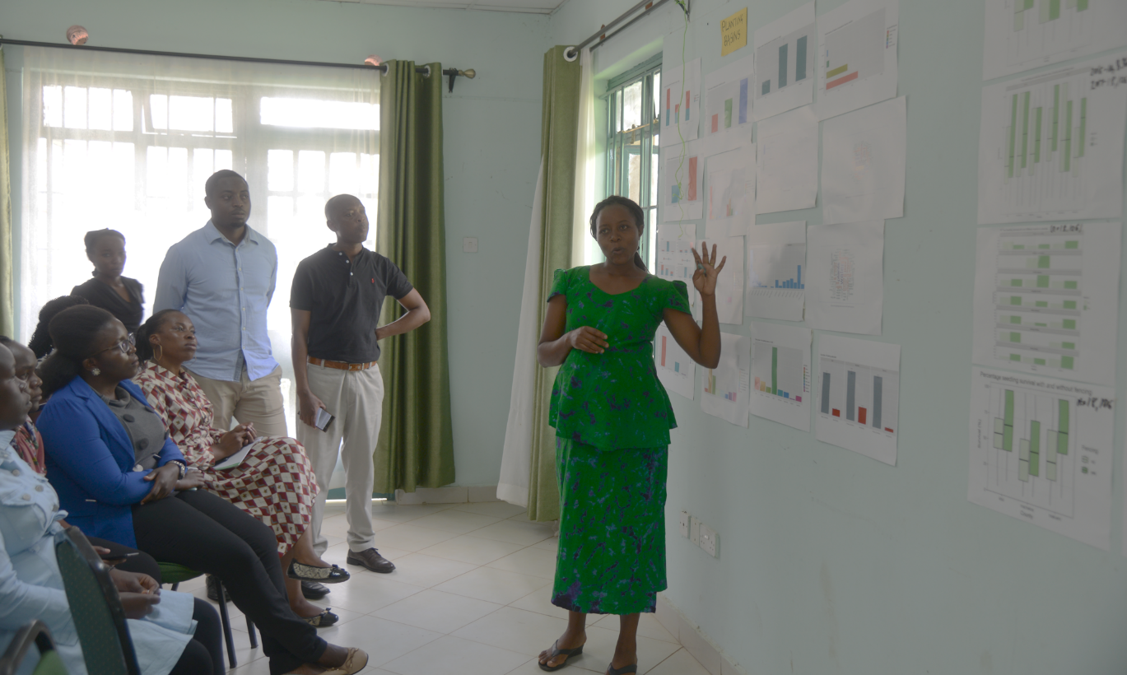
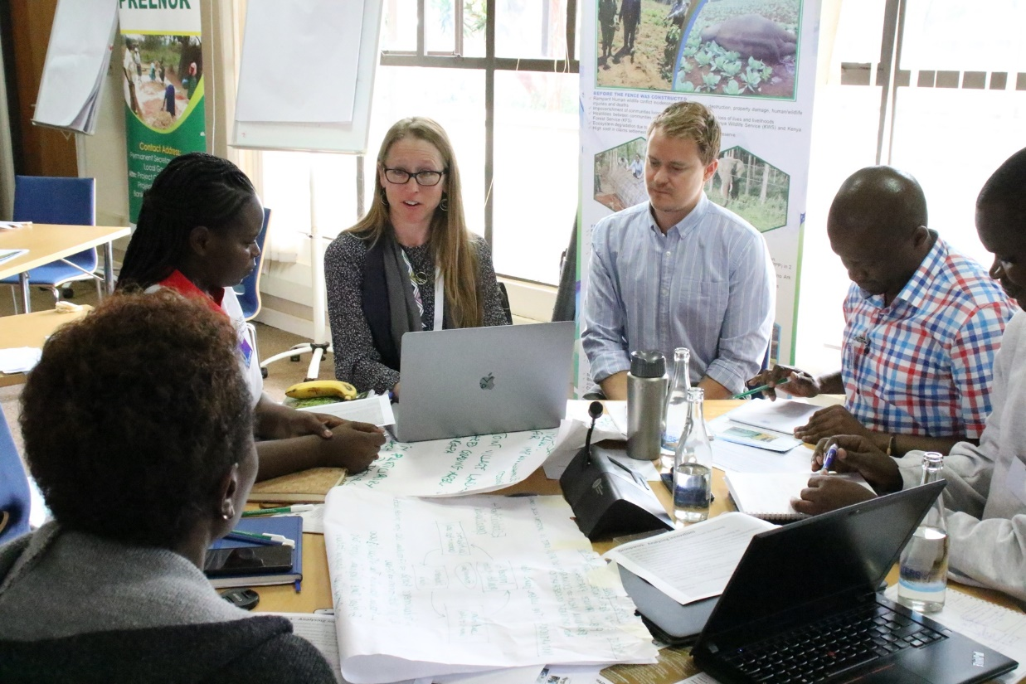
Co-learning with nested Communities of Practice:
Development & Government
Project Community Facilitators sharing evidence with development & Government partners in Makueni County.
Sharing project outputs with IFAD Programmes during IFAD Knowledge Sharing Day in Nairobi.

Slide 10
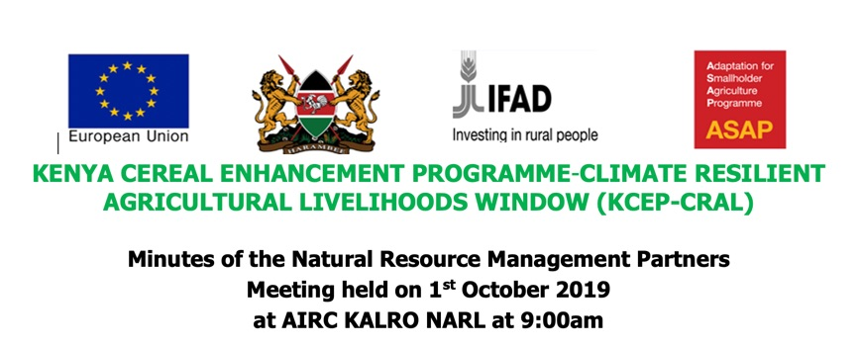
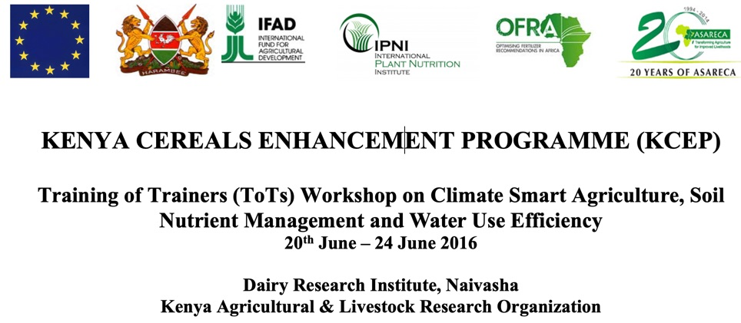
Co-learning with nested Communities of Practice:
Development & Government II
‘KCEP-CRAL IFAD Loan Programme in 13 Counties- which overlap with our project action Counties’
Continual engagement with KCEP-CRAL and NRM partners to share lessons learned from the project including a focus on soil health and farmer innovation.
Early engagement with KCEP-CRAL IFAD Programme, in Training of Trainers workshops followed by validation workshops led by KALRO.

Slide 11
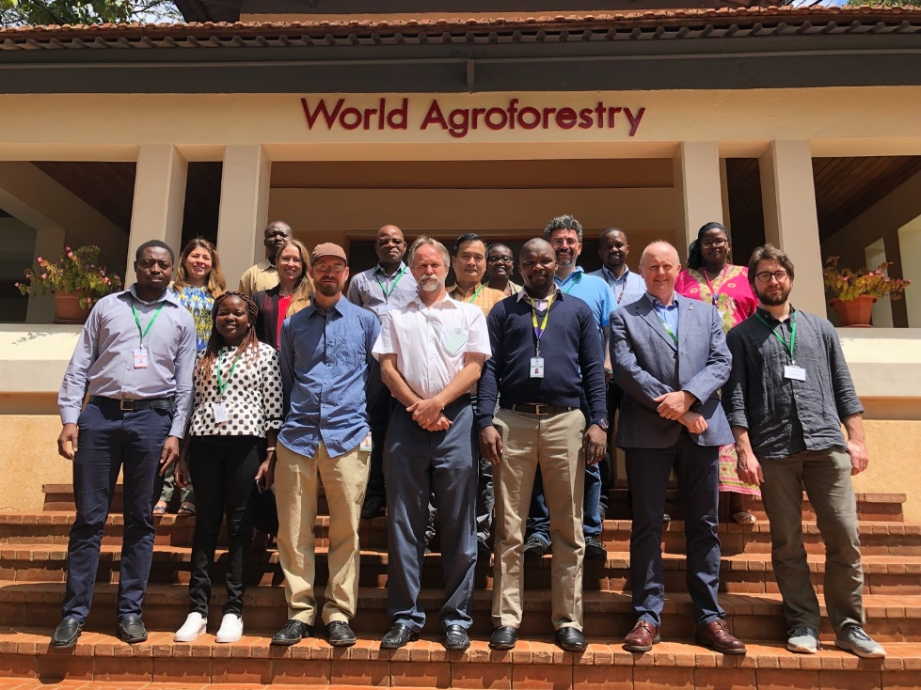
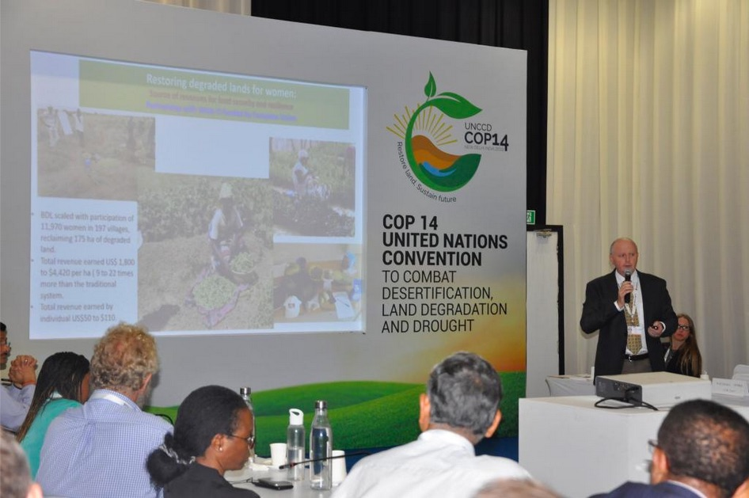
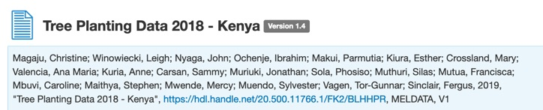
Co-learning with nested Communities of Practice:
Global Community
Annual Project team meetings
Side event at the UNCCD COP 14 in India
https://ifad-un.blogspot.com/2019/09/cop14-day-1-setting-tone-to-achieve.html
Sharing of datasets online:
https://data.mel.cgiar.org/dataset.xhtml?persistentId=hdl:20.500.11766.1/FK2/E4MRCZ

Slide 12
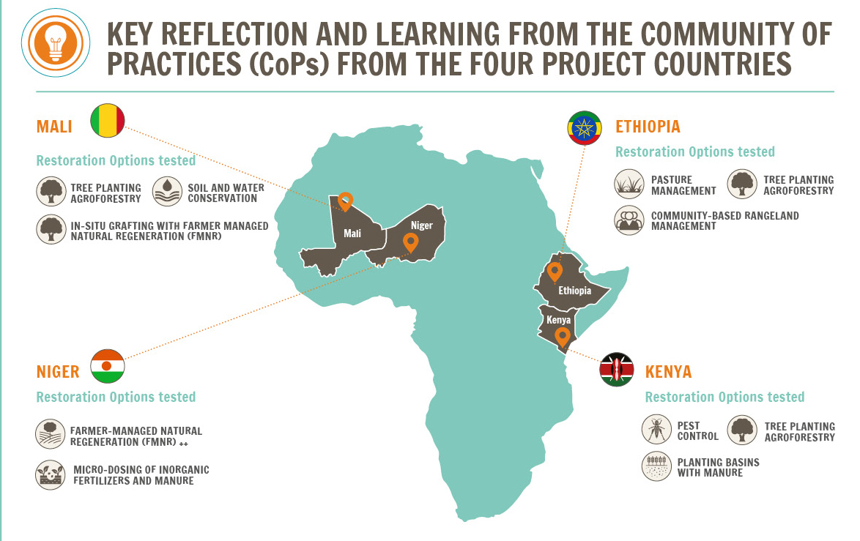
Implementing farmer-centered restoration through collaboration with development partners and large programmes to scale
Over 20,000 farming households implemented & evaluated restoration options on their farms also 30,000 pastoralists
Increased knowledge of what works where for whom
Farmer yields increased 2-6 times
Over 100,000 trees producing in Kenya and > 30,000 in Mali
Improved rangeland management in communal grazing lands in Kenya and Ethiopia
Increased capacity to implement regenerative practices
  Farmer-led innovation

Slide 13
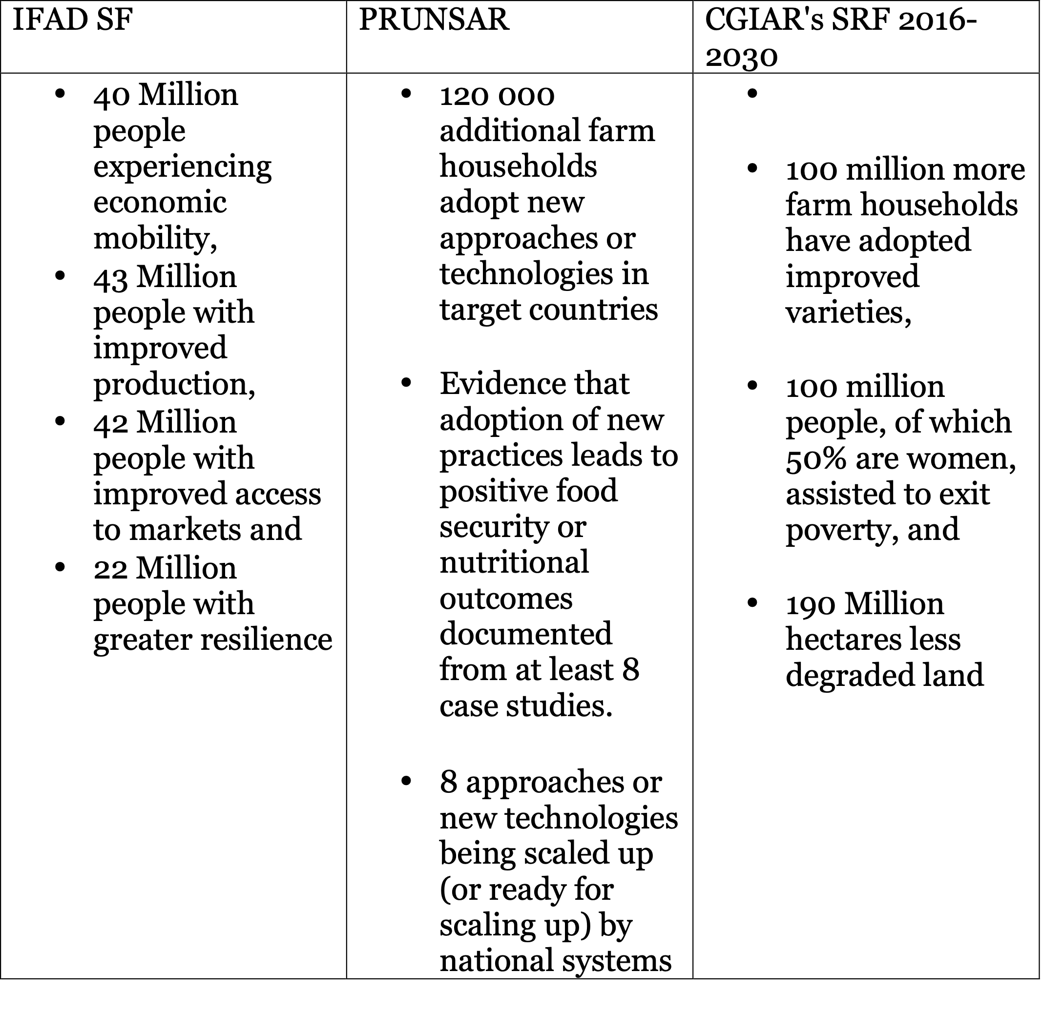
Contributing to IFAD, PRUNSAR and CGIAR Strategic Frameworks

Slide 14
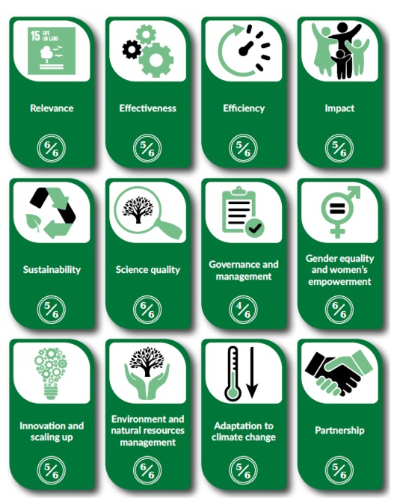
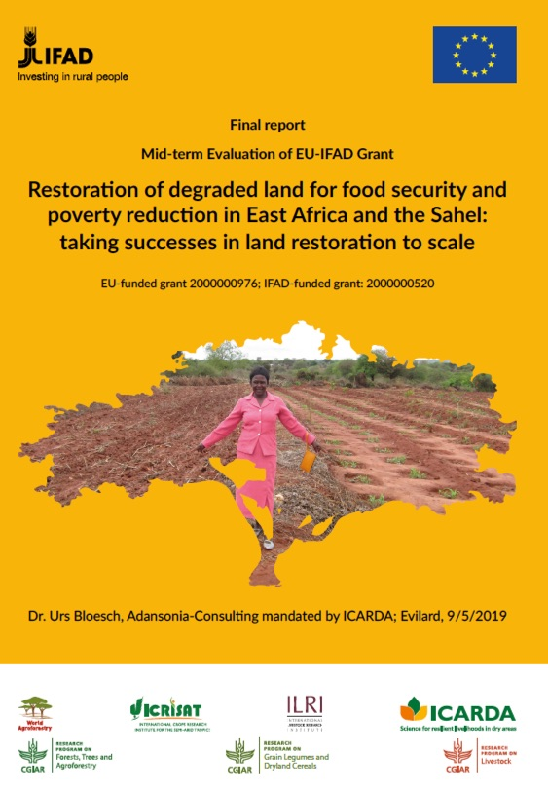
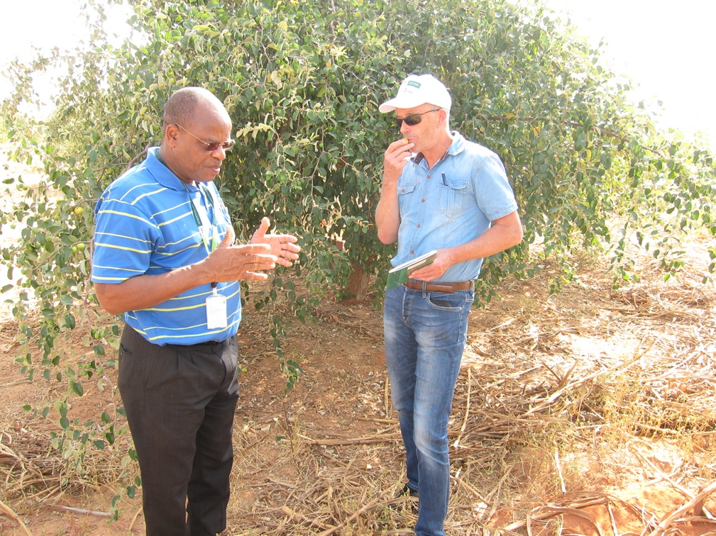
Results of the mid-term evaluation
It considers the IFAD Evaluation Manual and the CGIAR standards for independent external evaluation and the respective Independent Evaluation Arrangement (IEA)

Slide 15
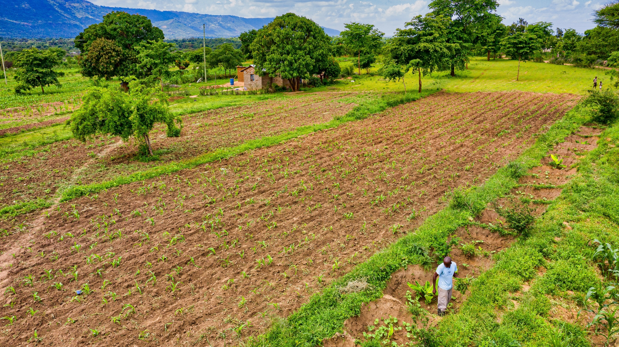
Key messages
High farmer participation is key for scaling
Large-scale impact requires locally appropriate innovation to be widely adopted
Regular interactions with farmers, development partners, Government, researchers
Key changes in behavior from all stakeholders is needed:
Researchers need to be flexible and innovative in data collection as well as timely sharing of results to match the design cycle of stakeholders
Development partners need to be open to operating differently and allow space for monitoring and co-learning
Farmers engaged need to be available for monitoring
Donors to recognize the value of real-time science to inform development
  Re
Photo: Kelvin Trautman

Slide 16
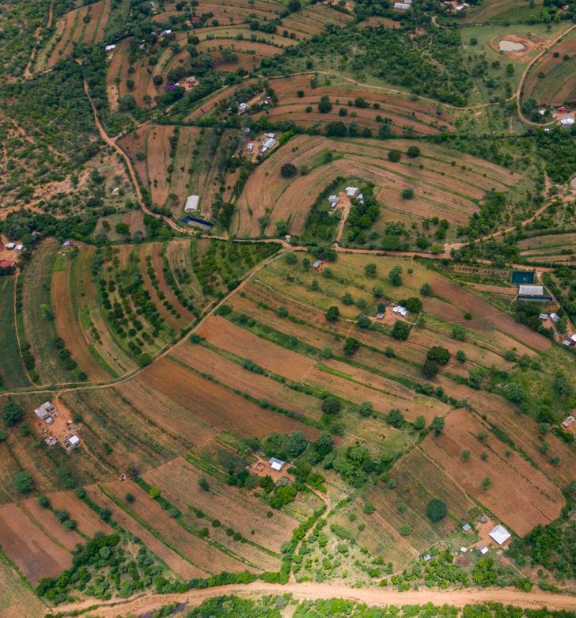

Explore project Resources
Farmer-centered restoration http://www.worldagroforestry.org/output/full-brochure-2020-using-planned-comparisons-east-africa-and-sahel
Blog: https://forestsnews.cifor.org/65934/kenyan-farmers-adopt-new-agroforestry-strategies-through-research-and-development-program?fnl=en
Co-learning with partners using Communities of Practice http://www.worldagroforestry.org/output/nested-communities-practice
Video: Scaling ecosystem restoration in agricultural landscapes: https://youtu.be/qvf0drWdTq4
Video: The role of healthy soil for restoration: http://worldagroforestry.org/output/healthy-soil-key-functioning-ecosystems
Gender: https://forestsnews.cifor.org/65320/agroforestry-basins-stir-up-big-benefits-for-women-in-kenya-drylands?fnl=en
IFAD Podcast: https://www.ifad.org/en/web/latest/podcast/asset/42098555#valencia
Photo: Kelvin Trautman

Slide 17
Thank you!
Leigh Ann Winowiecki - L.A.Winowiecki@cgiar.org @lawinowiecki
Fergus Sinclair- F.Sinclair@cgiar.org
World Agroforestry (ICRAF),
United Nations Avenue, Gigiri,
P.O Box 30677-00100, Nairobi, Kenya
Phone: +254 20 722 4000
Fax: +254 20 722 4001
Email: icraf@cgiar.org
Website: www.worldagroforestry.org

