Slide 1
Indigenous Knowledge System for managing the flooding water commons in Zambia
Everisto Mapedza, IWMI
IASC Nairobi, Kenya
24 June 2023

Slide 2
Overview of Presentation
Introduction
Study area
Methods
Findings
Policy implications
Conclusion

Slide 3
Introduction
  “Weather information is not about data or models, it is about people. And it is about data or models only as far as data and models can serve the needs of people (poor and vulnerable children, women and men)” paraphrased from Westoby 1967.

Slide 4
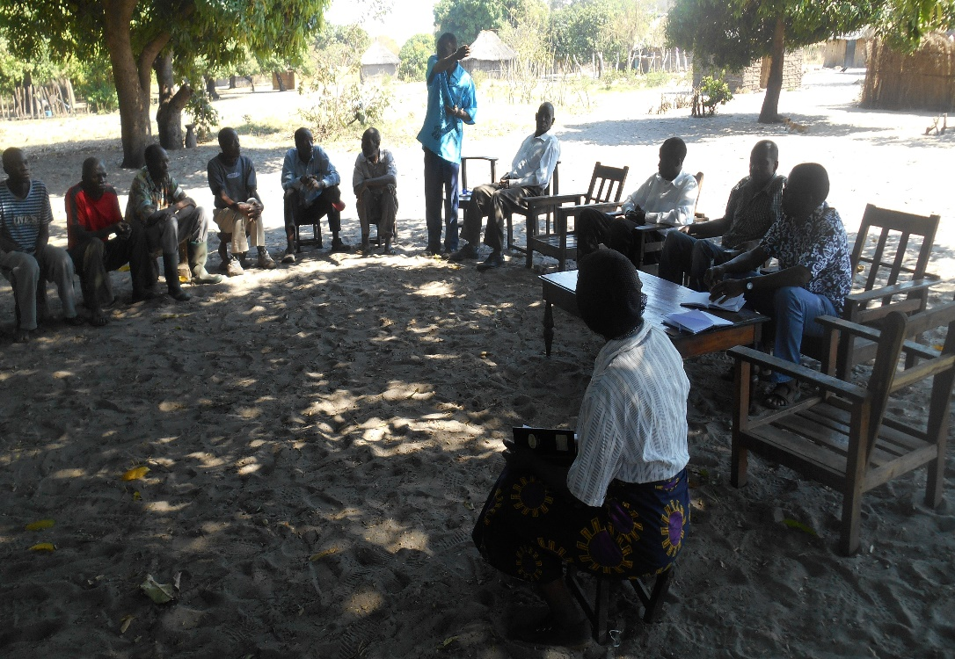
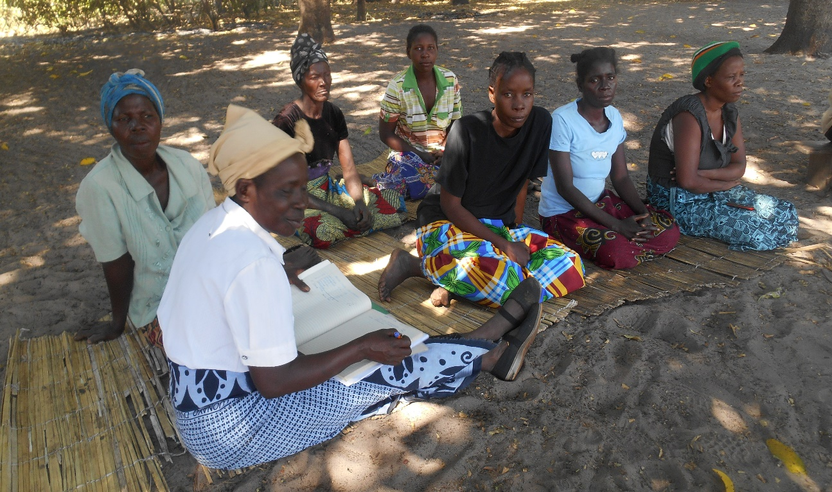
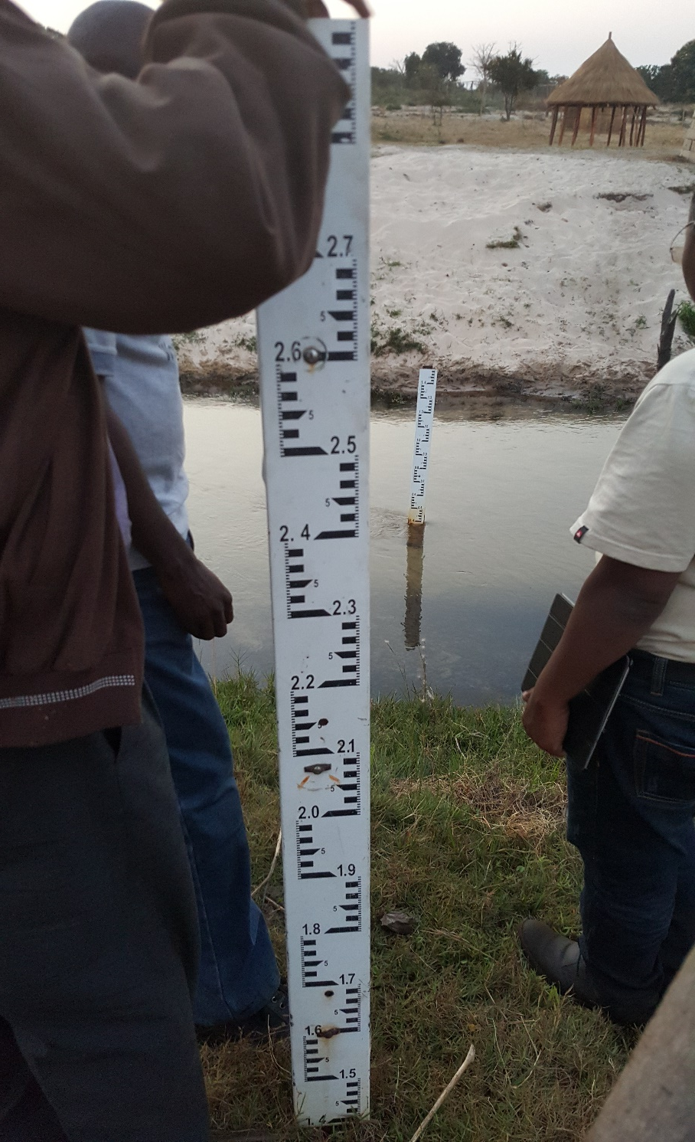
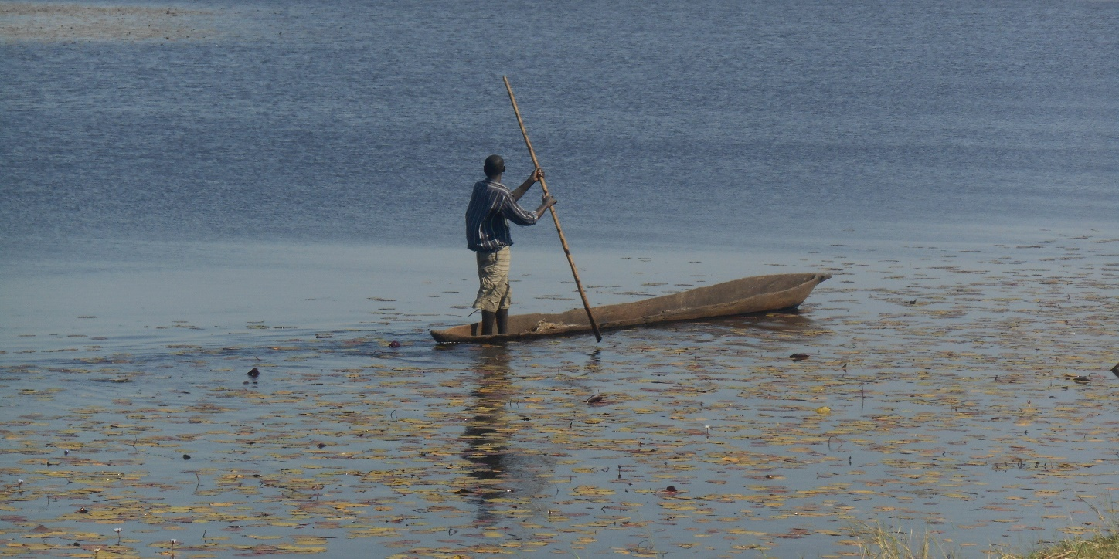
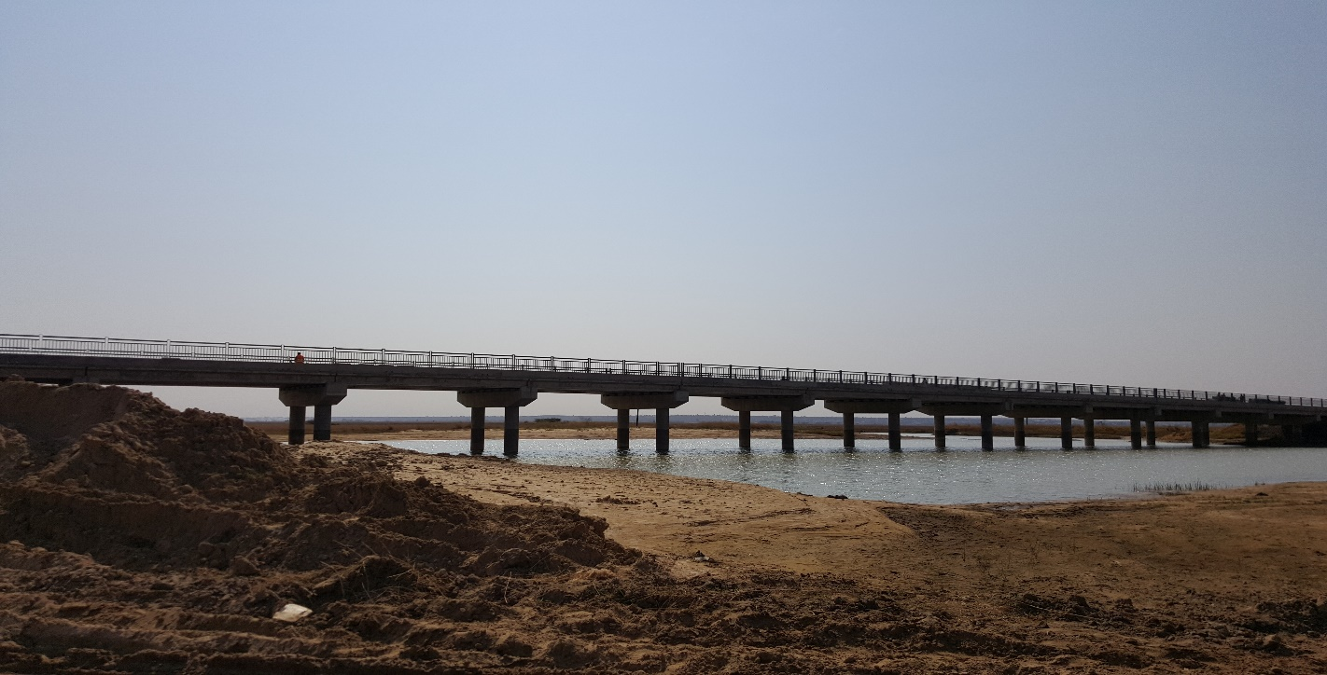
Introduction

Slide 5
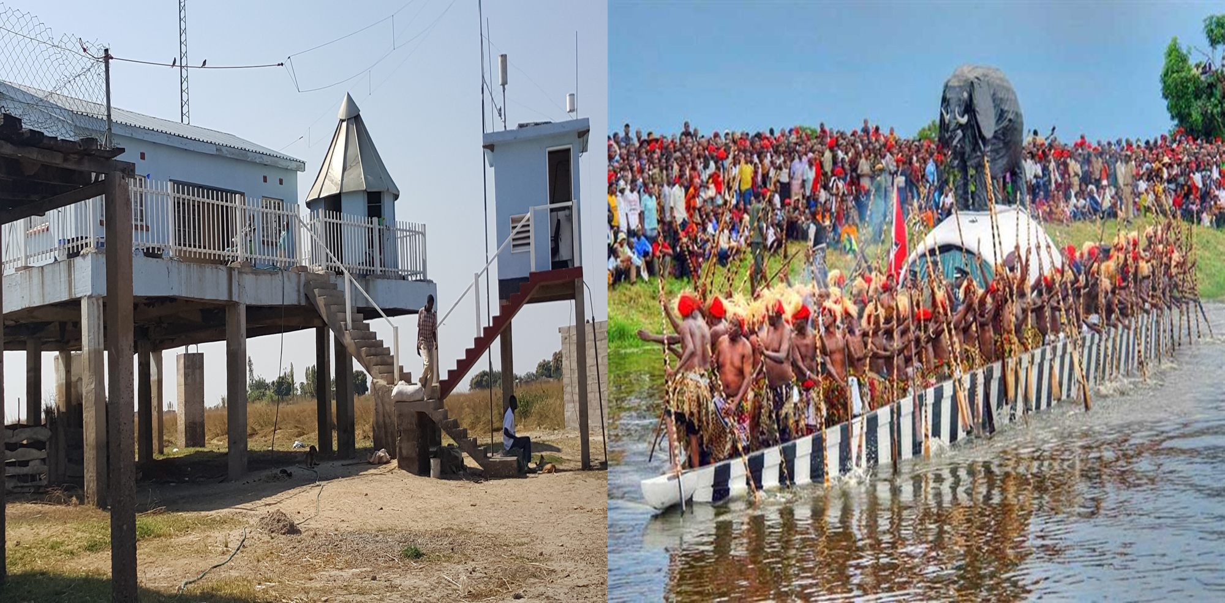
Introduction (cont’d)

Slide 6
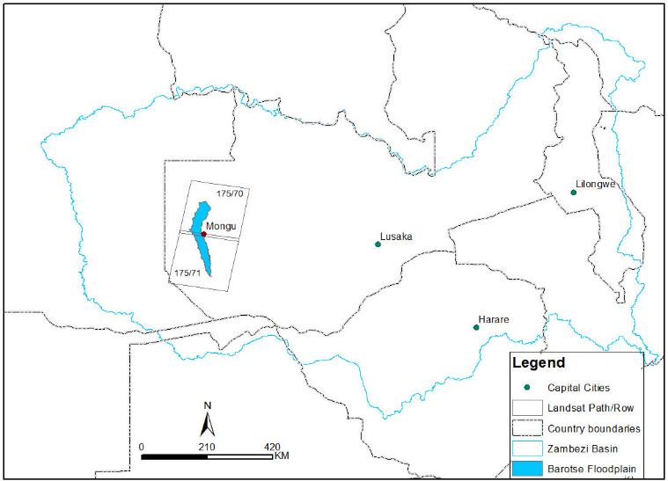
Introduction (cont’d)

Slide 7
Methods
  Literature review
  Participatory-GIS
  Questionnaire survey
  Qualitative: FGDs, Key informant interviews and field observations and narratives

Slide 8
Knowledge on flooding history

Slide 9
Flooding IKS-EWS
  Spider Ballooning – Mendayi
  Silk threads appearance – 1 month before flood begins
  This is signal to start harvesting crops such as rice
  Fish also start migrating upstream

Slide 10
Flooding Changes IKS
  Tumbombo insects tell direction of flooding
  When the beetle, found in plain grass, is looking upwards – flooding levels still rising.
  When the beetle turns to look downwards – flooding inundation is receding.

Slide 11
Drought IKS observations
  Abundance of wild fruits Mubula, Mahuluhulu as well as domesticated fruits such as mangoes
  Practice deep planting (Liyabelela)
  Increase size of homestead mounds (mazulu)
  Might not be need to move to upland

Slide 12
Gender and IKS
  Lozi proverb sinamusali kimutu?
  Cleaver: Whose indigenous knowledge is it?
  FGDs and survey show that IKS is gendered
  Gendered representation - flood and canal institutions
  Concern Worldwide and PPS – gender quotas
  Exclusion from political space - disempowering (Kabeer, 2012)

Slide 13
So What?
  Beyond binary – IKS + Western Science – livelihoods
  Climate change solutions – within a context (adaptation and mitigation)
  Co-production of ‘science’ and ‘knowledge’
  Global Initiatives – WMO, UNDRR – Sendai Framework, UNFCC, SDGs – offer an opportunity to insert IKS

Slide 14
Conclusion
  Practical examples where IKS is operational
  Gender and Social Inclusion
  Local ownership - Co-production of science
  Human Right and Democratic requirement
  Ethical requirement
  Stronger together – Leave No (IKS) Science Behind!

Slide 15
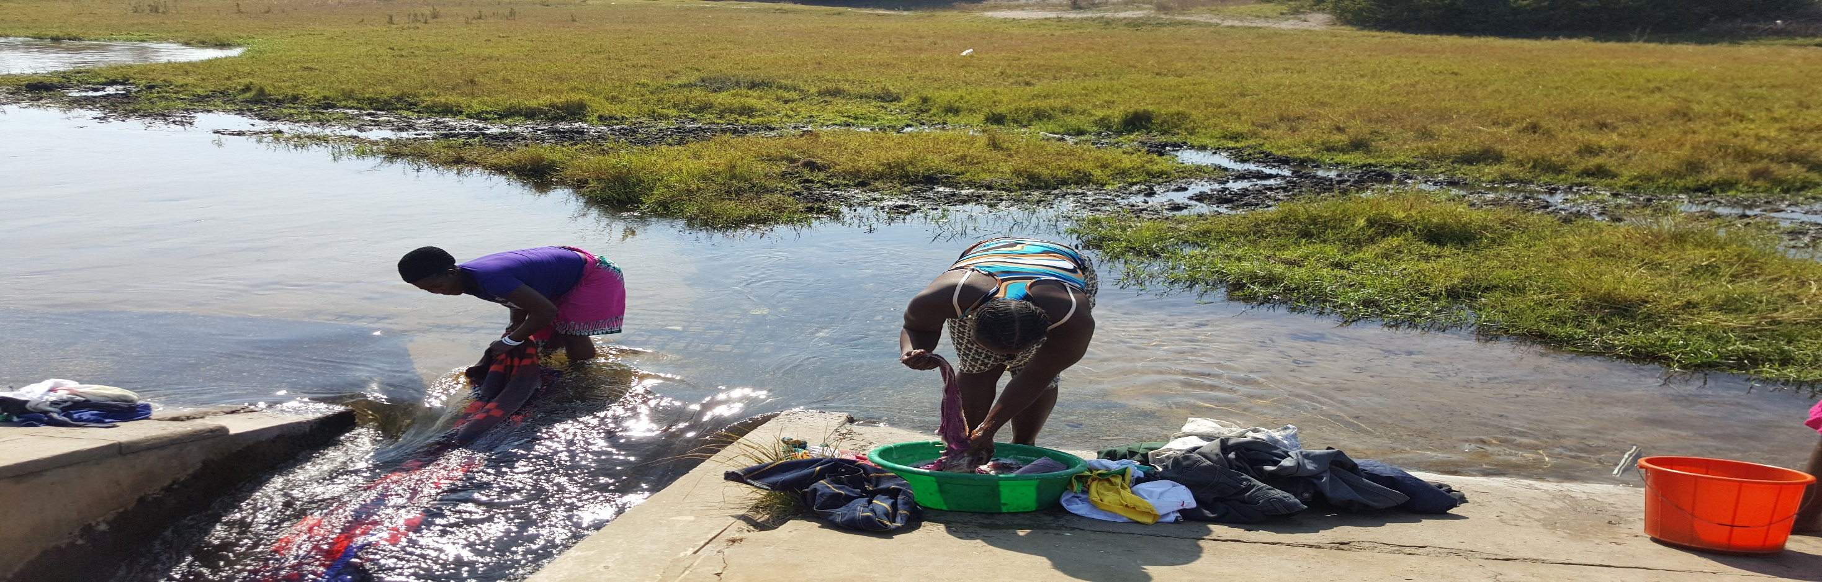
Thank you; Merci Beaucoup, Asante Sana
Email: E.Mapedza@cigar.org

